Slide 1
The Hollywood style
4th November, 2011
Magdalena Tutka - Gwozdz, Ph. D.
Department of Media and Communication

Slide 2
Historical-cultural background of the style
System of production
Viewers’ expectations
“The Golden Age” of Hollywood, 1930 - 48
Films from the period 1917 - 1960, David Bordwell, Janet Staiger and Kristin Thompson, The Classical Hollywood cinema: Film Style & Mode of Production to 1960
The style has been formed in 30’s and 40’s,
evolved in 50’s and faced a crisis in 60’s

Slide 3
The Principles of Hollywood Style:
Distinctness & Intelligibility
Realism & Objectivity
Transparency
Influence on Emotions
- The goal: to allow spectators experience what they desire
- The middle: telling a life-like story

Slide 4
The Principle of Distinctness & Intelligibility
a. Viewers should be able to reconstruct whole story on the basis of the plot
„McGuffin” (Alfred Hitchcock), f. ex. Raiders of the Lost Ark, Steven Spielberg (1984),
Conflict between the protagonist and his counterforce, f. ex. High Noon, Fred Zinnemann (1952)
Conception of narrative depends on the cause-effect chain and centers on the characters
Specific devices and tactics that serves to maintain an unrestricted flow and development of the story:

Slide 5
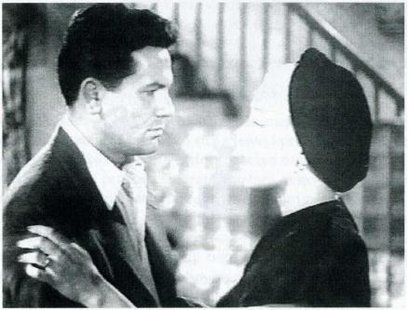
The Principle of Distinctness & Intelligibility
b. The ideal point of view
The camera on the level of human eye
The clear composition of the frame

Slide 6
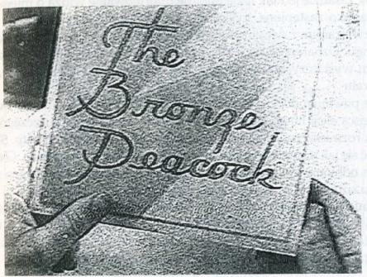
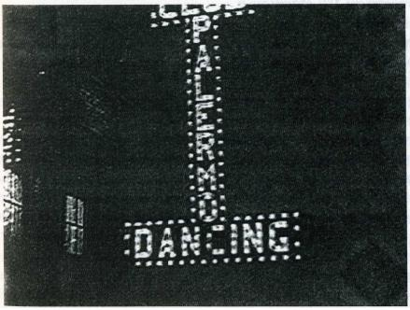
The Principle of Distinctness & Intelligibility
c. “Psychological” editing
- Orientation in space and time (photos from the Little Caesar, M. LeRoy, 1931)

Slide 7
The 180-degrees rule

Slide 8
The Principle of Distinctness & Intelligibility
d. The 180-degrees system ensures:
- that relative positions in the frame remain consistent
- consistent eyelines
- consistent screen direction
f. ex. High Noon

Slide 9
The Principle of Distinctness & Intelligibility
e. Full shot as an establishing shot
f. The principle of narrative

Slide 10
The Principle of Distinctness & Intelligibility
g. Very quick and clear description of the character f. ex. the first scene from The Postman Always Rings Twice, Tay Garnett (1946) and / or the character presented by one of his or her specific treat, f. ex. the first scene from the Little Caesar

Slide 11
The Principle of Distinctness & Intelligibility
h. The image of an actor which is being carried from one film to another
i. Personality reduced to the stereotype
j. The information game with a viewers

Slide 12
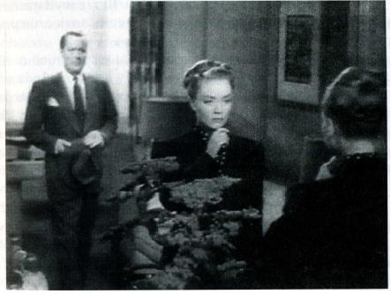
The Principle of Objectivity
Viewers watch the story events directly (from the position of the witness), without any form of mediation
The subjective perspective is visibly distinguished from the rest of the film, most often as the perspective of a character,
f. ex. Lady in the Lake,
Robert Montgomery (1947)

Slide 13
The Principle of Realism
Impersonal character of film process reinforces the impression of credibility
Trustworthy, but not true world, f. ex. King Kong, Merian C. Cooper, Ernest B. Schoedsack (1933)
Psychological mechanisms are respected
The conditional mode - “If I had been there, it could have looked like this”

Slide 14
The Principle of Transparency
Assumes that film is recounted in the way that makes spectator unable to mark that it happens
Camera mustn’t be visible
Autothematic approach and quotations from the other films cannot be applied
The actor mustn’t look directly into the camera

Slide 15
The Principle of Transparency Hollywood directors’ goal is to unfold the story without any interruptions or disturbances
It is provided by continuity editing (arranging of the shots so as to tell a story clearly and coherently)
Match on action, f. ex. High Noon
Point of view shot or eyeline match,
f. ex. The Postman Always Rings Twice
Point of view cutting, f. ex. Lady in the Lake
Constant screen direction
Rhythm of the cutting
Diegetic sound

Slide 16
The Principle of Transparency Few specific editing patterns that work as conventional figures:
Analytical / synthetical cutting
Shot / reverse shot, f. ex. Casablanca, Michael Curtiz (1942)
Montage sequence as a kind of temporal ellipsis (compressing a lengthy series of actions into a few moments), f. ex. Citizen Kane, by Orson Welles (1941)

Slide 17
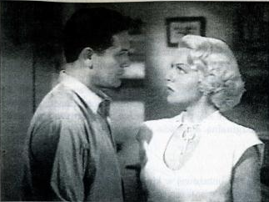
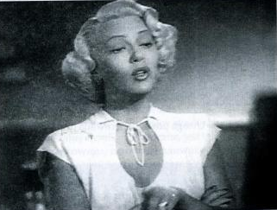
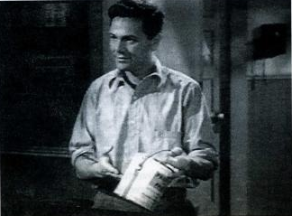
Show / Reverse shot

Slide 18
The Principle of Transparency Refinements of Continuity Editing
Crossing the axis of action legitimately by taking one shot on the line itself
Quick, sudden and repeated alternations of place of the action (chase scenes, outdoor action)
Cross-cutting, f. ex. Birth of the Nation, D. W. Griffith (1914); 7 pounds, Gabriele Muccino (2008)
Softening of montage: dissolve, fade in /
fade-out (signalizing the time lapse), f. ex. Hurricane, Norman Jewison (1999)

Slide 19
The influence on the sphere of emotions...
...based on the mechanism of projective identification involves the emotional engagement of the spectators
We are likely to say “it was done really well!” after we have watched the “successful” Hollywood film
We are likely to focus on technical lacks if we’ve watched the “poor” one

Slide 20
Hollywood style as a special form of organizing a film - the principles & conventions
1. Casablanca, Michael Curtiz (1942)
2. High Noon, Fred Zinnemann (1952)
3. King Kong, Merian C. Cooper, Ernest B. Schoedsack (1933)
4. Lady in The Lake, Robert Montgomery (1947)
5. Little Caesar, Mervyn LeRoy (1931)
6. The Postman Always Rings Twice, Tay Garnett (1946)
7. Raiders of the Lost Ark, Steven Spielberg (1984)
Rear Window, Alfred Hitchcock (1954)

Slide 21
Polemics with the Hollywood style
1. L'Avventura, Michelangelo Antonioni (1960)
2. Blade Runner, Ridley Scott (1982)
3. Citizen Kane, Orson Welles (1941)
4. Kindergarten Cop, Ivan Reitman (1990)
5. Rosmary’s Baby, Roman Polański (1968)
6. The Silence of the Lambs, Jonathan Demme (1991)
7. Stalker, Andrej Tarkovskij (1979)
Unforgiven, Clint Eastwood (1992)
Read it later! Intensified continuity in The Film Art.
An Introduction, D. Bordwell, K. Thompson, pp. 250 - 253

Slide 22
The question of the influence of Hollywood on the documentary
May constructing of an illusionary image of the reality be more effective way to illustrate it than its faithful recording?
Film narrative which influences viewers’ emotions and thus increases credibility and objectivity of the recounted story is a common sphere for documentary and fictional film
Film narrative cannot exist without active participation of the viewers, Roland Barthes, En sortant du cinéma, «Communications » nr 23, Paris 1975
A classical Hollywod-film as a tempting and enchanting object... (just for “ordinary” spectators?), Roland Barthes, Le plaisir du texte, Paris 1973

Slide 23
The sample film analysis, Rear Window, Alfred Hitchcock (1954)
Please identify director’s choices regarding to:
camera technique (distance to the object, framing, shooting angles, movements etc.)
mise-en-scène (setting, costume & make up, lighting & colour, staging)
editing (specific devices or patterns, like shot / reverse-shot, match on action, 180-degrees system, fade in, fade out, dissolves, rhythm of cutting)
sound (source, purpose of use, relation to the image)
narrative structure (range & depth of information, spatial & temporal relationships of the events, description of character)
specific motifs (graphic & sound effects, camera work, props, character’s behaviour) that make the story coherent
Thank you for your attention!

