Slide 1
Operating Systems:
Processes &
CPU Scheduling
INF1060:
Introduction to Operating Systems and Data Communication
Wednesday, September 18, 2013

Slide 2
Overview
Processes
  primitives for creation and termination
  states
  context switches
  (processes vs. threads)
CPU scheduling
  classification
  timeslices
  algorithms

Slide 3
Processes

Slide 4

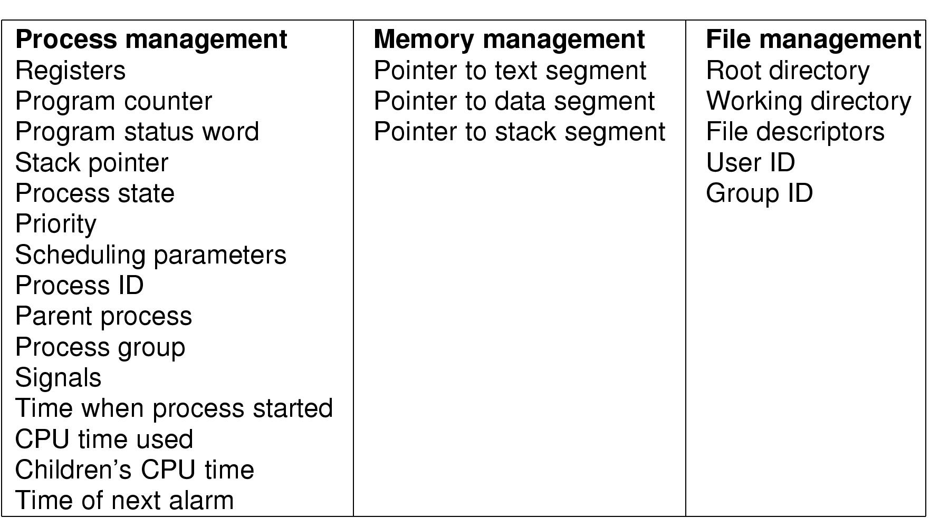
Processes
What is a process?
The "execution" of a program is often called a process
Process table entry (process control block, PCB):
Process
Program
Notes:
Process vs. program
- program often part of process
- program can fork several processes

Slide 5
Process Creation
A process can create another process using the
pid_t fork(void) system call (see man 2 fork) :
  makes a duplicate of the calling process including a copy of virtual address space, open file descriptors, etc…
  (only PIDs are different – locks and signals are not inherited)
  return value if …
    …parent: child process’ PID when successful, -1 otherwise
    …child: 0 (if successful - if not, there will not be a child)
  both processes continue in parallel
Other possibilities include
  int clone(…) – shares memory, descriptors, signals (see man 2 clone)
  pid_t vfork(void) – suspends parent in clone() (see man 2 vfork)
Notes:
clone: unlike fork, the new process share parts of execution environment like memory, table of file descriptors and signals handlers. Main use for threads
vfork: special case of clone, parent is suspended until child “exits” or calls “execve”

Slide 6
Process Creation – fork()
Prosess 1
Prosess 2
right after fork()
How is it possible to get different results?
(the programs do contain the same code!!)
after termination
(or any later time)
right after fork()
Process control block (process descriptor)
PID
address space (text, data, stack)
state
allocated resources
…
make_sandwitch()
make_burger()
make_small_cake()
fork()
make_coffee()
make_big_cake()
buy_champagne()
Notes:
Return value of FORK….

Slide 7
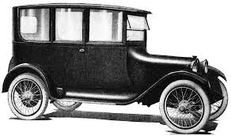

Program Execution
To make a process execute a program, one might use the
int execve(char *filename, char *params[], char *envp[]) system call (see man 2 execve):
  executes the program pointed to by filename (binary or script) using the parameters given in params and in the environment given by envp
  return value
    no return value on success, actually no process to return to
    -1 is returned on failure (and errno set)
Many other versions (frontends to execve) exist, e.g.,
execl, execlp, execle, execv and execvp (see man 3 exec)
fork(..)
execve(..)
process 1:
process 2:
Notes:
DESCRIPTION
execve() executes the program pointed to by filename. filename must be
either a binary executable, or a script starting with a line of the
form "#! interpreter [arg]". In the latter case, the interpreter must
be a valid pathname for an executable which is not itself a script,
which will be invoked as interpreter [arg] filename.
argv is an array of argument strings passed to the new program. envp
is an array of strings, conventionally of the form key=value, which are
passed as environment to the new program. Both argv and envp must be
terminated by a null pointer. The argument vector and environment can
be accessed by the called program's main function, when it is defined
as int main(int argc, char *argv[], char *envp[]).
execve() does not return on success, and the text, data, bss, and stack
of the calling process are overwritten by that of the program loaded.
The program invoked inherits the calling process's PID, and any open
file descriptors that are not set to close-on-exec. Signals pending on
the calling process are cleared. Any signals set to be caught by the
calling process are reset to their default behaviour. The SIGCHLD sig-
nal (when set to SIG_IGN) may or may not be reset to SIG_DFL.
If the current program is being ptraced, a SIGTRAP is sent to it after
a successful execve().
If the set-user-ID bit is set on the program file pointed to by file-
name, and the calling process is not being ptraced, then the effective
user ID of the calling process is changed to that of the owner of the
program file. i Similarly, when the set-group-ID bit of the program
file is set the effective group ID of the calling process is set to the
group of the program file.
The effective user ID of the process is copied to the saved set-user-
ID; similarly, the effective group ID is copied to the saved set-group-
ID. This copying takes place after any effective ID changes that occur
because of the set-user-ID and set-group-ID permission bits.
If the executable is an a.out dynamically-linked binary executable con-
taining shared-library stubs, the Linux dynamic linker ld.so(8) is
called at the start of execution to bring needed shared libraries into
memory and link the executable with them.
If the executable is a dynamically-linked ELF executable, the inter-
preter named in the PT_INTERP segment is used to load the needed shared
libraries. This interpreter is typically /lib/ld-linux.so.1 for bina-
ries linked with the Linux libc version 5, or /lib/ld-linux.so.2 for
binaries linked with the GNU libc version 2.
RETURN VALUE
On success, execve() does not return, on error -1 is returned, and
errno is set appropriately.

Slide 8
Process Waiting
To make a process wait for another process, one can use the
pid_t wait(int *status) system call (see man 2 wait):
  waits until any of the child processes terminates (if there are running child processes)
  returns
    -1 if no child processes exist
    PID of the terminated child process and puts the status of the process in status
  see also wait4, waitpid
fork(..)
wait(..)
process 1:
process 2:
Notes:
WAIT / WAITPID:
DESCRIPTION
All of these system calls are used to wait for state changes in a child of the calling
process, and obtain information about the child whose state has changed. A state change
is considered to be: the child terminated; the child was stopped by a signal; or the
child was resumed by a signal. In the case of a terminated child, performing a wait
allows the system to release the resources associated with the child; if a wait is not
performed, then terminated the child remains in a "zombie" state (see NOTES below).
If a child has already changed state, then these calls return immediately. Otherwise
they block until either a child changes state or a signal handler interrupts the call
(assuming that system calls are not automatically restarted using the SA_RESTART flag of
sigaction(2)). In the remainder of this page, a child whose state has changed and which
has not yet been waited upon by one of these system calls is termed waitable.
wait() and waitpid()
The wait() system call suspends execution of the current process until one of its chil-
dren terminates. The call wait(&status) is equivalent to:
waitpid(-1, &status, 0);
The waitpid() system call suspends execution of the current process until a child speci-
fied by pid argument has changed state. By default, waitpid() waits only for terminated
children, but this behaviour is modifiable via the options argument, as described below.
The value of pid can be:
< -1 meaning wait for any child process whose process group ID is equal to the absolute
value of pid.
-1 meaning wait for any child process.
0 meaning wait for any child process whose process group ID is equal to that of the
calling process.
> 0 meaning wait for the child whose process ID is equal to the value of pid.
The value of options is an OR of zero or more of the following constants:
WAIT4:
DESCRIPTION
The wait3() and wait4() system calls are similar to waitpid(2), but additionally return
resource usage information about the child in the structure pointed to by rusage.
Other than the use of the rusage argument, the following wait3() call:
wait3(status, options, rusage);
is equivalent to:
waitpid(-1, status, options);
Similarly, the following wait4() call:
wait4(pid, status, options, rusage);
is equivalent to:
waitpid(pid, status, options);
In other words, wait3() waits of any child, while wait4() can be used to select a spe-
cific child, or children, on which to wait. See wait(2) for further details.
If rusage is not NULL, the struct rusage to which it points will be filled with account-
ing information about the child. See getrusage(2) for details.

Slide 9
Process Termination
A process can terminate in several different ways:
  no more instructions to execute in the program –
  unknown status value
  a function in a program finishes with a return –
  parameter to return the status value
  the system call void exit(int status) terminates a process and returns the status value (see man 3 exit)
  the system call int kill(pid_t pid, int sig) sends a signal to a process to terminate it (see man 2 kill, man 7 signal)
A status value of 0 indicates success,
other values indicate errors

Slide 10
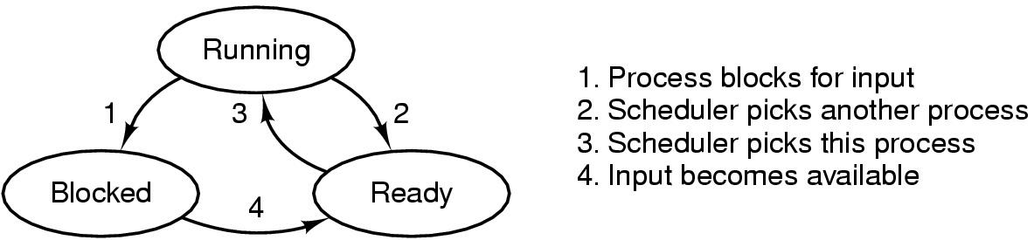
Process States
Termination
Creation

Slide 11
Context Switches
Context switch: the process of switching one running process to another
  stop running process 1
  storing the state (like registers, instruction pointer) of process 1
  (usually on stack or PCB)
  restoring state of process 2
  resume operation on program counter for process 2
  essential feature of multi-tasking systems
  computationally intensive, important to optimize the use of context switches
  some hardware support, but usually only for general purpose registers
Possible causes:
  scheduler switches processes (and contexts) due to algorithm and time slices
  interrupts
  required transition between user-mode and kernel-mode

Slide 12
Processes vs. Threads
Processes: resource grouping and execution
Threads (light-weight processes)
  enable more efficient cooperation among execution units
  share many of the process resources (most notably address space)
  have their own state, stack, processor registers and program counter
Process
Process
- address space
- registers
- program counter
- stack
- …
information global to
all threads in a process
- address space
- other global process data
- address space
- registers
- program counter
- stack
- …
- state
- registers
- program counter
- stack
- state
- registers
- program counter
- stack
threads
threads
information local
to each thread
...

Slide 13
Processes vs. Threads
Processes: resource grouping and execution
Threads (light-weight processes)
  enable more efficient cooperation among execution units
  share many of the process resources (most notably address space)
  have their own state, stack, processor registers and program counter
  no memory address switch
  thread switching is much cheaper
  parallel execution of concurrent tasks within a process
No standard, several implementations (e.g., Win32 threads, Pthreads, C-threads)
(see man 3 pthreads)
Example: time using futex to suspend and resume processes (incl. systemcall overhead):
Intel 5150: ~1900ns/process switch, ~1700ns/thread switch
Intel E5440: ~1300ns/process switch, ~1100ns/thread switch
Intel E5520: ~1400ns/process switch, ~1300ns/thread switch
Intel X5550: ~1300ns/process switch, ~1100ns/thread switch
Intel L5630: ~1600ns/process switch, ~1400ns/thread switch
Intel E5-2620: ~1600ns/process switch, ~1300ns/thread contex
http://blog.tsunanet.net/2010/11/how-long-does-it-take-to-make-context.html
Process
- address space
- other global process data
- state
- registers
- program counter
- stack
- state
- registers
- program counter
- stack
threads
threads
...
Notes:
The last exampple Intel E5-2620 =
A dual Intel Sandy Bridge-EP, 2Ghz - a hexa-core with HyperThreading = total of 12 cores, or 24 "hardware threads". Kernel: 3.4.24 x86_64.

Slide 14
Example
#include <stdio.h>
#include <stdlib.h>
#include <sys/types.h>
#include <sys/wait.h>
#include <unistd.h>
int main(void){
pid_t pid, n;
int status = 0;
if ((pid = fork()) == -1) {printf("Failure\n"); exit(1);}
if (pid != 0) { /* Parent */
printf("parent PID=%d, child PID = %d\n", (int) getpid(), (int) pid);
printf("parent going to sleep (wait)...\n");
n = wait(&status);
printf("returned child PID=%d, status=0x%x\n",
(int)n, status);
return 0;
} else { /* Child */
printf("child PID=%d\n", (int)getpid());
printf("executing /store/bin/whoami\n");
execve("/store/bin/whoami", NULL, NULL);
exit(0); /* Will usually not be executed */
}
}
[vizzini] > ./testfork
parent PID=2295, child PID=2296
parent going to sleep (wait)...
child PID=2296
executing /store/bin/whoami
paalh
returned child PID=2296, status=0x0
[vizzini] > ./testfork
child PID=2444
executing /store/bin/whoami
parent PID=2443, child PID=2444
parent going to sleep (wait)...
paalh
returned child PID=2444, status=0x0
Two concurrent processes
running, scheduled differently
Why???

Slide 15
CPU Scheduling

Slide 16
Scheduling
A task is a schedulable entity/something that can run
(a process/thread executing a job, e.g.,
a packet through the communication
system or a disk request through the file system)
In a multi-tasking system, several
tasks may wish to use a resource
simultaneously
A scheduler decides which task
that may use the resource,
i.e., determines order
by which requests are serviced,
using a scheduling algorithm
requests
scheduler
resource

Slide 17

Why Spend Time on Scheduling?
Scheduling is difficult and takes time – RT vs NRT example

Slide 18
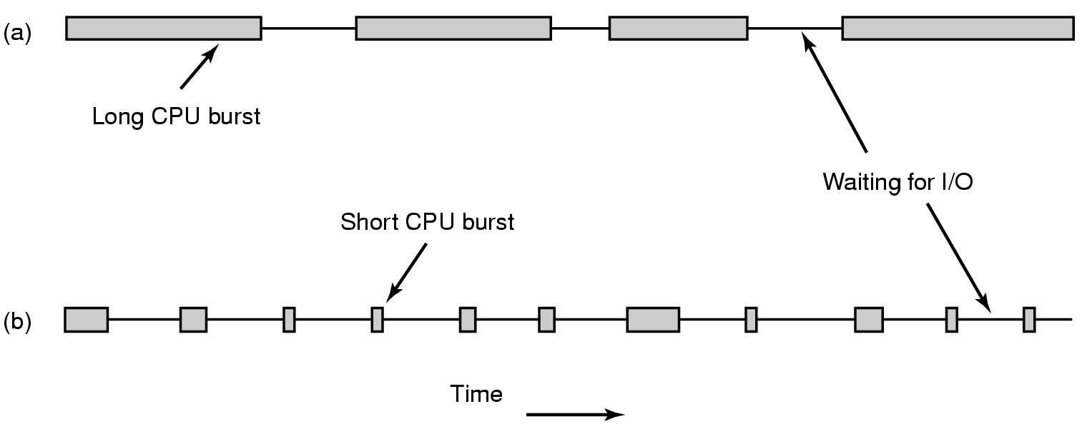
Why Spend Time on Scheduling?
Optimize the system to the given goals
  e.g., CPU utilization, throughput, response time, waiting time, fairness, …
Example: CPU-Bound vs. I/O-Bound Processes:
  Bursts of CPU usage alternate with periods of I/O wait

Slide 19

Why Spend Time on Scheduling?
Example: CPU-Bound vs. I/O-Bound Processes (cont.) – observations:
  schedule all CPU-bound processes first, then I/O-bound
  schedule all I/O-bound processes first, then CPU-bound?
  possible solution:
  mix of CPU-bound and I/O-bound: overlap slow I/O devices with fast CPU
CPU
DISK

Slide 20
FIFO and Round Robin
FIFO:
Run
  to completion (old days)
  until blocked, yield or exit
Advantages
  simple
Disadvantage
  when short jobs get behind long
Round-Robin (RR):
FIFO queue
Each process runs a timeslice
  each process gets 1/n of the CPU in max t time units at a time
  the preempted process is put back in the queue

Slide 21
FIFO and Round Robin
Example: 10 jobs and each takes 100 seconds
FIFO – the process runs until finished, no overhead (!!??)
  start: job1: 0s, job2: 100s, ... , job10: 900s → average 450s
  finished: job1: 100s, job2: 200s, ... , job10: 1000s → average 550s
  unfair, but some are lucky
RR - time slice of 1s, no overhead (!!??)
  start: job1: 0s, job2: 1s, ... , job10: 9s → average 4.5s
  finished: job1: 991s, job2: 992s, ... , job10: 1000s → average 995.5s
  fair, but no one are lucky
Comparisons
  FIFO better for long CPU-intensive jobs (there is overhead in switching!!)
  but RR much better for interactivity!
But, how to choose the right time slice??

Slide 22
Case: Time Slice Size
Resource utilization example
  A and B run forever, and each uses 100% CPU
  C loops forever (1 ms CPU and 10 ms disk)
  assume no switching overhead
Large or small time slices?
  nearly 100% of CPU utilization regardless of size
  Time slice 100 ms: nearly 5% of disk utilization with RR
  [ A:100 + B:100 + C:1 → 201 ms CPU vs. 10 ms disk ]
  Time slice 1 ms: nearly 91% of disk utilization with RR
  [ 5x (A:1 + B:1) + C:1 → 11 ms CPU vs. 10 ms disk ]
What do we learn from this example?
  The right time slice (in this case shorter) can improve overall utilization
  CPU bound: benefits from having longer time slices (>100 ms)
  I/O bound: benefits from having shorter time slices (≤10 ms)

Slide 23
Scheduling
A variety of (contradicting) factors to consider
  treat similar tasks in a similar way
  no process should wait forever
  short response times (time _{request submitted} - time _{response given} )
  maximize throughput
  maximum resource utilization (100%, but 40-90% normal)
  minimize overhead
  predictable access
  …
Several ways to achieve these goals, …
…but which criteria is most important?

Slide 24
Scheduling
“Most reasonable” criteria depends on who you are
  Kernel
    Resource management
      processor utilization, throughput, fairness
  User
    Interactivity
      response time
      (Example: when playing a game, we will not accept waiting 10s each time we
      use the joystick)
    Predictability
      identical performance every time
      (Example: when using the editor, we will not accept waiting 5s one time and 5ms another time to get echo)
“Most reasonable” criteria depends on environment
  Server vs. end-system
  Stationary vs. mobile
  …

Slide 25
Scheduling
“Most reasonable” criteria depends on target system
  Most/All types of systems
    fairness – giving each process a fair share
    balance – keeping all parts of the system busy
  Batch systems
    turnaround time – minimize time between submission and termination
    throughput – maximize number of jobs per hour
    (CPU utilization – keep CPU busy all the time)
  Interactive systems
    response time – respond to requests quickly
    proportionality – meet users’ expectations
  Real-time systems
    meet deadlines – avoid loosing data
    predictability – avoid quality degradation in multimedia systems

Slide 26
Scheduling
Scheduling algorithm classification:
  dynamic
    make scheduling decisions at run-time
    flexible to adapt
    considers only the actual task requests and execution time parameters
    large run-time overhead finding a schedule
  static
    make scheduling decisions at off-line (also called pre-run-time)
    generates a dispatching table for run-time dispatcher at compile time
    needs complete knowledge of the task before compiling
    small run-time overhead
  preemptive
    currently executing task may be interrupted (preempted) by higher priority processes
    preempted process continues later at the same state
    overhead of contexts switching
  non-preemptive
    running tasks will be allowed to finish its time-slot (higher priority processes must wait)
    reasonable for short tasks like sending a packet (used by disk and network cards)
    less frequent switches

Slide 27
Preemption
Tasks waits for processing
Scheduler assigns priorities
Task with highest priority will be scheduled first
Preempt current execution if
  a higher priority (more urgent) task arrives
  timeslice is consumed
  …
Real-time and best effort priorities
  real-time processes have higher priority
  (if exists, they will run)
To kinds of preemption:
  preemption points
    predictable overhead
    simplified scheduler accounting
  immediate preemption
    needed for hard real-time systems
    needs special timers and fast interrupt and context switch handling
requests
scheduler
preemption
resource

Slide 28
Preemption
RT vs NRT example:
RT process
delay
request
round-robin
process 1
process 2
process 3
process 4
…
process N
RT process
RT process
request
delay
priority,
non-preemtive
process 1
process 2
RT process
process 3
process 4
…
process N
RT process
request
only delay of switching and interrupts
priority,
preemtive
process 1
p 1
RT process
p 1
process 2
process 2
p 1
process 3
process 3
process 2
process 4
process 4
process 3
…
…
process 4
process N
process N
…
process N

Slide 29
Many Algorithms Exist
First In First Out (FIFO)
Round-Robin (RR)
Shortest Job First
Shortest Time to Completion First
Shortest Remaining Time to Completion First
(a.k.a. Shortest Remaining Time First)
Lottery
Fair Queuing
…
Earliest Deadline First (EDF)
Rate Monotonic (RM)
…
Most systems use some kind of priority scheduling

Slide 30
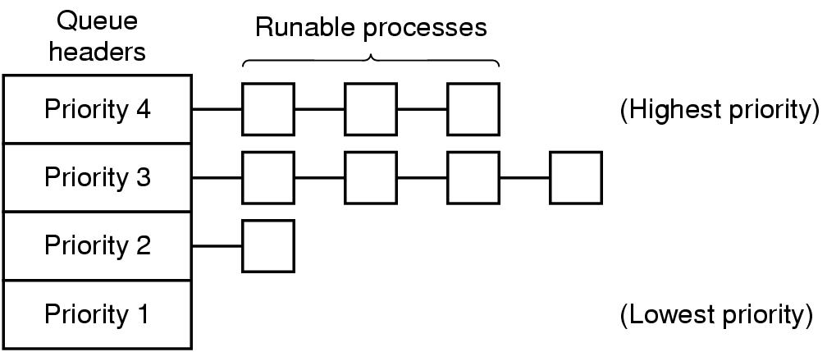
Priority Scheduling
Assign each process a priority
Run the process with highest priority in the ready queue first
Multiple queues
Advantage
  (Fairness)
  Different priorities according
  to importance
Disadvantage
  Users can hit keyboard frequently
  Starvation: so maybe use dynamic priorities?

Slide 31
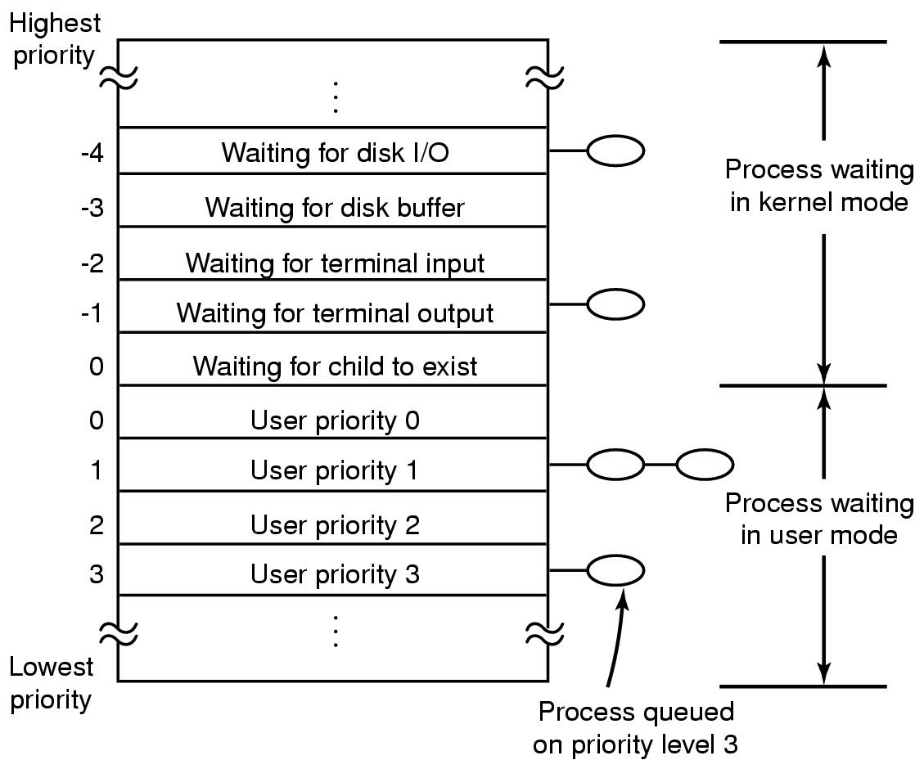
Traditional scheduling in UNIX
Many versions
User processes have positive
priorities, kernel negative
Schedule lowest priority first
If a process uses the whole time
slice, it is put back at the end of
the queue (RR)
Each second the priorities are
recalculated:
priority =
  CPU_usage (average #ticks)
  nice (± 20)
  base (priority of last corresponding kernel process)

Slide 32
Scheduling in Windows 2000, XP, …
Preemptive kernel
Schedules threads individually
Time slices given in quantums
  3 quantums = 1 clock interval (length of interval may vary)
  defaults:
    Win2000 server: 36 quantums
    Win2000 workstation: 6 quantums (professional)
  may manually be increased between threads (1x, 2x, 4x, 6x)
  foreground quantum boost (add 0x, 1x, 2x):
  an active window can get longer time slices (assumed need for fast response)

Slide 33
Scheduling in Windows 2000, XP, …
32 priority levels:
Round Robin (RR) within each level
Interactive and throughput-oriented:
  “Real time” – 16 system levels
    fixed priority
    may run forever
  Variable – 15 user levels
    priority may change:
    thread priority = process priority ± 2
    uses much → drops
    user interactions, I/O completions → increase
  Idle/zero-page thread – 1 system level
    runs whenever there are no other processes to run
    clears memory pages for memory manager
Real Time (system thread)
31
30
...
17
16
Variable (user thread)
15
14
...
2
1
Idle (system thread)
0

Slide 34
Scheduling in Windows 8 (…server 2008, 7)
http://msdn.microsoft.com/en-us/
library/windows/desktop/
ms681917(v=vs.85).aspx
Still 32 priority levels, with 6 classes - RR within each:
  REALTIME_PRIORITY_CLASS
  HIGH_PRIORITY_CLASS
  ABOVE_NORMAL_PRIORITY_CLASS
  NORMAL_PRIORITY_CLASS (default)
  BELOW_NORMAL_PRIORITY_CLASS
  IDLE_PRIORITY_CLASS
  each class has 7 thread priorities levels with different base priorities
Dynamic priority (can be disabled):
  foreground
  window receives input (mouse, keyboard, timers, …)
  unblocks
  if increased, drop by one level every timeslice until back to default
Support for user mode scheduling (UMS)
  each application may schedule own threads
  application must implement a scheduler component
Real Time (system thread)
31
30
...
17
16
Variable (user thread)
15
14
...
2
1
Idle (system thread)
0
Notes:
See http://msdn.microsoft.com/en-us/library/windows/desktop/ms681917(v=vs.85).aspx

Slide 35
Scheduling in Linux
Preemptive kernel
Threads and processes used to be equal,
but Linux uses (from 2.6) thread scheduling
SCHED_FIFO
  may run forever, no timeslices
  may use it’s own scheduling algorithm
SCHED_RR
  each priority in RR
  timeslices of 10 ms (quantums)
SCHED_OTHER
  ordinary user processes
  uses “nice”-values: 1≤ priority≤40
  timeslices of 10 ms (quantums)
Threads with highest goodness are selected first:
  realtime (FIFO and RR):
  goodness = 1000 + priority
  timesharing (OTHER):
  goodness = (quantum > 0 ? quantum + priority : 0)
Quantums are reset when no ready
process has quantums left (end of epoch):
quantum = (quantum/2) + priority
SCHED_FIFO
1
2
...
99
100
SCHED_RR
1
2
...
99
100
nice
-20
-19
...
18
19
SCHED_OTHER
default (20)

Slide 36
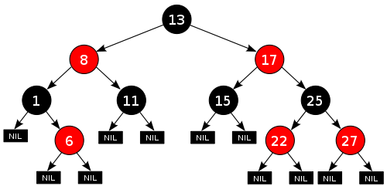
Scheduling in Linux
http://kerneltrap.org/node/8059
The current kernels (v.2.6.23+) use the Completely Fair Scheduler (CFS)
  addresses unfairness in desktop and server workloads
  uses ns granularity, does not rely on jiffies or HZ details
  uses an extensible hierarchical scheduling classes
    SCHED_NORMAL – the CFS desktop scheduler – replace SCHED_OTHER
    SCHED_BATCH – similar to SCHED_OTHER, but assumes CPU intensive workloads
    SCHED_RR and SCHED_FIFO (SCHED_RT)
      use 100 priorities
  no run-queues, a red-black tree-based timeline
  of future tasks based on virtual runtime
  does not directly use priorities, but instead uses them as a decay factor for the time a task is permitted to execute
Notes:
http://linux.die.net/man/2/sched_setscheduler
http://www.ibm.com/developerworks/linux/library/l-completely-fair-scheduler/
http://kerneltrap.org/node/8059

Slide 37


When to Invoke the Scheduler?
Process creation
Process termination
Process blocks
Interrupts occur
Clock interrupts in
the case of preemptive
systems

Slide 38
Future Chips: Something to think about!?
Future Chips:
Intel’s Single-chip Cloud Computer (SCC)
http://techresearch.intel.com/ProjectDetails.aspx?Id=1
What does introduction of such processors mean in terms of scheduling?
  many cores
  different memory access latencies
  different connectivity
  …
memory controller
memory controller
memory controller
memory controller
P54C core
L2 cache
L1 cache
mesh interface unit
router
P54C core
L2 cache
L1 cache
message passing buffer

Slide 39
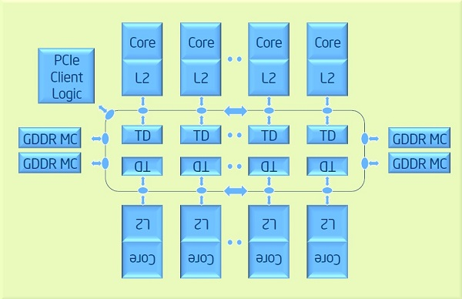
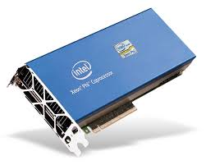
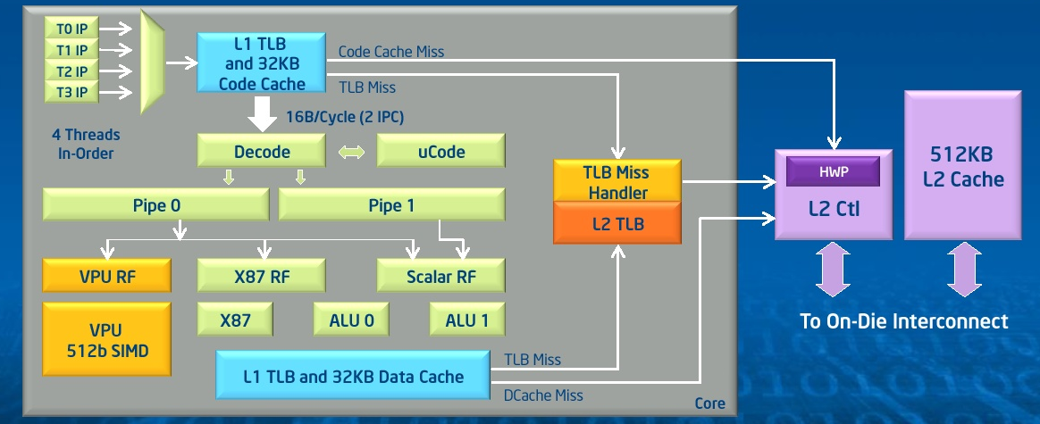
Future Chips: Something to think about!?
Future Chips: Intel’s Xeon Phi
  up to 61 cores
  8 memory controllers
  fully coherent
  L2 caches
  High Performance
  On-Die
  Bidirectional
  Interconnect
  …
What does such processors
mean in terms of scheduling?
  many cores
  different memory access latencies
  different connectivity
  …

Slide 40
Summary
Processes are programs under execution
Scheduling performance criteria and goals are
dependent on environment
The right timeslice can improve overall utilization
There exists several different algorithms targeted for various systems
Traditional OSes like Windows, UniX, Linux, ... usually use a priority-based algorithm

