Slide 1

Architecture-based approach to build adaptive software
Presenter
Kashif Dar
kashifd@ifi.uio.no
INF5360: Seminar on Dependable and Adaptive Distributed Systems
Department of Informatics
University of Oslo
February 08, 2011

Slide 2
Papers to present
An Architecture-Based Approach to Self-Adaptive Software
  By P. Oreizy, M. Gorlick, R. Taylor, D. Heimbigner, G. Johnson, N. Medvidovic, A. Quilici, D. Rosenblum, and A. Wolf,
  published in IEEE Intelligent Systems. May-June, 1999
Rainbow: Architecture-Based Self-Adaptation with Reusable Infrastructure
  By David Garlan, Shang-Wen Cheng, An-Cheng Huang, Bradley Schmerl, Peter Steenkiste,
  Publisher: IEEE Computer Society, pp. 46-54, October, 2004

Slide 3
An Architecture-Based Approach to Self-Adaptive Software
Examines the fundamental role of software architecture in self-adaptive systems
Topics covered:
  Self-adaptive software introduction
  Degrees of self-adaptability
  Dynamic Software architecture definition
  Adaptation management

Slide 4
Sample scenario
mission: fleet of unmanned air vehicles to disable an enemy airfield
replan their mission, dividing
into two groups: SAM-suppression and airfield-suppression
surface-to-air missile (SAM)
launchers now guards the airfield
airfield

Slide 5
What happened
Specialized algorithms for detecting and recognizing SAM launchers
Replannning by Analyses that include feedback from new situation
New software components are dynamically loaded and integrated without requiring restart, or any downtime
Taking place autonomously

Slide 6
Self-adaptive software
Definition:
Behavior: anything the software is expected to do
Run-Time: do not need to be shut down to make the change
Changes in operating environment: anything observable by the software system, e.g. end-user input, external hardware devices and sensors, or program instrumentation
Self-adaptive software is a software that modifies its own behavior at run-time in response to changes in its operating environment

Slide 7
Issues for adaptation
What Conditions?
  Performance boost, failure recovery, re-configuration
Open or Closed adaptation
  Is new application behavior can be added at runtime?
Type of autonomy
  Fully autonomic, Self-contained, Human-in-the-loop
  Frequency
  Opportunistic, continuous, or lazy, as needed
  Cost Effectiveness
  Benefits should outweigh the cost of adaptation
  Information Type and Accuracy

Slide 8
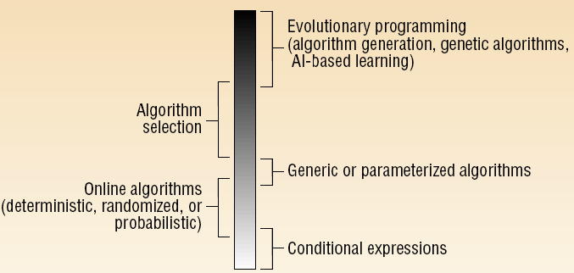
Degrees of adaptability

Slide 9
Conditional expressions
Program evaluates an expression and alters its behavior based on the outcome
E. g. if/switch statements

Slide 10
Online algorithms
assume future events are uncertain
leverage knowledge about the problem and the input domain to improve efficiency
E. g. memory-cache paging algorithm

Slide 11
Generic algorithms
Provide behaviors that are parameterized
E.g. polymorphic type in OOPLs, working with instances of new classes (derived from known classes or implement known interfaces)

Slide 12
Algorithm selection
Selection of the effective algorithm among a fixed set of available algorithms based on environment properties
E. g. Self optimizing compiler uses program-profiling data collected during program execution to select another optimization algorithms

Slide 13
Evolutionary programming
Using properties of the operating environment and knowledge gained from previous execution to generate new algorithms

Slide 14
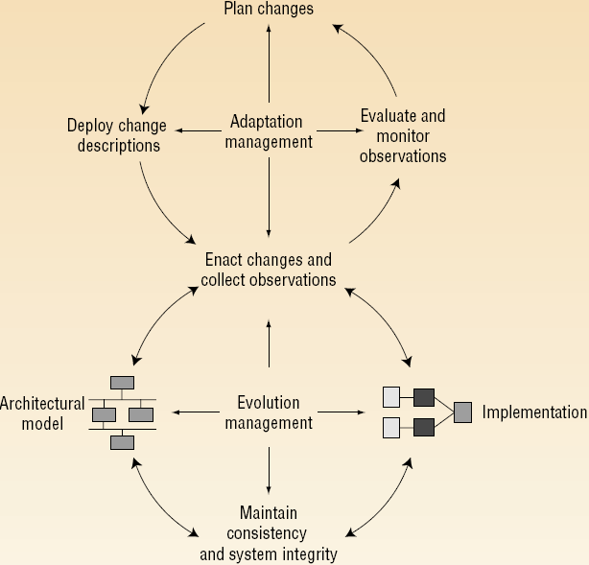
Adaptation methodology

Slide 15
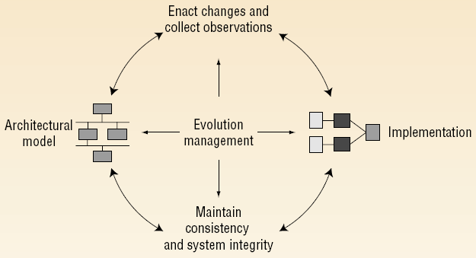
Architectural model

Slide 16
Architecture-driven development
From Architectural model to Implementation
Consistency between model and Implementation
System: network of coarse-grained components bound together by connectors
Connectors are transport and routing services for messages or objects
Components do not know how their inputs and outputs are delivered or transmitted or even what their sources or destinations might be
Connectors know exactly who is talking to whom and how
Separating computation from communication

Slide 17
Dynamic software architecture
In dynamic systems: modification in behaviour at run-time by making the following architectural changes:
  Adding new components
  Removing existing components
  Replacing existing components
  Changing the connectivity structure between components
Two approaches to dynamism at the architectural level:
  C2
  Weaves

Slide 18
C2 and Weaves
Both
  distinguish between components and connectors
  no restriction on their implementation language
  communication between components by exchanging asynchronous messages (C2) or objects (Weaves)
  all communication between components must be via connectors

Slide 19
C2
System as a hierarchy of concurrent components bound together by connectors
Component is aware of components “above” it and unaware of components residing at the same level or “beneath” it
Communication between a component and those below it is handled implicitly using events
  Whenever a component changes its state, it broadcasts this to all components below it
C1
C2
C3
C4
C5
C6
C7

Slide 20
Weaves
Dynamic, objectflow-centric architecture
Components consume objects as inputs and produce objects as outputs
Components do not knows the semantics of the connectors that delivered its input objects or transmitted its output objects
C1
Obj1 returns
C2
C3
C4
Obj2

Slide 21
Maintaining consistency

Slide 22
Maintaining consistency and integrity
Preserving an accurate and consistent model of components and connectors
Maintain a strict correspondence between the architectural model and the executing implementation
Architecture Evolution Manager (AEM)
  maintains the consistency between architectural model and implementation
  prevents changes from violating architectural constraints

Slide 23
Enacting changes

Slide 24
Enacting changes
Possible sources of architectural change
Architecture editor
  To construct architecture and describe modifications
  With analysis tools such as design analyzer or domain-dependent analyzer
Modification interpreter
  Tool to interpret change scripts written in a change-description language to primitive actions supported by the AEM

Slide 25
Adaptation methodology

Slide 26
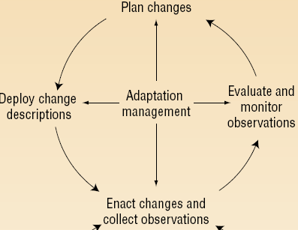
Collecting observations
Varieties of observations: event generation, …
Observers for notification of exceptional events
Expectation agent
  detecting and noting single events is not enough
  responds to the occurrence of event patterns
New techniques for reducing the monitoring overhead

Slide 27
Evaluate and monitor observations
Adaptive demands arise from inconsistencies or suboptimal behavior
Evaluating and observing an application’s execution, including, performance monitoring, constraint verification, …

Slide 28
Plan changes
The task of accepting the evaluations, defining an appropriate adaptation, and constructing a blueprint for executing that adaptation
Two forms
  Observation planning: determines which observations are necessary for deciding
  Adaptation planning: determines exactly which adaptations to make and when

Slide 29
Deploy change descriptions
Change descriptions
  Included are any new required components or connectors and their affiliated annotations
  Interact with the AEM to translates the change in descriptions into specific updates of implementation

Slide 30
Summary
Paper main goal
  Introducing an architecture-based approach to managing self-adaptive software
To achieve this goal
  Describe dynamic software architecture
  Explain how architectural model eases software adaptation

Slide 31
Interesting points
Key issues for adaptive software: open-closed, cost effective, ...
  Classification of self-adaptability, ranging from conditional expressions to evolutionary programming
  Describing two dynamic software architectures: C2 and Weaves
  Making effort to connect software development process with adaptation process

Slide 32
Questions and discussion
The authors claim that they have developed an infrastructure for dynamic adaptation
  The infrastructure is described at an abstract level
  No details of how an implementation of the infrastructure works
  How are architectural constraints expressed and checked?
  Which architecture is suitable?
  The Reasoning model for Evaluation or Plan changes?

Slide 33
Rainbow: Architecture-based Self-adaptation
By David Garlan et al, 2004
Notes:
Want everyone to walk away knowing our work.
We're looking for collaboration... to the extent we can try our system on IBM-style system.

Slide 34
Outline
Motivation
Approach
Preliminary Work
Demo
Discussion of Challenges

Slide 35
Many Things Can Go Wrong
Resource variability
Changing environments
Shifting user needs
System faults
Application or network connection fails
Software Application(s)
Server load changes
Wireless device moves into a different network
User attempts foul-play
The system should dynamically adapt to these problems.

Slide 36
External Adaptation
Global system perspective
Important system-level behaviors and properties
Explicit system integrity constraints
Architectural model &
Adaptation mechanism
adapt
monitor
Software Application(s)

Slide 37
Desirable Solution
Ideally, we’d like a solution that
  enables software engineers
  to use architectural models
  to adapt existing systems
Key Challenge: One size does not fit all
Solution should be
    General
    cost-effective
    composable

Slide 38
Rainbow Approach
Architecture Layer
Adaptation
Engine
Arch
Evaluator
Adaptation
Executor
Model
Manager
Gauges
Effector mechanisms
Translation
Infrastructure
Monitoring mechanisms
System Layer
System API
Effectors
Resource
Discovery
Probes
Running System
Notes:
Explain the Rainbow architecture and adaptation cycle.

Slide 39
Our Rainbow Approach (2)
Architecture Layer
Architecture Layer
Adaptation
Engine
Adaptation
Engine
Arch
Evaluator
Arch
Evaluator
Adaptation
Engine
Arch
Evaluator
Model
Manager
Adaptation
Executor
Model
Manager
Adaptation
Executor
Model
Manager
Adaptation
Executor
Gauges
Gauges
Translation
Infrastructure
Translation
Infrastructure
System Layer
System Layer
System API
System API
Effectors
Resource
Discovery
Probes
Effectors
Resource
Discovery
Probes
Running System
Running System

Slide 40
Rainbow as a Tailorable Framework
General framework with
  Reusable infrastructure + tailorable mechanisms
Specialized to targeted
  system + adaptation goals
Main components
  Monitoring mechanisms
  Model manager
  Architectural evaluator
  Adaptation engine
  Effector mechanisms
What’s tailored
Properties
Vocabulary of model
Architectural constraints
Strategies & tactics
Operators

Slide 41
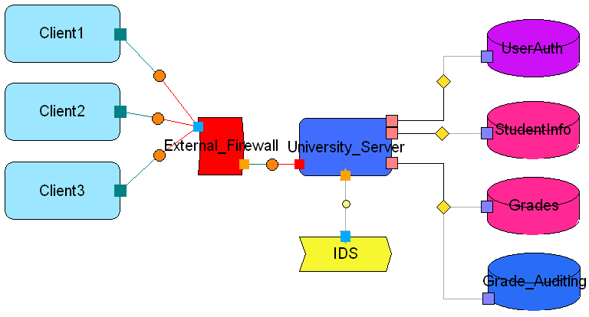
Demo: University Grade System
Students using university web
  University aims to provide timely and ubiquitous access
  One student tries to hack in and change his grades
Possible (escalating) responses:
  Turn on auditing
  Switch authentication scheme
  Sandboxing
  Move grades data
  Close off connections
  Partition network
  Turn off services

Slide 42
Demo : University Grade System
Composite system style:
  Client-server + data repository
Adaptation goals investigated:
  Performance + security
Adaptation strategies to counter perfor-mance problems
counterIntrusion, counterDoS…
Constraints on performance properties
Invariant
intrusionProb <=
threatThreshold
Client-server architecture change operators
GradeServer
.addService(), DbT.audit()
Vocabulary of client-server elements and performance properties
Firewall, Db, ServerT
intrusion%, load
Mapping of elements and operators to system-level actions
Db ⬄
MySQL DB,
etc.
System properties to monitor
intrusion behavior patterns; specific IDS

Slide 43
Rainbow Illustrated – Intrusion Detection
Rainbow
Mechanisms
False! Find the right tactic
Adaptation
Engine
Client2.isolate() /
Grades.audit()
True?: intrusion_prob <= max_prob
Model Manager
Adaptation
Executor
Arch
Evaluator
Client2.intrusion_prob = 75%
Translator
Change link / Add Auditing
Grade change

Slide 44
Preliminary Work Shows Promise
Rainbow prototype
  Integrated mechanisms and tested control cycle
  Demonstrated usefulness for specific adaptation scenarios
Two case studies
  Three styles of system
    Client-server, service-coalition, data repository
  Three kinds of adaptation goals
    Performance + security + cost
Adaptation language under development

Slide 45
Some Research Problems
Architectural “recovery” at run time.
Efficient, scalable constraint evaluation
Environment modeling and scoping
Handling multiple models and dimensions of concern
Reasoning about the correctness of a repair strategy
Non-deterministic arrival of system observations
Avoiding thrashing
Adapting the adaptation strategies

Slide 46
The END

