Slide 1
Branding
Arild Aspelund
IØT, NTNU

Slide 2
Norsk Kundebarometer
Top 5 – Satisfaction
Skandiabanken
Flytoget
Hurtigruten
Toyota
BMW
Bottom 5 – Satisfaction
Troms Kraft Marked
Finansavisen
Lidl
Notar
SASBraathens

Slide 3
Norsk Kundebarometer
Top 5 – Loyalty
Meny
Skandiabanken
Flytoget
Coop Marked
Alliance
Bottom 5 – Loyalty
Skeidar
DnbNOR Eiendom
Postbanken Eiendom
Finansavisen
Notar

Slide 4
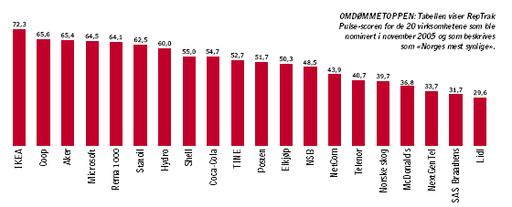
RepTrak Norge 2006
Kilde: Apeland Informasjon og Reputation Institute

Slide 5
Outline
What is a Brand
What does it consist of and what can it do for you
What is Brand Equity and how can you build it?
What are the key decision points in setting a branding strategy

Slide 6
A Brand
A name, term, sign, symbol
or design, or a combination of them,
intended to identify the goods
or services of one seller or group
of sellers and to differentiate
them from those of competitors.

Slide 7
Some Key Elements of a Strong Brand
Consistency between
Customer’s values and perceived benefits
Firm’s core competencies
Customer’s brand associations

Slide 8
What is Branding?
Endowing products and services
with the power of a brand.

Slide 9
What Can a Good Brand Do for You?
Identify the maker
Simplify product handling
Organize accounting
Offer legal protection

Slide 10
What Can a Good Brand Do for You?
Signify quality
Create barriers to entry
Serve as a competitive advantage
Secure price premium

Slide 11
What is Brand Equity
The differential effect that brand
knowledge has on consumer
response to the
marketing of that brand.

Slide 12
Brand Elements
Brand
names
URLs
Slogans
Elements
Logos
Characters
Symbols

Slide 13
Brand Knowledge
Thoughts
Feelings
Knowledge
Beliefs
Images
Experiences

Slide 14
Brand Associations
Strong
Unique
Favorable

Slide 15
What do you know?

Slide 16
Managing Brand Equity
Brand Reinforcement
Brand Revitalization
Brand Crises

Slide 17
Creating a Brand Strategy
Develop new brand elements
Apply existing brand elements
Use a combination of
old and new

Slide 18
Branding: Offensive Strategy - Increasing Conversion Rates
Awareness
Familiarity
Consideration
Purchase
Loyalty
Ambassador
84
50
50
60
41
95
80
40
20
12
5
73
15
11

Slide 19
Branding: Defensive Strategy - The Brand Fortress
Brand Association
Perceived Core Competencies of Supplier
Perceived Benefits of Supplier

Slide 20
Summary and continuation
Summary
What are Brands and Branding and what can they do for you?
Elements of a brand and how you can put these things together to a branding strategy
Continuation
Pricing

