Slide 1
Product and Price Strategies
Arild Aspelund
IØT, NTNU

Slide 2
Outline
Product differentiation and product positioning
Understanding pricing
Some typical pricing mistakes
A six-step method for price setting
Product-Mix pricing

Slide 3
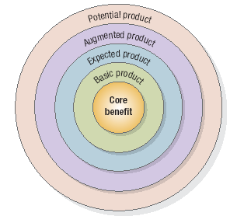
The Customer Value Hierarchy

Slide 4
Product Categories
Durability
Durable
Non-durable
Tangibility
Services
Use
Consumer goods
Industrial goods

Slide 5
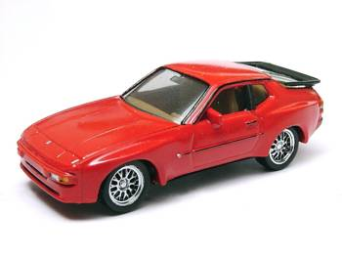
Product Differentiation
Form
Features
Performance quality
Conformance quality
Durability
Reliability
Reparability
Style

Slide 6
Service Differentiation
Ordering ease
Delivery
Installation
Customer training
Customer consulting
Maintenance and repair

Slide 7
Product and Service Mix
Width
Number of different product lines
Length
Number of variants within each product line
Depth
Total number of different products
Consistency
How closely related are the different products in the product mix
Supporting and complementary services

Slide 8
The Psychology of Pricing
Reference prices
Most people don’t remember most actual prices, but refers to internal or external reference prices
Price-quality inference
There is a tendency to believe there is a positive price-quality relationship in any product market
Price associations
9,99
Odd and even numbers

Slide 9
Some Common Mistakes in Pricing
Determine costs and take traditional industry margins
Failure to revise price to capitalize on market changes
Setting price independently of the rest of the marketing mix
Price
Product
Place
Promotion
Failure to vary price by product item, market segment, distribution channels, and purchase occasion

Slide 10
A 6-step Pricing Procedure
Select the price objective
Determine demand
Estimate costs
Analyze competitor price mix
Select pricing method
Select final price

Slide 11
1 – Price Objectives
Survival
Maximum current profit
Maximum market share
Maximum market skimming
Product-quality leadership

Slide 12
2 – Determine Demand
Price Sensitivity
To what extent do consumers care about prices on these types of offerings
Estimation of demand
What is your total market potential?
What is realistically your share of the pie?
Price elasticity of demand
How will your total market (and your specific market segment) change with price changes?

Slide 13
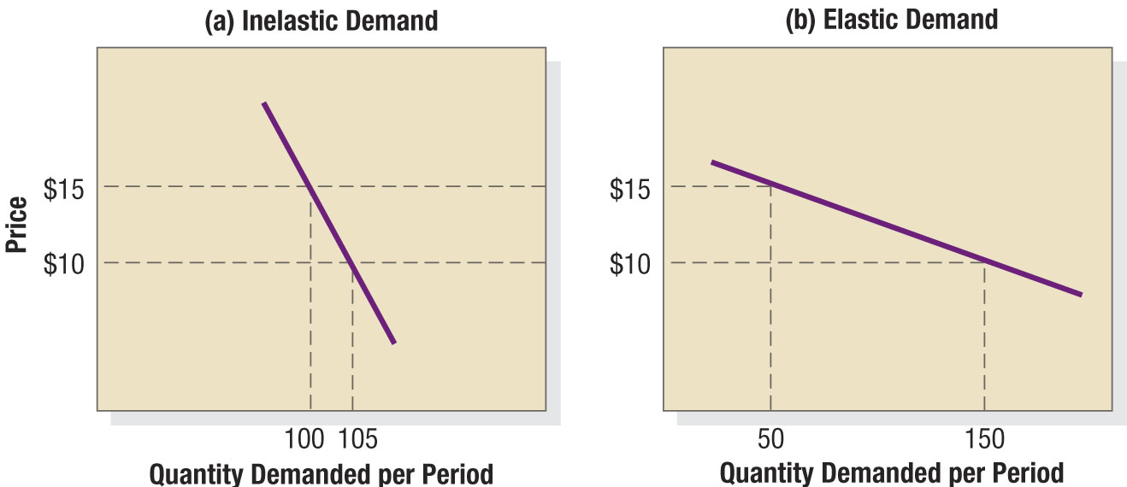
2 – Determine Demand

Slide 14
3 – Estimation Costs
Fixed costs
Variable costs
Total costs
Average cost
Cost at different levels of production

Slide 15
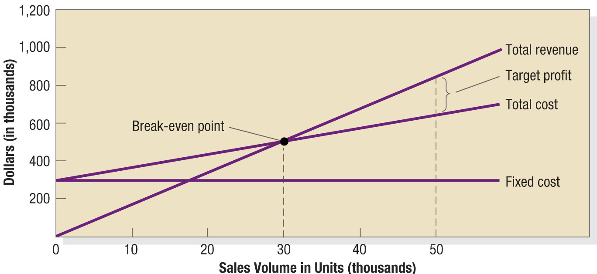
3 – Estimation Costs

Slide 16
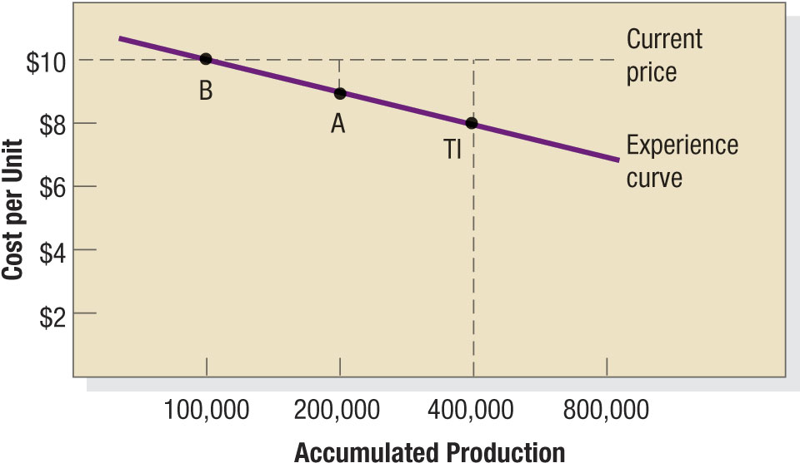
3 – Estimation Costs

Slide 17
4 - Analyze Competitors’ Price Mix
Analyze competitors’ costs, price structures and offers
Consider Some of the Real Champions of Pricing
Public air transportation
Convenience chains

Slide 18
Prices as a function of competition

Slide 19
5 – Select Pricing Method
Mark-up pricing
Target-return pricing
Perceived-value pricing
Value-pricing
Going-rate pricing
Auction-type pricing
English, Dutch, sealed-bidding, and repeated

Slide 20
6 – Select Final Price
In addition to the offering-specific your need to consider the following aspects concerning your marketing campaign and organization
Impact of other marketing activities
Company policies and brand consistency
Consumers’ risk association
New and unknown market actors
Reactions from other parties
Suppliers, partners, other stake holders

Slide 21
Pricing Product Mixes (1)
Product line pricing
Differ prices on different products in the product line
Optional-feature pricing
Offer a stripped version and variable prices on optional features
Captive-product pricing
Different pricing on durable and non-durable products or supportive services

Slide 22
Pricing Product Mixes (2)
Two-part pricing
Fixed fee plus a variable usage fee
By-product pricing
Selling production “surplus”
Product-bundling pricing
Bundle several product or services with individually low prices, but high combined value

Slide 23
Summary and continuation
Summary
Product and service differentiation
Product and service mix
Psychology of pricing
Mistakes in pricing
A 6-step model for pricing
Product-mix pricing
Continuation
Market Channels and Value Networks

