Slide 1
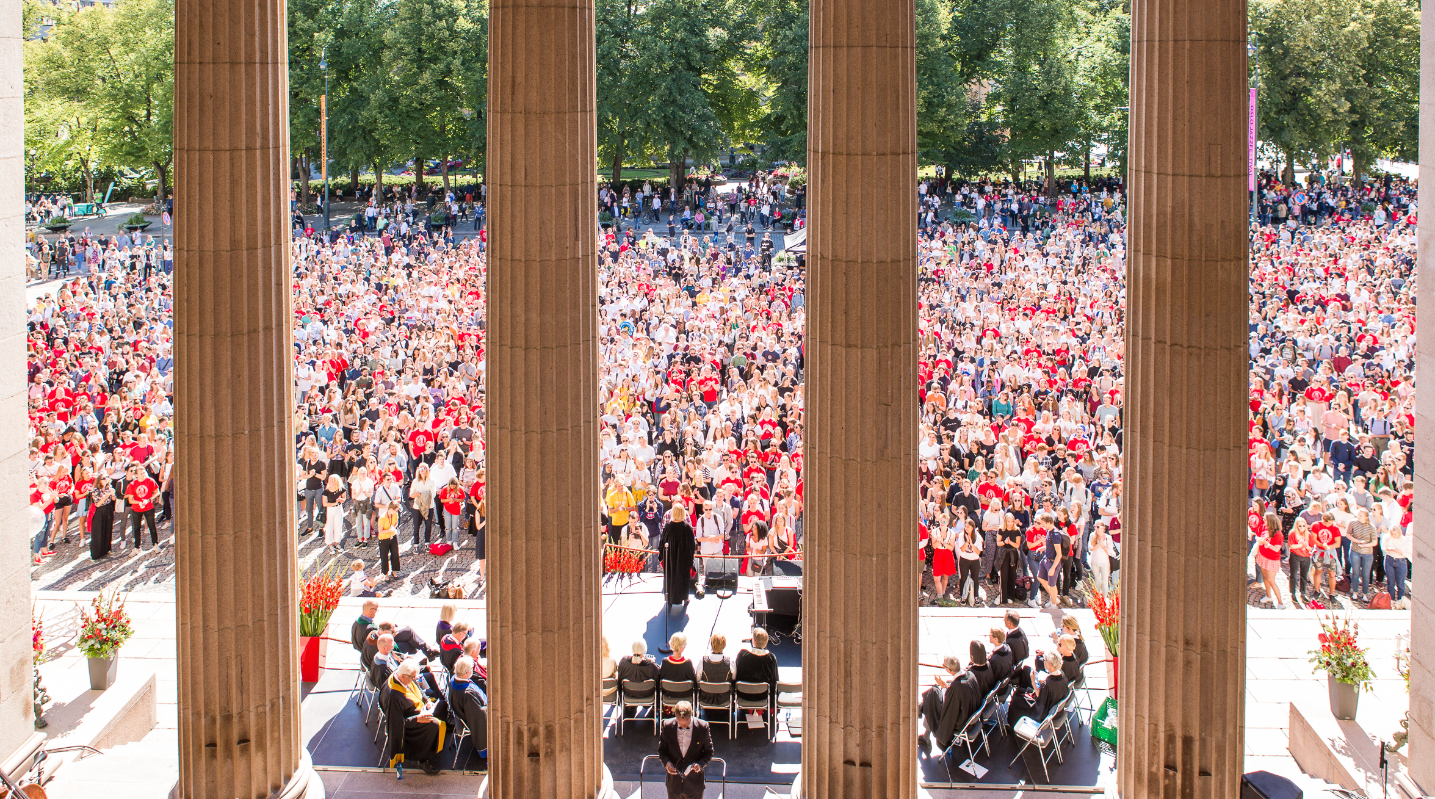
Welcome to the University of Oslo
Starter package for new employees

Slide 2
Our social mission
Education
Research
Cultural interaction
Innovation

Slide 3
Key figures
8 faculties
2 museums
60
6,600 employees
The world’s 60
best university
27,500 students
Notes:
Must be updated with correct figures on placement in ranking - correct in 2020 is 60

Slide 4
About the subject department
Briefly about the department
Important goals for the department
Main work areas

Slide 5
Your first year at the University of Oslo
The onboarding at the University of Oslo lasts for one year.
You will have regular meetings with your immediate manager to discuss your needs, tasks and goals.
Some of your colleagues will be part of a team that will help you with practical questions, things you may be wondering about and introduction to work areas.
You will receive an offer to participate in relevant courses and you will receive specific assignments that will be an important part of your training.

Slide 6
Your most important tasks and goals
The purpose is to have a dialogue to reconcile expectations
Brief description of the role, tasks and important goals.

Slide 7
Introduction plan
[First month]
[Second and third month]
[Fourth to sixth month]
[Sixth to twelfth month]
Introduction | Meetings and follow-up with the manager Introduction meetings with employees/partners - Area 1 - Area 2 - Area 3 - Area 4 Meeting with buddy and/or mentor Introduction to main task 1 Introduction to main task 2 | Meetings and follow-up with the manager Meetings with employees/partners - Area 1 - Area 2 - Area 3 - Area 4 Follow-up main task 1 Follow-up main task 2 | Regular onboarding meetings with manager Regular meetings with mentor Status and reporting responsibilities and tasks | Regular onboarding meetings with manager Regular meetings with mentor Status and reporting responsibilities and tasks
Regular meetings | Set up regular meetings that the new employee shall attend | Set up regular meetings that the new employee shall attend | Set up regular meetings that the new employee shall attend | Set up regular meetings that the new employee shall attend
Relevant courses/seminars etc. | Assess whether there are relevant courses/seminars or events that the new employee should attend | Assess whether there are relevant courses/seminars or events that the new employee should attend | Assess whether there are relevant courses/seminars or events that the new employee should attend | Assess whether there are relevant courses/seminars or events that the new employee should attend

Slide 8
Plan week 1 Meeting invitations will be in your calendar when you start
 | Monday | Tuesday | Wednesday | Thursday | Friday
08:00-09:00
09:00-10:00
10:00-11:00
11:00-12:00
12:00-13:00
13:00-14:00
14:00-15:00
15:00-16:30

Slide 9
Plan week 2
 | Monday | Tuesday | Wednesday | Thursday | Friday
08:00-09:00
09:00-10:00
10:00-11:00
11:00-12:00
12:00-13:00
13:00-14:00
14:00-15:00
15:00-16:00

Slide 10
Training and competency development
During the first couple of weeks, you and your immediate manager will have conversations about training and competence development
You will receive specific tasks/projects
Look at these recommended courses too:
Notes:
Course offers for employees: https://www.uio.no/for-ansatte/kompetanse/tema/

Slide 11
Useful resources
Manager information
Reading material
Practical tips
HR-related
About the University of Oslo)
New at the University of Oslo
Strategy 2030
Annual plans (Norwegian)
Ethical guidelines
IT support
Estate Services
Security Operation Centre
Communication, web publishing and graphic profile
Personal start page
Printing
Employee Card
Parking
Room bookings (Norwegian)
Events at the University of Oslo
Finding your way around the University of Oslo
For employees page
The self-service portal
Working hours
Salary and reimbursement
Employee benefits
Leave of absence
All about travel
The Occupational Health Service
Secondary/external employment
Reporting censurable conditions
Course offers
Art and culture
Personnel manual for the University of Oslo (Norwegian)
Rules and guidelines
ePhorte (case processing and archive)
Tableau - statistics and reports (Norwegian)
Financial management (Norwegian)
Human resources administration

Slide 12
We look forward to meeting you

