Slide 1
UiO EU-office 2020
Introduction to your EU-project at UiO

Slide 2
(Acronym) – Grant Data (data hentes fra portalen)
Call:
Type of Action: ERC grants
Acronym:
Current Phase: Number:
Duration:
GA based on the:
Start Date:
Estimated Project Cost:
Requested EU Contribution:
Contact: (project officer)

Slide 3
Agenda
Funding & tender opportunities
Grant Agreement
Employment
Financial Issues
Reporting
Budget
Payments
Audit
EU research support at UiO

Slide 4
Funding & tender opportunities ‘My Projects’
H2020 management and implementation will be carried out from start to finish through the Funding & tender opportunities (Participant Portal)
All ongoing projects are available to individuals through their ‘EU Log-in’ (previously European Commission Authentication Service (ECAS)) profile under ‘My Projects’ > ‘My Area’ which becomes visible after logging in.
Comprehensive guidance concerning the management of projects is available in the Online Manual.

Slide 5
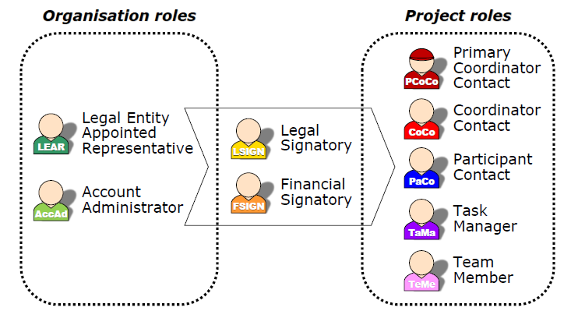
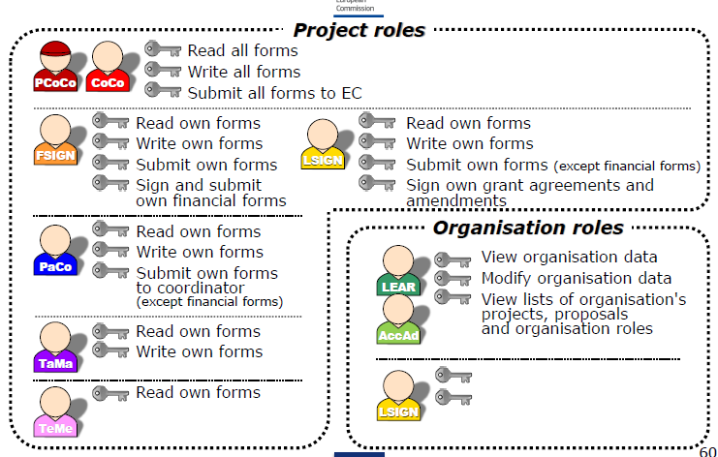
Funding & tender opportunities: Access and Roles
Access through ECAS-System (European Commission Authentication System):
email-address is used as identification

Slide 6
(acronym) – EU’s Funding & Tender Portal (oversiktsbilde over alle som har roller i prosjektet, hentet fra portalen)

Slide 7
Contract – Grant Agreement
The Grant Agreement is always signed by UiO represented by the appointed Legal Signatory. For contract amendments the UiO EU-office (FADM) needs to be contacted.
Function of the contract
The contract specifies all rights and obligations of the partners.
The contract presents predictability and solutions in case of conflicts.
The contract is a steering tool for the partners
Is to be used actively during the whole project period
Defines deliverables
States project number, project type, budget, reporting periods, regulations etc.
The annotated version of the Model Grant Agreement explains and illustrates the legal text

Slide 8
Contract – Grant Agreement
The Agreement is composed of:
Terms and Conditions
General and specific data and regulations with regard to the project
Annex 1 Description of the action (DoA)
Based on the project proposal
Annex 2 Estimated budget for the action
Annex 3 Accession Form
Signed by the partners to participate in the project
Annex 4 Model for the financial statements
Example for Form C – the financial reporting
Annex 5 Model for the certificate on the financial statements
Basis for the Audit Report
Annex 6 Model for the certificate on the methodology
Not applicable for UiO

Slide 9
Contract - Consortium Agreement
CA determines the relationship among the project partners
Describes the governance of the project
Managing of intellectual property rights and patents (IPR)
Provides structures and solutions in case of conflicts
Obligatory for most projects (always highly recommended)
Has to be in agreement with the Description of Action and the rest of the GA
There are different models for the Consortium Agreement. UiO prefers the DESCA model
UiO as an institution is part of the consortium agreement. Therefore it is negotiated and signed on a central level
For negotiations and mendments the EU-office (FIADM) needs to be contacted (eu-office@admin.uio.no )

Slide 10
Financial Issues – Direct Costs and Indirect Costs
The funding rate is 100 % of the eligible direct costs
Direct costs are specific costs directly linked to the work done in the project – such as personnel costs, travel costs, equipment bought for the project, subcontracting
Indirect costs (overhead) will be covered by a uniform 25% flat-rate of your eligible direct costs
Typical indirect costs are telephone charges & photocopies, rent, heating, electricity, PCs, laptops, office software etc

Slide 11
Financial Issues – Eligible Direct Costs
Eligible direct costs must be generated by the implementation of the action
In order to be eligible the project costs must be:
incurred by the beneficiary (actual)
incurred directly in connection with the action
incurred during the project duration
identifiable & verifiable in the beneficiary’s accounts
compliant with national law and the beneficiary's usual accounting principles
reasonable, justified, in accordance with sound financial management (economy & efficiency)
indicated in the budget
In Horizon 2020 value added tax is an eligible cost for beneficiaries who cannot claim refund for VAT from other sources. This accounts for UiO.

Slide 12
Financial Issues – Non-Eligible Costs
Non-eligible Costs
Costs not related to the action or costs paid by another source
Interests and related costs, including exchange losses and debt or service charges
National charges like customs duty, indirect taxes
Unnecessary and excessive expenses

Slide 13
Financial Issues – Cost Categories
Personell costs
Other direct costs
Equipment
Travel
Other direct costs
Subcontracting

Slide 14
Employment and Time recording
The usual rules for employment at UiO are applied
No time records necessary for researchers working exclusively on the project, instead they need to sign a “Declaration on person”
Individuals who do not work exclusively on the project need to keep time records for the time worked on the project

Slide 15
Time sheets
Time sheets need to contain the following information:
Title and number of the action, as specified in the GA
Beneficiary's full name, as specified in the GA
Full name, date and signature of the person working on the action
Number of hours per day declared for the action
Supervisor’s full name and signature
Reference to the action tasks and work package described in annex 1, to easily verify that the work carried out matches the work assigned
Description of the activities performed to show what work was carried out
Time sheets should be prepared on a monthly basis
Link to UiO’s approved templates for timesheets: https://www.uio.no/for-ansatte/arbeidsstotte/okonomi/efp/soknad-og-kontrakt/budsjettering/index.html

Slide 16
UiOs retningslinjer for rapportering av lønnskostnader til EU
Alle personalkostnadene som rapporteres i Financial Statement skal være basert på beregnet timepris – også for fulltidsansatte som ikke fører timelister
Beregning av timepris skal ta utgangspunkt i siste avsluttede regnskapsår
Deler av lønnen som betales en gang i året (for eksempel feriepenger) tas med i beregningen i det året hvor de er regnskapsført.
Rapporteres lønn for deler av regnskapsåret må timeprisen beregnes med utgangspunkt i fjorårets lønnskostnader for den ansatte. Har vedkommende ikke vært ansatt foregående år brukes inneværende år for beregning av timepris.
Mal for lønnsavregning i H2020: https://www.uio.no/for-ansatte/arbeidsstotte/okonomi/efp/eus-rammeprogram/

Slide 17
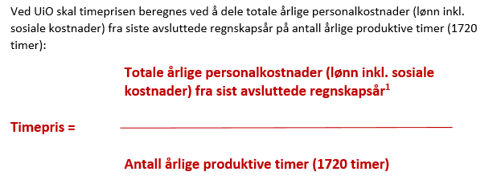
Beregning av timepris

Slide 18
Beregning av refusjon

Slide 19
Costs for equipment
UiO’s guidelines and system for procurement have to be followed
Costs are depreciated with regard to UiO’s usual practice
Only costs depreciated during the project period can be reported to the European Commission

Slide 20
Other direct costs
Other direct costs – such as costs for publications, travel, consumables
Travel costs:
Travel costs have to be directly linked to the objectives of the project. For example, to be able to travel to a conference, the participant must give a presentation or present a poster and document linked to the project.
Documentation: travel expense invoice (reiseregningen) with all documentation, objective of the travel, proof of the relationship with the project (program, invitation, participant list, etc.)
Meals:
Costs for dinner/ meals is in general not covered. The only exception is meals served as an integrated part of an event/ conference.
Documentation: the program and participant list of the event.

Slide 21
Subcontracting
Only allowed for special tasks defined in Annex 1 (DoA) and needs to be presented in the budget for the action
Subcontractors have to be chosen based on ”Best value for money” and need to follow the standard tendering procedures (UiO’s usual practice on procurement)
Examples: Translations, websites, analysis
The amount spent on ”subcontracting” is excluded from the calculation of indirect costs

Slide 22
Reporting
Scientific and financial reporting:
Month 12
Month 30
Month 48
Scientific reports – continuous reporting
Financial reports

Slide 23
Payments
 |  |  |  |  |  |  | Time-to-Pay | From
One Pre-financing |  |  |  |  |  |  | 30 days | The latest between starting date and entry into force
 | → Retention 5 % of maximum grant for the Guarantee Fund
Interim Payments |  |  |  |  |  |  | 90 days | From reception of periodic report
 | → Based on financial statements (EU contribution= eligible costs approved * reimbursement rate)
 | → Limit = 90 % of the maximum grant (Retention 10%)
Payment of the Balance |  |  |  |  |  |  | 90 days | From reception of final reports

Slide 24
Financial Statement
The layout of the Financial Statement corresponds to the layout of the budget
Average of the daily exchange rates published in the Official Journal of the EU calculated over the reporting period. Use the editable charts on the website of the European Central Bank at:
http://www.ecb.europa.eu/stats/exchange/eurofxref/html/index.en.html
The reported figures in Financial Statement have to correspond to the figures in UiO’s project accounts
In addition to the Financial Statement the beneficiary shall provide an overview of personnel with regard to work packages, a list of all travels, a list of all publications etc

Slide 25
Audit – Certificate on financial statements
At UiO the Internal Audit Unit (Intern revisjon) carries out the Certificate on financial statements
Only for final reports when total EU contribution claimed by the beneficiary on the basis of actual costs + unit costs for average personnel ≥ EUR 325.000 (excluding e.g. flat rates / indirect costs !)
The Department should contact the Internal Audit Unit for an appointment at least 3 weeks before reporting deadline
The documentation for the audit includes the contract, work contracts, invoices, depreciation plans, timesheets, etc.
The project is responsible for providing the needed documentation and that the project is in compliance with the rules
In addition the European Commission can conduct Audits at any time up to two years after final payment

Slide 26
Open Access
Obligation to make sure any peer reviewed journal article which is published is openly accessible, free of charge. The open access policy can be found in the H2020 online manual
For self-archiving (‘Green’ open access), researchers can deposit the final peer-reviewed manuscript in a repository of their choice. In this case, they must ensure open access to the publication within the embargo period of six months of publication - 12 months in case of the social sciences and humanities.
Costs for publishing Open Access are eligible for reimbursement during the duration of the action as part of the Horizon 2020 grant.
UiO about Open access

Slide 27
Information on EU-funding
The Model Grant Agreement states the following:
"29.4 Information on EU-funding. Obligation and right to use the EU-emblem
Unless the [Commission][Agency]requests or agrees otherwise or unless it is unpossible, any dissemination of results (in any form, including electronic) must:
(a) display the EU emblem and (b) include the following text:
"This project has received funding from the [European Union's Horizon 2020 research and innovation programme][Euratom research and trainingprogramme 2014-2018] under grant agreement No [Number]".
When displayed together with another logo, the EU emblem must have appropriate prominence. […]"
"29.5 Disclaimer excluding [Commission][Agency] responsibility
Any dissemination of results must indicate that it reflects only the author's view and that the [Commission ][Agency] is not responsible for any use that may be made of the information it contains."

Slide 28
Acknowledgement of EU-funding
Nettsider for EU-prosjekter ved UiO
Råd for UiO-ansatte om utforming av prosjektnettsider
H2020 Communication Manual

Slide 29
Key messages
Comply with H2020 rules/own HI rules/procedures
Consider periodic CFS for assurance (one final invoice)
Only indicate the reality in timesheets
Avoid excessive and uneconomic costs
Avoid unnecessary purchases in the last few months/weeks of the project just to consume budget
Ensure visibility of H2020 financing
Avoid situations of conflict of interest
Prepare thoroughly for an audit + don't sit on a problem and wait for an audit to find it– seek our help/advice!

Slide 30
There is further information on the Commission’s website:
H2020 COORDINATORS' DAY GRANT AGREEMENT PREPARATION 21 February 2020
H2020 COORDINATORS' DAY: Amendments / Reporting and Payments 12 May 2020

Slide 31
Archiving routines at UiO
Filed at the central level:
Only legal documents signed on paper:
Ie. Consortium Agreement
Filed at the local level:
All documents signed electronically through the portal, as well as project related communication:
Declaration of Honour
Grant Agreement
Contract Amendments
Scientific reports
Financial reports – Financial statements
Certificate of the financial statements
Important e-mails, etc

Slide 32
EU Research Support at UiO
EU Research Support at UiO is provided by UiO's EU-Office and advisers at the faculties and departments, who work in close collaboration to offer professional research support on Horizon 2020.
Contact UiO's EU-office and/or you local support unit if:
You have questions related to all aspects of EU-funded activities at UiO.
you would like to discuss opportunities for H2020-funded support to one or more fields/research groups
you need help and advice on how to find or understand H2020 documents and/or calls
you wish to develop/participate in a project under H2020 as a coordinator or a partner
you need advice or guidance on other EU funded initiatives
Contact EU Research Support at UiO
http://www.uio.no/english/for-employees/support/research/funding/eu-funding/contact-eu.html

Slide 33
EU Research Support at UiO
HORIZON 2020: EU Research Funding: This page provides information about EU funding possibilities. Check funding schemes and find your call. Realize your research ideas step by step through the process from application to closing of the project. Find facts and success stories about EU funding at UiO, and get inspired. Learn who you can contact for help.
How to apply for, negotiate and manage Horizon 2020 projects: Here you will find information about all stages of a Horizon 2020 projects's life cycle; from how to get started through application process, contractional phase and managing and finalizing the project.

