Slide 1
DjembeDance @ MSP
Sagar Dutta and Rainer Polak

Slide 2
TOC
Brief outline of DjembeDance
Current work-task: synching mocap to audio
Future work within DjembeDance

Slide 3
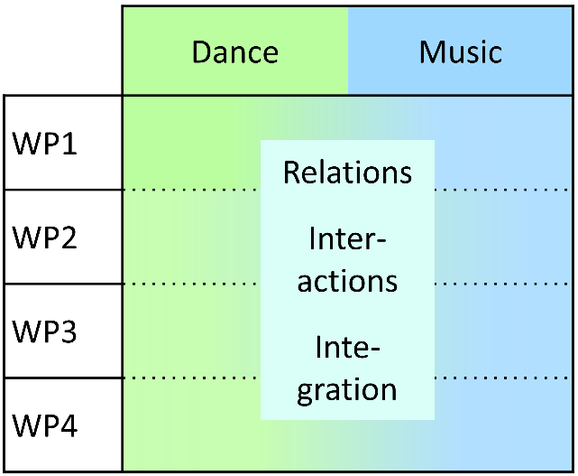
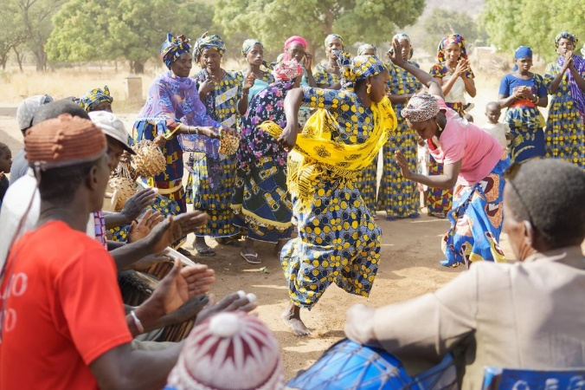
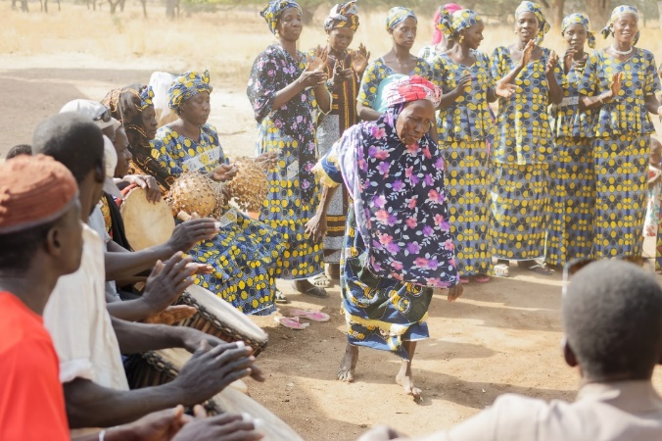
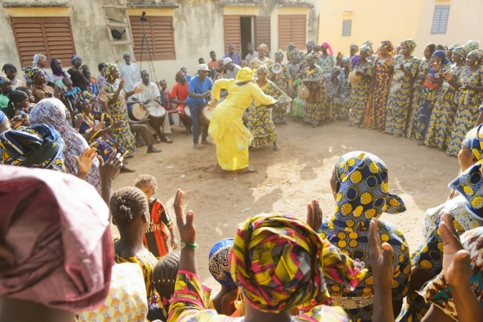
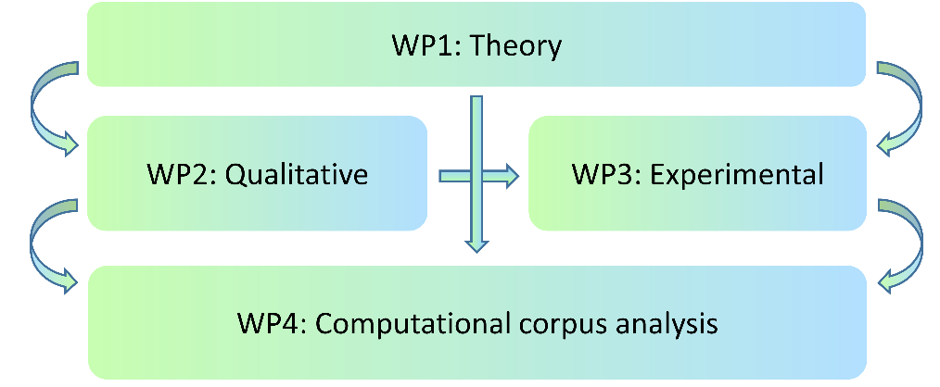
Project ambitions

Slide 4
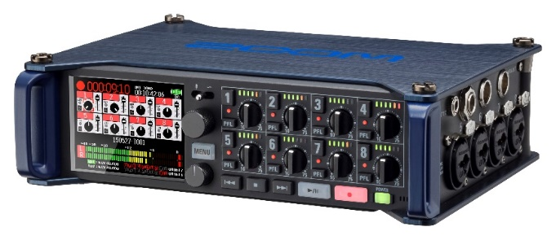
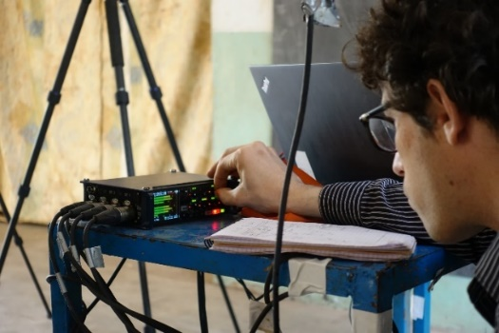
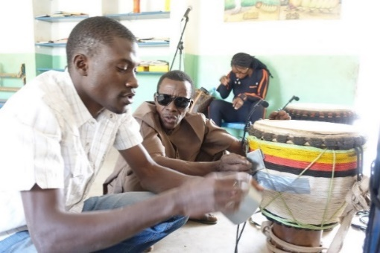
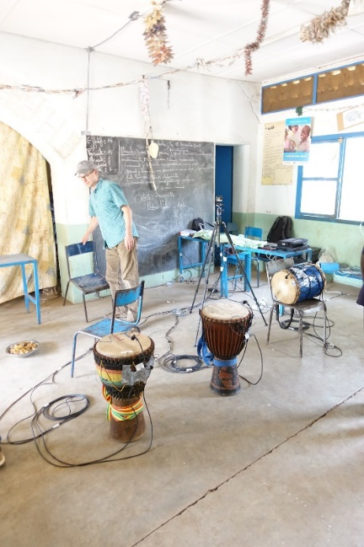
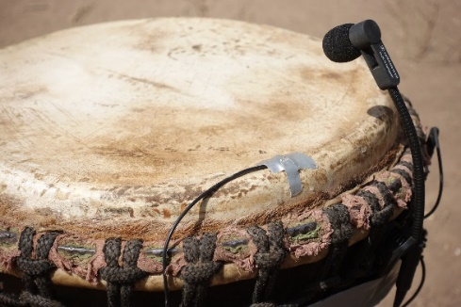
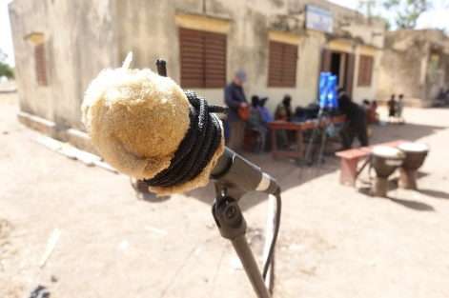
Audio
Notes:
In terms of equipment, we used a Zoom F8 for 8-track audio

Slide 5
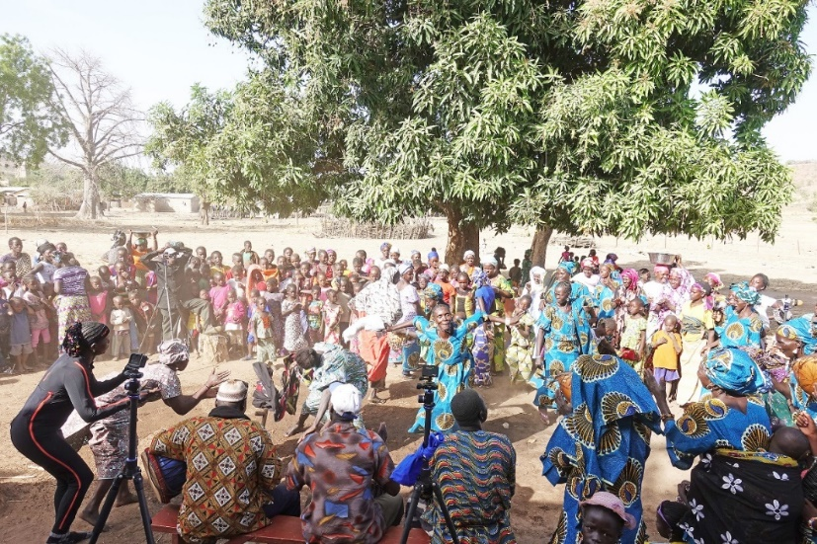
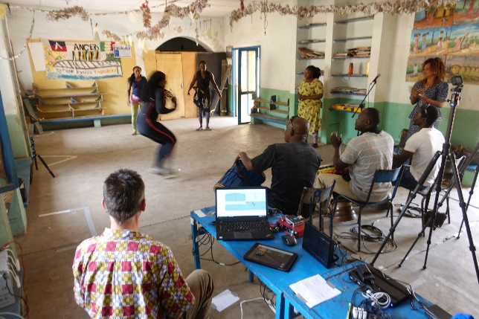
Audio and Video
Notes:
In terms of equipment, we used a Zoom F8 for 8-track audio

Slide 6
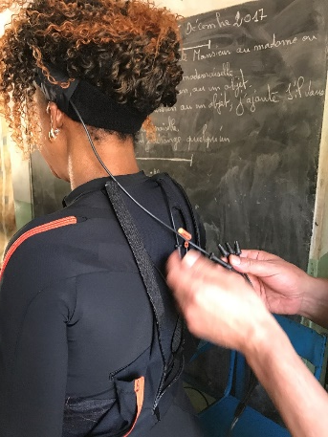
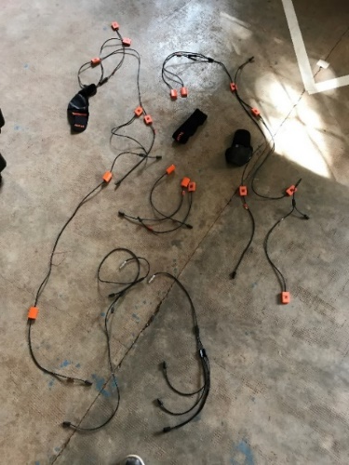
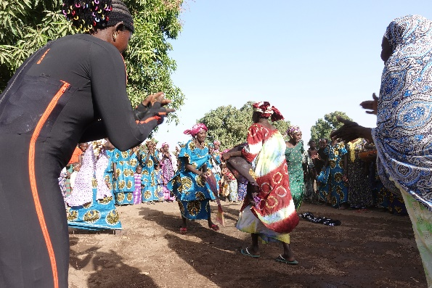
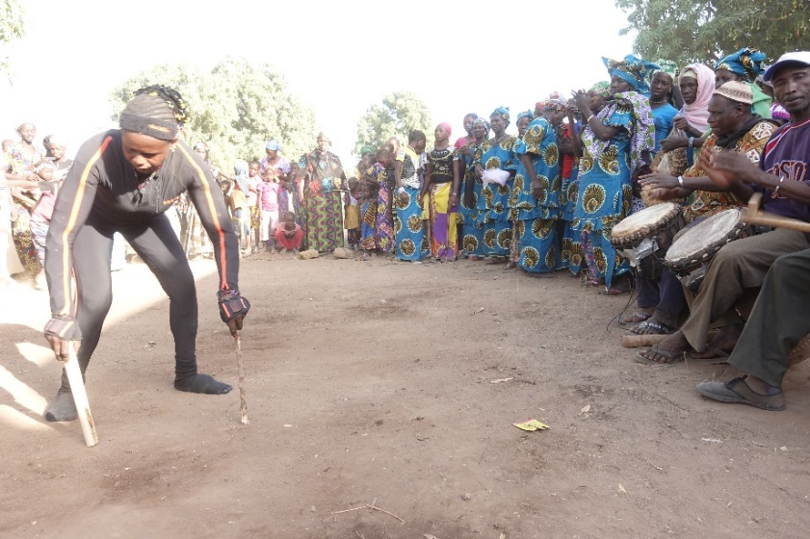
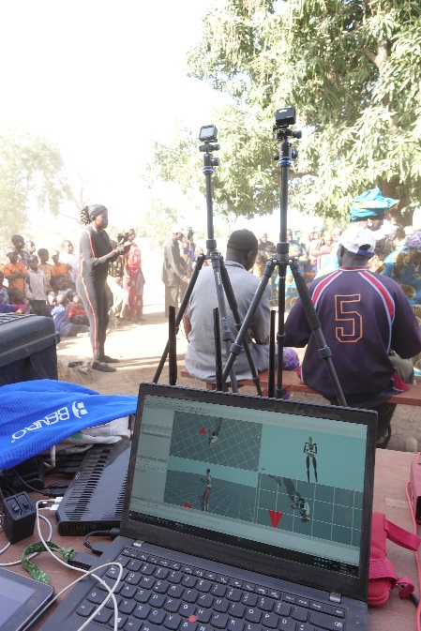
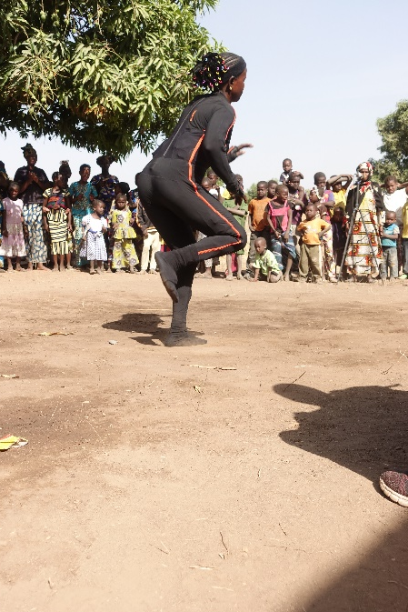
Motion Capture
Notes:
Finally, we had one XSENS Link, which is an inertial-based fully-body MoCap system, using a WiFi to send data to a PC.

Slide 7
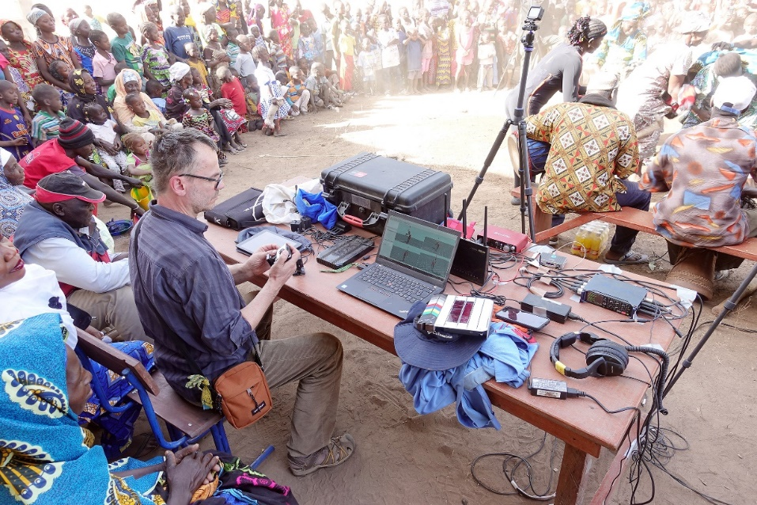
Recording situations
Urban professionals, 6 sessions, 6+ hs
Rurak community, 2 sessions, ~4 hs
Notes:
When we had this in the pocket, we also realized the somewhat less predictable but all the more exciting recording of a serious public village celebration.

Slide 8
Synchronizing mocap to audio

Slide 9
Calibration procedure
Include in a single recording
calibration event: tick, rise-time:
<1 msec audio
<1frame (4.16msec) mocap
test event: clapperboard slate
Calculate expectation for mocap slate from audio timings
Interpret mocap data plot at expected time-point
Result: Impact occurs
On the frame showing the steepest slope in resultant acceleration (XYZ)
1-3 frames before first peak
1 frame = 4.16 msec

Slide 10
Example Tick 1
Right hand, Raw sensor data, Free acceleration

Slide 11
Tick 1 (zoom-in)
1 frame (4.16 msec)

Slide 12
Example Slate 1 (Test event impact)
Impact (timing calculated from audio)
Steepest slope

Slide 13
Slate 1 (zoom-in)
Impact
Steepest slope

Slide 14
Slate 2 (zoom-in)

Slide 15
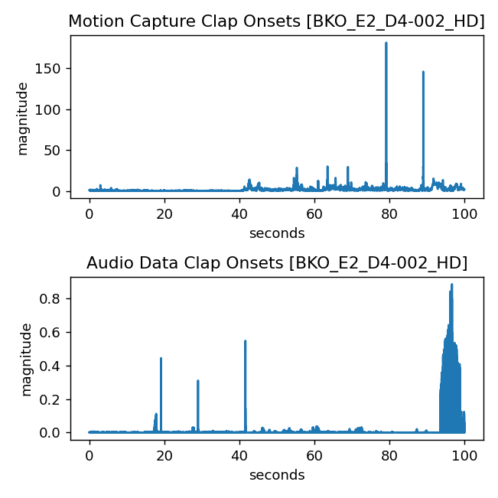
Cross Modal Synchronization
Step 1: Select segment with clap onsets
Fig. 1: Visualization of first 100 seconds
Fig. 2: Visualization of last 100 seconds

Slide 16
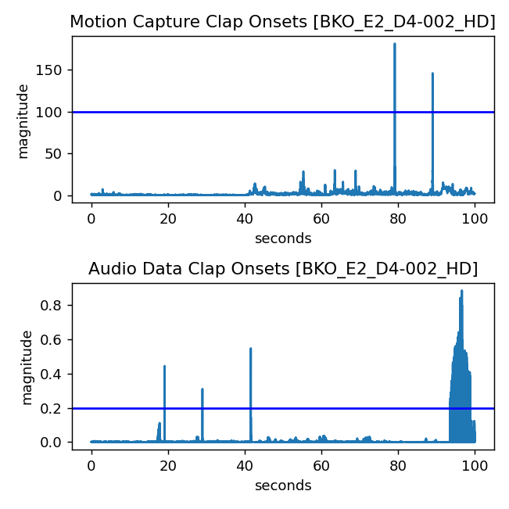
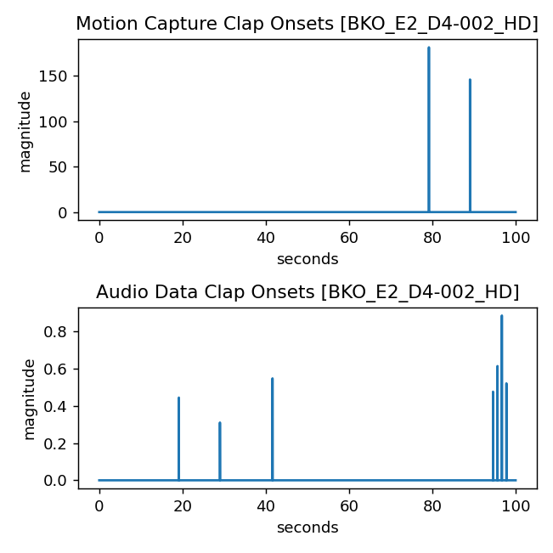
Step 2: Set threshold for peak detection
Fig. 3: Threshold selection for peak detection
Fig. 4: Extracted Peaks

Slide 17
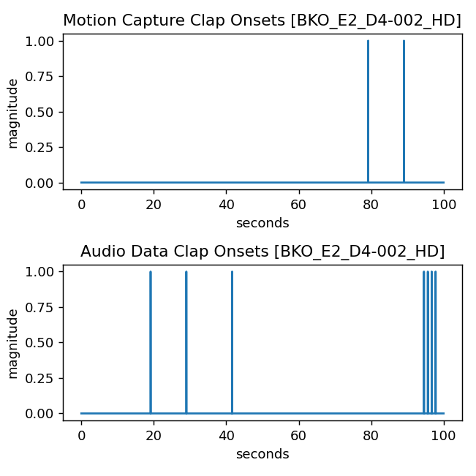
Step 3: Normalizing Peak Value to Unity and Mocap Up-sampling
@240Hz
mocap onsets: [79.175, 89.0375]
mocap peak frame: [19002 21369]
@48KHz
mocap onsets: [79.175, 89.0375]
mocap peak frame: [3800400, 4273800]
@48KHz
audio onsets: [19.1212917, 28.9886042, 41.612375, 94.571375, 95.6385833, 96.7002083, 97.7877708]
audio peak frame: [ 917822 1391453 1997394 4539426 4590652 4641610 4693813]
Fig. 5: Normalization of peaks

Slide 18
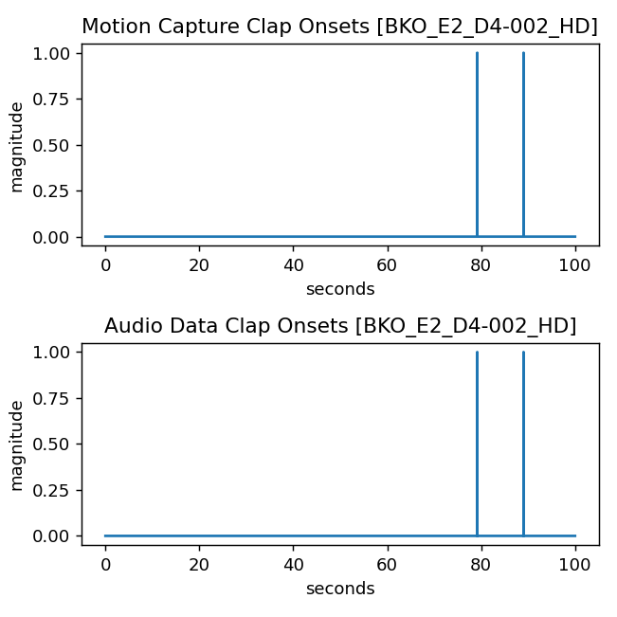
Step 4: Apply correlation and find offset
Audio Frames to shift for sync. : 2882462
Time shift: 60.051 seconds
Synchronized Peaks: [79.175, 89.0375]
Fig. 6: Synchronization of mocap and audio

Slide 19
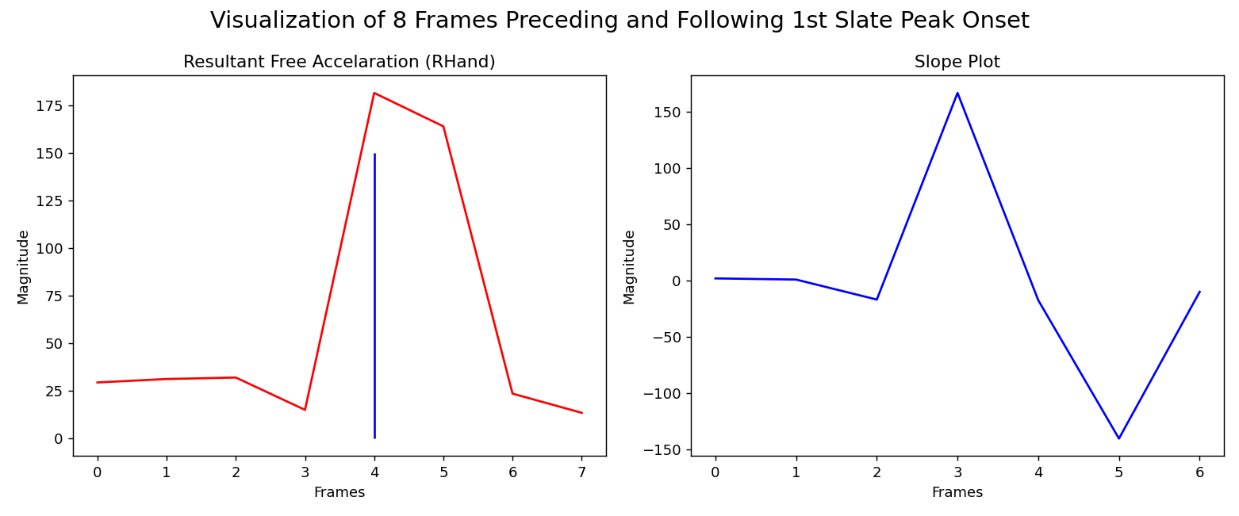
Step 5: Mocap Frame Correction
Fig. 7: Synchronization of mocap and audio

Slide 20
Future work within DjembeDance
MIR: Extract from audio
Drum stroke onsets (timings)
Drum stroke sounds (pitch/timbre)
Vocals pitch over time (melody)
Dance analysis in MoCap
Distribution of perceptually salient events (contrasts) across a reference periodicity (metric cycle)
Kinetic energy (aggregated velocity, acceleration)
Directional change
Spatiotemporal patterns:
Movement motifs per body-part (Basic gestures)
Full-body composite rhythms
Music-Dance analysis: Correlational, Causal

Slide 21
Movement patterns and musical meter: periodicity coordination (Toiviainen et al. 2010)
Objective: Analyze periodicity in music-induced movement across various tempi
Methodology:
Focus on potential and kinetic energy of the body.
Utilize location markers for movement analysis.
Principal Component Analysis (PCA) of body segments to identify dominant movement patterns
Key Findings:
Participants synchronized with periods of one, two, and four beats
Systematic relationship of body part size/mass and periodicity/tempo
Large size/mass body parts (e.g., torso) tend to use longer periodicities/slower tempos (e.g., 2/4-beat cycles)
Smaller size/mass body parts (e.g., arms) tend to use shorter periodicities/faster tempos (e.g., 1-beat cycle)
Toiviainen, P., Luck, G., & Thompson, M. R. (2010). Embodied Meter: Hierarchical Eigenmodes in Music-Induced Movement. Music Perception

Slide 22
Movement patterns and musical meter: periodicity coordination (Toiviainen & Carlson 2022)
Objective: Investigates how eigen movements in music-induced dancing depends on musical content and genre.
Methodology:
Use of trial-space-frequency tensor for capturing the complexity of movements
Decomposition of data using tensor decomposition techniques
Identification of 12 principal movement components
Key Findings:
Time-frequency domain decomposition is better
Some eigen movements synchronized with music
Difference found in eigen movement amplitude between genres
Toiviainen, P., & Carlson, E. (2022). Embodied Meter Revisited. Music Perception

Slide 23
Limitations of the Toiviainen approache(s)
Principal Components are noncorrelated thus movement patterns synchronized to the different metrical levels are noncorrelated as well.
Assumes stationary data within the analysis window of PCA which may not capture certain dynamics of movement (e.g., translation and rotation).
Their (2010) calculation of kinetic energy from speed excludes kinematic variables of velocity and acceleration from the analysis.
Phase information is lost in the (2022) frequency-domain analysis, which is good for the analysis of frequency-locked body parts, but not good for phase-dependent analysis, e.g.,
the synchronization quality (accuracy and precision) between music and dance;
composite rhythm patterns emerging from coordinated but phase-shifted body-parts.

Slide 24
Further analysis
Empirical Mode Decomposition
Independent Component Analysis
Denoising Source Separation
Multidimensional Scaling

Slide 25
Further ideas (collaboration? qualification?)
Use video
Use video as additional information to improve beat tracking algorithms
Compare mocap:video (1 dancer)
Use MoCap as ground-truth/training data for 3D←2D/video estimation
Compare lead dancer (mocap/video) with other dancers (video)
Acknowledge audience member behaviours
Compare audience:dancers
Estimate audience contribution to music:dance correlation

