Slide 1
Data management and GDPR for researchers
Staff info meeting, 19 March 2019
Marit Eldholm

Slide 2
Research ethics (NESH)
The Norwegian National Research Ethics Committee (NESH): Guidelines (4th ed, June 2016)
Respect for individuals
Privacy, duty to inform, consent, confidentiality, limited reuse, storage...
Respect for groups and institutions
Public administration: restricted access
The research community
Co-authorship, plagiarism, citation practice, data sharing, impartiality, integrity, student-supervisor relationship...
Commissioned research
Dissemination of research

Slide 3
European Commission
“The fact that your research is legally permissible does not necessarily mean that it will be deemed ethical. Crucially, if your research proposal involves the processing of any personal data, whatever method is used, you – and all of your partners, collaborators and service providers – must, if called upon, be able to demonstrate compliance with both legal and ethical requirements. Such requests could come from data subjects, funding agencies or data protection supervisory authorities. When developing and implementing your proposal, it is your responsibility to identify the appropriate legal provisions and ensure compliance.”

Slide 5
Why ARENA guidelines?
EU-funded projects, increasingly also national:
Research ethics reflections in proposals
Data Management Plans required
Data sharing expected (justified if not)
Two sets of guidelines (For employees)
GDPR: Personal data in research
Managing and sharing research data

Slide 6
Who is responsible?
UiO (‘data controller’)
Data owner (!), legally responsible, Data Protection Officer
Data subjects can claim compensation for injury
Head of department (ARENA director)
Privacy responsibility for all processing of personal data related to research projects at their unit
Routines and guidelines, training resources, controls, internal UiO audit
Researchers (‘project manager’)
Privacy of the research participants at all phases

Slide 7
25 May 2018
Europe-wide data protection legislation
Allow citizens to have greater control over how their data is stored and managed by third parties

Slide 8
GDPR: Possible pitfalls
Misunderstanding of what counts as personal data
Misinterpretation of ‘anonymity’
Not sufficient information to research participants/informants
Definition of sensitive personal data

Slide 9
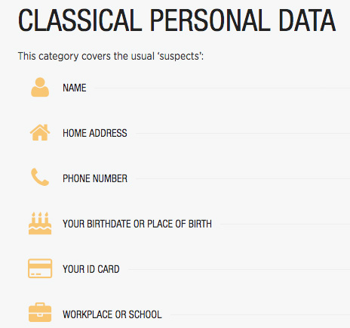
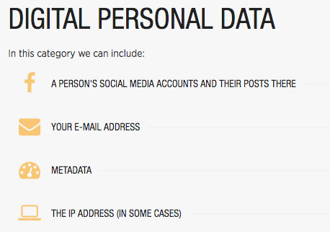
Personal data = anything that discloses your identity, that is unique to you (GDPR: ‘any information relating to an identified or identifiable natural person’)

Slide 10
Notification to NSD
(Norwegian Centre for Research Data)
Will you process personal data?
Notification Form to NSD (“meldeskjema”)
At least 30 days prior to commencing data collection
You must await their assessment before you start collecting data
A project must be notified even if you only publish anonymous data
It is how you will process personal data in the project as a whole, from the beginning of data collection to the publishing of results, that determines whether you have to submit a Notification Form

Slide 11
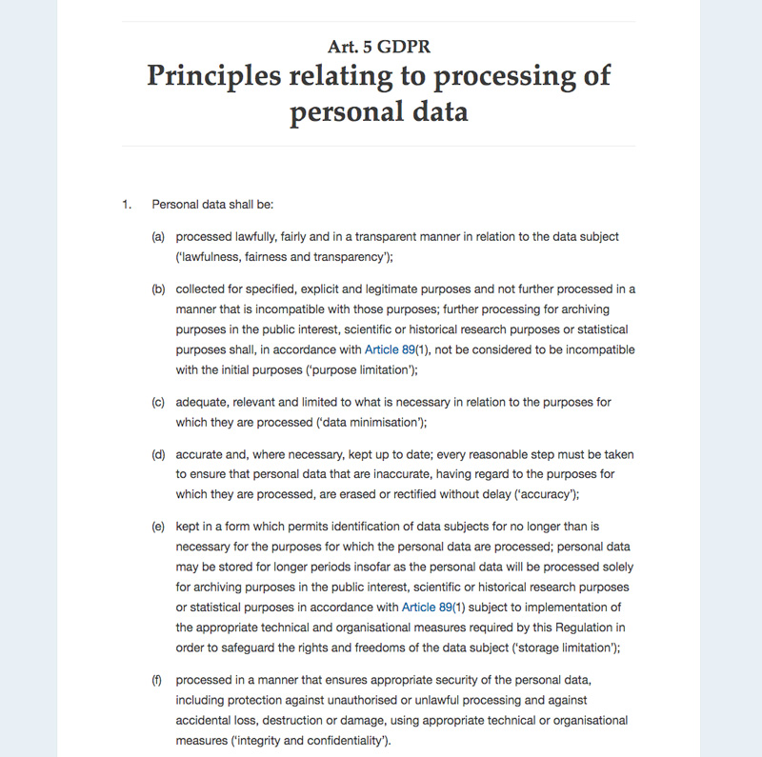

Slide 12
Important distinction
Anonymisation
Pseudonymisation
Removing the possibility of identifying individuals in a dataset, with the tools that can reasonably be expected to be used, also for researcher
Outside the scope of GRPR
Still have to inform about how the data is handled before anonymization
The data can no longer be attributed to a specific data subject without the use of additional information
= de-identification
GDPR only partially applies
data can be used beyond the original purpose
data subjects’ rights to access, rectification, or erasure no longer apply
participants must be informed that such rights will be annulled upon pseudonymisation
GDPR Recital 26

Slide 13
Re-use of data beyond original purpose
Generally, re-use of identifiable personal data requires the consent of the participants.
This does not apply to anonymised data, acquired for example for use in statistics, where the researcher cannot link persons and data. When the data have been anonymised, the researcher does not know which person the data and the material come from. However, anonymity must not be confused with de-identified data, where personal data are removed, so that no unauthorised persons are able to establish who the research subjects are, but where the researcher is able to link individuals and data. Re-use of such de-identified data requires consent if researchers supplement registry studies with data obtained through active contact with the participants. When re-using and linking this type of data set, for example in registry studies that are large-scale, of a long duration, or which use geodata, it may also be possible to locate or identify individuals indirectly. In such cases, researchers should make renewed attempts to obtain consent, even though this is difficult in practice. If researchers do not find it possible to obtain consent, they have a particular responsibility to explain why the research is of such great benifit that it justifies deviating from this principle. In such cases, researchers have a general responsibility to inform the persons involved and the general public.
NESH guidelines, p. 18 (art. 10)

Slide 14
Legal basis
‘lawfulness of processing’
Informed consent
Public interest
Legitimate interest
GDPR Art. 6(1)(a)
The data subject has given consent to the processing of his or her personal data for one or more specific purposes
GDPR Art. 6(1)(e)
Processing is necessary for the performance of a task carried out in the public interest
GDPR Art. 6(1)(f)
Processing is necessary for the purposes of the legitimate interests pursued by the controller […], except where such interests are overridden by the interests or fundamental rights and freedoms of the data subject which require protection of personal data […]
Researcher’s responsibility to consider,
NSD to decide if well-grounded

Slide 15
Information to data subjects
Art. 13 GDPR: Information to be provided where personal data are collected from the data subject
Addressed in participant information sheet and consent form
GDPR-compliant ARENA template
To be adapted to the audience and nature of the research, plain language, simplified terms

Slide 16
Participant Information Sheet
Purpose of the study
Why has the informant been chosen?
Define population, sampling, recruitment procedure
How and when data collected
Recording, storage, deletion
Pseudonymisation, anonymisation
Confidentiality
Right to access, rectification, erasure
Contact details

Slide 17
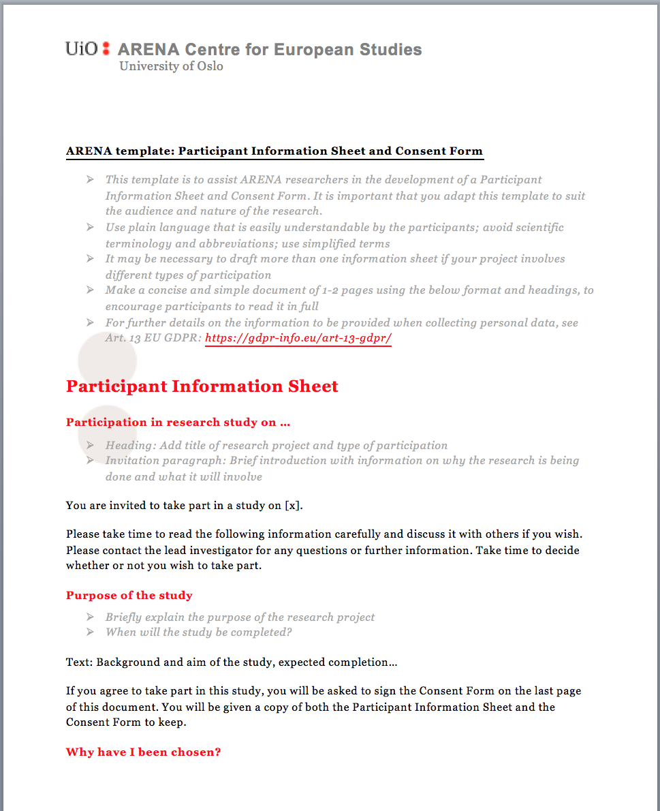

Slide 18
Consent - Art. 6(1)(a)
The consent must be documented
Signed consent forms kept on file with the researcher
Recorded (audio): Can you prove who is talking?
Store the consent along with and as long as you store the personal data
Consent forms themselves may be sensitive; follow the UiO storage guide

Slide 19
Consent or public interest?
Ethical and legal considerations
Challenges - some examples
Listhaug case: Consent withdrawn
FFI study of foreign fighters: Public interest, but duty to inform made it practically impossible
CREX: Extremists as vulnerable persons (Norwegian Data Protection Authority)
Ethical Guidelines for Internet Research (English, Dec 2014) – Norwegian updated Sep 2018

Slide 20
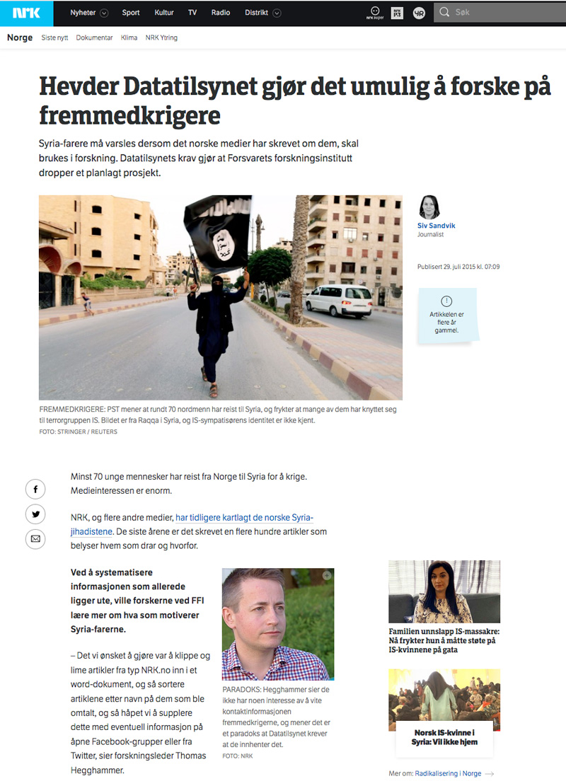
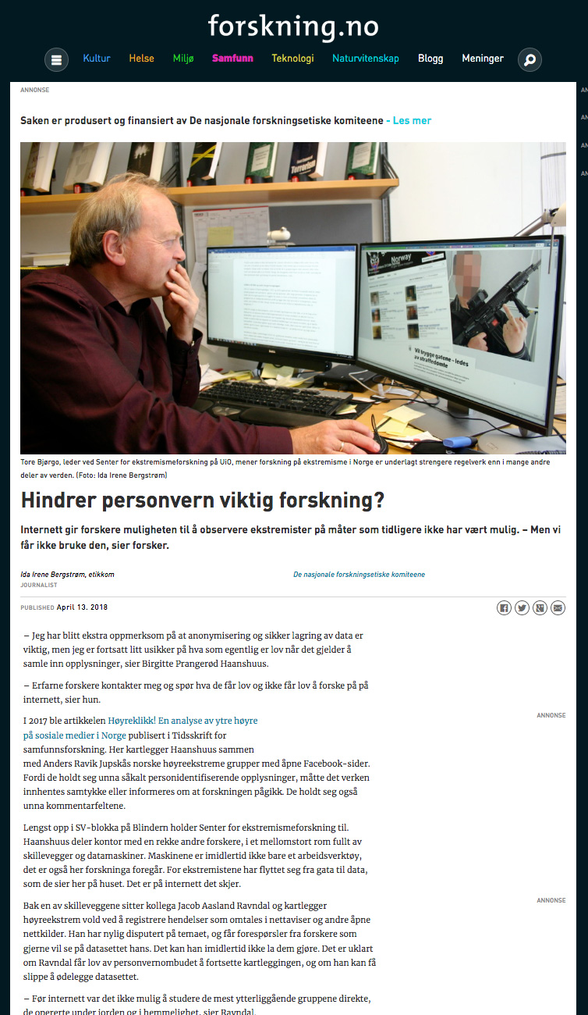

Slide 21
What could possibly go wrong?
Violations of privacy:
Sensitive data about research respondents/informants goes astray
Data on informants or respondents in research is used for entirely different and irreconcilable purposes than what they consented to

Slide 22
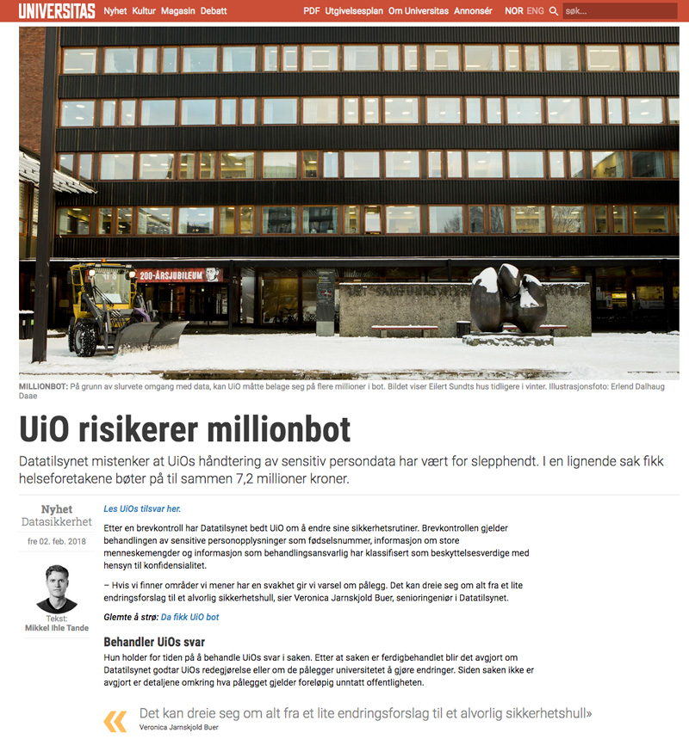
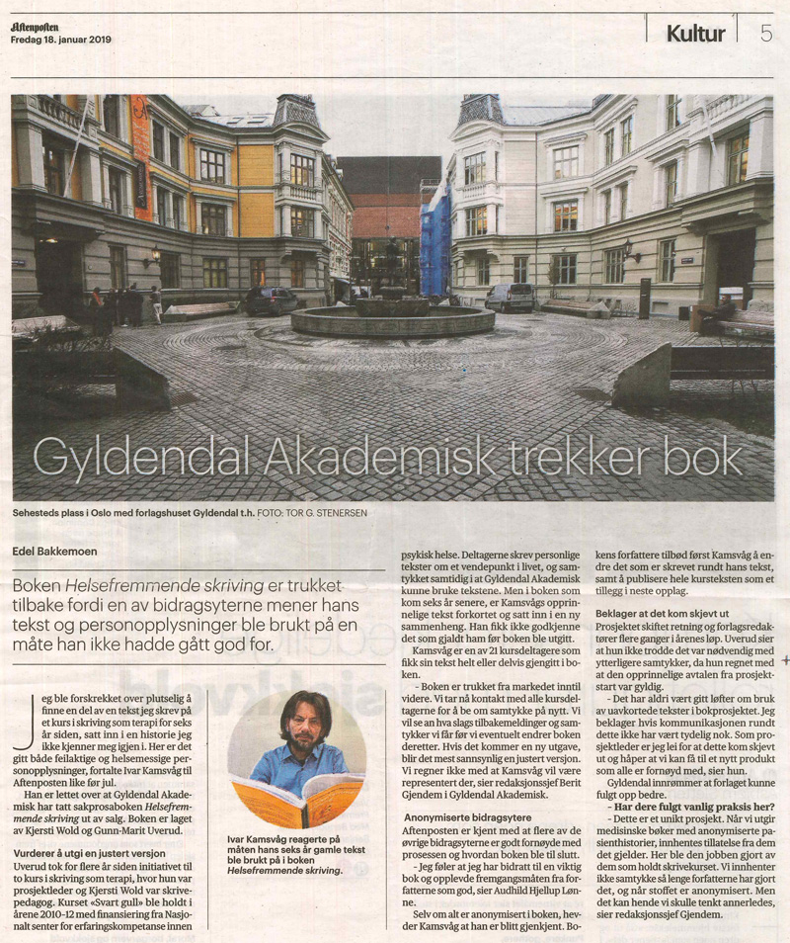

Slide 23
Source: Sarah Jones, Open Science Days 2015: FOSTER: Managing and sharing research data

Slide 24
Principles of FAIR data management
Why share data?
Considerations to be made in individual cases, but need to explain if not share-worthy

Slide 25
Data sharing
Research material should be made available to other researchers for secondary analysis and further use. Sharing of research data is often a prerequisite for building up knowledge, comparing results and critically testing the work of others. Improved openness and quality assurance can be achieved by sharing data.
At the same time, data sharing gives rise to ethical challenges relating to privacy and confidentiality. Therefore, the norm of transparency and data-sharing, particularly in large-scale registry research, should be balanced against other considerations and requirements of research ethics.
Generally, those responsible for collecting material have the priority right to use it in analyses and in publications. Data acquired with the aid of public funding must be made publicly available after a short period.
NESH guidelines, p. 30 (art. 29)

Slide 26
Source: Sarah Jones, Open Science Days 2015: FOSTER: Managing and sharing research data

Slide 27
Data management plans
Source: OpenAIRE webinar on Open Research Data in Horizon 2020, 30 May 2017 (Marjan Grootveld, DANS)

Slide 28
Data Management Plans
Requirement for H2020 collaborative projects (GLOBUS, PLATO, EU3D)
Overall plan with dataset descriptions (made by individual researchers, one description per dataset)
Examples and templates available (ARENA intranet)
NRC projects
New requirements (BENCHMARK, LEGOF…)

Slide 29
Data Management Plan contents
Data types
Metadata
Storage and archiving
Sharing
See Managing and sharing research data web page (ARENA intranet) for links and further information

Slide 30
Source: Sarah Jones, Open Science Days 2015: FOSTER: Managing and sharing research data

Slide 31
Coming up…
Ask an expert lunch meeting – 2 April 2019
UiO’s data protection officer (Maren Magnus Voll)
IT experts (processing, storage etc)
Send your questions to Marit!
Report missing information or own experiences to revise the guidelines
FAQ page for ARENA researchers
ARENA support: Marit (personal data protection)

