Slide 1
Welcome to Asia and Middle East Studies:
Chinese Culture and Society

Slide 2
Programme structure
The course of study consists of a total of 120 ECTS credits:
Compulsory courses, 40 credits
Elective courses, 20 credits
Thesis preparation, 30 credits (different options)
Master’s thesis, 30 credits

Slide 3
https://www.uio.no/english/studies/programmes/aas-master/programme-options/chics/structure/

Slide 4
AMS4900 - International Project Term in Asia and the Middle East
Third semester
Internship that will give you an opportunity to get relevant
work experience, use your academic skills in a practical manner,
and present yourself in an international work environment
The internship must be carried out at an
embassy/consulate or in an organization/company in East Asia
Internship through UiO's agreement with the Ministry of Foreign Affairs (UD) - only for students with a Norwegian citizenship
Information meeting in the spring. Contact: international@ikos.uio.no

Slide 5
INTPART
Third semester
The INTPART exchange
programme with Zhejiang University
Scholarships of 72.000 NOK
Contact: international@ikos.uio.no
https://www.uio.no/english/studies/programmes/aas-master/programme-options/chics/abroad/intpart-exchange-programme.html

Slide 6
Develop interdisciplinary competence in environmental and climate change studies.
Parallel with your Master programme over two years.
20 credits in total: 4 courses (5 credits each).
Information meeting 23 September 16:15. Time and place will come under “messages” and in “my studies”.
Application: deadline 15 October.
https://www.uio.no/english/studies/programmes/ehs/

Slide 7
Registrations every semester
Register and apply for courses in Studentweb
Pay the semester fee and the Kopinor fee
Registration deadline:
Autumn: 1 September
Spring: 1 February
https://www.uio.no/english/studies/registrations/
Notes:
Kari

Slide 8
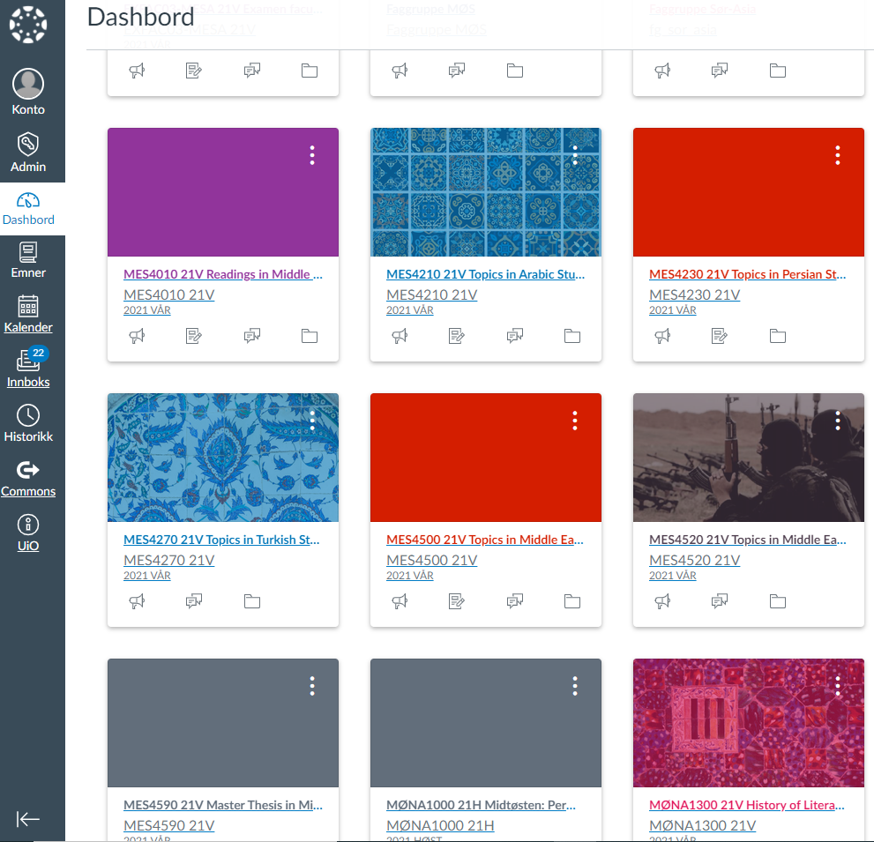
Canvas
communicate with teachers and students
submit papers
find deadlines and messages from the teacher

Slide 9
My studies
schedule with teaching, exams and Canvas assignments
messages from your courses and study programme
shortcuts to tools and services

Slide 10
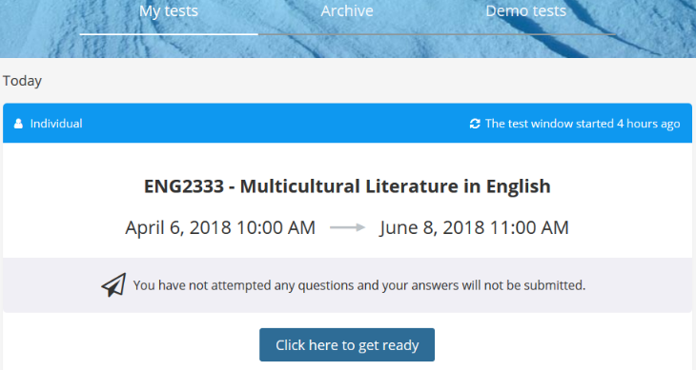
Inspera
Digital examination system
Term paper, portfolio (file upload)
Log in with UiO username and password
https://www.uio.no/english/studies/examinations/submissions/submit-answer/

Slide 11
Student ID and student card
Digital student ID app on your mobile phone
Register as a student in Studentweb
Pay the semester fee
Student card
Access to buildings and rooms, retrieving printouts, library card
SiO Customer Service in the Kristian Ottosen building
Bring valid semester receipt and passport/national ID
https://www.uio.no/english/studies/registrations/card/
Notes:
Kari

Slide 12
Special needs and leave of absence
Special needs in everyday study situation
Special examination arrangements
Leave of absence and reduced study progression
Contact your student advisor!
Application deadline: 1. September/1. February
https://www.uio.no/english/studies/special-needs-leave-part-time/

Slide 13
Reading room for master’s students
3rd floor in P. A. Munchs building
Access with your student card
Book a space up to three days in advance
Fixed spaces in the reading room are only given to students with documented special needs
Book cabinets: masterlesesal@ikos.uio.no with name and locker number for registration
One meter social distancing requirement
https://www.hf.uio.no/ikos/english/studies/master/reading-room/index.html

Slide 14
https://www.uio.no/english/studies/contact/speak-up/index.html

Slide 15
Corona information
All students can book a corona-test at SiO Health.
Infection prevention e-course:
You may complete a 15-minute online digital infection prevention course before coming to campus in Canvas
Students will be exempt from social distancing requirements during teaching.
In our reading rooms we will maintain the one meter social distancing requirement and the booking system.
All courses will start hybrid, but may be offered physical only later in the semester
Register for vaccine: https://www.sio.no/en/health-services/vaccines/covid-19-vaccine
The Smittestopp app
As you already know: Remember social distancing, wash your hands and stay at home if you are sick.
https://www.uio.no/english/about/hse/corona/

Slide 16
Contact information
Student advisor: Trude Lind
Meetings by appointment – send me an email first
E-mail: trude.lind@ikos.uio.no
Phone: +47 22 85 81 05

