Slide 1
Universal design and digital accessibility: What are we doing at UiO?
Accessibility Project (phase 2)
Ida Meland and Ida Marie Solås (USIT)
5 May 2022
Notes:
ICT Accessibility at UiO

Slide 2
Accessibility is based on the idea
that services should be available to everyone.
Regardless of age, ability to function
or level of education.
What is accessibility?
Notes:
...
Så, hvorfor trenger tjenester å være universelt utformet?

Slide 3
In a digital society students depend on using many digital tools every day
Everything from semester registration to creating a new password
Especially in regards to courses, for example:
Check course schedule
Receive messages
Presentations from lectures
Lecture videos
Get and deliver assignments
Exams
Notes:
Alt dette må kunne gjennomføres for å fungere som student, og skal kunne gjøres selv om du har en funksjonsnedsettelse

Slide 4
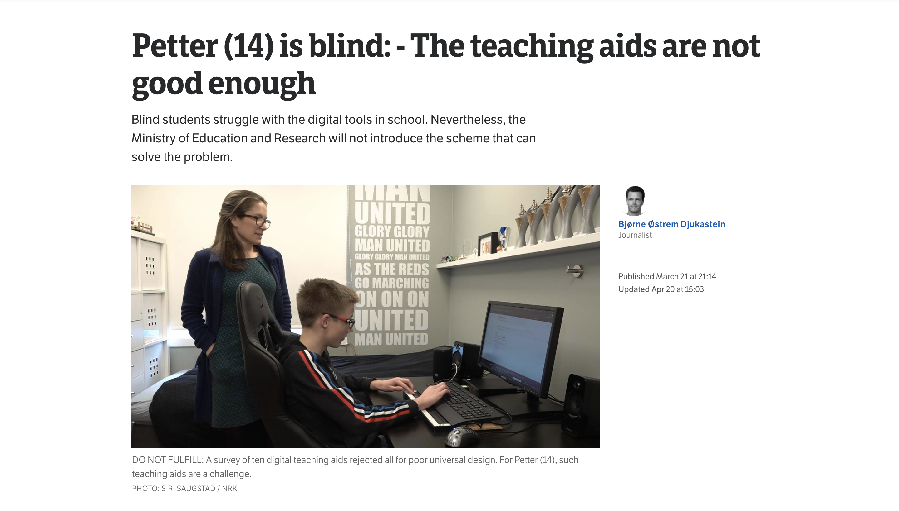
Example of why universal design is necessary (1)
Screenshot from NRK article published 21 March 2022 (in Norwegian)
Notes:
For at Petter på 14 som er blind også kan bruke digitale verktøy som brukes i skolen. Dette er hentet fra en artikkel i NRK tidligere i år som setter fokus på at læremidlene ikke er gode nok i dag og blinde elever sliter med digitale verktøy.

Slide 5
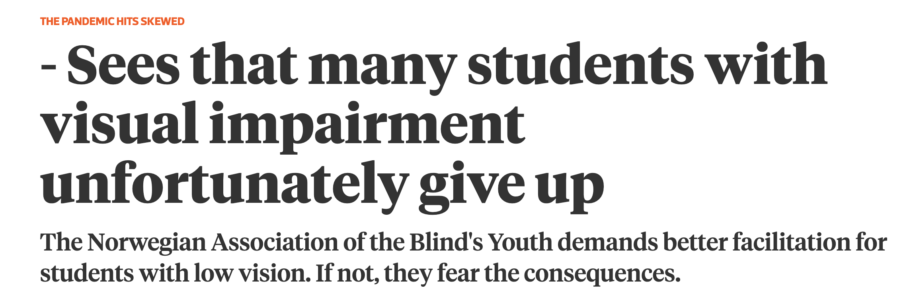
Example of why universal design is necessary (2)
Screenshot from Khrono article, published 25 April 2021 (in Norwegian)
Notes:
En annen overskrift «Ser at mange studenter med synshemming dessverre gir opp» ble publisert i Khrono i fjor. Hvor Norges Blindeforbunds Ungdom krever bedre tilrettelegging for studenter med svaksynthet.
For det er sånn at ->

Slide 6
Who needs accessible ICT?

Slide 7
🖐 Raise your hand if any of the following apply to you
Your hearing is not perfect
Are blind or partially sighted
Wear glasses or contact lenses
Color blind
Have reading or writing difficulties
Have ADHD or difficulty concentrating
Are or have been pregnant
Broke an arm or a leg
Drink alcohol
Been abroad without knowing the language well
Have been stressed
Slept really badly one night

Slide 8
Necessary for some, good for everyone

Slide 9
Functional abilities are divided into four categories
👁
Sight
👂
Hearing
⚙️
Motor skills
🧠
Cognition
Notes:
Oppsummert er universell utforming ødvendig for noe, men det er også bra for alle.
Syn:
Blind, Miste linser eller brillene, får en betennelse på øyet, dårligere syn med alderen, Prøve å lese noe på mobilen ute i sola.
Kognisjon:
Lese- og skrivevansker, Når vi er slitne og hodet er brukt opp til andre ting. Eller for noen som ikke er så gode i norsk enda, Eller du er stressa og må finne ut av hvordan du skal få levert eksamen innen tidsfristen.

Slide 10
Disabilites can be permanent, temporary or situation dependent

Slide 11
Sight
Permanent
🧑‍🦯
Blind
Temporary
👓
Forgot your glasses
Situation
☀️
Out in bright sunlight
Notes:
Oppsummert er universell utforming ødvendig for noe, men det er også bra for alle.
Syn:
Blind, Miste linser eller brillene, får en betennelse på øyet, dårligere syn med alderen, Prøve å lese noe på mobilen ute i sola.
Kognisjon:
Lese- og skrivevansker, Når vi er slitne og hodet er brukt opp til andre ting. Eller for noen som ikke er så gode i norsk enda, Eller du er stressa og må finne ut av hvordan du skal få levert eksamen innen tidsfristen.

Slide 12
Motor skills
Permanent
🖐
Tremurs
Temporary
🤕
Broken arm
Situation
👩‍🍼
Baby on the arm
Notes:
Oppsummert er universell utforming ødvendig for noe, men det er også bra for alle.
Syn:
Blind, Miste linser eller brillene, får en betennelse på øyet, dårligere syn med alderen, Prøve å lese noe på mobilen ute i sola.
Kognisjon:
Lese- og skrivevansker, Når vi er slitne og hodet er brukt opp til andre ting. Eller for noen som ikke er så gode i norsk enda, Eller du er stressa og må finne ut av hvordan du skal få levert eksamen innen tidsfristen.

Slide 13
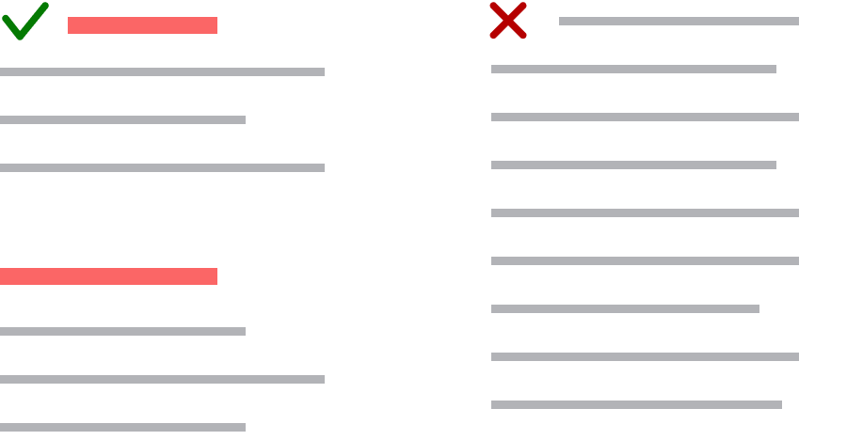
Example: How a page title and heading levels are useful for everyone
👱 Easier for everyone to get an overview and find content
👁 Easier to navigate with a screen reader
😰 Helps stressed students quickly find the correct content
🔍 Beneficial for search engine optimalization
Notes:
Et eksempel på uu-krav som alle drar nytte av er riktig bruk av sidetitler og overskriftsnivåer.

Slide 14
What requirements apply to UiO?
Current regulations: WCAG 2.0 (uutilsynet.no) WCAG = Web Content Accessibility Guidelines
Regulations from February 2023: WCAG 2.1 (uutilsynet.no) and WAD (uutilsynet.no)
Notes:
Gjeldende regelverk er WCAG 2.0. For offentlig sektor har også WCAG 2.1 og WAD blitt en del av regelverket og skal følges fra 1 februar 2023.
WCAG = Web content accessibility guidelines
WAD = Eus webdirektiv

Slide 15
ICT and digital content made for students and/or the public *WAD specify that the requirements also applies to new intranets
What needs to be accessible?
Notes:
Digital content used in courses and/or for dissemination of information
Nye lovkrav spesifiserer at det gjelder både intranett og ekstranett

Slide 16
What must be accessible – in reality
🔧 Technical framework
UiO has a responsibility to ensure that digital services from third-party providers (for example Canvas) meet the legal requirements
📄 Content – both documents and content that are published in html (uio.no, Canvas ++)
Use heading levels in the right order
Add alternative text to pictures and illustrations
Write in plain language
Links must be descriptive
Tables are used to present data, not to control layout or design
Use a text alternative for video and audio
Tools: Autotekst and Panopto (ntnu.no)
Notes:
Autotekst - automatic transcription from speech to text, a service developed by USIT
Panopto (ntnu.no) can be used at UiO from autumn 2022. Service for recording, editing and publishing videos, and can automatically generate subtitles for videos.

Slide 17
Our goal is for UiO to be accessible to everyone, both as a place of study and a workplace.
As a contribution to this, USIT has taken several measures to improve accessibility of UiO's
digital services.

Slide 18
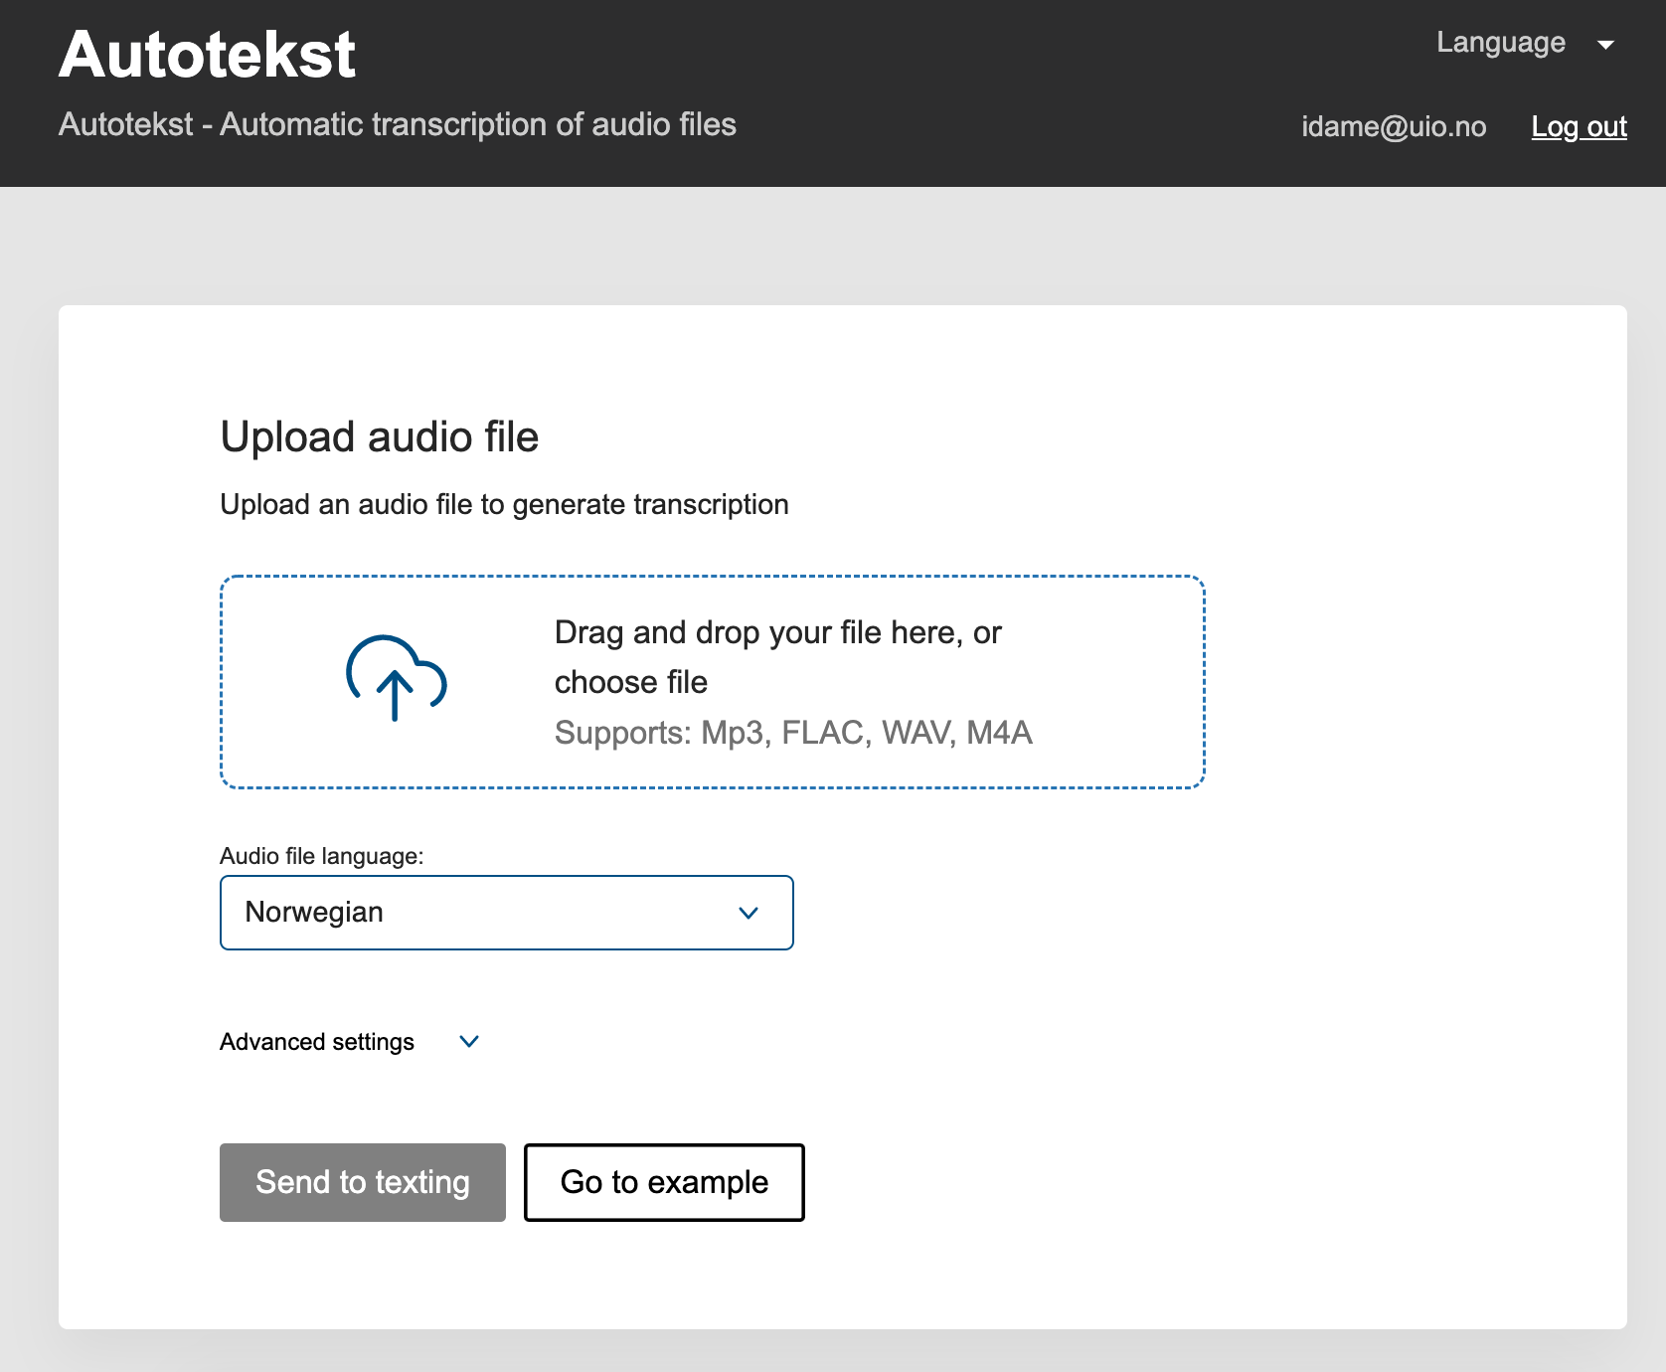
AUTOTEKST automatic transcription for speech to text
A tool to automatically transcribe speech to text by using Google Speech to Text technology.​

Slide 19
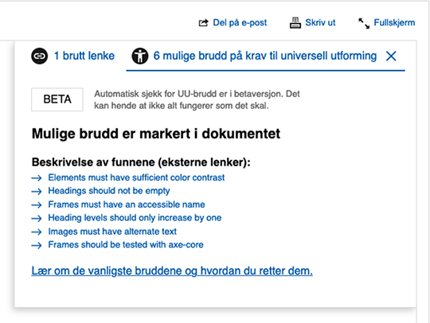
"UU-SJEKK" implemented in our CMS (Vortex) annen skjermdump inn her?
Automatically check if your website/content is accessible

Slide 20
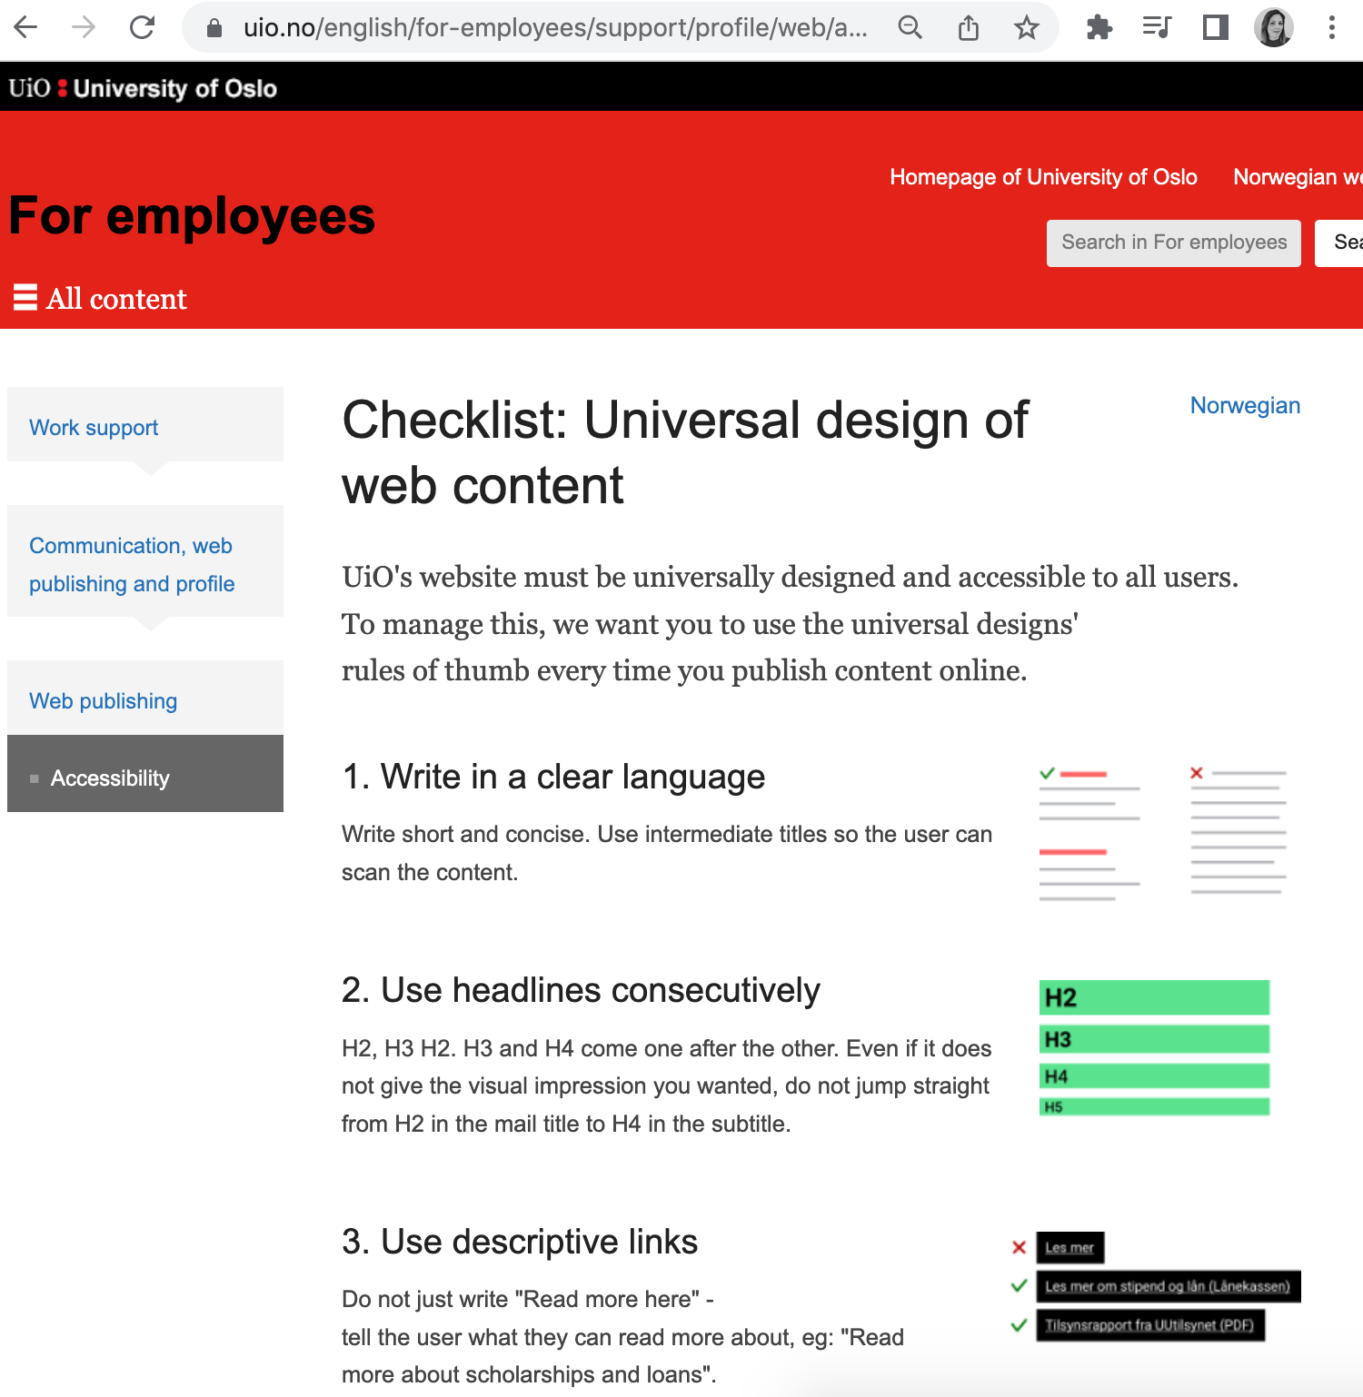
Checklist: Universal design of web content (UU-vettregler)
UiO's websites must be accessible to all users. To manage this, we ask you to follow these rules every time you publish content online.
https://www.uio.no/english/for-employees/support/profile/web/accessibility/checklist-for-universal-design-on-uio.html

Slide 21
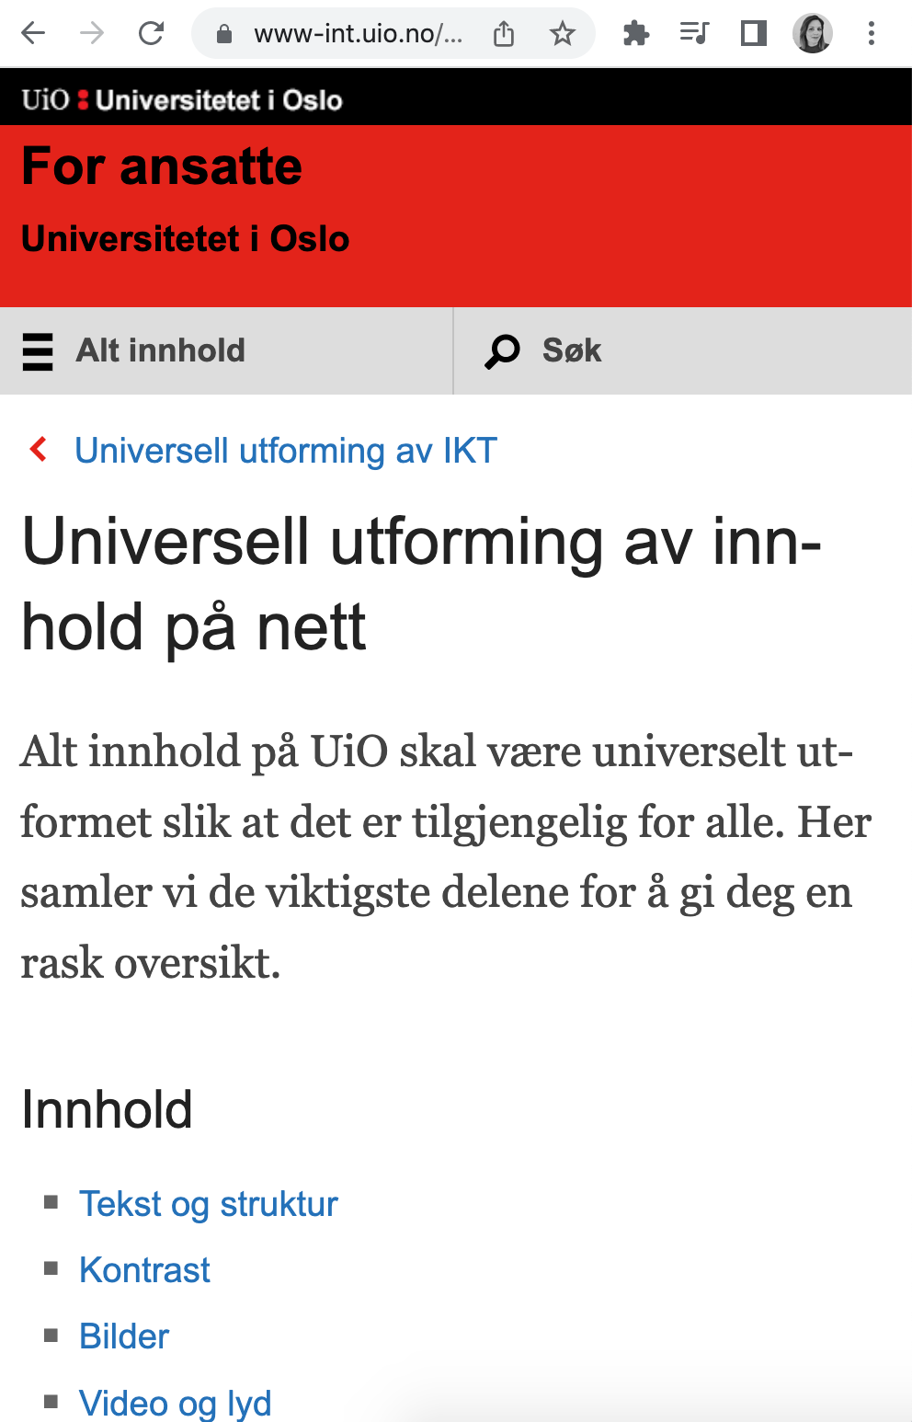
Information material/guide for accessibility of ICT at UiO
New information material will soon be published
Will guide you whether you are making teaching material, information content, design or code

Slide 22
Background for Accessibility Project, phase 2
In 2021 we finished phase 1 of the project that measured the degree of accessibility in UiO's digital services and content. In addition, we checked the competency of system owners in regard to accessibility issues.
Services that were checked: uio.no, Canvas, Devilry, Oria, EHMS and UiO Password Services
Findings from phase 1: Major WCAG failures in services that were checked
One of the recommendations from phase 1: anchoring and training at the faculties/academic environments

Slide 23
Actions in phase 2
Project period for this phase is February - June 2022
Informational meetings about accessibility requirements at all units at UiO (similar to GDPR project). Each faculty/unit is itself responsible for meeting the legal requirements for accessibility.
Present the central support services for accessibility (from autumn 2022)
Now creating guides and courses for the most important accessibility issues (example: “How to make accessible presentations”)

Slide 24
How do we solve this?
Some things require technical solutions
UiO centrally has a responsibility for the largest services like uio.no and Canvas.
Local services are the responsibility of the units themselves.
The main emphasis is on the content that is published
This applies to everyone who publishes and creates content that is aimed at students or the general public, both centrally and locally.
The goal is for this to become part of the way everyone works, at all levels

Slide 25
Central support services for accessibility at USIT
Support services available from autumn
Provide guidance for how to work with universal design
Contribute to test and evaluate web solutions
Guides about accessibility (currently under development)
Webinar about "Accessibility in practice" – date to come
Questions about accessibility can be sent to uu-kontakt@usit.uio.no
Notes:
UU I praksis. Med workshops etterpå? F.eks. webinar som sier noe generelt og så egne workshops rettet mot Canvas og Vortex? Kanskje Insera?

Slide 26
Further plans for Accessibility Project
Before summer:
Informational meeting at units
Create guides and information
In the autumn there will be focus on:
Cooperate with the purchasing department
Canvas
uio.no

Slide 27
Questions? 🖐 Project leader: ida.meland@usit.uio.no uu-kontakt@usit.uio.no

