Slide 1

A leading European university
Subtitle
Name Last Name
Title
University

Slide 2
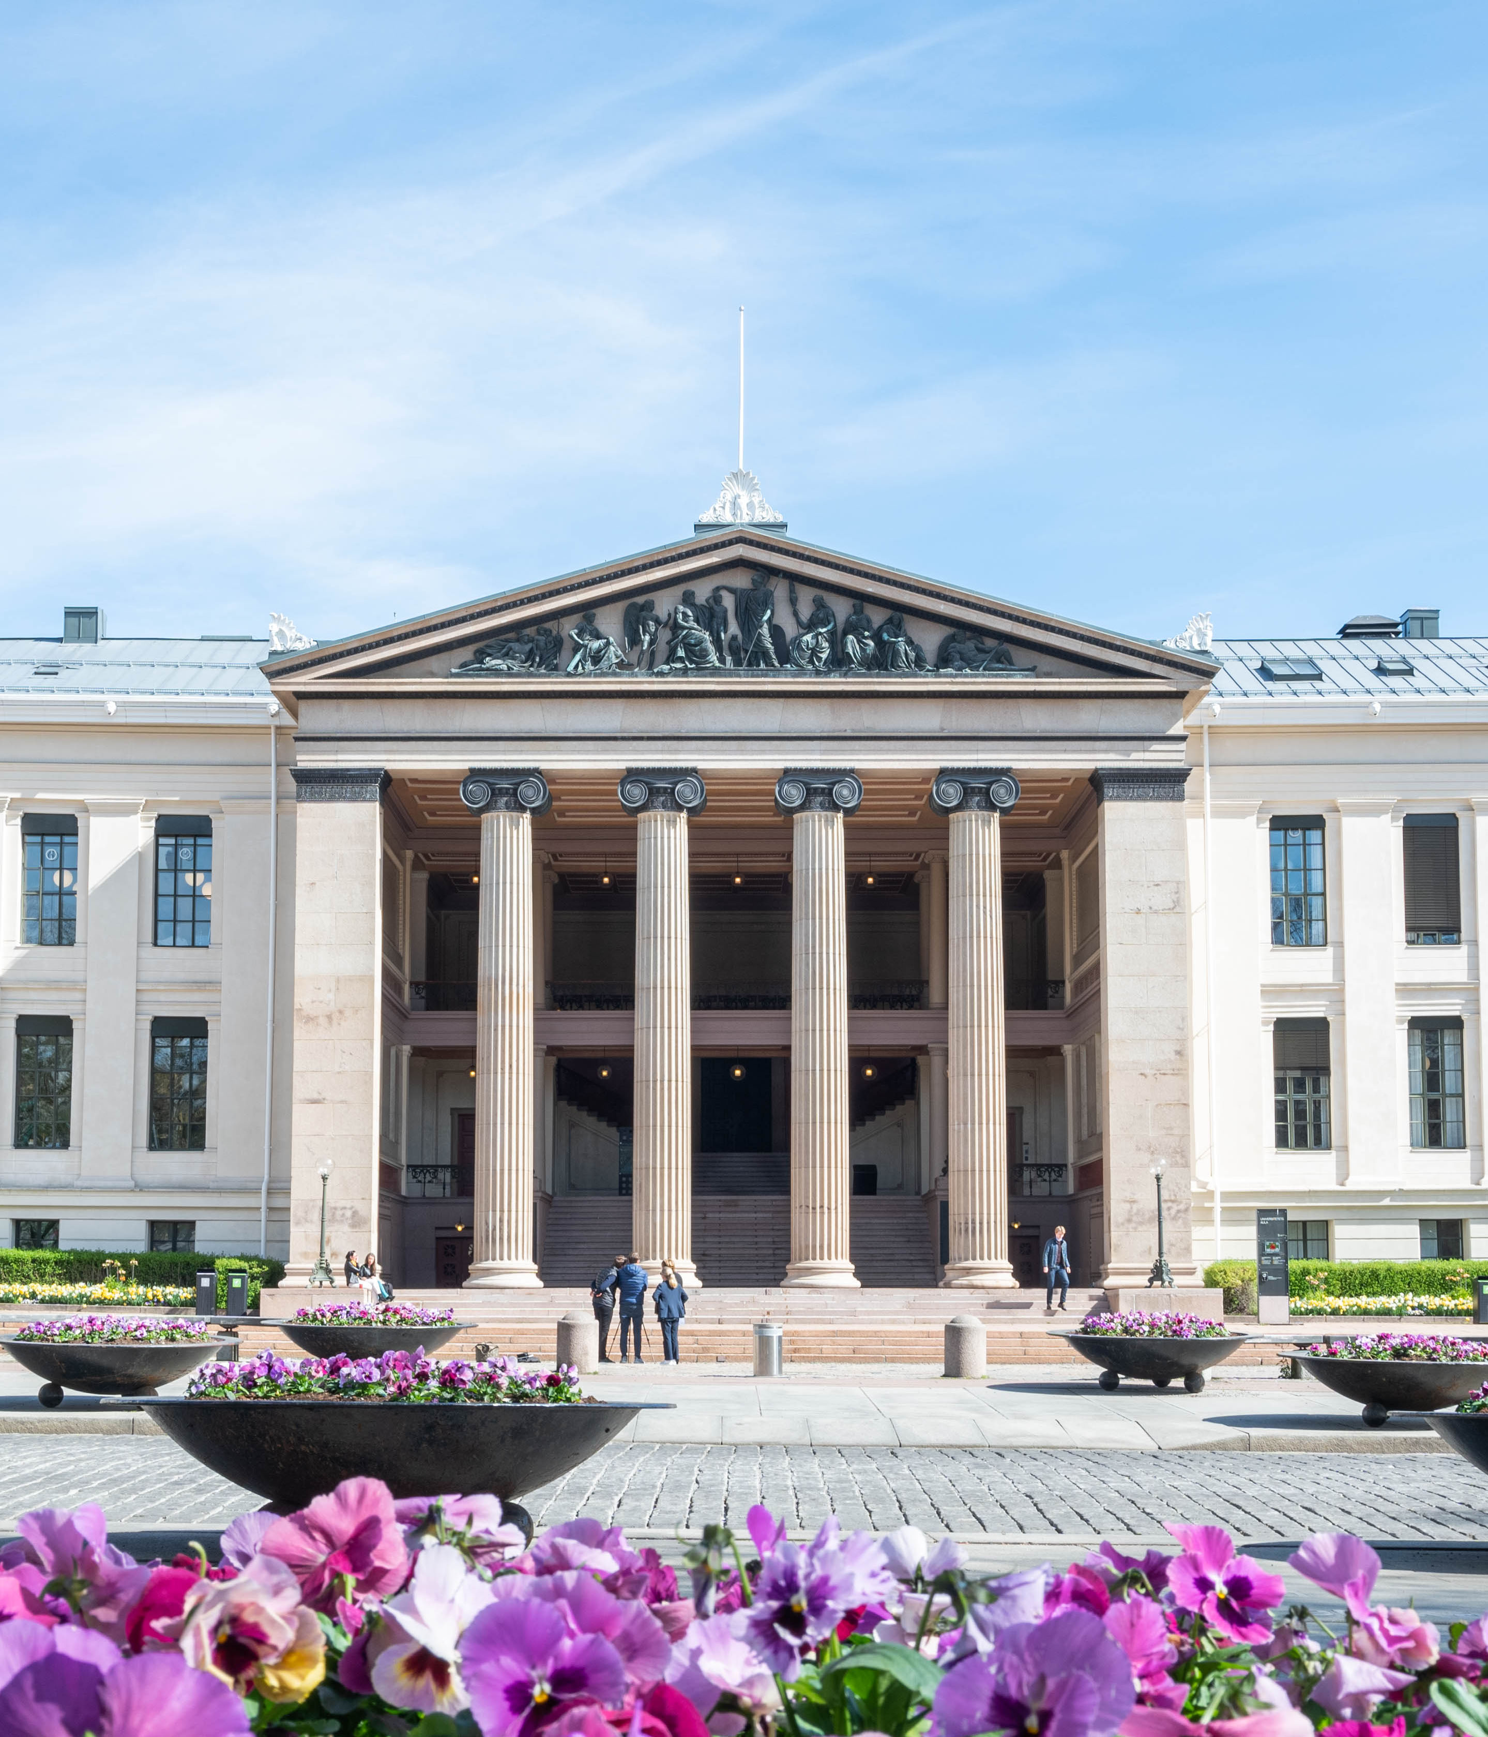

The oldest institution for research and higher education in Norway
Education, research, dissemination and innovation since 1811

Slide 3
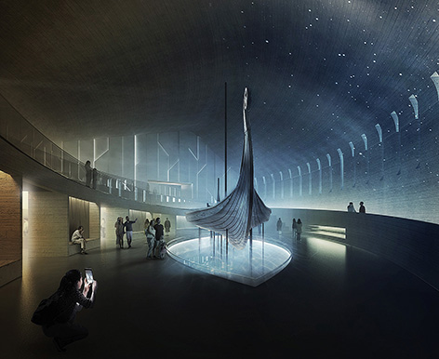
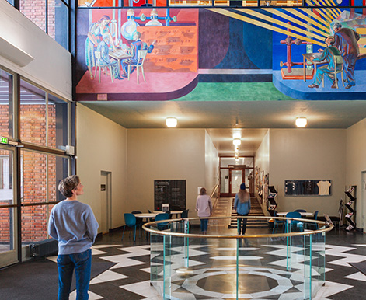


University of Oslo today
Ranked as the world´s 73rd best research university *Shanghai Ranking
5 Nobel Prize Winners
8 faculties
2 museums
7 000 employees
25 000 students
200+ study programs
14 Centres of Excellence
Notes:
Må sjekke ut bilder

Slide 4
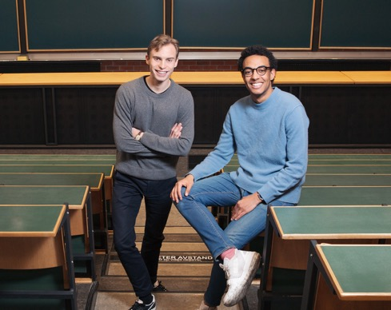

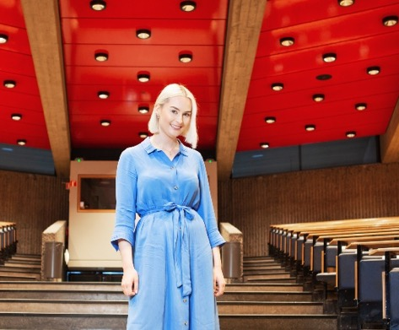

Education
25 000
students
5 000
students graduated
Students that are the most pleased with the academic content of their studies
*Study Barometer 2022
16 000
qualified students with UiO as first choice
Goal of 50 percent student exchange

Slide 5
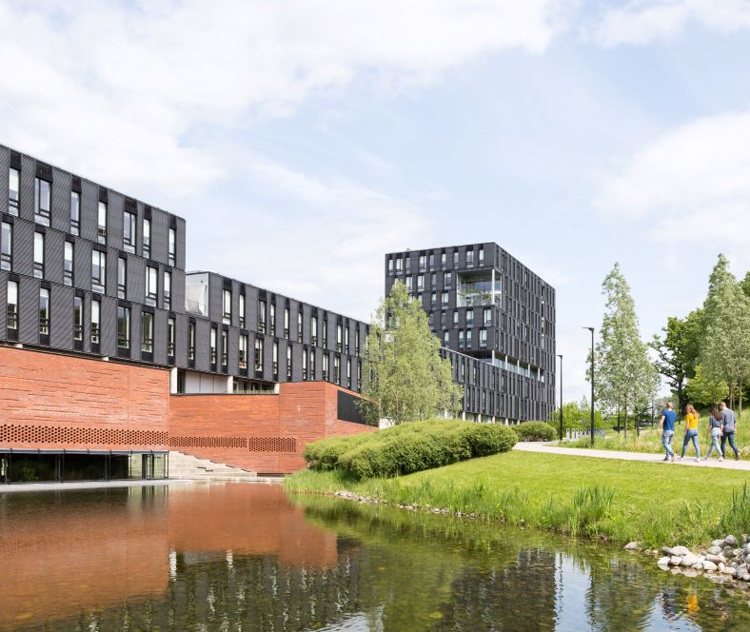
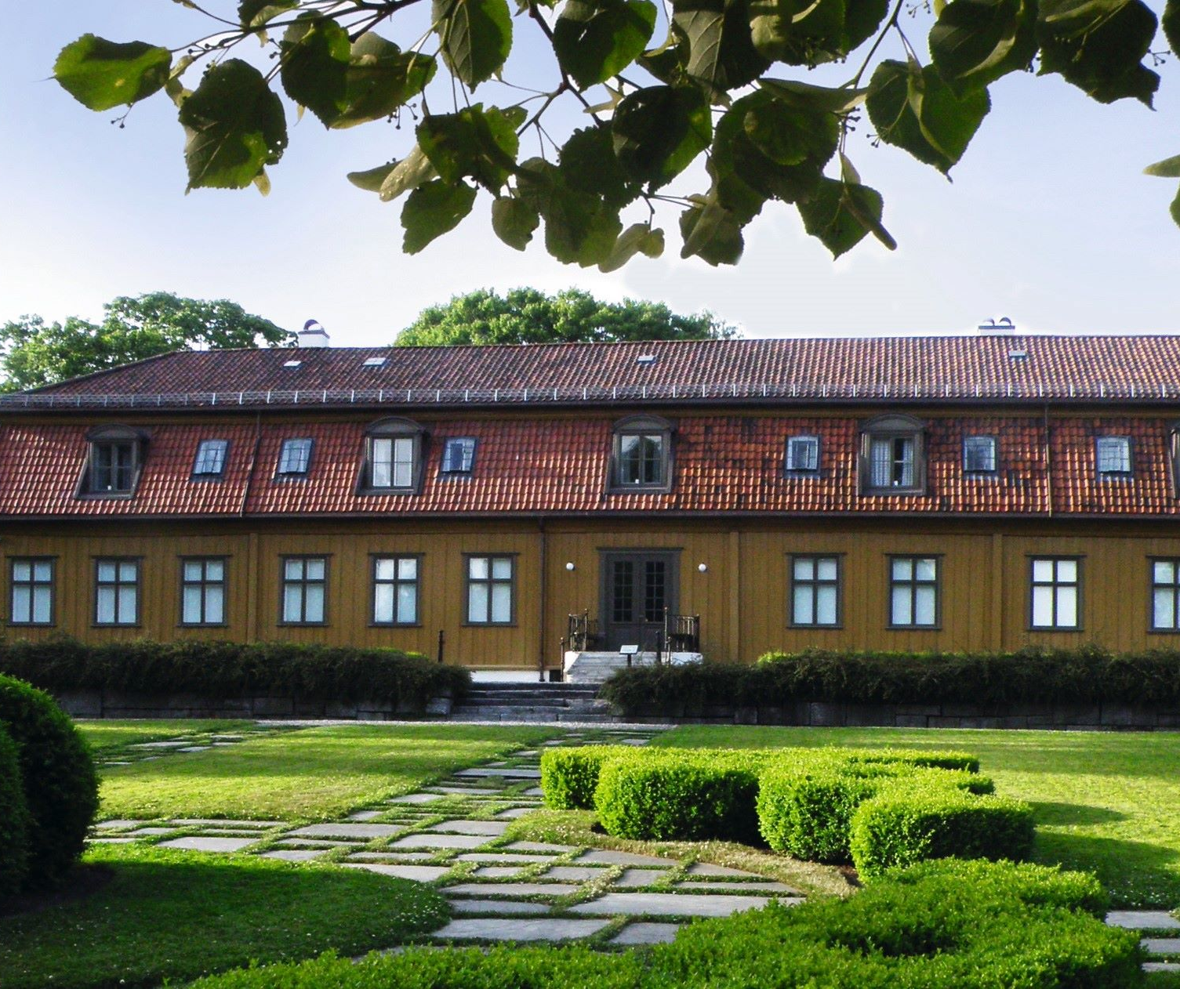
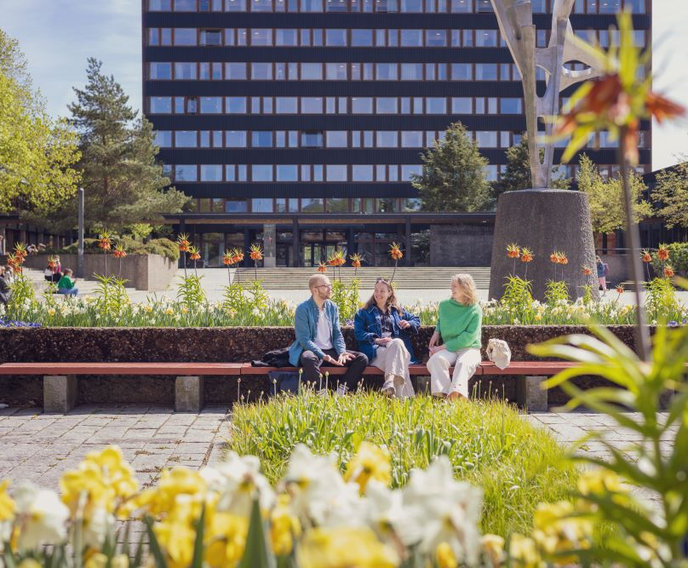

Campuses
Blindern
City Centre
Science City
Tøyen

Slide 6

Strategy 2030
Our ambitions
Promote independent, ground-breaking, long-term research
Educate students with the knowledge, ability and willingness to create a better world
Strengthen the dialogue with the outside world and work to ensure that knowledge is put to use
Be an innovative organisation and an attractive place of work and study

Slide 7
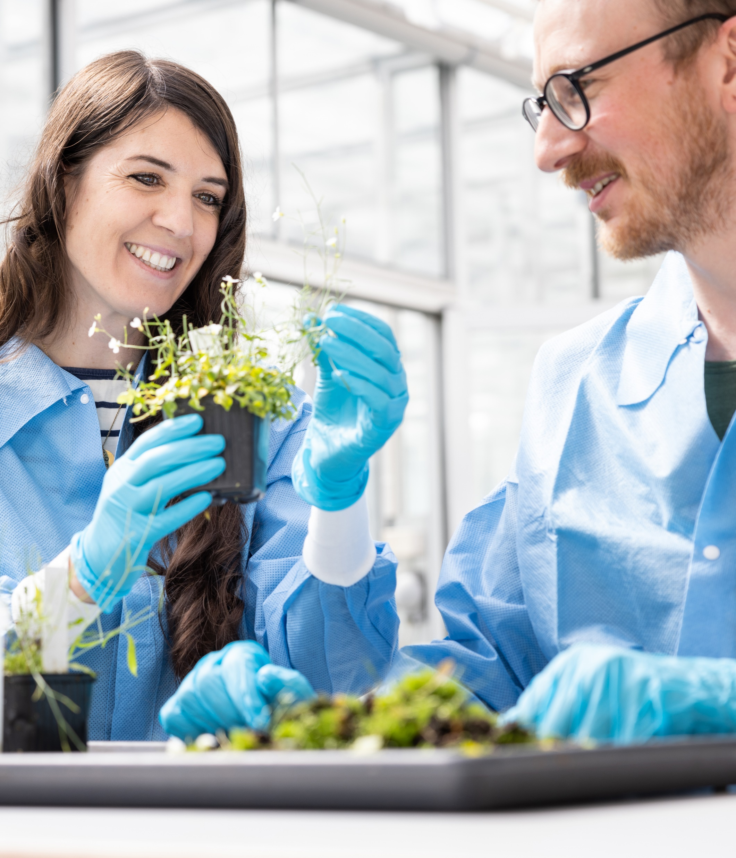
Comprehensive climate and environmental strategy
Our ambitions
Offer education related to climate, environment and sustainability for all students
Strengthen interdisciplinary research within the fields of climate, environment and sustainability
Reduce our climate footprint and further develop a green campus
Notes:
https://www.flickr.com/photos/noraddir/30577111838

Slide 8
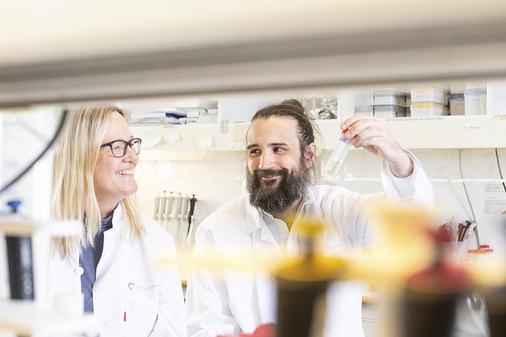

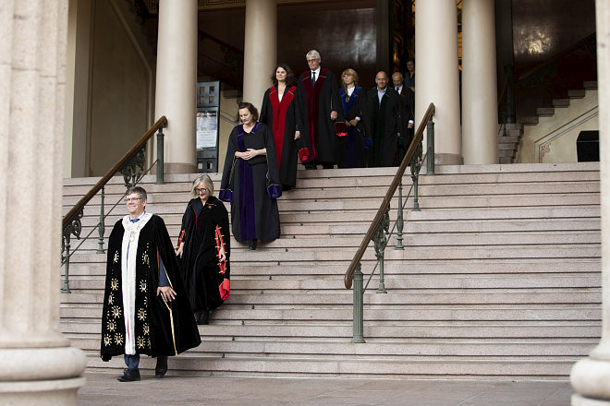
A research-intensive university
9 centres for excellent research
4 centres for excellent education
2 centres for research-based innovation
1 centre for environment-friendly energy research
424 doctorates awarded (2022)

Slide 9


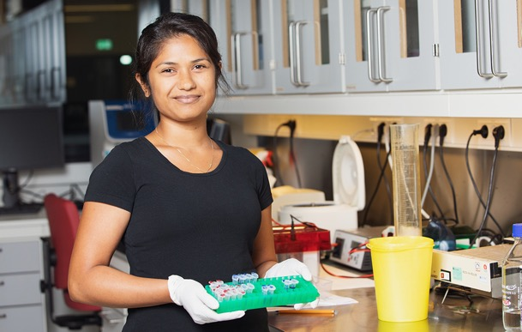
Interdisciplinary priority areas
UiO:Energy and Environment
Strengthening interdisciplinary research within the fields of sustainable energy, climate and environment
UiO:Democracy
Strengthening interdisciplinary research within the field of democracy
UiO:Life Science
Strengthening interdisciplinary research within the fields of health and environment

Slide 10
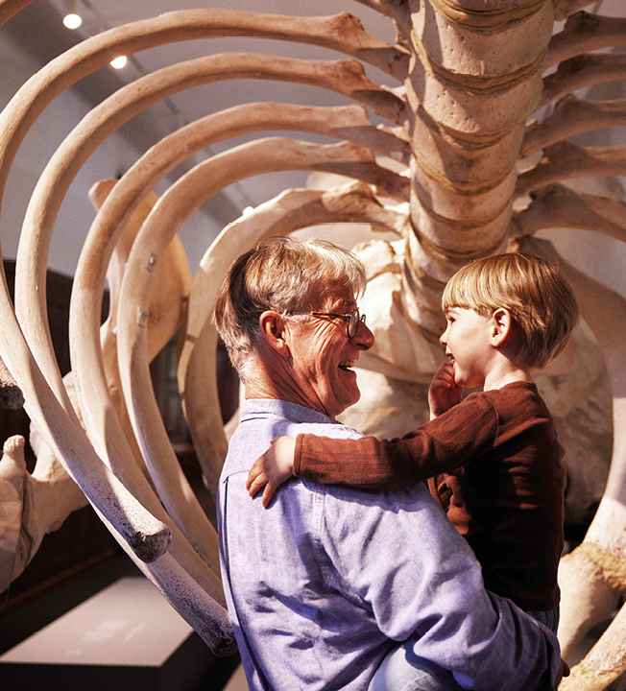


UiO in Oslo
Natural History Museum
Explore 4,5 billion years of natural history
Museum of the Viking Age
A research museum of the Viking Era
Botanical Garden
A living museum

Slide 11

Global UiO
Strategic collaboration
University network and alliances (Circle U., The Guild)
Student and staff mobility programs (Erasmus+, Nordlys/plus)
Project funding:
ERASMUS+
INTPART
UTFORSK
NORPART, NORHED
Sett inn bilde her
Notes:
Research cooperation across all continents
Program cooperation with the Nordic countries, Europe, India, Brazil, South Africa, China, Japan and the United States.
Erasmus+
European University Alliance Circle U.

Slide 12
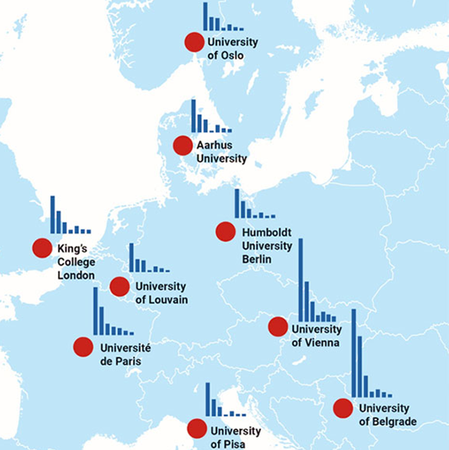
Circle U.
Mission
Empowering our students and staff to mobilize knowledge for impact in order to make the world a better place.
Aarhus Universitet, Danmark
Humboldt-Universität zu Berlin, Tyskland
King’s College London, Storbritannia
Univerzitet u Beogradu, Serbia
Université catholique de Louvain, Belgia
Université Paris Cité, Frankrike
Università di Pisa, Italia
Universität Wien, Østerrike
Sett inn bilde her

Slide 13
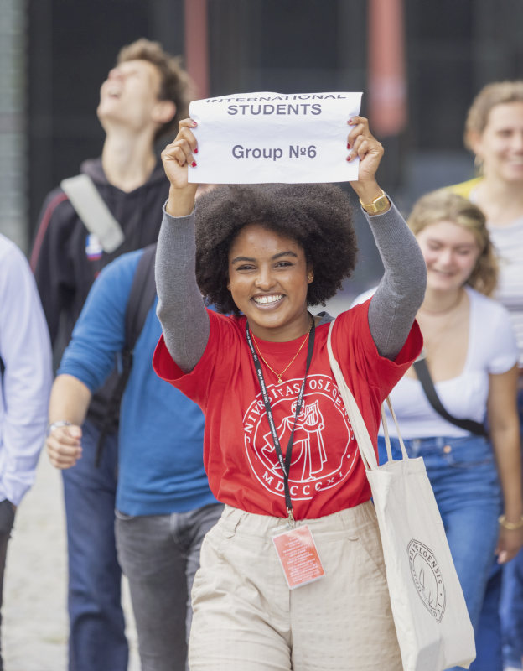
Incoming Student Exchange
1400 students per year
Top 5 countries
  Germany
  The Netherlands
  Italy
  France
  Spain
Foto: Jarli&Jordan/UiO

Slide 14

Outbound Student Exchange
1000 student per year
Top 5 countries
  Australia
  USA
  France
  Italy
  UK
Foto: Augusta

Slide 15


