Slide 1
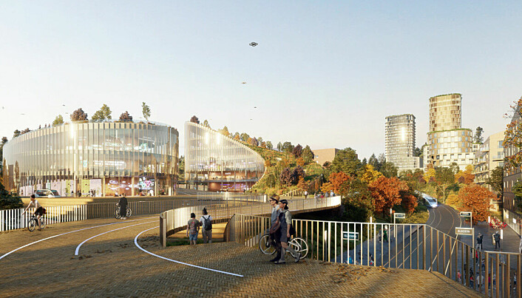
Data- og beregningsvitenskap for grønn omstilling
IT-konferansen 2023

Slide 2
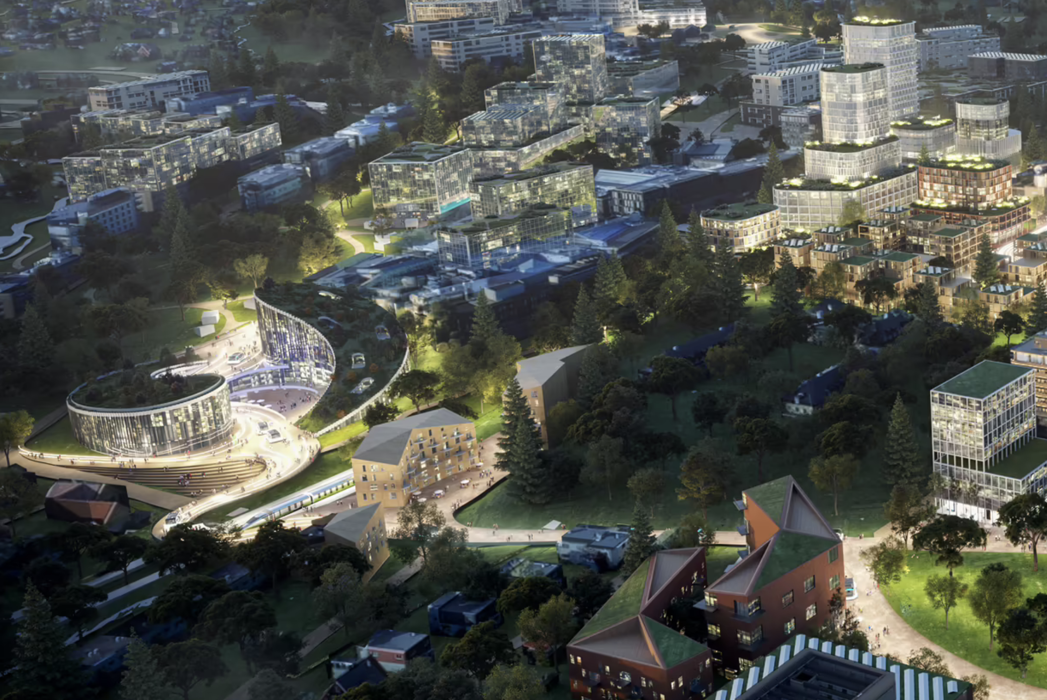
The role of dScience is to.....
build an internationally leading research community in computational and data science at the University of Oslo
deliver important (digital) contributions to the green transition of society and a sustainable future for all
be a frontrunner in developing and maintaining collaboration between academia, industry and the public sector, including being a key player in the development of Oslo Science City
Notes:
Dette bildet skisserer oppgaven til dScience slik den er definert av UiO.

Slide 3
Hvordan skape større verdier fra
digitale ressurser (data)?

Slide 4
The landscape of dScience!
Machine
learning
Knowledge
representation
Artificial
intelligence
Logics
DIGITAL
RESOURCES
Ocean
and space
Bank
and finance
Digital twin
technologies
(High Performance)
Computing
Statistics
Data and system
architectures
Energy
and climate
Communication
and media
Robotics and
autonomy
Connectivity and
security
Health
and medicine
Mobility and
smart
environments
Visualization
Digital governance
Image/signal
analysis
Ethics and
legal issues
Sensor and
sensor networks
Language
technology

Slide 5
dScience board
dScience
dScience Council
dScience Community Forum
(Hosting)
Community services
Data science services
Partner
program
Large
projects
NORA
Norwegian AI Consortium
DLN@UiO

Slide 6
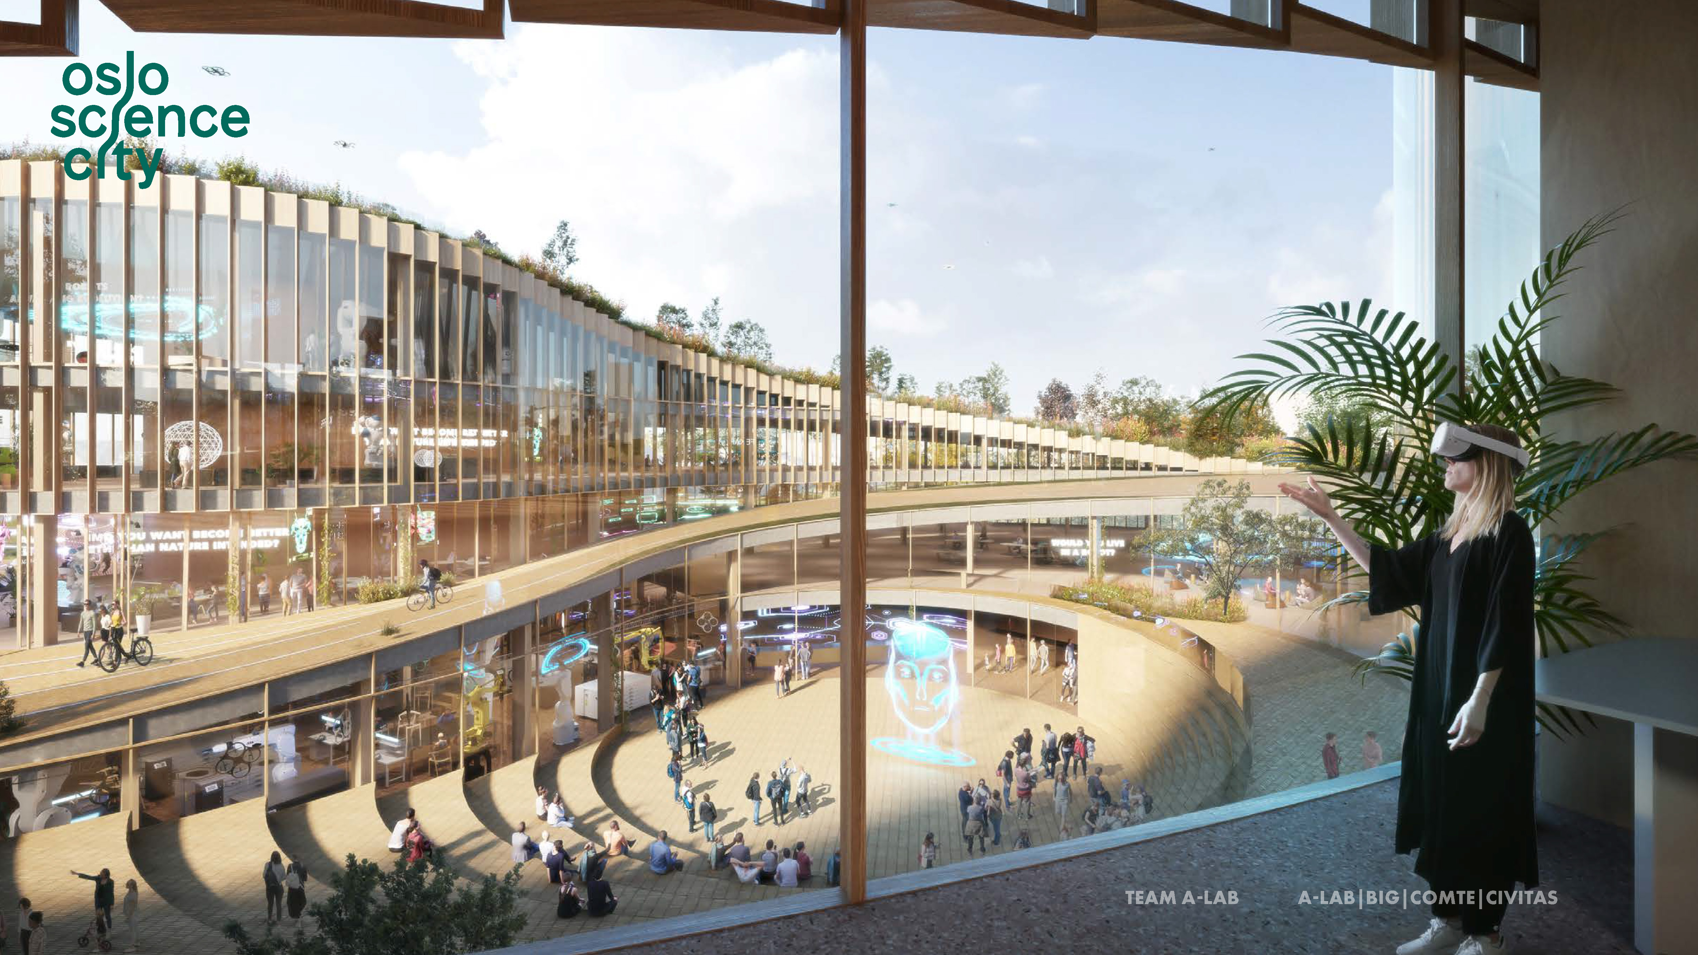
Integreat – Norwegian Centre for Knowledge-driven Machine Learning
(CoE funded 2023-2033)
Norwegian AI Cloud
(National infrastructure funded 2023-2027)
DSTrain - Data Science Training
(Marie Curie COFUND (EU) proposal 2024-2028)
DARE/dEnergy, Proposal for Research Centre for Environmental-friendly Energy, 2024-2031
Portefolio of existing projects
(100+ projects)
40+ research groups with 320 (80) PhD-students
36 events with 1600 participant in 2022
Data and compute services
(TSD, Educloud, Fox, Sigma2, Lumi, EOSC...)

Slide 7
Formålet med dScience Partnerprogram
Skape større verdier fra data og digitale ressurser
Bidra sterkt til grønn omstilling
Bidra i utvikling av lønnsomme arbeidsplasser
Ta internasjonale posisjoner på utvalgte områder

Slide 8
dScience partnerprogram
Prosjekter
Kompetanse
Kapasitet
Tilgang til froskere
(og prosjekter)
Rekruttering
Trendforståelse
Veiledning/mentorering
Søknadsarbeid og gejnnomføring
(NFR, EU, etc.)
Nærings-/offentlig PhD
Systematisk
kapasitetsbygging
Kurs og seminarer
“Advanced impact studies”
(nytt virkemiddel!)
Nettverk
Møteplasser

Slide 9







Slide 10
Some Initiatives
Data
Enhanced production and use of renewable energy.
Resource efficiency in healthcare
Sustainable risk management (climate risk)
Participating in the
ClimateHealth initiative
Digital twins for marine systems
Domain
Knowledge
Data science for democracy
Asset modeling and optimization
Language technology
Algorithms
Compute power

Slide 11
Hva bør være vår «digitale»
forskningsagenda for
grønn omstilling?

Slide 12
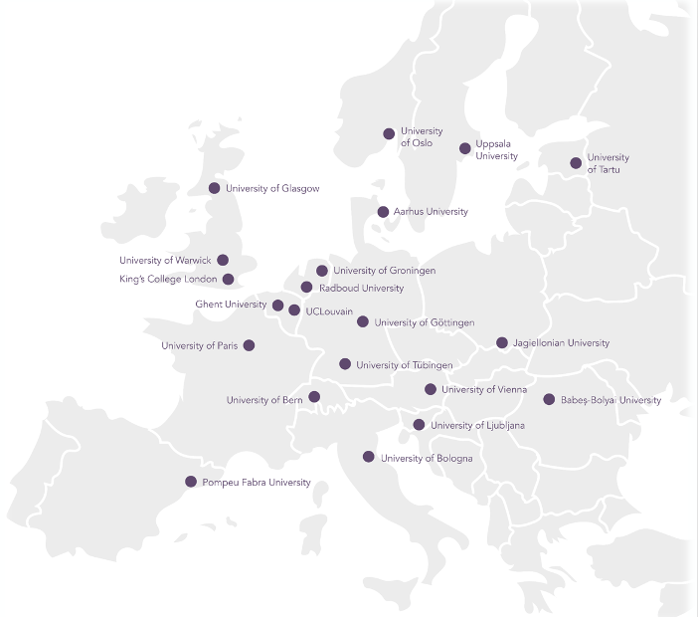

What should be Europe´s
digital research agenda
to achieve a successful
green transition of society?
How can we ensure that the
digital part of the world
becomes (more) sustainable?
The Twin Transition Century (report will be published Q3 2023)
Notes:
Dette bildet skisserer oppgaven til dScience slik den er definert av UiO.

Slide 13

3
8
11-12
36-60-4

Slide 14
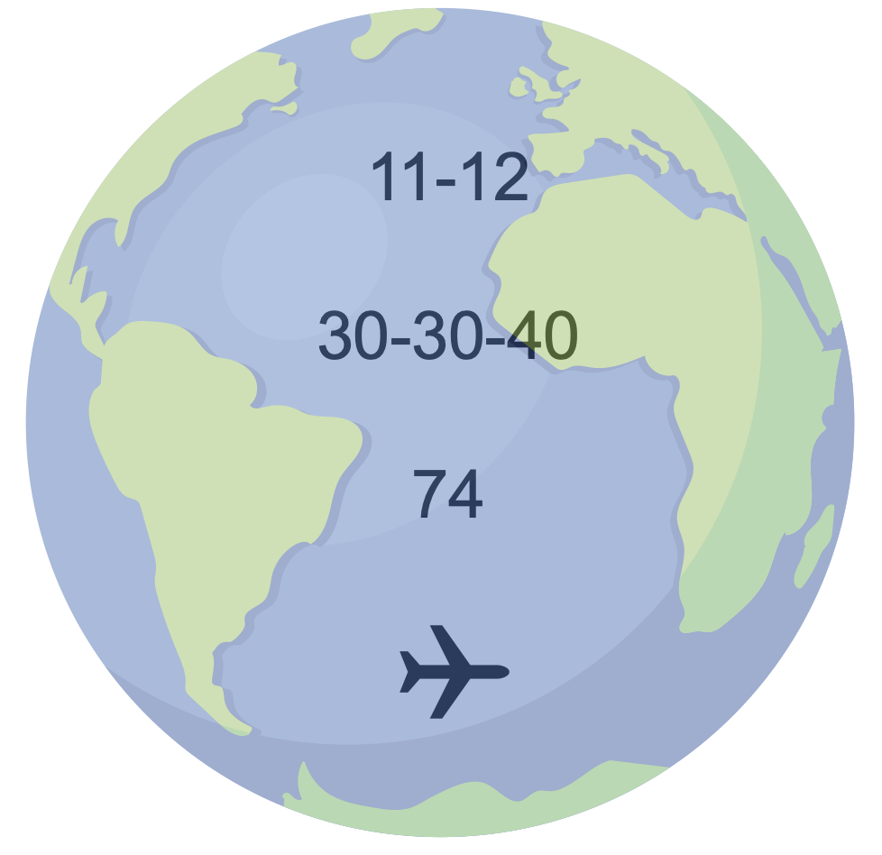

Slide 15
The European Green Deal
Striving to be the first climate-neutral continent (within 2050)
Twin Transition

Slide 16
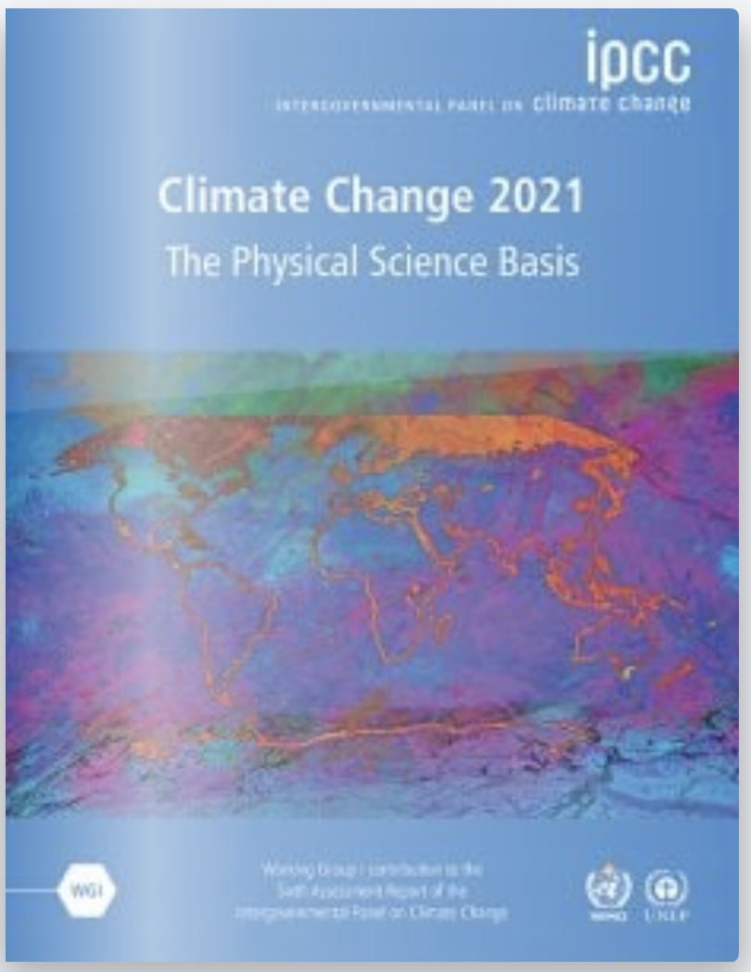
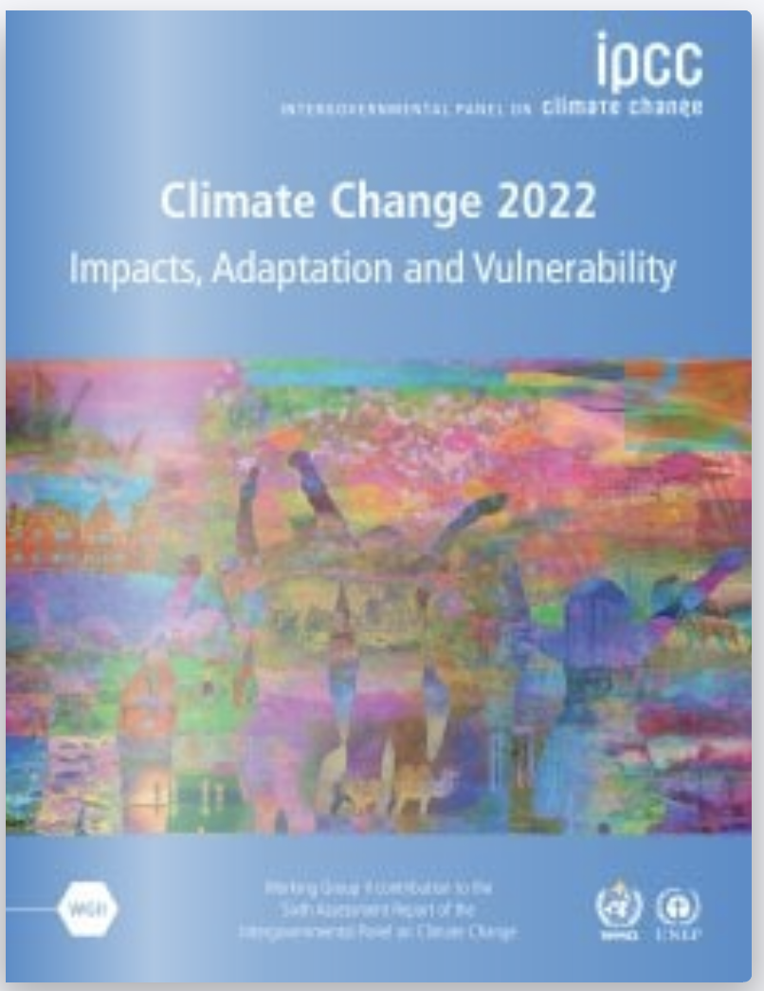
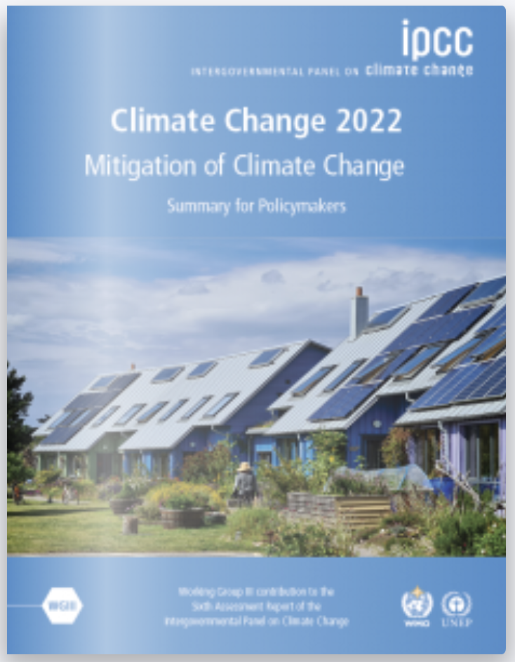
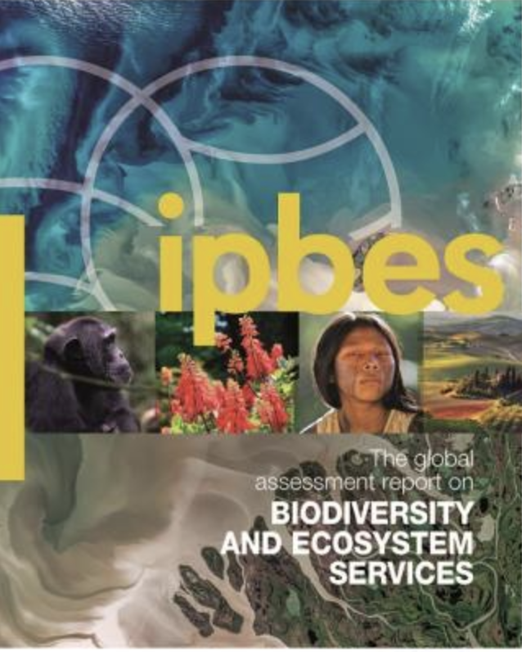
The Twin Transition
The digital transition
of society consists all processes at all levels in society producing and applying infrastructure, services, applications and human behavior that depend on digital representation of knowledge
and computer power.
The green transition
of society is about reducing greenhouse gas emissions, preserving and restoring nature, reversing environmental degradation and ensuring that the energy of the future comes from renewable sources.

Slide 17
Data Science
and Computing
Sensor
Technologies
Digital twins
technologies
Edge
computing
Natural Sciences
Technology
Social Sciences
Humanities and Arts
Machine
learning (AI)
Electronics and
materials
The Green Transition
Security and
resilience
Participation and
opinion formation
Distributed
systems architectures
Creation of
profitable jobs
Connectivity
Sciences
Digital
Governance

Slide 18
The Energy Transition
Everything is
connected to everything!
A Just
Transition
Saving Nature
The Future Unexpected Challenges
A Climate-Friendly Digitized Society

Slide 19
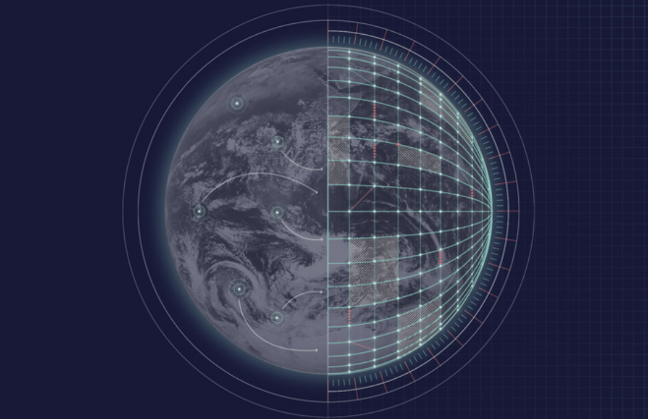
Saving Nature
What should be our digital research agenda
for helping out on saving/restoring nature – over and under water.
(loss of biodiversity and environmental degredation)
Deeper understanding of changes
Destination Earth
Coordinated handling of earth data
Seeking optimal
and just actions
(https://digital-strategy.ec.europe.eu)

Slide 20

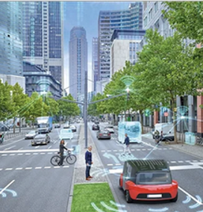
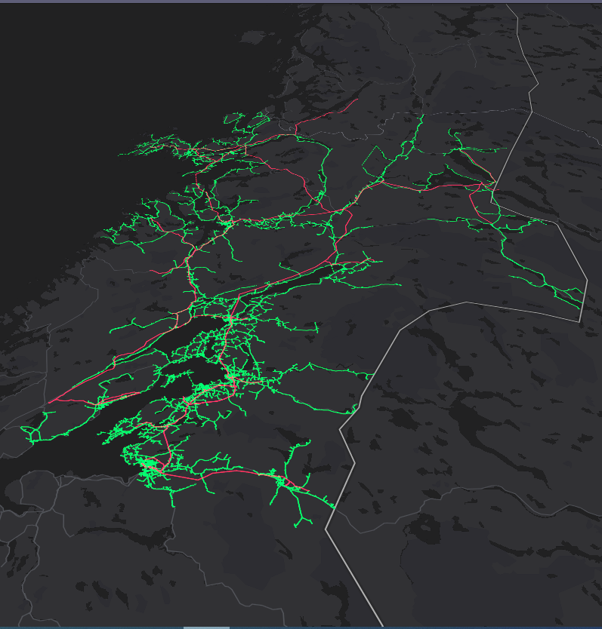
The Energy Transition
What should be our digital research agenda to ensure an
efficient transition to the age of renewable energy?
An energy
efficient society
Zero-emission mobility
The energy system of tomorrow

Slide 21
A Just Transition
What should be our digital research agenda
to ensure a socially and economically fair transition?
Twin transition governance!
Digital divide
Politics
Attention
Consume
Regulations
Participation
Ensure democratic and fair opinion formation
Solidarity
Taxes
Communication
Economy
Hunger
Sharing knowledge
Establish green circular
value chains.
Demographics
Fake news
(Social) media

Slide 22
A Climate-Friendly Digitized Society
How can we ensure that the digital part of the
world becomes (more) sustainable?
Establish green
computing facilities
Store and transport
less data, share more data
Develop more energy-efficient algorithms and software
Reduce data volumes as early as possible – edge computing
Produce more energy-efficient computer/chips and quantum computing might solve a few problems
Make plans for digital waste disposal and recycling of digital equipment

Slide 23
The Twin Transition Century
Recommendations to ourselves,
to policy makers, to funding organization
to be launched in september 2023!
We do not know what we do not know!
Hence, we must be prepared for the unexpected.
Short-term actions are needed, however long-term actions are equally important.

Slide 24
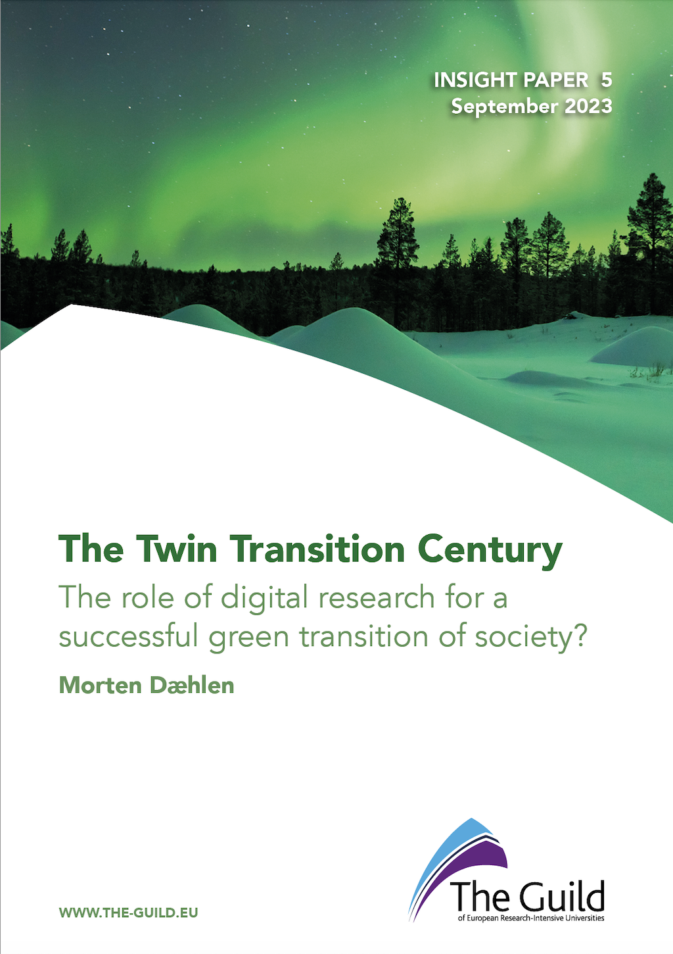
Thanks to you!
..and thanks to numerous people
in The Guild Network + others!
Notes:
Dette bildet skisserer oppgaven til dScience slik den er definert av UiO.

