Slide 1
Changes in the finance, payroll and HR/personnel area from 1 May 2021, and important dates and deadlines

Slide 2
Contents
What is BOTT
New Financial Model
Guidelines for use
Purchase Orders after 15 March
New solution for hourly hires and assignment contracts
Important deadlines
Important changes in the Payroll Area
Training

Slide 3
WHAT IS BOTT?

Slide 4





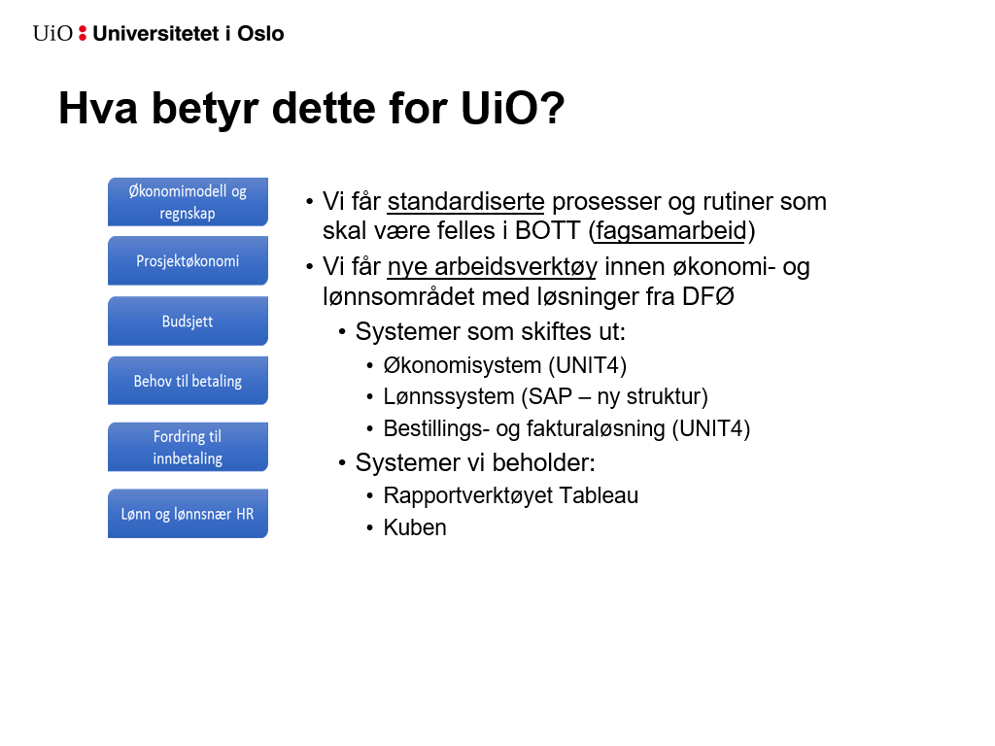
What is BOTT?
BOTT is the administrative collaboration between University of Bergen (UiB), University of Oslo (UiO), Norwegian university of science and technology (NTNU) and The Arctic University of Norway (UiT)

Slide 5

DFØ is the Service Provider
The Norwegian Agency for Public and Financial Management (DFØ) is the new service provider of finance and payroll solutions for BOTT.
Go Live Dates:
UiB: 1.1.2021
UiO: 1.5.2021
NTNU: 1.1.2022
UiT: 1.1.2022

Slide 6
What does this mean for UiO?
Financial Model and Accounting
BOTT standardized administrative processes and routines.
New systems and tools with DFØ as our new service provider.
Project Accounting
Budgeting
Purchase to Pay
Accounts Receivable
Payroll

Slide 7


The new systems
Finance UNIT4 ERP
Purchase to Pay UNIT4 ERP
Payroll DFØ SAP
HR/Personell DFØ SAP self-service portal
  Time and absence records, expenses, leave applications, flextime, transfer of vacation days, travel invoices etc.
  DFØ also provides a mobile phone app (DFØ app) where these tasks can be performed

Slide 8
Systems that will not be replaced
The reporting tool Tableau
The TendSign tool for competition and contract administration

Slide 9
NEW FINANCIAL MODEL

Slide 10
BOTT Financial Model 1.0
Defintion:
  BOTT Financial Model is an accounting string with dimensions and associated relations, that provides structured information about the company
Purpose:
  The Financial Model contains information required for BOTT to be able to report in accordance with identified needs, both from internal and external stakeholders

Slide 11
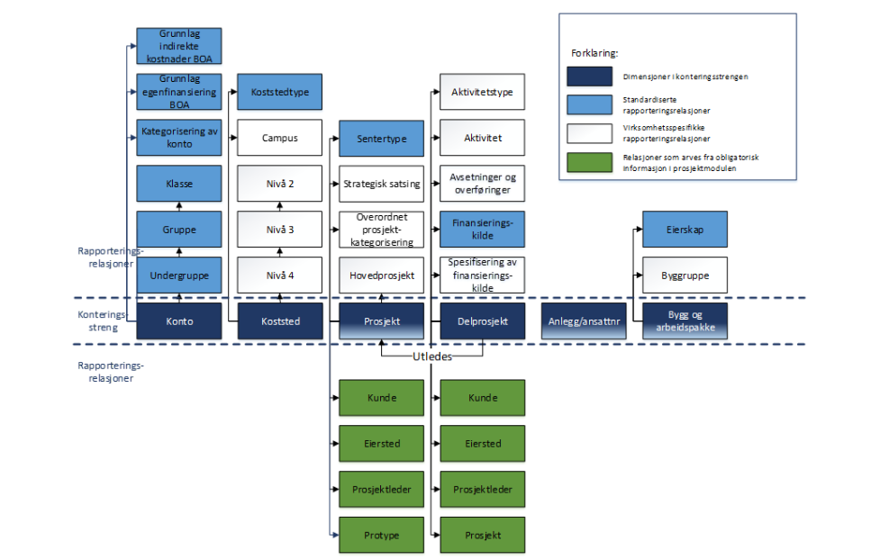




Construction of the Financial Model
Accounting dimensions
(dark blue)
Reporting relations (light blue) Standardized for BOTT
Company specific relations (white)
Used to specify cost centers, strategic focus areas, project categorization, source of funding, activities)
Project relations
Inherited from the project module (green)

Slide 12
Dimensions in BOTT Financial Model 1.0
  Most elements are recognizable, such as konto (account) and koststed (cost center)
  Changes:
    A new project structure, supported by a project module.
    For sponsored and comission-based activity, BOA.
    The current dimension “tiltak” will be replaced by new structures based on the dimensions prosjekt (project) and delprosjekt (subproject).
    For budget allocations.
    Extensive use of relations as a supplement to the accounting dimensions.

Slide 13
Current and new accounting strings
Current accounting string at UiO
The new BOTT accounting string
Posting level
Art (konto)
Prosjekt
Sted
Tiltak
Motpart
Konto
Koststed
Prosjekt
Delprosjekt
Anlegg/ ansattnr
Bygg/ arbeids-pakke
derived
Konto
Koststed
Delprosjekt
Bygg/ arbeids-pakke

Slide 14
Sponsored and comission-based activity (BOA projects)
Dimension Prosjekt is contract level (Project)
We will create one project per contract (as today)
Not posting level
5 first digits (ex 12000)
Dimension Delprosjekt is posting level (Subproject)
One subproject per financier (self-financing incl.)
  External subproject supports external framework
  Self-financing project supports deductible
3 digits (Ex: 12000-001)
Dimension Bygg/arbeidspakke
Used for work packages when required by the financier
Relation Hovedprosjekt (Main project)
When needed: to link projects together in a structure/hierarchy
Use of the accrual principle facilitates the relation Finansieringskilde (source of financing) on dimension Delprosjekt (subproject) to provide us with an ongoing basis for performance based redistribution (RBO).

Slide 15
Budget allocations
The current dimension “tiltak” will be replaced by new structures based on the dimensions prosjekt (project) and delprosjekt (subproject) and use of relations.
Dimension Delprosjekt (Subproject)
Use of relations is explained on next slide.
Dimension Prosjekt (Project)
The purpose of the relation Strategisk satsing (strategic focus area) is to highlight the use of resources related to areas of strategic focus.
UiO will not implement this by 1 May 2021, as level of ambition for use is not yet decided.

Slide 16
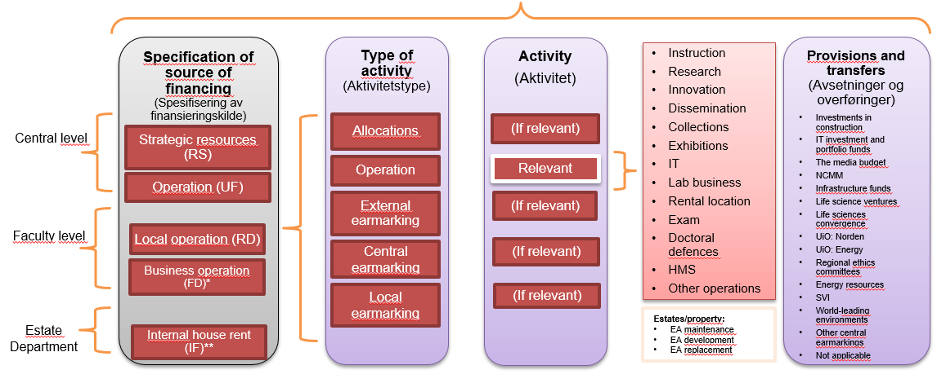
Dimension Delprosjekt (Subproject)
Levels of relations
Level 1: Specification of source of financing (Spesifisering av finansieringskilde)
Indicates whether funds are allocated at central or faculty level. At central level, a distinction is made between the disposition being strategic vs. operational (RS and UF). At faculty level, there is a distinction between funds allocated via the ordinary distribution model (RD) and business operations (FD). Internal house rental scheme (IF) is created to meet EA's needs.
Level 2: Type of activity (Aktivitetstype)
Used to categorize whether the funds are earmarked, allocated or operational. For earmarked funds, it is further specified whether the earmarking is central, local or external.
For centrally earmarked funds, the relation “provisions and transfers” will be used to obtain a simple overview of the financial status of various central earmarkings.
Level 3: Activity (Aktivitet)
Used if there is a need for further specification of
activity.
Next slide for further details

Slide 17

Relations on delprosjekt (subproject)
Budget allocations
Specification of source of financing
(Spesifisering av finansieringskilde)
Type of activity
(Aktivitetstype)
Activity
(Aktivitet)
Instruction
Research
Innovation
Dissemination
Collections
Exhibitions
IT
Lab business
Rental location
Exam
Doctoral defences
HMS
Other operations
Provisions and transfers
(Avsetninger og overføringer)
Investments in construction
IT investment and portfolio funds
The media budget
NCMM
Infrastructure funds
Life science ventures
Life sciences convergence
UiO: Norden
UiO: Energy
Regional ethics committees
Energy resources
SVI
World-leading environments
Other central earmarkings
Not applicable
Central level
Strategic resources (RS)
Allocations
(If relevant)
Operation
Relevant
Operation (UF)
External earmarking
(If relevant)
Faculty level
Local operation (RD)
Central earmarking
(If relevant)
Business operation (FD)*
Local
earmarking
(If relevant)
Estate Department
Estates/property:
EA maintenance
EA development
EA replacement
Internal house rent (IF)**
* Used to categorize activities that have a business like character, e.g. USIT's sales of services, the public activities at the museums or the NPD's clinic activities
** The value is only used by the Estate Department

Slide 18
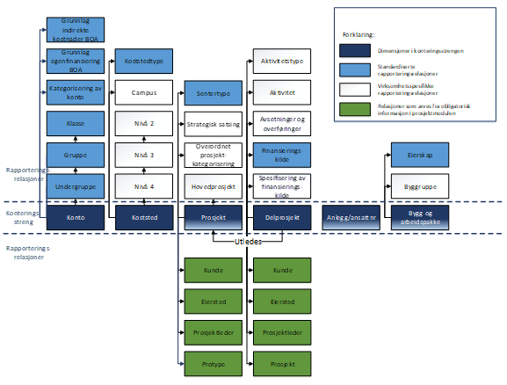

The Financial Model one piece of a bigger picture
……..«how much of the grant allocated to this project have we spent so far?»….
… requires a well structured financial model, data warehouse, financial analysis software and reporting tools.
……..«what’s left of the budget funds earmarked for creating equal opportunities ?»….
«can I afford a new doctoral research fellow on my project?»…
……«where can I find information on the strategic investment in life sciences?»
Data warehouse with data from several sources
Financial Control

Slide 19
THE NEW FINANCIAL MODEL
GUIDELINES FOR USE

Slide 20
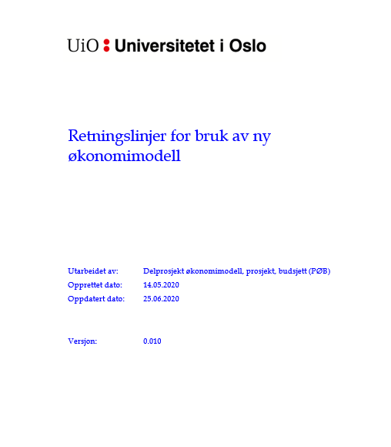
Guidelines for use
Content:
Purpose, prerequisites and definitions
Structure and sample values
Guidelines for use
Recommendation on how the guidelines should be observed
How to manage the document
This document will be available mid-April.

Slide 21
PURCHASE ORDERS AFTER 15 MARCH

Slide 22
Purchase Orders 15 March – 1 May
No orders will be converted to the new system Unit4
Please create as few orders as possible in Basware PM after 15 March - to avoid additional administrative work
Orders made after 15 March in Basware PM must be manually linked to the invoice in Unit4
From 1 May orders can be created in Unit4, and matched with the invoice there.

Slide 23
NEW SOLUTION FOR HOURLY HIRES AND ASSIGNMENT CONTRACTS

Slide 24
Hourly hires and assignment contracts new solution
Replaces today's eBilag system
Contracts from the eBilag system will not be converted into the new solution
  Contracts with a duration longer than 30.04.21 must be re-registered in the new system with 01.05.21 as the starting date
Contracts that have not been approved by the external party or where the employee will not perform the work after all, are to be deleted

Slide 25
IMPORTANT DEADLINES

Slide 26

Registration of working hours, holidays, etc.
The final deadline for being up to date with registration of working hours, holidays and the like in the current SAP-UiO HR portal is 30 April 2021
  It will not be possible to correct previously registered hours after this date. Pay slips from the SAPUiO HR portal will not be transferred to the new system.
If you need your pay slips for refinancing, bank loans, etc., you must download them yourself before 30 April 2021

Slide 27

Applications for leave and holiday
Applications for leave and holiday before 1 May 2021 must be registered and approved in SAPUiO by 30 April 2021.
Applications for leave and holiday after 1 May 2021 must be registered in the DFØ SAP Self-Service Portal.
Faculties that have registered holiday after 1 May in SAPUiO on behalf of academic staff, must withdraw these registrations and re-enter them in DFØ SAP.

Slide 28

Travel invoices and refund claims
The deadline for registering travel expenses and reimbursement claims in SAPUiO is 31 March.
Travel expenses incurred after 31 March are not to be registered in SAPUiO, but in the DFØ SAP Self-Service Portal after 1 May.
Travel advances are only given in exceptional cases.
  If you are going to travel after March 31 and before May 1st, we recommend using a credit card or asking for an invoice, rather than applying for a travel advance.

Slide 29
Historical data
Historical data will be locked down in connection with the transition, and will later be transferred to a separate database.
  In the transition phase, there will therefore be limited access to data from the old systems.
After 1 May, employees will not be able to access or update historical data from before 1 May
  The administration will have access to solutions for retrieving necessary historical data for reporting, audits etc.

Slide 30

Flextime
Flextime exceeding 50 hours must be used before 31 August.
If you have negative flextime exceeding -10 hours, you and your immediate superior will receive an automatic notice of this 2 months before 31 August.
Usually the settlement period for flextime is from January to December. Due to the corona pandemic, the settlement time has been moved to 31 August.

Slide 31
IMPORTANT CHANGES IN THE PAYROLL AREA

Slide 32

Payment of salary
Salary will be paid on the 12th of each month (currently on the 15th)
Monthly and hourly wage earners will be paid on the 12th of each month
Fees will be paid twice a month
Refunds for travel and other expenses will be paid weekly

Slide 33

Employee categories
From 1 May, UiO will operate with three employee categories instead of two
  Administrative staff
  Operational and technical personnel / other employees
  Teaching and research staff
These categories will also be linked to salary cost in the accounts, in addition to other details such as the SCO code

Slide 34

Time Registration
It will only be possible to record working hours within the point in time specified in the flextime agreement
Overtime can only be entered in accordance with contractual rules
There is an automatic notification to your manager in case of flextime that exceeds -10 hours
A comment will be mandatory when registering overtime
It will only be possible to make corrections in registered hours for the current and previous month.

Slide 35
Employee information
All employees must enter their next of kin in a personal profile in the DFØ SAP self-service portal
Employees' names and residential addresses for the new system are obtained from the National Population Register
There will be an update from the National Register before the first payroll run on 12 May
Your staff profile at UiO retrieves data from the payroll system. If you currently have a different name on the employee webpages than you do in the National Register, the name on the employee pages will be changed when we switch systems.
It will not be possible to use nicknames for employees in the personnel data.

Slide 36
TRAINING

Slide 37

Training for administrative staff and managers takes place in the period February to June 2021
Role-based training
Combination of e-learning, videos and digital workshops and courses.

Slide 38
Training for all employees
On UiO's “For employees” web pages:
e-learning
videos
guidelines
on filling in travel invoices and reimbursements, register time and absence records etc. will be posted towards the end of April.

Slide 39

Link to the project website:
UiO: Økonomi og lønn - For ansatte - Universitetet i Oslo
If you have any questions, please contact your local implementation coordinator (lokalt innførings-ansvarlige):
Prosjektgruppe, styringsgruppe, faggrupper, ressursteam og lokalt innføringsansvarlige - For ansatte - Universitetet i Oslo (uio.no)

