Slide 1
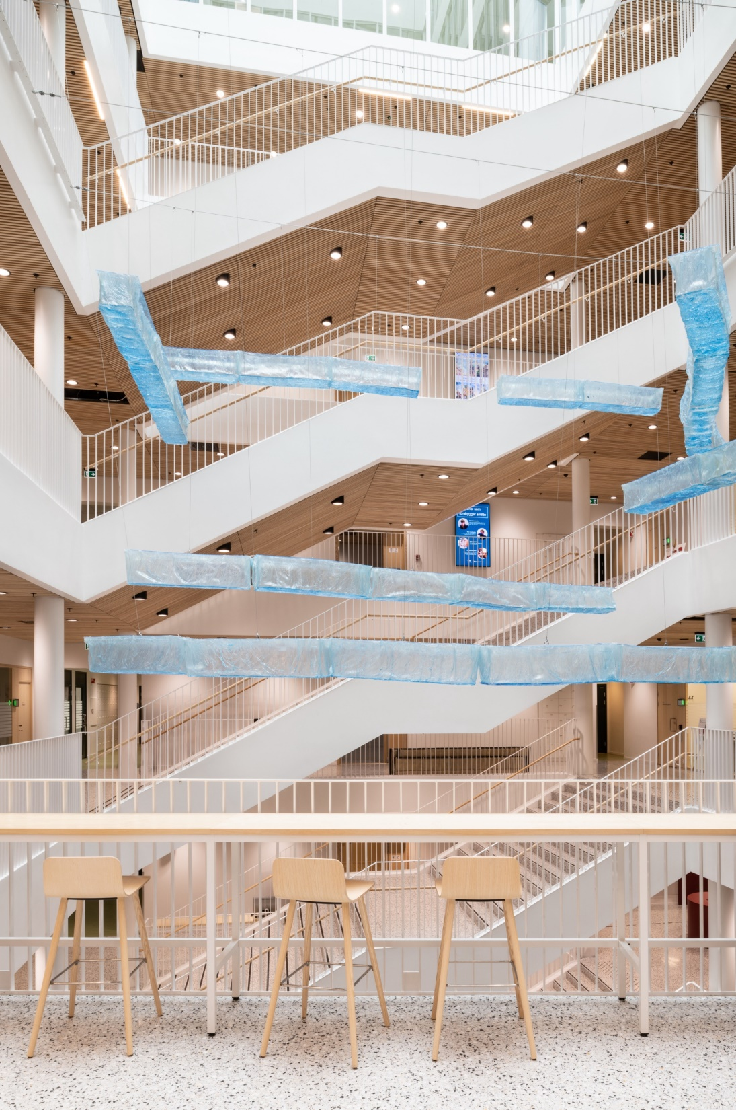
University of Oslo
Faculty of Law
Dept of Public and International Law
ARK – The Work Environment Survey 2022

Slide 2
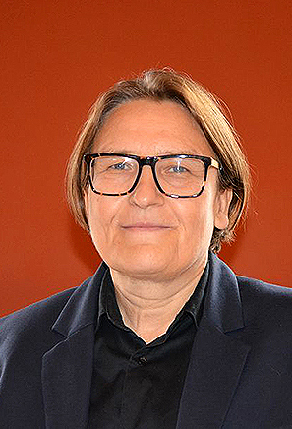
A good working environment is important for all of us
That is why we need to have a systematic approach to develop our working environment
The ARK-process will help us to maintain the positive aspects of our working environment, and to improve what needs to be improved.
We will achieve more through a joint effort for our working environment. Thank you for participating!
Ragnhild

Slide 3

Agenda:
Work environment development - why and how?
Presentation of survey report
Map areas to preserve and develop (group work)
Summary and way forward

Slide 4
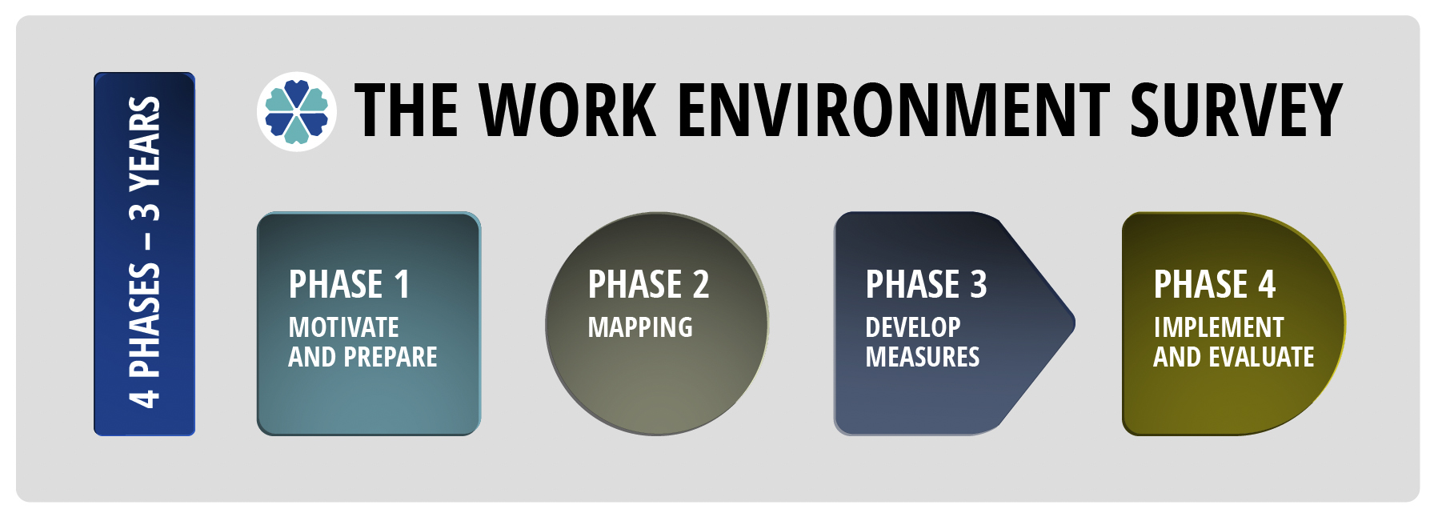

Slide 5



Psychosocial and organizational work environment
Work tasks
- Interaction between work tasks and People
Social relationships
- Interaction between people
Organizational framework
- Interaction between people and structural conditions at the work place
Notes:
Work tasks
- The interaction between us as individuals and the work tasks we have
This may, for example, be about our experience of:
to have a meaningful job
to have an influence on how the work tasks are to be solved
whether the job provides satisfaction and job satisfaction
whether the job provides an opportunity for professional development
to apply knowledge and skills
Social relationships
- the interaction between people
This can, for example, be about our experience of:
collaboration and fellowship with colleagues
work climate and communication
relationship to management
to be recognized for our efforts
Organizational framework (organizational work environment) - the interaction between person - and structural and formal conditions in the organization
This can, for example, be about our experience of how:
units, groups, teams, etc. are organized
formal channels for communication and participation work
the information flow works
formal guidelines and routines work

Slide 6






Culture and climate
Balance between demands and control
THIS WORKS
Predictability
Role clarity
Balance between effort and reward
Management
STAMI Statens arbeidsmiljøinstitutt, 2018
Notes:
The National Institute of Occupational Health (2018). THESE FACTORS ALSO APPLY DURING CORONA
Demands vs. control
Demands = job demands – the things people experience as demanding and expend a lot of resources and energy on.
Control = self-control over work performance and daily work (autonomy).
A good balance between job demands and autonomy contributes to motivation, dedication to one’s work and job satisfaction.
Role clarity
A lack of role clarity refers to having an unclear picture of one’s responsibilities, tasks and what is expected at one’s job.
Role conflict arises when someone feels that a conflict exists between different roles they hold.
It is detrimental to face role uncertainty or role conflict over time.
Lack of clarity can lead to conflicts of interest and "chatter" between people. It may be a sign of poor organization and planning.
Balance between effort and reward
As an employee, you need to feel that you are getting something back for the effort you put into your job.
Recognition, positive challenges and opportunities for development are important types of rewards.
Salaries and perks are just one part of this picture.
Management
Empowering, fair, supportive, close?
Predictability
Creates security and experience of control
Planning and clarity
Clear tasks and areas
Culture and climate
Language and communication – how do we talk to/about and behave towards each another?
Understanding diversity – how to handle differences
What are our meeting rules and meeting culture like? Do we distinguish between the issue and the individual in professional discussions?
How do we relate to involvement, conflicts, sick leave or sitting in an office landscape?
https://stami.no/magasin-arbeid-og-helse-2018/
https://www.youtube.com/watch?v=olRPXgIP3oE

Slide 7

What do you experience as demanding in your job?
What helps you to thrive and do a good job?

Slide 8
Participation in the survey:
  ⦁ at IOR 58 employees were invited to participate 16.03.2022
  ⦁ Response rates:
    ⦁ Universitetet i Oslo: 63.7%
      ⦁ Sex: women: 67.2%, men: 60.2%
      ⦁ Categories: leaders: 90.7%, academics: 62.5%, PhD-candidates: 53.9%, technical/adm: 75.2%
      ⦁ Position size: under 50%: 25.2%, 50-99% position: 53.6%, 100% position: 65.2%
    ⦁ Det juridiske fakultet: 51.0%
    ⦁ Institutt for offentlig rett: 32.8%
Notes:
The average response rate in the U&H sector is 67%.
Response rates are calculated on the basis of registry data for gender, job category and the percentage of full-time equivalency.
Self-reporting forms the basis for any response rate where the categories permanent or temporary employee is used.
Responses are deleted from the data material in the cases:
No consent was given. Consent must be given to participate in the working environment survey, and to retain of data for future comparison in time and research. In cases where consent is not given for storing data over time for comparison or research, the response is deleted immediately after the report to the institution has been prepared.
The respondent has not pressed the "finished" button on the last page.
Less than one scale is answered; this constitutes an empty response.
Forwarded links that are replied to.

Slide 9
  Response rates: IOR
year | responses | percent
2022 | 19 | 32.8
2015 | 23 | 40.4
Notes:
Previously, managers were included in the response rate, even though their response was not part of the unit's report. As of autumn 2019, the manager's answers are only included in the response percentage and report for the upper level. This can, in cases where historical data is used, mean that there are different figures for the number of responses and response rate in old and new reports.

Slide 10
Themes that have been mapped
The individual and the job
Interaction leaders and employees
Communication and participation
Collaboration and cooperation
Dealing with unfavorable occurrences
Support, social interaction and culture

Slide 11
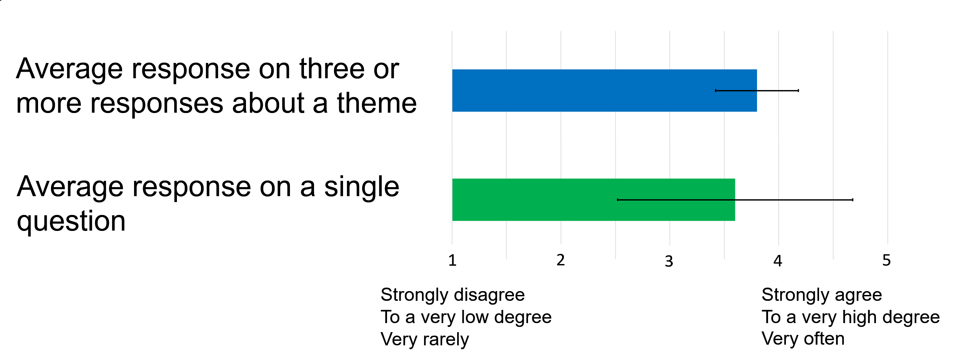
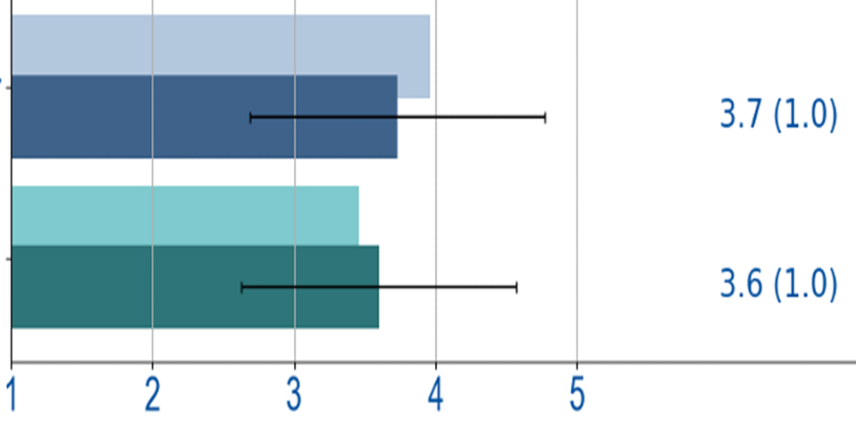
Presentation of the results – explanation
Aerage value is the endpoint of the column, value is specified to the right of the column.
The black horizontal line shows the standard deviation.
The line indicates whether the answers are similar (short line) or different (long line).
The darker bar shows the Dept of Public and Intl Law, the lighter bar the Faculty of Law
Notes:
The bar charts shows the average response on single questions (green charts) ore scales about a theme (blue charts) in the survey. The value is specified to the right of the column.
All responses are coded to make 5 the most positive response.
It was possible to choose five alternative responses to each statement. The end points was defined in three possible ways:
Strongly disagree / To a very low degree / Very rarely
Strongly agree / To a very high degree / Very often
In cases were the questions not are relevant for everyone to answer, “Not applicable" has been an answer option.
The standard deviation is an indication of variation from the mean and tell something about how much diversification there is in the data. The value is specified in parenthesis to the right of the average value.
Large standard deviation = The respondents have different experiences and are not giving a clear message.
Little standard deviation = The respondents have similar experiences and give a clear message.

Slide 12
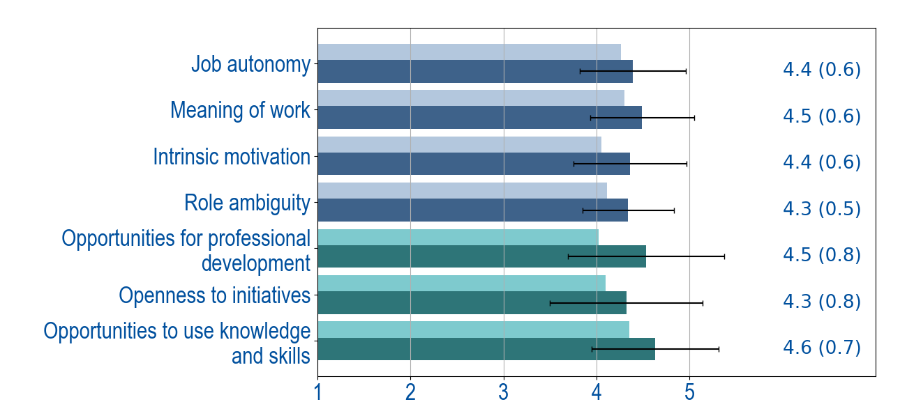
The individual and the job (the Dept’s score from here on)
Notes:
Answer option: 1 5
Job autonomy Strongly disagree Strongly agree
Maps the extent of autonomy and influence over how the work is carried out.
“I have a sufficient degree of influence in my work”
“I can make my own decisions on how to organize my work”
“There is room for me to take my own initiatives at work”
“I manage the working situation in the direction I want”
Meaning of work To a very low degree To a very high degree
Maps the respondents experience of having a meaningful work.
“My work tasks are meaningful”
“I feel that the work I do is important”
“I feel motivated and involved in my work”
Intrinsic motivation Strongly disagree Strongly agree
Maps whether the employees experience intrinsic job motivation. I.e. that they experience pleasure, interest and enjoyment in their jobs.
“My work tasks are in themselves an important driving force in my job”
“My work tasks are fun”
“My job is so interesting that it alone strongly motivates me”
“Now and then I am so inspired by my job that I almost forget things around me”
Role Ambiguity Strongly disagree Strongly agree
Maps whether employees have a clear picture of responsibilities, tasks and what is expected of them in their jobs.
“I have a clear understanding of the goals and objectives of my work”
“I know which tasks to prioritize if I don’t have enough time”
“I know what my responsibilities are”
Opportunities for professional
development To a very low degree To a very high degree
“My job offers good opportunities for professional development”
Openness to initiatives To a very low degree To a very high degree
“Initiatives are appreciated, so that one feels encouraged to take on new challenges”
Opportunities to use knowledge
and skills To a very low degree To a very high degree
“My work allows me to make use of my knowledge and skills”

Slide 13
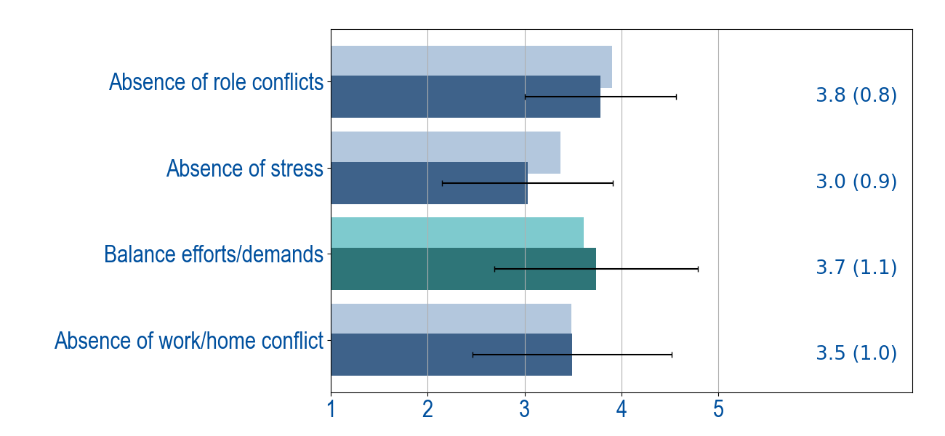
The individual and the job
Notes:
Three of these scales are reversed. It is thus the absence of the perceived situations that impacts the column.
Answer option: 1 5
Absence of role conflicts Very rarely Very often
Maps weather employees experience that there is conflicts between own roles, that different people expect different from them, or that it is conflict between you’re their own and others expectations.
“I must often do things that I feel should have been done in a different way”
“I am given assignments without adequate resources to complete them”
“I receive incompatible requests from two or more people”
“My job involves tasks that are in conflict with my personal values”
Absence of stress Very rarely Very often
The scale intends to map experiences of stress and excessive workload:
“I have too much work and too little time to do it”
“I feel as if I am never off work”
“I have a bad feeling when I think about my job”
Balance efforts / demands Very rarely Very often
“There is a well-balanced relationship between the performance demands of my job and my ability of meeting them”
Absence of work-home-conflict Very rarely Very often
A high score indicate that the respondents not experience that there is a work-home-conflict.
“Stress at work makes me irritable at home”
“My job makes me feel too tired to do the things that need attention at home”
“Job worries or problems distract me when I am at home”

Slide 14
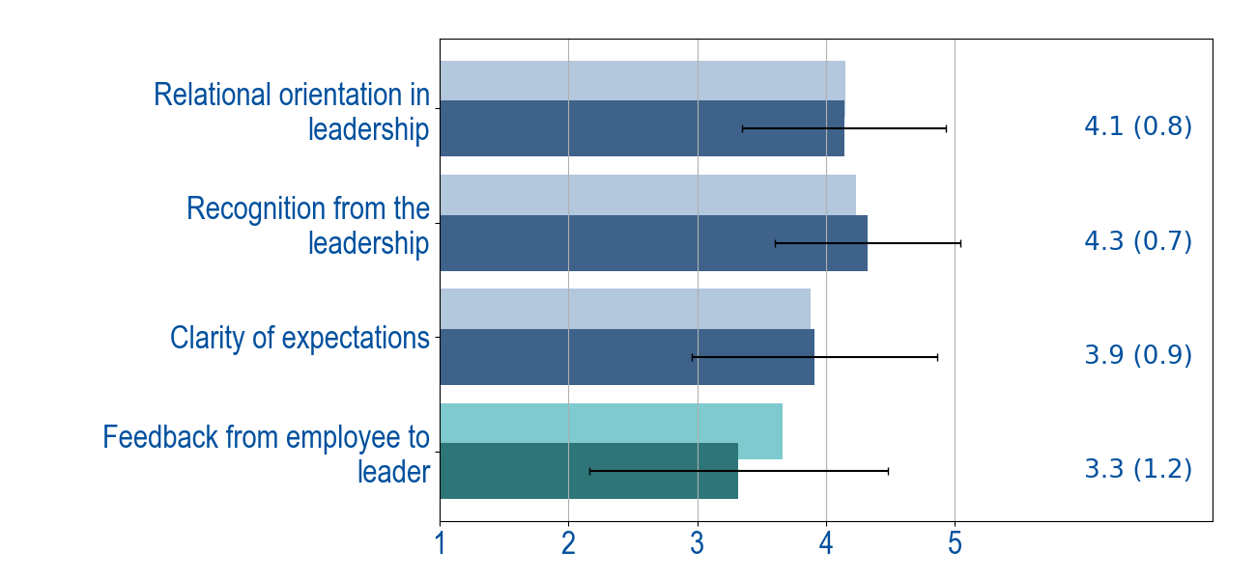
Interaction Leaders and Colleagues
Notes:
Answer option: 1 5
Relational orientation in leadership To a very low degree To a very high degree
Maps the employees' perception of the leader's relational orientation and facilitation:
“The unit management expresses confidence in my skills”
“The unit management facilitates the development of my autonomy”
“The unit management facilitates the development of my competence”
“The unit management makes me feel competent”
“The unit management spends time listening to me”
Recognition from the leadership To a very low degree To a very high degree
The scale capture to what extent the employees experience to be recognized.
“My work is recognized and appreciated by the unit management”
“I am respected by the unit management”
“I am treated fairly by the unit management”
Clarity of expectations Strongly disagree Strongly agree
The items measures to which purpose of one`s work tasks is clear.
“What is expected of me at work is clearly expressed”
“I have a clear understanding of which tasks constitute my job”
“I feel that the objectives of my job are diffuse and unclear” ®
Feedback from employee to leader To a very low degree To a very high degree
“I talk with The unit management about how s/he can help me perform well at work”

Slide 15
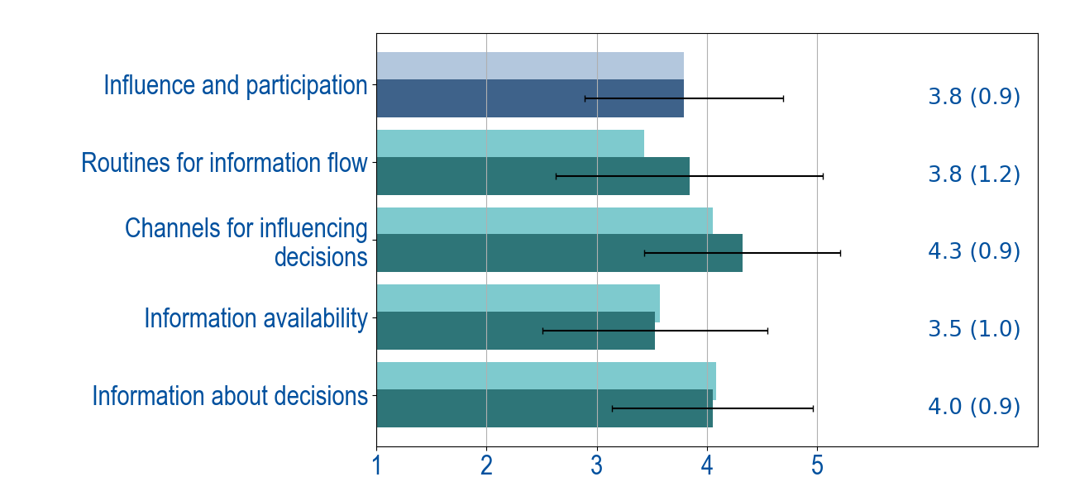
Communication and participation
Notes:
Answer option: 1 5
Influence and participation Strongly disagree Strongly agree
Maps whether employees feel encouraged to, or have the opportunity to participate in decision-making processes:
“We are encouraged to participate when important decisions are made”
“We are encouraged to express our views on planned decisions that affect our work”
“Only people in the management are involved in decisions that affect the unit's work”
Routines for information flow Strongly disagree Strongly agree
“We have efficient routines for the flow of information”
Channels for influencing decisions Strongly disagree Strongly agree
“I know what channels to use to influence decisions”
Information availability Strongly disagree Strongly agree
“It is easy to acquire the information I need to do a good job”
Information about decisions Strongly disagree Strongly agree
“I keep informed about important decisions that affect my work”

Slide 16
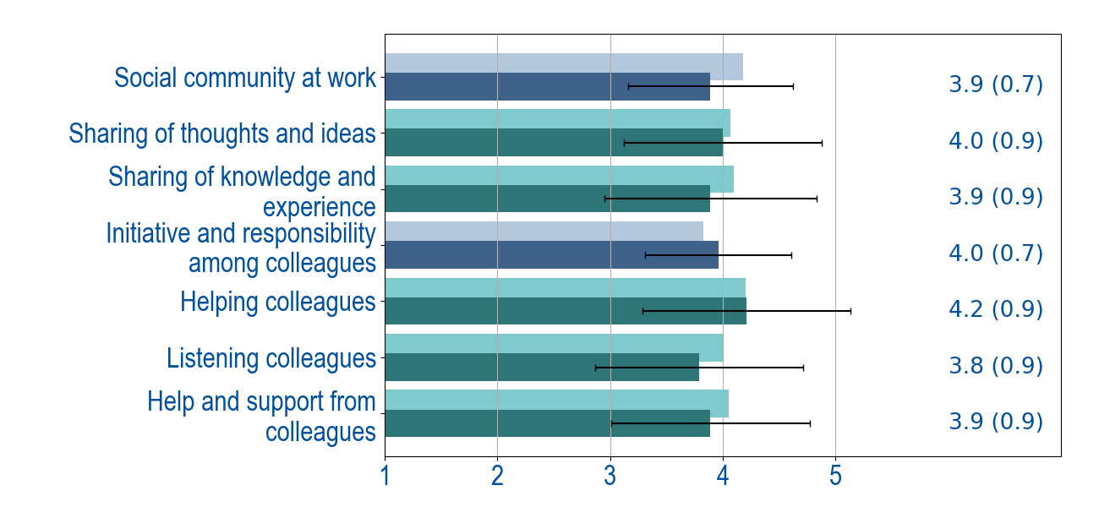
Collaboration and Cooperation
Notes:
Answer option: 1 5
Social community at work Very rarely Very often
Maps weather the respondents experience that there is a good social community at their unit:
“There a good atmosphere between my colleagues and myself”
“There is a good sense of fellowship at my unit”
“I feel that I am a part of a community at my unit”
Sharing of thoughts and ideas Very rarely Very often
“At my unit, we share thoughts and ideas”
Sharing of knowledge and experience Very rarely Very often
“At my unit, we share knowledge and experience”
Initiative and responsibility among
colleagues Very rarely Very often
The scale intends to map weather the employees experience to be part of the organization by taking responsibility for something beyond themselves:
“I take on tasks without being asked”
“I help others in my unit with tasks that are actually their own responsibility”
“I assist my colleagues, even when it strictly speaking is not part of my job”
Helping colleagues Very rarely Very often
“I help my colleagues succeed in their work”
Listening colleagues Very rarely Very often
“My colleagues are willing to listen when I face problems in my work”
Help and support from colleagues Very rarely Very often
“I get the help and support I need from my colleagues”

Slide 17
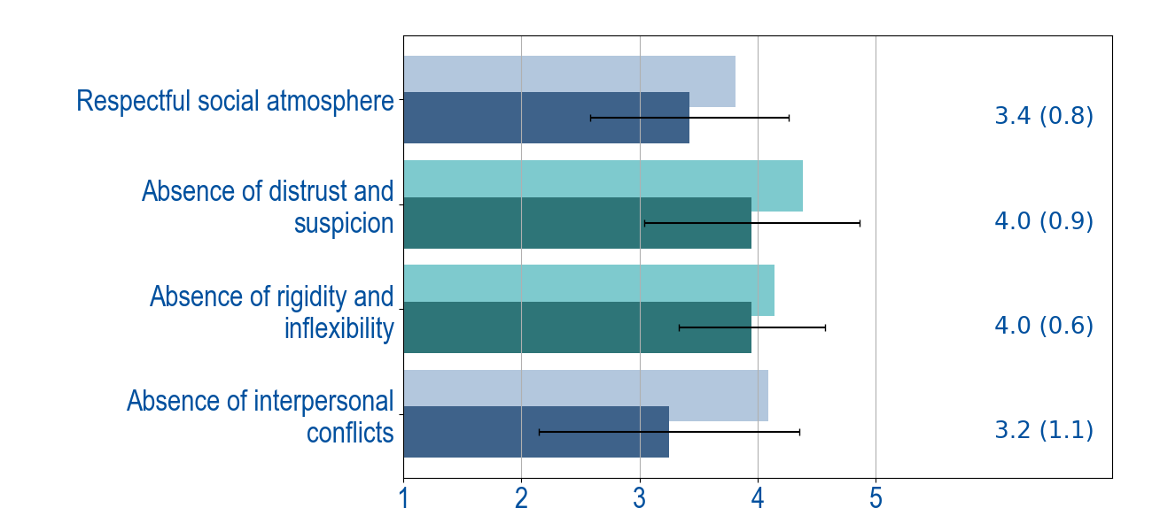
Collaboration and Cooperation
Notes:
These scales are reversed. It is thus the absence of the perceived situations that impacts the column.
Answer option: 1 5
Respectful social atmosphere Strongly disagree Strongly agree
The scale maps whether employees experience civility in the workplace, based on the assumption that this contributes to mutual respect:
“Rude behavior is not accepted at the unit”
“Angry outbursts are not tolerated at the unit”
“Generally, we have a respectful social atmosphere”
Absence of distrust and suspicion Strongly disagree Strongly agree
“The working climate at my unit is distrustful and suspicious”
Absence of rigidity and inflexibility Strongly disagree Strongly agree
“The working climate at my unit is rigid and inflexible”
Absence of interpersonal conflicts Strongly disagree Strongly agree
Map whether the employees experience being affected by interpersonal conflicts between colleagues:
“My work is hampered by power struggles at the unit”
“In my unit, intrigues impair the work climate”
“In my unit, there is a great deal of tension due to prestige and interpersonal conflicts”

Slide 18
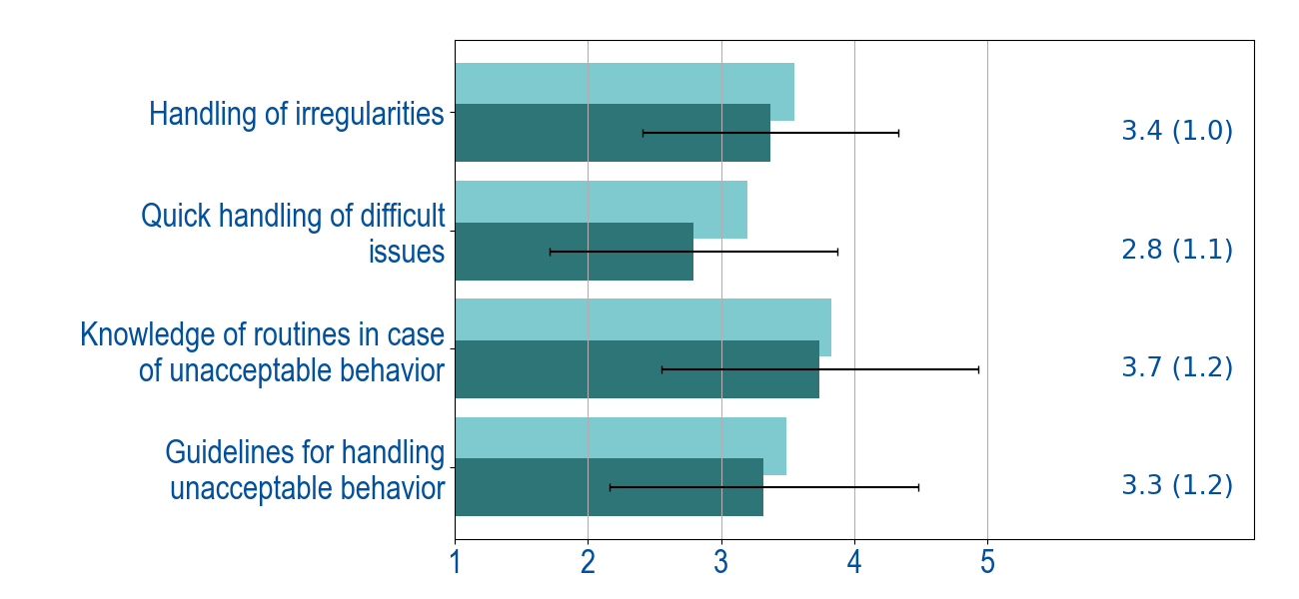
Dealing with unfavourable occurrences
Notes:
Answer option: 1 5
Handling of irregularities Strongly disagree Strongly agree
“In case of irregularities, we address the problem directly with the person involved”
Quick handling of difficult issues Strongly disagree Strongly agree
“In our unit, we address difficult issues as soon as possible”
Knowledge of routines in case of
unacceptable behavior Strongly disagree Strongly agree
“I know what to do if I or a colleague is subjected to bullying, harassment or other unacceptable behavior”
Guidelines for handling unacceptable
behavior Strongly disagree Strongly agree
“We have clear guidelines on how to proceed if someone is subjected to bullying or harassment”

Slide 19
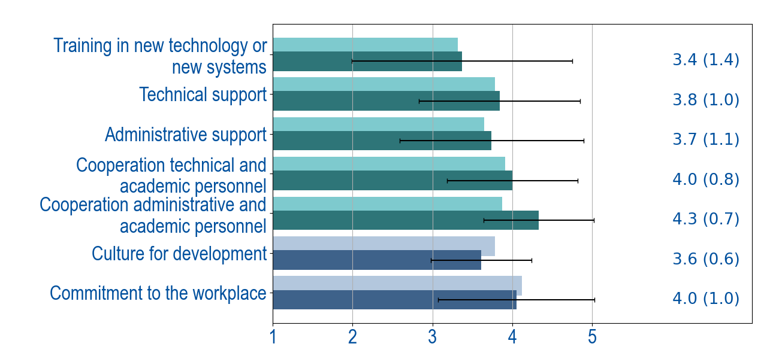
Support, social interaction and culture
Notes:
Answer option: 1 5
Training in new technology or
new systems To a very low degree To a very high degree
“I get the training I need when new technology or new administrative systems are introduced”
Technical support Very rarely Very often
“I get the technical support I need in my daily work”
Administrative support Very rarely Very often
“I get the administrative support I need in my daily work”
Cooperation technical
and academic personnel Very rarely Very often
“Cooperation between technical and academic personnel works well at our unit”
Cooperation administrative
and academic personnel Very rarely Very often
“Cooperation between administrative and academic personnel works well at our unit”
Culture for continuous
development Strongly disagree Strongly agree
Maps whether employees experience that there is a culture for continuous development in their unit:
“In my unit, no one listens to new suggestions and ideas” ®
“My unit is flexible and constantly adapts to new ideas”
“My unit is open-minded and adapts to changes”
Commitment to the workplace To a very low degree To a very high degree
A high score indicate that the respondents have a positive commitment to their workplace.
“I gladly tell others about my workplace”
“I would recommend a close friend to apply for a position at my workplace”
“My workplace is of great personal significance to me”

Slide 20
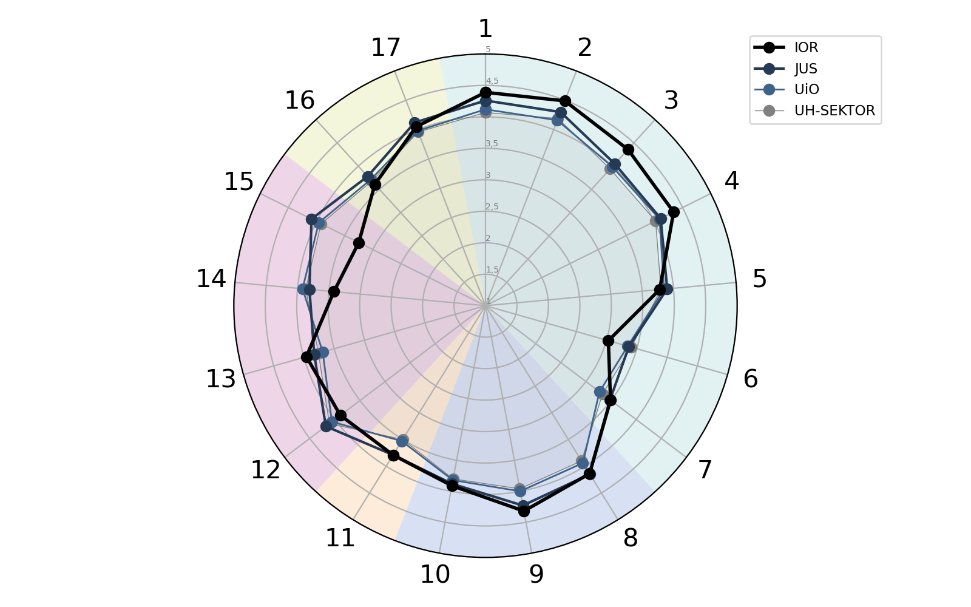
Summary
Support, social interaction and culture
17: Commitment to the workplace
16: Culture for continuous development
The individual and the job
1: Job autonomy
2: Meaning of work
3: Intrinsic motivation
4: Role ambiguity
5: Absence of role conflicts
6: Absence of stress
7: Absence of work/home conflict
Collaboration and cooperation
15: Absence of interpersonal conflicts
14: Respectful social atmosphere
13: Initiative and responsibility among colleagues
12: Social community at work
Interaction - Leaders and collegaues
8: Relational orientation in leadership
9: Recognition from the leadership
10: Clarity of expectations
Communication and participation
11: Influence and participation
Notes:
This summary shows how each unit's response to the scales in the questionnaire compared to the hierarchical units above. The optional modules and the single questions are not included in this summary. The summary can therefore only be seen as a rough overview.
In the process of identifying issues that need to be preserved or improved, the summary should be used together with the single questions and other important issues at the unit.

Slide 21
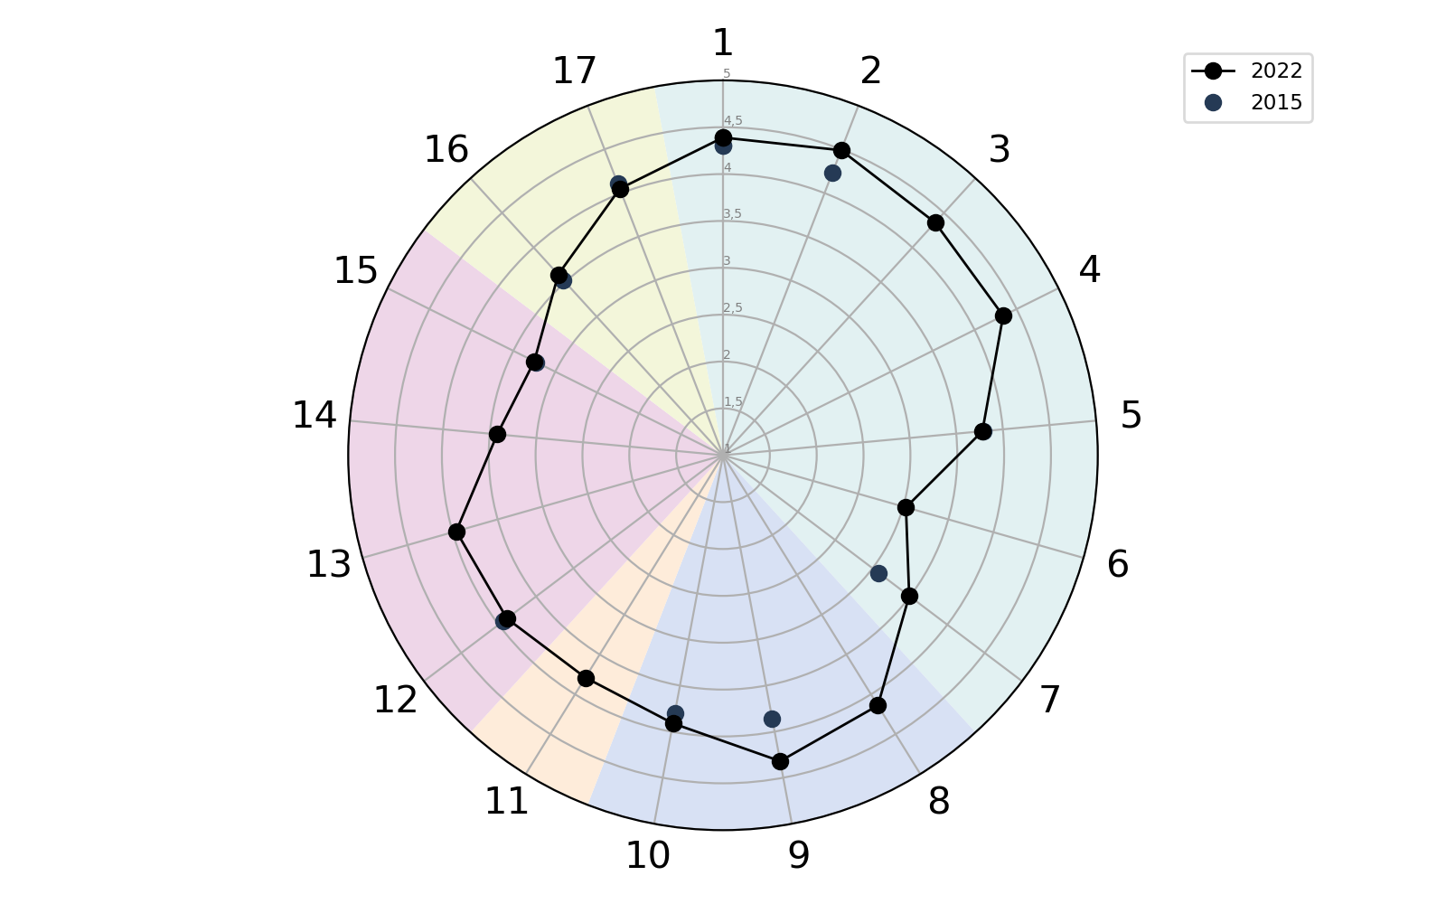
Comparison over time, own unit
Support, social interaction and culture
17: Commitment to the workplace
16: Culture for continuous development
The individual and the job
1: Job autonomy
2: Meaning of work
5: Absence of role conflicts
7: Absence of work/home conflict
Collaboration and cooperation
15: Absence of interpersonal conflicts
12: Social community at work
Interaction - Leaders and collegaues
9: Recognition from the leadership
10: Clarity of expectations
Notes:
In this summary, results are presented over time for the unit. Only the scales that have always been part of the questionnaire are included.
Be aware that the questions have been slightly altered since the last survey 2015.

Slide 22
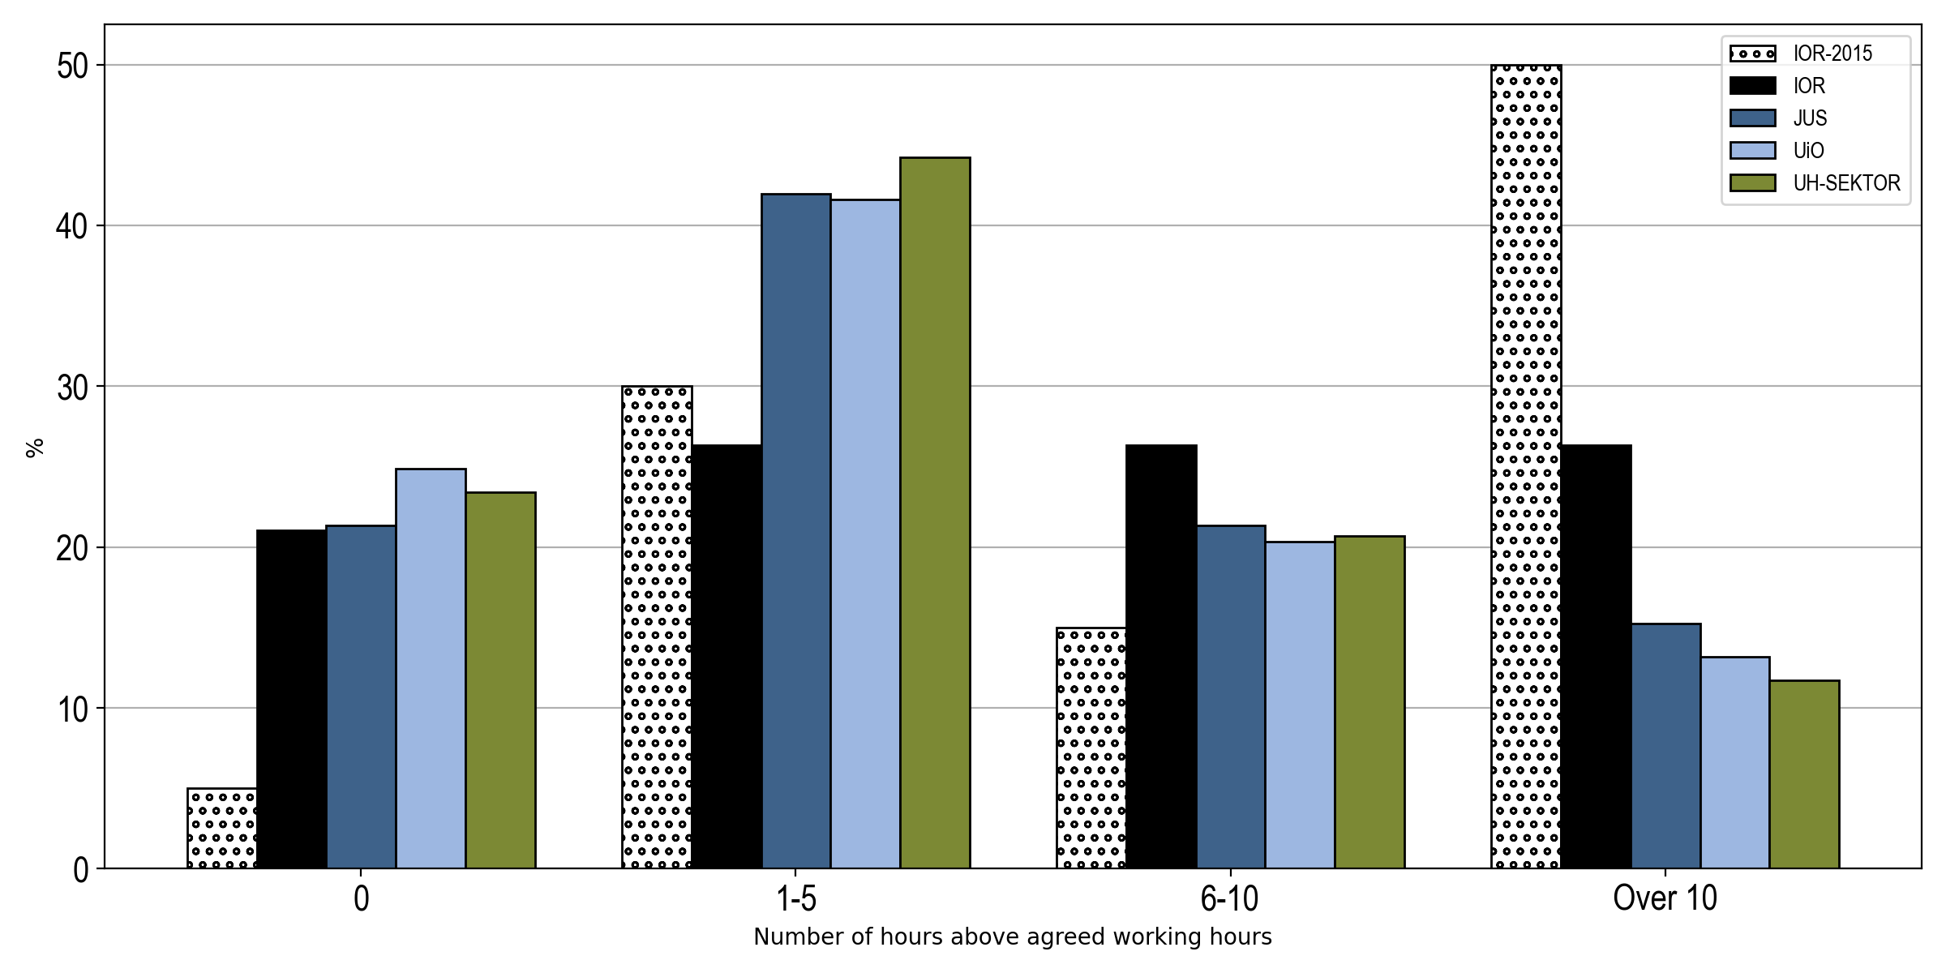
Working hours
Notes:
What kind of working hours arrangement do you have?
Employees who responded that they have clearly defined fixed or flexible working hours (applies to almost all technical/administrative staff, including research assistants), got this question:
“Not counting hours for which you receive compensatory time off (‘avspasering’), how many hours over and beyond your agreed working hours do you normally work per week?”
Employees who responded that they have ‘Independent position’ without clearly defined working hours (applies to academic personnel, including research fellows, rectorate, deans and some others in the top management)
Or
“Not sure / don’t know”, got this question:
“How many hours do you normally work per week in addition to what you find reasonable for your position?”
In the presentation of the results, the two questions are combined.
The purpose of these questions is to make an overview of working hours that can be seen as problematic. High incidence of extra work should be seen in the context of the scales: "stress", "work-home conflict", "role conflict" and the single question "experience of balance between effort and demands". See the second slide "The individual and the job"

Slide 23
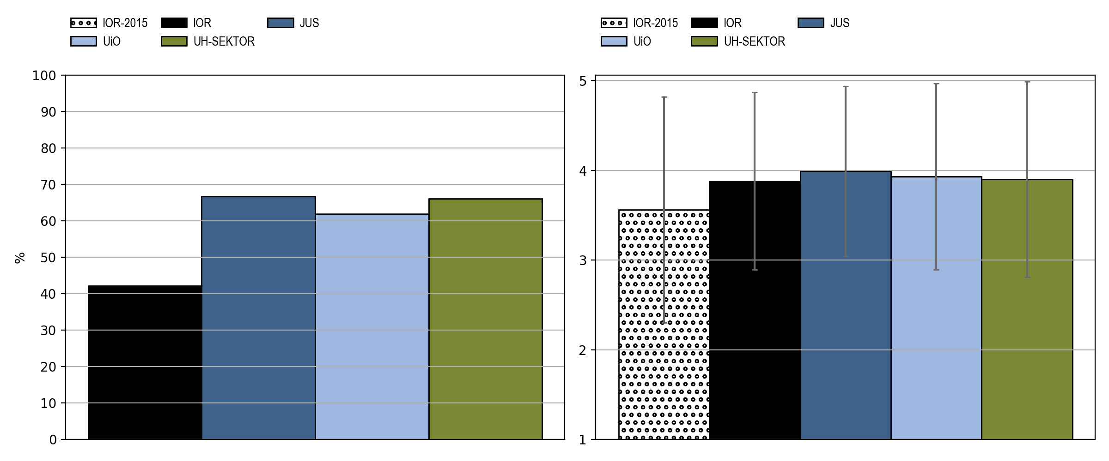
Employee review
Have you had an employee review during the last 12 months?
Percent replying «yes»
Mean experienced utility value of the employee review
Notes:
On the scale from 1 – 5, how do you feel about the employee review(s) you have had during the last 24 months?
1 = A waste of time
5 = Very positive
The black vertical line in the diagram, which shows the value of the employee review, shows one standard deviation in each direction.

Slide 24
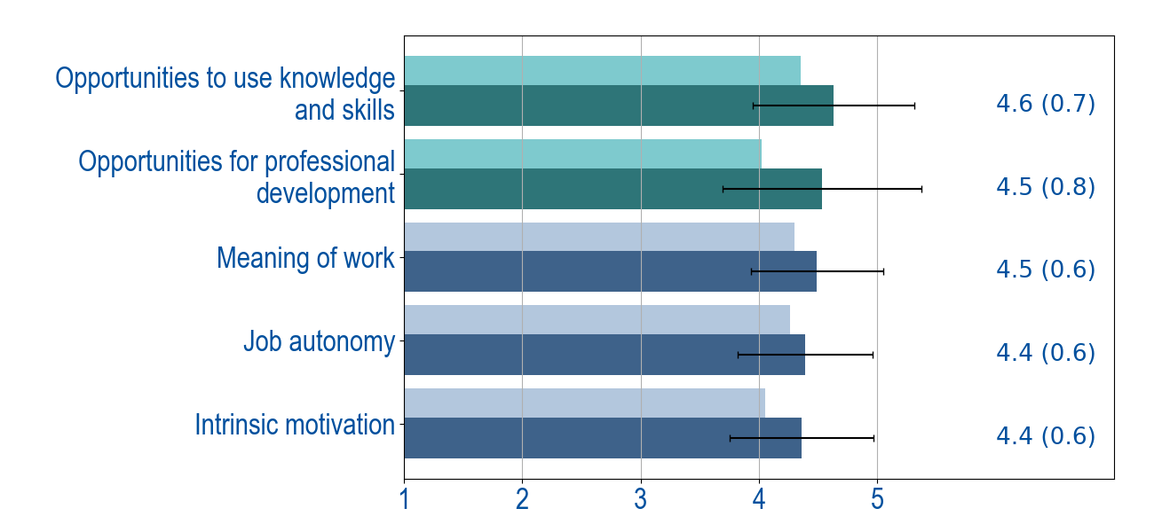
Top scores

Slide 25
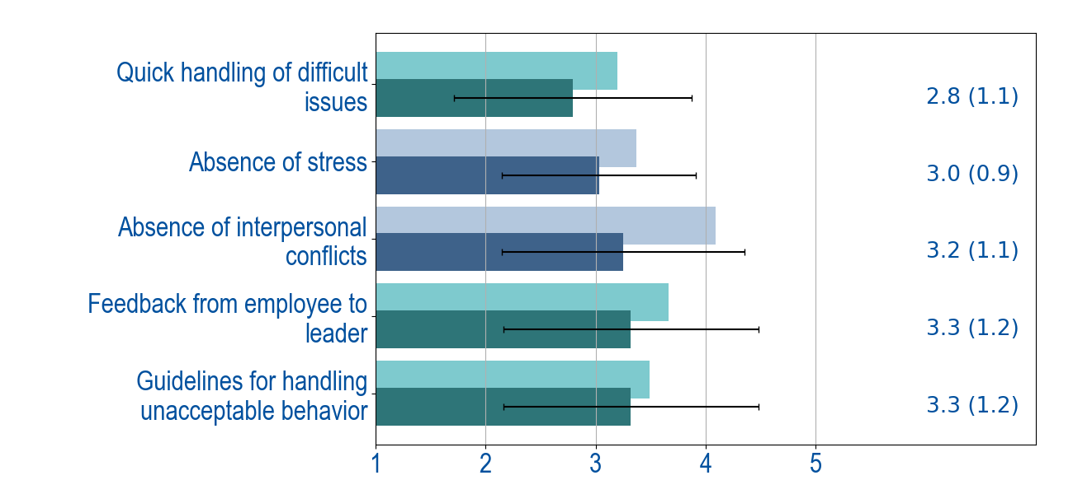
Lowest scores

Slide 26
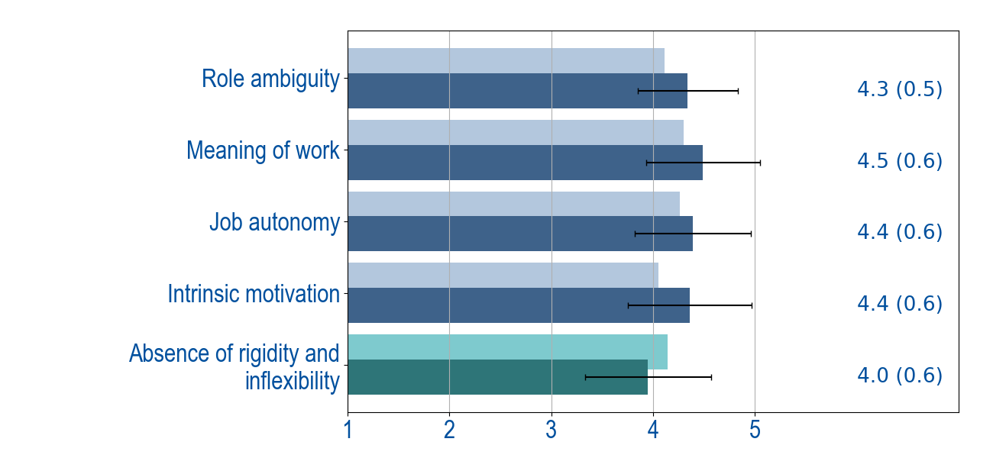
Top agreement
Notes:
Equal answers indicate equal experiences.
It may be that the conditions that emerge here are important positive conditions you should take care of.
In cases where there are similar experiences of more negative conditions, this can be an important signal that something needs to be improved.

Slide 27
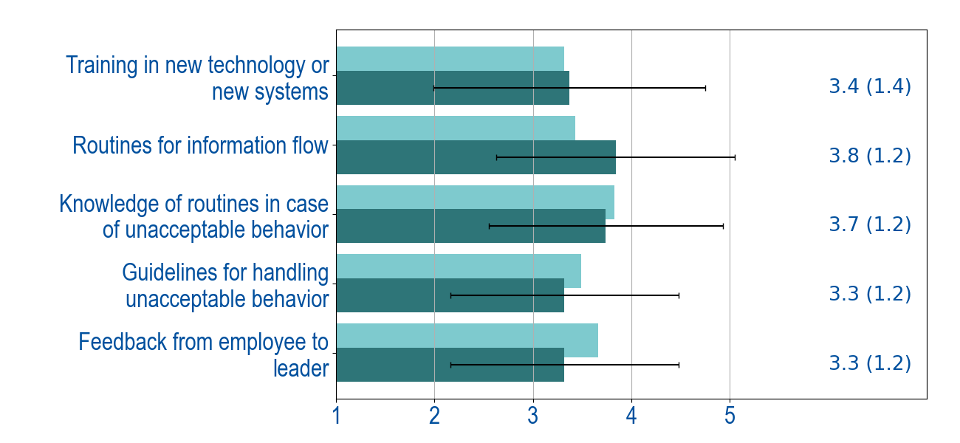
Top disagreement
Notes:
We do not know how the answers have been distributed. We only know that there are different experiences.
Variations in the answers can be both positive and potentially problematic. What these different experiences are about will depend entirely on the situation one is in.
It may be that conditions that emerge here form the basis for assessment of whether something must be taken into account in particular in the work environment work.

Slide 28

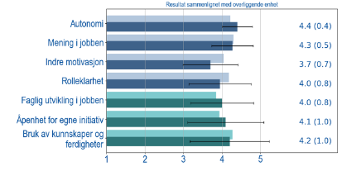


Complete mapping (1) and (2) and develop measures (3)
Create a common understanding of the report and consider other important factors
Decide on areas to preserve and areas to improve
3. Develop and prioritize measures​​
Proposals for
work environment improvement measures and actions
Report from the survey
Areas to preserve and to improve
Other important factors
Notes:
Excamples of other important areas:
- Home office
- Pandemic
- Different localisation (8 campus)
- Resources
- Create frameworks for addressing topics one may disagree on (ytringsklima)
Keep the focus on what it is possible to do in your own unit. Areas outside your own unit have to be taken care of by others.
It is possible to do part 1 and 2 in the same meeting.

Slide 29
Other conditions that are important to include?
Internally in own unit:
Experiences from the coronaperiod
Internal organization, meeting structures, projects and processes
Cultural diversity
Geographical location
Conditions outside own unit:
Collaborate with other entities across the organization
Management and organizational matters at the upper level
Overall systems and structures
    Organization, meeting structures, projects and processes
    Digital tools and systems
Notes:
Not all conditions can be mapped in a good way in a questionnaire. In the process of finding conditions that are to be improved or preserved, it is therefore important to have room for it to be completely different conditions than those that have been mapped, which turn out to be the ones to work on.
There may be some of the points pointed out in the slide, but there may also be completely different conditions.
It may be appropriate to collect these inputs on a parkinglot, a digital "board“ or a separate flipchart.
When it comes to conditions outside one's own unit from the parkinglot, they must be brought to the forums where they can be influenced. They should also be brought into management teams and coordinated with matters pointed out by other units. The manager is responsible for this happening. The safety representative must ensure that this is done.

Slide 30
Focus on the areas you can influence
External factors
Small degree of influence
Demands
and expectations
of the
Government
Overlying Unit
Some degree of influence
Norwegian laws
Circle of influence
Administrational systems
UiO policy and guidelines
My own unit
and myself
High degree of influence
Collaboration, communication, collegiality, organization of the work, development of competence tools, relationships, methods of work, culture…
Framework
Model of Financing
Organization of overlying units
Leadership and organizational culture
Pandemic
Decision making structure

Slide 31
Guidelines for group work
Getting organized
Choose a spokesperson – responsible for seeing that everyone has a chance to speak and be heard
Choose a note taker – responsible for writing down the group's answers
Guidelines
Nothing is right or wrong
Everyone has knowledge that is important– be open-minded
Ask clarifying questions – important to listen and be curious
Look ahead and seek common understanding

Slide 32
Reach areas to preserve and develop:
Individual reflection: Which three conditions are you most happy with? Which three conditions do you think are most important to improve?
Group work: Share your individual reflections.
Come to an agreement on the four areas you think are the most important to continue working on.
3. Plenary: The groups present for each other what they have come up with. Select the areas that you think are most important for your unit to work on.

Slide 33
Help questions for identifying conservation and development areas:
What are you most satisfied with in the report?
What were you most suprised about in the report?
What can this say about us as a group?
What positive effects does this factor contribute to you / us?
Which of the factors with the lowest score do you think is most important to improve?
What do you hope can be the effect of improving these? What can be the first step in the right direction?

Slide 34
Arrange measures
Make sure to come up with a rich supply of ideas for possible actions.
Concretize the ideas and what they will be able to contribute.
What measures will you prioritize to implement?
Create and action plan (who will do what when)

Slide 35
Help questions for initiative development:
Why is this important?
What can this help us to achieve?
What is it important that we continue with?
What does it look like if we succeed?
What do we do in other ways?
How do we see that this measures has been implemented? What would change?
Notes:
These help questions can be used when assessing if ideas that come up are realizable and effective.

Slide 36
ACTION PLAN
Conservation / Development area | Description of measures | GOALS (as specific as possible) | Responsible | Responsible | Deadline (evaluated / Completed) | Deadline (evaluated / Completed)
For example clearer roles in the management team. | Monthly meetings with group leaders. Regular discussions about what should be taken care of by whom. | Clear roles and good role understanding among both managers and employees. | Head of department. Everyone is responsible for participating | Head of department. Everyone is responsible for participating | Start-up Immediately. Evaluation after ½ years | Start-up Immediately. Evaluation after ½ years
​Online allmeetings | ​Continue the digital general meetings that the leader introduced during the corona era. | ​Everyone gets direct information from the leader regardless of location. | ​Department manager | ​Department manager | ​Continuation. | ​Continuation.
Direct participation at a large department | The head of department participates in the subject group meetings at least once a semester and / or in strategically important matters. | Employees can discuss with and give direct input to the head of department. | Department and subject group leader | Department and subject group leader | Will be tested in 2022 | Will be tested in 2022
Research forum | Create and arena for sharing research results – your own and others’. An hour-long extended lunch meeting every other Thursday | Build competence and inspiration for research and teaching. | Per and Lise | Per and Lise | Start-up after Easter | Start-up after Easter
Conditions to be taken to other levels in the organization:
Description of the problem, purpose and possible proposals for measures |  | Responsible for dissemination | Adressed |  | Feedback about solution
​Different description of routines in connection with stays abroad. Different allocation of research terms. |  | ​Head of department | ​The management team |  | ​
Notes:
It can take time to concretize an action plan. If you do not finish during the mapping meeting, the groups can continue the work later.
In cases where it is necessary to supply resources in the form of people or money, the management of the unit must be connected. Some measures may also need to be included in the budget process.
Those who are given responsibility for implementing measures are also responsible for including the others in the work and evaluation of the measure.
How many measures should be included in the action plan? This is considered in each individual process. Remember that it is better to have few measures that are implemented, than many that are not.

