Slide 1
PIL PROGRAM
Cecilia M. Bailliet

Slide 2
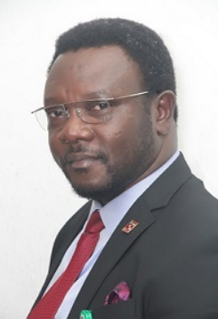
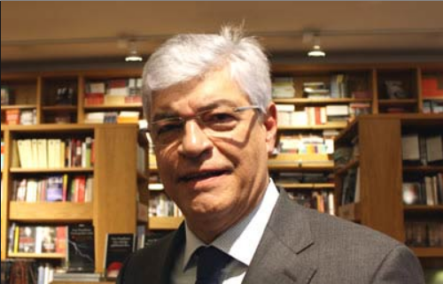
PIL Masters began 2003 with 11 students (11 applications) and now has 39 students (449 applications)
Countries: Afghanistan (1), Albania (2), Antigua and Barbuda (3), Argentina (4), Australia (5), Austria (6), Azerbaijan (7),
Bangladesh(8), Belarus (9), Bosnia-Hercegovian (10), Brazil (11), Bulgaria (12), Cameroon (13), Canada (14), Czech Rep. (15), Chile (16)
China (17) Colombia (18), Costa Rica (19), Croatia (20), Egypt (21),
Eritrea (22), Estonia (23), Ethiopia (24), Finland (25), France (26), Gambia (27), Georgia (28), Germany (29),
Ghana (30), Great Britain (31), Greece (32), Honduras (33), Hungary (34), Iceland (35), India (36), Iran (38),
Ireland (39), Israel (40), Italy (41), Jamaica (42), Kenya (43), Kzakhstan (44), Kirgistan (45), Lebanon (46), Libya (47),
Lithuania (48), Malawi (49), Malaysia (50), Mexico (51), Montenegro (52), Nepal (53), Netherlands (54), New Zealand (55),
Nigeria (56), North Macedonia (57), Norway (58), Pakistan (59), Palestine (60), Paraguay (61), Peru (62), Philippines (63),
Poland (64), Portugal (65), Romania (67), Russia (68), Serbia (69), Slovakia (70), Slovenia (71), Somalia (72), South Korea (73),
Spain (74), Sri Lanka (75), Sweden (76), Switzerland (77), Tajikistan (78), Tanzania (79), Thailand (80), Trindad and Tobago (81),
Turkey (82), Uganda (83), Ukraine (84), USA (85), Uzbekistan (86), Venezuela (87), Vietnam (88), Zimbabwe (89)
Problem: We no longer receive students from Africa!
We currently have 13 Norwegians in PIL
We have had ambassadors as students and lecturers!!!
Our graduates have become International Law Professors,
Advisors to Presidents, or work in Ministries and IOs.

Slide 3
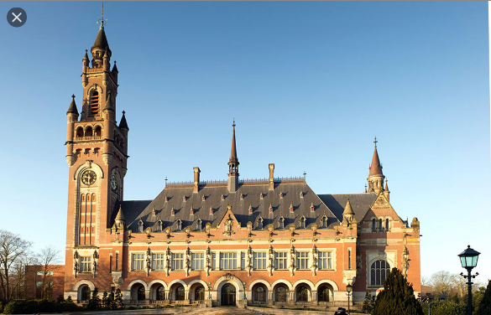
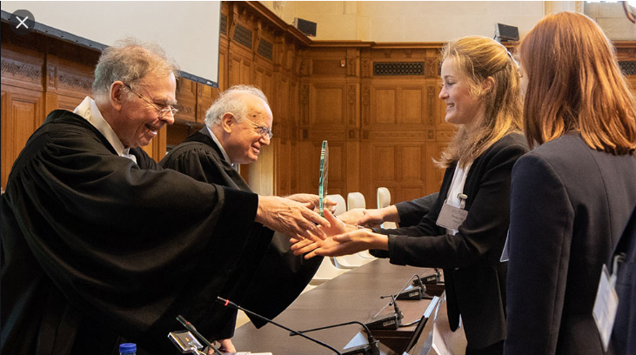
Study Trip-Telders Moot Court
There were three study trips to the Hague
to visit the ICJ, ICC, PCA, etc. in 2007-2009.
Students attended hearings, met with
Judges, Lawyers,
The trips were cancelled for lack of funding.
Telders Moot Court since 2010-
We won in 2012!!!!
Budget- We used to have 70.000 to cover
the trips, moot court, etc. This was cut.
The Faculty does not give us money but
has paid for Telders.
IOR has given us symbolic support for pizza
and diploma ceremony.

Slide 4
Specializations until 2020
LL.M. in Public International Law
LL.M. in PIL with programme option in International
Criminal and Humanitarian Law
LL.M. in PIL with programme option in International
Environmental and Energy Law
LL.M. in PIL with programme option in International
Trade, Investment and Commercial Law
LL.M. in PIL with programme option in Human Rights
Common Obligatories were PIL Class, Legal Writing, and Masters Thesis
Additional Obligatory classes related to specializations

Slide 5
Reform
PIL Masters Recommendation made to cut Legal Writing and Oral Advocacy Course because of Si Fra complaint and student attrition, but this was an SMR course so it was not cut
Law of the Sea was cut, International Arbitration was cut
IOR chose to offer Trade every other year,
End of PIL Specializations
But students continue to seek to specialize in Trade Law, Employers need the competence, and the World Trade System is fragmented at present requiring attention by law schools

Slide 6
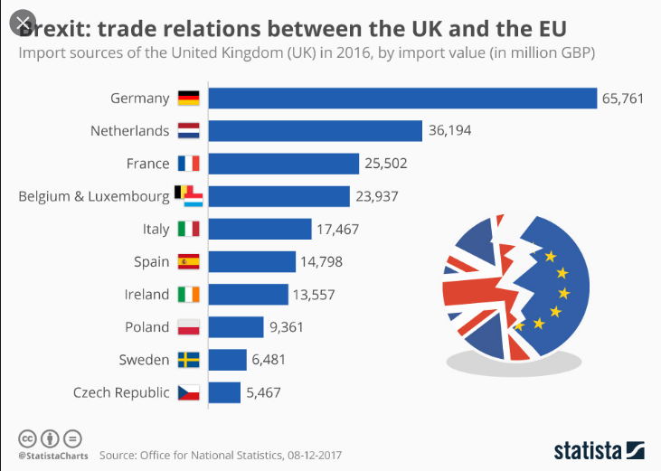
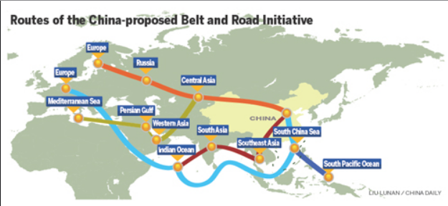
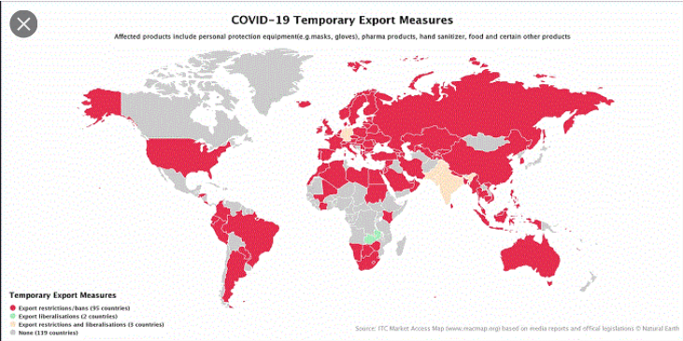
International Educational Market- LLMs with Trade Law/International Economic Law NO other LLM has courses every other year
University of Amsterdam
University of Rotterdam
University of Maastricht
University of Vienna
University of Helskini
Utrecht University
Tilburg University
University of Groningen
University of Leiden
University of Edinburgh
University of Essex
University of Manchester
Stockholm University
University of Leuven

Slide 7
New Program Structure after Loss of Trade Law- Fall Semester
One Obligatory: JUS5540 – Public International Law
JUS5503 – Human Rights and Counter-Terrorism: Striking a Balance? (Every other autumn starting)
JUS5134 – International Law of Peace (Every other autumn)
JUS5520 – International Environmental Law
JUS5730 – International Humanitarian Law (The Law of Armed Conflict)
JUS5850 – International Trade Law (Every other autumn starting 2019)

Slide 8
Due to the cut of electives, PIL Students chose Electives from Other Programs, unfortunately they were scheduled at the same time as PIL
JUS5540 – Public International Law Monday 14:15-16:00
JUS5690 – Robot Regulation Monday 14:15-16:00
HUMR5131 – Human Rights in History, Philosophy and Politics Monday 14:15-16:00

Slide 9
Spring Semester
JUS5530 – Refugee and Asylum Law
JUS5560 – International Constitutional Law and Democracy
JUS5570 – International Criminal Law
JUS5630 – Privacy and Data Protection
JUS5851 – International Investment Law
JUS5910 – Women's Law and Human Rights
JUS5911 – International Climate Change and Energy Law

Slide 10
External Panel Review of PIL 2016
Prof. Dr. Jan Wouters, chair (Full Professor of International Law and International Organizations, Director of the Leuven Centre for Global Governance Studies and the Institute for International Law, University of Leuven),
Mr. Fredrik Bockman Finstad (Deputy Director General, Norwegian Ministry of Justice and Public security),
Mrs. Margit F. Tveiten (Director General, Norwegian Ministry of Foreign Affairs), and
Ms. Nina Kolbe (student at the Oslo Public International Law Programme).
Trade Law, Sanctions, and Law of the Sea relevant to Ministry of Foreign Affairs

Slide 11
UD Rettsavdeling
Rettsavdelingen er juridisk ekspertorgan for regjeringen og sentralforvaltningen, med et særlig ansvar for samordning av norske folkerettslige synspunkter i internasjonale fora. Sentrale arbeidsområder er internasjonal havrett, FN-rett, WTO-rett, EØS-rett, traktatrett og immunitetsspørsmål, miljørett, menneskerettigheter, humanitærrett, internasjonal strafferett, sanksjoner og restriktive tiltak
Regjeringsadvokatembetet om å føre saker for disse organer. Avdelingen har for tiden 38 medarbeidere fordelt på Seksjon for humanitær- og strafferett, Seksjon for traktat-, miljø- og havrett, og Seksjon for EØS- og handelsrett.

Slide 12
Need to Restore International Economic Law Specialization by offering Trade Law every year
Obligatory Elements:
Public International Law
International Trade Law
International Investment Law
International Commercial Law

