Slide 1
In-depth review of the results from the survey for
Department of Mathematics PhD research Fellows

Slide 2
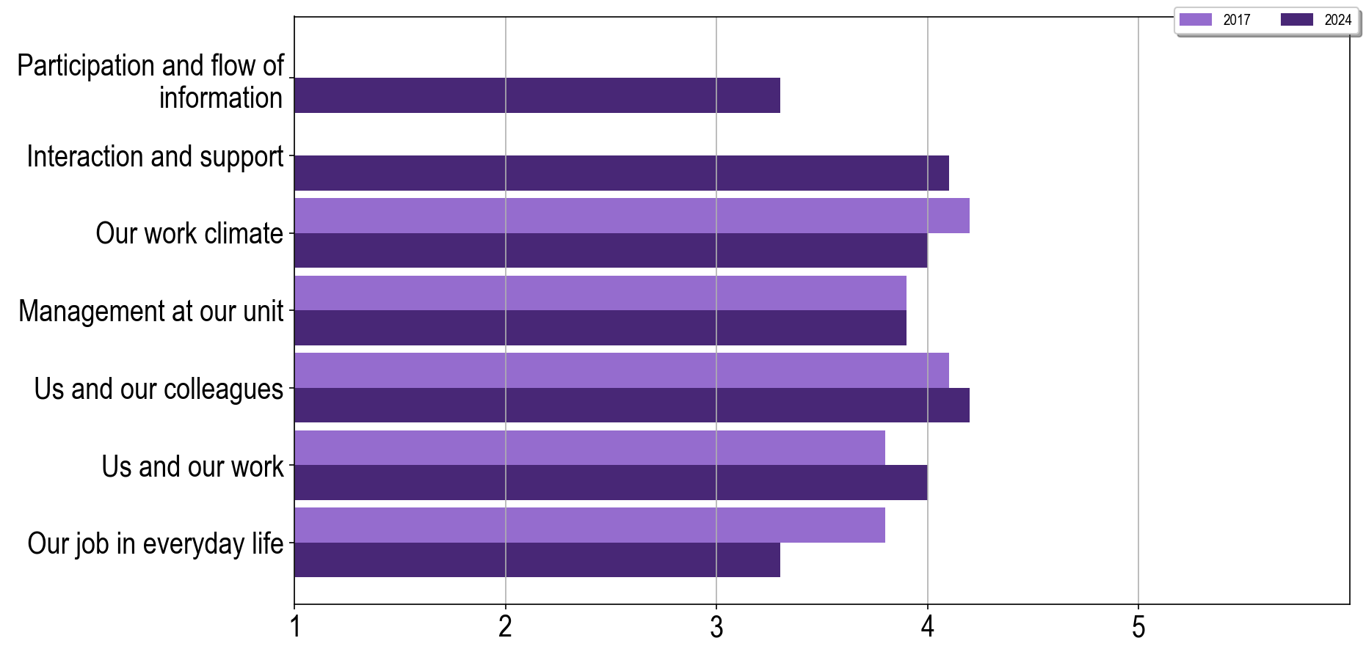
Development in Our Work Environment
Notes:
On this slide, you can find an overview of the different levels of measures that are screened in the work environment survey. More detailed information about what has been measured within the different levels will be presented on the following slides

Slide 3
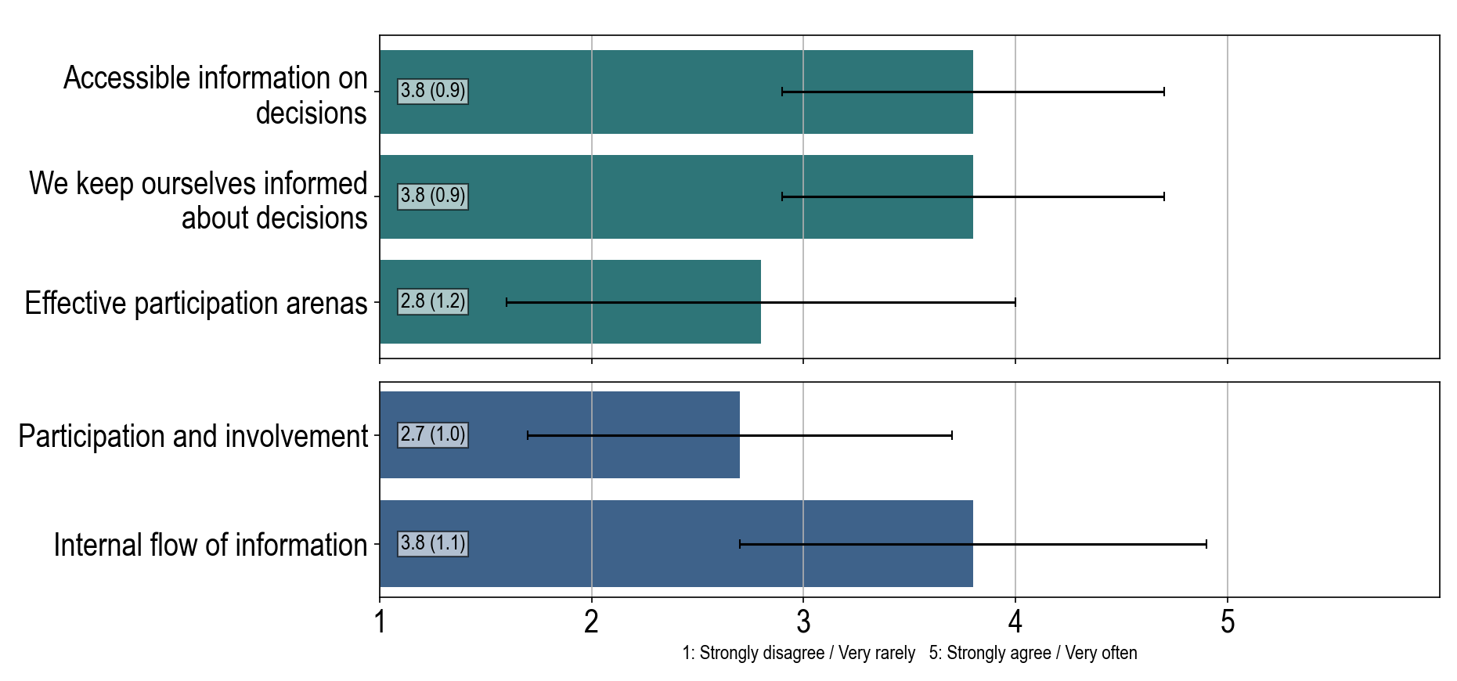
Participation and flow of information
Notes:
More information about the variables: Accessible information on decisions At my unit, it is easy to stay informed about important decisions concerning my work: 3.8(0.9) 1: Very rarely - 5: Very often We keep ourselves informed about decisions I try to keep informed about important decisions concerning my work: 3.8(0.9) 1: Very rarely - 5: Very often Effective participation arenas At my unit we have functional arenas in which we can participate regarding decisions that affects work: 2.8(1.2) 1: Strongly disagree - 5: Strongly agree Participation and involvement: 2.7(1.0), is a scale variable calculated from: At my unit we are encouraged to participate when important decisions are being made: 2.7(1.1) 1: Strongly disagree - 5: Strongly agree At my unit we are encouraged to express our views on planned decisions that affect our work: 2.8(1.2) 1: Strongly disagree - 5: Strongly agree At my unit only the management is involved in important decisions (R)*: 2.6(1.0) 1: Strongly disagree - 5: Strongly agree Internal flow of information: 3.8(1.1), is a scale variable calculated from: At my unit it is easy to find the information I need to do my job: 4.0(1.0) 1: Strongly disagree - 5: Strongly agree At my unit we have good procedures for internal information flow: 3.3(1.3) 1: Strongly disagree - 5: Strongly agree At my unit there is room to communicate what I need to do my job: 4.1(1.1) 1: Strongly disagree - 5: Strongly agree

Slide 4
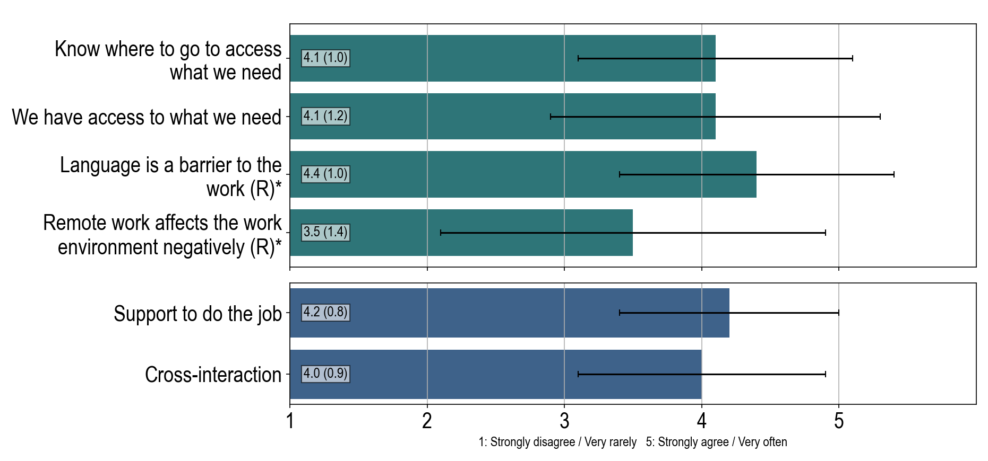
Interaction and support
Notes:
* These questions were originally negatively formulated, here they are reversed so that a higher score represents a positive outcome. More information about the variables: Know where to go to access what we need In my everyday working life I know where to go to get access to what I need: 4.1(1.0) 1: Very rarely - 5: Very often We have access to what we need In my everyday working life I have access to what I need: 4.1(1.2) 1: Very rarely - 5: Very often Language is a barrier to the work (R)* At my unit, language is a barrier in the planning and execution of work (R)*: 4.4(1.0) 1: Strongly disagree - 5: Strongly agree Remote work affects the work environment negatively (R)* Working from home negatively affects the work environment at my unit (R)*: 3.5(1.4) 1: Strongly disagree - 5: Strongly agree Support to do the job: 4.2(0.8), is a scale variable calculated from: In my everyday working life I receive the administrative support I need: 4.1(0.9) 1: Very rarely - 5: Very often In my everyday working life I receive the technical support I need: 4.2(0.9) 1: Very rarely - 5: Very often Cross-interaction: 4.0(0.9), is a scale variable calculated from: The interaction between UN and AD works well at our unit: 3.8(1.1) 1: Strongly disagree - 5: Strongly agree The interaction between UN and ST works well at our unit: 4.2(0.9) 1: Strongly disagree - 5: Strongly agree The interaction between AD and ST works well at our unit: 4.2(1.0) 1: Strongly disagree - 5: Strongly agree

Slide 5
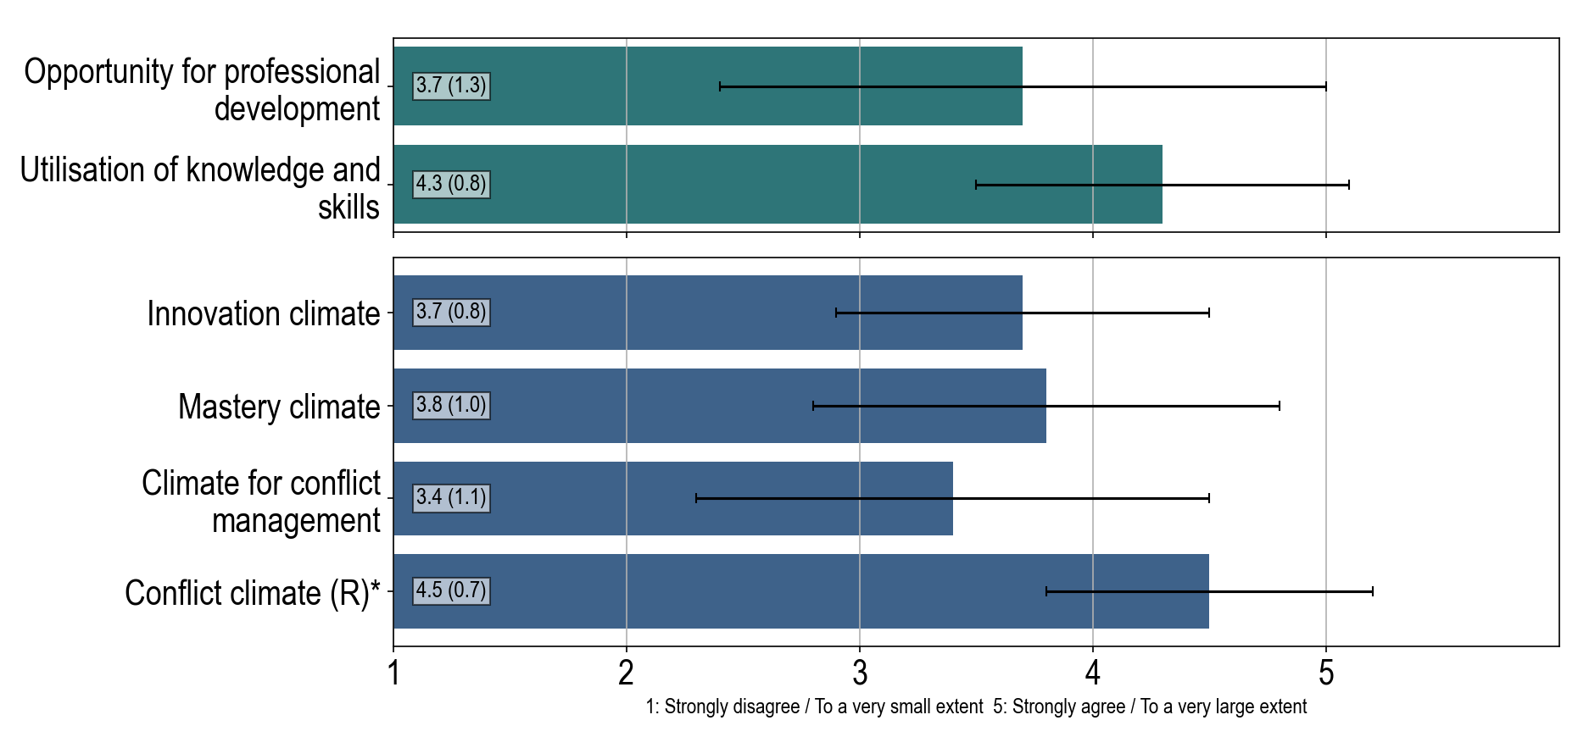
Our work climate
Notes:
* These questions were originally negatively formulated, here they are reversed so that a higher score represents a positive outcome. More information about the variables: Opportunity for professional development At my unit I have good opportunities to develop professionally in my job: 3.7(1.3) 1: Strongly disagree - 5: Strongly agree Utilisation of knowledge and skills At my unit I get to use my knowledge and skills at work: 4.3(0.8) 1: Strongly disagree - 5: Strongly agree Innovation climate: 3.7(0.8), is a scale variable calculated from: At my unit there is no one who listens to new proposals and ideas (R)*: 3.7(0.9) 1: Strongly disagree - 5: Strongly agree At my unit we are flexible and open to new ideas: 3.7(1.0) 1: Strongly disagree - 5: Strongly agree At my unit we are open to and adapt to changes: 3.9(0.9) 1: Strongly disagree - 5: Strongly agree Mastery climate: 3.8(1.0), is a scale variable calculated from: At my unit learning and development are prioritized: 3.7(1.2) 1: Strongly disagree - 5: Strongly agree At my unit we share ideas and knowledge with each other: 3.9(1.2) 1: Strongly disagree - 5: Strongly agree At my unit there is room to try out new ways of working: 3.7(1.1) 1: Strongly disagree - 5: Strongly agree Climate for conflict management: 3.4(1.1), is a scale variable calculated from: At my unit irregularities are addressed with the person involved: 3.4(0.8) 1: Strongly disagree - 5: Strongly agree At my unit the management addresses problems as soon as they arise: 3.0(1.5) 1: Strongly disagree - 5: Strongly agree At my unit difficult issues are addressed as soon as they arise: 3.6(1.1) 1: Strongly disagree - 5: Strongly agree At my unit I feel that it is safe to report adverse incidents if they occur: 3.6(1.6) 1: Strongly disagree - 5: Strongly agree Conflict climate (R)*: 4.5(0.7), is a scale variable calculated from: At my unit power struggles make it difficult to get the job done (R)*: 4.5(0.9) 1: To a very small extent - 5: To a very large extent At my unit the work environment is negatively affected by intrigues (R)*: 4.4(0.7) 1: To a very small extent - 5: To a very large extent At my unit there is a lot of tension due to prestige (R)*: 4.5(0.7) 1: To a very small extent - 5: To a very large extent

Slide 6
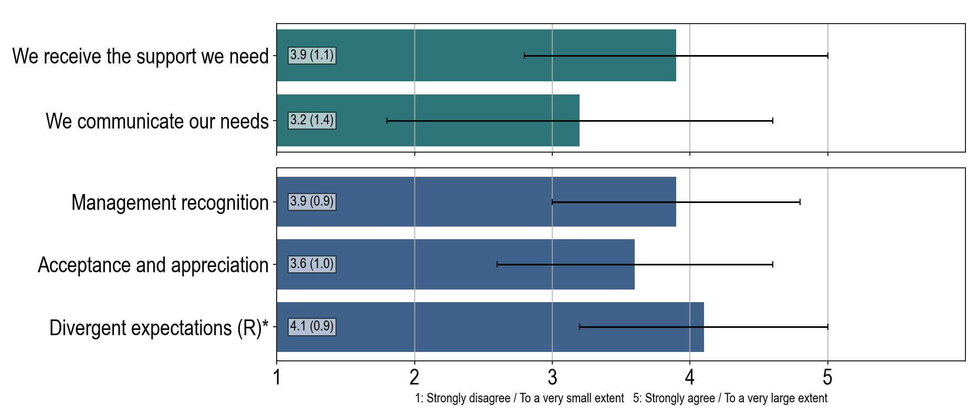
Management at our unit
43.8 % states that they had an appraisal interview in the last year, and 85.7 % experienced it as useful or very useful.
Notes:
* These questions were originally negatively formulated, here they are reversed so that a higher score represents a positive outcome. More information about the variables: We receive the support we need I receive the support I need from the management to get my job done: 3.9(1.1) 1: Strongly disagree - 5: Strongly agree We communicate our needs I try to inform the management about how they can contribute to me doing a good job: 3.2(1.4) 1: Strongly disagree - 5: Strongly agree Management recognition: 3.9(0.9), is a scale variable calculated from: My work is recognized and appreciated by the management: 3.8(1.1) 1: To a very small extent - 5: To a very large extent I am respected by the management: 3.9(0.8) 1: To a very small extent - 5: To a very large extent I am treated fairly by the management: 4.1(0.9) 1: To a very small extent - 5: To a very large extent Acceptance and appreciation: 3.6(1.0), is a scale variable calculated from: I find that the management creates room for trial and error at work: 3.9(1.3) 1: To a very small extent - 5: To a very large extent I find that my work efforts are appreciated by the management: 3.7(1.1) 1: To a very small extent - 5: To a very large extent I feel that my input and opinions are valued by the management: 3.2(1.2) 1: To a very small extent - 5: To a very large extent I can express my opinion without fearing negative reactions from the management: 3.8(1.3) 1: To a very small extent - 5: To a very large extent Divergent expectations (R)*: 4.1(0.9), is a scale variable calculated from: I experience that the management and I have different perceptions of what my work tasks are (R)*: 4.0(1.1) 1: To a very small extent - 5: To a very large extent I experience unclear signals about my work tasks from one and the same leader (R)*: 4.1(0.8) 1: To a very small extent - 5: To a very large extent I experience different expectations from two or more of the leaders about what I should do at work (R)*: 4.1(1.0) 1: To a very small extent - 5: To a very large extent

Slide 7
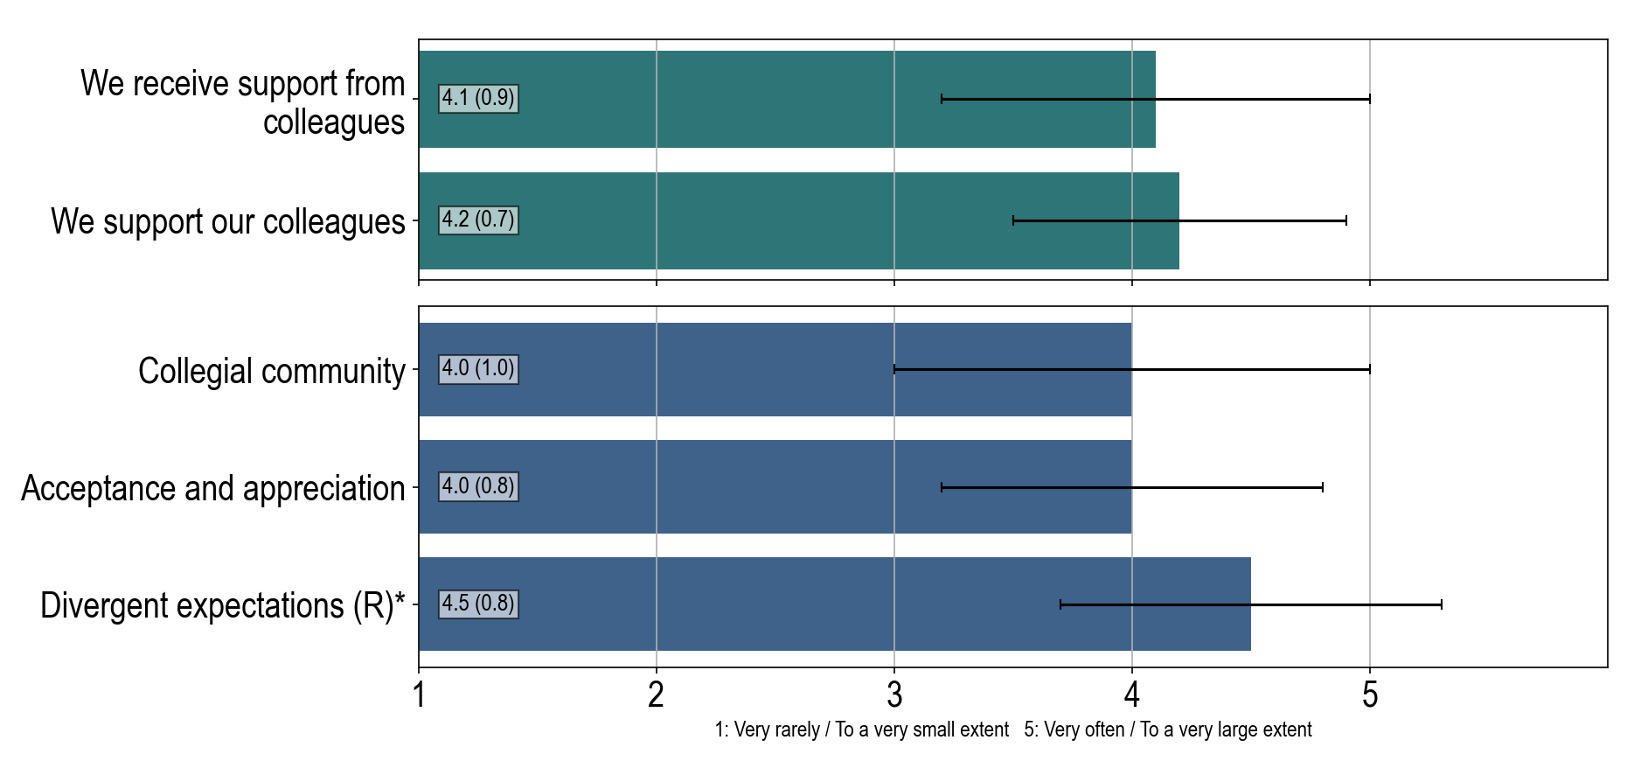
Us and our colleagues
Notes:
* These questions were originally negatively formulated, here they are reversed so that a higher score represents a positive outcome. More information about the variables: We receive support from colleagues I find that my colleagues try to help me succeed in my work: 4.1(0.9) 1: Very rarely - 5: Very often We support our colleagues I try to help my colleagues succeed in their work: 4.2(0.7) 1: Very rarely - 5: Very often Collegial community: 4.0(1.0), is a scale variable calculated from: There is a good atmosphere between me and my colleagues: 4.5(0.6) 1: To a very small extent - 5: To a very large extent There is a strong sense of community between me and my colleagues: 3.7(1.3) 1: To a very small extent - 5: To a very large extent I feel that I am part of a community of colleagues: 3.7(1.1) 1: To a very small extent - 5: To a very large extent Acceptance and appreciation: 4.0(0.8), is a scale variable calculated from: I find that there is room for trial and error among my colleagues: 4.1(0.8) 1: To a very small extent - 5: To a very large extent I find that my work efforts are appreciated by my colleagues: 4.1(0.9) 1: To a very small extent - 5: To a very large extent I feel that my colleagues appreciate when I share input and opinions: 4.1(1.0) 1: To a very small extent - 5: To a very large extent I can express my opinion without being afraid of negative reactions from my colleagues: 3.9(0.9) 1: To a very small extent - 5: To a very large extent Divergent expectations (R)*: 4.5(0.8), is a scale variable calculated from: I experience that my colleagues and I have different perceptions of what my work responsibilities are (R)*: 4.4(0.9) 1: To a very small extent - 5: To a very large extent I experience unclear signals about my work tasks from one and the same colleague (R)*: 4.5(0.7) 1: To a very small extent - 5: To a very large extent I experience different expectations from two or more of my colleagues about what I should do at work (R)*: 4.5(0.7) 1: To a very small extent - 5: To a very large extent

Slide 8
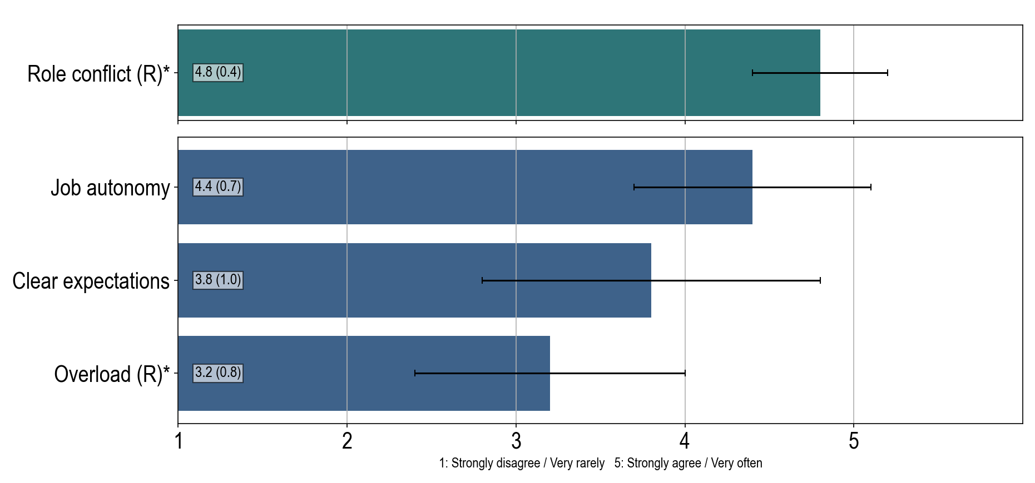
Us and our work
Notes:
* These questions were originally negatively formulated, here they are reversed so that a higher score represents a positive outcome. More information about the variables: Role conflict (R)* I have to carry out tasks that are in conflict with my personal values (R)*: 4.8(0.4) 1: Very rarely - 5: Very often Job autonomy: 4.4(0.7), is a scale variable calculated from: I have sufficient influence in the execution of my work: 4.2(1.0) 1: Strongly disagree - 5: Strongly agree I can decide for myself how to plan the work that I do: 4.4(0.7) 1: Strongly disagree - 5: Strongly agree There is room for me to take my own initiatives in my work: 4.6(0.6) 1: Strongly disagree - 5: Strongly agree I manage my work situation in the direction I want: 4.3(0.9) 1: Strongly disagree - 5: Strongly agree Clear expectations: 3.8(1.0), is a scale variable calculated from: It is clear and explicit what is expected of me at work: 3.7(1.2) 1: Strongly disagree - 5: Strongly agree I have a clear understanding of which tasks are part of my work responsibilities: 3.8(1.3) 1: Strongly disagree - 5: Strongly agree I find my work goals to be vague and unclear (R)*: 3.8(1.1) 1: Strongly disagree - 5: Strongly agree Overload (R)*: 3.2(0.8), is a scale variable calculated from: I have sufficient time to complete my tasks: 3.1(1.0) 1: Very rarely - 5: Very often I work under excessive time pressure (R)*: 3.2(0.9) 1: Very rarely - 5: Very often I have too much to do at work (R)*: 3.1(0.8) 1: Very rarely - 5: Very often

Slide 9
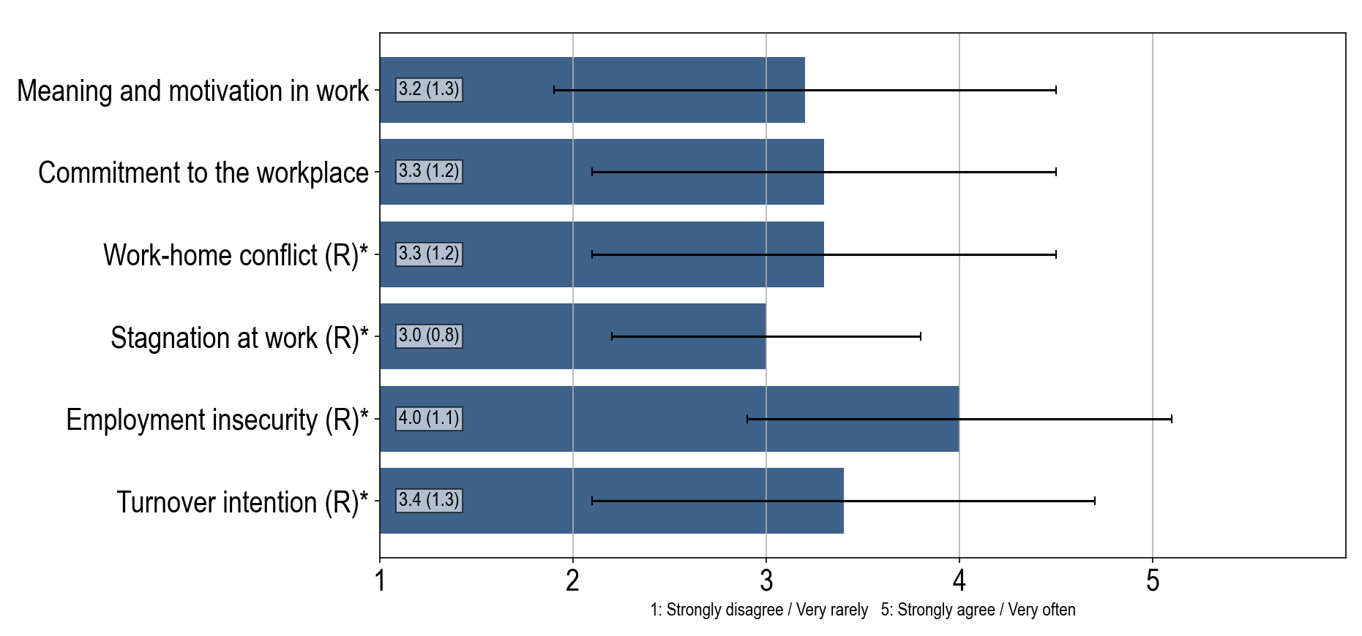
Our job in everyday life
Notes:
* These questions were originally negatively formulated, here they are reversed so that a higher score represents a positive outcome. More information about the variables: Meaning and motivation in work: 3.2(1.3), is a scale variable calculated from: I find my work tasks to be meaningful: 3.2(1.3) 1: To a very small extent - 5: To a very large extent I feel that the work I do is important: 2.9(1.4) 1: To a very small extent - 5: To a very large extent I feel motivated and engaged in my work: 3.3(1.3) 1: To a very small extent - 5: To a very large extent Commitment to the workplace: 3.3(1.2), is a scale variable calculated from: I am happy to tell others about my workplace: 3.3(1.4) 1: To a very small extent - 5: To a very large extent I would recommend a good friend to apply for a position at my workplace: 3.6(1.4) 1: To a very small extent - 5: To a very large extent My workplace means a lot to me: 3.1(1.3) 1: To a very small extent - 5: To a very large extent Work-home conflict (R)*: 3.3(1.2), is a scale variable calculated from: Work-related stress makes me irritable at home (R)*: 3.5(1.4) 1: Very rarely - 5: Very often My job makes me too tired to do things that require my attention at home (R)*: 3.0(1.4) 1: Very rarely - 5: Very often Concerns or problems at work distract me at home (R)*: 3.4(1.3) 1: Very rarely - 5: Very often Stagnation at work (R)*: 3.0(0.8), is a scale variable calculated from: My prospects in this organisation are good: 2.6(1.2) 1: Strongly disagree - 5: Strongly agree I worry about my career development in this organization (R)*: 3.2(1.2) 1: Strongly disagree - 5: Strongly agree I worry about having less stimulating work tasks in the future (R)*: 3.3(1.1) 1: Strongly disagree - 5: Strongly agree Employment insecurity (R)*: 4.0(1.1), is a scale variable calculated from: I worry that I may lose my job (R)*: 4.2(1.2) 1: Strongly disagree - 5: Strongly agree I feel that my employment is safe and secure: 3.8(1.4) 1: Strongly disagree - 5: Strongly agree Turnover intention (R)*: 3.4(1.3), is a scale variable calculated from: I often think about quitting my current job (R)*: 3.8(1.5) 1: Strongly disagree - 5: Strongly agree I may quit my current job in the next 12 months (R)*: 3.7(1.6) 1: Strongly disagree - 5: Strongly agree In the next 12 months, I will probably actively look for new employment opportunities (R)*: 2.8(1.8) 1: Strongly disagree - 5: Strongly agree

Slide 10
Management of Adverse Incidents
We know what to do in case of unacceptable behavior: Towards ourself 62.5 % , towards others 50.0 % .
UiO has its own employees, services, and systems for reporting and following you up
If you wish or need follow-up on your case, it is important that you notify someone.
Inform your immediate supervisor or a higher-level manager.
You can use the university’s reporting system called Si i fra! (Speak-up!)
You can also inform your safety representative or the chief safety representative
If you want support or guidance, you can also contact the Occupational Health Service (BHT). The Occupational Health Service are subject to a duty of confidentiality.
Others who can provide support are union representatives in your labor union or external professionals with legally mandated confidentiality (e.g., lawyer, doctor, psychologist)

Slide 11
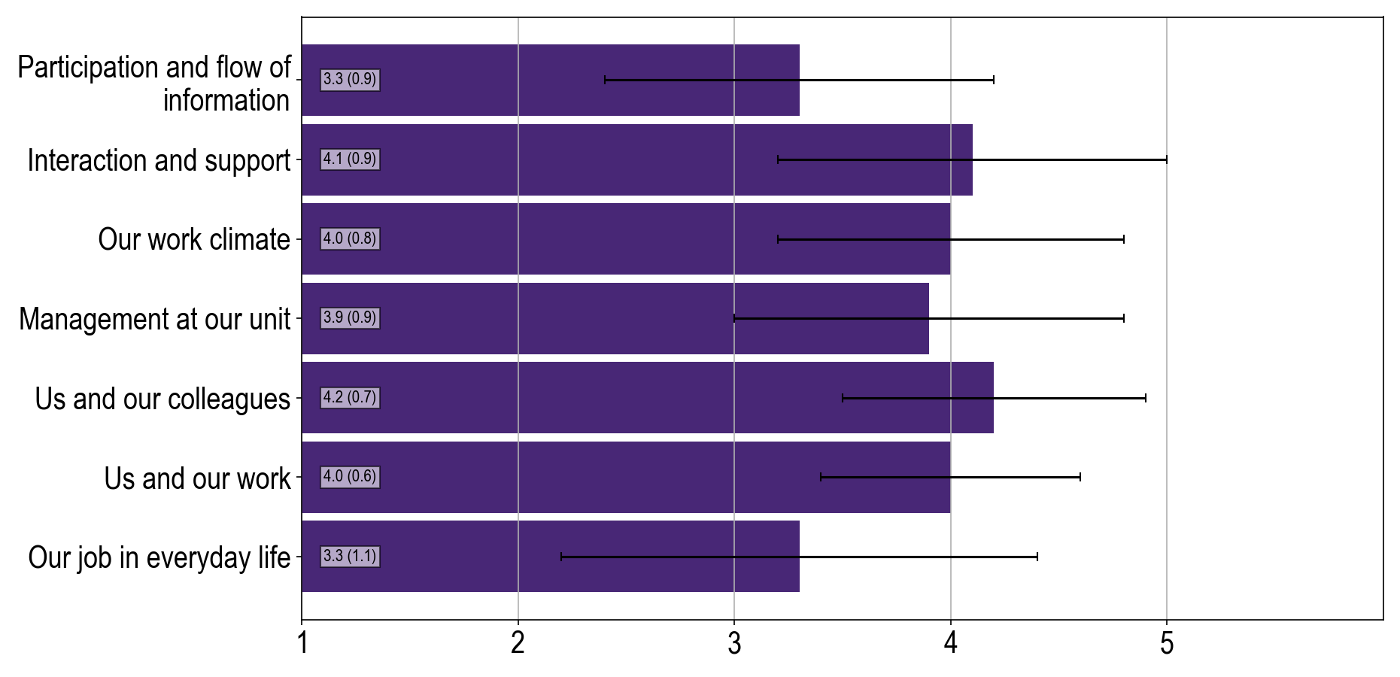
Our Work Environment Summarized

Slide 12
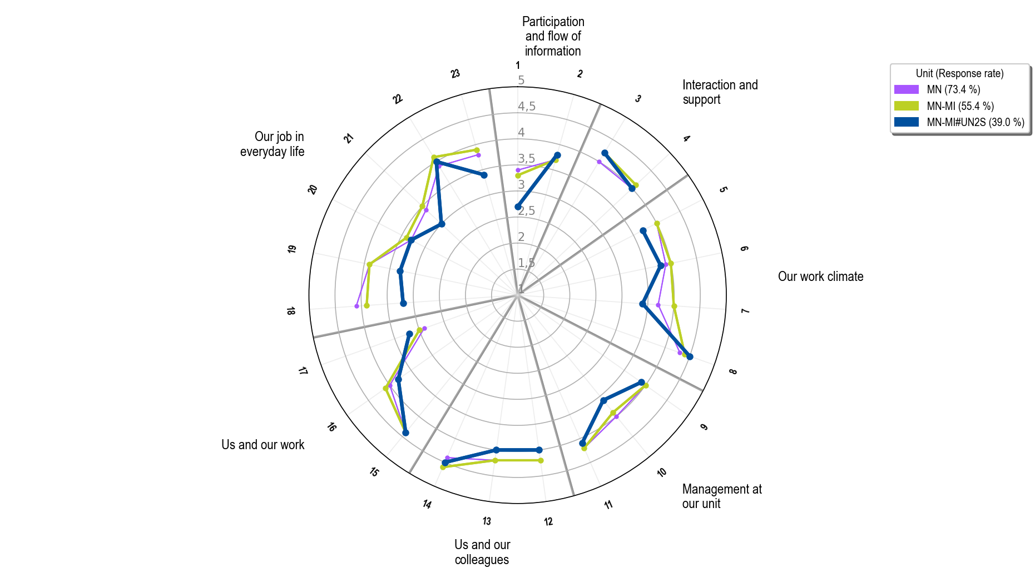
Notes:
Participation and flow of information 1:Participation and involvement 2:Internal flow of information Interaction and support 3:Support to do the job 4:Cross-interaction Our work climate 5:Innovation climate 6:Mastery climate 7:Climate for conflict management 8:Conflict climate (R)* Management at our unit 9:Management recognition 10:Acceptance and appreciation 11:Divergent expectations (R)* Us and our colleagues 12:Collegial community 13:Acceptance and appreciation 14:Divergent expectations (R)* Us and our work 15:Job autonomy 16:Clear expectations 17:Overload (R)* Our job in everyday life 18:Meaning and motivation in work 19:Commitment to the workplace 20:Work-home conflict (R)* 21:Stagnation at work (R)* 22:Employment insecurity (R)* 23:Turnover intention (R)*

Slide 13
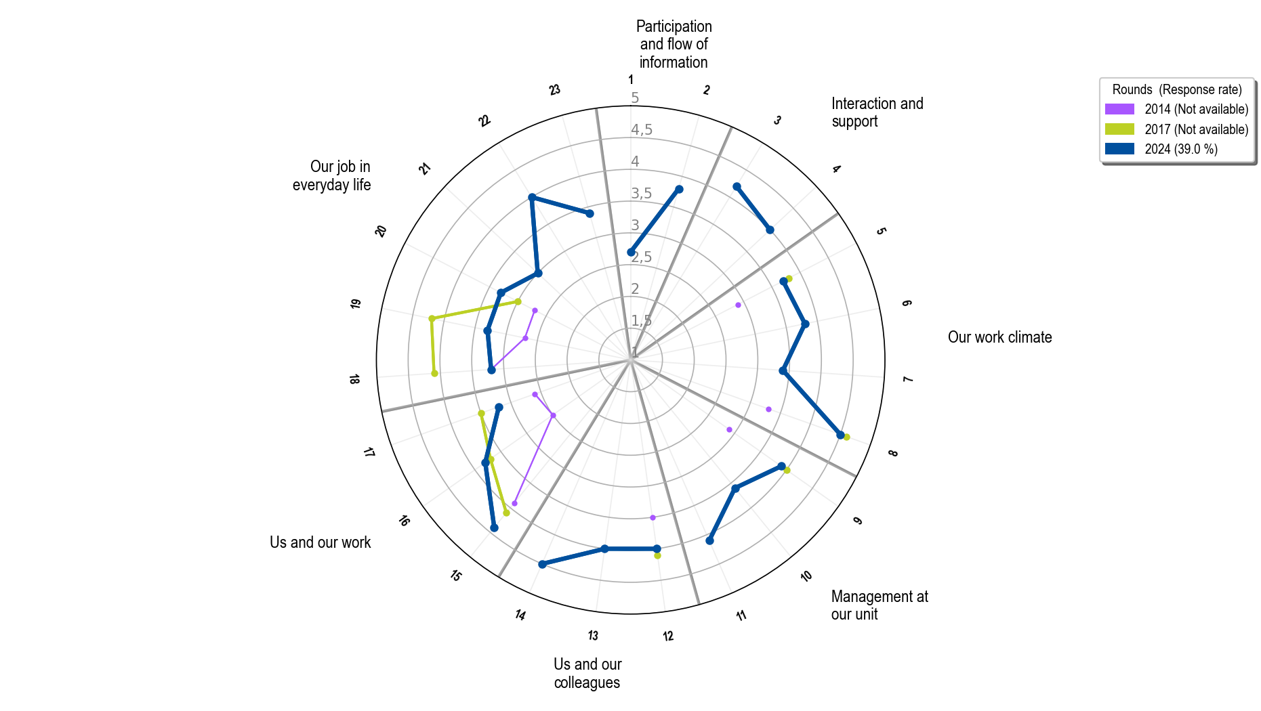
Notes:
Participation and flow of information 1:Participation and involvement 2:Internal flow of information Interaction and support 3:Support to do the job 4:Cross-interaction Our work climate 5:Innovation climate 6:Mastery climate 7:Climate for conflict management 8:Conflict climate (R)* Management at our unit 9:Management recognition 10:Acceptance and appreciation 11:Divergent expectations (R)* Us and our colleagues 12:Collegial community 13:Acceptance and appreciation 14:Divergent expectations (R)* Us and our work 15:Job autonomy 16:Clear expectations 17:Overload (R)* Our job in everyday life 18:Meaning and motivation in work 19:Commitment to the workplace 20:Work-home conflict (R)* 21:Stagnation at work (R)* 22:Employment insecurity (R)* 23:Turnover intention (R)*

