Slide 1
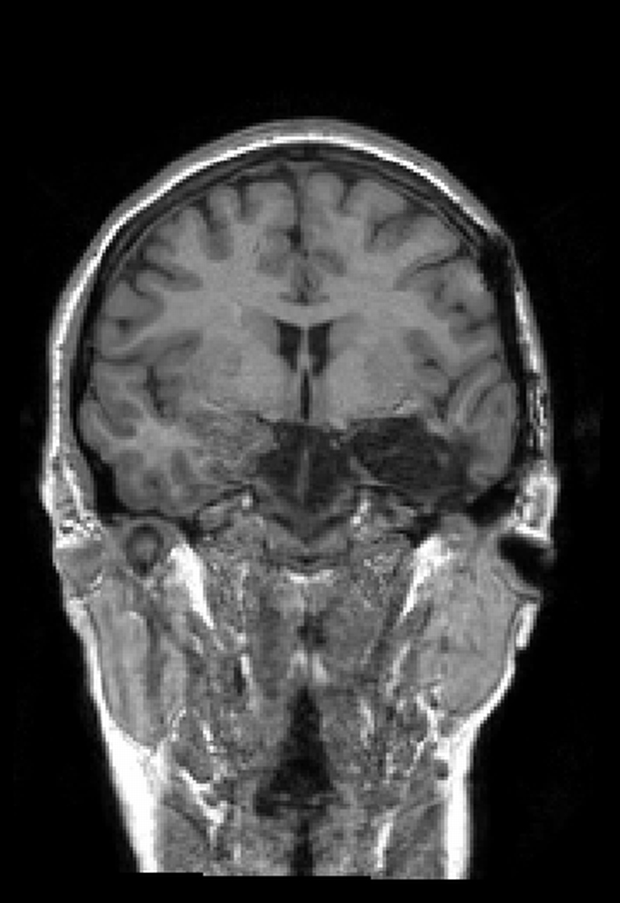
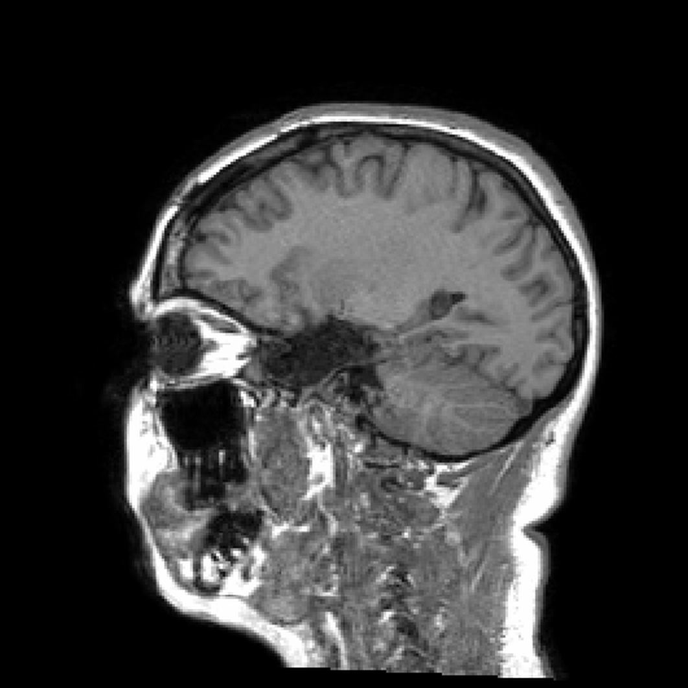
Hjerneskade Kasus: En 22 år gammel kvinne
(en tumor var fjernet fra venstre hemisfære av kirurgen)
Notes:
Forskning har identifisert hippocampuset som et nøkkel område for læring og hukommelse

Slide 2
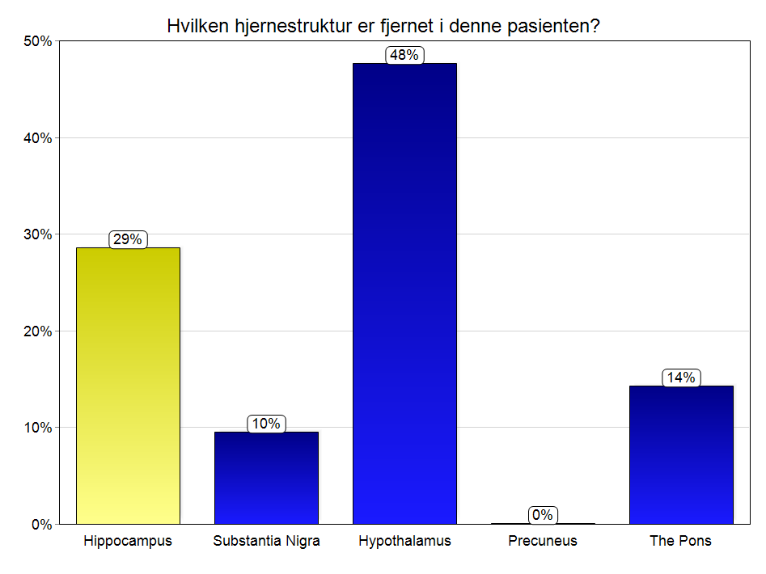
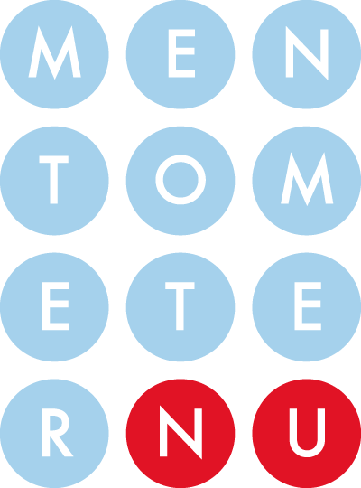
Hvilken hjernestruktur er fjernet i denne pasienten?
A. Hippocampus
B. Substantia Nigra
C. Hypothalamus
D. Precuneus
E. The Pons
Notes:
Forskning har identifisert hippocampuset som et nøkkel område for læring og hukommelse

Slide 3
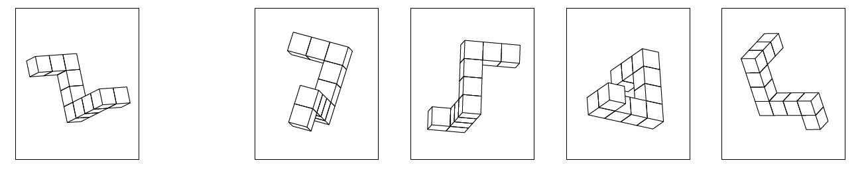
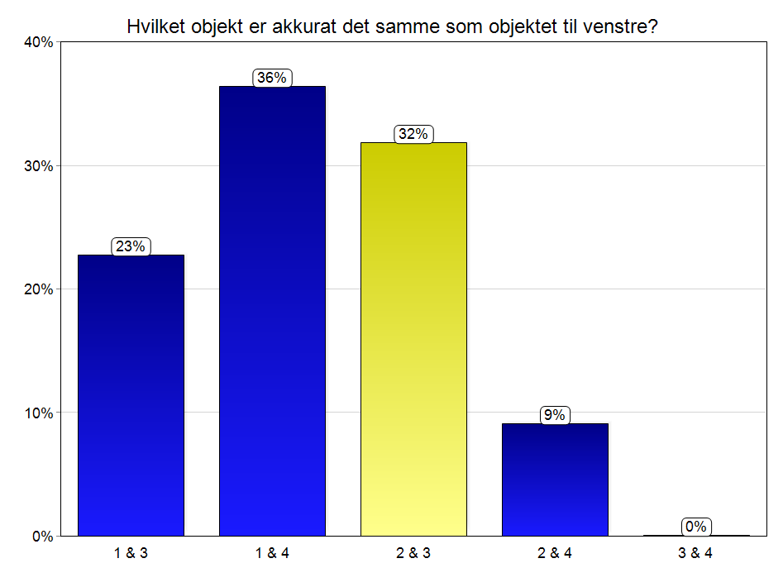
Hvilket objekt er akkurat det samme som objektet til venstre, bare sett fra en forskjellig synspunkt?
1
2
3
4
A. 1 & 3
B. 1 & 4
C. 2 & 3
D. 2 & 4
E. 3 & 4

Slide 4
Universe = Cards with letter on one side and number on the other side
“If consonant on one side then odd number on the other side!”
A
K
4
7

Slide 5
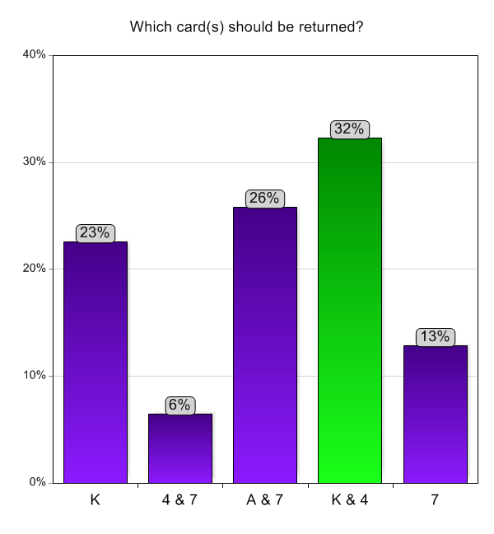
Which card(s) should be returned to verify that the rule “If consonant (p) then odd (q)” is respected?
K
4 & 7
A & 7
K & 4
7

Slide 6
Universe: Norwegian brown bar (Schrøder)
“If you want to consume alcohol then you have to be at least 18 years!”
øl
Notes:
Social Pragmatic Schemes of Reasoning?

Slide 7
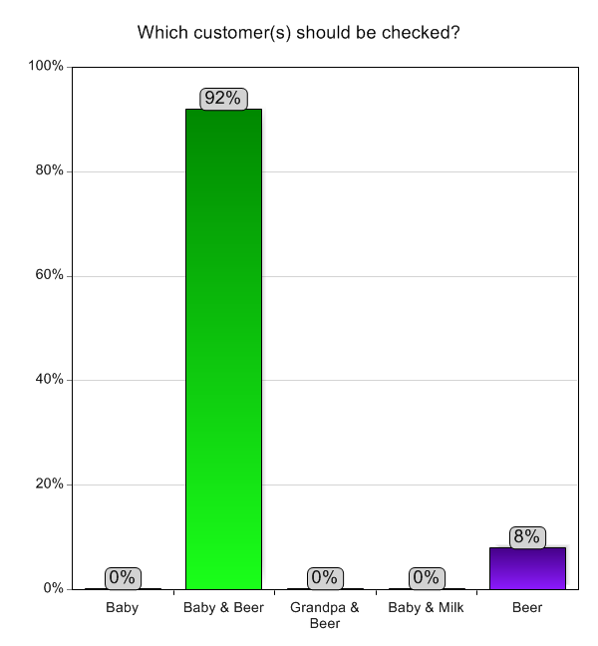
Which customer(s) should be checked to verify that the rule “If alcohol (p) then 18 years (q)” is respected
Baby
Baby & Beer
Grandpa & Beer
Baby & Milk
Beer

Slide 8
AK47 x Schrøder
 |  | Schrøder
 |  | Baby & Beer | 1, 3, 4 or 5
AK47 | K & 4 | 37% | 2%
 | 1, 2, 3 & 5 | 41% | 20%
What would be Piaget’s interpretation?
What would be your interpretation?

Slide 9
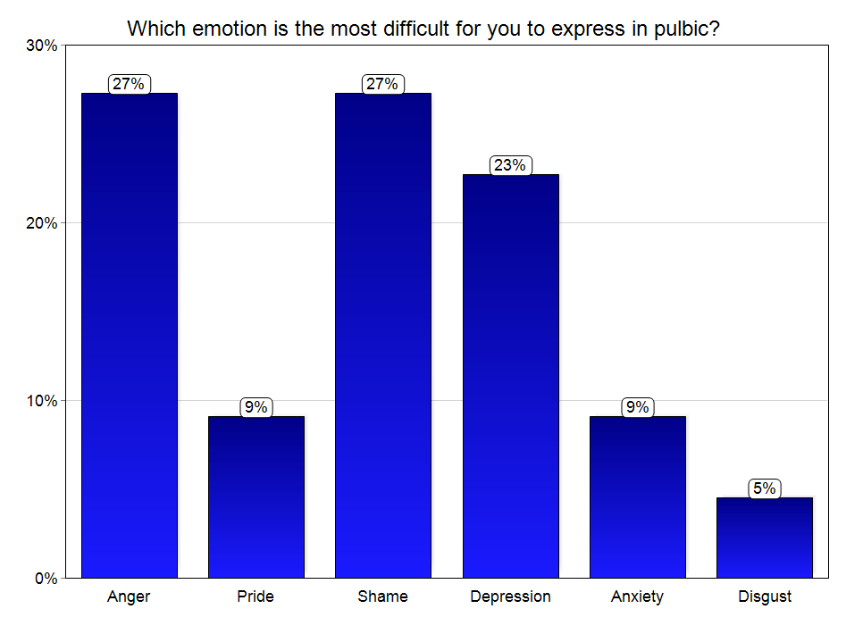

Which emotion is the most difficult for you to express in public?
Anger
Pride
Shame
Depression
Anxiety
Disgust

Slide 10
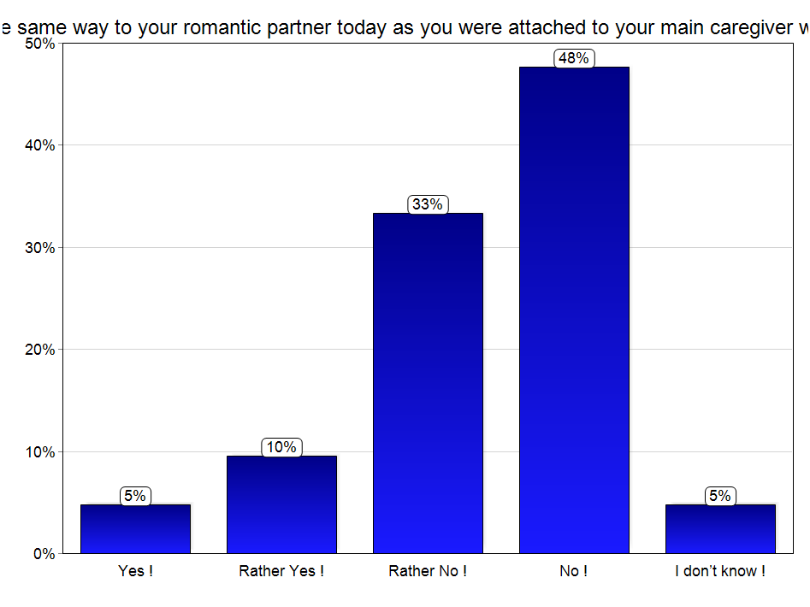
Are you attached in the same way to your romantic partner today as you were attached to your main caregiver (mother) when you were a child?
Yes !
Rather Yes !
Rather No !
No !
I don’t know !

Slide 11
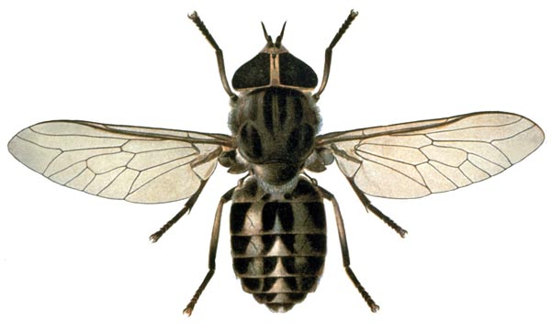
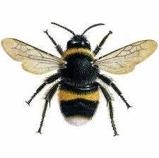
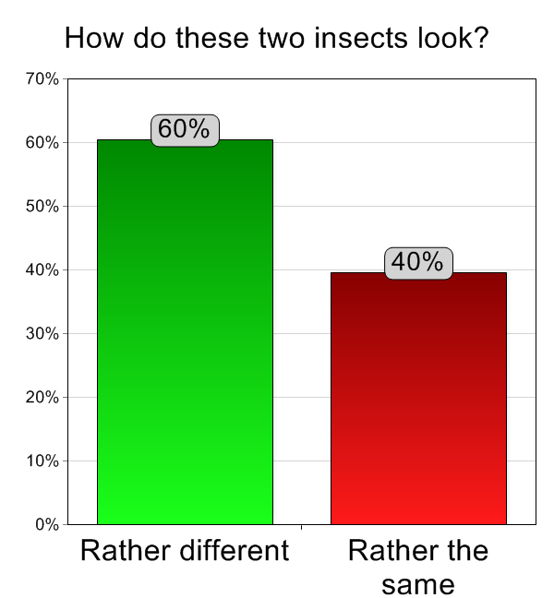
How do these two insects look?
Rather ≠ (thesis – A)
Rather = (antithesis – non-A)

Slide 12
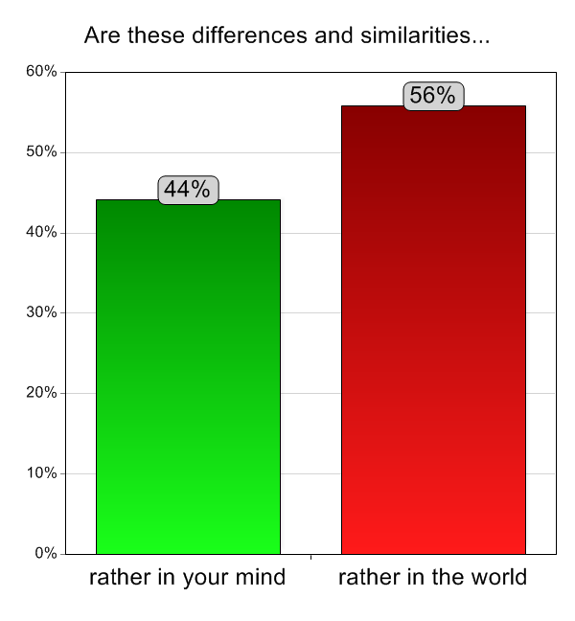
Are these differences & similarities...
rather in your mind
rather in the world
What about the bible?

Slide 13
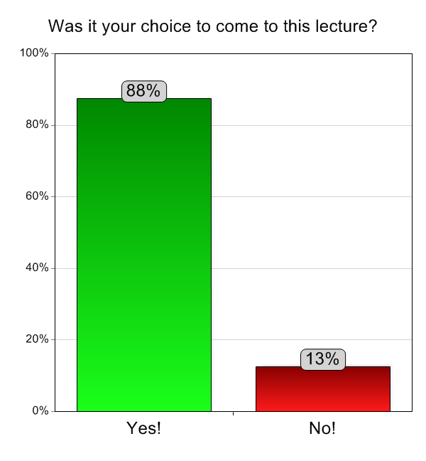
Was it your choice to come to this lecture?
Yes!
No!

Slide 14
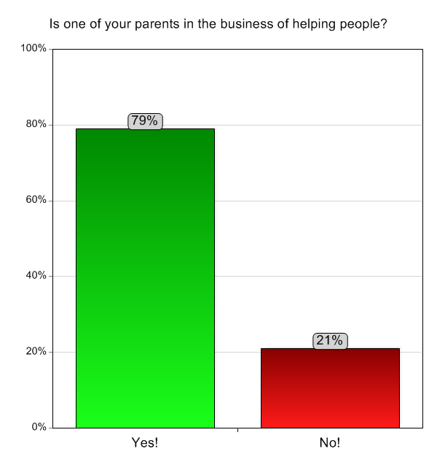
Is one of your parents in the “business” of helping people?
Yes!
No!
Was it your choice or your parents’ choice to come to this lectures!?
Notes:
Doctor, Nurse, Psychiatrist, Psychologist, Teacher, Pedagogue, Social worker, Priest, etc.

Slide 15
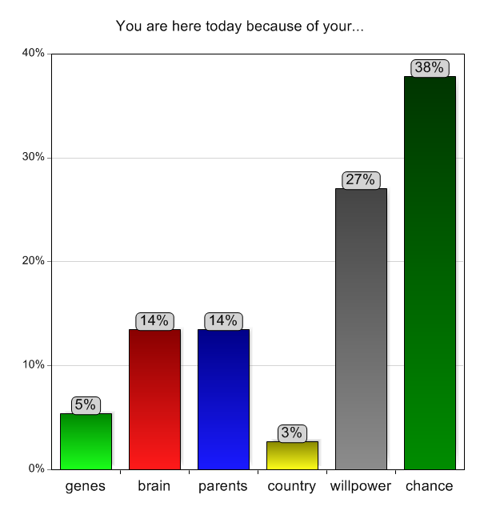
You are here today because of your...
genes
brain
parents
country
willpower
chance
From Oslo to Pampallacta: walk, cycle, car, bus OR train AND plane OR boat (Mayor, 2016) – Affordance, Vicariance, Necessity & Sufficiency
Notes:
genes you got from your parents (grandparents, etc.)
combination (variation) of the genes of your parents (egg x sperm)
(epigenetic) expression of your genes through out your ontogenesis
maturation of your brain through out your ontogenesis
physiology (chemistry) of your brain today
education (values) you got from your parents
possibilities offered by the society in which you are living (and its history)
ontogenesis of your own mind
power of your own will
chance

Slide 16
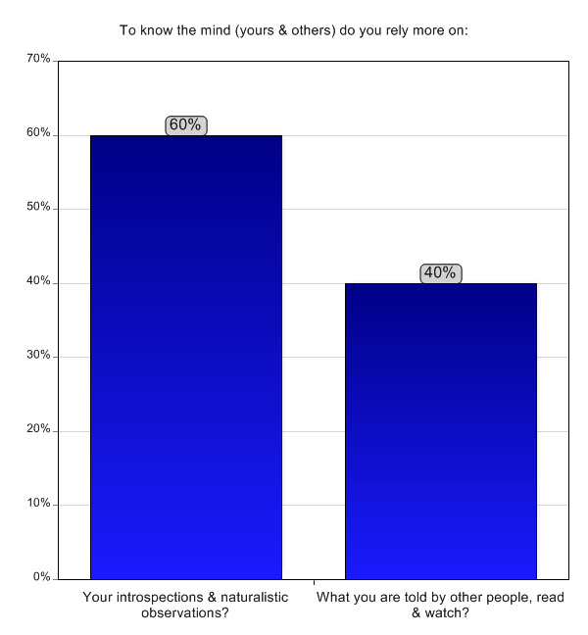
To know the mind (yours & others) do you rely more on:
Your introspections & naturalistic observations?
What you are told by other people, read & watch?

Slide 17
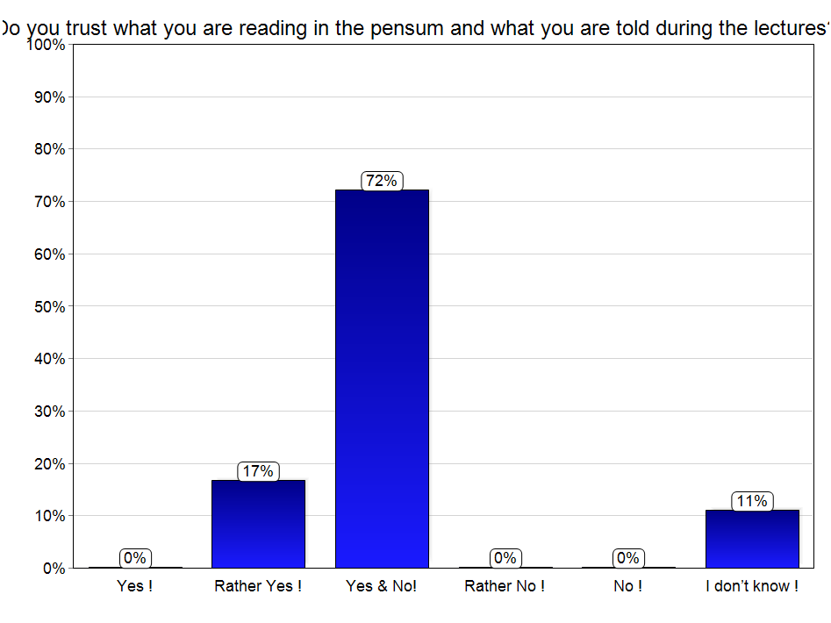
Do you trust what you are reading in the pensum or what you are told during the lectures by the teachers?
Yes !
Rather Yes !
Yes & No!
Rather No !
No !
I don’t know !
Relation with attachment?

Slide 18
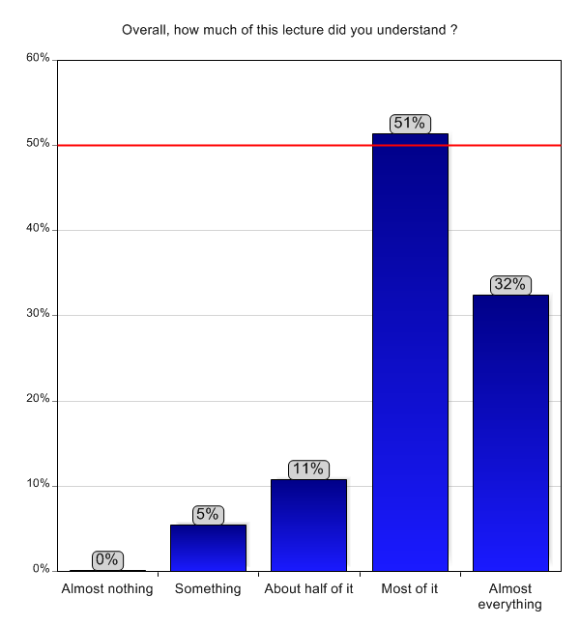





Overall, how much of this lecture did you understand ?
Almost nothing
Something
About half of it
Most of it
Almost everything

Slide 19
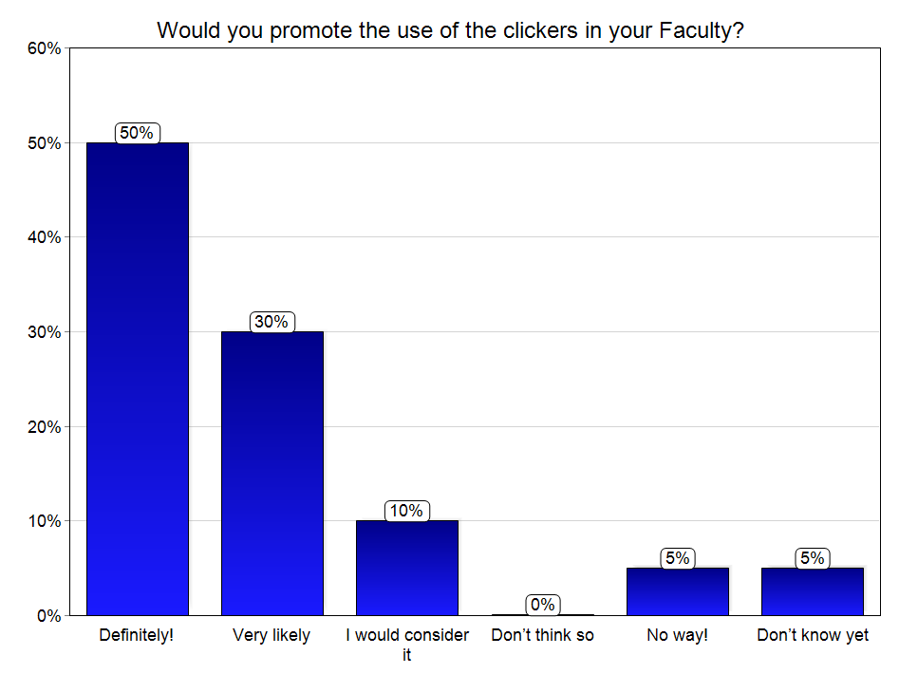
To click or not to click?
Would you promote the use of the clickers in your Faculty?
Definitely!
Very likely
I would consider it
Don’t think so
No way!
Don’t know yet

