Slide 1
Academic Refuge Erasmus+ Strategic Partnership
Marit Egner, Project Coordinator,
University of Oslo
UiO Internationalisation seminar 8 June 2017

Slide 2
Academic Refuge Project Facts
Full project title: Strategic partnership to promote core academic values and welcome refugees and threatened academics to European campuses
Project partners: University of Oslo (lead), UNICA
Scholars at Risk Network, University of Ljubljana
Associate partners: EUA, EAIE
Budget: 300,000 euros
Duration: 3 years, Sept 2016 to Aug 2019

Slide 3
Refugees in HE and Scholars at Risk
Synergies of approaches?

Slide 4
Background
Worldwide, more than 65 million people are currently uprooted by wars and persecution, 21 million refugees
6 percent of displaced people are in Europe
Less than one per cent of world’s refugees attend higher education; compared to 34 per cent total global (UNHCR Trends 2015)
25 percent in Syria (2011) had higher education
There are ca 50 000 Syrian refugees with HE in Europe + ca 2000 scholars

Slide 5
UNICA responses
Many different initiatives at member universities
Recognition
Academic preparation
Bridging courses
Integration
Buddies
Guiding and Councelling
Languages
Online courses
Admission
Internships

Slide 6
Information day
Online language training
Guidance and councelling – Drop in
Cooperation with the municipality
Academic Network – Buddy groups
Academic Practise - Internships
Lecture series
http://www.uio.no/english/about/collaboration/academic-dugnad/

Slide 7
Scholars at Risk – a network of universities
As SAR members, university leadership, staff, faculty, and students have the opportunity to actively engage in:
Protection hosting threatened scholars for temporary academic visits referring scholars to the network for assistance | Advocacy offering Student Advocacy Seminars to teach real-world advocacy skills supporting scholars in prison by writing letters of appeal work with the SAR Academic Freedom Monitoring Project | Learning attending SAR conferences and workshops inviting SAR scholars to share their stories on campus joining research groups looking at pressing issues facing international higher education

Slide 8
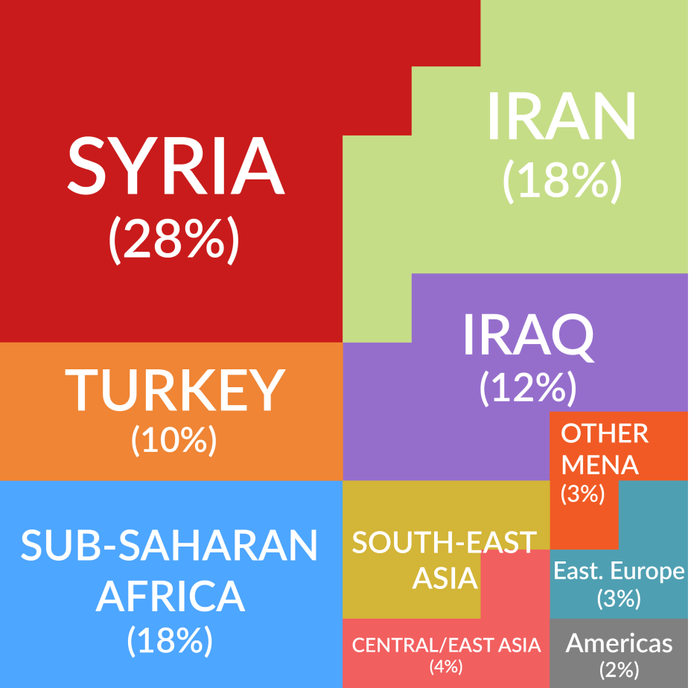
Scholar Countries of Origin
SAR currently provides assistance to threatened scholars from over 25 countries around the world.

Slide 9
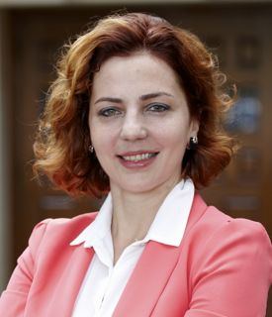
The Scholars
SAR-assisted scholar
Dr. Anna Dolidze
International Law
Home country: Georgia
Risks: Intimidation, surveillance, and arrest in retaliation for her open criticism of policies relating to the operation and independence of the Georgian judiciary
SAR Network positions: NYU Law School, USA and Western University, Canada
Where is she now? In 2015, Dr. Dolidze
returned to Georgia to begin an appointment as Deputy Defense Minister. In June 2016, she was appointed the chief legal adviser to the President of Georgia.

Slide 10
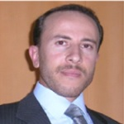
The Scholars
SAR-assisted scholar
Dr. Kassem AlSayed Mahmoud
Food Science
Home country: Syria
Risks: Targeted by the government for defecting from compulsory military service
SAR Network position: Ghent University, Belgium, arranged with the UAF-SAR Netherlands & Belgium Section
Where is he now? Dr. AlSayed is working as a postdoctoral researcher in Belgium and dreaming of returning to his homeland.

Slide 11
Mohamed
Dentist from Aleppo in Syria
PhD from France
Worked as Ass. Prof. and Dentist in Syria
Worked 2 years at UiO through SRF
Authorisation as a Dentist in two years!
Options: Post.doc./dentist/clinical instructor

Slide 12
Academic Refuge Project Facts
Full project title: Strategic partnership to promote core academic values and welcome refugees and threatened academics to European campuses
Project partners: University of Oslo (lead), UNICA
Scholars at Risk Network, University of Ljubljana
Associate partners: EUA, EAIE
Budget: 300,000 euros
Duration: 3 years, Sept 2016 to Aug 2019

Slide 13
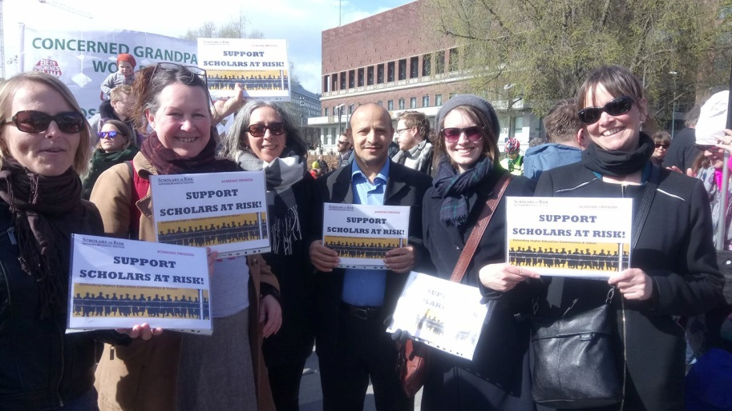
Goals of the project
Two overlapping goals:
Improve the capacity of European universities to assist refugees and threatened academics
Promote greater respect for academic freedom and greater protection for higher education values

Slide 14
Primary activities and outputs
2017:
Develop curriculum and implement two-part training on (a) welcoming refugees and threatened academics to campus and (b) promoting higher education values
2018:
MOOC: The Global University, Academic Freedom and Higher Education Values
2019:
Electronic Handbook on Putting Higher Education Values into Practice

Slide 15
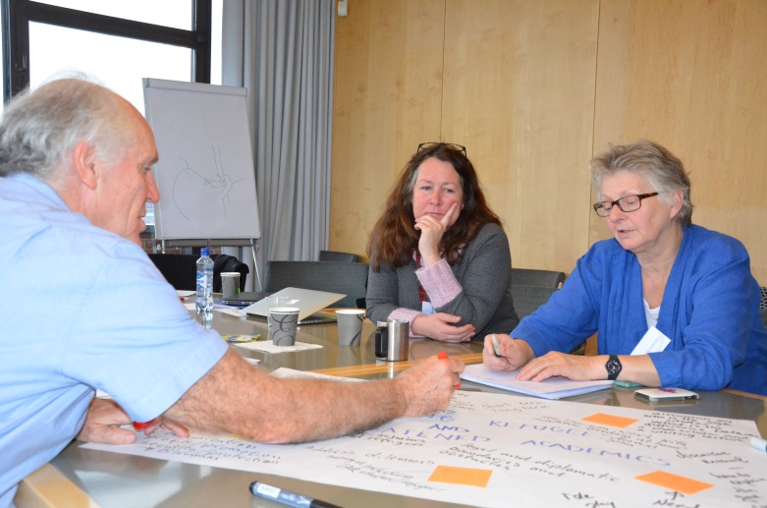
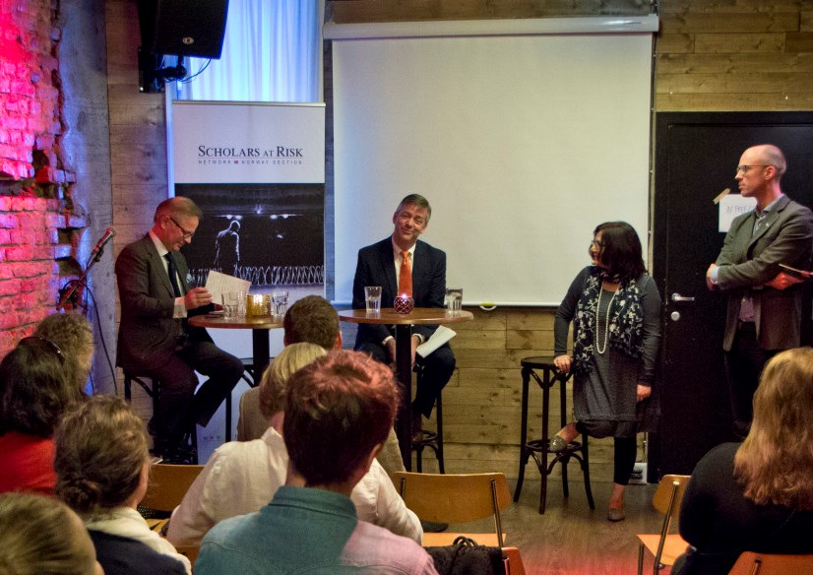
Additional activities
Project meetings
Preparatory workshops with experts
3 multiplier events for non-partners
Staff mobility for SAR scholars

Slide 16
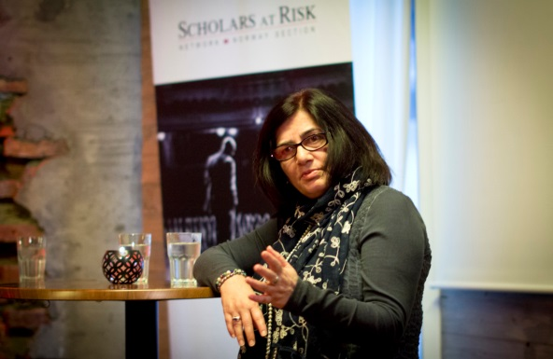
June 2017
Academic Refuge Staff Training week
5 days at the University of Oslo 19-23 June
Values in higher education
Welcoming refugees and threatened academics
Participants
110 applications to participate
60 participants, from UNICA and SAR member universities
Some new training material
A One-day open conference 21 June:
Academic Refuge: The Role of Universities in Turbulent Times

Slide 17
Anticipated longer-term outcomes
Greater number of refugees and threatened academics assisted by European universities
Improved quality of assistance
Improved capacity of refugee scholars to help rebuild regions once conflict subsides
Contribute to a vision of the displaced as welcome contributors to communities
Increased awareness of the importance of academic freedom not only to societies in transition but everywhere

Slide 18
Setting up a Strategic partnership
Establishing the partnership
Who, why, how?
More partners?
Setting priorities
The project overall idea
Fit with EU and national priorities
Project goals

Slide 19
Setting up (continued)
Concrete activities
Not all types of activities and costs can be covered under Erasmus+
Intellectual outputs as work packages
Staff training, MOOC and handbook
What you want to do and what is elligible
Budgets and rates are different from real costs
A good application is an agreed project plan

Slide 20
Time table

Slide 21
Governance and quality assurance
Internal in the project
Project team directly involved
External evaluator – critical friend
Project board – leaders of project team members
External – to the Erasmus+ programme

Slide 22
Thanks for your attention.
https://www.uio.no/english/about/global/globally-engaged/academic-refuge/

