Slide 1
Image Sonification as Unsupervised Cross-Modal Domain Transfer (W.i.P)
Bálint Laczkó
Main Supervisor: Alexander R. Jensenius

Slide 2
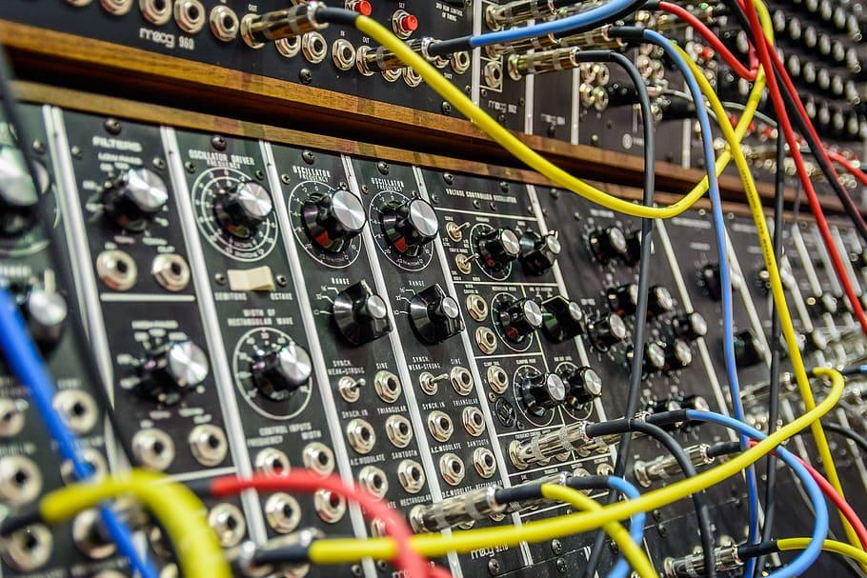
The Limits of Parameter Sonification
Synth parameters
Sounding result
Dataset of features
Mapping
DSP graph

Slide 3
The Limits of Parameter Sonification
?
Synth parameters
Sounding result
Dataset of features
Mapping
DSP graph
Distance ≠ Distance

Slide 4
The latent meaning

Slide 5
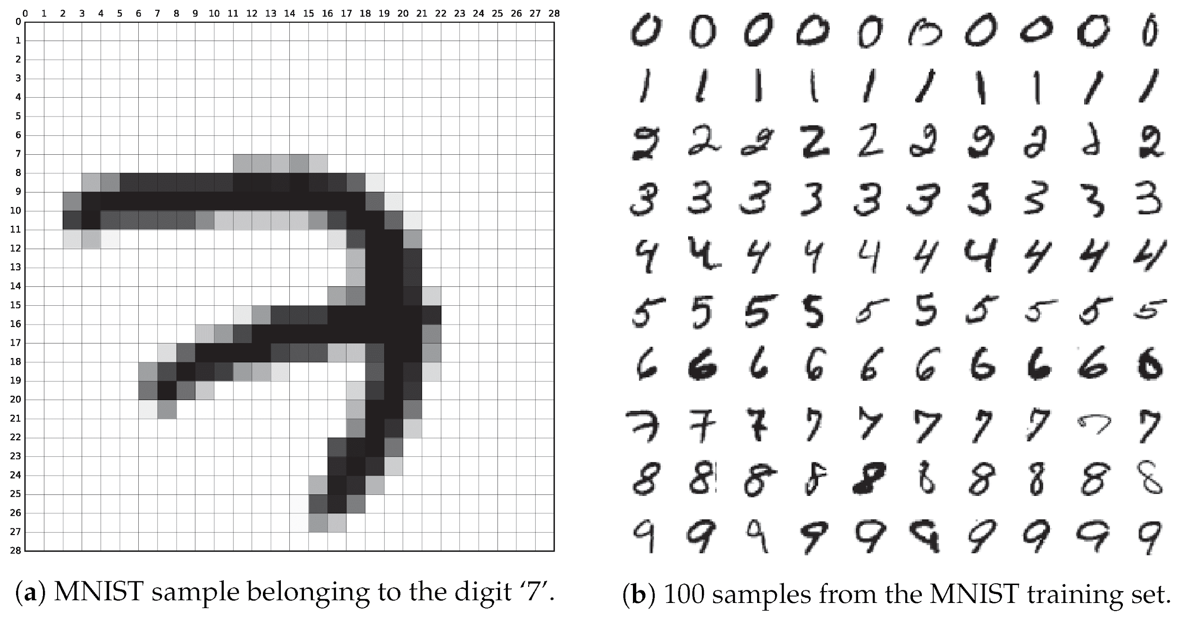
Image from: Baldominos, A., Saez, Y., & Isasi, P. (2019). A survey of handwritten character recognition with mnist and emnist. Applied Sciences, 9(15), 3169.

Slide 8
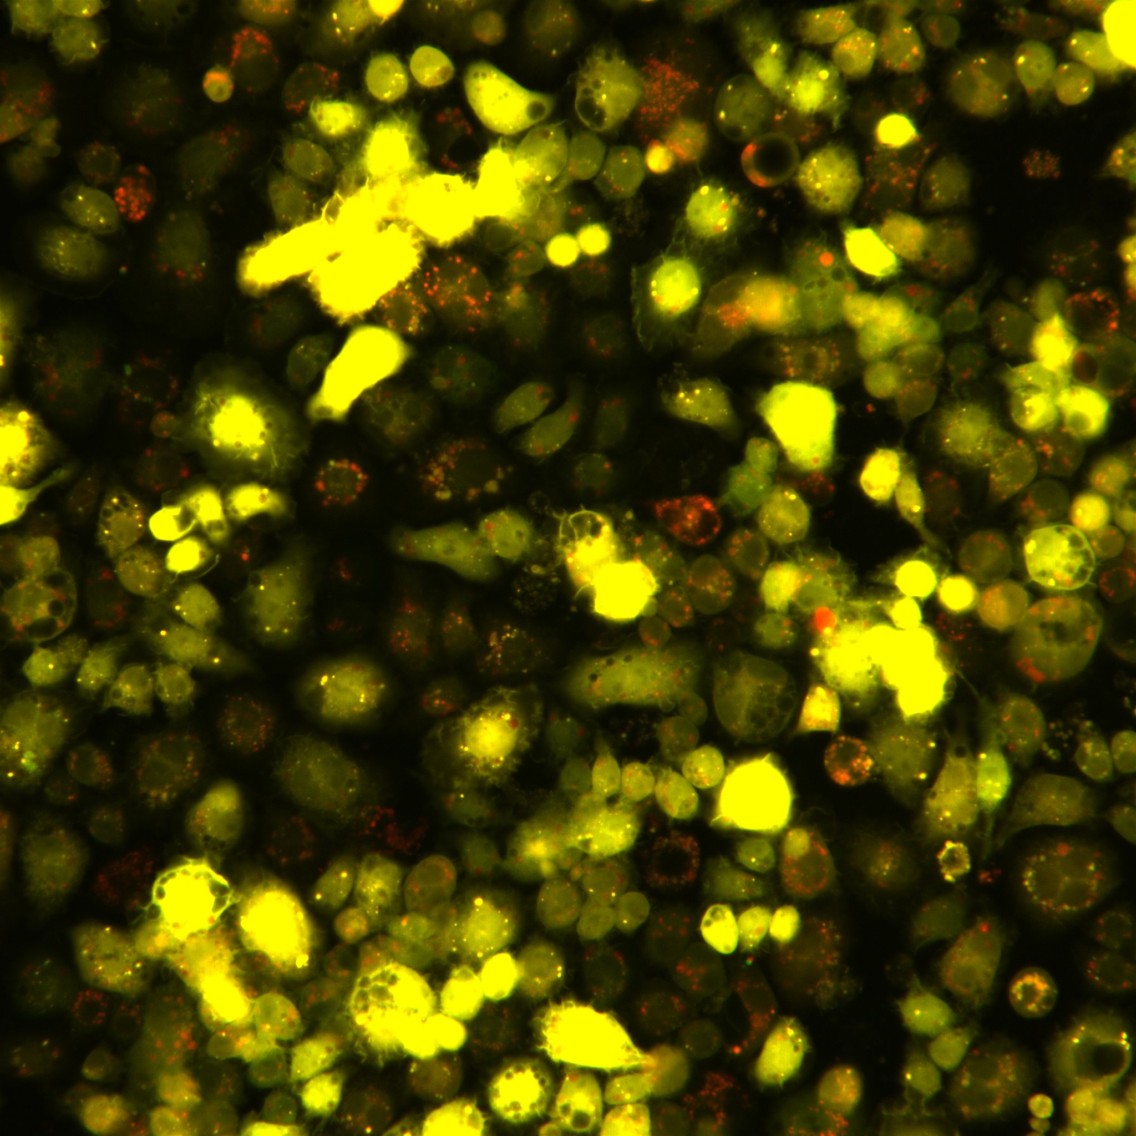
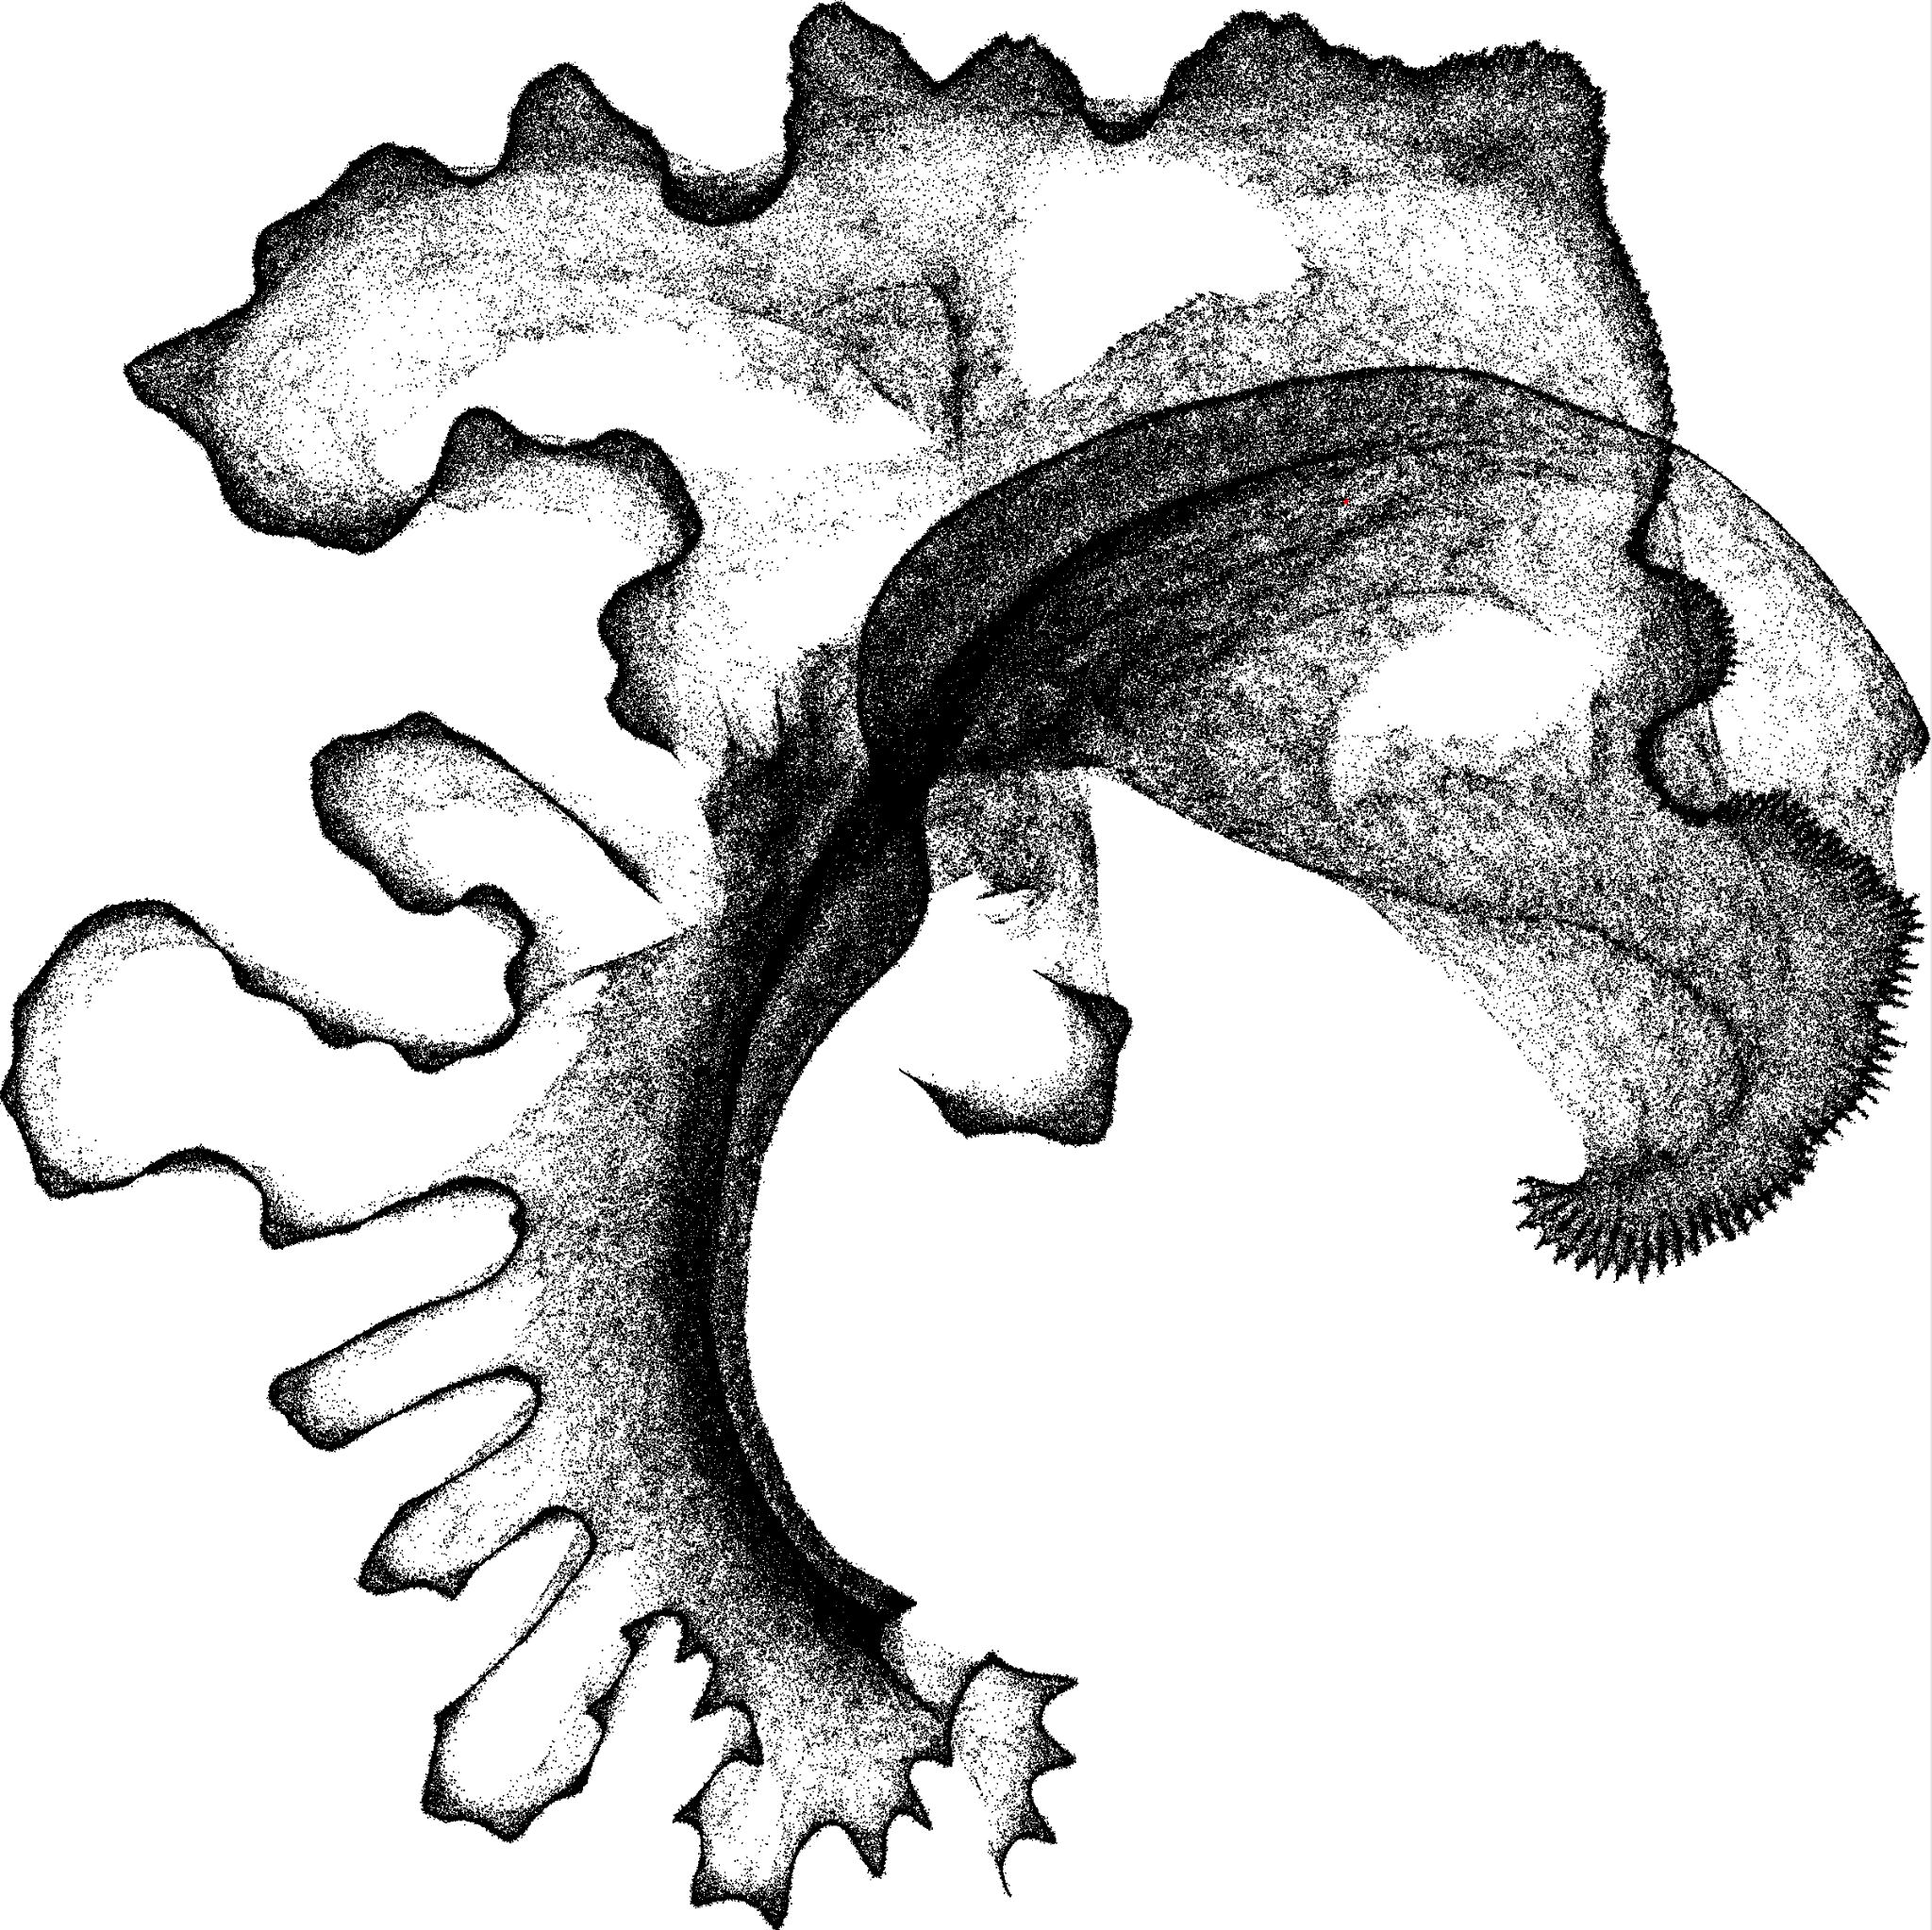
Image from: Al Outa, A., Hicks, S., Thambawita, V., Andresen, S., Enserink, J. M., Halvorsen, P., ... & Knævelsrud, H. (2023). Cellular, a cell autophagy imaging dataset. Scientific data, 10(1), 806.
1M FM synth sounds represented by 200 Mel-bands, clustered by UMAP

Slide 9
The potential of representation learning and unsupervised domain transfer for image sonification

Slide 10
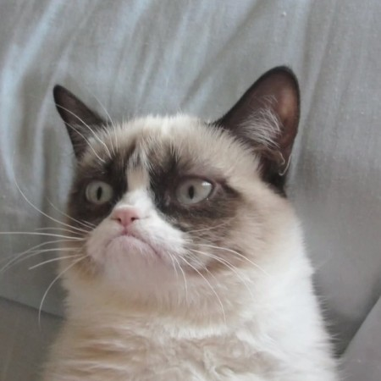
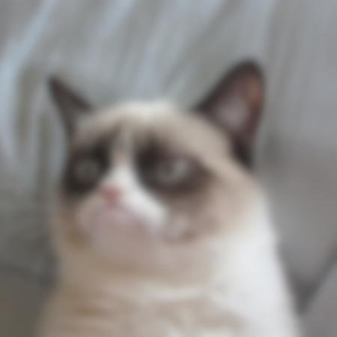
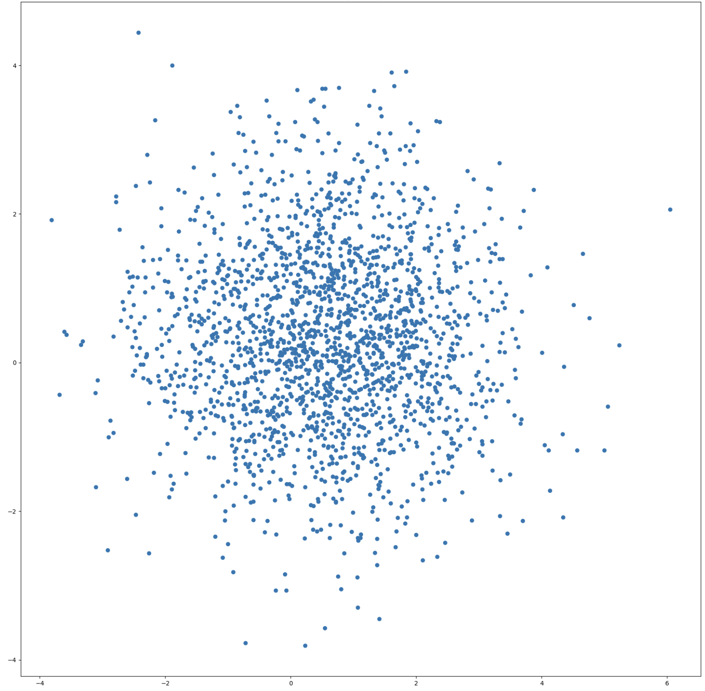
Variational Auto-Encoders
μ
Encoder
Z
Decoder
σ

Slide 11
In search of disentangled representations

Slide 12
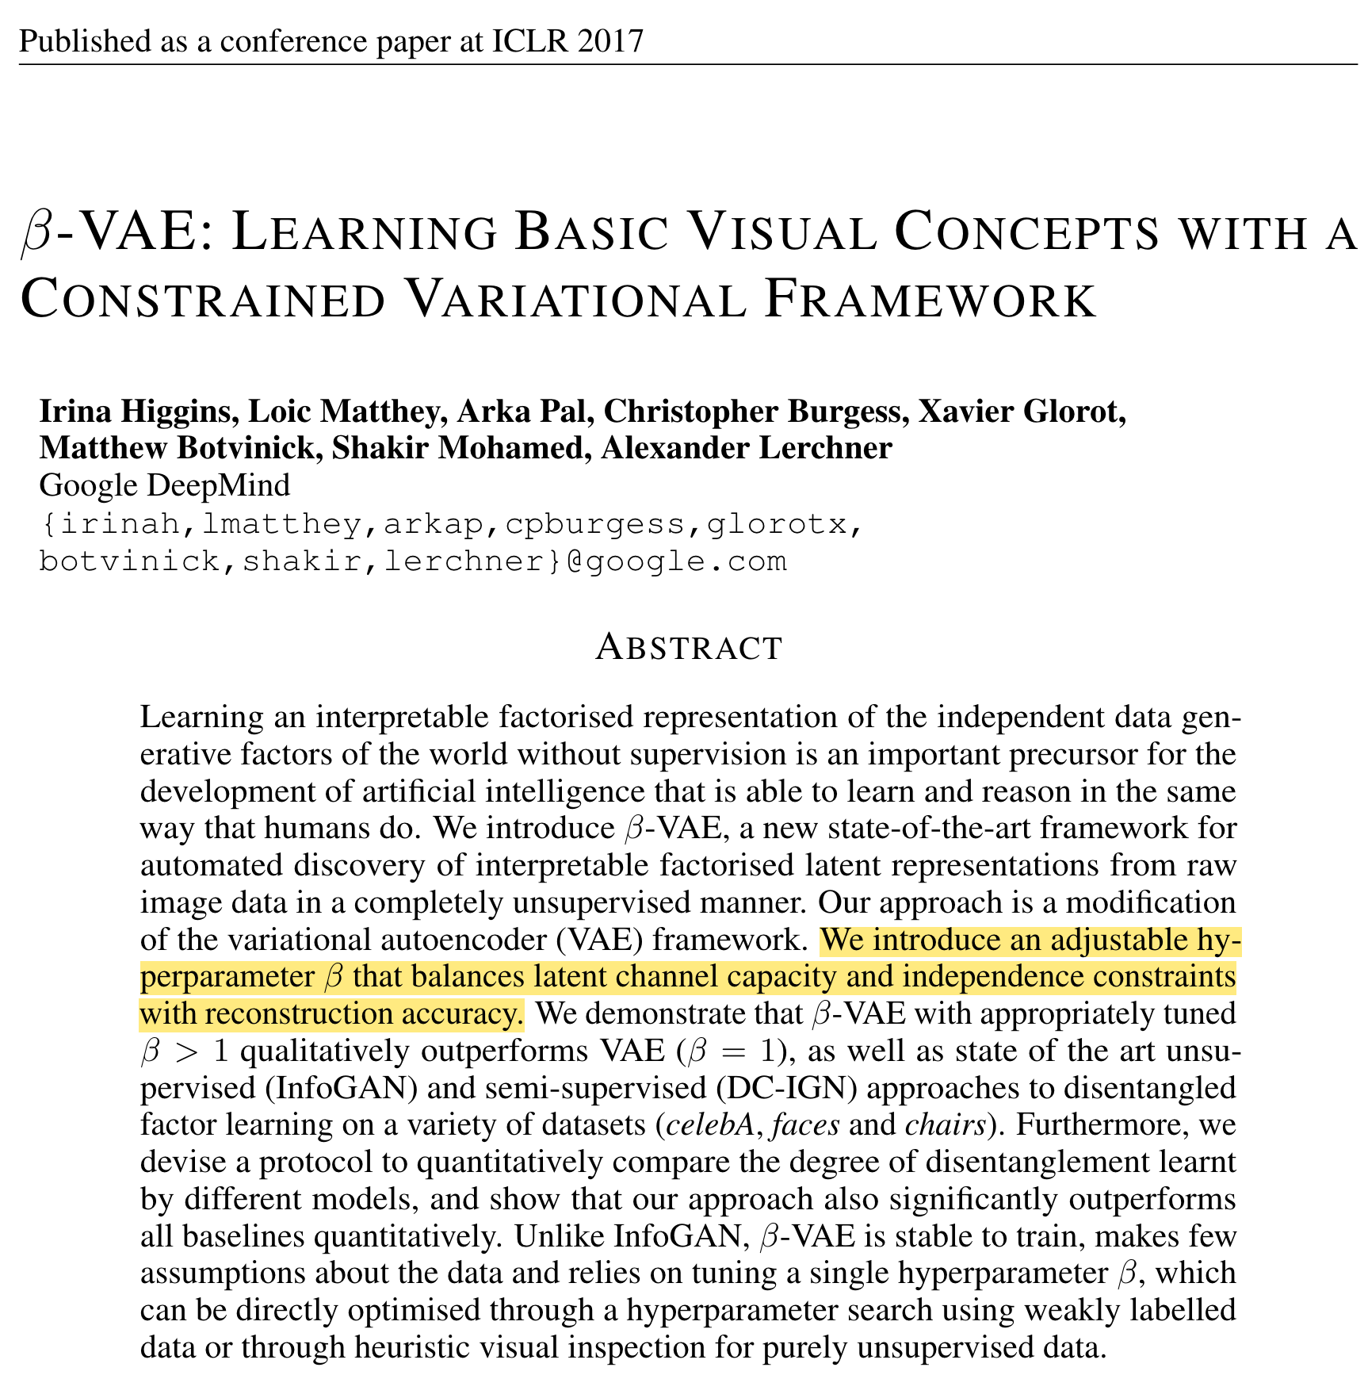
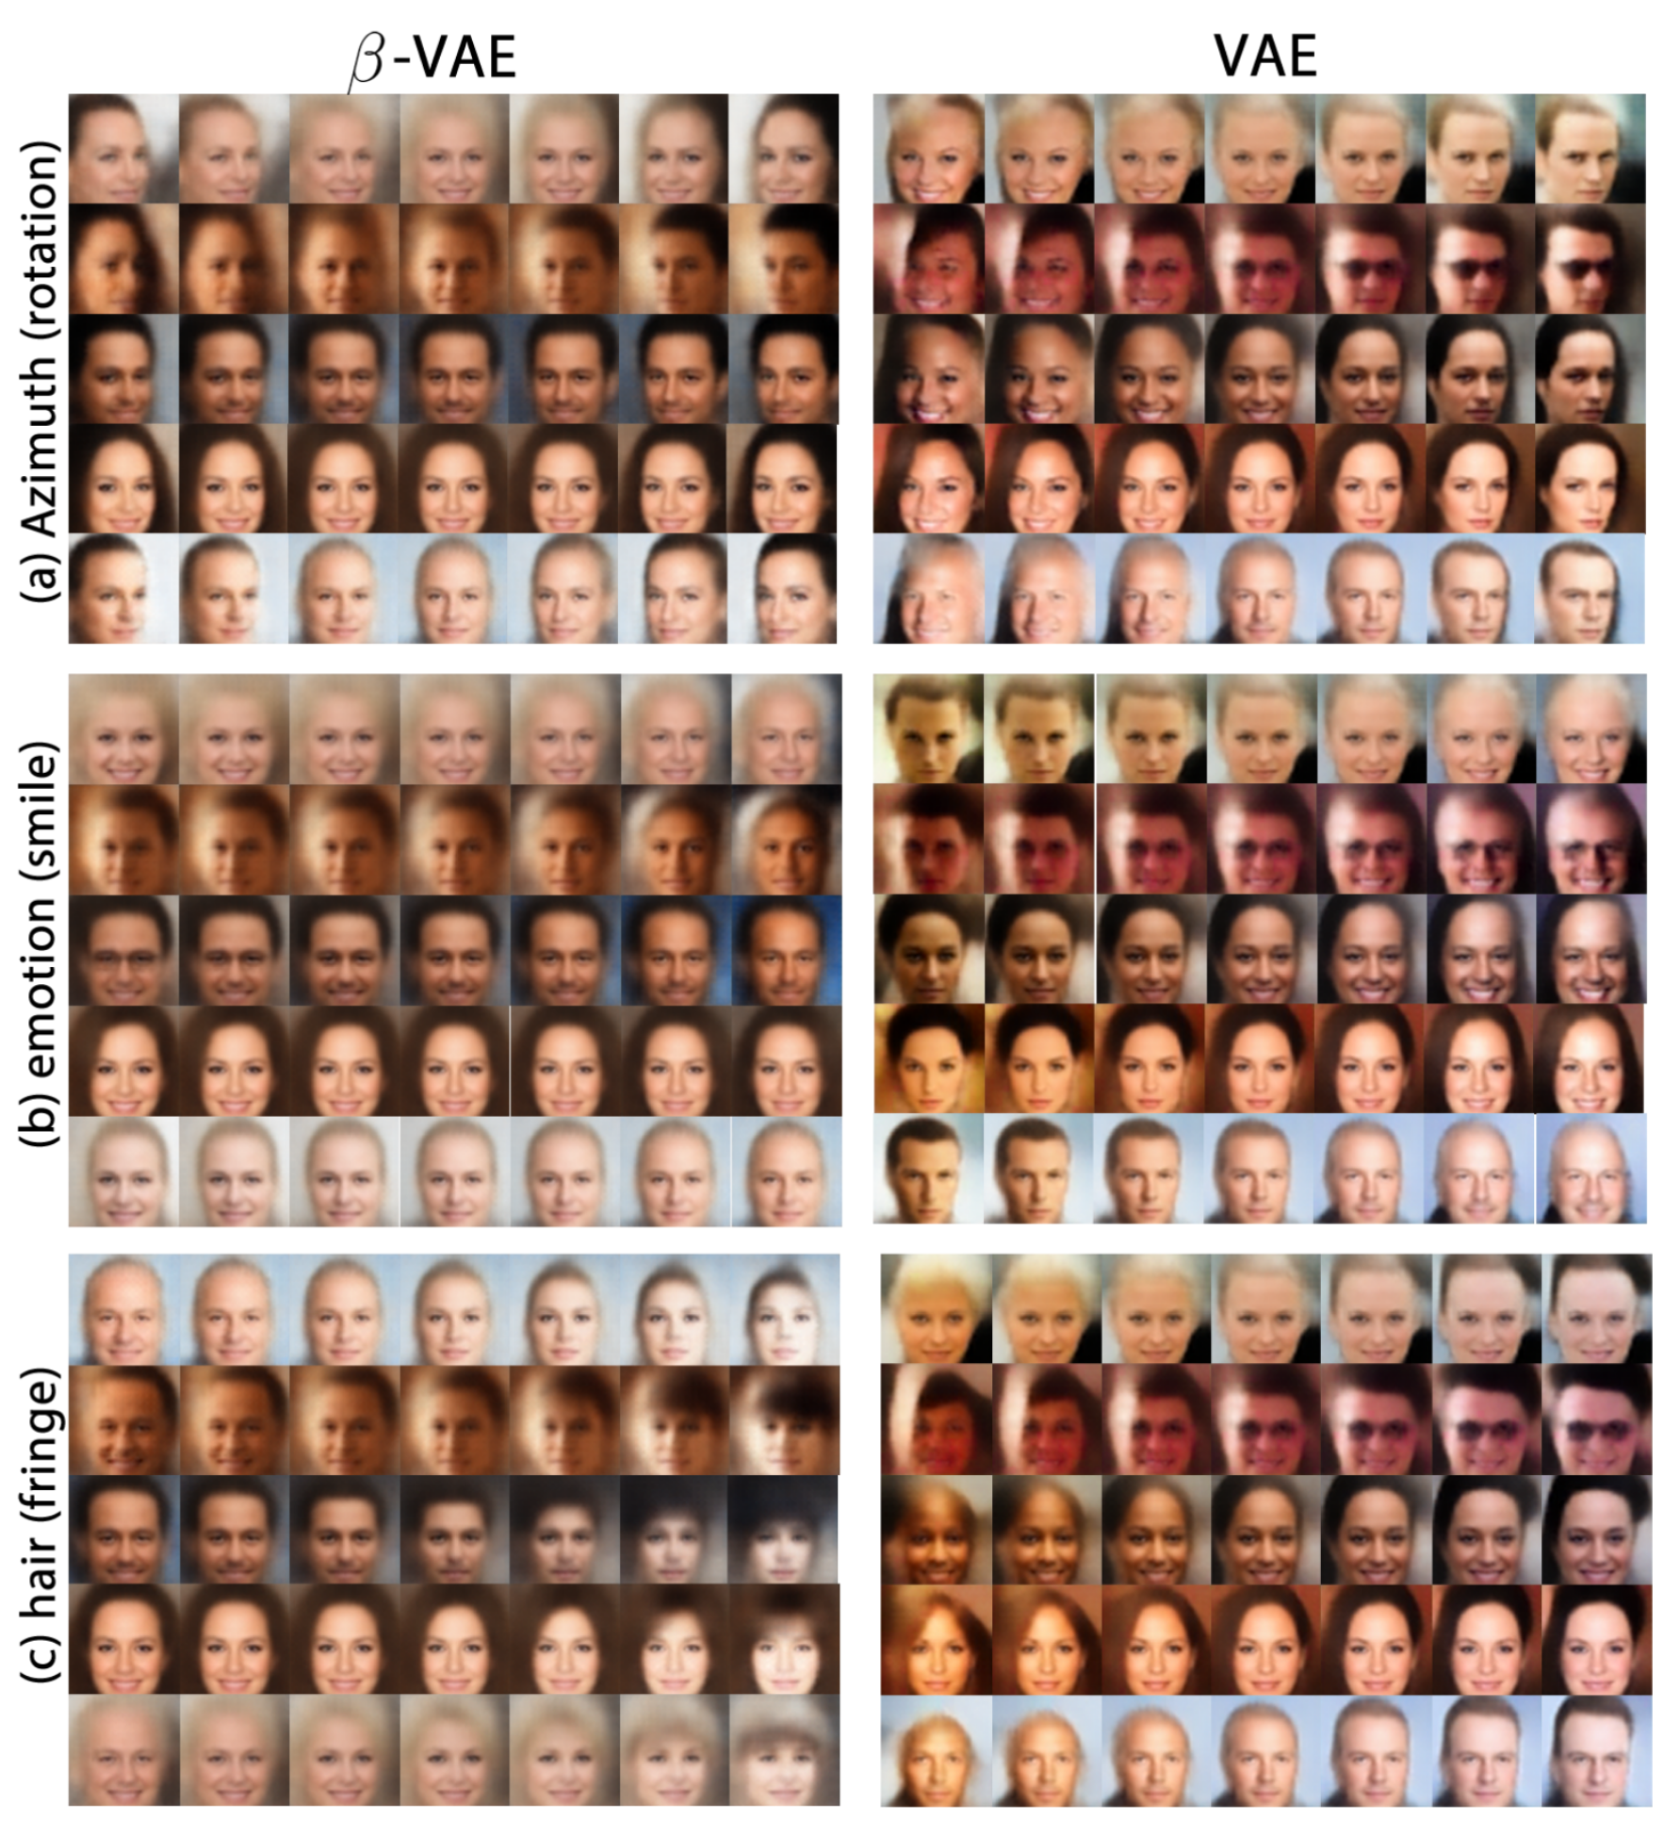

Slide 13
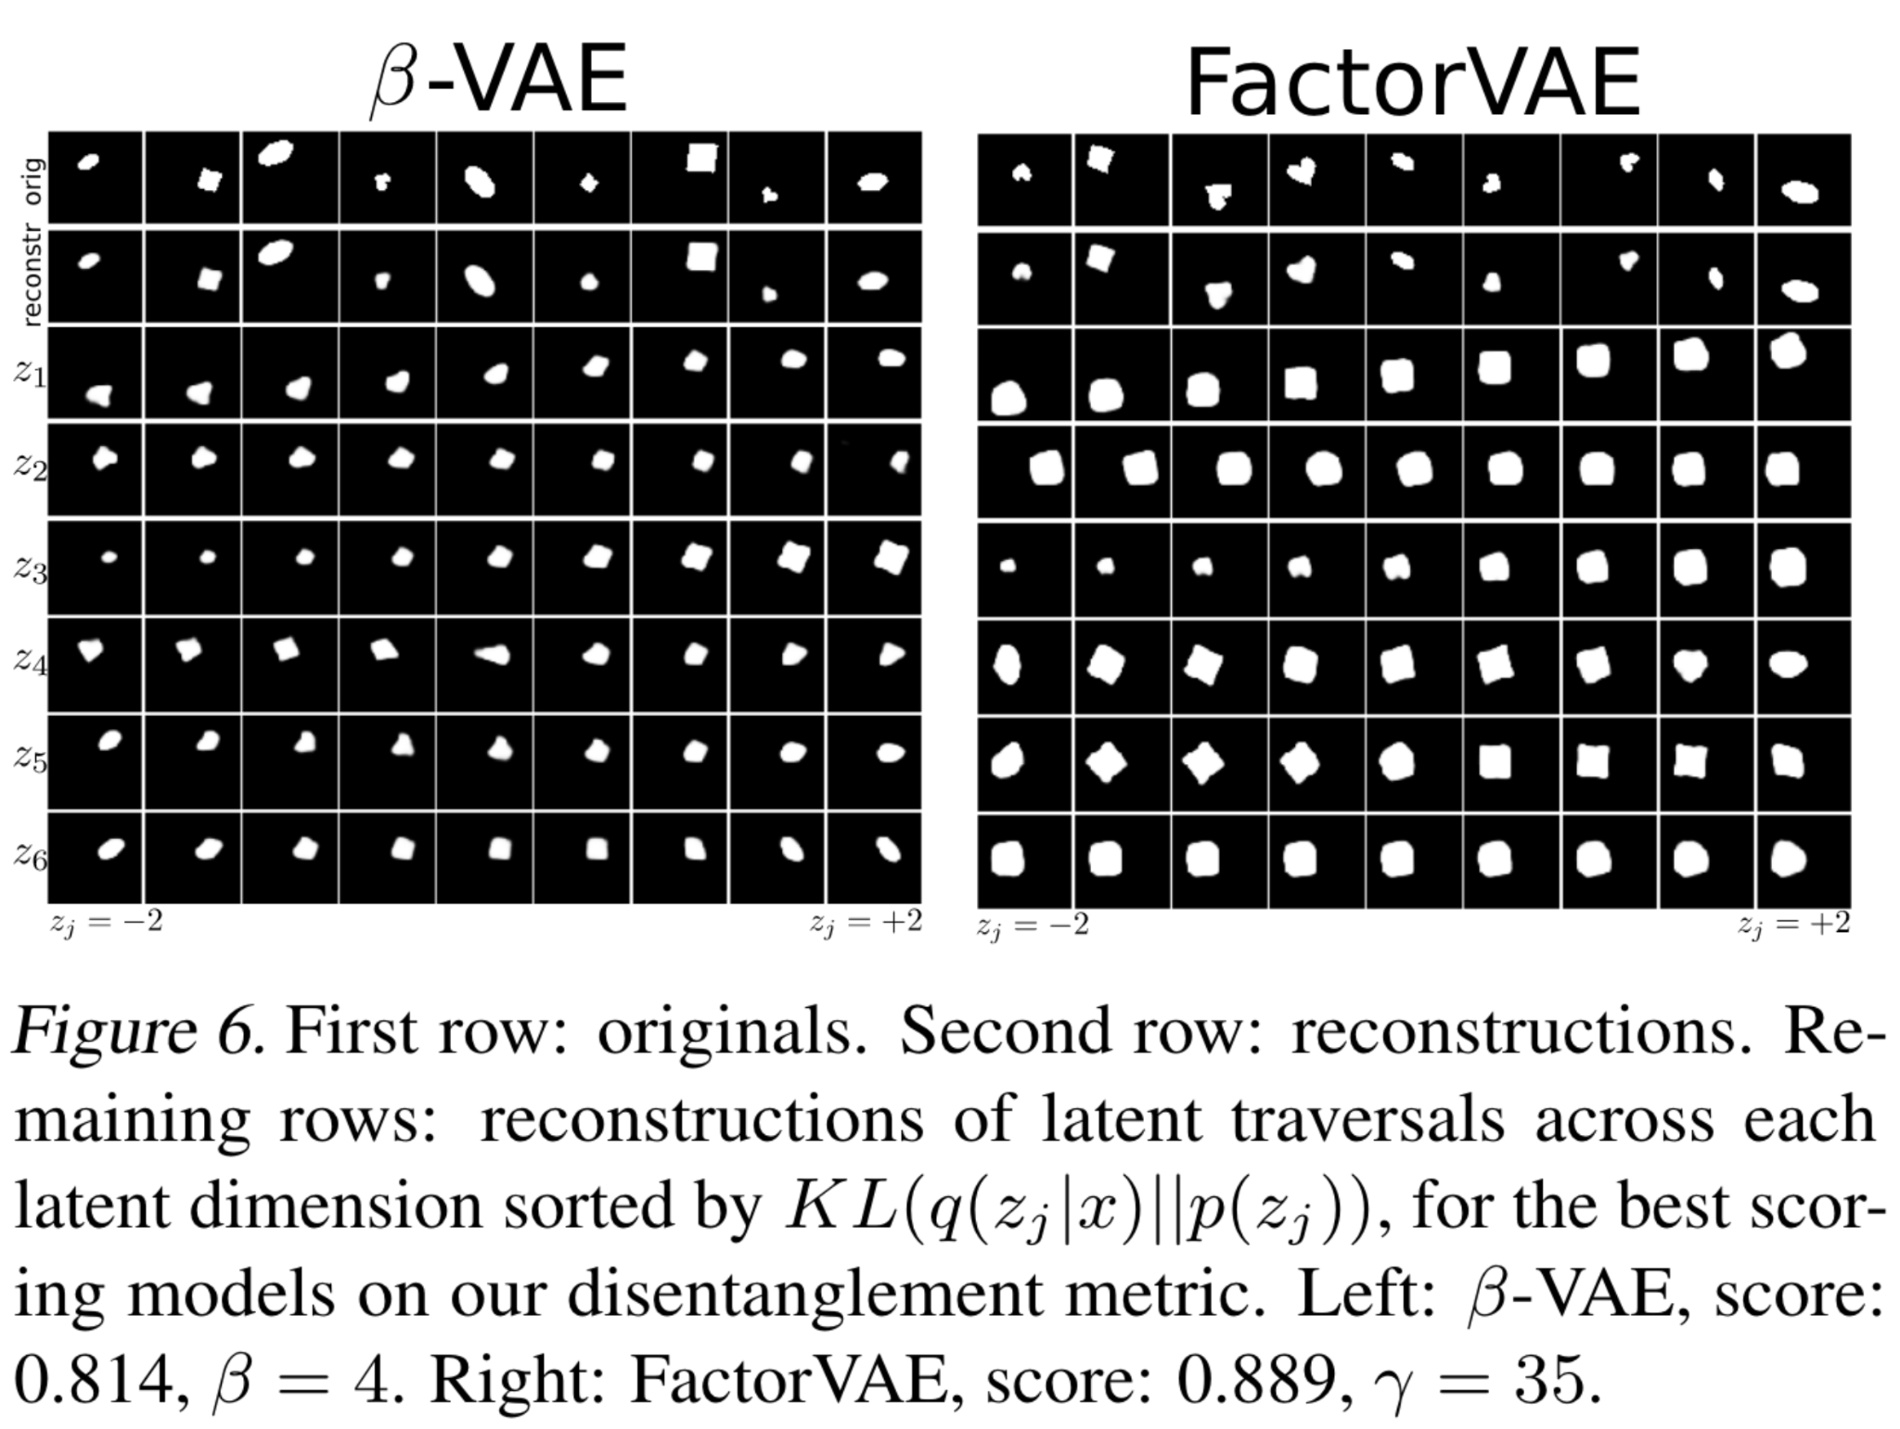
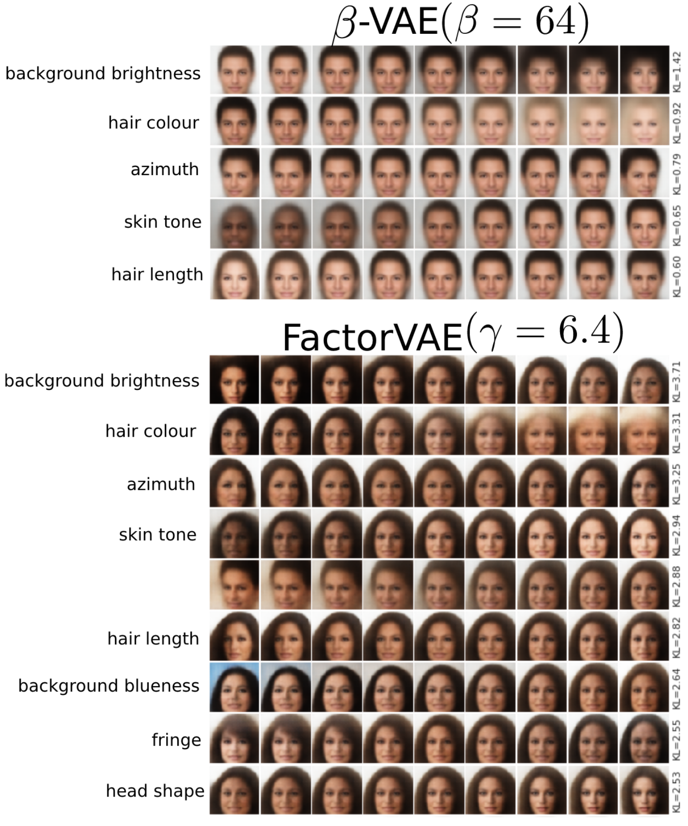

Slide 14
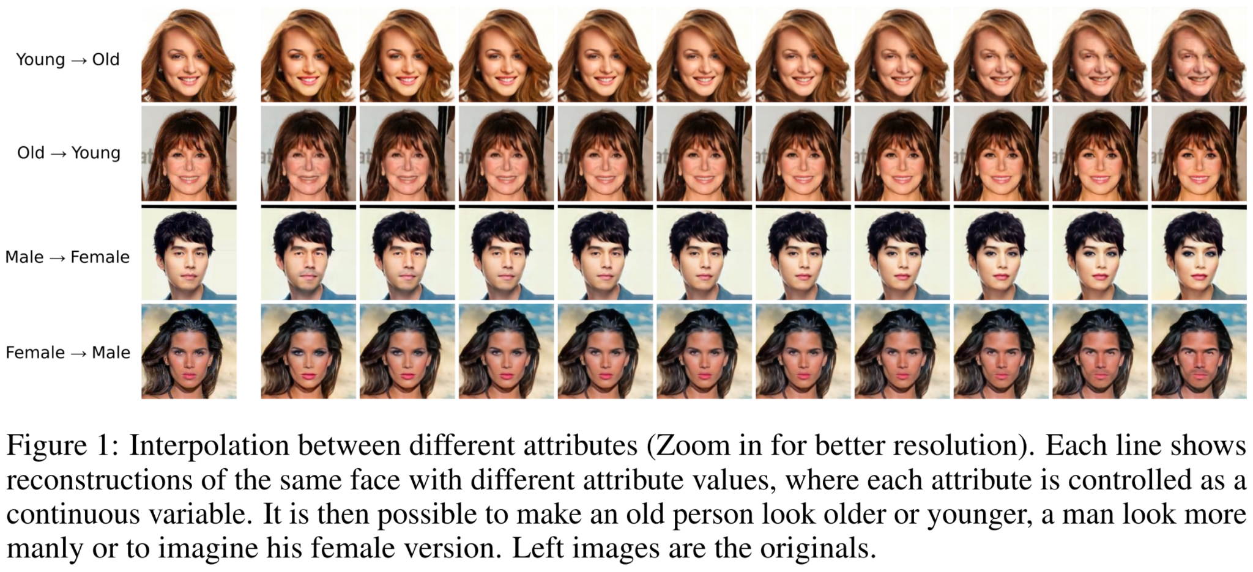

Slide 15
Unsupervised cross-modal domain transfer

Slide 16
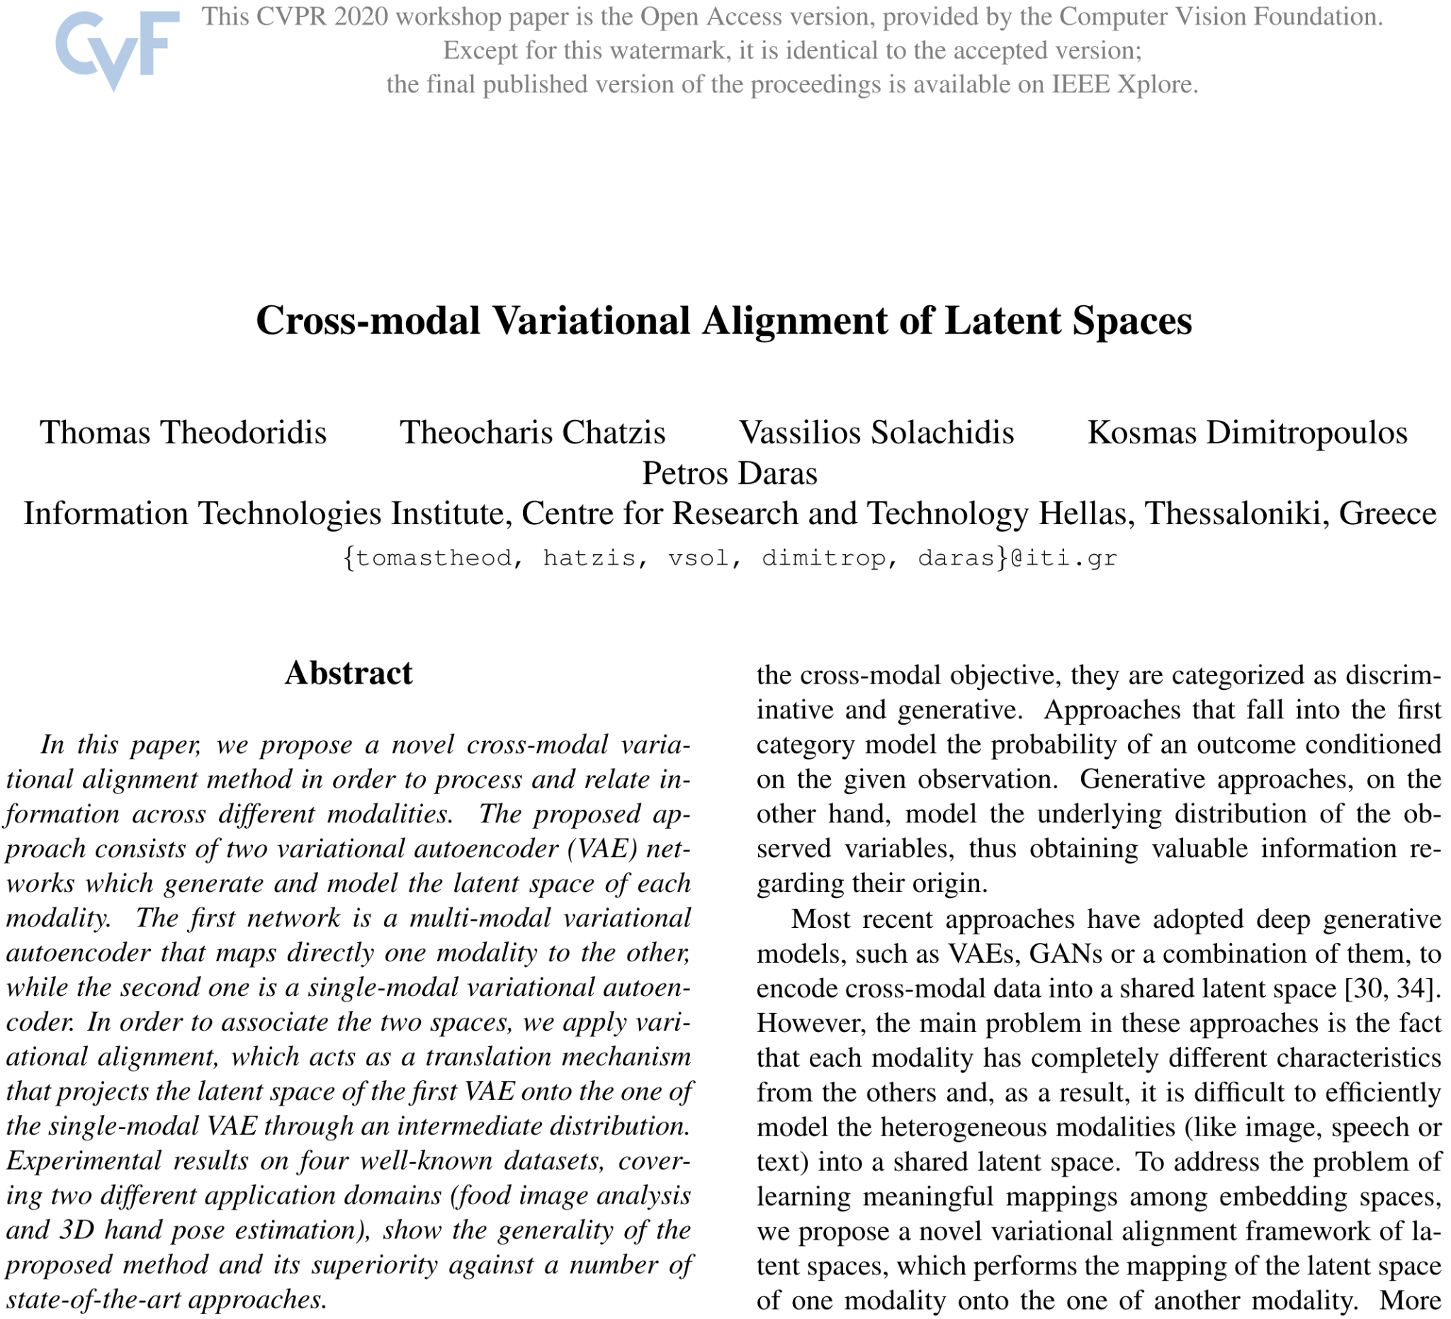
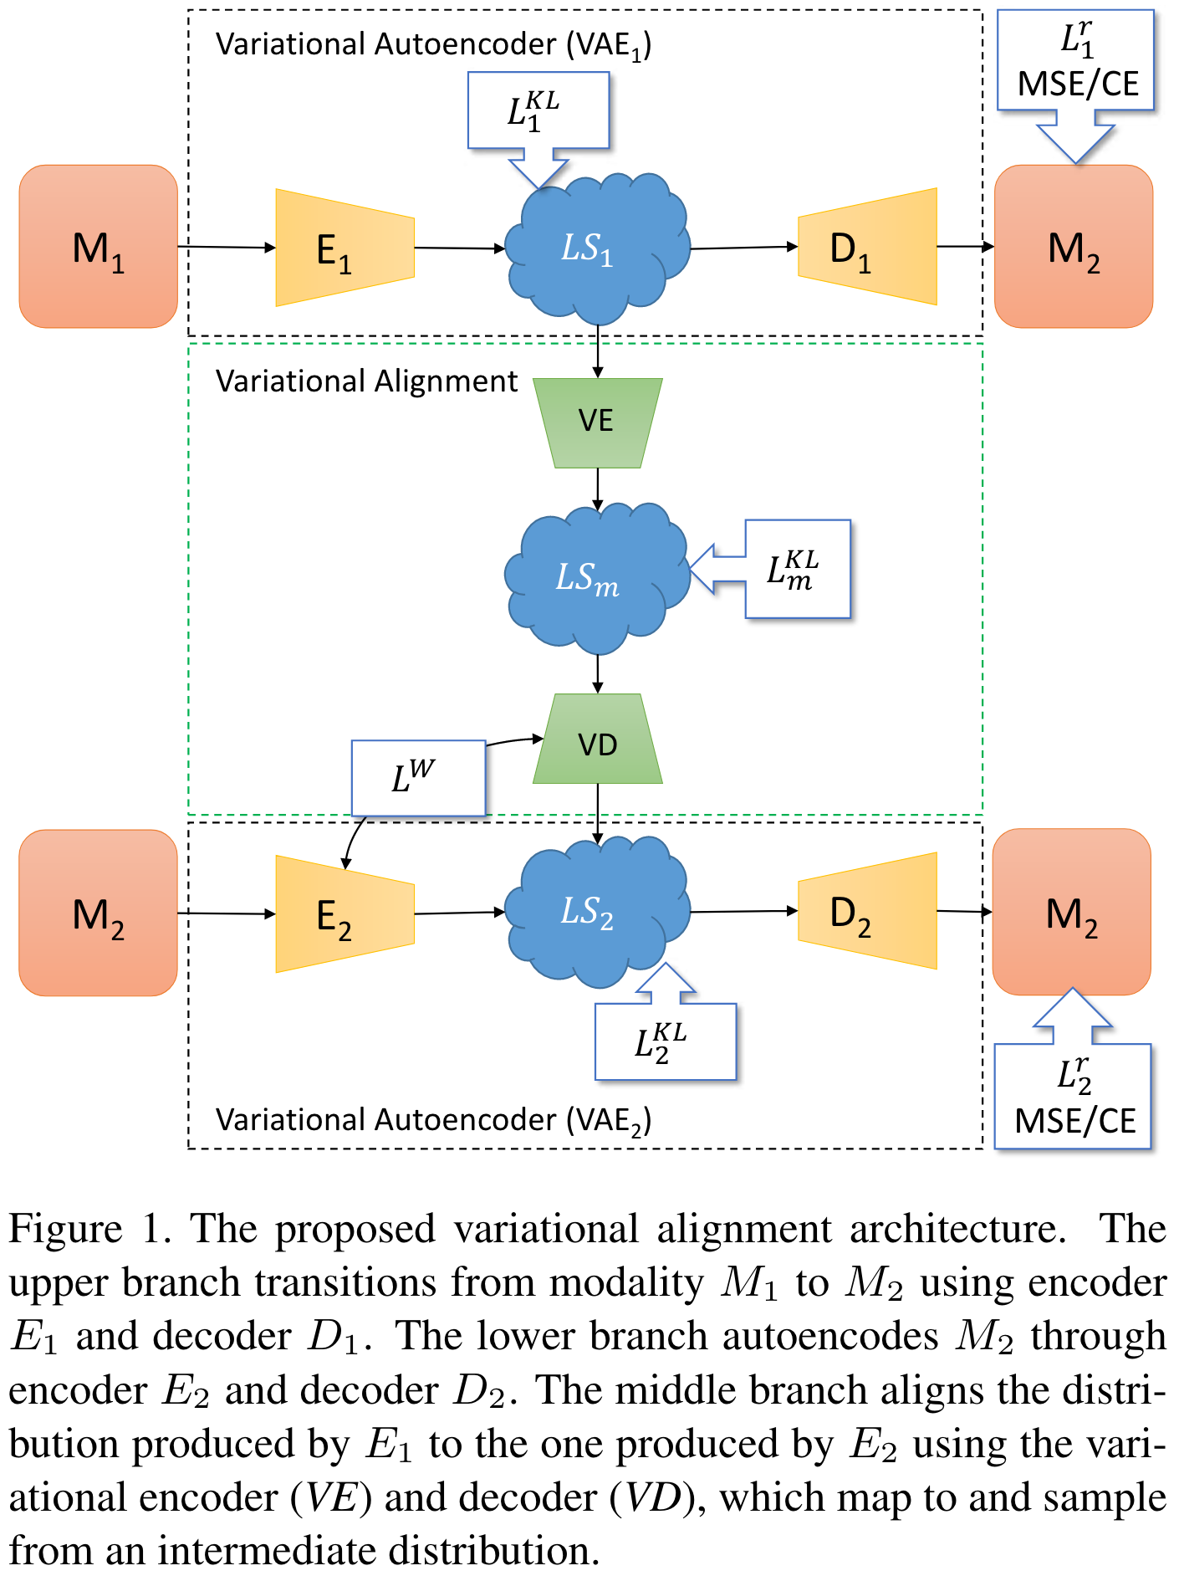

Slide 17
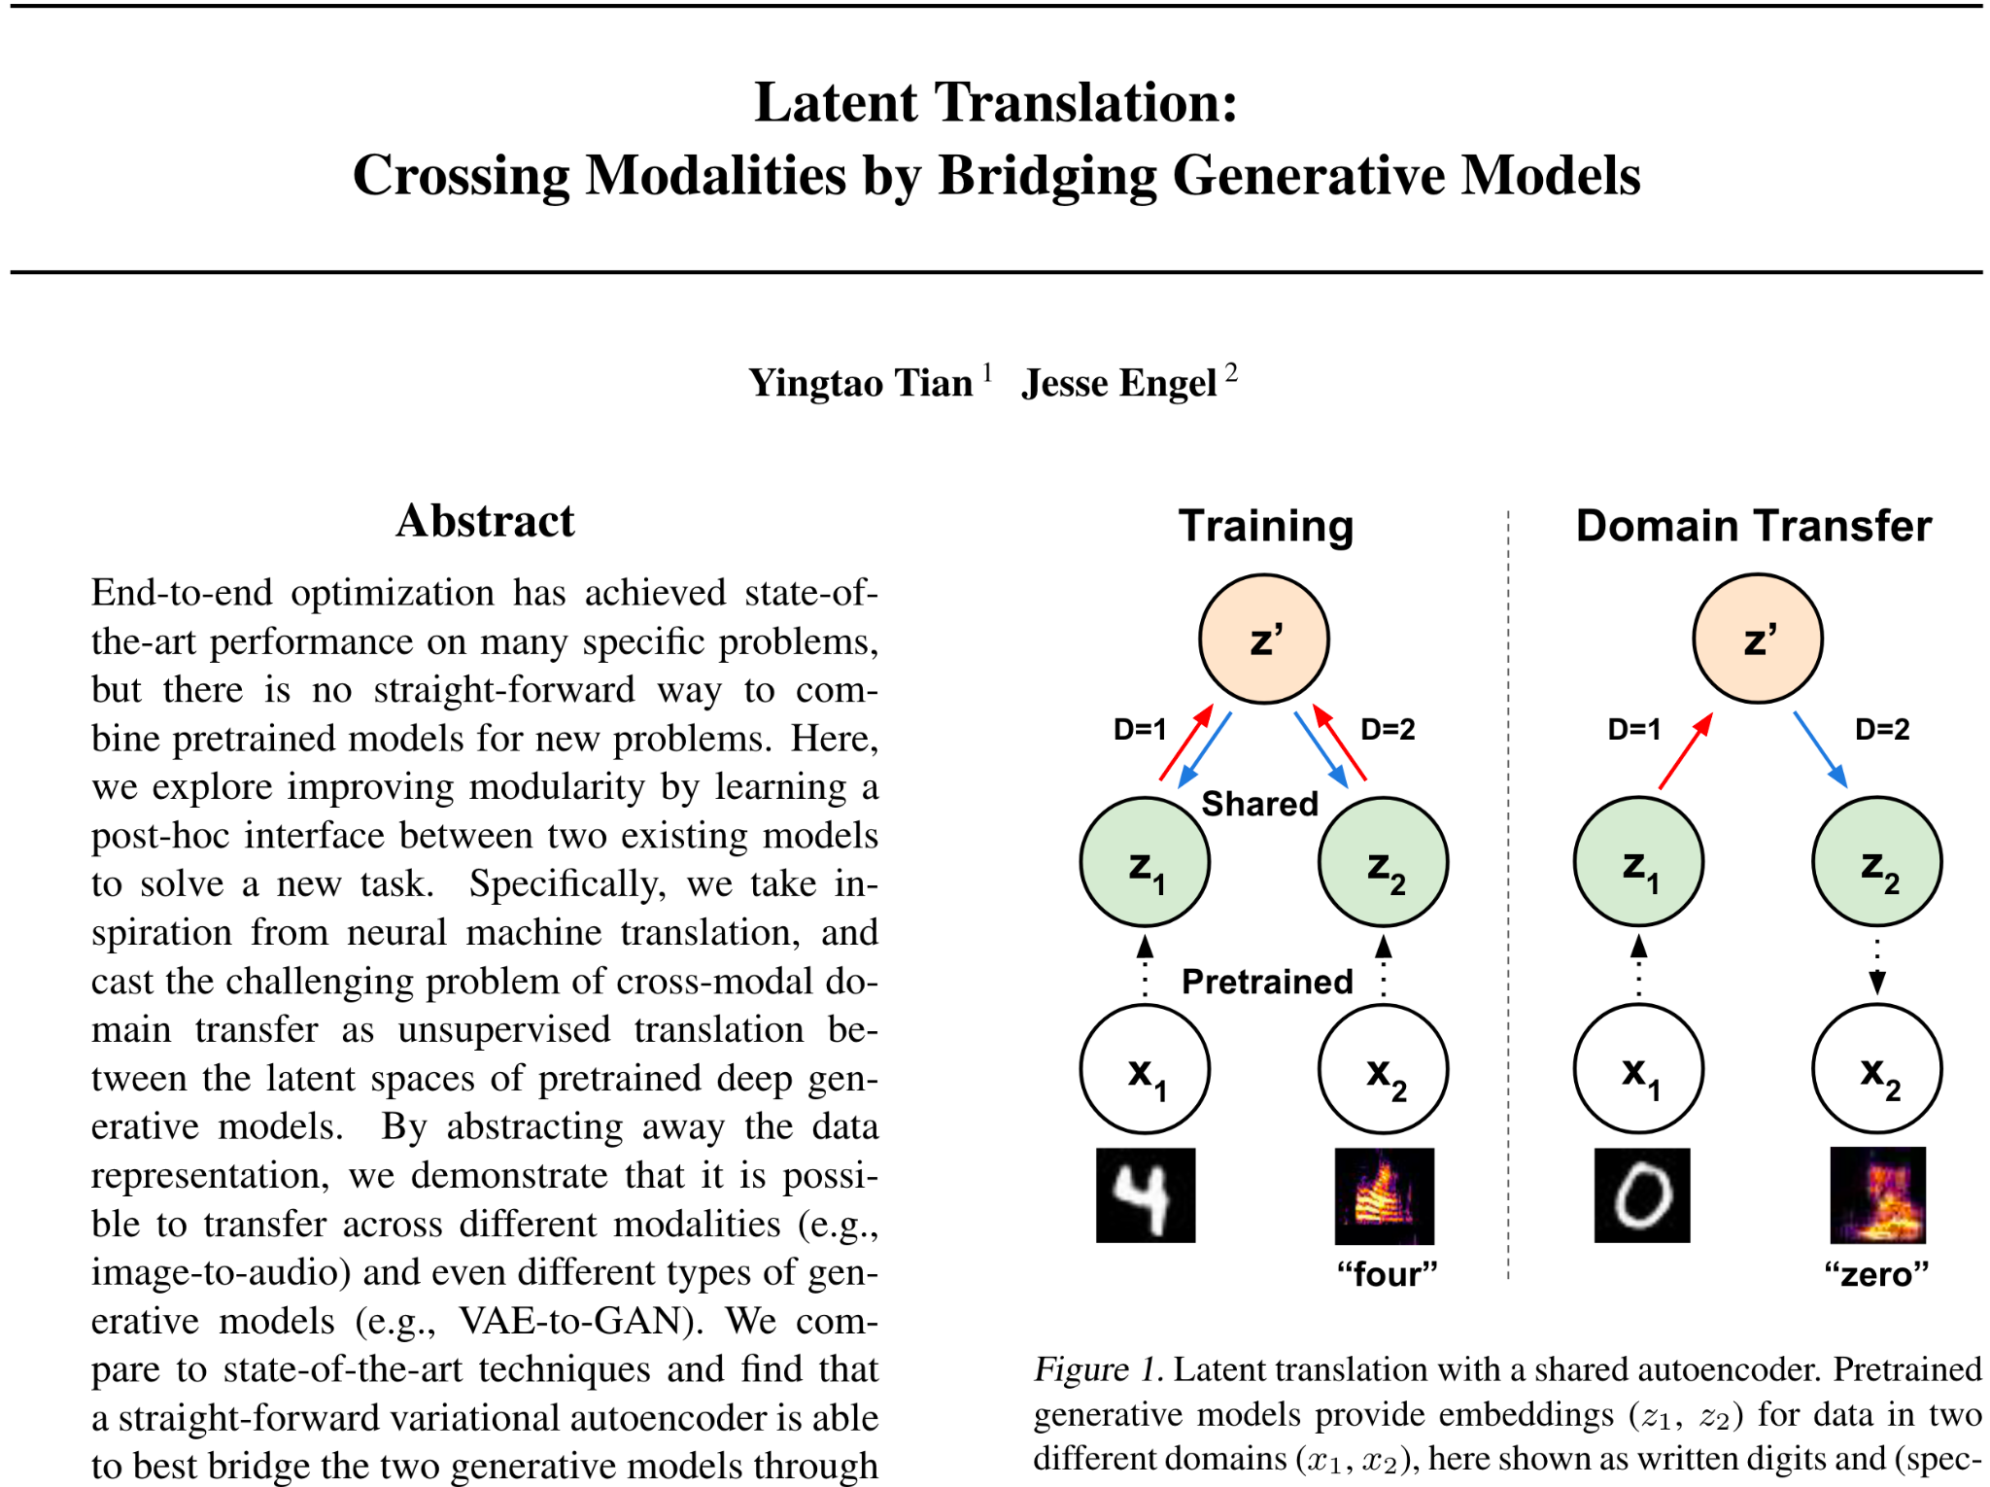

Slide 19
AudioViewer demo

Slide 20
Potential benefits
Learn “best” features
(challenge existing bias in image analysis)
Able to capture abstract features like “age” or “gender”
Fit the mapping to the data
Generalize better across similar datasets
Builds upon pre-trained models (can swap models & retrain mapping)

Slide 21
Image Sonification as Unsupervised Cross-Modal Domain Transfer (W.i.P)

Slide 22
“Problem”
?
Synth parameters
Sounding result
Dataset of features
Mapping
DSP graph
Distance ≠ Distance

Slide 23
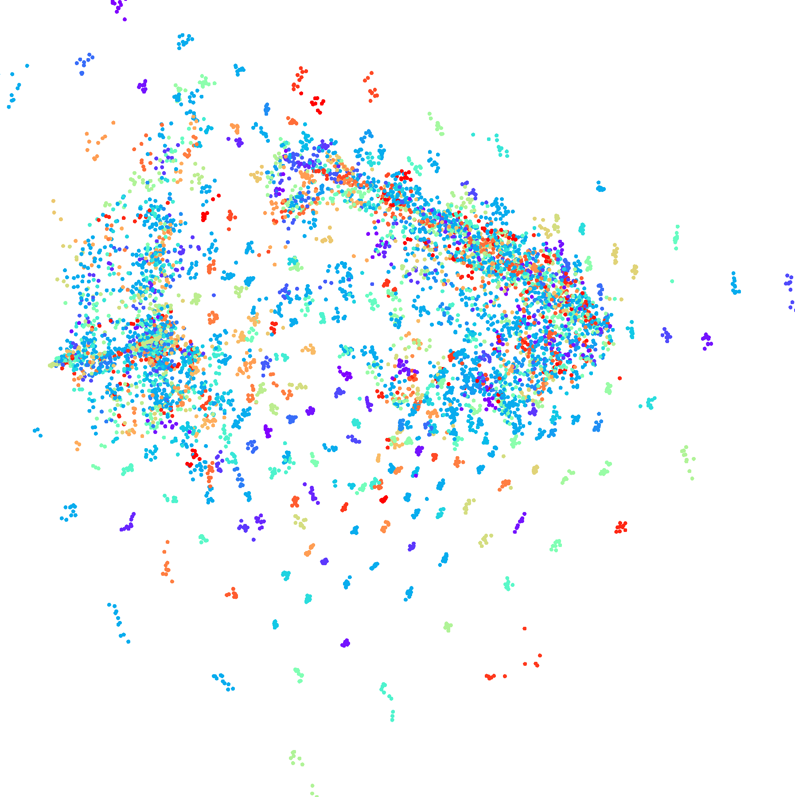
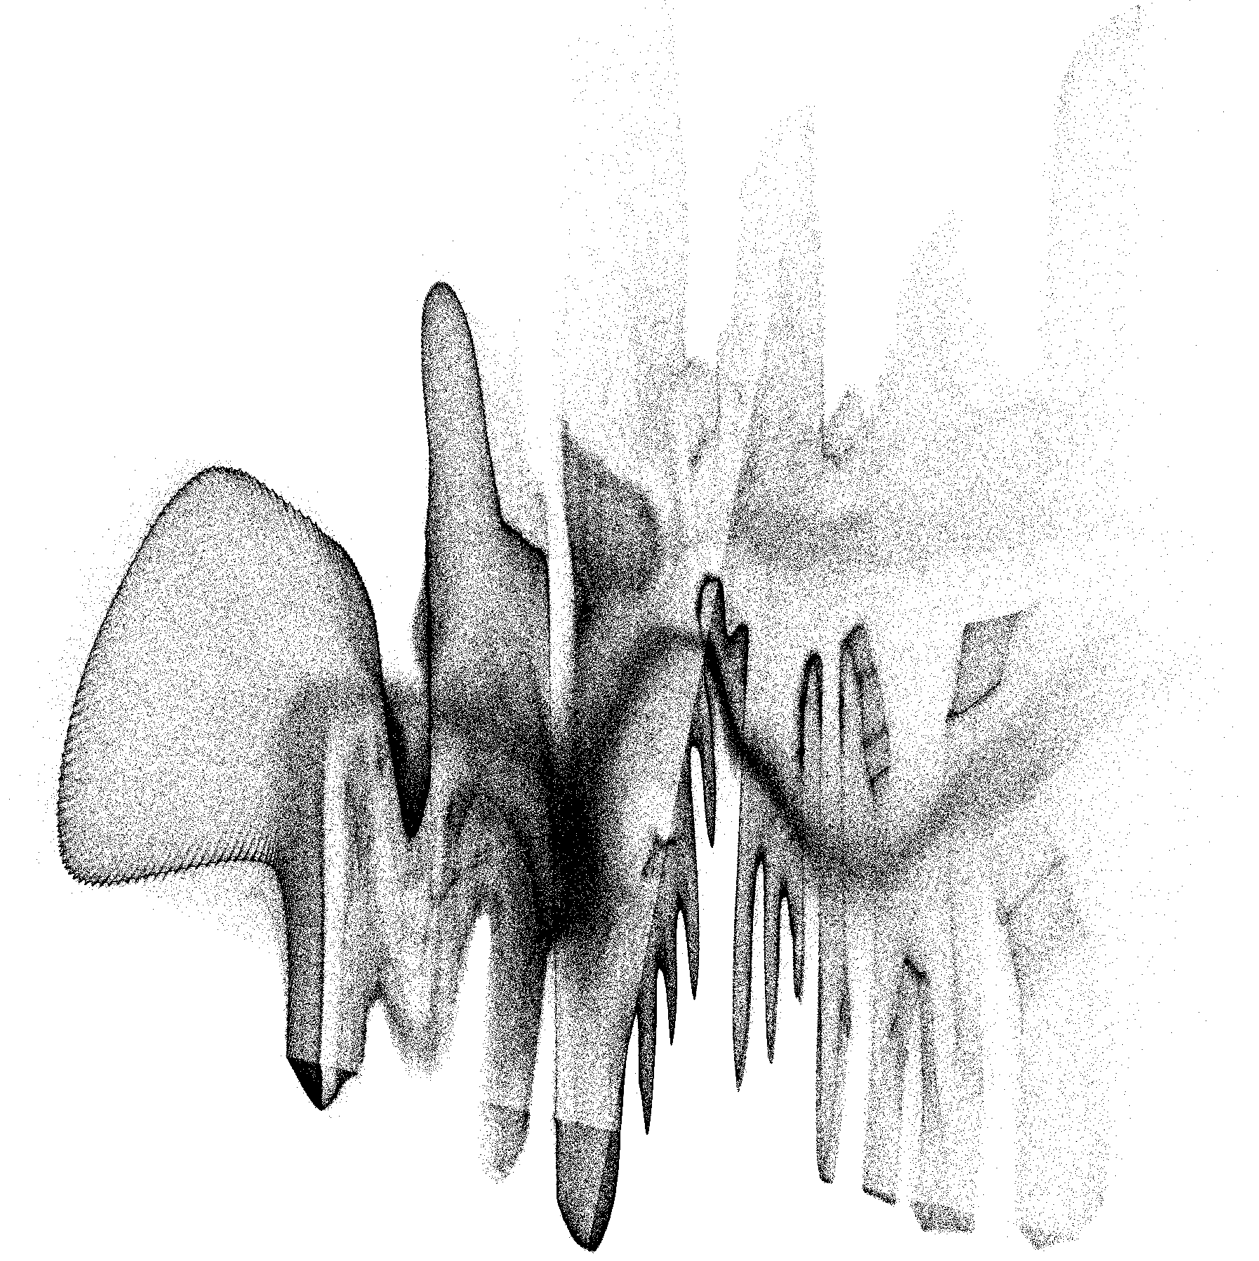
“Solution”
Image VAE
(latent space)
Sound VAE
(latent space)
Sound dataset
Image dataset
Mapping
Distance = Distance

Slide 24
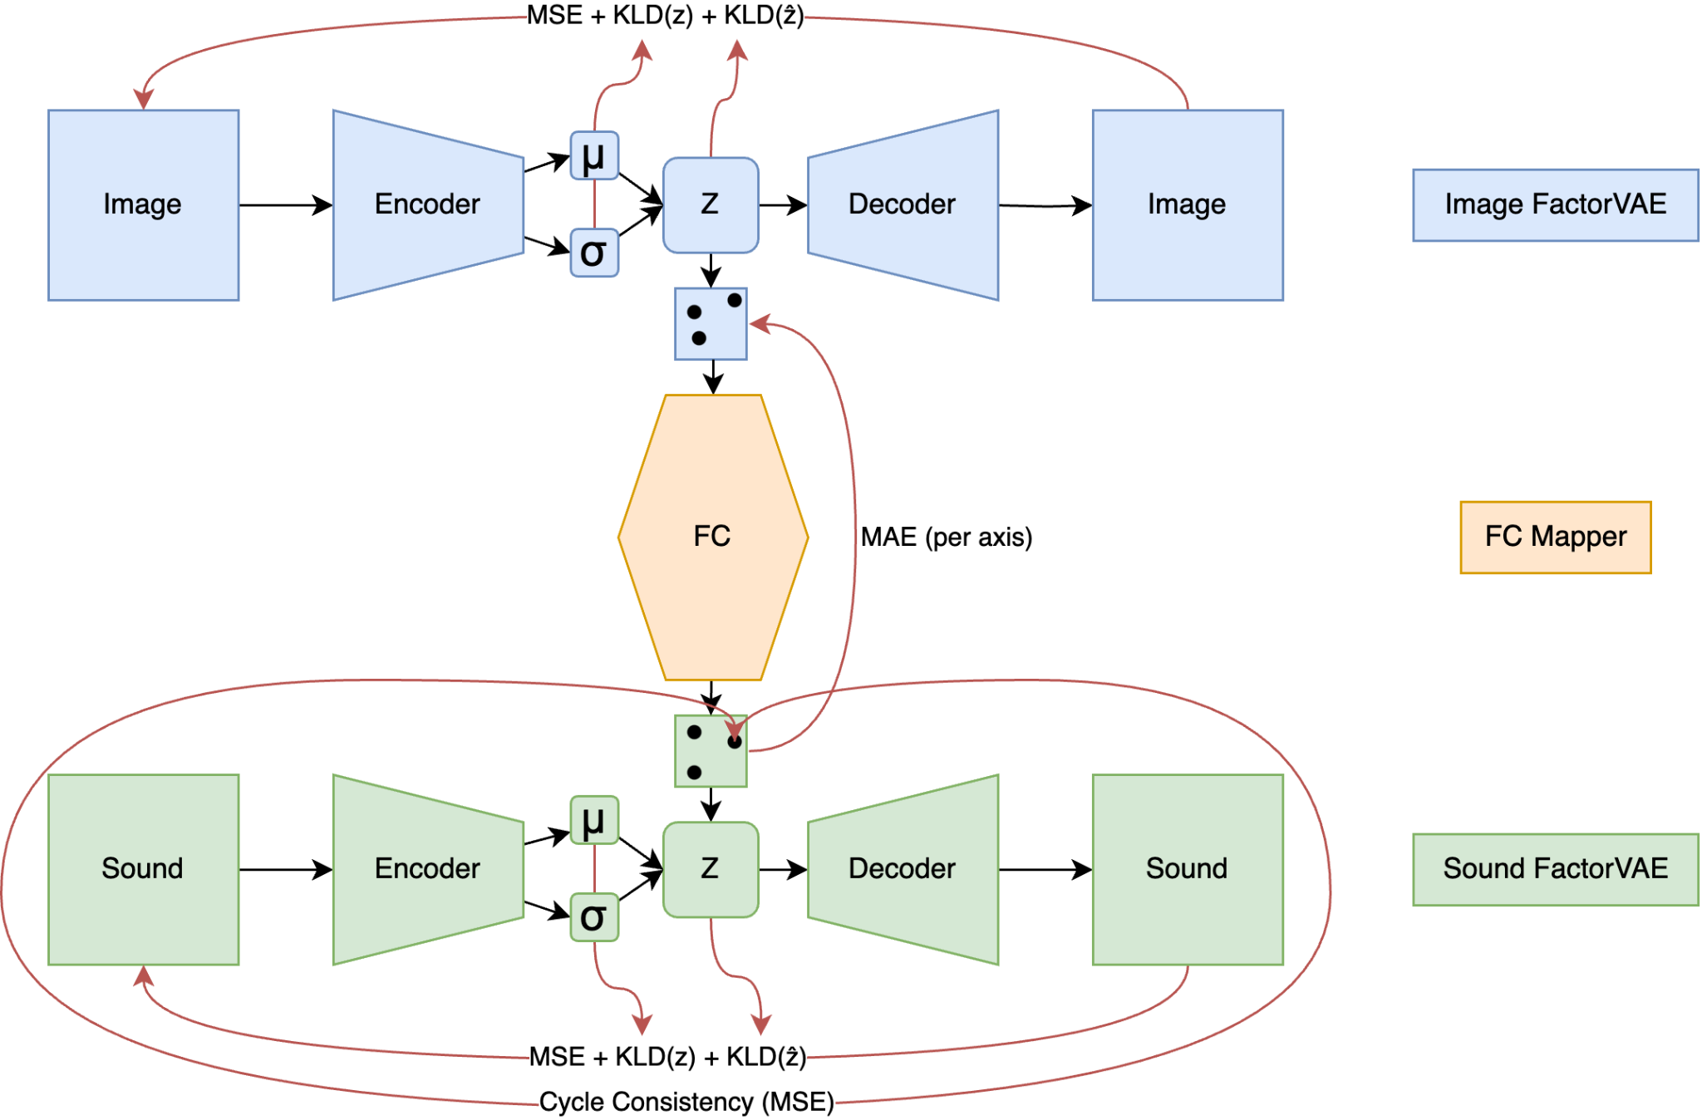

Slide 25
Experiment 1: synthetic datasets, map 2 factors
Create a scenario that’s easy to verify
Create image & sound datasets with two independent varying factors
Test if the system can:
Recognise the factors in both datasets and create disentangled representations of them
Find the best fitting mapping between latent spaces
The system is only told that there are 2 factors

Slide 26
Image Dataset: white squares over black bg
Only varying factors: x & y coordinates
Use a FactorVAE with a 2D latent space
(use falloff “light” to combat sparse image)

Slide 27
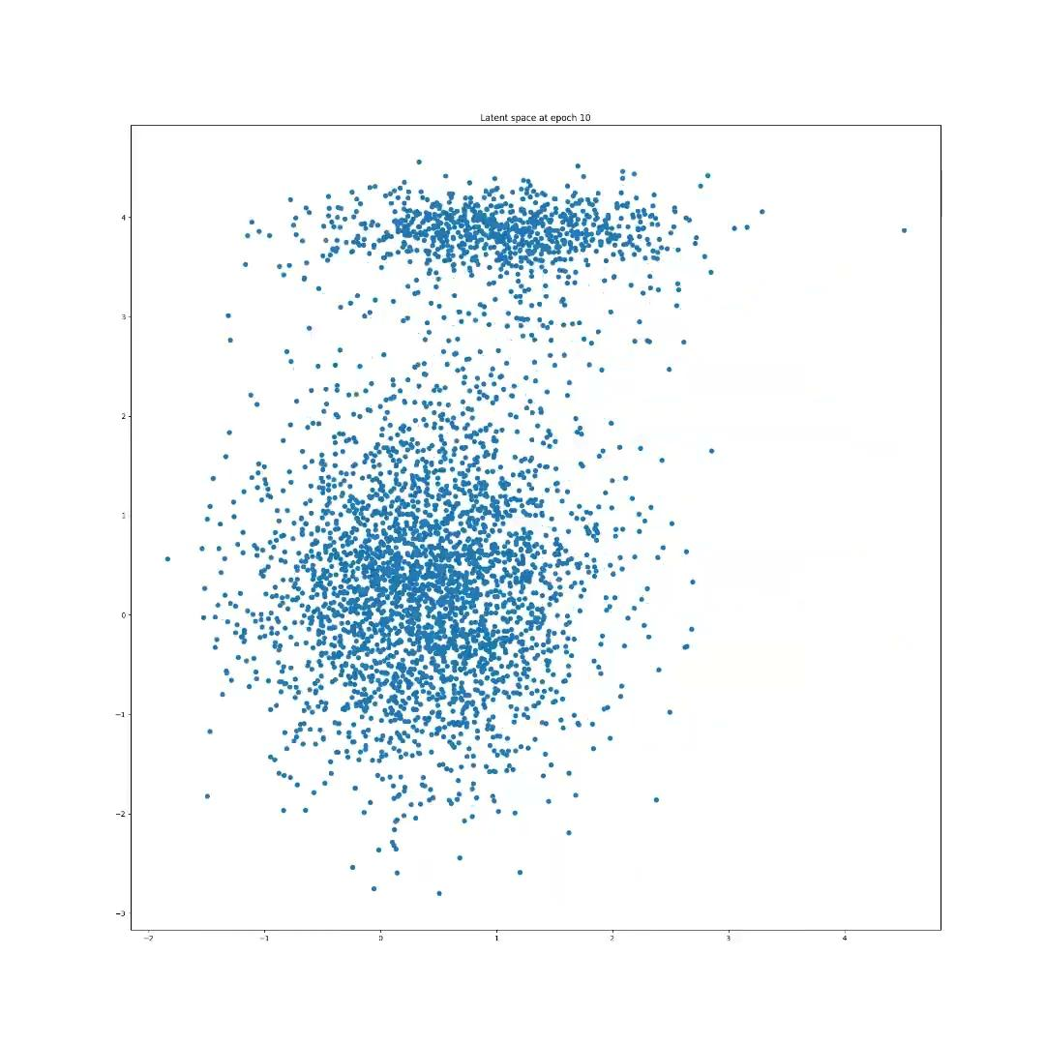
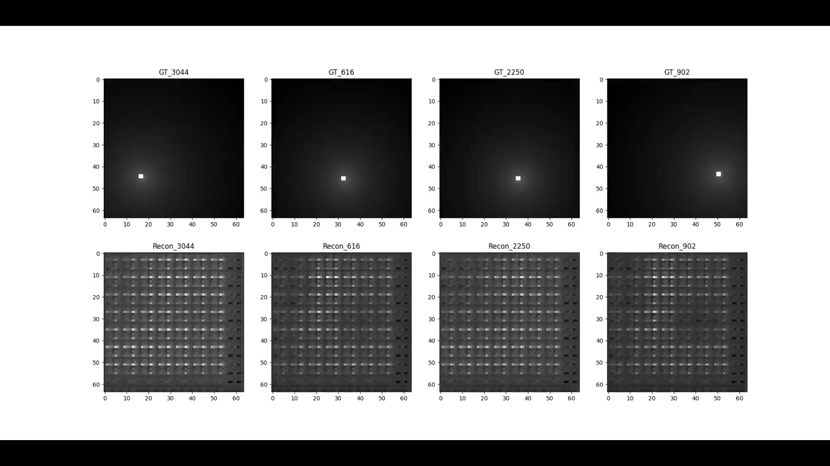
Training…

Slide 28
Traverse latent space

Slide 29
Sound dataset: Sine waves
Only varying factors: pitch & loudness
Input representation: 64x1 Mel bands averaged over time, dB scaled
Use a FactorVAE with a 2D latent space

Slide 30
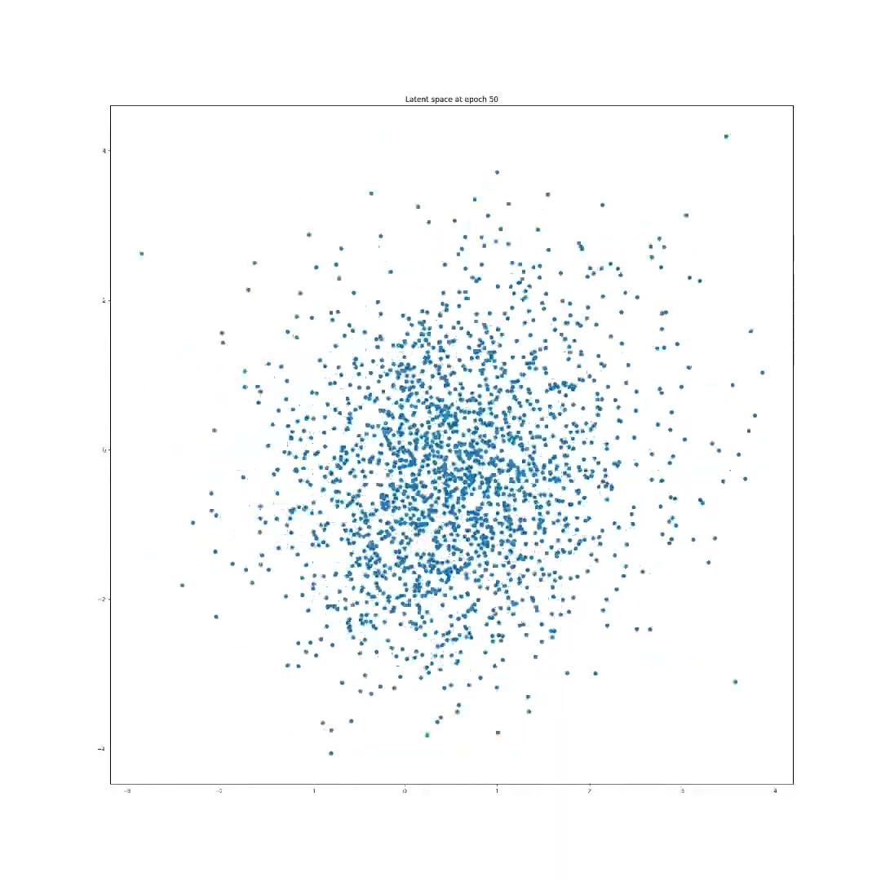
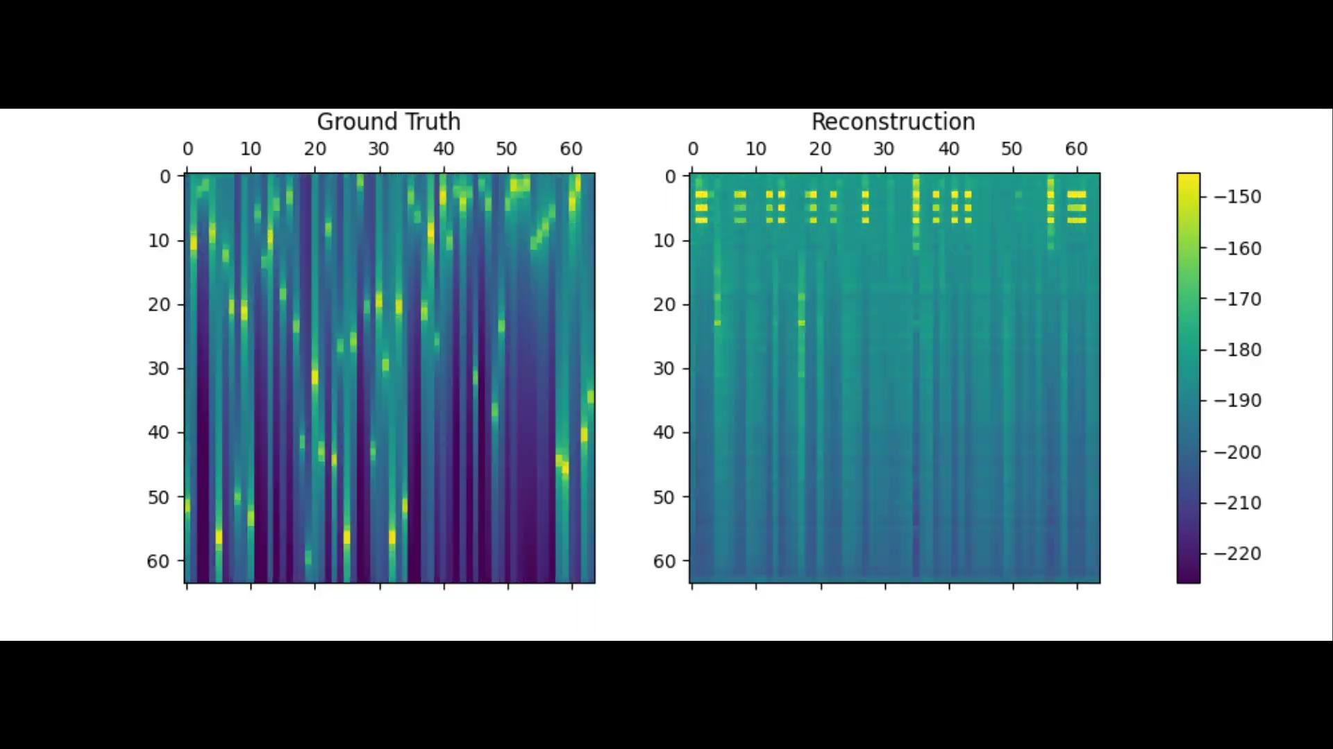
Training…

Slide 31
Traverse latent space

Slide 32
Training the Mapper
1st stage: only use locality loss
Since using FactorVAE-s → per axis!
2nd stage: ramp up cycle consistency (keep locality)

Slide 33
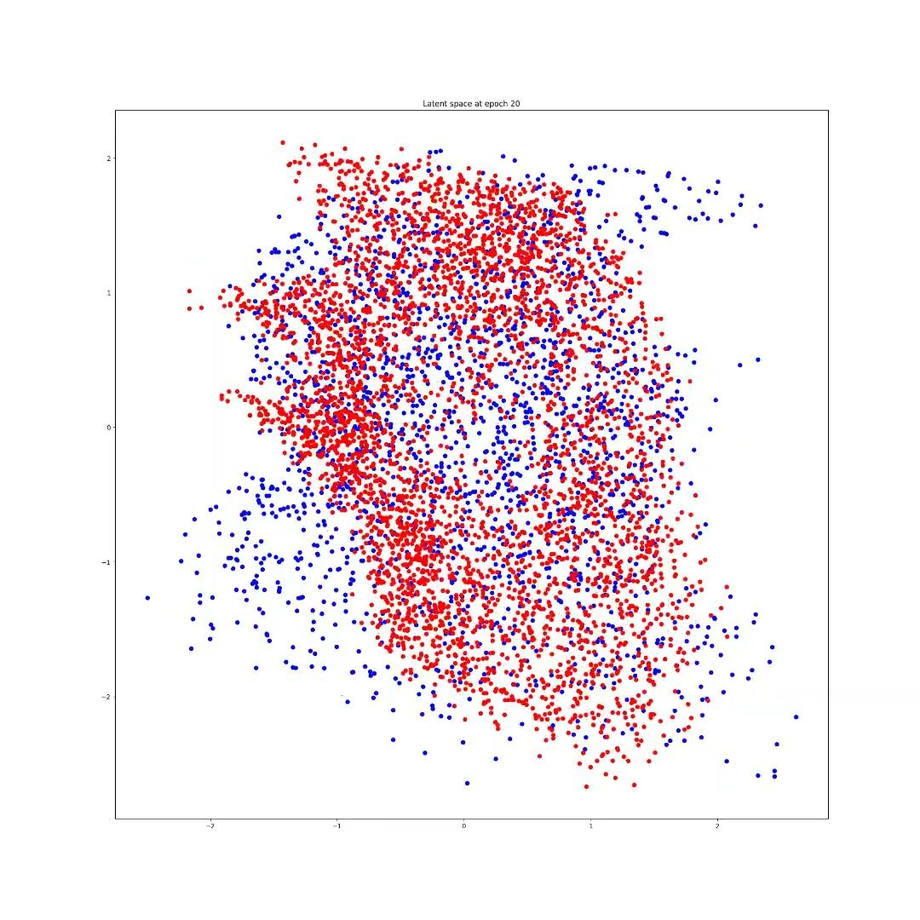
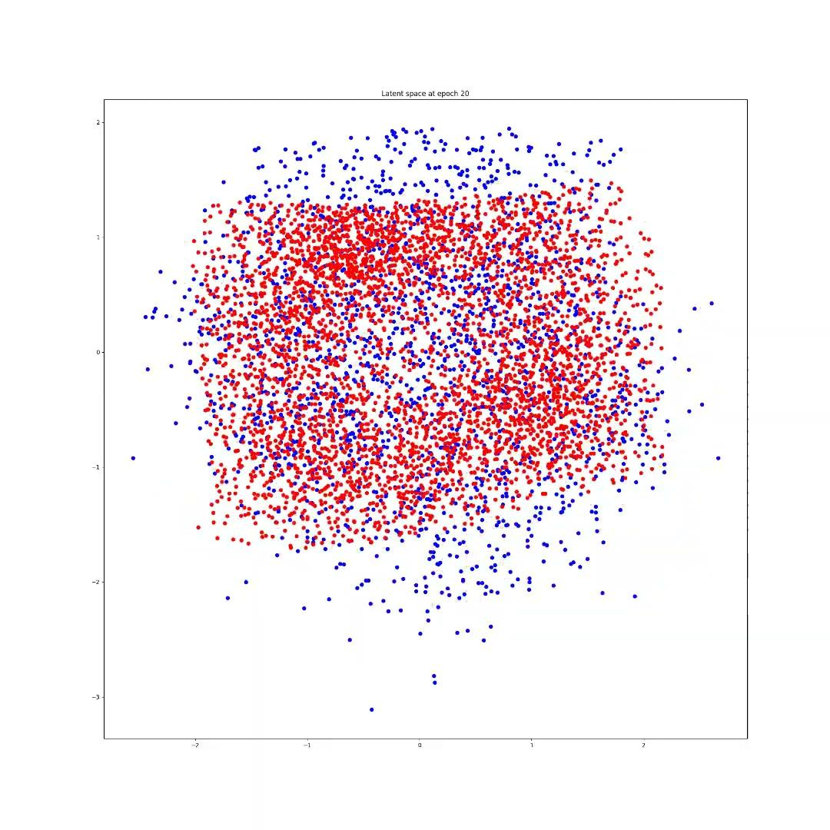
Training…

Slide 34
Live demo… :)

Slide 35
Discussion
Reconstructions need to have OK quality in target model
Assumption 1: latent dimensionality needs to match
Assumption 2: the extents of latent spaces match
AudioViewer design vs mine: factorVAE-s → need to preserve the meaning of axes
Problem with representation: quiet sine waves produce numerically smaller errors?
Synthetic datasets don't necessarily have gaussian priors
Mapper training in 2 stages
Cycle consistency is king

Slide 36
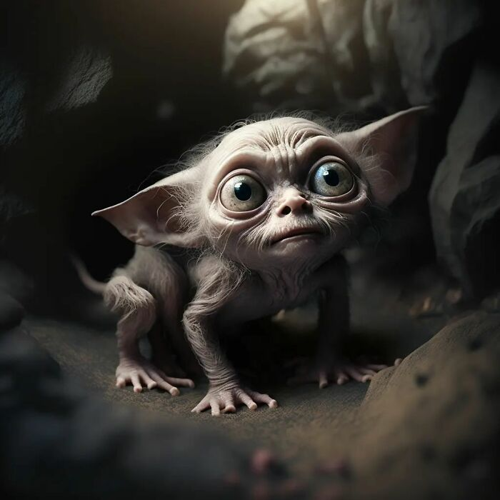
Gollum kitty
(thank you :)
Image from: If 30 Famous Characters Were Kittens, Made By AI Dreams | Bored Panda

