Slide 1
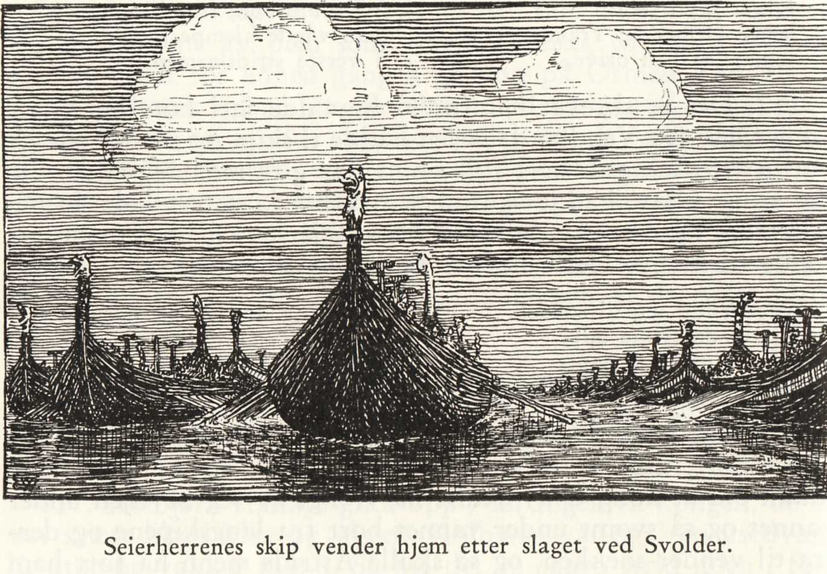
Norwegian history I

Slide 2
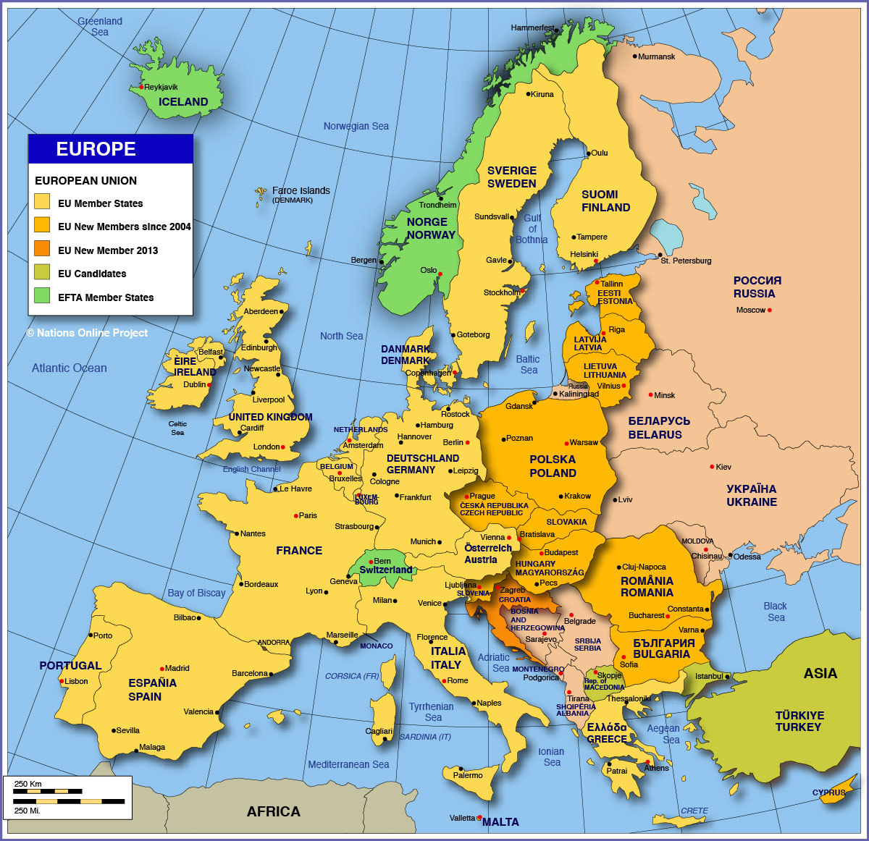
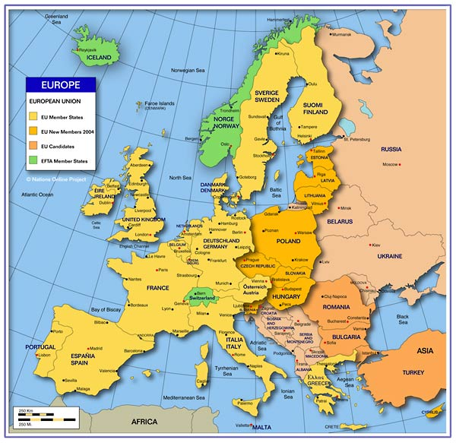
Europe
Notes:
Europe

Slide 3
Norway’s natural resources
Fisheries
Forestry
Mining industries
Shipping
Today: oil and gas
Tomorrow?

Slide 4
Future challenges
Reduce global warming
Industrial innovation
Development of green energies to replace oil and gas

Slide 5
Europe
Notes:
Europe

Slide 6
Prehistoric Norway
10 000 BC Migration into Scandinavia
4000 BC Agriculture
1800 BC Bronze
500 BC Iron

Slide 7
200 AC: Runes
Carved into stone
Commemoration of persons and events
Not a written culture in Norway until 11th century

Slide 8
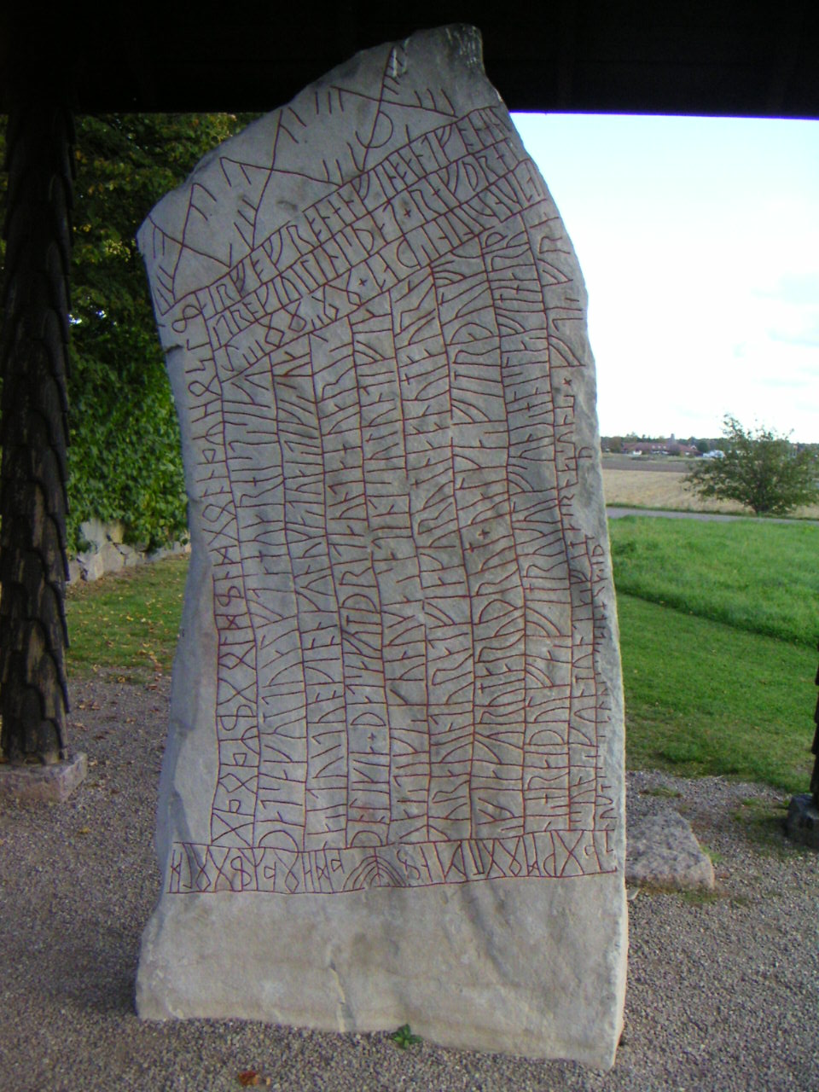

Slide 9
500 AC: Seagoing ships
Settlements mainly along the coast
Ships used for fishing, transport and trade
”Norway”- ”Norwegen”- ”Norvège” = The way north
Maritime traditions essensial in Norwegian culture

Slide 10
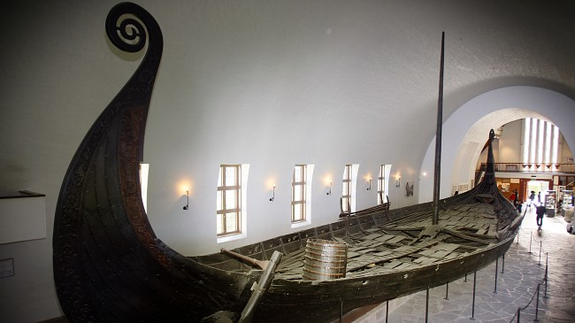
The Oseberg ship

Slide 11
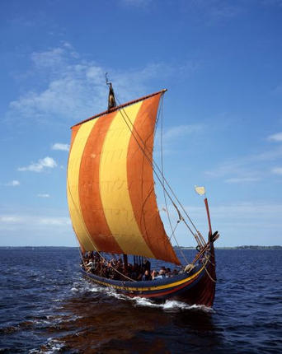

Slide 12
300-500 AC: Migration period
Tribal peoples from the east migrated into western Europe and Scandinavia
Regional kingdoms
Clan society

Slide 13
Pre-state institutions
Ting
- Regional political assemblies
Law
- Regional lawcodes, oral tradition
Religion
- Polytheistic, non-dogmatic. Emphasizing life on earth

Slide 14
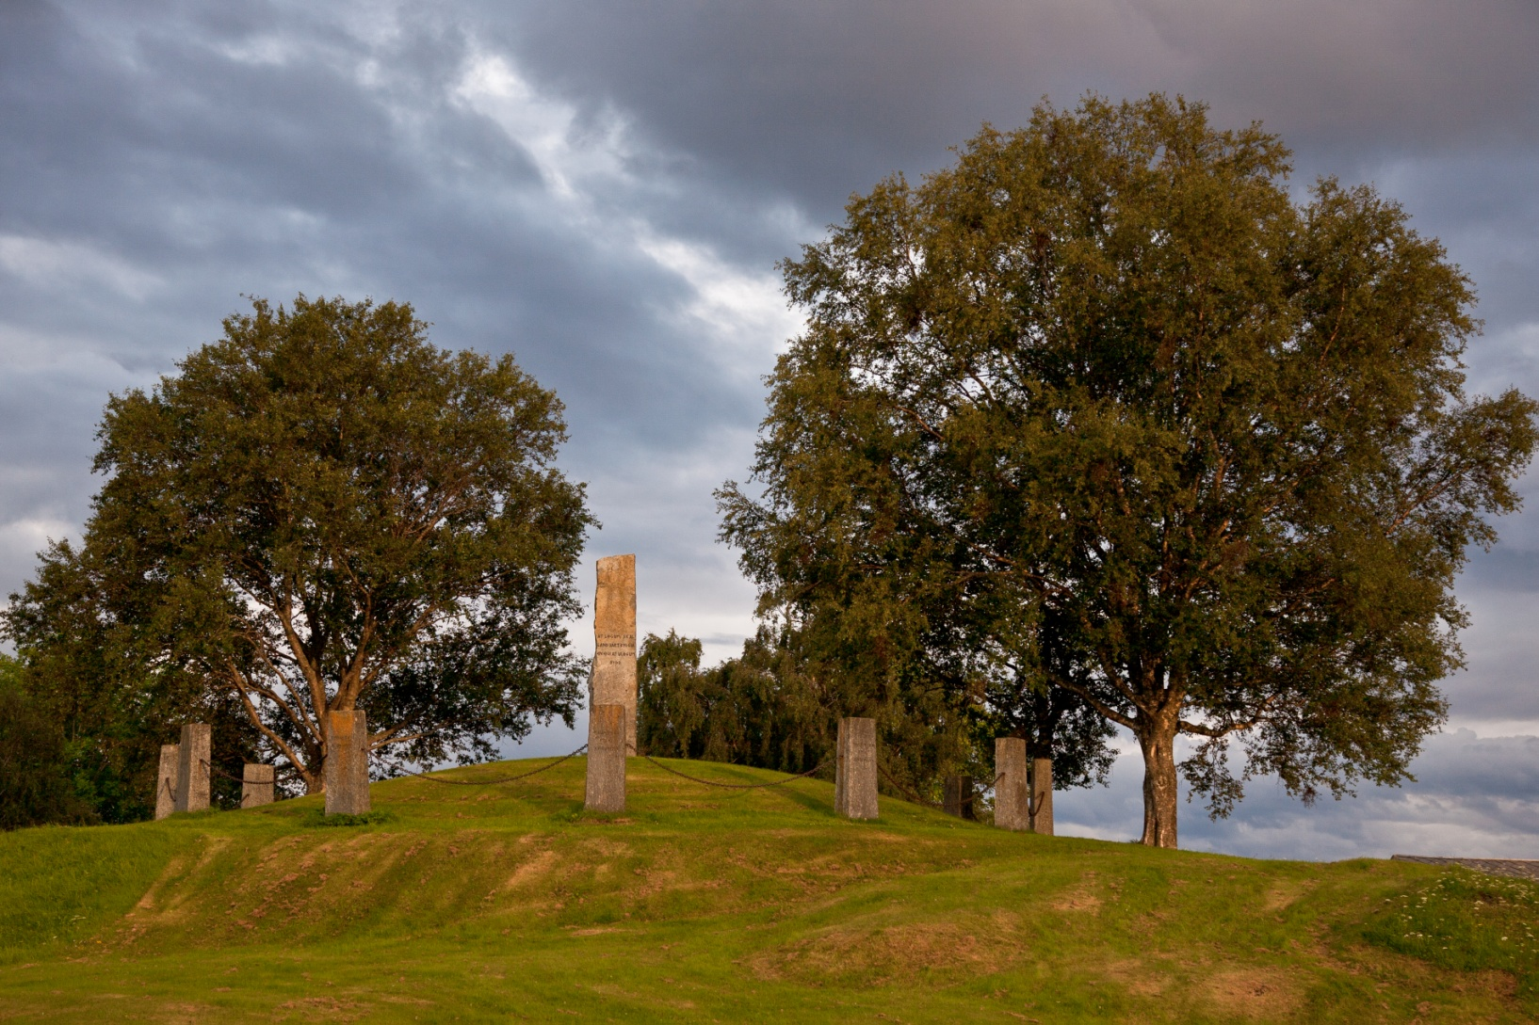

Slide 15
Pre-state institutions
Ting
- Regional political assemblies
Law
- Regional lawcodes, oral tradition
Religion
- Polytheistic, non-dogmatic. Emphasizing life on earth

Slide 16
The Viking Age
Armed warriors from Scandinavia attack settlements abroad
Lindisfarne 793
Viking colonies: North Sea- and Baltic region, Russian inland, The British Isles, Normandy, Iceland, Greenland, New Foundland.

Slide 17
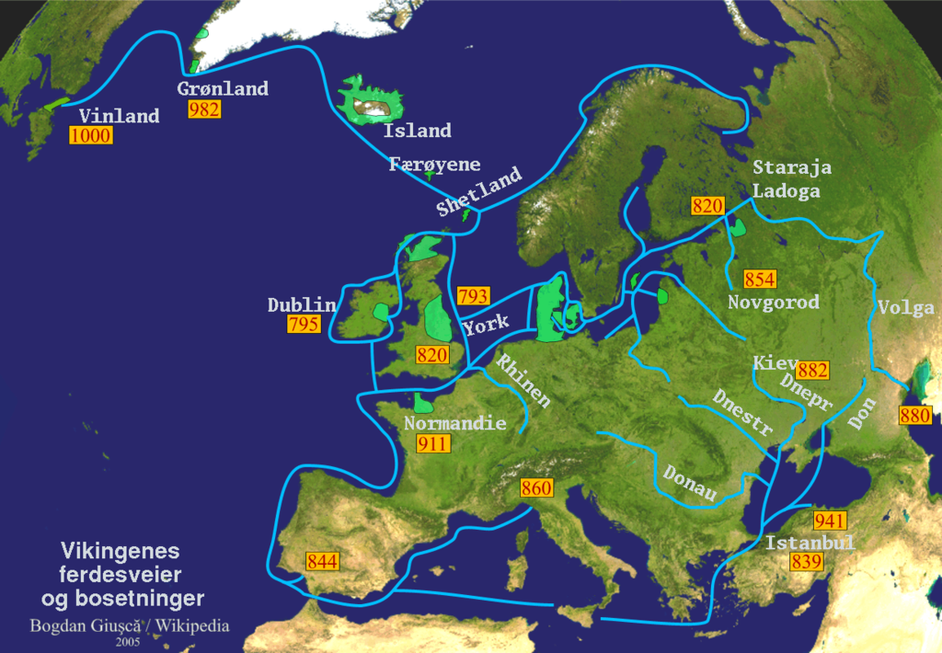
Viking campaigns and settlements

Slide 18
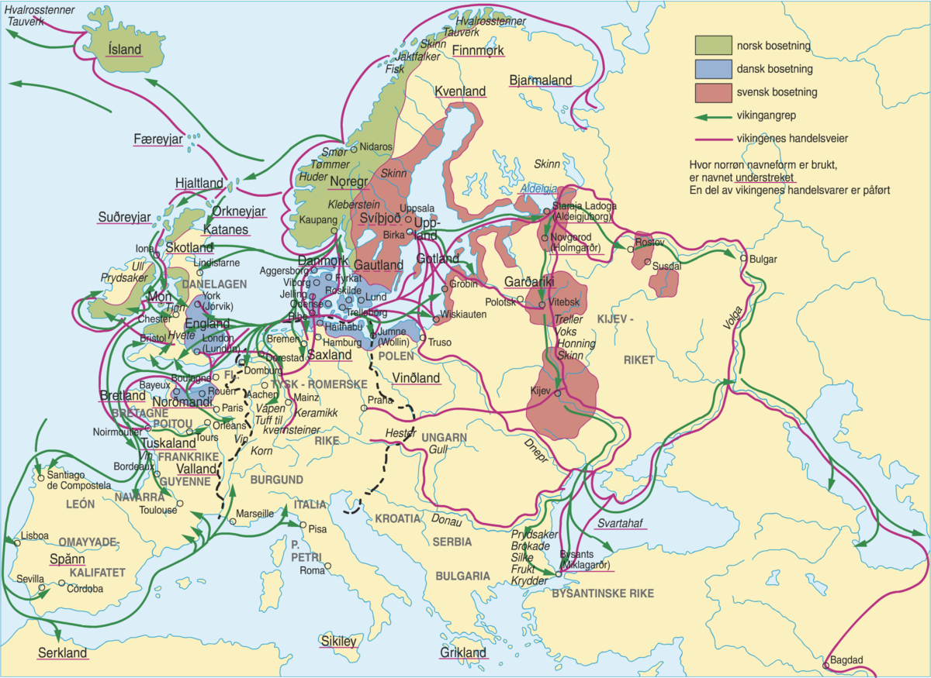

Slide 19
What caused the expansions?
Good naval skills and equipment
High stakes and low risk: Weak opposition abroad
Military conflicts at home drove people away from the country
Overpopulation?

Slide 20
Viking trade
Commercial excange along the travelling routes
Natural products and slaves against luxury items and silver
Urban settlements/market places: Dublin, York, Dorestad, Hedeby, Skiringssal, Birka, Novgorod
Many viking towns disappeared with viking trade

Slide 21
Viking age legacy
Political unification
National kingdom: Harald Fairhair 872
Religious reform
Missionary kings: Håkon the Good, Olav Trygvason, Olav the Holy (St. Olav)

Slide 22
St. Olav, the reforming figure king 1015-1030
Viking king and Christian martyr
Legend and saint
Olav’s defeat the turning point: Monarchy and church generally accepted as institutions after Olav

Slide 23
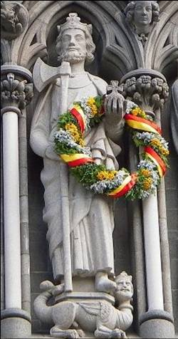

Slide 24
1030-1130: Consolidation of Norwegian kingdom
Strong military rulers
Western colonies brought under royal administration
Harald Hardruler
Magnus Barefoot
Sigurd Crusader

Slide 25
1130-1240: Civil wars
Rivaling parties and kings fight over hegemony
The problem of royal succession: a system based on inheritance and popular election

Slide 26
Authority contest between Monarchy and Church
1152: The Norwegian church underlain Rome
Church claim political independence: pope versus German emperor
In Norway: Church party versus rojalist party, archbishop Eystein versus king Sverre
King Sverre excommunicated 1194
The medieval church: wealthy and powerful

Slide 27
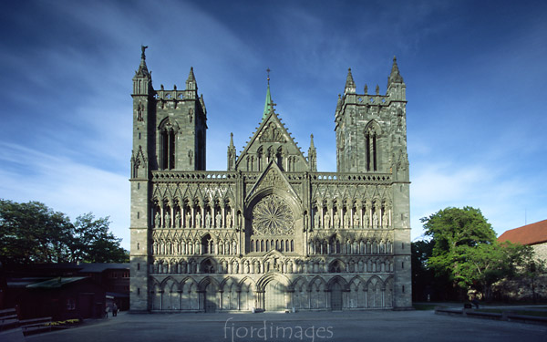

Slide 28
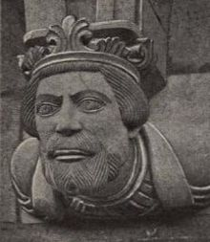
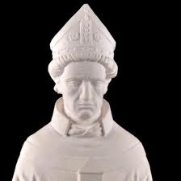
Monarch versus archbishop
Sverre
Eystein

Slide 29
Culmination of the medieval kingdom
Monarchy extended its power and administration: Royal ombudsmen
Foreign policy: Focus on Norwegian North Sea Empire under king Håkon Håkonsson
King Magnus Lawmender: Diplomacy abroad. Administrative reforms at home
National lawcode 1274.
Settlement between monarchy and the church 1277
King Håkon 5th: Great building activity. Oslo capital

Slide 30
Social conditions
Population growth
Peasants: from freeholders to tenant farmers
The free position of Norwegian peasants
The old clan aristocracy displaced by a new elite of royal ombudsmen

Slide 31
Chivalric culture
Feudal forms adapted into Norwegian social system: barons and knights
Smaller social differences than abroad
Chivalric ideals
Fine arts and literature
Snorre Sturlasson: Heimskringla
The impact of christianity: a more humane society

Slide 32
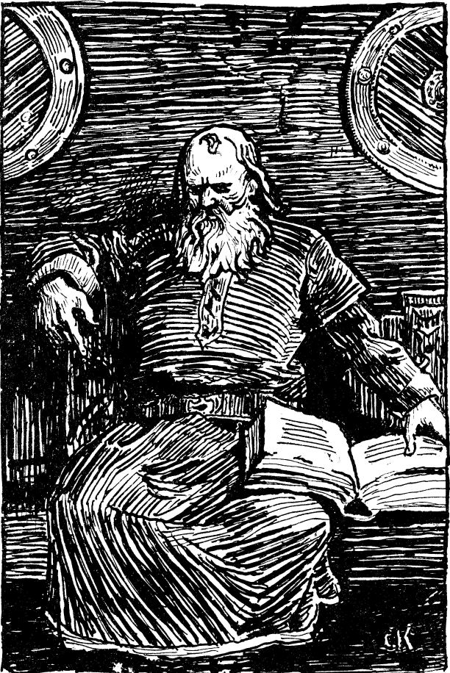
Snorre Sturlasson

Slide 33
Black death and economic crisis
1349: Nearly half the population killed by plague
Many farms left vacant
Price fall on agricultural products
Hard times for rural aristocracy
Better times for subsistence farmers

Slide 34
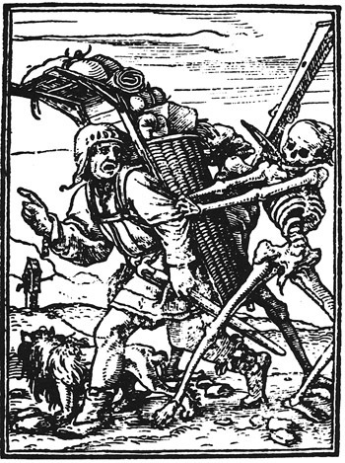

Slide 35
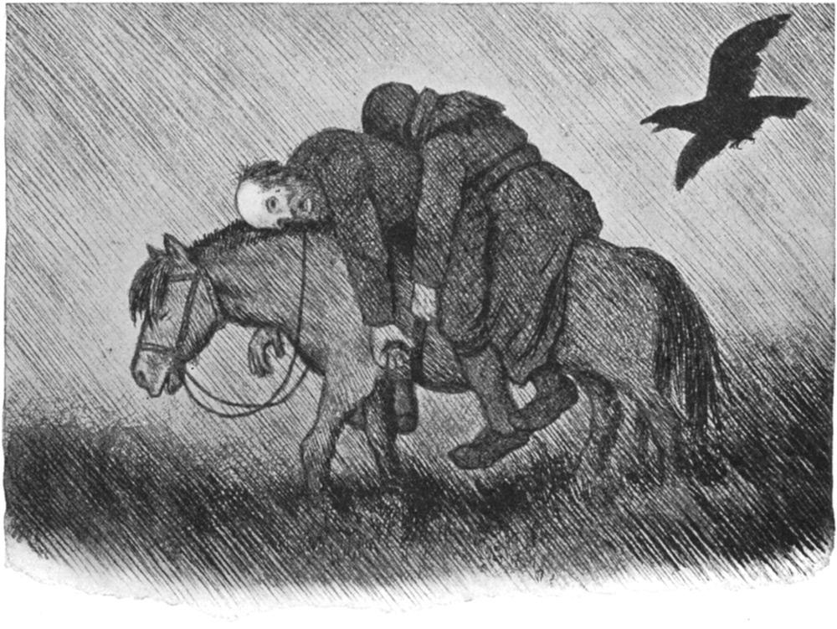

Slide 36
From national independence to subordination under Denmark
Personal union with Sweden.
Outside threats cause political unrest in Scandinavia
The Hanseatic Leaugue
The Kalmar Union
Union with Denmark
The fief system: Danish nobility take over the administration in Norway
Archbishop defender of national independence
1537: Reformation. Full national subordination

Slide 37
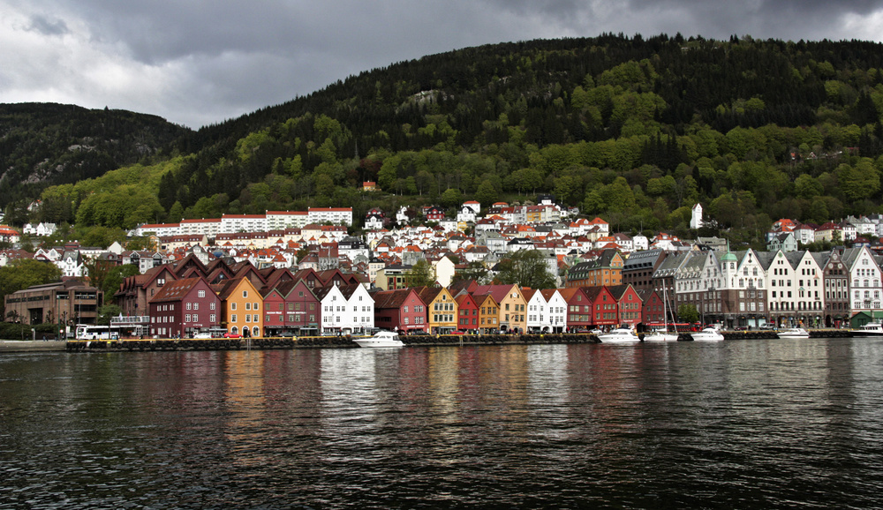

Slide 38
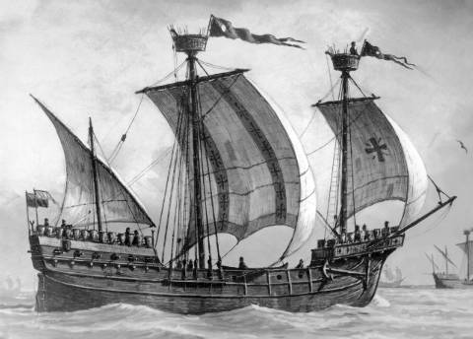

Slide 39
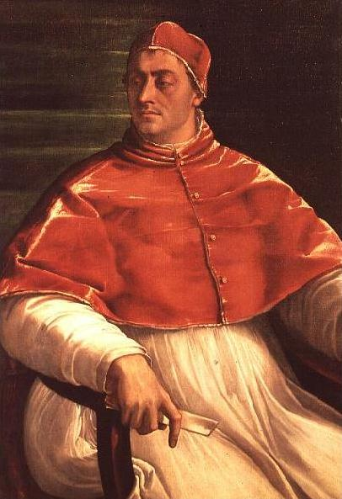

Slide 40
Economic setback 1350-1500
Due to falling prices in agriculture and population loss
The big landowners got poorer
The climate got colder
Shift from corn production to livestock farming
Better times for the farmers

Slide 41
Economic growth after 1500
Hansa monopoly broken
Timber trade/sawmill industry
Shipping
Mining industries

Slide 42
Population development
Year population
1300 450 000
1355 225 000
1660 440 000
1801 883 553

Slide 43
From 1537: Danish rule
Lutheranism replace catholicism. The church underlain monarchy. All church property transferred to the crown.
Danification
Peasant freedom – thanks to geographical conditions
Norwegian mindset – explains ”no to EU”?

Slide 44
The wars with Sweden
The Seven Years War 1563-70
The Kalmar War 1611-13
The Hannibal Feud 1643-45
The Revenge War 1657-60
The Great Nordic War 1700-21

Slide 45
Royal autocracy 1660-1814
All power to the king. The aristocracy deprived of privileges
Administrative reform: Fief system replaced by professional royal bureaucracy.
”The twin kingdoms”: Denmark and Norway = one state

Slide 46
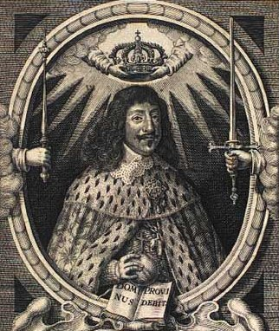

Slide 47
Danish cultural influence
The Bible translated to Danish
Danish was the literary language
All higher education in Danish
Danish language for the upper classes, Norwegian for the common people

Slide 48
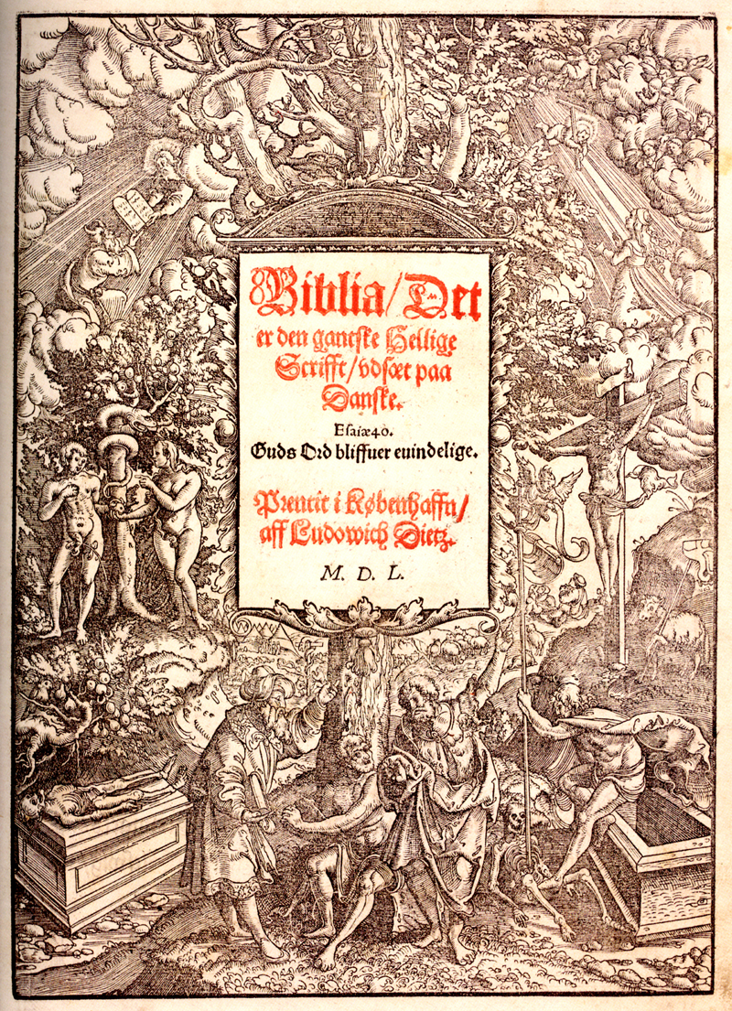

Slide 49
Danish cultural influence
The Bible translated to Danish
Danish was the literary language
All higher education in Danish
Danish language for the upper classes, Norwegian for the common people

