Slide 1
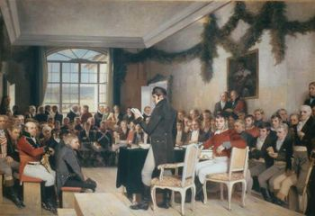
Norwegian history 2

Slide 2
Final stages of the Danish union
Commerce and Enlightenment propel Norwegian need for own institutions
Demands for national bank and university
1807: War with England causes isolation and collapse for Denmark/Norway.
Denmark/Norway joins Napoleon
Kiel Treaty January 1814: Denmark concedes Norway to Sweden

Slide 3
1814: The miracle year
Spring: The leap for independence: National conference, liberal constitution and king election
Summer: War and surrender
Autumn: Negotiations with Sweden: Norway enters a personal union with Sweden. The constitution accepted by the Swedes

Slide 4
National conference at Eidsvold 1814

Slide 5
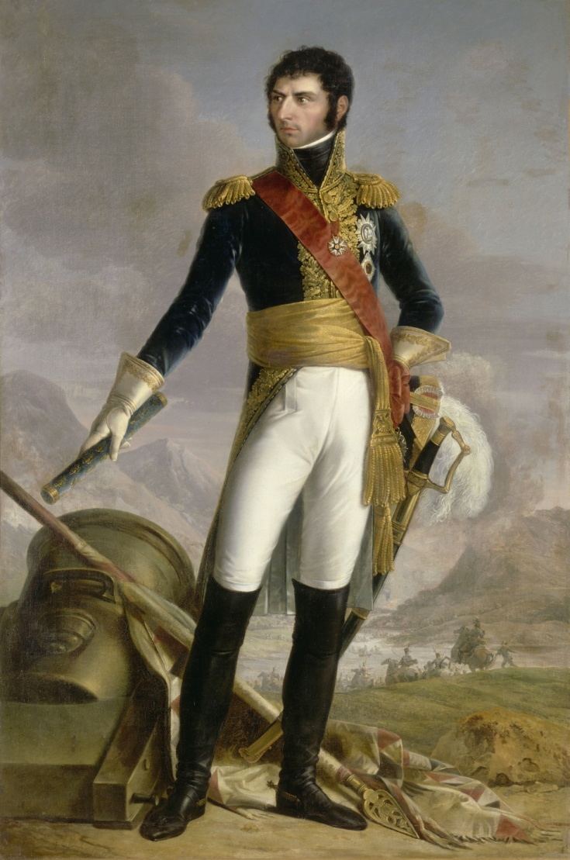
King Carl Johan Bernadotte

Slide 6
The 1814 constitution
Based on Enlightenment ideas and American and French models
Civil rights
Popular sovereignty
Representative government
Division of powers:
Executive: the king and his cabinet
Legislative/funding: the parliament (Stortinget)
Judicial : the courts
Limited franchise: Men over 25 with a minimum of income/property

Slide 7
Patriotism and romanticism
17th of May celebrations
National romanticism
Nynorsk (New Norwegian language)
Folkeeventyr (Folk tales)
Folketoner (Folk music)
”The glorious past”

Slide 8
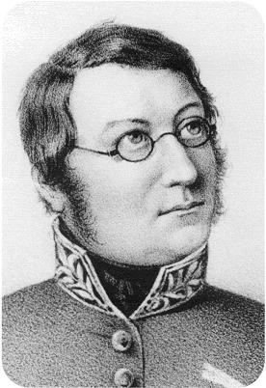
Henrik Wergeland 1808-1845

Slide 9
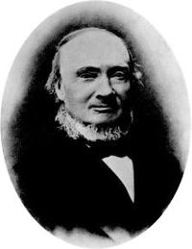
Ivar Aasen

Slide 10
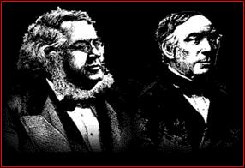
Asbjørnsen & Moe

Slide 11
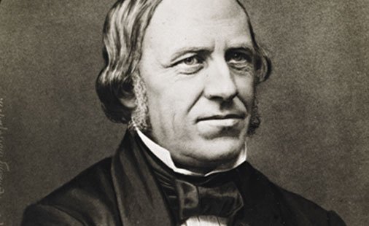
Ludvig M. Lindeman

Slide 12
The ”Embedsmenn era” 1814-84
A privileged bureaucratic elite
The farmers enter politics
Local government act 1837
The great transitions:
Commercial farming, new industries, migration to the towns
Stortinget: Farmers and urban intellectuals join forces.
”Venstre alliance” against conservative establishment

Slide 13
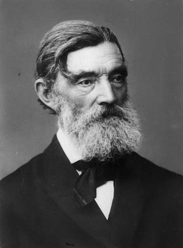
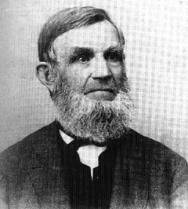
The ”Venstre” alliance
Sverdrup
Jaabæk

Slide 14
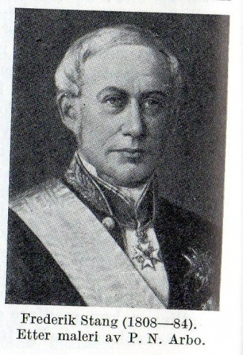
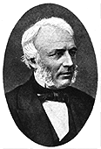
Concervative leaders
Stang
Schweigaard

Slide 15
1870’s and 80’s: Liberal Venstre overturn conservative hegemony
Political battles over the constitution:
Annual Storting sessions
”All powers should meet in this hall…”
The royal veto
Venstre triumph: Parliamentarism 1884

Slide 16
1884: Eve of modern democracy
Parliamentarism
Political parties: Venstre, Høyre, Ap
Newspapers, interest organisations, grassroot movements
Public debate
Ibsen, Bjørnson, Munch
Womens’ rights
Male suffrage 1898, female suffrage 1913

Slide 17
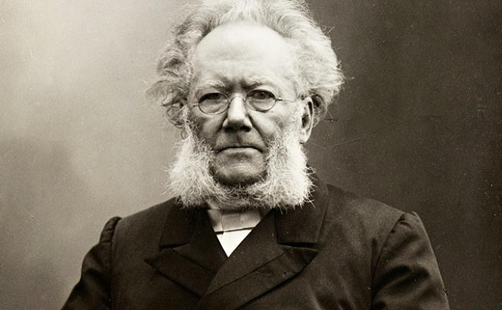
Henrik Ibsen

Slide 18
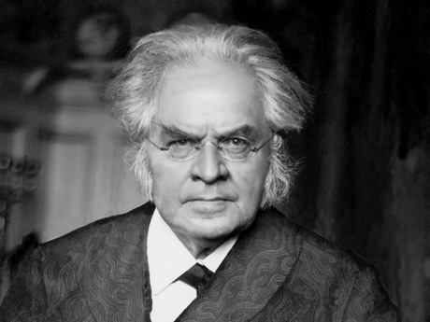
Bjørnstjerne Bjørnson

Slide 19
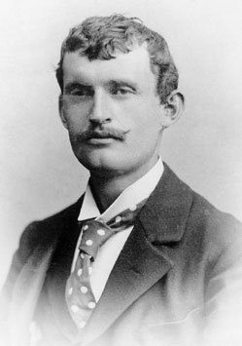
Edvard Munch

Slide 20
1884: Eve of modern democracy
Parliamentarism
Political parties: Venstre, Høyre, Ap
Newspapers, interest organisations, grassroot movements
Public debate
Ibsen, Bjørnson, Munch
Womens’ rights
Male suffrage 1898, female suffrage 1913

Slide 21
Rush towards modernism
Modern industries from wood/fish
Norwegian shipping
Modern infrastructure: Railways, roads, shiplines
Migration to USA
Urban growth

Slide 22
Population development
Year total towns country area
1815 885 000 10% 90%
1855 1.5 mill 17% 83%
1890 2 mill 31% 69%
1910 2.4 mill 39% 61%
1930 2.8 mill 47% 53%
1970 3.8 mill 66% 34%
2017 5,2 mill 81% 19%

Slide 23
End of the Swedish union
Quest for national independence
Norwegian demands:
Own embassies/representations abroad
Own military, own flag
Norwegian and Swedish nationalism
The labour movement: an anti nationalist, pacifist force

Slide 24
1905: National independence and modernization
Monarchy by popular vote
The link to England
Neutralism
”The new working day”
New industrialism: Foreign investments, hydro electric power, concession laws, chemical and metallurgical industries. The link to Germany.
Economic growth
Setback during WW1

Slide 25
Vemork power plant Rjukan, Telemark

Slide 26
1905: National independence and modernization
Monarchy by popular vote
The link to England
Neutralism
”The new working day”
New industrialism: Foreign investments, hydro electric power, concession laws, chemical and metallurgical industries. The link to Germany.
Economic growth
Setback during WW1

Slide 27
Turbulent interwar years
Economic deflation. Mass unemployment
Political crisis:
Political polarization, strikes, lock-outs
Government instability
Norway’s nazi party (NS) 1933
1935: Ap government
1940: The collapse of neutralism

Slide 28
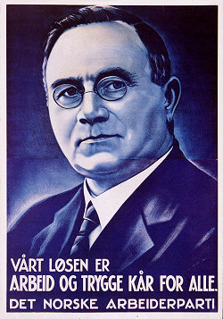
Johan Nygaardsvold

Slide 29
WW2 1940-45
German occupation April 9th 1940. Weak military resistence. The King’s ”No” to Hitler.
Government and royal family escape to London. The commercial fleet under allied command
German cooperation strategy fails and lead to provisory German administration and Norwegian nazi government

Slide 30
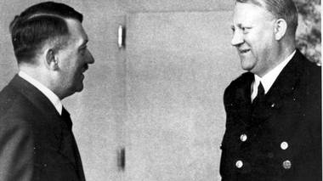
Quisling visiting in Berlin

Slide 31
WW2 1940-45
From 1941: Nazification and moral resistence. Persecution and terror.
From 1943: Underground resistence/sabotage
Deportation of the Norwegian jews 1942
Economic exploitation
Aftermath: the legal prosecutions against nazi party members. A national trauma

Slide 32
Postwar period 1945-65
Ap hegemony
UN membership (Trygve Lie first gen. Secretary)
Cold war: from bridgebuilding to western orientation: Marshall aid 1948. NATO membership 1949
Economic reconstruction:
”Capitalist plan economy”
Regulations
Focus on heavy industries
Public welfare: New public insurances and social benefits

Slide 33
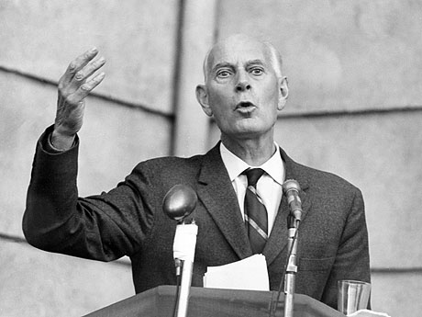
Einar Gerhardsen

Slide 34
Postwar period 1945-65
Ap hegemony
UN membership
Cold war: from bridgebuilding to western orientation: Marshall aid 1948. NATO membership 1949
Economic reconstruction:
”Capitalist plan economy”
Regulations
Focus on heavy industries
Public welfare: New public insurances and social benefits

Slide 35
Legacy of social democracy
The National insurance act 1966
Statoil 1972

Slide 36
Left wing radicalism challenge AP hegemony
1968: Paris and Prague
Marxism-leninism
Battle of EU membership: grassroot versus political establishment
Rise of feminism. The law of free abortion 1979
1973: Oil crisis invoke inflation, economic stagnation and labour conflicts. Ap loses hegemony.

Slide 37
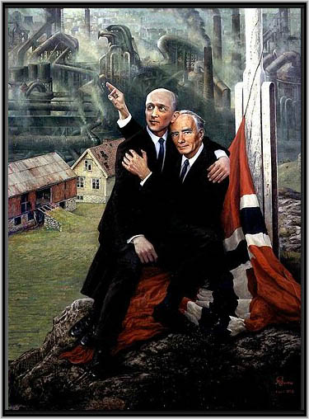
Rolf Groven: ”New romanticism” 1972

Slide 38
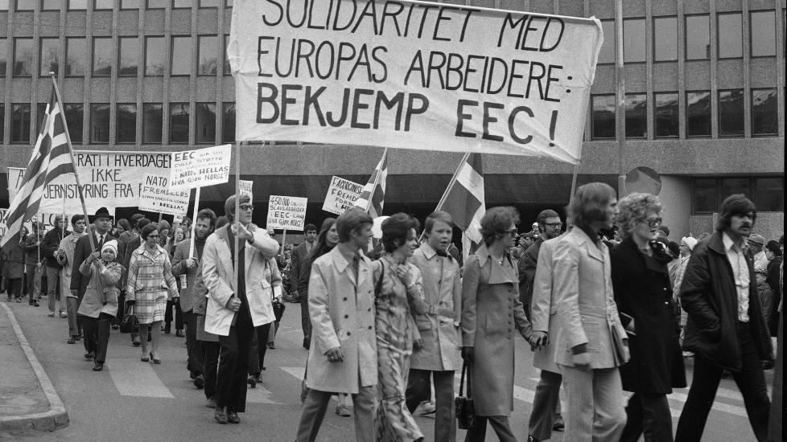

Slide 39
Left wing radicalism challenge AP hegemony
1968: Paris and Prague
Marxism-leninism
Battle of EU membership: grassroot versus political establishment
Rise of feminism. The law of free abortion 1979
1973: Oil crisis invoke economic stagnation and labour conflicts. Ap loses hegemony.

Slide 40
1980ies: Conservative wave
New liberalism. Conservative revival
Høyre government 1981
Economic liberalization. End of NRK broadcasting monopoly
Ap comeback in the 1990’ies
The EU vote 1994

Slide 41
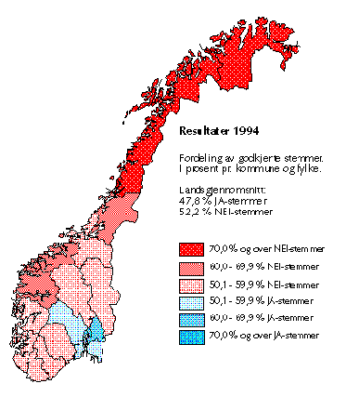
EU popular vote 1994

Slide 42
Cabinets after WW2
1945-63 Ap
1963 H KrF Sp V
1963-65 Ap
1965-71 H KrF Sp V
1971-72 Ap
1972-73 H KrF Sp V
1973-81 Ap
1981-83 H
1983-86 H KrF Sp
1986-89 Ap
1989-90 H KrF Sp
1990-97 Ap
1997-2000 KrF Sp V
2000-01 Ap
2001-05 H KrF V
2005-13 Ap SV Sp
2013-? H FrP

Slide 43
Political parties represented in Stortinget 2013-17
Ap Arbeiderpartiet 55repr. 30,8 %
H Høyre 48 26,8
Frp Fremskrittspartiet 29 16,3
KrF Kristelig folkeparti 10 5,6
Sp Senterpartiet 10 5,5
V Venstre 9 5,2
SV Sosialistisk venstreparti 7 4,1
MDG Miljøpartiet de grønne 1 2,8

Slide 44
Political parties on a scale from left to right
SV Ap MDG Sp V KrF H Frp
left center right

