Slide 1
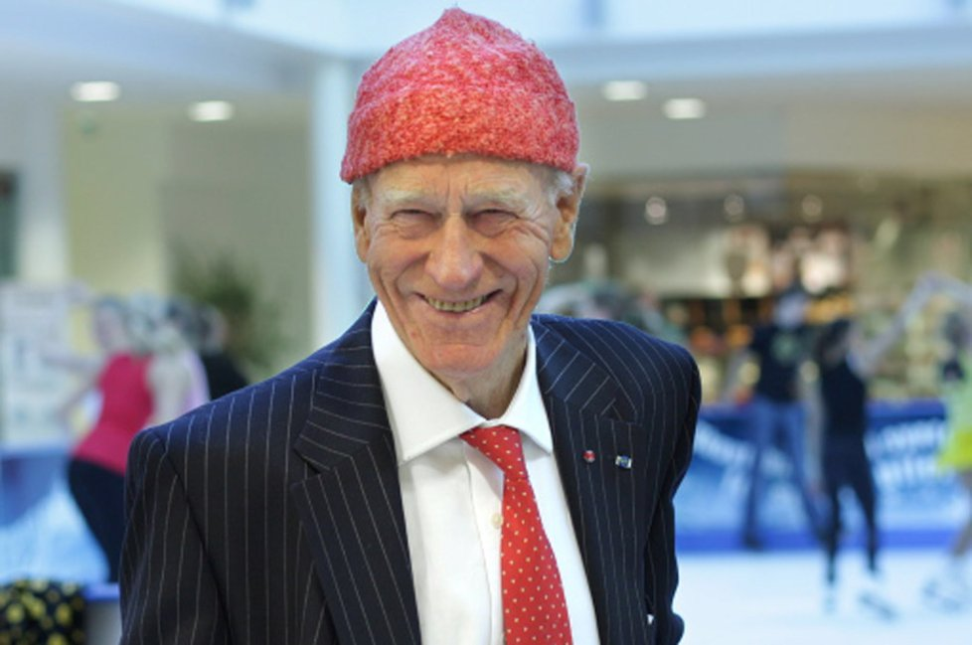
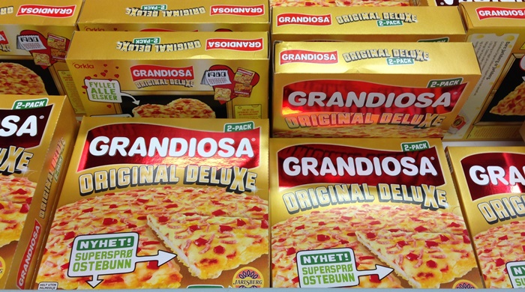
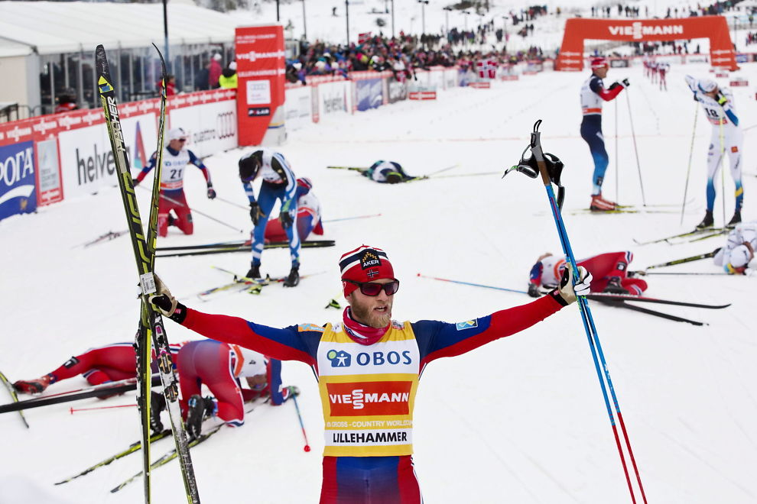
Norwegian Culture and Identity: Equality as Sameness?
NORINT0500 - Norwegian Life and Society Tom Bratrud. Department of Social Anthropology, University of Oslo tom.bratrud@sai.uio.no

Slide 2
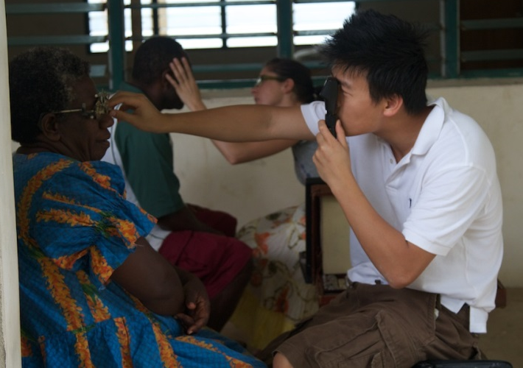
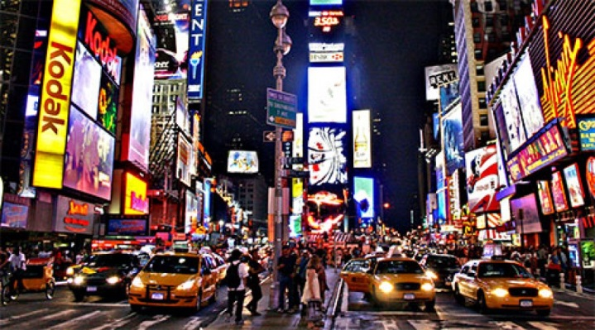
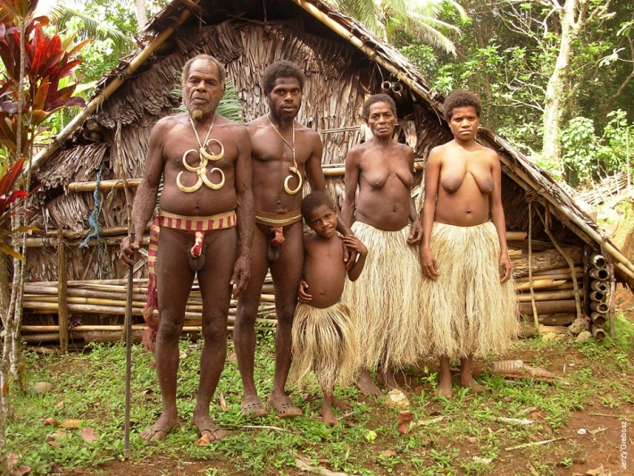
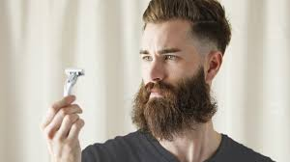
What is social anthropology?
The comparative study of humans in societies: social interaction and meaning-making
Interested in grasping the “natives’ point of view” – why do people do what they do?

Slide 3
What is culture?
Culture is that complex whole which includes knowledge, belief, art, law, morals, custom, and any other capabilities and habits acquired by man as a member of society.
Often presumed to be shared and long-term. Unifies people here-and-now and over time. BUT! Culture changes ALL THE TIME – and we change it.

Slide 4
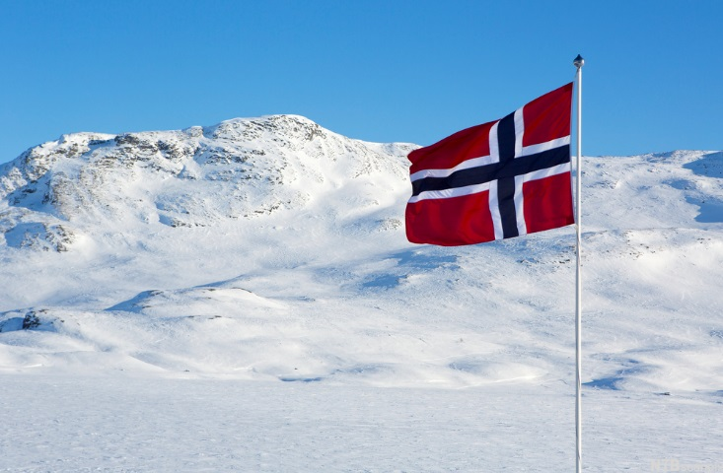
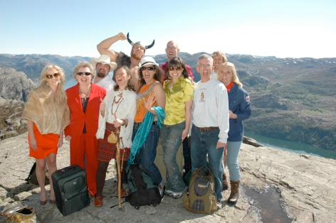
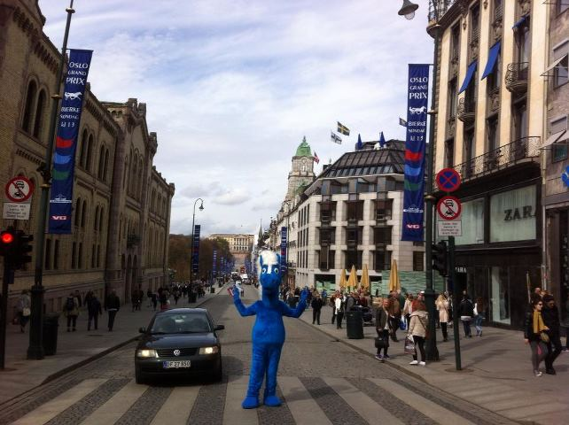
How is Norwegian culture?

Slide 5
Norway in a picture?

Slide 6
«Gate-keeping concepts»
Key cultural notions or phenomena that cannot be ignored when approaching a cultural area.
Examples: - The caste system in South Asia
- Gift-exchange in Melanesia - Liberty and individualism in USA

Slide 7
«Equality as sameness»
People who eat, drink, consume and act in more or less the same way are also believed to share the same values and therefore consider themselves, and are considered by others, as equals in a more fundamental sense.
In Norway there is a passion for social equality
Moderation as virtue.
Fellowship is often expressed through engaging in activities that stress equality, mutuality and cooperation.

Slide 8
King Olav (1903-1991) during the oil crisis in 1973

Slide 9
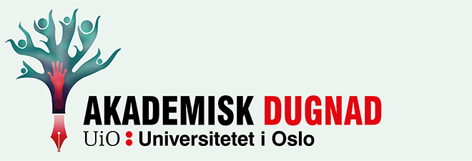
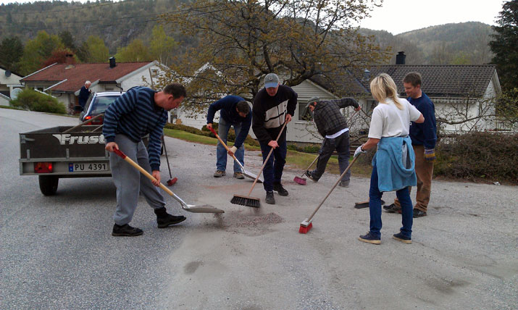
Example: “Dugnad”
“Dugnad is” “voluntary” community work
Found in kindergartens, housing co-operatives, football clubs etc.
Both on local and national level

Slide 10
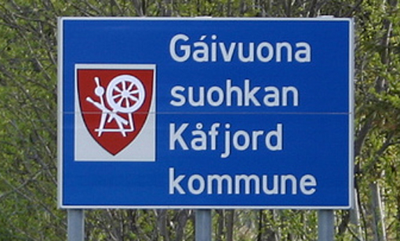
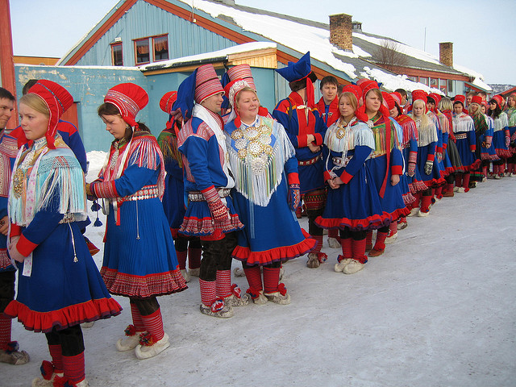
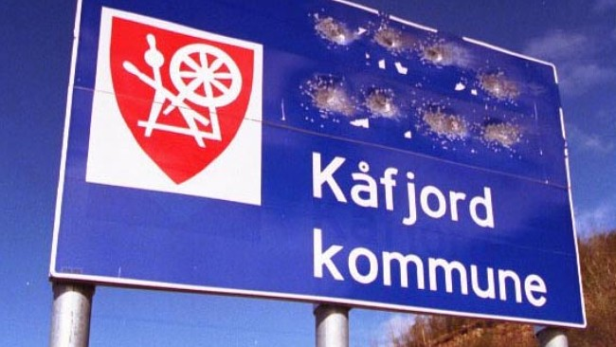
“Equality as sameness.” Consequences
1: People who are regarded as different are excluded from certain informal social arenas.

Slide 11
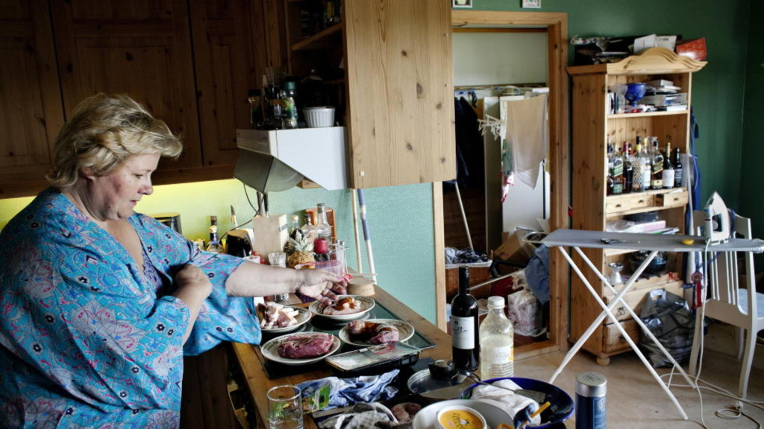
“Equality as sameness.” Consequences
2: Hierarchical elements and tendencies are concealed.
They can willfully be subdued - and situations where there may be conflicting values are avoided.

Slide 12
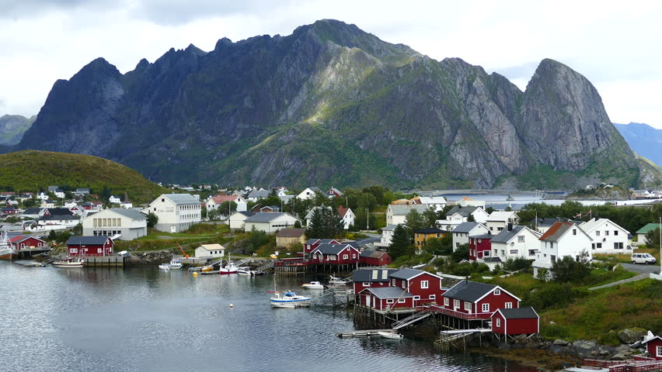
“Equality as sameness.” Consequences
3: The key narrative of Norwegian cultural homogeneity remains unchallenged

Slide 13
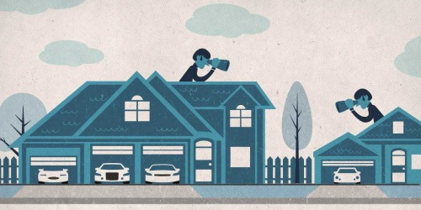
“Equality as sameness.” Consequences
4: “Difference equals inequality”: little tolerance of others’ hierarchical arrangements, regarding gender, financial differences, etc.

Slide 14
How does “equality” shape Norwegian everyday life?
Frugality, moderation, simplicity

Slide 15
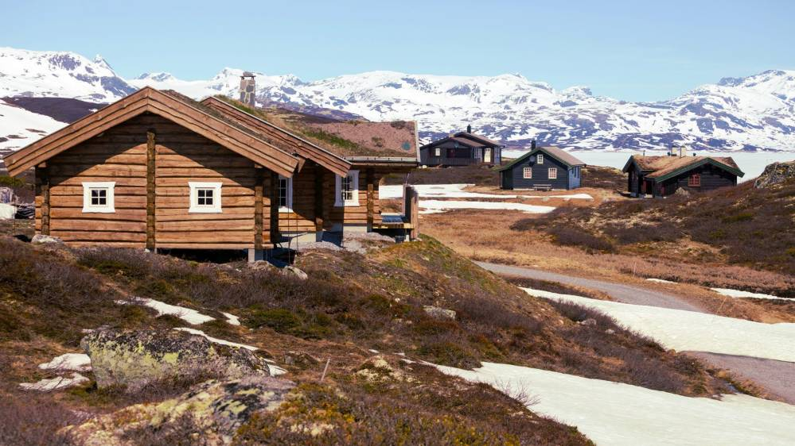
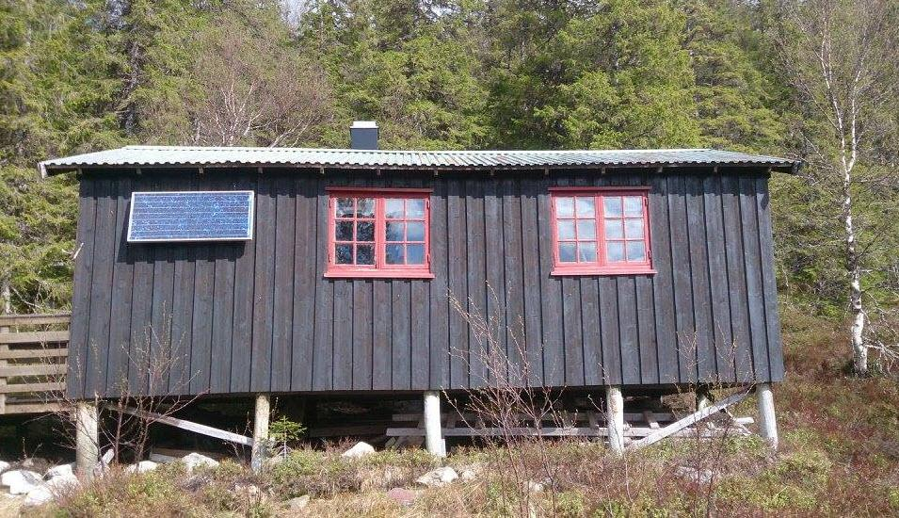
“The simple life”: Hytte
50% of Norwegians have access to a «hytte» in the mountains or by the sea

Slide 16
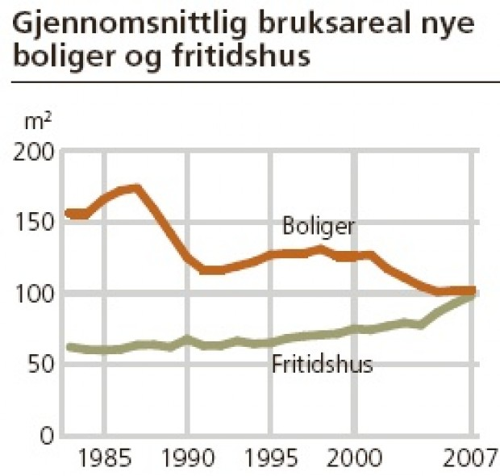
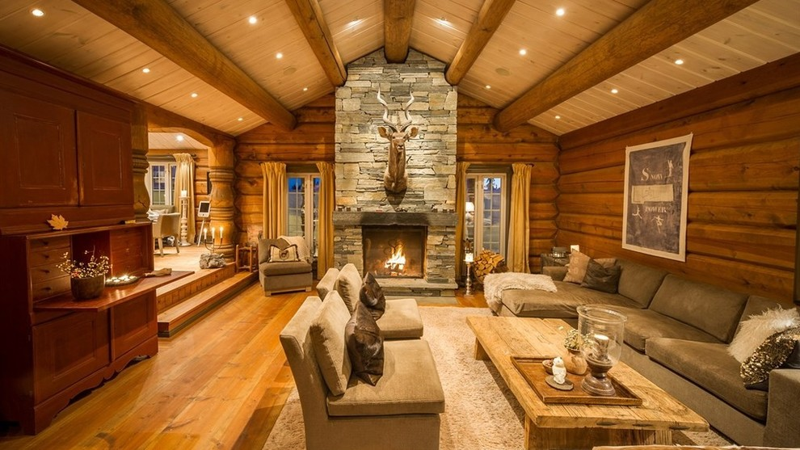
“The simple life” in 2017

Slide 17
«Eating equality»: The «matpakke»

Slide 18
Food is tied to identity
“We are what we eat - that is, equals”

Slide 19
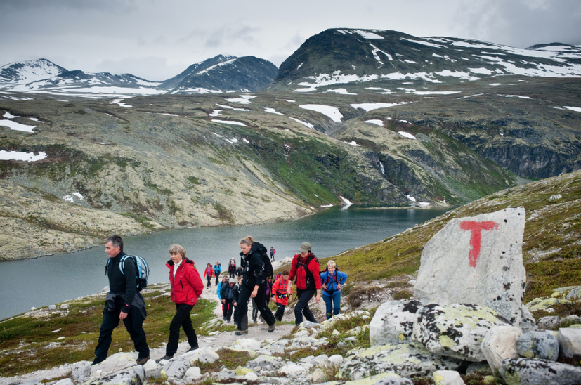
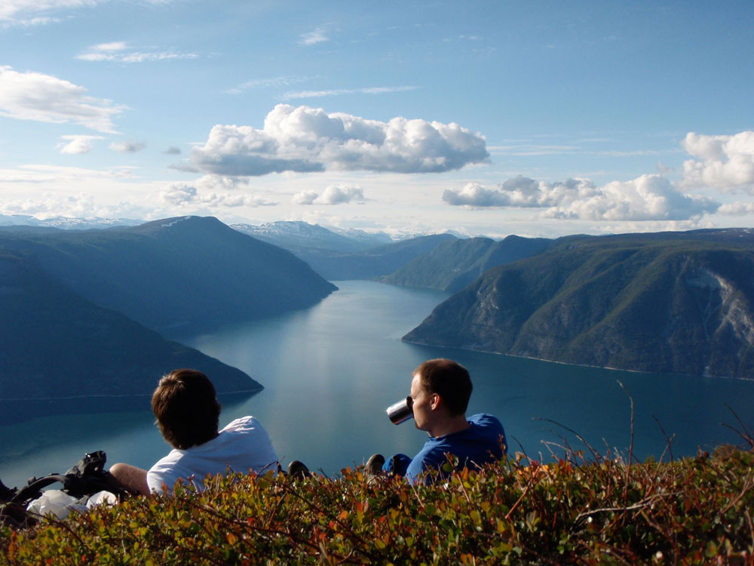
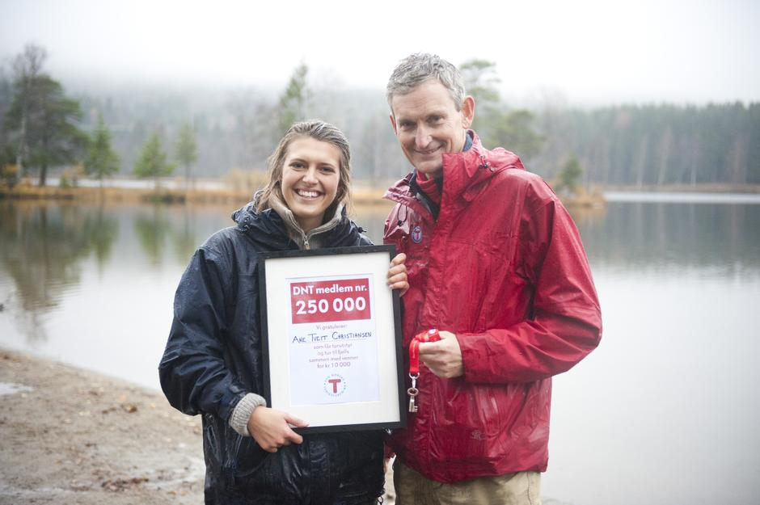
“Gå på tur” (take a hike, be in the outdors)

Slide 20
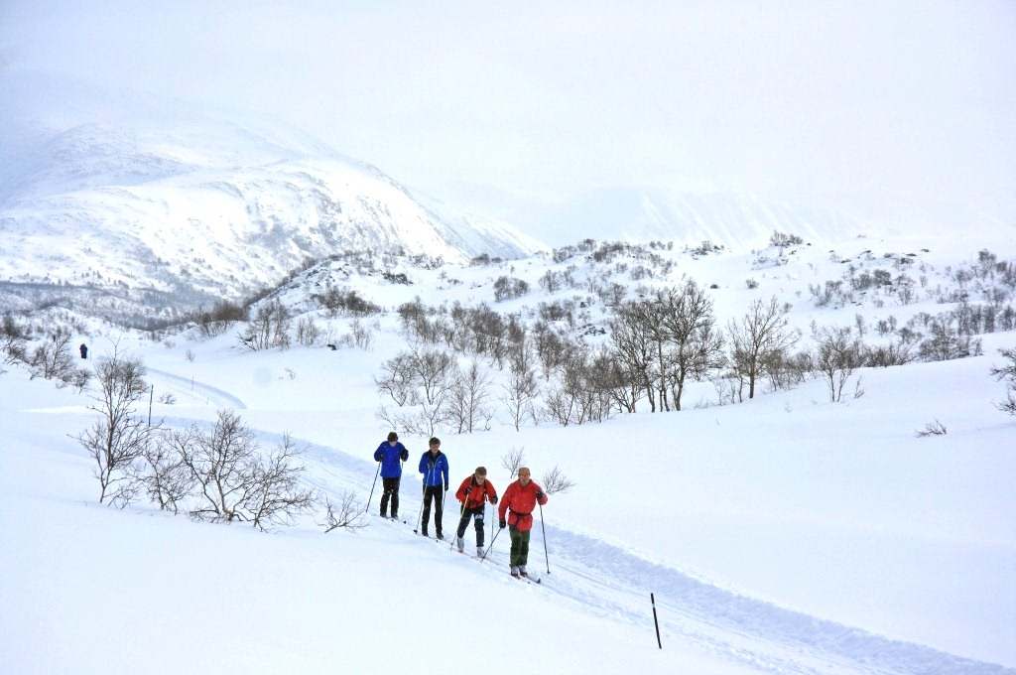
Cross country skiing as identity performance

Slide 21
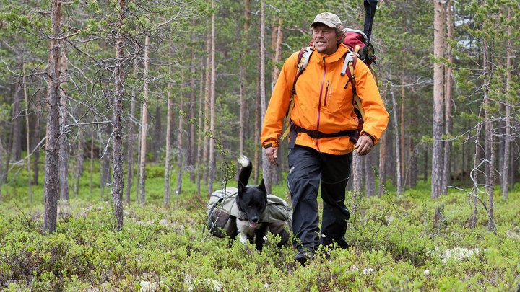
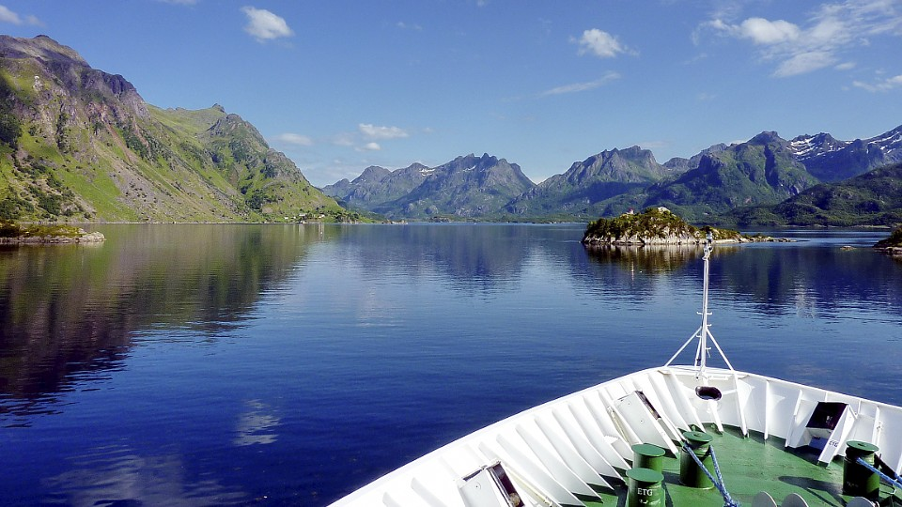
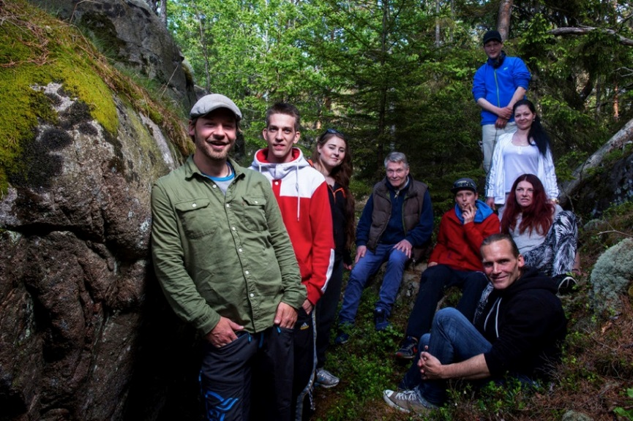
The simple life in Norwegian popular culture

Slide 22
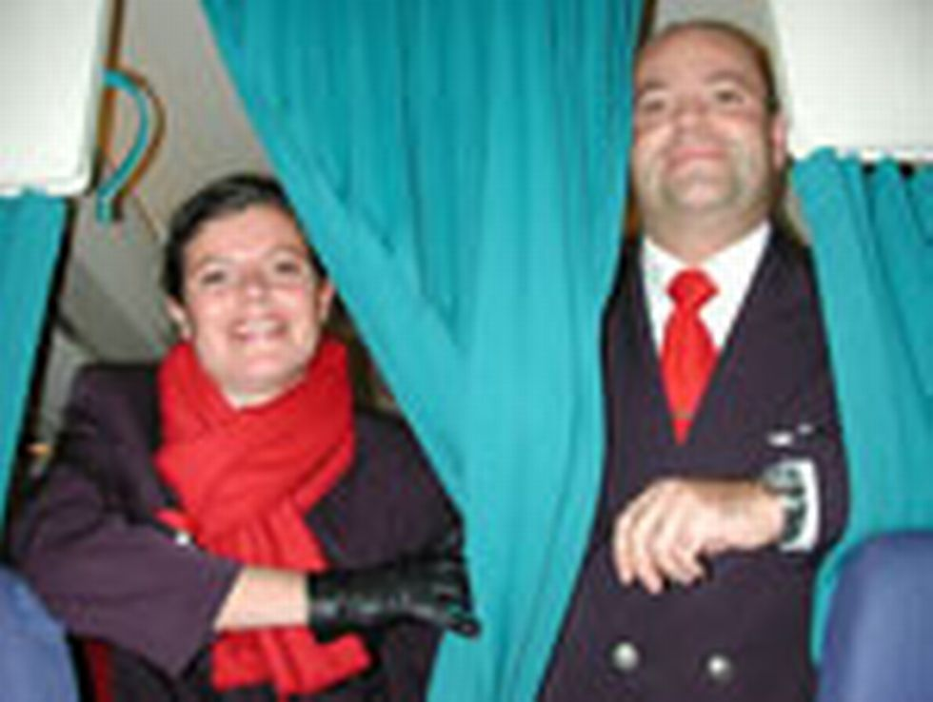
When culture is not taken seriously…

Slide 23
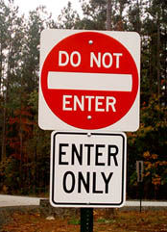
Culture and contradictions
Cultures are not seamless entities: There are also many contradictions!

Slide 24
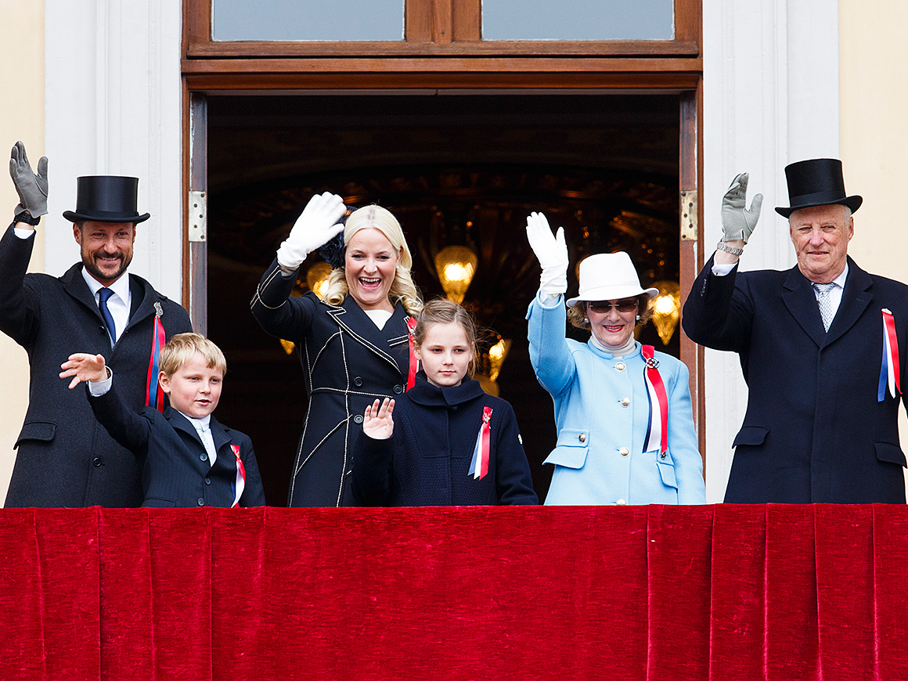
Norwegian monarchy, a cultural scandal?

Slide 25
Louis Dumont. The hierarchy of values
- Egalitarianism/equality is the whole (body)
- The Royal family is accepted as long as they submit themselves to this whole (i.e. «act as commoners»).

Slide 26
Norwegian culture?
What is “chosen” to represent a nation? How does power shape this process?
How are differences and that which does not fit evaded?
- How do values, ideas and pratices change over time? Influenced by global processes?

Slide 27
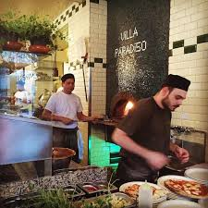
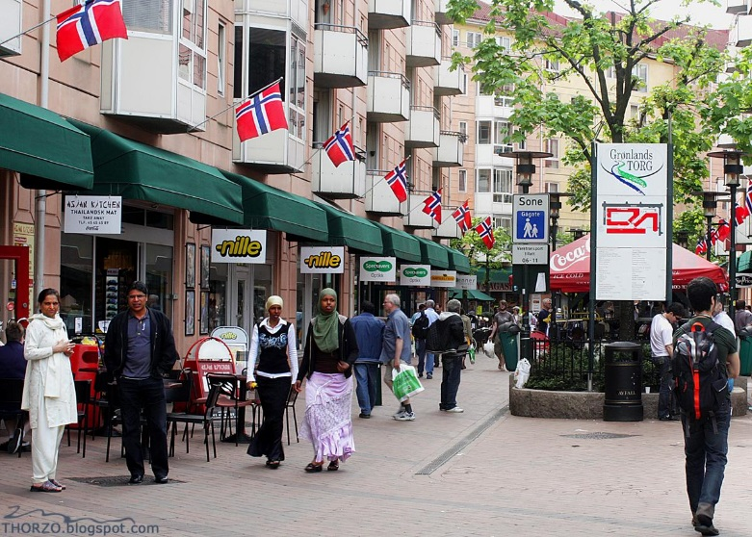
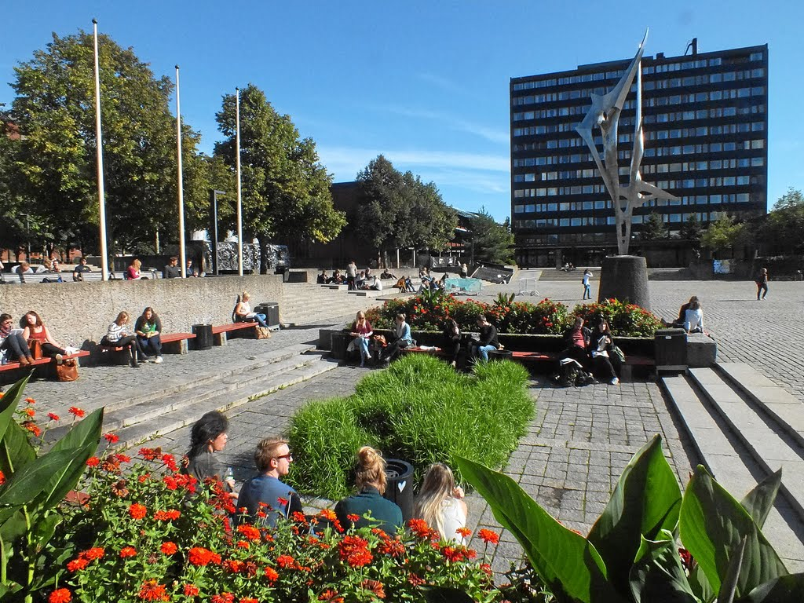
Welcome to Norway!

