Slide 1
NORINT0500
Norwegian Life and Society
THE NORWEGIAN LEGAL SYSTEM
Nertila Kuraj, PhD
Department of Public and International Law, UiO
nertila.kuraj@jus.uio.no
Oslo, 13 November 2017

Slide 2
Outline
Introduction
Foundation: the Constitution of 1814
The legislative branch: the parliament
The executive branch: the government
The judiciary: the courts
Common or civil law system?
Major trends

Slide 3
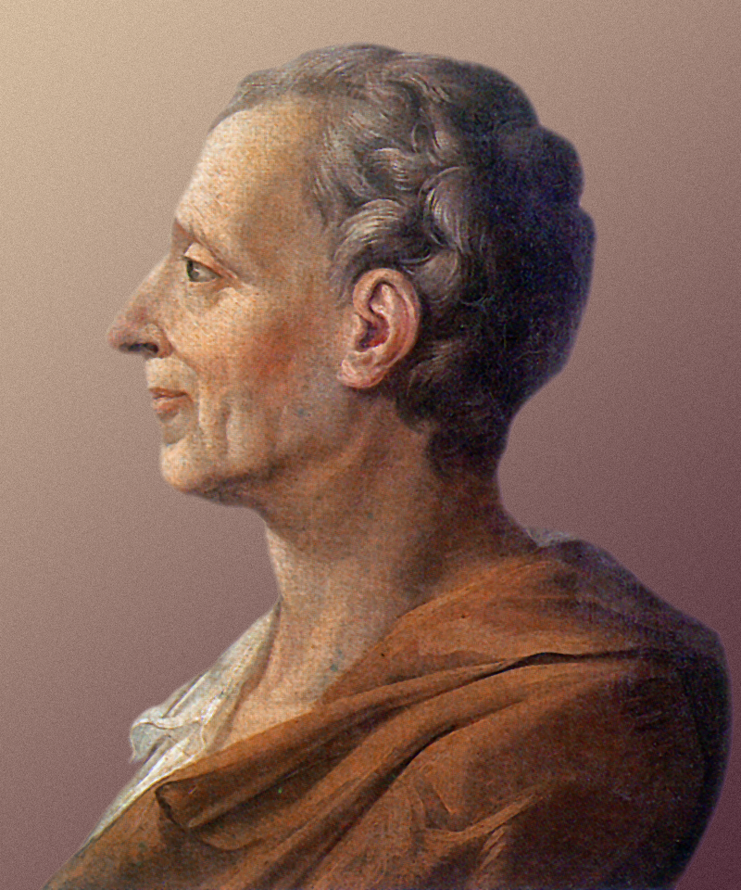
1. Introduction
How did the European legal systems, including the Norwegian legal system, come about?
17th century ‘Age of Enlightenment’ challenging absolutist monarchies
Montesquieu
  separation of powers doctrine
  system of ‘checks and balances’

Slide 4
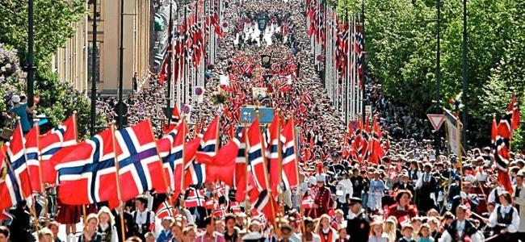
2. Foundation: The Constitution of 1814
17th of May 1814: adoption of Norwegian Constitution
syttende mai/Grunnlovsdagen
Norway goes from union with Denmark into union with Sweden as consequence of Napoleonic Wars
1905: Norwegian independence; Prince Carl of Denmark as the first “Norwegian” King (becomes King Håkon VII)

Slide 5
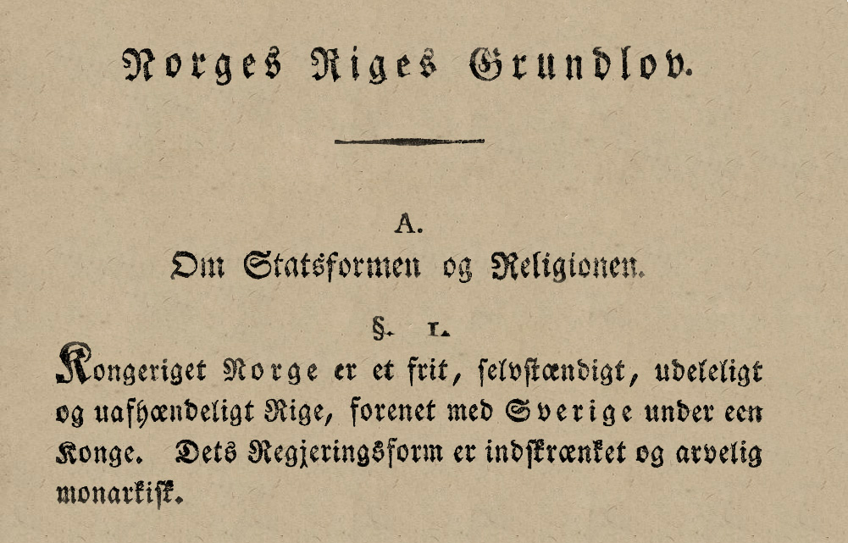
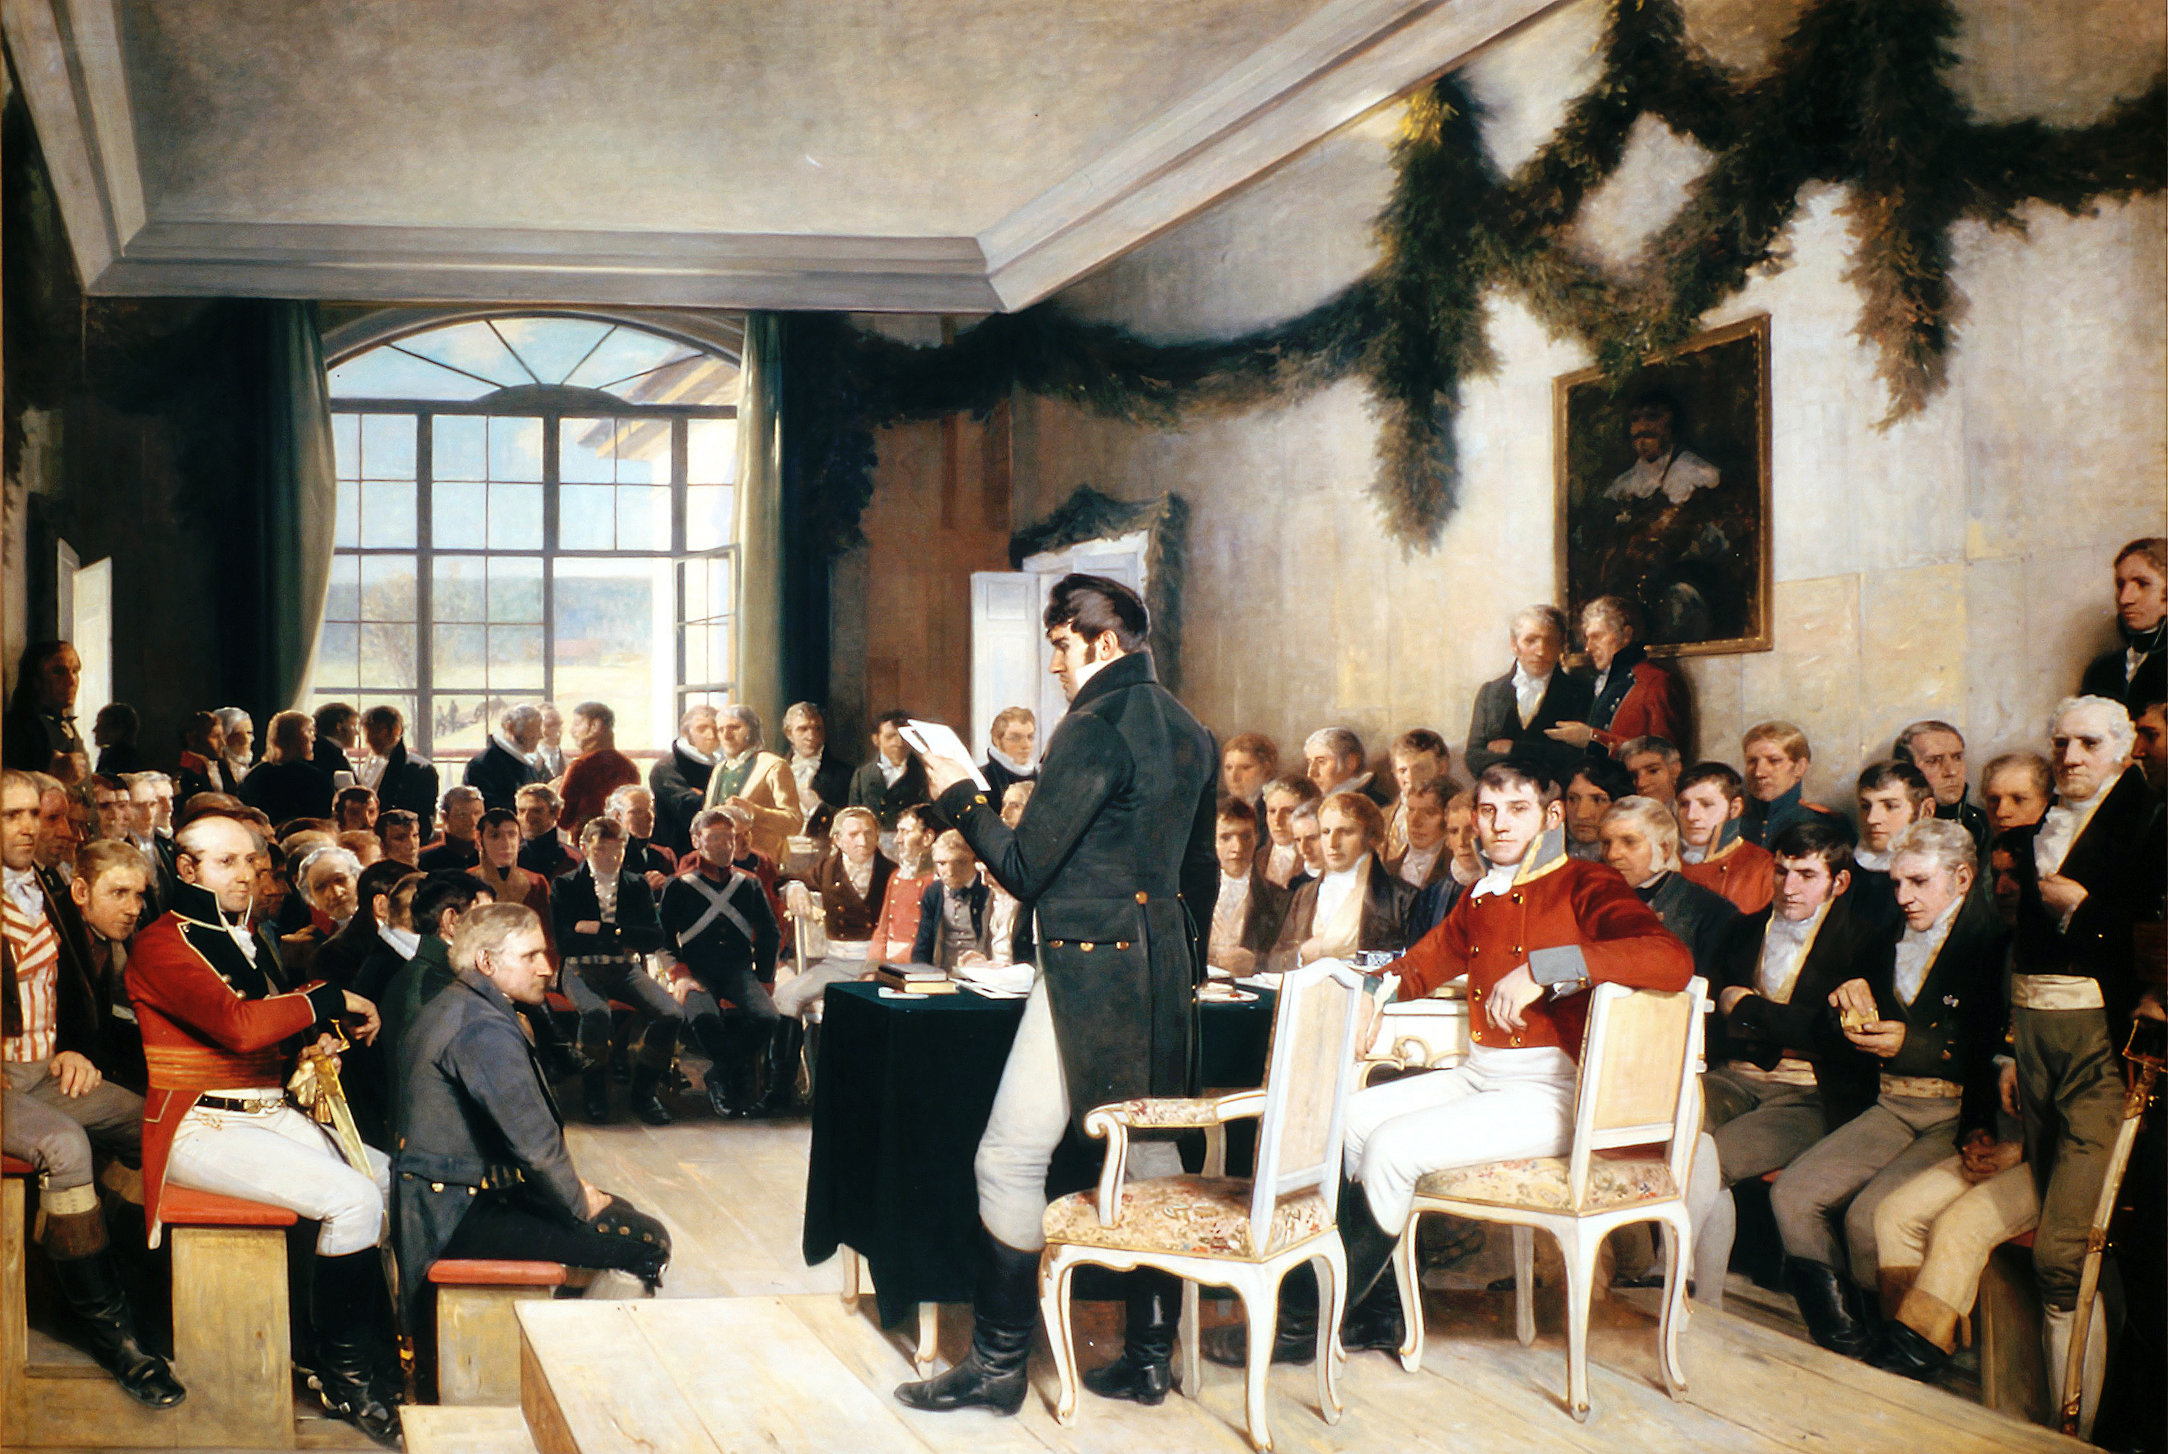
The Constitution
  inspired by US, France
  radical and democratic (sovereignty of the people – elected legislative body: the Stortinget)
  constitutional monarchy
  legally binding, limiting legislative and executive powers
  judicial review as part of division of powers

Slide 6
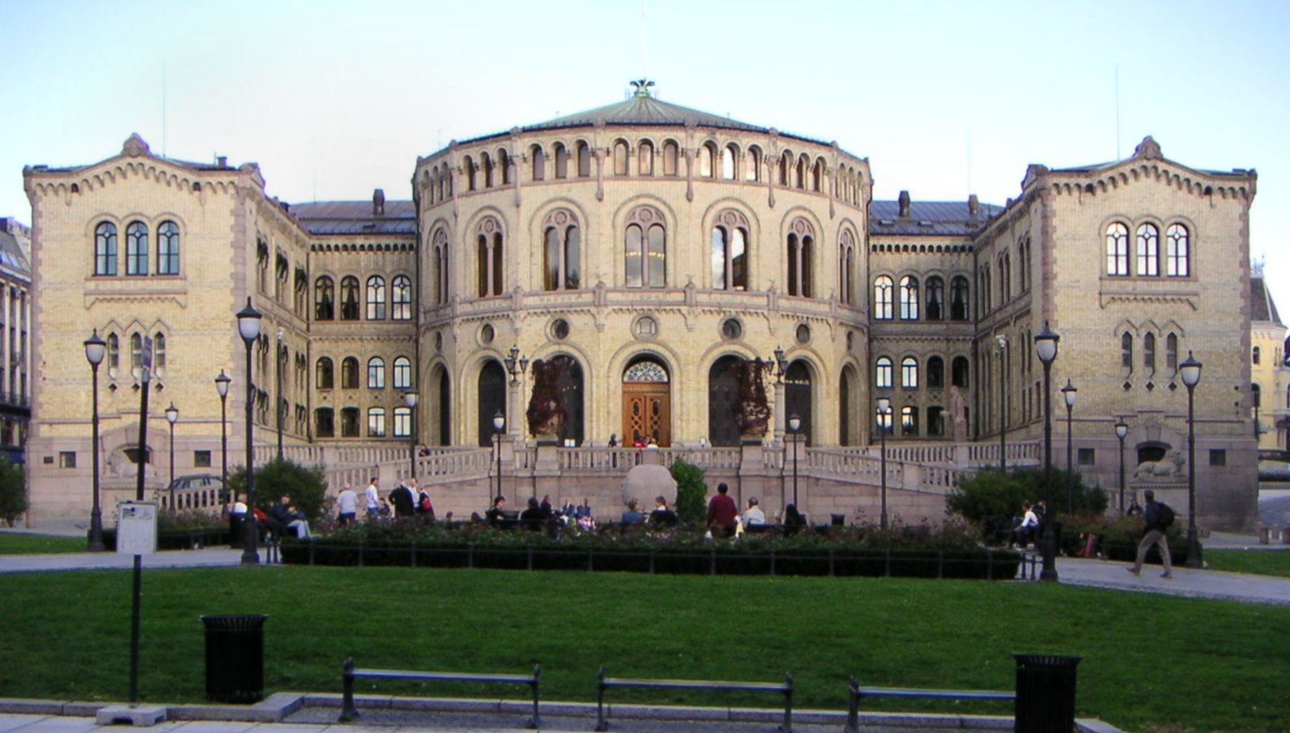
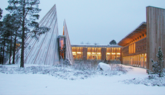
3. The Parliament (Stortinget) – the legislative branch
“The people exercise the legislative power through the Stortinget”
unicameral
power to issue new legislation
principle of legality
  rule of law
  state authorities obliged to act through parliamentary legislation (e.g. criminal sanctions, taxes)
  citizens able to foresee their legal position (legal certainty)
constitutional limitations on legislator
  division of powers
  judicial review (fundamental rights)
Sametinget representing Sami people

Slide 7
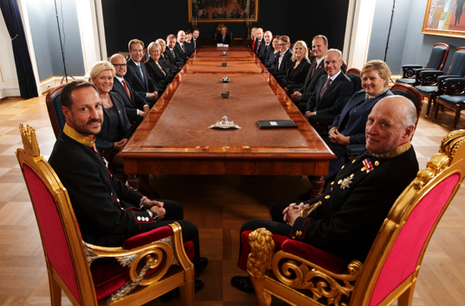
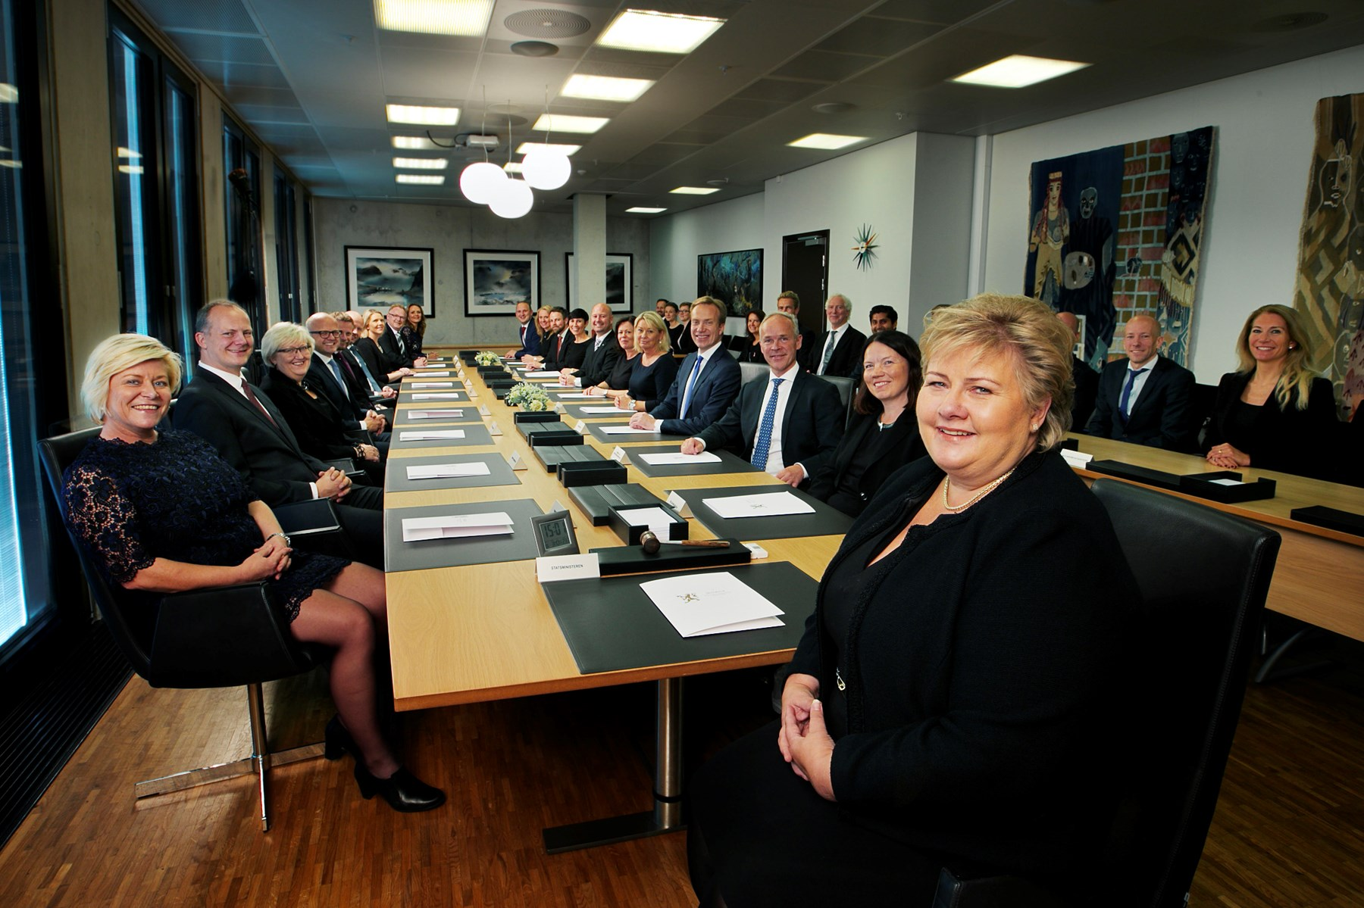
4. The Government – the executive branch
The Council of State:
chaired by the King
adoption of decisions
The governmental conference:
chaired by the Prime Minister
preliminary discussions
matters of main significance

Slide 8
The executive branch (2)
Legislative process:
Substantial influence on the legislative process (“lov”) through control of administration (ministries)
Power to issue directives and regulations (“forskrifter”) – delegated powers
Executive power – enforcing legal order:
control of police and military
Criminal cases
Civil cases
Other fields of law

Slide 9
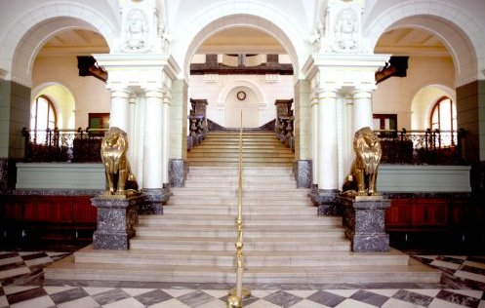
5. The judiciary – the court system
independence of courts
control of executive and legislative (judicial review)
  May 2014 amendments to Constitution: more fundamental rights
other tasks of the courts
  general jurisdiction
  criminal cases
    no investigative courts
  civil cases
    not all disputes settled in courts of law
    conciliation proceedings
  administrative cases
    courts can only rule in legal matters
    court decisions ‘within reasonable time’

Slide 10
Hierarchy of the Court system
Supreme Court
“Høyesterett”
Appeal Courts
”Lagmannsrett”
District Courts
”Tingrett”

Slide 11
District Courts
64 District Courts
jurisdiction in all matters (general jurisdiction)
  no division of ordinary courts and administrative courts
  no division of criminal courts and civil courts
  no separate constitutional court(s)
Appeal Courts
only 6 Appeal Courts
right to appeal
  in civil cases
  in criminal cases

Slide 13
The Norwegian Supreme Court
Restricted right to appeal
  determined by Appeals Selection Committee
Purpose
Principal goal: ensure clarity and development of the law within the framework that follows from the Constitution and law
  Not to ensure right outcome in each and every case
  Ensure uniformity of legal process
  Resolve matters where the law is unclear
  Develop the law
  Decide in matters of principle
Above: Toril Marie Øie, the first woman ever to hold the post of Chief Justice of the Supreme Court of Norway (2016)

Slide 14
Composition of the courts
Professional judges
District Courts: 1/2 (Cv+2) (Cr+3)
Appeals Courts: 3 (Cv/Cr+ 4)
Supreme Court
1 of the 2 chambers: 5
Grand Chamber: 11
plenary session: 20
Lay judges
Civil cases:
None, but parties may demand
Criminal cases:
Lay judges in majority in first and second instance. None in the Supreme Court.
Jury trials in major criminal cases (3+7)

Slide 15
Court proceedings and hearings
Civil cases
strong oral tradition
witnesses, documentary evidence and legal arguments presented directly before the court during “main hearing”
Criminal cases
oral tradition even stronger
judges as "tabula rasa”
presumption of innocence
evaluation of evidence
principle of contradiction
principle of transparency

Slide 16
6. A civil or common law system?
Civil law
extensive and detailed legislation
principles of law; strong doctrines
Common law
case-law developed by courts of law
tradition
Norwegian law
importance of parliamentary legislation
legislation less detailed
trusts courts to find “spirit of the law”
but courts emphasise the “preparatory works” of legislators
Supreme Court’s case-law highly important
Courts recognised to “develop law”
Fields of law that are not legislated
Scandinavian “legal pragmatism” – fewer principles and doctrines

Slide 17
7. Some major trends affecting the Norwegian legal system
wide administrative powers in aftermath of WWII
increased protection of citizen’s position
protection of those in weaker positions
deregulation – more free market?
EU and EEA
human rights
soft on crime – tougher on crime?

