Slide 1
Senter for rettsinformatikk
EUs forslag til AI forordning
- betydningen for forvaltningen
Naomi Lintvedt
Stipendiat

Slide 2
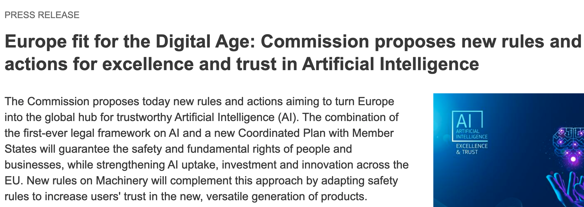
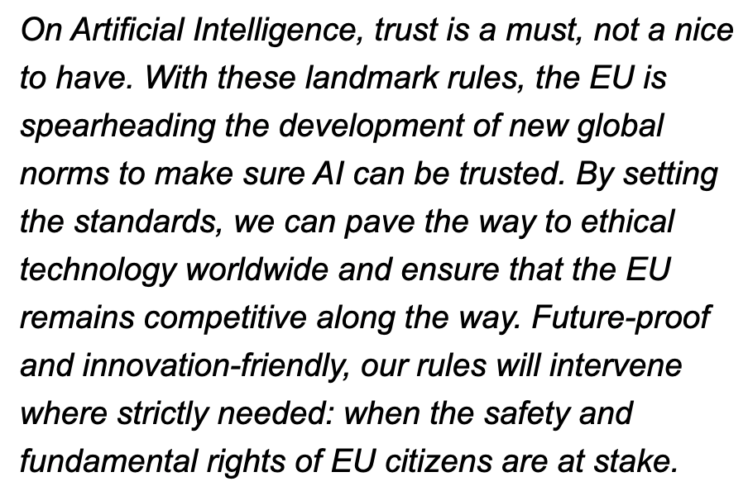
21. april 2021
https://digital-strategy.ec.europa.eu/en/news/europe-fit-digital-age-commission-proposes-new-rules-and-actions-excellence-and-trust-artificial

Slide 3
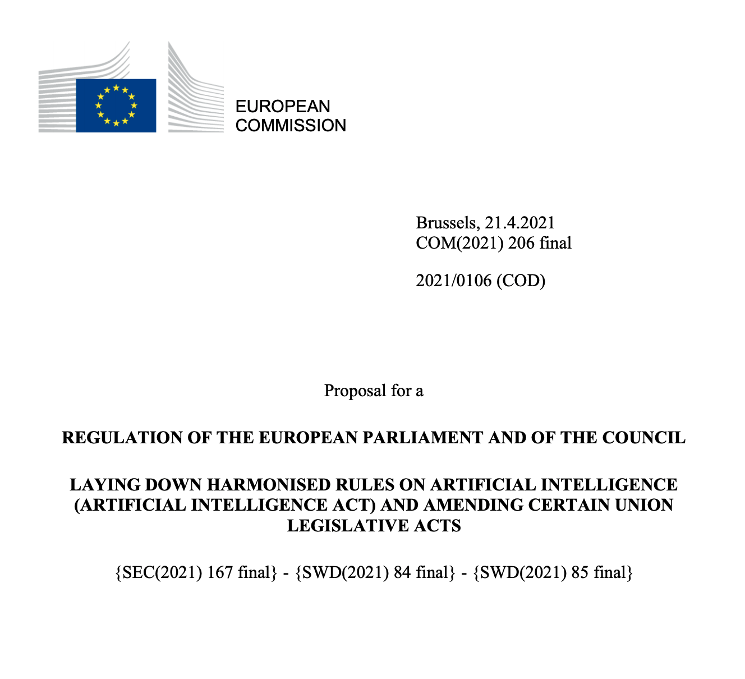
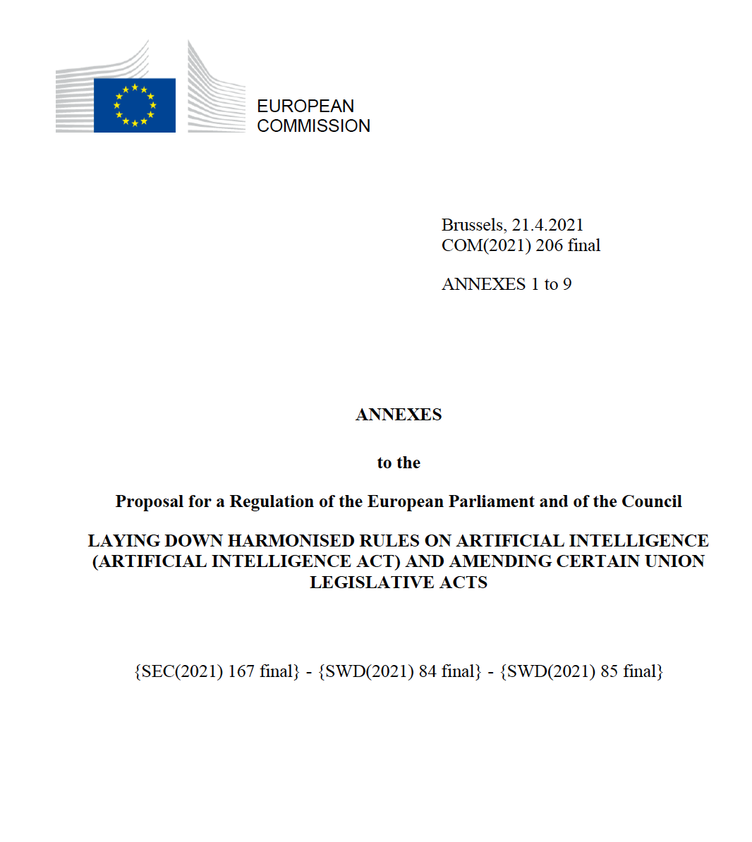
https://digital-strategy.ec.europa.eu/en/library/proposal-regulation-laying-down-harmonised-rules-artificial-intelligence

Slide 4
Formålet er ...

Slide 5
men også ...

Slide 6
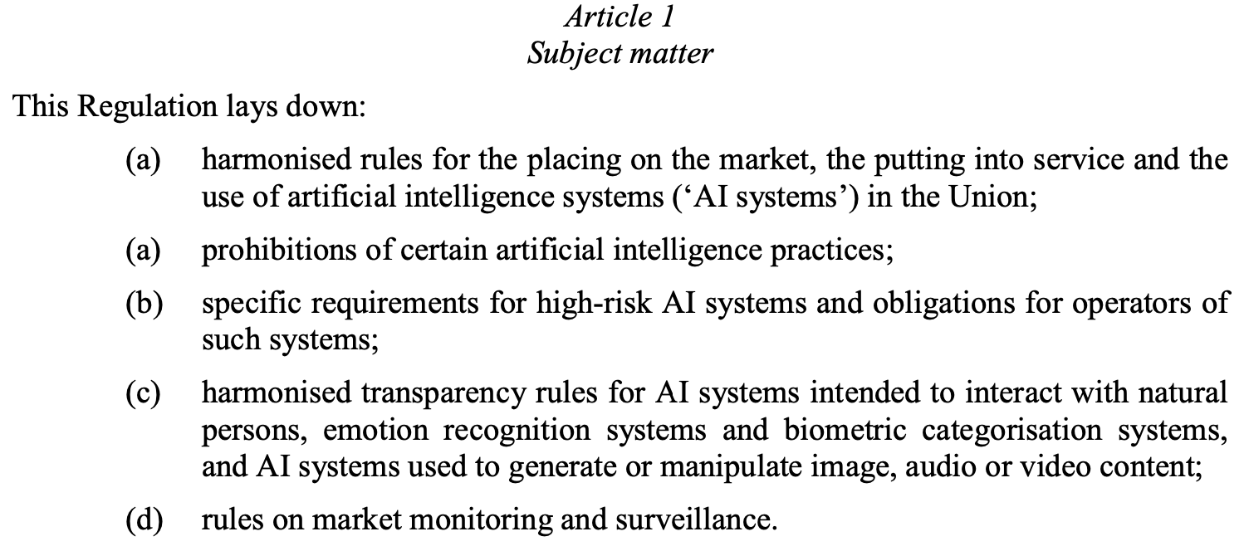

Slide 7
Virkeområde
providers placing on the market or putting into service AI systems in the Union, irrespective of whether those providers are established within the Union or in a third country;
users of AI systems located within the Union;
providers and users of AI systems that are located in a third country, where the output produced by the system is used in the Union;
‘user’ means any natural or legal person, public authority, agency or other body using an AI system under its authority, except where the AI system is used in the course of a personal non-professional activity

Slide 8
AI definisjon
‘artificial intelligence system’ (AI system) means software that is developed with one or more of the techniques and approaches listed in Annex I and can, for a given set of human-defined objectives, generate outputs such as content, predictions, recommendations, or decisions influencing the environments they interact with; art 3(1)
Annex I
(a) Machine learning approaches, including supervised, unsupervised and reinforcement learning, using a wide variety of methods including deep learning;
(b) Logic- and knowledge-based approaches, including knowledge representation, inductive (logic) programming, knowledge bases, inference and deductive engines, (symbolic) reasoning and expert systems;
(c) Statistical approaches, Bayesian estimation, search and optimization methods.

Slide 9
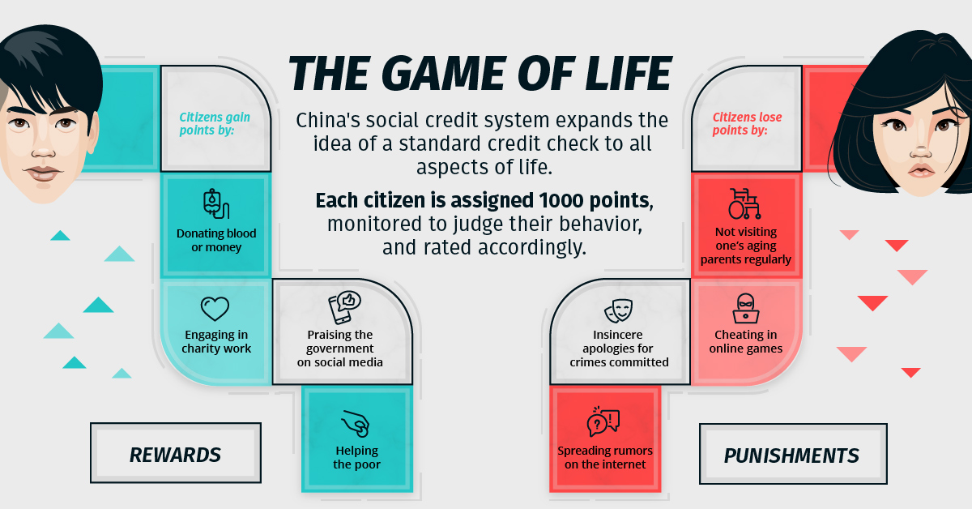
Forbudt AI art 5

Slide 10
Høyrisiko AI Annex III

Slide 11
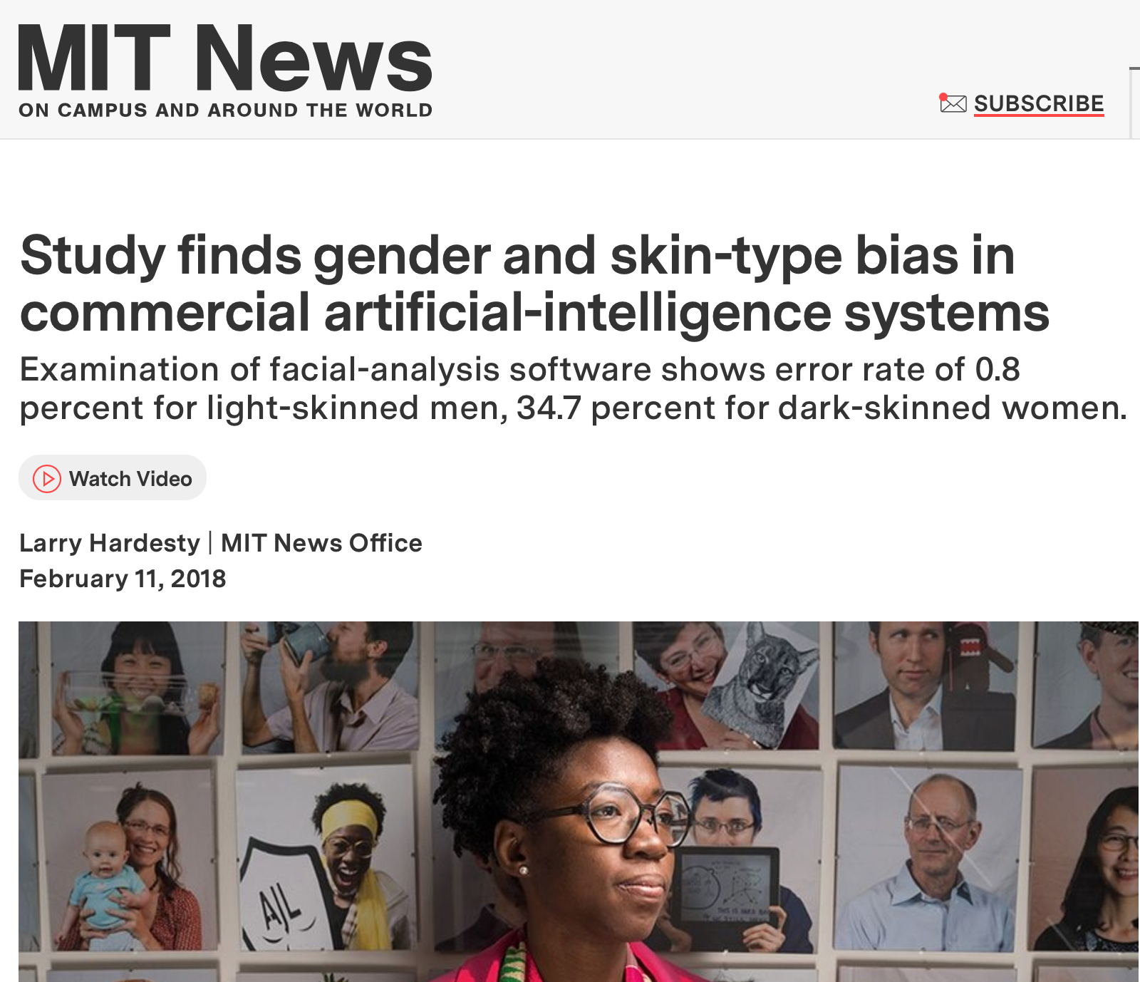
https://news.mit.edu/2018/study-finds-gender-skin-type-bias-artificial-intelligence-systems-0212

Slide 12
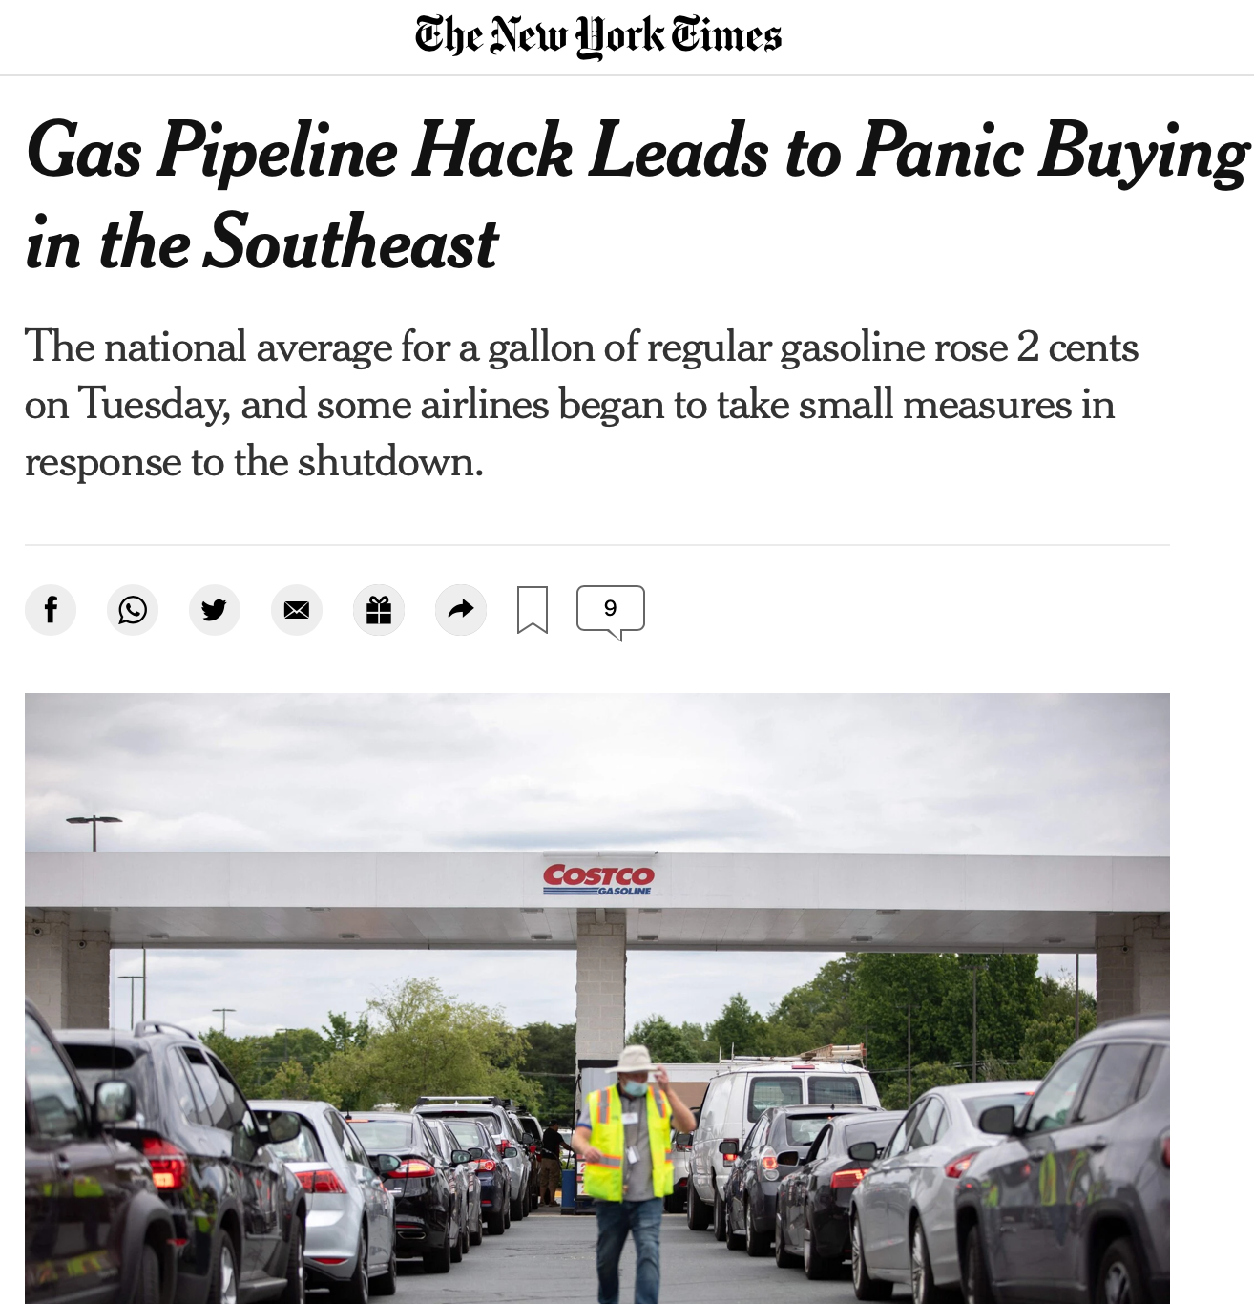

Slide 13
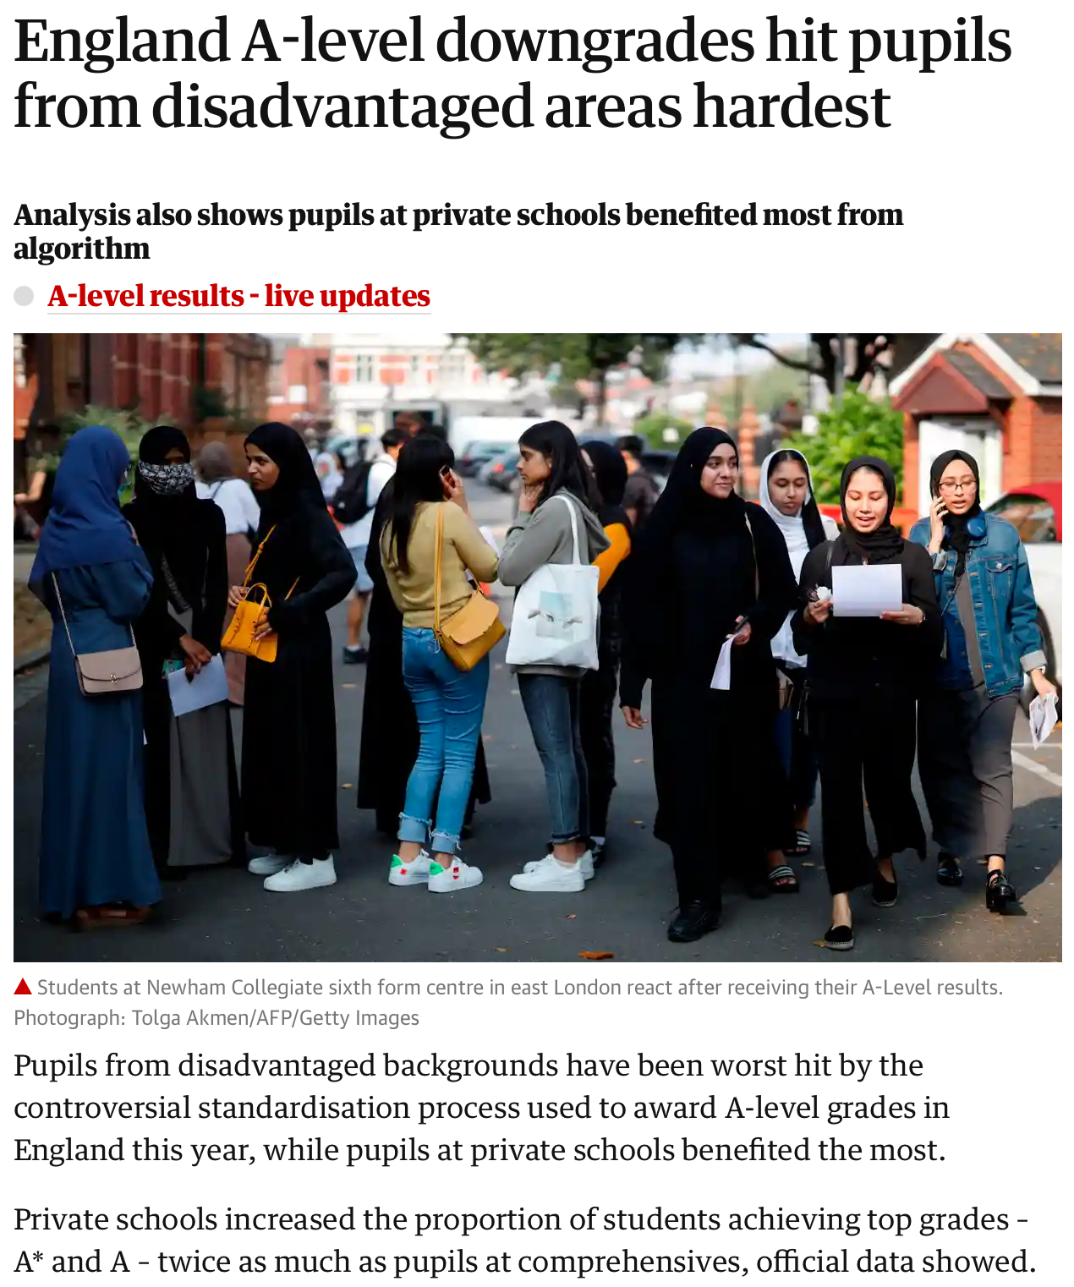
https://www.theguardian.com/education/2020/aug/13/england-a-level-downgrades-hit-pupils-from-disadvantaged-areas-hardest

Slide 14
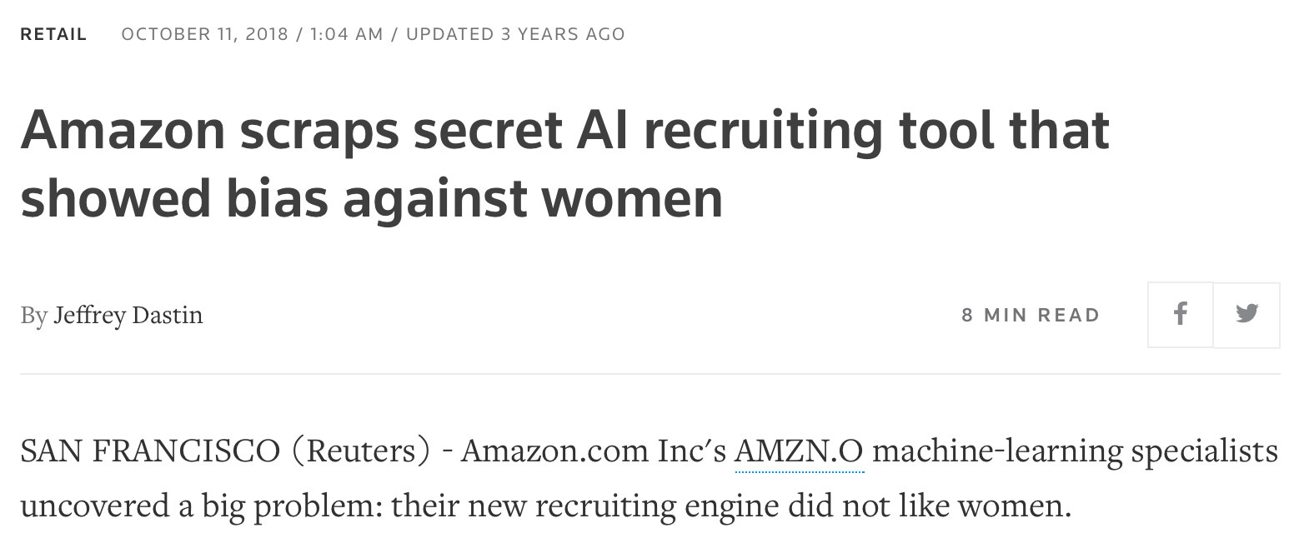
https://www.reuters.com/article/us-amazon-com-jobs-automation-insight-idUSKCN1MK08G

Slide 15
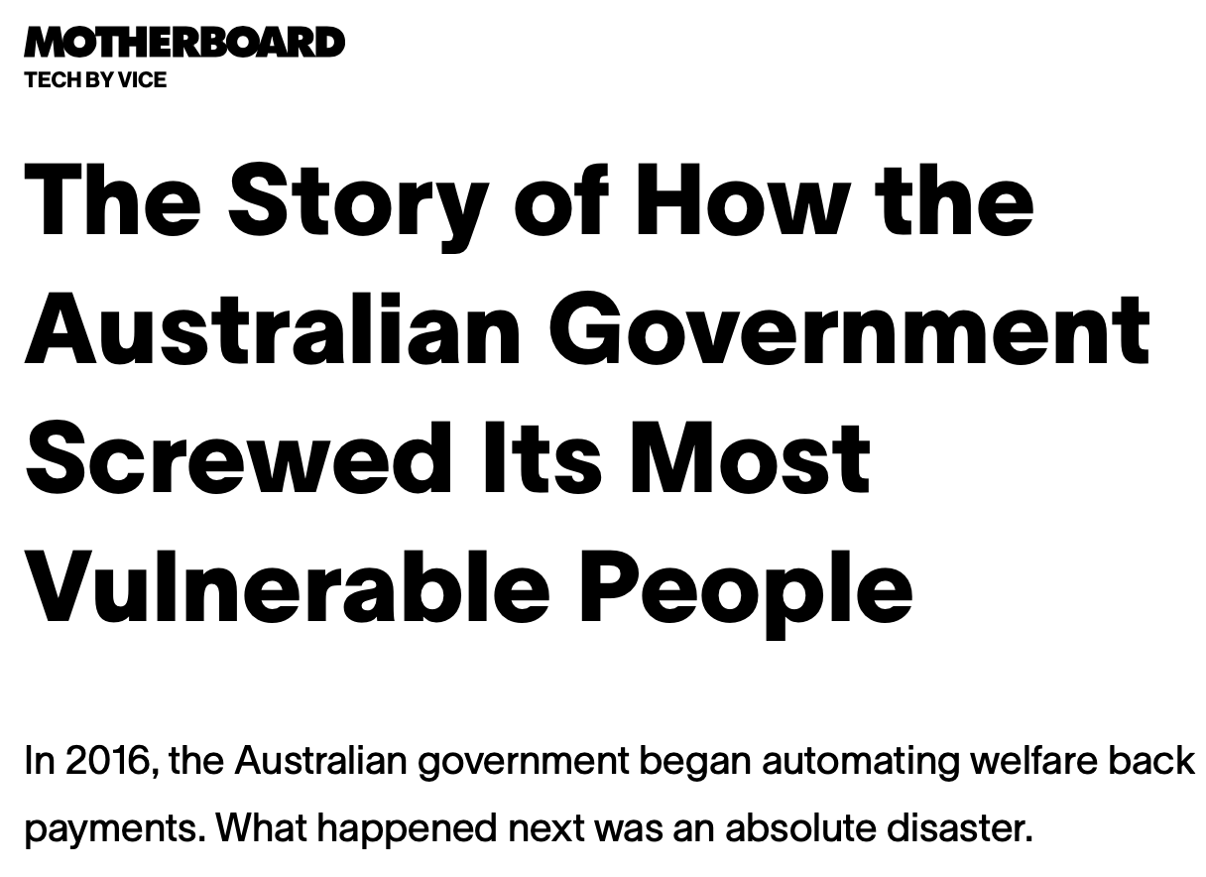
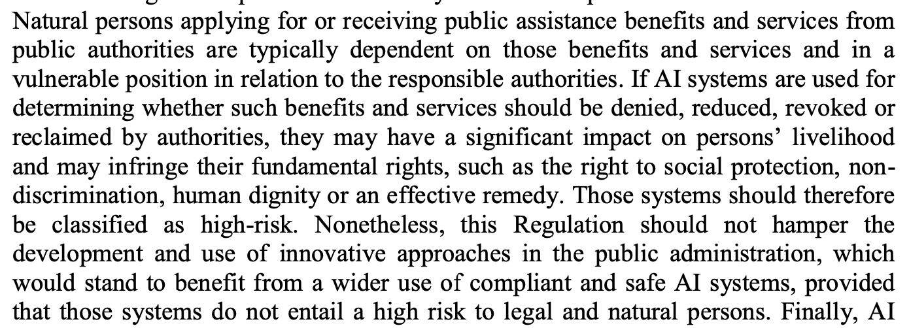
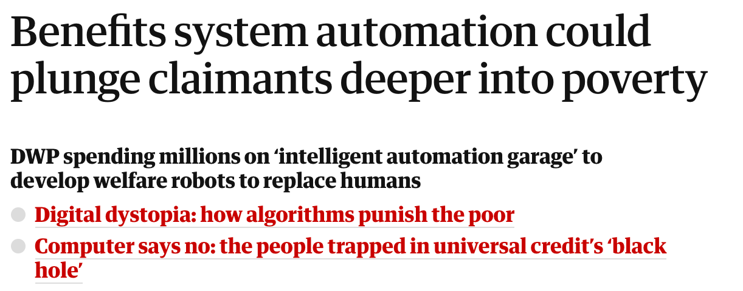
https://www.vice.com/en/article/jgq35d/how-a-discriminatory-algorithm-wrongly-accused-thousands-of-families-of-fraud
https://www.theguardian.com/technology/2020/feb/05/welfare-surveillance-system-violates-human-rights-dutch-court-rules
(37)
https://www.vice.com/en/article/y3zkgb/the-story-of-how-the-australian-government-screwed-its-most-vulnerable-people-v27n3
https://www.theguardian.com/technology/2019/oct/14/fears-rise-in-benefits-system-automation-could-plunge-claimants-deeper-into-povertt

Slide 16
(37)
https://www.bbc.com/news/business-50432634

Slide 17
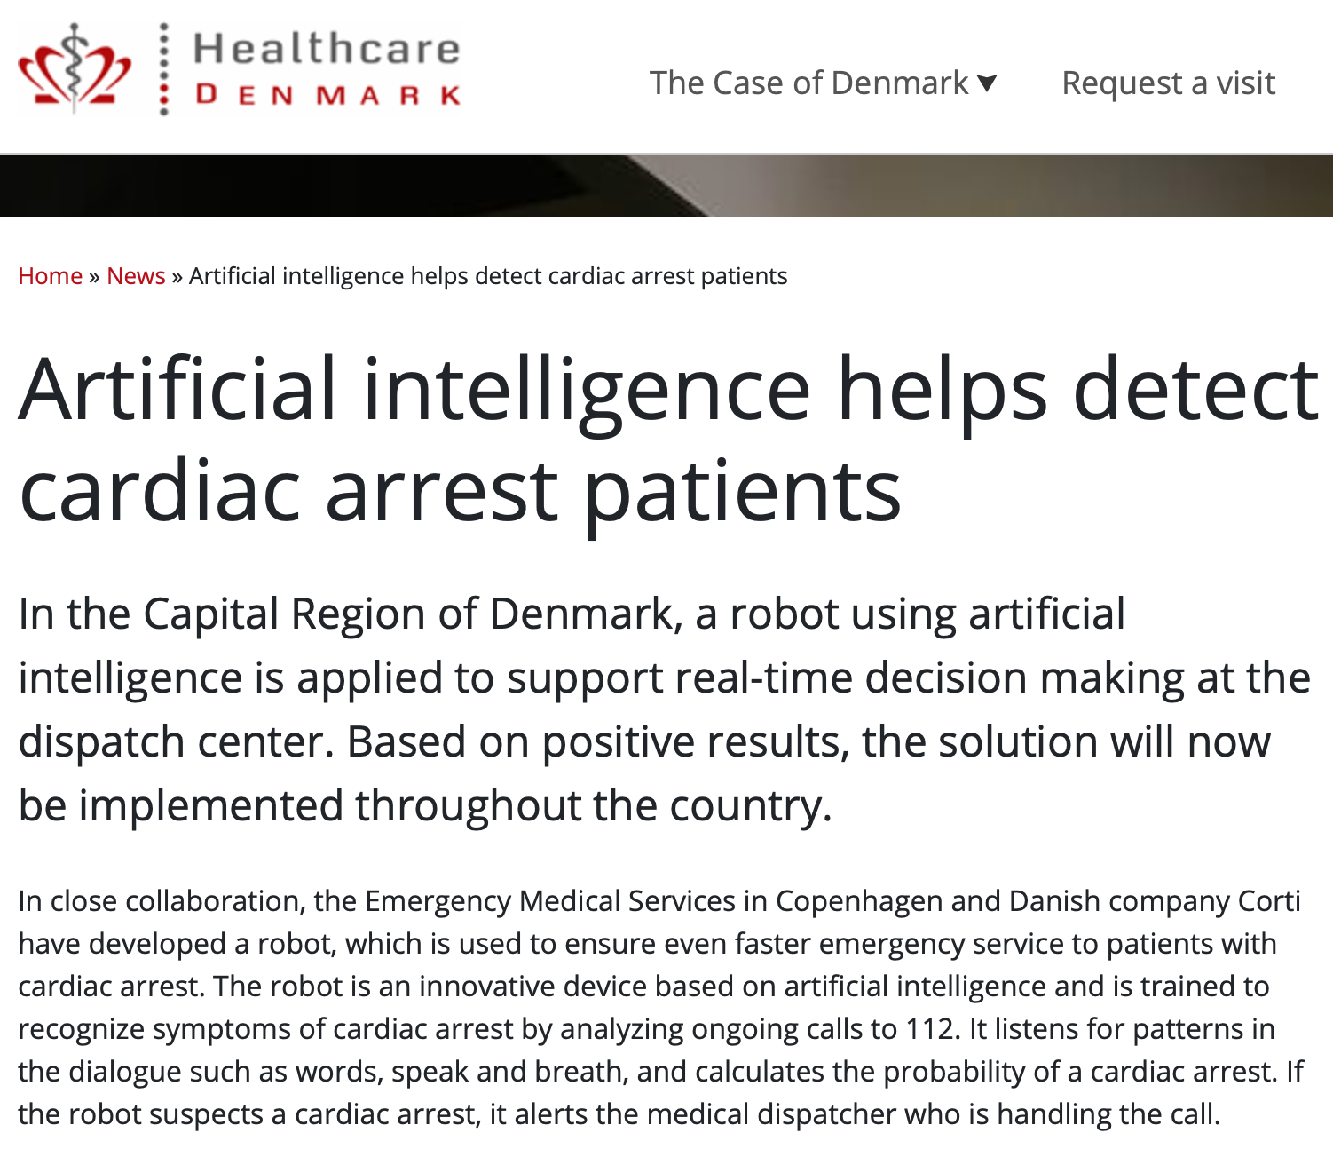
(37)
https://www.healthcaredenmark.dk/news/artificial-intelligence-helps-detect-cardiac-arrest-patients/

Slide 18
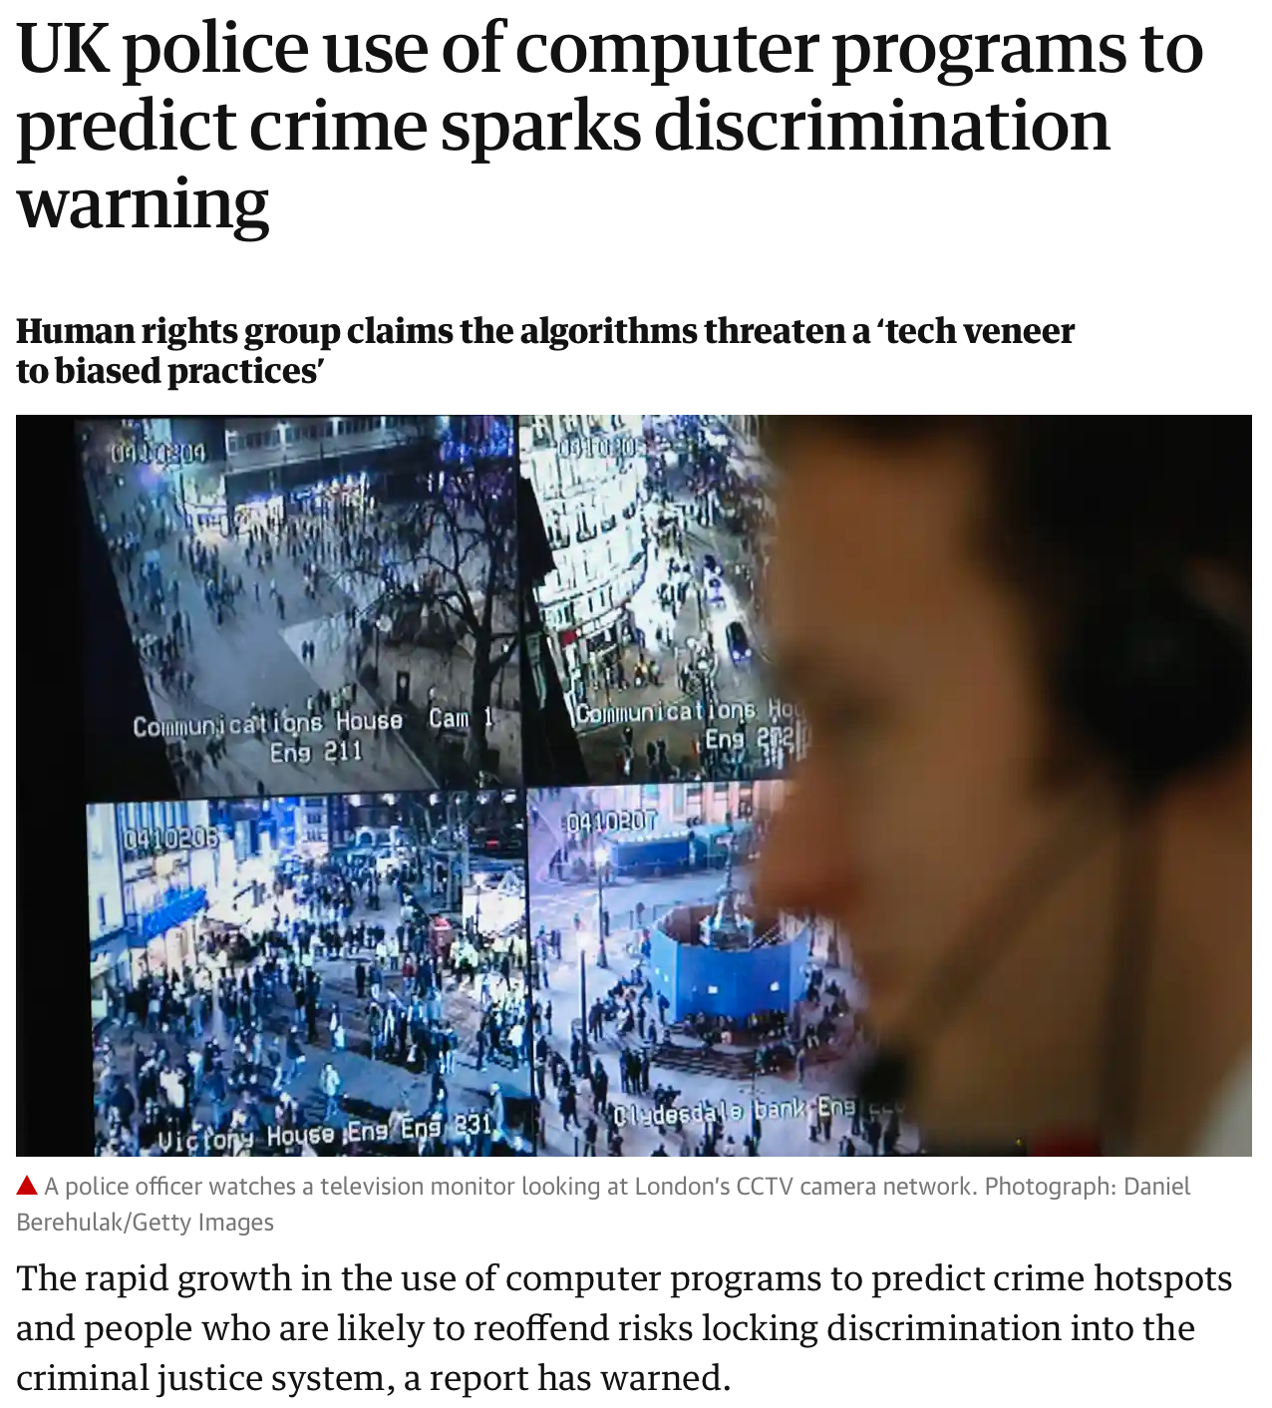
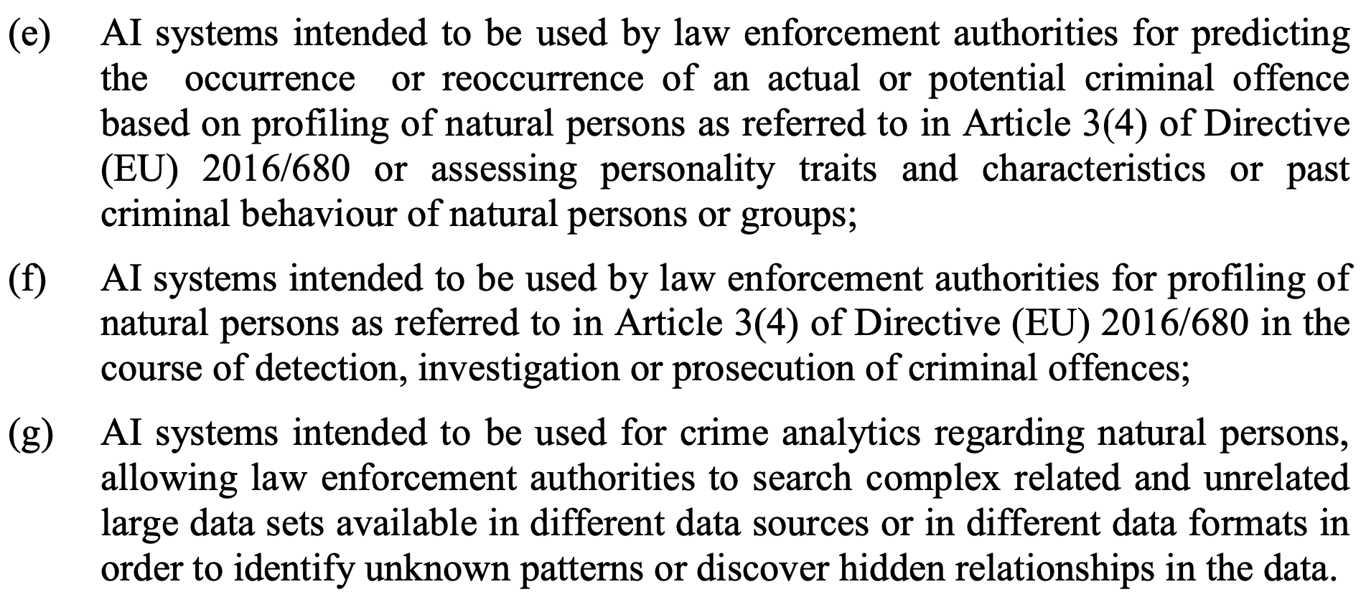
https://www.wired.co.uk/article/police-violence-prediction-ndas
https://www.theguardian.com/uk-news/2019/feb/03/police-risk-racial-profiling-by-using-data-to-predict-reoffenders-report-warns

Slide 19
https://www.bbc.com/news/technology-53650758

Slide 20
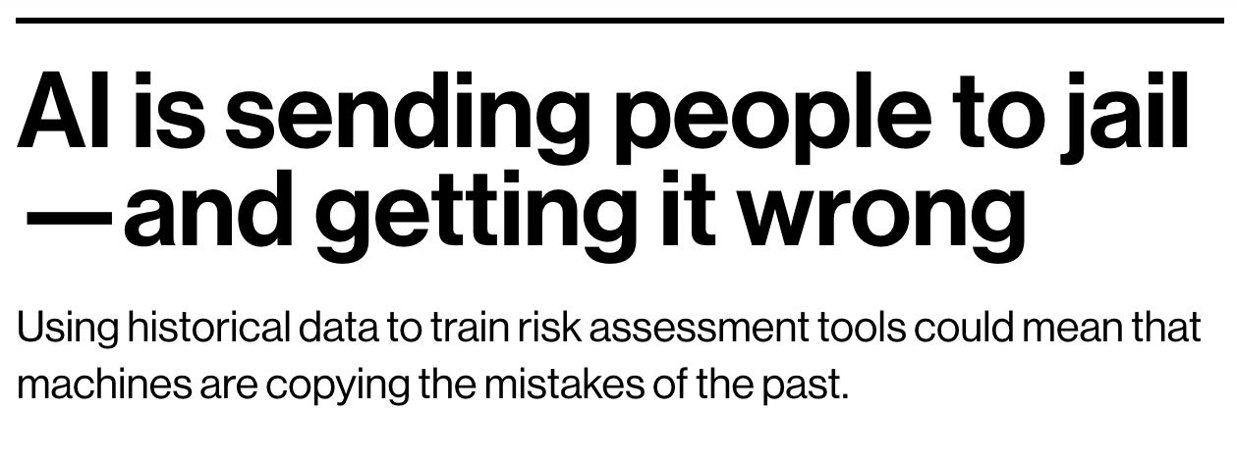
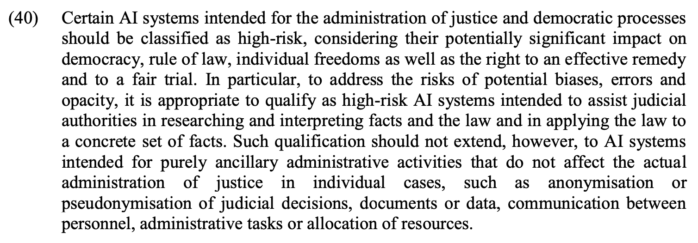
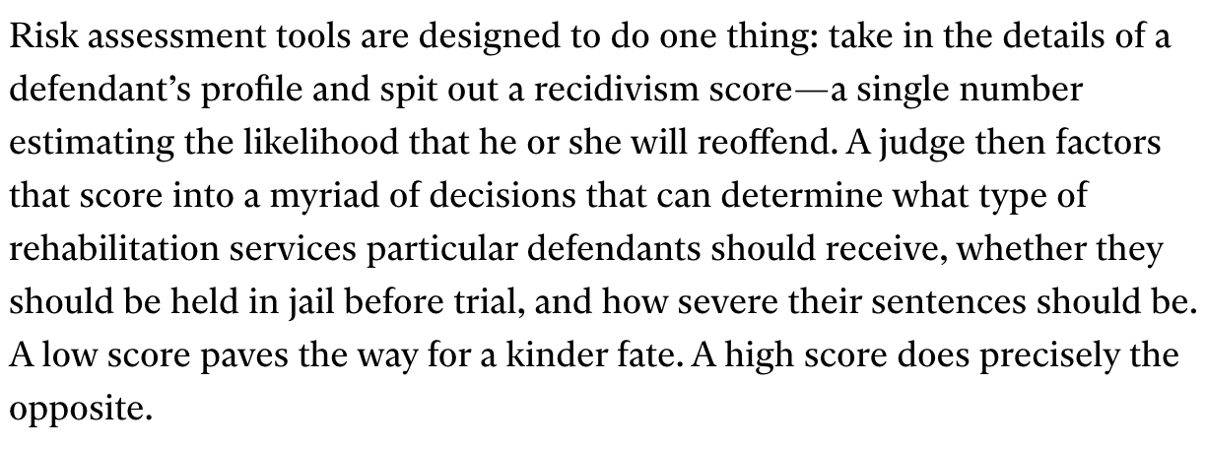
https://www.technologyreview.com/2019/01/21/137783/algorithms-criminal-justice-ai/

Slide 21
Høyrisiko AI vs GDPR art 22
AIA Annex III 5(b), 4(a), 3(a), 5(a), 7(d)
GDPR fortale 71, EDPB retningslinje s 21-22
Creditworthiness or credit score
Recruitment or selection of candidates in employment
Determining access to educational or vocational training institutions
Evaluate the eligibility for public assistance benefits and services
Examination of applications for asylum, visa and residence permits
Online credit application
e-recruiting practices
Access to education, e.g., university admission
Entitlement to or denial of a particular social benefit granted by law, such as child or housing benefit
Refuse admission to a country or denial of citizenship

Slide 22
AIA gir ikke rettslig grunnlag

Slide 23
Data and data governance art 10

Slide 24
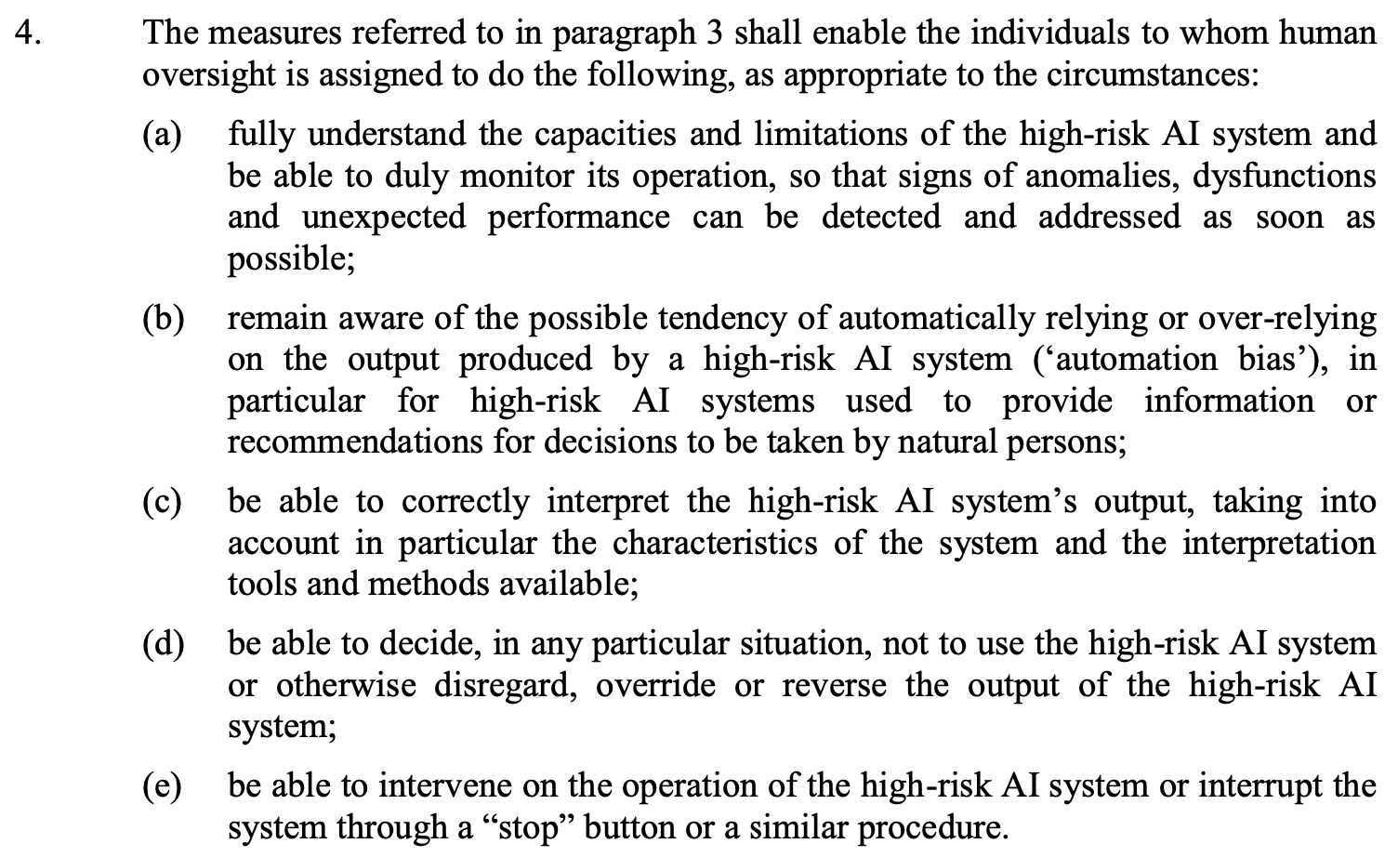
Human oversight art 14

Slide 25
Hva er sammenhengen mellom AIA og GDPR?
Ca. sånn ....
GDPR
AIA

Slide 26
‘relevant data’, not adequate, accurate, limited?
AIA art 29(3), GDPR art 5
AI regulatory sandbox legal basis for further processing
AIA recital 72, Title V, GDPR art 6(4)
‘biometric categorisation system’ sex, age, hair colour, eye colour, tattoos, ethnic origin or sexual or political orientation - mix of biometric data, special categories and then some?
AIA art 3(35)
‘publicly available space’ vs ‘publicly accessible area’
AIA art 3(39), GDPR art 35(3)(c)
Serious incident or breach within 15 days vs personal data breach within 72h
AIA art 62(1), GDPR art 33
‘national supervisory authority’ vs data protection supervisory authority?
AIA art 3(42)

Slide 27
Takk for oppmerksomheten!
Naomi Lintvedt
Stipendiat
Senter for rettsinformatikk
Institutt for privatrett
Universitetet i Oslo
monali@jus.uio.no
Vulnerability in the Robot Society
Copyright © GROOVE X, Inc.

