Slide 1
Noen viktige EØS-relevante initiativ med direkte betydning for digitaliseringen av norsk offentlig forvaltning
Dag Wiese Schartum, AFIN

Slide 2
Oversikt over viktige relevante initiativ
European eGovernment Action Plan 2016-2020 (2016)
Informasjonsforvaltning og tilgang til data mv.
Dokumenter som i stor grad gjelder tilgang til og gjenbruk av data:
A European strategy for data (2020)
Data Governance Act (2020, proposal)
Open Data Directive 2019/1024, (cf. Dir. 2003/98/EC)
Free Flow of Non-personal Data Directive (2018)
Kunstig intelligens
Dokumenter som gjelder krav til KI-systemer (systemer som utnytter data)
White Paper on Artificial Intelligence: a European approach to excellence and trust
Proposal for a REGULATION OF THE EUROPEAN PARLIAMENT AND OF THE COUNCIL
LAYING DOWN HARMONISED RULES ON ARTIFICIAL INTELLIGENCE (ARTIFICIAL
INTELLIGENCE ACT) AND AMENDING CERTAIN UNION LEGISLATIVE ACTS

Slide 3
European eGovernment Action Plan 2016-2020 (2016)
Jf. lov om Oppgaveregisteret (plikt til å samordne nye oppgaveplikter)
Based on 7 principles:
Digital by Default
Once only principle: public administrations should ensure that citizens and businesses supply the same information only once to a public administration. Public administration offices take action if permitted to internally re-use this data, in due respect of data protection rules, so that no additional burden falls on citizens and businesses
Openness & transparency: (1) public administrations should share information and data between themselves and (2) enable citizens and businesses to access control and correct their own data; (3) enable users to monitor administrative processes that involve them; (4) engage with and open up to stakeholders (such as businesses, researchers and non-profit organisations) in the design and delivery of services.
Inclusiveness and accessibility
Cross-border by default
Interoperability by default: Public services should be designed to work seamlessly across the Single Market and across organisational silos, relying on the free movement of data and digital services in the European Union.
Trustworthiness & Security

Slide 4
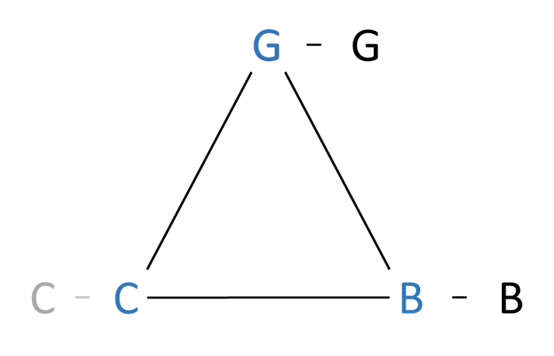
A European strategy for data (2020) - noen hovedpunkter
“Data is the lifeblood of economic development:
it is the basis for many new products and services,
driving productivity and resource efficiency gains
across all sectors of the economy, allowing for more
personalised products and services and enabling
better policy making and upgrading government services.”
G2G
“The Commission is convinced that businesses and the
public sector in the EU can be empowered through the
use of data to make better decisions.”
B2G
G2B
“Common European rules and efficient enforcement mechanisms
should ensure that:
data can flow within the EU and across sectors;
European rules and values, in particular personal data protection,
consumer protection legislation and competition law, are fully
respected;
the rules for access to and use of data are fair, practical and clear,
and there are clear and trustworthy data governance mechanisms
in place; there is an open, but assertive approach to international
data flows, based on European values.”
B2B

Slide 5
Open Government Directive og Data Governance Act
G
Open Data Directive 2019/1024, (cf. Dir. 2003/98/EC)
Jf. offentleglova § 7 (om bruk av offentleg informasjon)
G
G
Data Governance Act (2020, proposal)
a) Videreanvendelse av bestemte kategorier av data
i offentlige myndigheters besittelse
DDT
b) Datadelingstjenester
DAO
c) Dataaltruistiske organisasjoner
C
C
DK
DK
B
B
DK = Datakooperativer

Slide 6
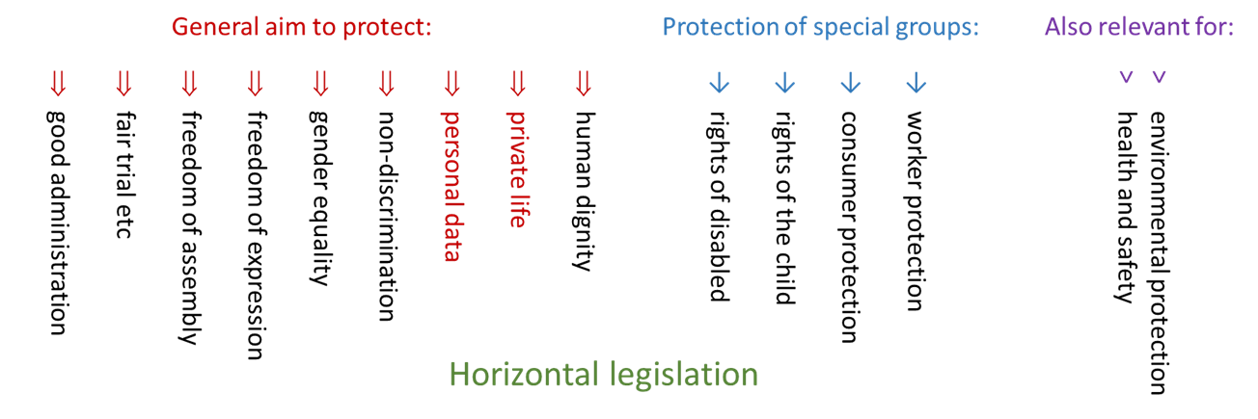
Artificial Intelligence Act (AIA) – forslag til ny forordning
AIA er tema for Naomi Lintvedts innlegg på seminaret neste onsdag 15.9, så gir bare en overordnet beskrivelse her
AIA bygger på fleksibel og dynamisk definisjon av kunstig intelligens (KI)
AIA er ment å regulere krav til KI-produkter, og er ikke formulert som nye rettigheter
Vil likevel ha beskyttelse av enkeltpersoner som effekt
Omhandler i liten grad personvern, men mange KI-systemer vil netopp bruke personopplysninger, så det er intim sammenheng mellom AIA og personvernforordningen (GDPR)
Forbyr visse anvendelser av KI (art. 5)
Stiller krav til «high-risk systems»
Hør podcast med diskusjon
av forslaget til AIA

