Slide 1
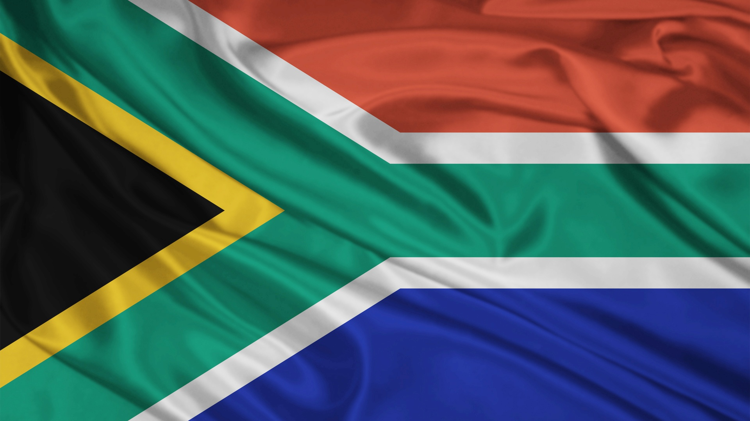
South Africa
Veronica Rosiejka, Chisato Matsuoka,
Elena Norkina, Trine Riis-Hansen

Slide 2
Background of South Africa
11 official languages and at least 8 other unofficial languages
5 ethnic groups: Black (80.2%), Coloured (8.8%), Indian/Asian (2.5%), White (8.4%), Other (0.5%)
Several ethnic sub-groups of the Black group: Zulu, Xhosa, Basotho, Bapedi, Venda, Tswana, Tsonga, Swasi, Ndebele, plus more
Notes:
To give context to this assessment, you first need to understand how diverse South Africa is. There are 11 official languages and at least 8 unofficial languages, all of which come from different ethnic groups. There are officially five ethnic groups in South Africa: Black, Coloured, Indian, White, and Other. But probably the most important thing to know is that the Black ethnic group is made up of many, many sub-groups, all of which have distinct cultures. These nine listed here are only the nine major ones, and it’s not all of them, but by far the largest groups are Zulu and Xhosa.

Slide 3
Apartheid 1948-1994
Racial segregation since colonial times, but the official system of Apartheid lasted from 1948 to 1994
Apartheid- legislated political and social system of racial segregation that severely suppressed the rights of Blacks and others, and promoted Whites
Bantustans set up for Blacks to 1) keep them out of cities and 2) deny protection and rights
Notes:
I have no doubt that you know what Apartheid was, but here is a very brief run-down of it. The word Apartheid means “separateness” or “apartness” in Afrikaans. The White minority ruled South Africa and political and social racial segregation was mandated by law. Racial segregation in South Africa dates as far back as colonial times, while the official system of Apartheid lasted for 46 years from 1948 to 1994. This segregation was more than just separate places for Blacks and Whites. The rights of Blacks and the other groups were heavily curtailed and they were severely disadvantaged in all areas of life. The Apartheid government established Bantustans, which were ethnic homelands, for Blacks, who were to ‘self-govern’. They did this to keep them out of urban areas and to use them as a political excuse to deny them rights and protection by the state. But not all Blacks lived in the Bantustans; most of them lived in townships, which still exist today. To put it very simply and briefly, Apartheid ended after what they call “The Struggle”.

Slide 4
Question 1
Which human rights standards and mechanisms are the most relevant to be applied in such cases of peace-building?
Elena Norkina

Slide 5
IHRL Standards in International Legal Instruments
The future for the diverse community of South Africa should be build on these instruments:
Universal Declaration of Human Rights (UDHR) (1948)
UN Minorities Declaration (1992)
International Convention on the Elimination of All Forms of Racial Discrimination (CERD) (1966)
International Convention on the Elimination of All Forms of Discrimination Against Women (CEDAW) (1979)
Convention Against Torture and Other Cruel, Inhuman or Degrading Treatment or Punishment (CAT) (1984)
Convention on the Rights of the Child (CRC) (1984)
International Covenant on Economic, Social and Cultural Rights (ICESCR) (1966)
Plus others…
Notes:
The human rights standards set out in these international human rights instruments, and others, such as the ICCPR, should be the foundation the new South Africa should be built upon during peace-building.

Slide 6
New Legislation
New legislation should be based on democratic values, social justice, and human rights with a focus on the existence of the rights of peoples
Two most basic principles as foundation:
Non-Discrimination
Equality
All human beings are born free and equal in dignity and rights
Notes:
New South African legislation should be based on democratic values, social justice, and human rights, and have a particular focus on the rights of ALL peoples. Therefore, the two most basic principles of non-discrimination and equality must serve as the foundation of legislation.
People shall not be discriminated against on the basis of race, gender, religion, language, colour, political opinion, national origin, property, birth, or other status. The new South African Constitution actually protects even more groups than this list here.
Everyone shall be equal before the law and are entitled to equal protection of the law, and equal access to public service.

Slide 7
Specific Human Rights to Provide for
The right to self-determination
The right to freedom of movement and residence within South Africa
Ethical and legal conduct
Equality in the exercise of rights and freedoms
Economic and social rights
Cultural minority rights
Special protection to cultural minorities
Notes:
Some specific human rights that must be provided for given the South African context are the right to self-determination; the right to freedom of movement and residence within South Africa; Ethical and legal conduct and human dignity – that is, state officials shall respect the principles of legality, necessity, non-discrimination, proportionality, and humanity; the equality in the exercise of rights and freedoms and that there must not be limitations on the principle of non-discrimination; economic and social rights – especially land rights and access to resources; and cultural minority rights, which must be specially protected

Slide 8
Mechanisms
Minority participation in public affairs is essential
Mechanisms are required to ensure group diversity is reflected in public institutions, and the minorities are represented and have a voice
Mechanisms for effective participation
Notes:
Minority participation in public affairs is essential to preserving their identity and to combating social exclusion.
Mechanisms are required in South African law that ensure that the diversity of groups is reflected in public institutions, and that minorities are represented, consulted, and have a voice in decisions that affect them. Mechanisms need to ensure participation is meaningful and effective.

Slide 9
National Mechanisms for Minority Participation
Effective participation involves dialogue between minorities and government officials
Forum on Minority Issues- provides thematic contributions and expertise. Analyzes best practices, challenges, opportunities, and initiatives
Notes:
Effective participation involves dialogue between minorities and government officials, as well as access to this dialogue.
The Forum on Minority Issues is probably one of the best existing mechanisms. The Forum provides thematic contributions and expertise to the work of the Independent Expert on minority issues. It also identifies and analyzes best practices, challenges, opportunities, and initiatives for the further implementation of the UN Declaration on Minorities.

Slide 10
Question 2
Which constitutional and territorial principles would you propose so that the interests and rights of the contending groups and minorities will be protected in the post-conflict system?
Veronica Rosiejka
Notes:
Just for a little bit of background, I spend three months this summer interning in South Africa for the South African Human Rights Commission. I’ve seen how unequal life is between the different ethnic groups and how terribly the current system works. I’ve based my assessment off what I know about South Africa and my experiences there.

Slide 11
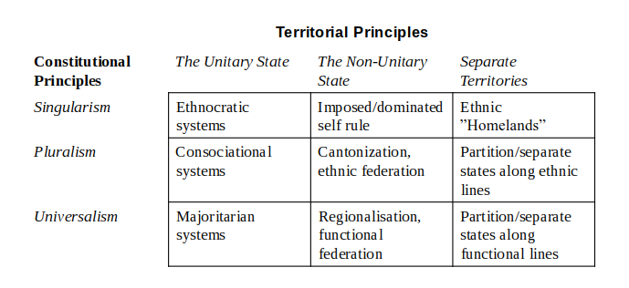
Notes:
This is the model Nils showed us last week. I’m going to use it to answer this question. I’m going to do that by first analyzing the three constitutional principles in relation to South Africa, then the three territorial principles.

Slide 12
What was South Africa Pre-1994?
Apartheid- Singular Unitary State (ethnocracy)
Bantustans- Separate Territories (ethnic homelands)
Notes:
South Africa under Apartheid was a Singular Unitary State, in other words, an ethnocracy, but also a little bit of Singular Separate Territories due to the Bantustans.

Slide 13
What is South Africa Now?
Democracy where everyone is treated the same (in theory), no matter group membership
Central government that delegates powers to provinces
Population still extremely bitter about Apartheid, many say no change
Notes:
So, what is South Africa now? It’s a democracy where, at least in theory, everyone is treated the same and has the same rights, no matter what group they belong to. The government is a central government that delegates powers to the provinces. So, South Africa moved from a Singular Unitary State to a Universal Unitary State where the political party that wins the majority vote governs, but the same party has been in power since 1994 (so you can perhaps even argue that it has remained a Singular Unitary State under the guise of democracy). The people of South Africa are still very, very bitter about Apartheid, and the government uses it a lot in its rhetoric to explain why things are still so bad. Many people say they perceive no change from Apartheid to democracy in regards to how they are treated.

Slide 14
Constitutional Principles Overview
Singularism- the State promotes and embodies the identity of one particular group. This often leads to the suppression of other groups and to discrimination
Pluralism- the national community is made of sub-groups, to which no preference is given. Not all groups are necessarily included
Universalism- group identity is irrelevant and everyone is considered equal
Notes:
Now we get to the analysis. How could we structure the state in order to drop Apartheid and avoid South Africa’s current problems? As I said, I’ll start with the constitutional principles and then move on to the territorial ones.
Singularism is when the state promotes and embodies the identity of one particular group, and this often, and to varying degrees, leads to suppression of, and discrimination against, other groups.
Pluralism is the conception that the national community is made up of sub-groups and no preference or promotion is given to a group, and they all have a fair say. However, not all groups are included in this.
Universalism is quite simply that everyone is considered equal and group identity is irrelevant.

Slide 15
Evaluating Constitutional Principles: My Choice
Singularism = NO
Universalism = NO
Pluralism = YES
Notes:
As I stated in my introduction, singularism is the constitutional principle South Africa employed during Apartheid. It absolutely didn’t work then, and a Singular rule of the Blacks over the other groups, even though they are the ethnic majority, is still not good because singularism by definition promotes only one identity and gives lower status to the others. We want to make sure that everyone’s rights are protected, which would very likely not be the case if we chose singularism. So this is out.
Why have I said no to universalism? It seems like the ideal. The reason is because universalism is what South Africa currently has, and it’s not working. Everyone is very protective of their ethnic identity and ethnic group, and their ethnicity is central to their personal identity. It’s not possible for them to put it in the back seat, and there are too many ethnic groups to make universalism work. Everyone will vote in a way that benefits their group and disadvantages another. This is what happens now.
So, my ultimate choice is pluralism, and I’ve already hinted at the reason. Ethnicity is too important to people in South Africa to have a system in which it is irrelevant. South Africa needs group identity to play a role in their political organization. The country is so diverse, and the history so bleak, that each group needs to have an equal say. I’m not dismissing the idea that they can use this to eventually work to universalism, but in their post-conflict situation, ethnicity needs to be recognized and play a role in rebuilding an equal society that benefits and protects all groups.

Slide 16
Evaluating Territorial Principles
Unitary State- the State is collected under one central government with all of the power
Non-Unitary State- the State is a union of partially self-governing states that fall under a central government
Separate territories- the State includes ethnic homelands or separate states
Notes:
Now that we’ve chosen a constitutional principle, it’s time to look at the territorial principles. A Unitary State is a state with a central government that wields all the power.
A Non-Unitary State is a federation. The state is formed of several partially self-governing states under a central government. Sovereign power is divided and each state has some control over what happens within it.
Separate territories are states that include ethnic homelands or separate states.

Slide 17
Evaluating Territorial Principle: My Choice
Unitary State- YES
Non-Unitary State- MAYBE
Separate territories- NO
Notes:
I found choosing this to be much harder than choosing a constitutional principle.
I do not think that establishing ethnic homelands or separate territories is good for South Africa. I think it would create too much fragmentation when the country really needs to try to come together. I also think that South Africa is actually too diverse for this. How would they create a territory for each ethnic group, especially those that are so small? You must remember that there are well over nine subgroups of just the Black ethnic group. And how would they determine where each physical territory should be? Not all ethnic groups have a traditional region anymore, and even if they do, the population has been so spread and mixed that it would require a lot of decision making and great physical upheaval.
Now for the ‘Maybe’. Given how important ethnic identity is in South Africa, it makes sense to create an ethnic federation, based on democracy, where each group has some sovereignty over a territory and have some control over their own affairs while a central government heads the country. I think this seems like a good choice for South Africa. However, the same issues with the division of the land and that physical location aspect of separate territories applies here as well. In addition, ethnic federalism can also lead to bids for secession and given the history of the country, I think this seems like a likely outcome. I’m not necessarily against secession, but I think that if this were to take place, it would only lead the country into yet another internal conflict. If this was not a likely possibility, and an acceptable solution to the land distribution could be agreed on, then I would suggest this territorial principle.
I say yes to a unitary state because one strong central government can most effectively unite all the peoples of South Africa together.
So now let’s see how all this comes together, even though I’m sure you all can guess.

Slide 18
Resulting Suggested Structure
Notes:
What I suggest, perhaps unsurprisingly, is a Pluralist Unitary State, that is, consociationalism, for South Africa, at least during the transition phase. Having a consociational system assures that everyone’s ethnic identity, which, as I said, is very important to people in South Africa, is taken into account and assures governance based on the consensus of all the major groups. It will give every group a say, which will ensure that their concerns and their voices are heard and their rights are protected because they will be able to stand up for them themselves rather than relying on someone else to maybe do it for them. Having one central government will help to build friendship between the different groups, which will help to strengthen the country in the long run, both in terms of government and society. South Africa rushed too quickly into the majoritarian system, which ended up just functioning as a way to air their anger and as a trap that continues to invoke Apartheid in order to perpetuate the situation. The Truth and Reconciliation Commission of South Africa was based on giving equal voice to victim and perpetrator after Apartheid. The government needs to do the same.

Slide 19
Question 3
Which elements of institutional power-sharing would you propose in this case?
Chisato Matsuoka

Slide 20
Power-Sharing Model
Power-sharing/consociationalism- division of political powers among different groups to maintain stability
Improvement of democracy, protection of minority rights, and management of conflicts
Notes:
Power-sharing, or consociationalism means the division of powers among different groups in ethnically diverse states. It leads to the improvement of democracy, the protection of minority rights, and the management of conflicts.

Slide 21
Four Principles
Grand coalition- the political leaders of all significant groups of the plural society cooperate in governing the country
Mutual veto- consensus among the groups is necessary to confirm the majority rule
Proportionality- proportional representation from each group
Segmental autonomy- minority autonomy over their own territory, community, and issues
Notes:
Power-sharing has four elements: Grand coalition, mutual veto, proportionality, and segmental autonomy.
Government by grand coalition means that the political leaders of all significant groups of the plural society cooperate in governing the country.
Consensus among the groups is necessary to confirm the majority rule. It gives each segment the guarantee that it will not be outvoted by the majority when its vital interests are at stake.
Power-sharing models need representation from each group based on population.
It accepts group autonomy over their own community and issues.

Slide 22
Obstacles in Post-Apartheid South Africa
Dominance of a single culture within all spheres of society
Apartheid had a colonizing effect on society
All societal institutions, whether economic, legal, political, or social, had to display the characteristics, interests, and desires of the communal and national will
Huge cleavage among different groups
With long segregation policy, there are huge gaps among different groups
Notes:
Since politics in South Africa was strongly preferential to the White minority for a long time, it is necessary to create a neutral society through power-sharing. However, the long segregation policy left behind two obstacles to promote pluralism in South Africa.
First, “White culture” dominated all spheres of society. Apartheid thus had a colonizing effect on society. All societal institutions, whether economic, educational, legal, political, or social, had to display the characteristics, interests, and desires of the communal and national will.
Second, there is a huge gap among different ethnic groups. Long segregation policy notably created different political and cultural identities, and it is difficult to unite different groups.

Slide 23
Solutions to These Obstacles
Dominance of a single culture within all spheres of society → Promotion of diversity
Huge cleavage among different groups → Unification of different groups into state identity
Notes:
For these obstacles, there would be two measures necessary.
First, it is necessary to diversify society to ensure the interests of all social groups. As I said previously, society was dominated by a certain, specific culture despite the diverse population of South Africa. Therefore, it is necessary to ensure the protection of each group’s culture. To achieve this goal, it is important to ensure all ethnic groups participate in political decision-making. As I also said before, all spheres of society were ‘colonized’ by certain values. It is necessary to penetrate other values into society. Political participation of these groups will make some policies for these marginalized people. It will also ease inequality among different groups.
Because of the long segregation policy, South Africa is fragmented into different groups, and we need to unite all ethnicities politically. The differences among groups ranges from political, economic, social, cultural, and so on. However, the creation of a national identity implies a sense of political community, some common institutions, and a single code of rights and duties for all members of the community. This will unite all the different groups as individuals in the same community.

Slide 24
Necessary elements of Power-Sharing in South Africa
Promotion of diversity
Mutual veto- protect minority interest by involving them in decision-making for their own issues and interest
Proportionality- ensures all groups participates in politics. It will correct imbalances that were created by minority rule
Segmental autonomy- creates their own space to maintain their own culture and society
Unification of different groups into state identity
Grand coalition- associates different groups into the same political community. Creates a sense of solidarity
Notes:
So, as I said, two approaches are necessary in South Africa: the promotion of diversity and the unification of different groups into a state identity. To achieve this goal, it is necessary to protect all groups’ independence while involving all groups in the same political system. For that, it is necessary to include all four principles of power-sharing.
First, segmental autonomy should be necessary for cultural policy. With their own autonomy system, they are able to maintain their own regulations. It also creates their own space to practice their culture. Certain rights, including cultural, linguistic, and religious rights, need individuals in a collective. Therefore, the preservation of groups through group autonomy will promote their enjoyment of their own culture “in their community and with the other members of their group”, as Article 27 of the ICCPR states.
Mutual veto is necessary to ensure the protection of minority interests. Majority rule is conducted with the consensus of all groups, so the danger that minority issues will be decided by majority decision will be avoided.
Proportional representation of the population will correct the imbalances created by the dominance of one culture and value system.
Lastly, a grand coalition enables all groups to take part in decision-making and brings all groups together into one political community. It will therefore facilitate the creation of a sense of solidarity among different groups.

Slide 25
Question 4
Which challenges and dilemmas would you expect to encounter in the implementation of the proposed arrangements?
Trine Riis-Hansen

Slide 26
Challenges for Power-Sharing in South Africa
Time vs. building of trust
No real participation and inclusion
Groups giving up power have distrust in the outcome
“Power-swap”- dynamics of transition and boundaries
Lack of representation and legitimacy
Dynamic identities- individual vs. collective identities?
Migration- a sensitive issue for power-sharing
Notes:
Here we’ve identified seven challenges to power-sharing in South Africa.
One: transition is not an easy process. The Establishment of trust between the parties is essential for a good transition that will be respected by all.
Two: are all of the groups actually at the table? If they aren’t, then there is a risk that this group might turn against the outcome. Are the groups who have limited formal political representation, like youths, being heard? Such groups must be consulted with and consideration for their concerns must be ensured.
Three: groups giving up power, in this case, the Whites, have to trust the results since they are losing privileges. If their concerns aren’t included in the agreement, they might rebel or sabotage the agreement.
Four: if the process is not assessing the risk for new power structures built on non-ethnic criteria, it might fail. For example, will people and groups outside the ANC, the political party in power, have access to things like jobs, land, and business licenses? Has the transition built new divides and new types of marginalization?
Five: Has the transition ensured ownership by the people by legitimate representation? We must ask who “owns” the process.
Six: Identity is dynamic. Are privileges granted based on territorial group identities in times of urbanization and migration?
And seven: migration might lead to new types of marginalization and exclusion, which is happening in South Africa. Has the agreement assessed this issue?

