Slide 1
FYS4260 - Microsystems and electronic packaging and interconnection technologies

Slide 2
Lab info
Lab room: 204
10 students at the time
Room is available Mon-Fri. from 9-17 (-21)
Laboratory supervisor:
Halvor Strøm: halvor.strom@fys.uio.no
Tuesday from 9-16
David Bang: davidmb@fys.uio.no
Thursday from 9-16

Slide 3
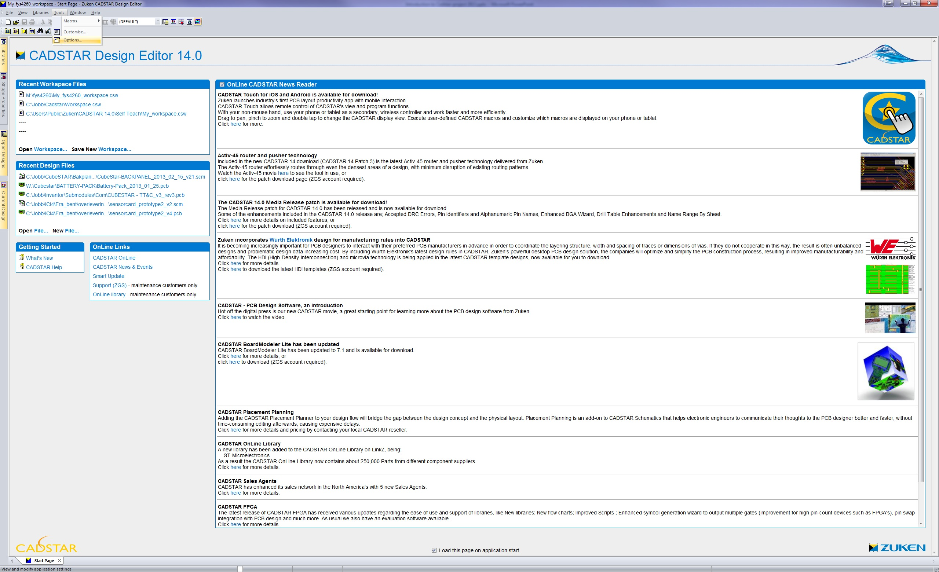
Setup – Cadstar I
Start CADSTAR Design Editor
Click ”Tools” => ”Options”
Screenshot of CADSTAR Design Editor

Slide 4
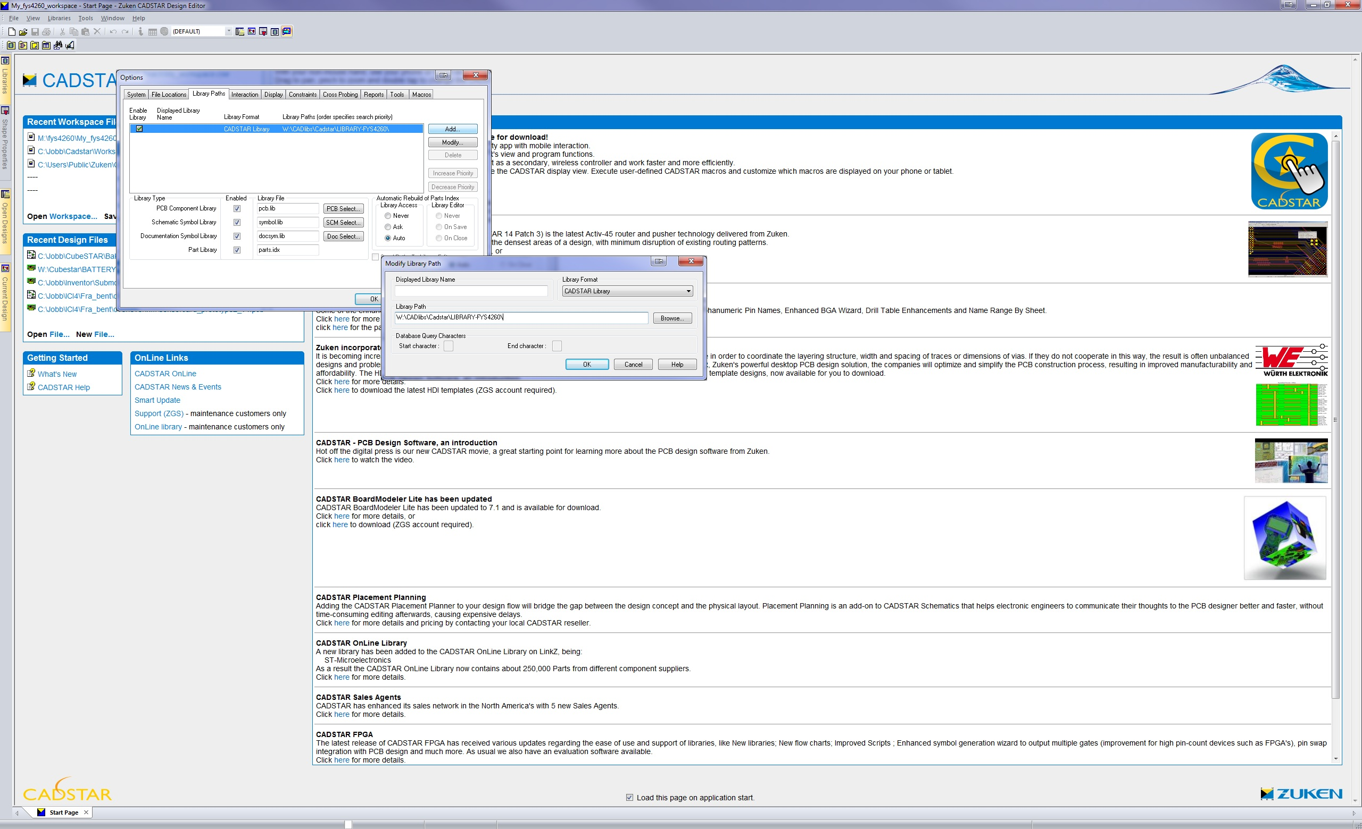
Setup – Cadstar II
Select ”Library path” tab and click ”Add”
Type in or find in browser: W:\CADlibs\Cadstar\LIBRARY-FYS4260
Click ”OK”
Adding component library

Slide 5
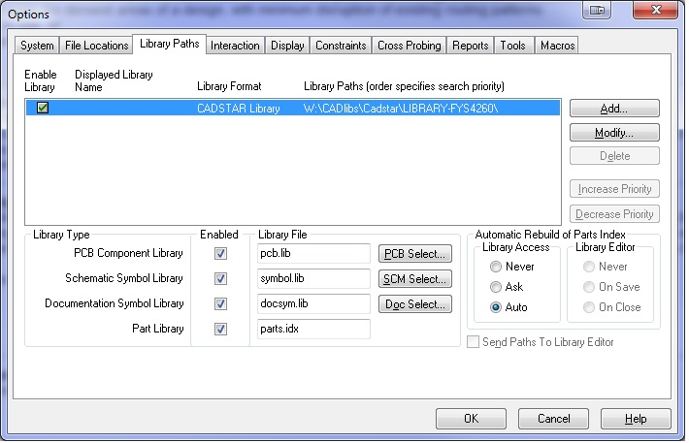
Setup – Cadstar III
Delete local component library
Finished adding FYS4260 prepared component library and deleted local library

Slide 6
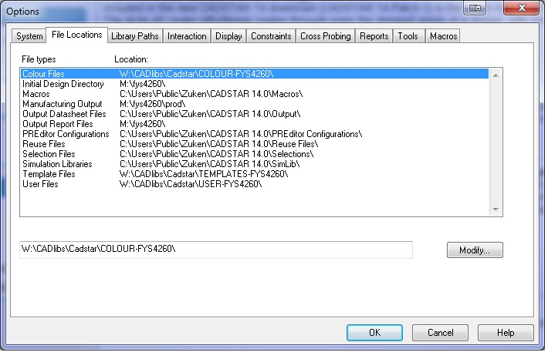
Setup – Cadstar IV
Load predefined templates
Color files
Template files
User files
Set design directories
Initial Design Directory
Manufacturing Output
Output Report Files
Remember to save workspace to preserve these settings for next time.
Screenshot of CADSTAR template setup

Slide 7
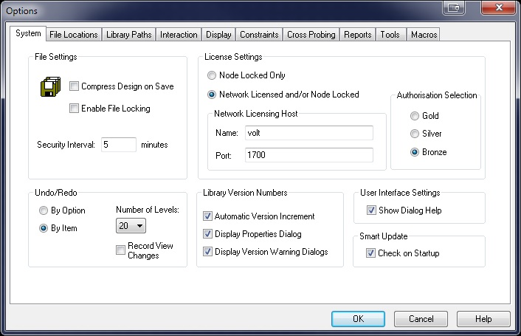
Setup – Cadstar V
Setup Network Licensing Host:
Name: volt
Port: 1700

Slide 8
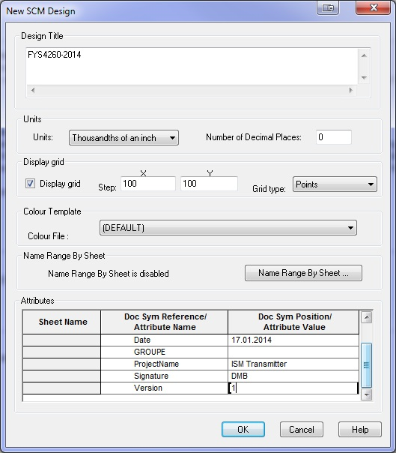
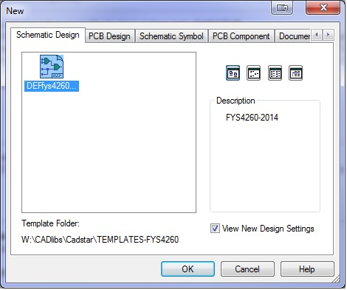
Project start
Click ”File” and ”new”
Press ”Schematic Design” => select ”DefFYS4260..”=> ”OK”
Press ”OK” again and input ”Design Title”and ”Attributes”

Slide 9
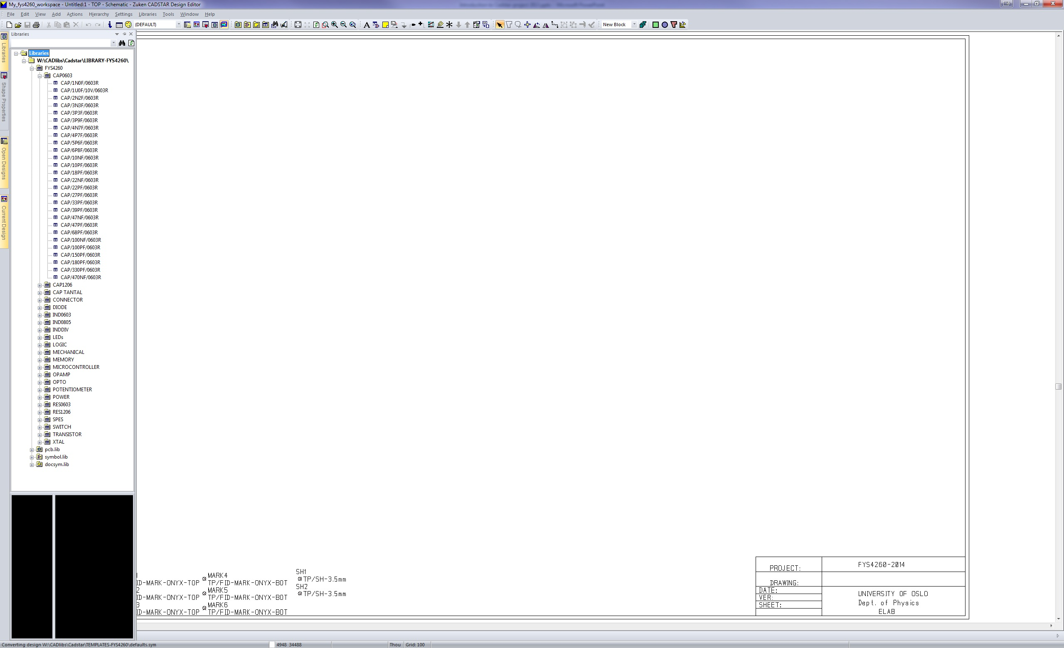
Schematic – Placing components
There are 2 ways of adding components
Searching component name/value/attributes
Picking component directly from library

Slide 10
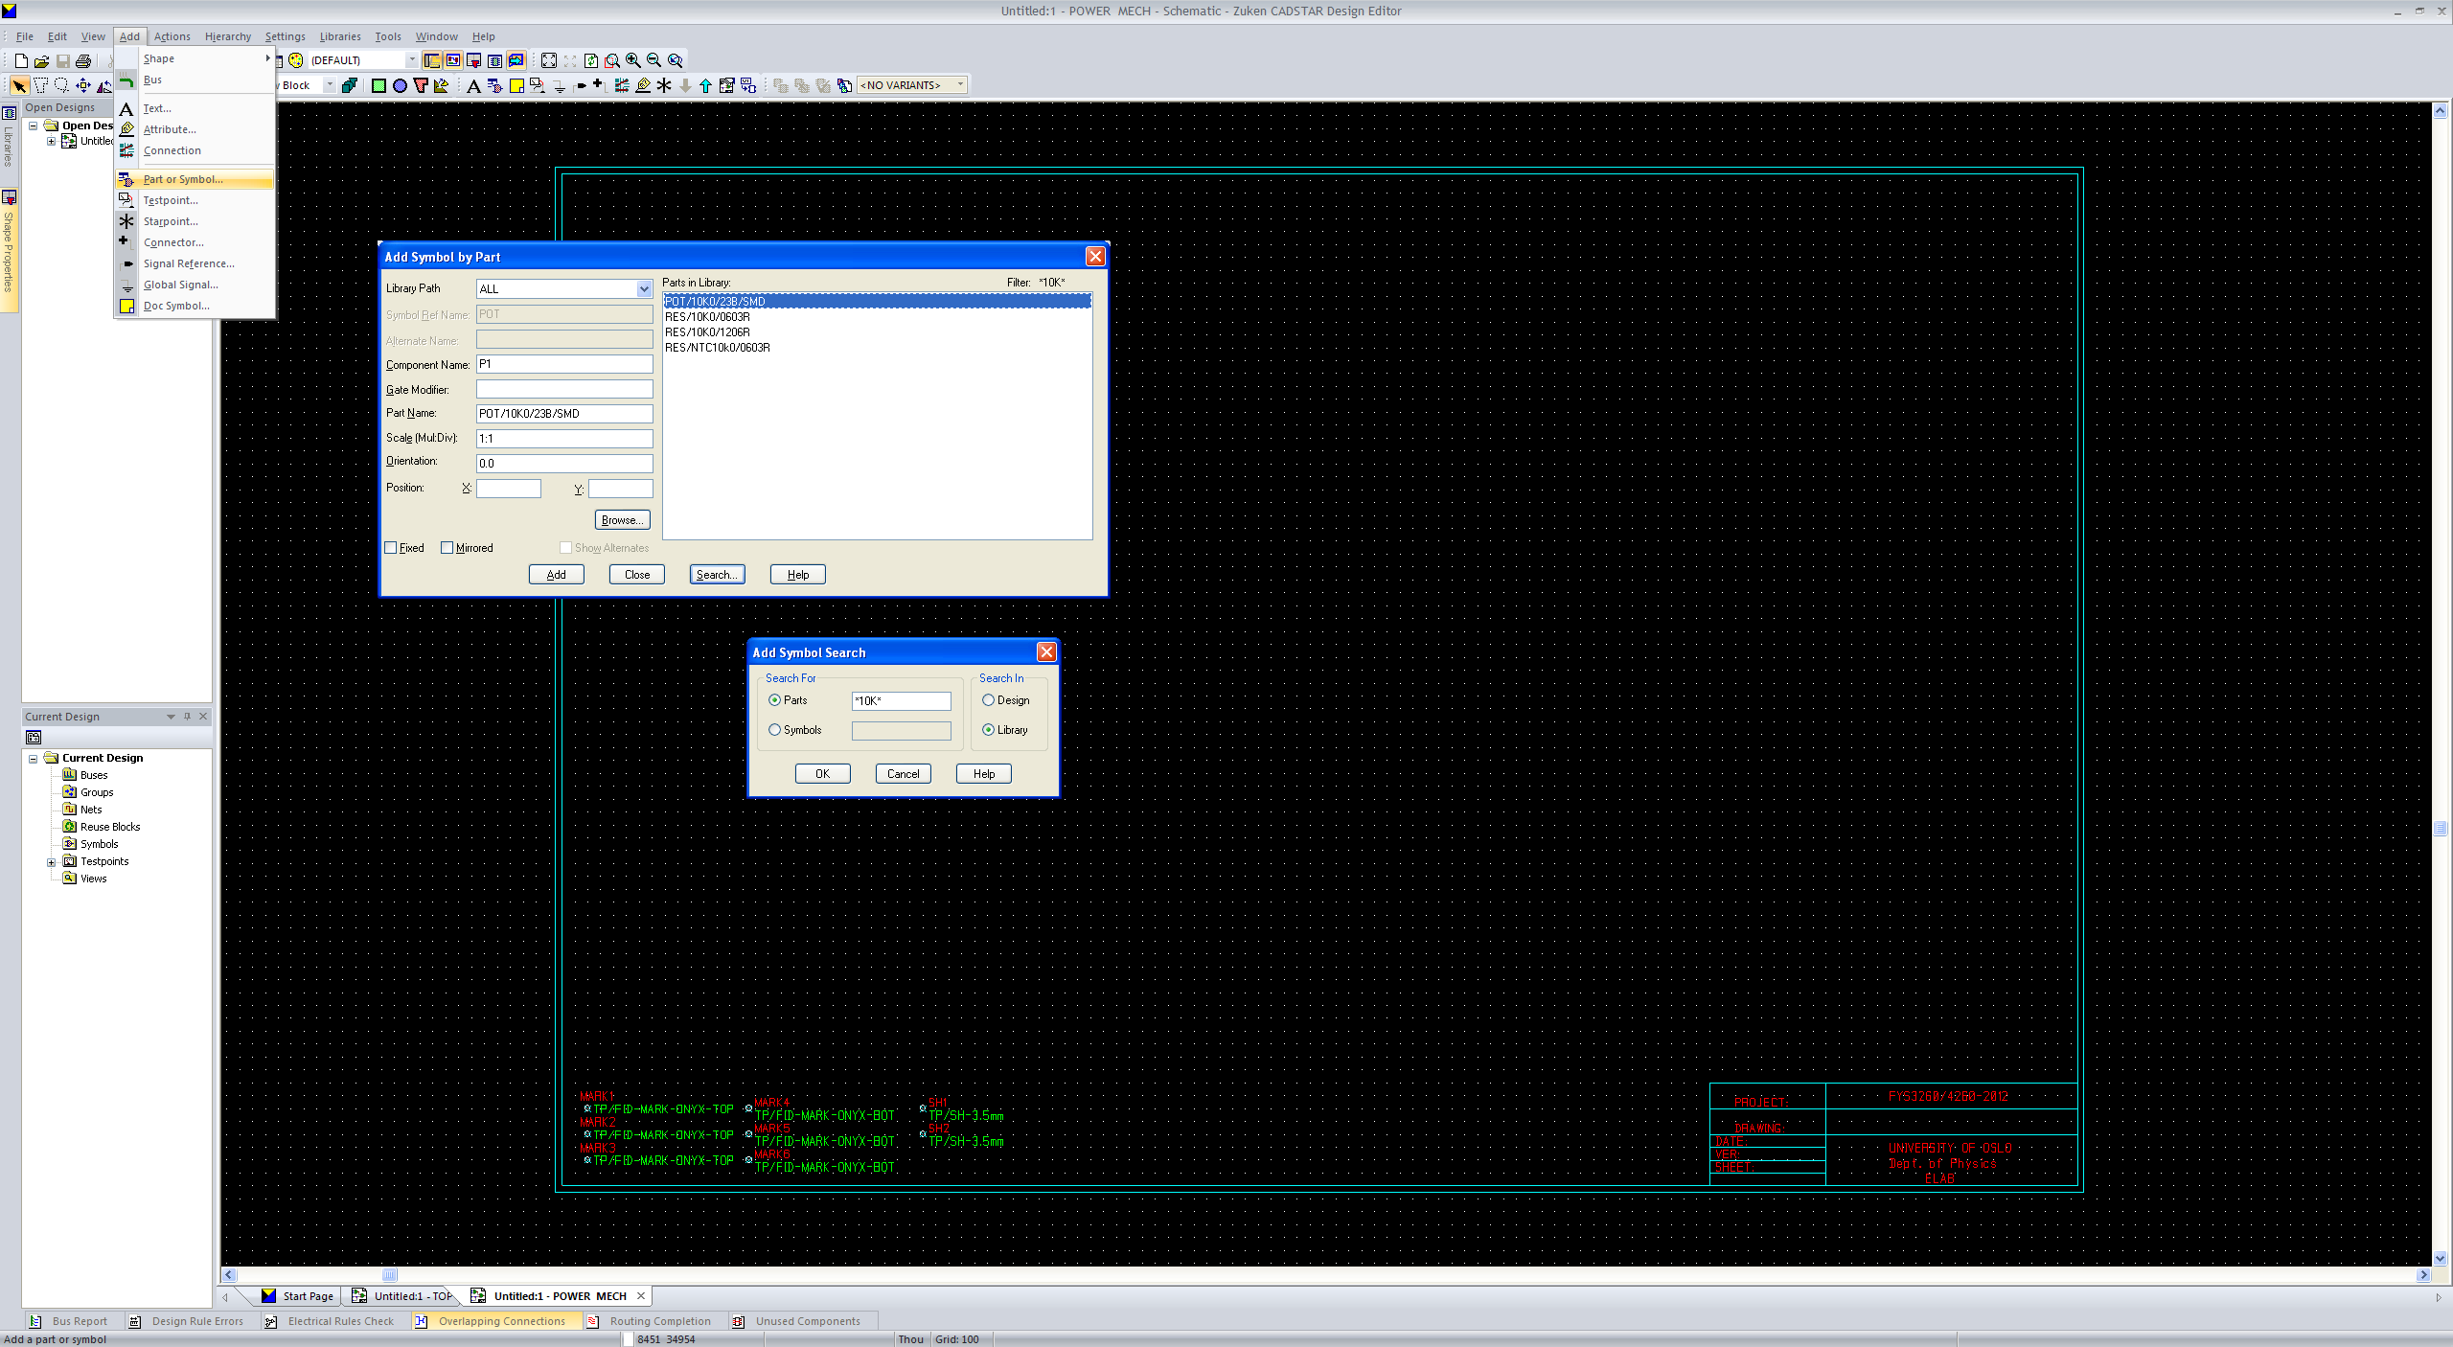
Schematic – Adding components II
Searching for components
Press ”Search”
Type ”*search word*” => ”OK”
Naming conventions:
0 ohm -> 0R0
47 ohm -> 47R0
4.5 Kohm -> 4K5
100nF - > 100n / 0.1u
3.4pF -> 3p4

Slide 11
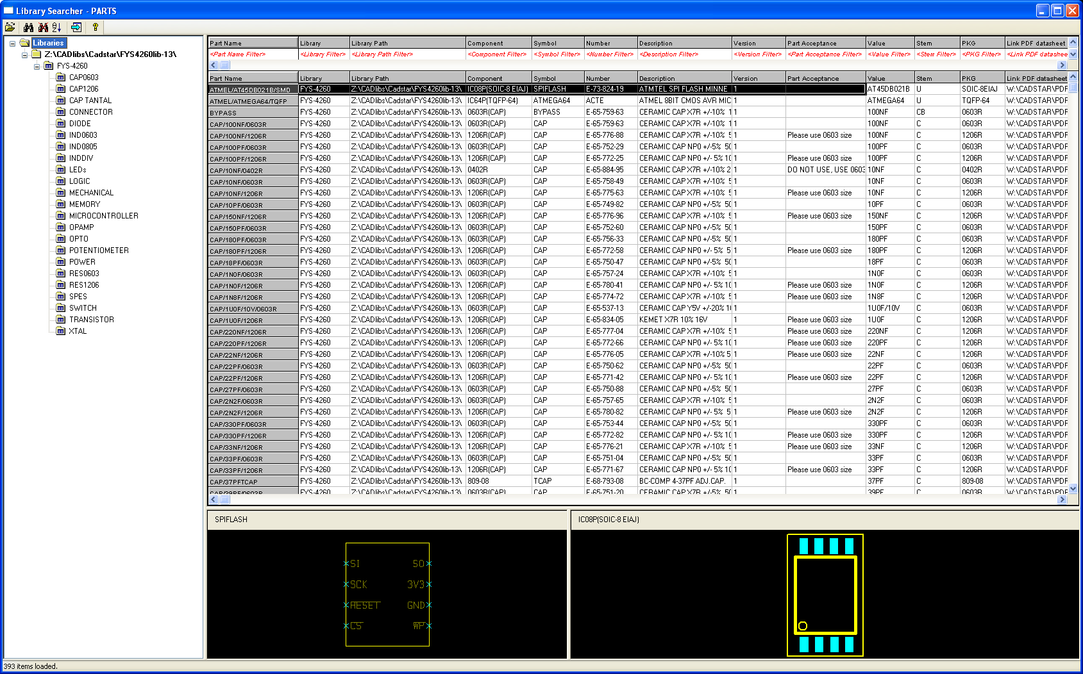
Schematic – Adding components III
Searching for components
Press ”Browse” => ”OK”
Select library and pick a component

Slide 12
Schematic – Component definition
SYMBOL (Schematic)
Parts description
Footprint (PCB component)
PARTS-LIB
SYMBOL
(Schematic)
FOOTPRINT
(PCB)

Slide 13
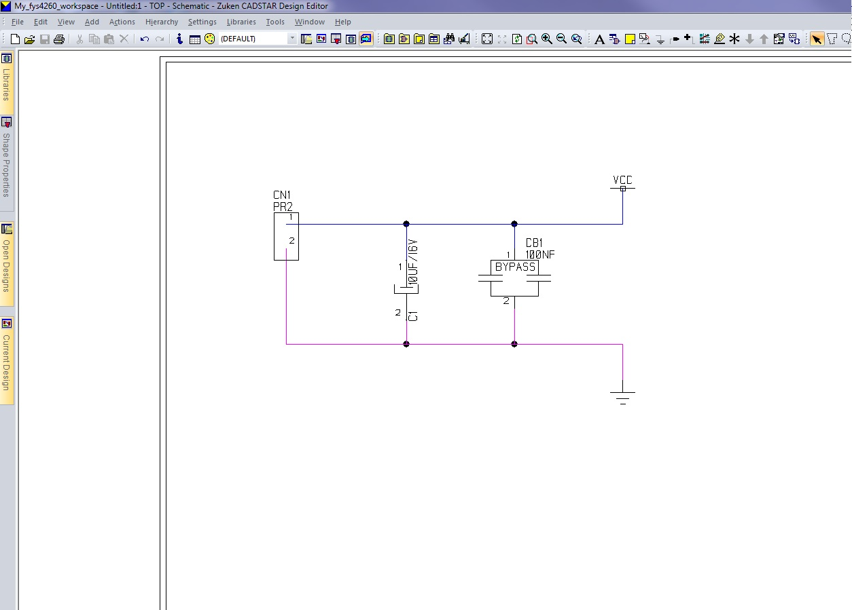
Schematic – Adding a power source
The circuit is powered by a 9V battery
Add a bypass capacitor for noise cancelling
Add an electrolyte/tantal capacitor for ripple and dips
And a voltage regulator..?

Slide 14
Schematic – Connections and Colour Codes I
There are 3 types of connections
POWER (Blue)
GND (Purple)
Signal (White)
Signal is set as default, POWER/GND must be defined the first time

Slide 15
Schematic - Hierarchy blocks

Slide 16
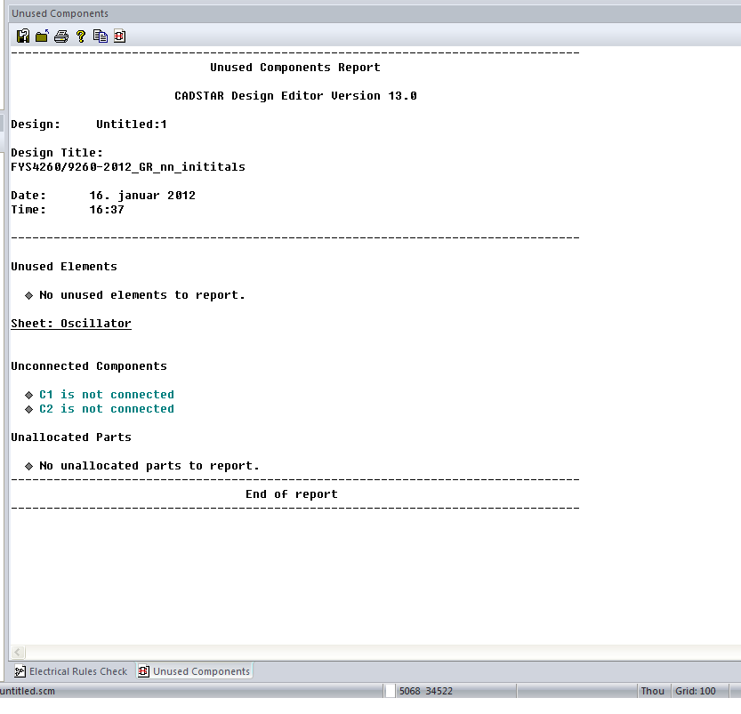
Schematic – Verifying design
Produce a report on unconnected component pins
Click ”Tools” => ”Reports” => ”unused components”.
”unused components” report

Slide 17
Links
Help guides:
CADSTAR’s Do-It-Your-Self: W:\CADlibs\Cadstar\cadstar_121_expressdiy.pdf
PCB Help: W:\CADlibs\Cadstar\PCBSelfTeach.pdf
Schematic Help: W:\CADlibs\Cadstar\SCMSelfTeach.pdf
Report guide: http://tid.uio.no/kurs/fys4260/Scientific_writing-Ohlckers.pdf

