Slide 1
Autumn 2016
FYS4340/FYS9340
Diffraction methods and electron microscopy

Slide 2
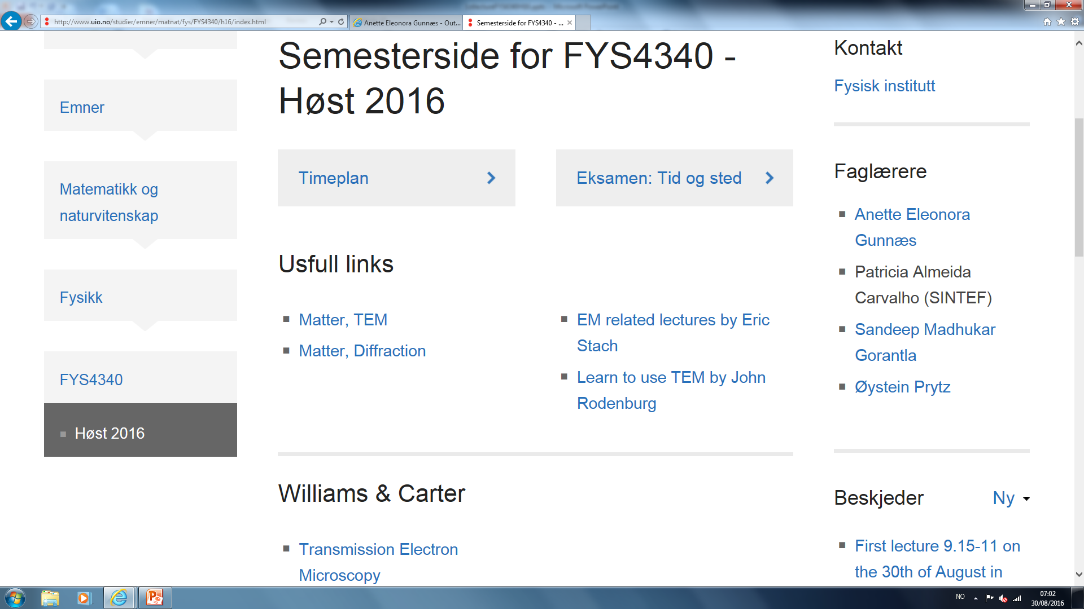
http://www.uio.no/studier/emner/matnat/fys/FYS4340/h16

Slide 3
Preliminary teaching schedule
Lectures on Tuesdays 09:15-11:00
Exercises and lab on Thursdays 12:15-16:00
Not every Thursday, will be announced.
Sometimes an extra lecture
Nothing planned for this week or next

Slide 4
Contact info:
Anette Gunnæs: eleonora@fys.uio.no
Sandeep Gorantla: s.m.gorantla@smn.uio.no
Patricia Carvalho: patricia.carvalho@sintef.no
Øystein Prytz: oystein.prytz@fys.uio.no
TEM lab: Phuong D. Nguyen: p.nguyen@fys.uio.no
Prep. lab: Ole Bjørn Karlsen: o.b.karlsen@fys.uio.no
HMS officer: Cecilie Granerød: cecilie.granerød@fys.uio.no

Slide 5
Diffraction methods and electron microscopy
Williams & Carter. Transmission Electron Microscopy. 2nd ed. Springer, 2009.
In particular parts 1,2, and 3
Various articles and papers (mandatory for PhD students)
Additional suggested reading: Fultz and Howe: Transmission electron microscopy and diffractometry of materials.
Both of these textbooks are available online on the UiO network.

Slide 6
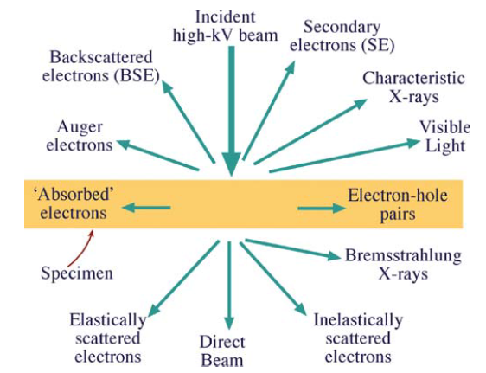
Curriculum
Instrumentation
Williams and Carter chapters: 1, 2, 3, 5, 6, 9
Specimen preparation
Williams and Carter chapter: 10
Diffraction
Williams and Carter chapters: 11, 12, 13, 16, 18, 19, 20, 21
Imaging
Williams and Carter chapters: 22, 23, 24, 25, 26, 27, 28
EDS
Williams and Carter chapters: not clarified yet

Slide 7
Why electron microscopy?
Many of the properties of a material are determined by its defects
Precipitates and chemical segregation
2D defects: Interfaces and planar defects
1D defects: Dislocations
0D defects: Interstitials and substitutions
Want to investigate these features on the relevant length scale

Slide 8
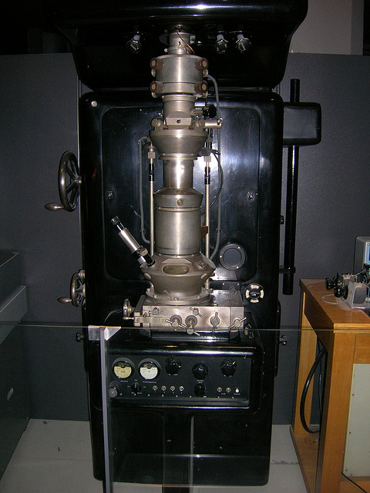
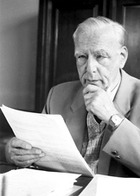
The first electron microscope
Knoll and Ruska, first TEM in 1931
Idea and first images published in 1932
By 1933 they had produced a TEM
with two magnetic lenses which gave
12 000 times magnification.
Ernst Ruska: Nobel Prize in physics 1986
Electron Microscope Deutsches Museum, 1933 model

Slide 9
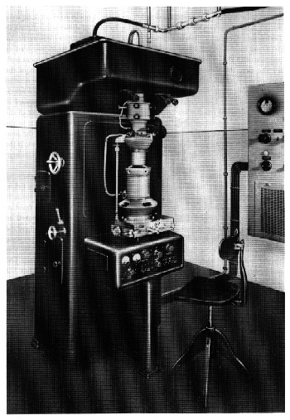
The first commercial microscopes
1939 Elmiskop by Siemens Company
1941 microscope by Radio corporation of America (RCA)
First instrument with stigmators to correct for astigmatism. Resolution limit below 10 Å.
Elmiskop I

Slide 10
Observations of dislocations and lattice images
1956 independent observations of dislocations by:
Hirsch, Horne and Wheland and Bollmann
-Started the use of TEM in metallurgy.
1956 Menter observed lattice images from materials with large lattice spacings.
1965 Komoda demonstrated lattice resolution of 0.18 nm.
Notes:
One exceptions was the work of yada who got crystallographic information from chrysotile fibres

Slide 11
Menter, 1956

Slide 12
Use of high resolution electron microscopy (HREM) in crystallography
1971/72 Cowley and Iijima
Observation of two-dimensional lattice images of complex oxides
1971 Hashimoto, Kumao, Hino, Yotsumoto and Ono
Observation of heavy single atoms, Th-atoms
Notes:
Th-compound supported on a graphite thin crystal film. Bright spots attributed to single Th atoms.

Slide 13
1970’s
Early 1970’s: Development of energy dispersive x-ray (EDX) analyzers started the field of analytical EM.
Development of dedicated HREM
Electron energy loss spectrometers and scanning transmission attachments were attached on analytical TEMs.
Small probes making convergent beam electron diffraction (CBED) possible.

Slide 14
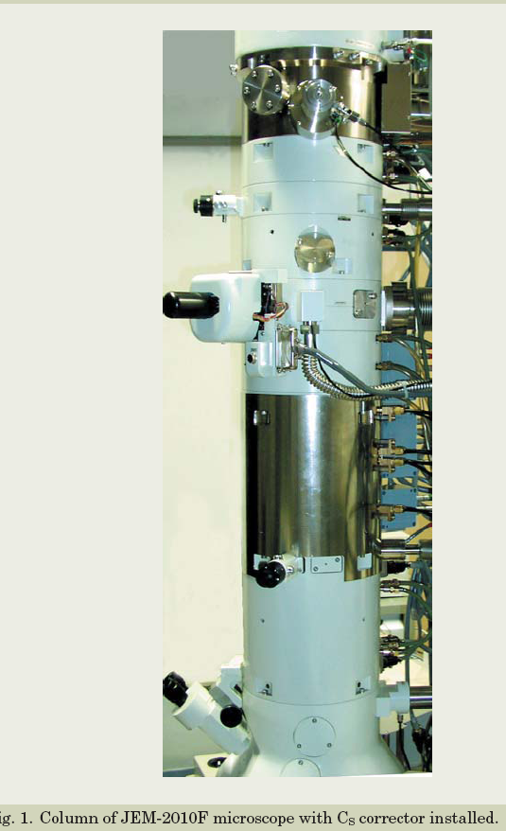
1980’s and 90’s
Development of combined high resolution and analytical microscopes.
An important feature in the development was the use of increased acceleration voltage of the microscopes.
Field Emission Guns (FEG)
Development of Cs and Cc correction
Probe and image
Improved energy spread of electron beam
More user friendly Cold FEG
Monocromator
2000’s

Slide 15
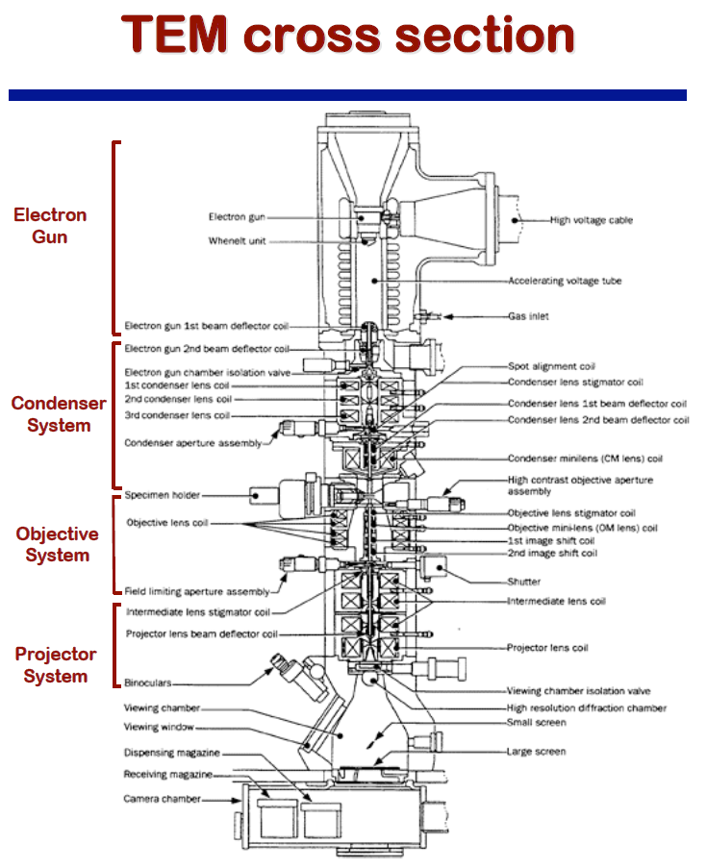
Eric Stach (2008), ”MSE 528 Lecture 4: The instrument, Part 1, http://nanohub.org/resources/3907

Slide 16
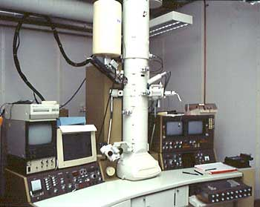
Apertures

Slide 17
The effect of accelerating the electron
U | k = λ⁻¹ (nm⁻¹) | λ (nm) | m/mo | v/c
1 V | 0.815 | 1.226 | 1.0000020 | 0.0020
10 V | 2.579 | 0.3878 | 1.0000196 | 0.0063
100 V | 8.154 | 0.1226 | 1.0001957 | 0.0198
10 kV | 81.94 | 0.01220 | 1.01957 | 0.1950
100 kV | 270.2 | 0.00370 | 1.1957 | 0.5482
200 kV | 398.7 | 0.00251 | 1.3914 | 0.6953
10 MV | 8468 | 0.00012 | 20.5690 | 0.9988
Relations between acceleration voltage,
wavevector, wavelength, mass and velocity

Slide 18
The requirements of the illumination system
High electron intensity
Image visible at high magnifications
Small energy spread
Reduce chromatic aberrations effect in obj. lens
Adequate working space between the illumination system and the specimen
High brightness of the electron beam
Reduce spherical aberration effects in the obj. lens
Notes:
Has to produce a uniform distribution of electrons on the specimen.
Chromatic aberration skisse
Spherical aberration skisse
Why do we want working space?

Slide 19
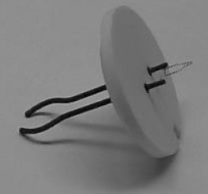
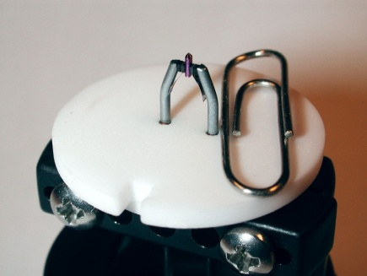
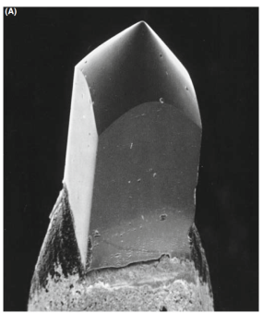
The electron source
Two types of emission sources
Thermionic emission
W
LaB6
Field emission
W
ZrO/W
Cold FEG Schottky FEG

Slide 20
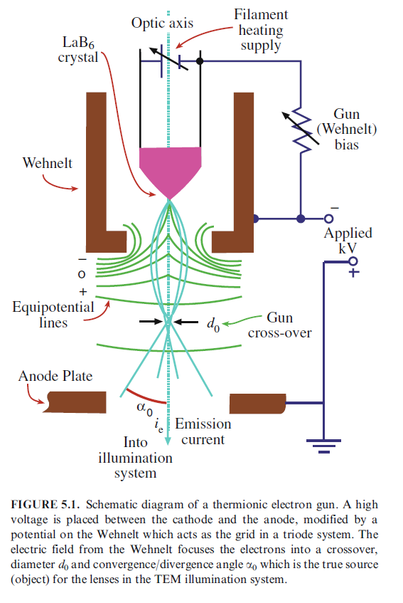
Thermionic guns
Filament heated to give
Thermionic emission
Tungsten (W)
Lanthanum hexaboride (LaB₆)
Filament negative
potential to ground
Wehnelt produces a
small negative bias
Brings electrons to
cross over

Slide 21
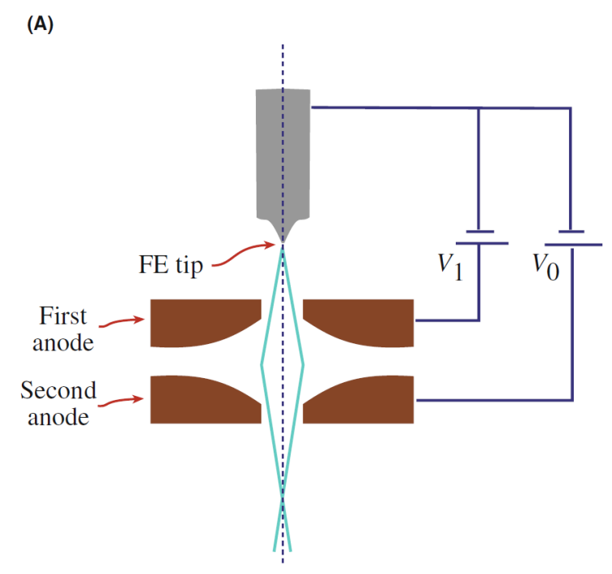
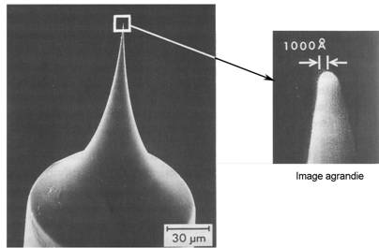
The Field emission gun (FEG)
The principle:
The strength of an electric field E is considerably increased at sharp points.
E=V/r
r_{W} < 0.1 µm, V=1 kV → E = 10¹⁰ V/m
Lowers the work-function barrier so that electrons can tunnel out of the tungsten.
Notes:
Three main parts and acts as an acceleration triode.
These parameters are interrelated and can be varied to optimize the performance of the gun.
Limited by the the properties of the electron source.

Slide 22
Electron lenses
Any axially symmetrical electric or magnetic field has the properties
of an ideal lens for paraxial rays of charged particles.
Electrostatic
Require high voltage - insulation problems
Not used as imaging lenses, but are used in modern monochromators or deflectors
Electromagnetic
Can be made more accurately
Shorter focal length
F= -eE
F= -e(v x B)
Notes:
Paraxial rays: rays close to the optcal axis.
Wien filter

Slide 23
Electromagnetic lens
Bore
Current in the coil creates
A magnetic field in the bore.
The magnetic field has axial
symmetry, but is inhomogenious
along the length of the lens.
Soft Fe pole piece
gap
Cu coil
The soft iron core can increase the field by several
thousand times.

Slide 24
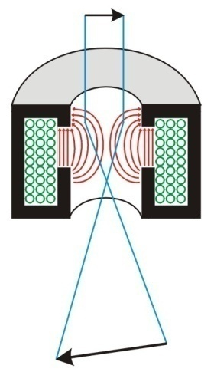
General features of electromagnetic lenses
Focuses near-axis electron rays with the same accuracy as a glass lens focuses near axis light rays.
Same aberrations as glass lenses.
Converging lenses.
The bore of the pole pieces in an objective lens is about 4 mm or less.
A single magnetic lens rotates the image relative to the object.
Focal length can be varied by changing the field between the pole pieces (changing magnification).
http://www.matter.org.uk/tem/lenses/electromagnetic_lenses.htm

