Slide 1
February 2017
Øystein Prytz
MENA3100
Spectroscopy in the TEM and SEM

Slide 2
Curriculum
Chapter 6 of the textbook
“Spectroscopy with incident x-rays and with incident electrons” by Johan Taftø
This lecture
Main focus is EDS in SEM and TEM, we also cover basic aspects of EELS

Slide 3
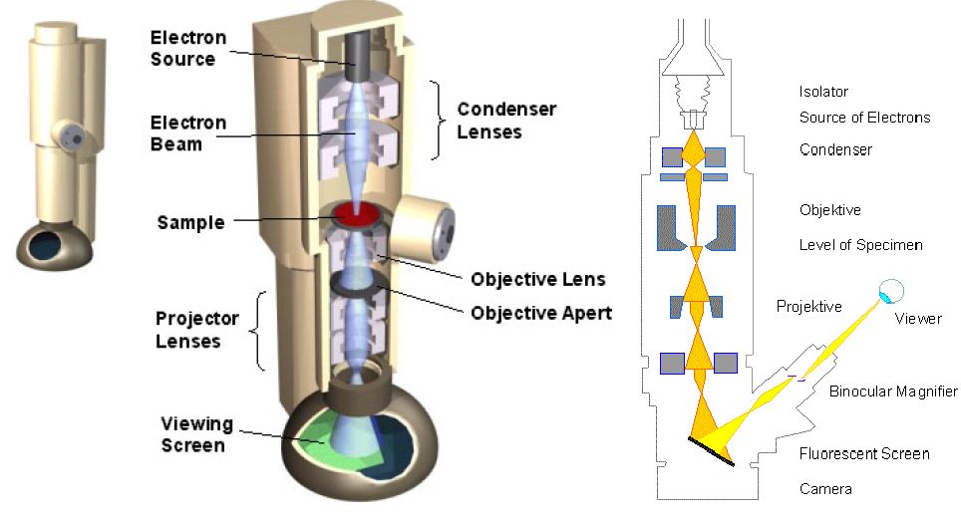
Simple overview of the TEM

Slide 4
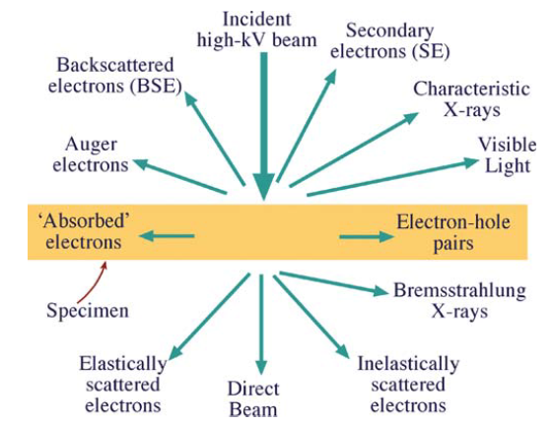
Electron beam – sample interaction
W&C

Slide 5
Energy transfer processes
The main energy transfer processes are:
Single electron excitations
Bremsstrahlung
Collective excitations (plasmons)
The first two processes are observed both in energy dispersive X-ray spectroscopy (EDS) and in electron energy loss spectrscopy (EELS).
The last process is only observed in EELS.

Slide 6
Single electron excitations
1: Incident electron transfers energy to a «core» electron of the atom, which exits the sample.
2: The atom is left in an excited state with a core hole.
3a: The atom can relax to the ground state either by emitting a photon (characteristic X-ray)…
3b:…or by emitting an Auger-electron

Slide 7
Nomenclature
Atomic shell | Main quantum number n | Orbital quantum number l | Total spin quantum number j | Spectroscopic notation
1s | 1 | 0 | +1/2, -1/2 | K
2s | 2 | 0 | +1/2, -1/2 | L₁
2p_{1/2} | 2 | 1 | 1/2 | L₂
2p_{3/2} | 2 | 1 | 3/2 | L₃
3s | 3 | 0 | +1/2, -1/2 | M₁
3p_{1/2} | 3 | 1 | 1/2 | M₂
3p_{3/2} | 3 | 1 | 3/2 | M₃
3d_{3/2} | 3 | 2 | 3/2 | M₄
3d_{5/2} | 3 | 2 | 5/2 | M₅

Slide 8
Nomenclature
W&C

Slide 9
More on nomenclature
Siegbahn notation is most commonly used to name the transitions generating X-rays.
However, this can get quite complicated as seen in the figure on the left.
The International Union of Pure and Applied Chemistry (IUPAC) recommends an alternative system that is simpler, but unfortunately not widely in use.
W&C

Slide 10
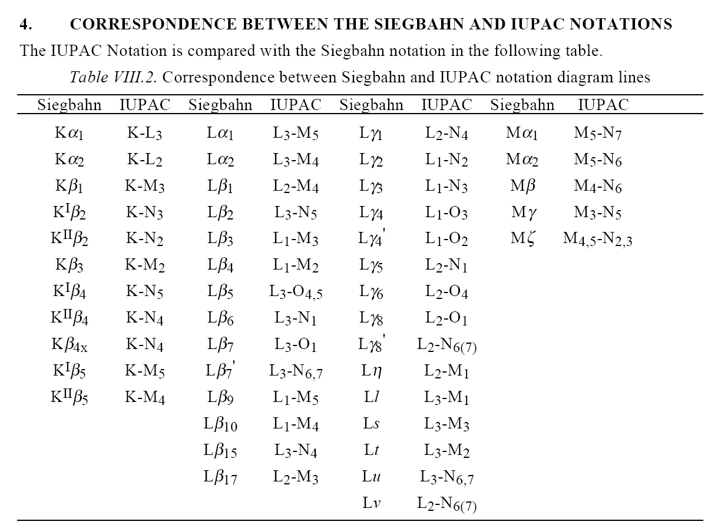
R. Jenkins et al. X-Ray Spectrometry 20(3), 149-155 (1991).

Slide 11
Single electron excitations
1: Incident electron transfers energy to a «core» electron of the atom, which exits the sample.
2: The atom is left in an excited state with a core hole.
3a: The atom can relax to the ground state either by emitting a photon (characteristic X-ray)…
3b:…or by emitting an Auger-electron

Slide 12
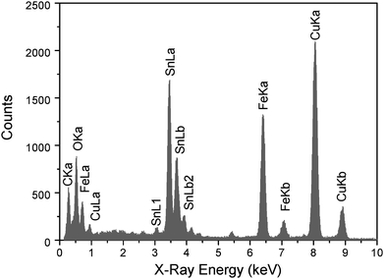
Copper K lines

Slide 13
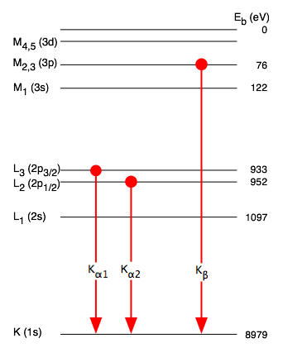
Copper K lines
E_{b}(K) = -8979 eV
E_{b}(L₃) = -933 eV
E_{b}(L₂) = -952 eV
E_{b}(M_{2,3}) = -76 eV
L₃ -> K transition (Kα₁)
E=hν= E_{b}(L₃)- E_{b}(K) = 8.046 keV
L₂ -> K transition (Kα₂)
E=hν= E_{b}(L₂)- E_{b}(K) = 8.027 keV
M_{2,3} -> K transition (Kβ)
E=hν= E_{b}(M_{2,3})- E_{b}(K) = 8.903 keV

Slide 14
Threshold/critical energy
In order to generate X-rays, the electron beam must have an energy E₀ larger than the critical energy E_{c} of the process.
Usually not a problem in TEM
E₀> 100 keV; E_{c}< 20 keV
BUT: with C_{s} correctors, low voltage operation has become more common. 60 keV, 40 keV, even down to 30 keV.
For heavy elements this may limit which characteristic X-rays are generated

Slide 15
Single electron excitations
1: Incident electron transfers energy to a «core» electron of the atom, which exits the sample.
2: The atom is left in an excited state with a core hole.
3a: The atom can relax to the ground state either by emitting a photon (characteristic X-ray)…
3b:…or by emitting an Auger-electron

Slide 16
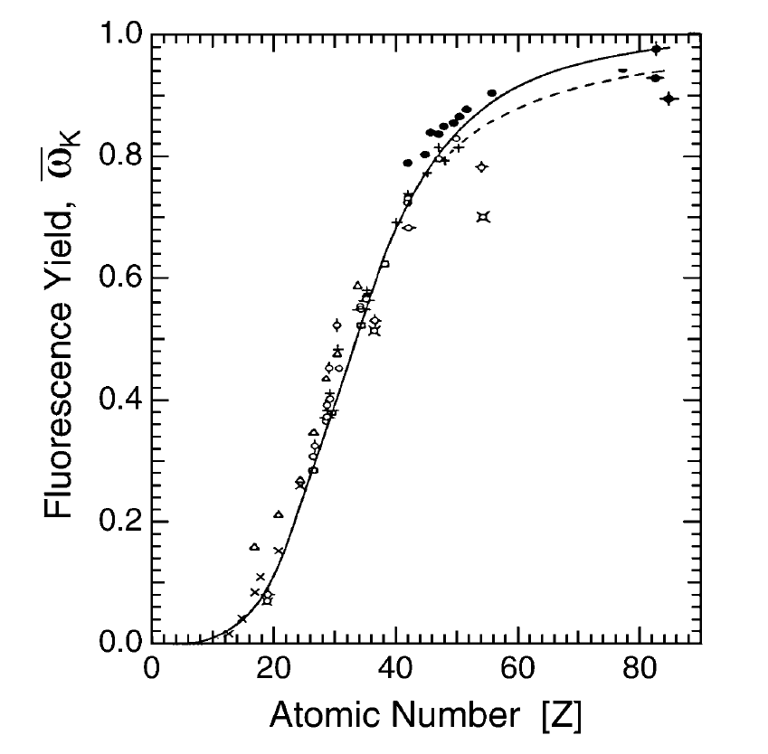
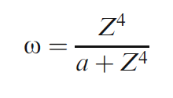
The fluorescence yield
The probability for generating a characteristic X-ray is given by the fluorescence yield ω
The probability of generating an Auger electron is the 1- ω.
F&H

Slide 17
Energy transfer processes
The main energy transfer processes are:
Single electron excitations
Bremsstrahlung
Collective excitations (plasmons)
The first two processes are observed both in energy dispersive X-ray spectroscopy (EDS) and in electron energy loss spectrscopy (EELS).
The last process is only observed in EELS.

Slide 18
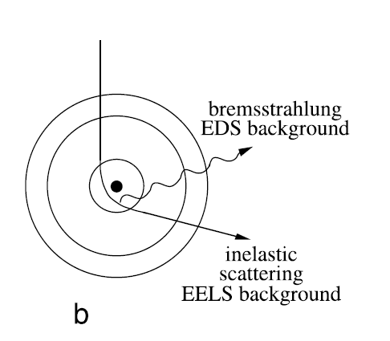
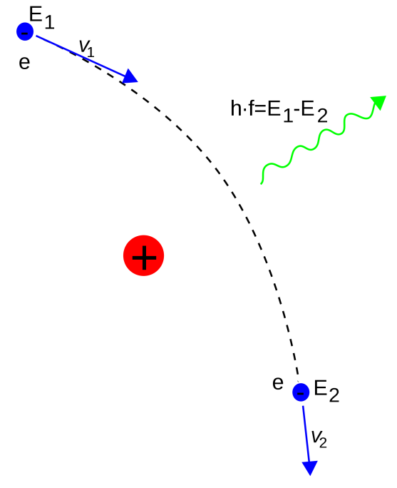
Bremsstrahlung
The change in trajectory is caused by an acceleration of the electron. The spectrum of the photons generated is given by the Fourier transform of a(t) for the electron.
F&H

Slide 19
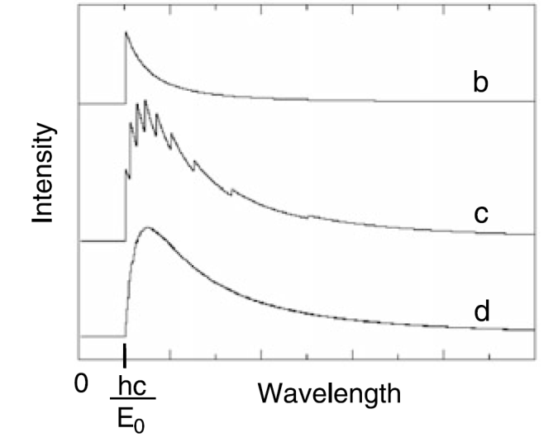
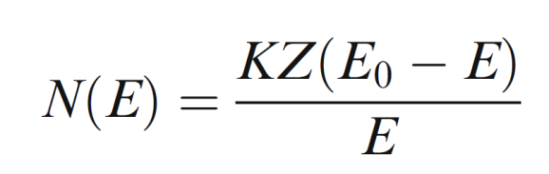
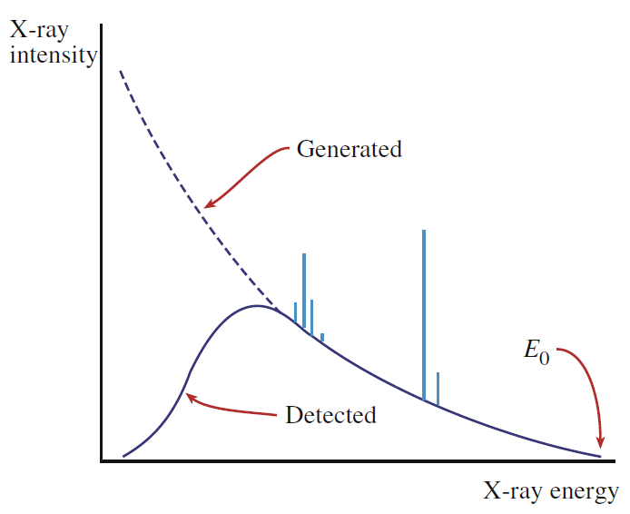
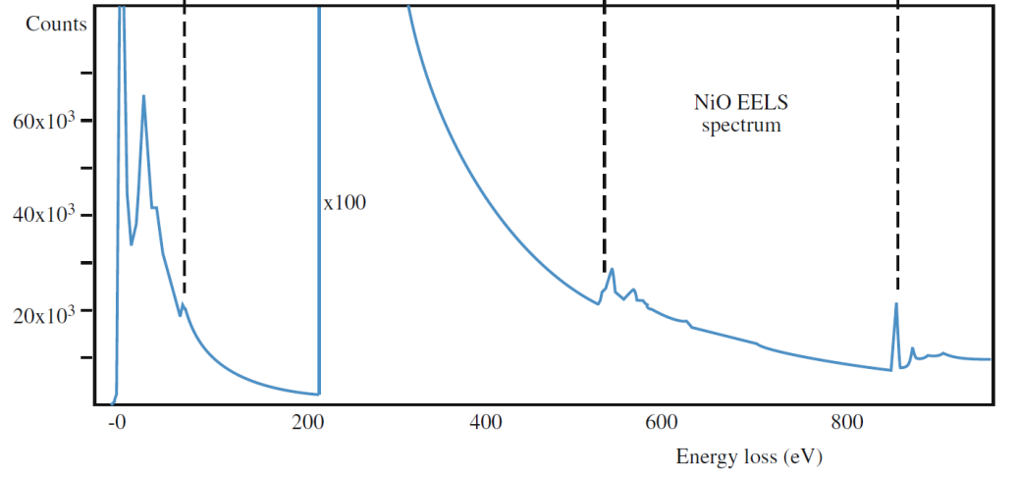
Bremsstrahlung
Kramer’s cross section for production of bremsstrahlung
Single bremsstrahlung event
Several events
Many events
W&C
F&H

Slide 20
Instrumentation
How ca we detect detect X-rays and measure their energy?

Slide 21
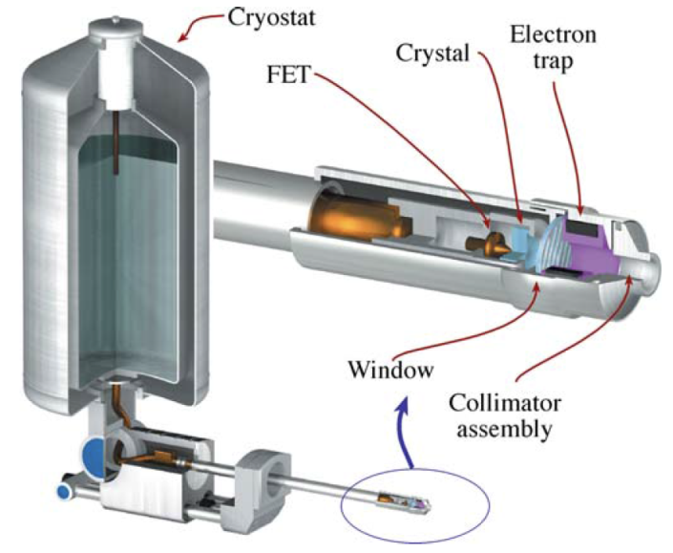
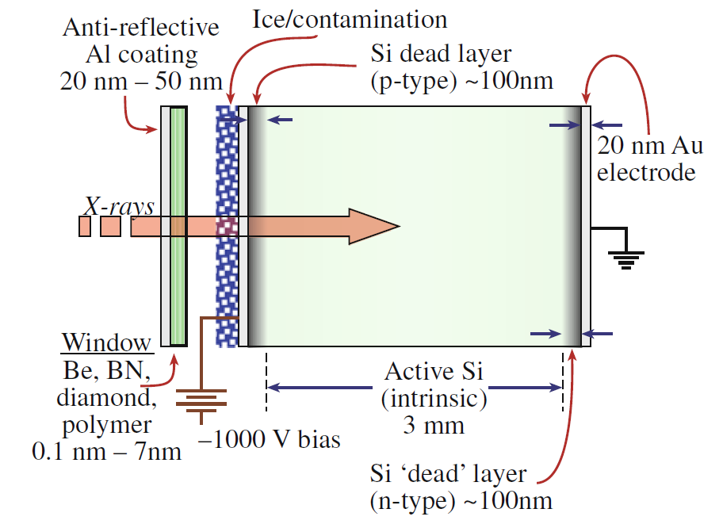
The detector and electron/hole-pair generation
Characteristic X-rays are generated in the specimen and enter the detector
There, they generate a number of electron/hole-pairs depending on their energy
The electron/hole-pairs are separated by an applied bias, and the current measured
W&C

Slide 22
The detector and electron/hole-pair generation
Historically, the most common detectors have been the Si(Li) detectors
The so-called Silicon-drift detectors (SDD) have been used for SEM for quite a while, and are becoming more common also for TEM
The detectors are usually cooled to avoid
  diffusion of dopants in the strong applied bias
  thermal noise
Si(Li) detectors are usually cooled to
LN₂ temperatures (-196 °C)
SDD detectors can make do with only
Peltier cooling (~-30 °C)
W&C

Slide 23
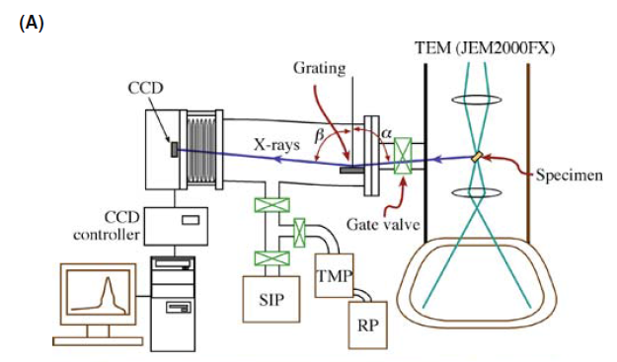
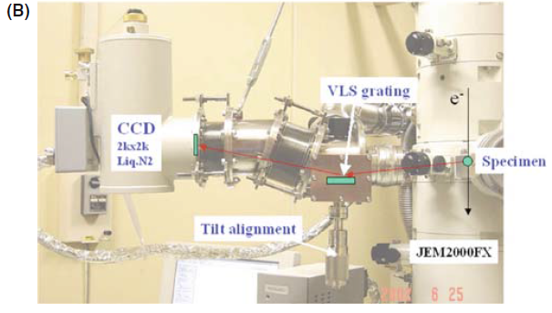
WDS vs EDS
Uses a diffraction grating (crystal) to select X-rays with particular energy (wavelength)
Braggs law
Wavelength dispersive, in stead of energy dispersive
Excellent energy resolution
Low background, no detector artefacts
Good for light elements
Serial detection
Movable parts
Low effective detection angle

Slide 24
Quantification from EDS spectra
How to get from a spectrum to composition
Assumptions usually made in EDS in TEM
Cliff-Lorimer k-factor method
Limits of the CL-method and the assumptions made

Slide 25
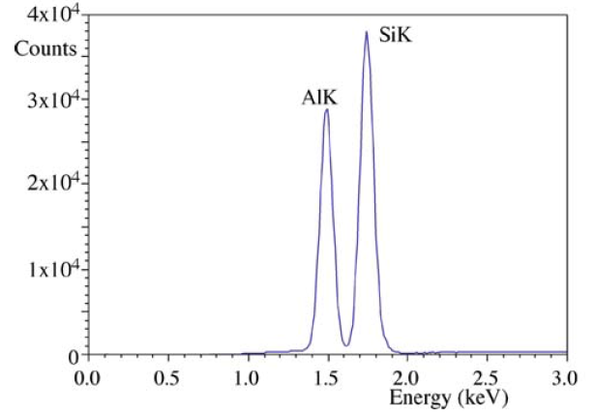
How to get from a spectrum to composition

Slide 26
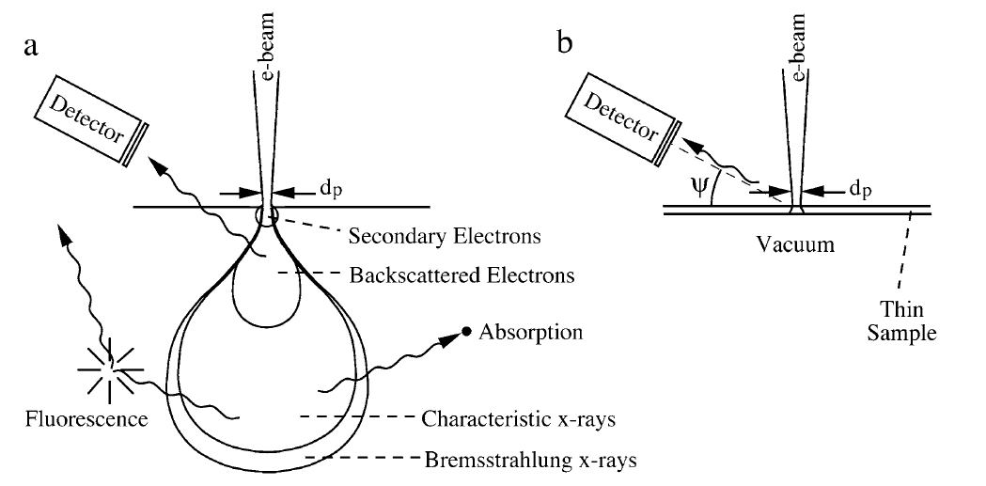
X-ray generation in the SEM
F&H

Slide 27
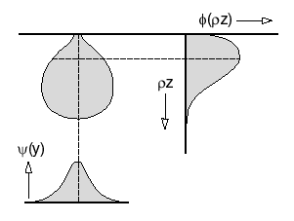
ZAF and ϕ(ρz) [phi-rho-z]
Z – how the electrons penetrate the sample (stopping power and backscatter)
A – Absorption of X-rays generated
F – Fluorescence of secondary photons
ϕ(ρz) is the function describing the «mass-depth» dependence of X-ray production

Slide 28
The thin film approximation
In the SEM
In the TEM
F&H

Slide 29
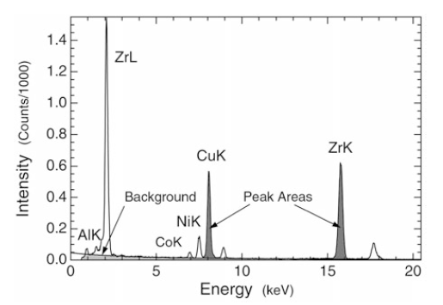




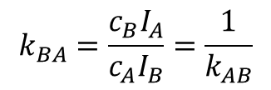
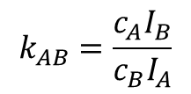

The Cliff-Lorimer equations
Binary system
$$c_{A}+c_{B}=1$$
$\frac{c_{A}}{c_{B}}=k_{AB}\frac{I_{A}}{I_{B}}$
$$k_{AB}=\frac{c_{A}I_{B}}{c_{B}I_{A}}$$
$$k_{BA}=\frac{c_{B}I_{A}}{c_{A}I_{B}}=\frac{1}{k_{AB}}$$
Ternary system
$$c_{A}+c_{B}+c_{C}=1$$
$\frac{c_{B}}{c_{C}}=k_{BC}\frac{I_{B}}{I_{C}}$
$$k_{AC}=k_{AB}k_{BC}$$
F&H

Slide 30
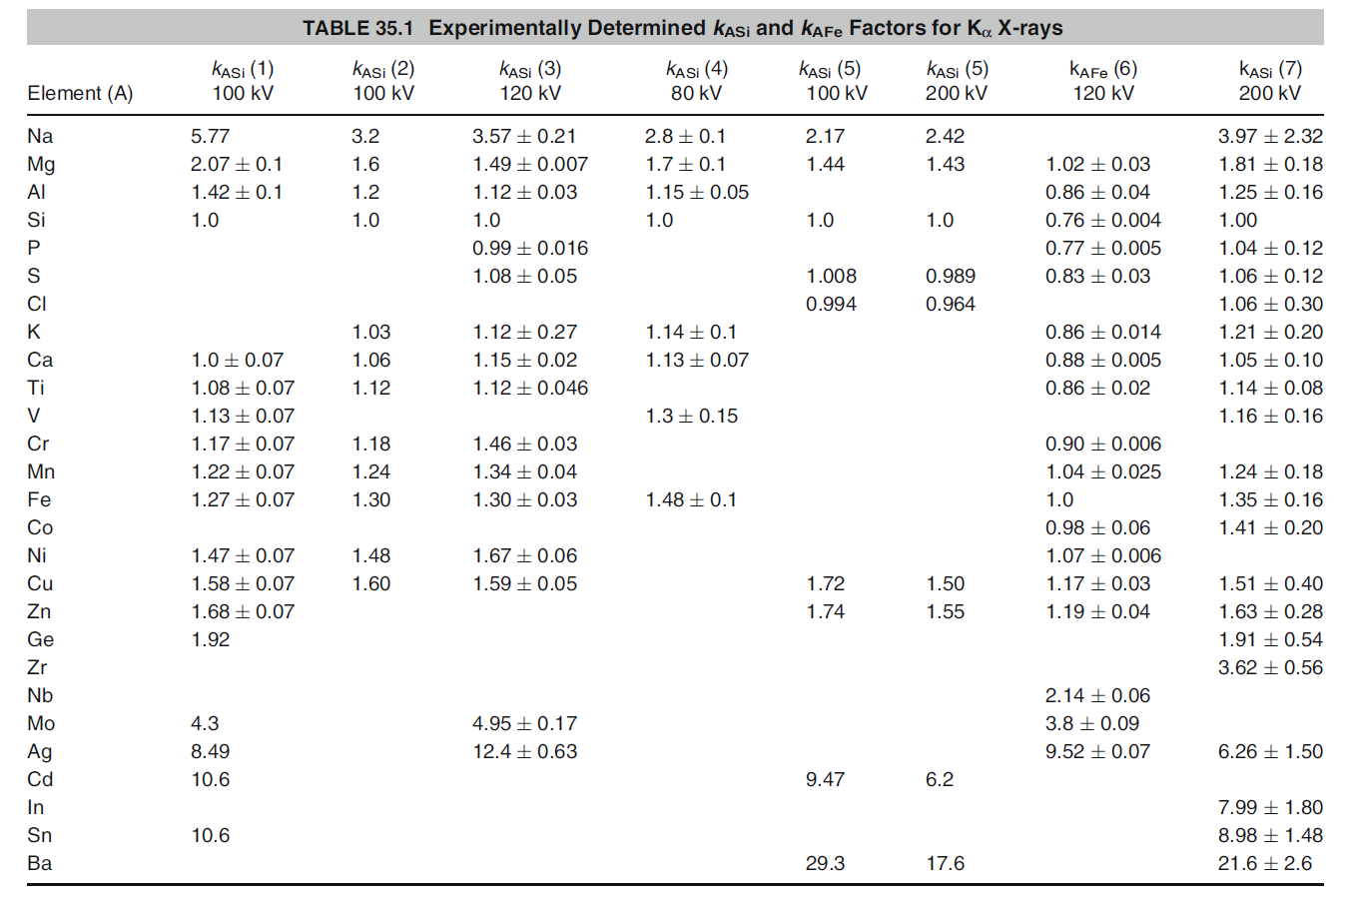
k-factors are not constants
W&C

Slide 31
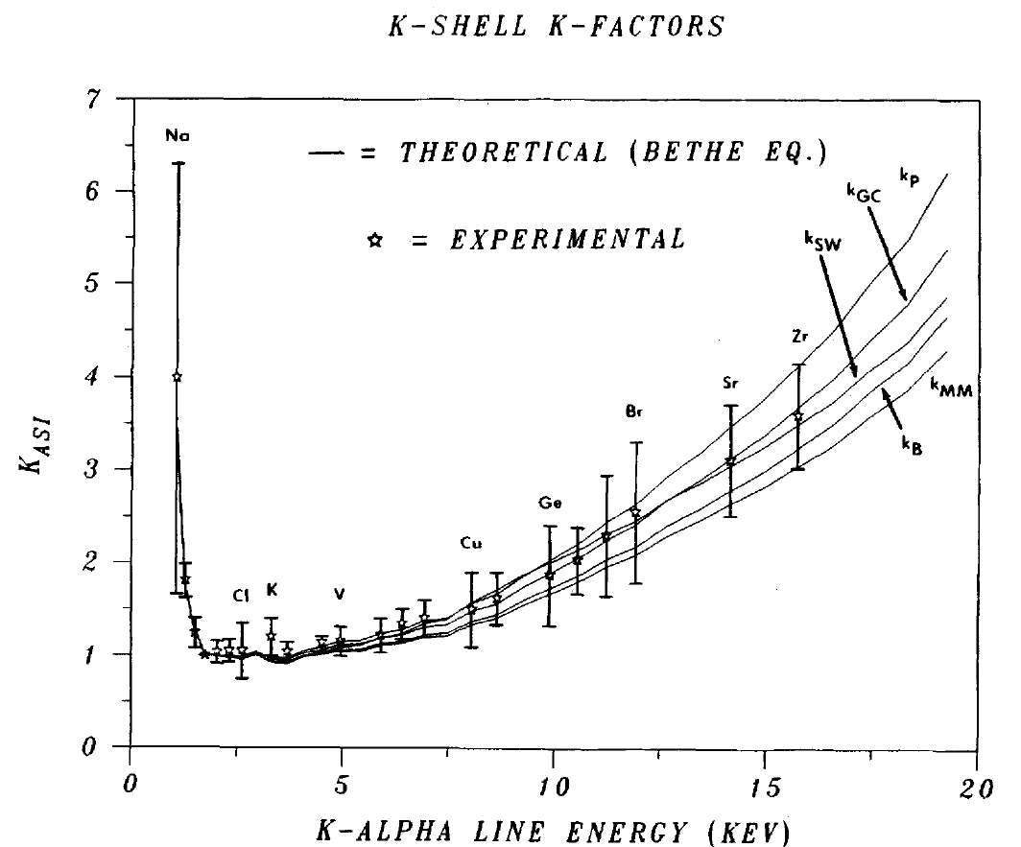
Sheridan (1989)

Slide 32
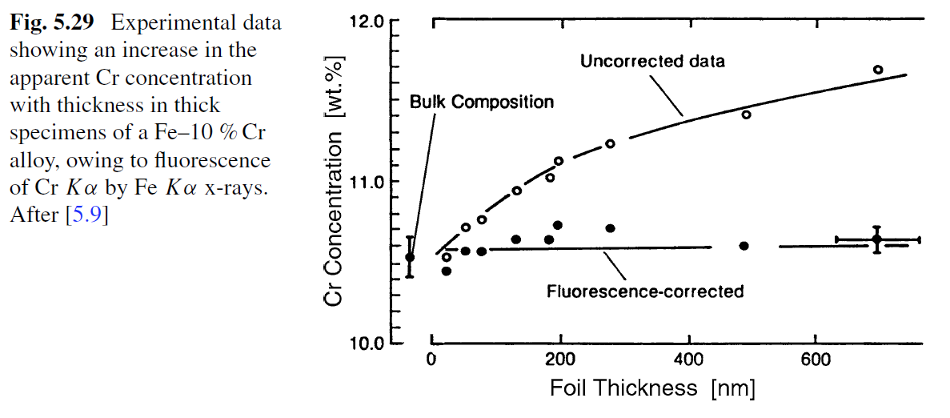
Limits to the thin film approximation
F&H

Slide 33
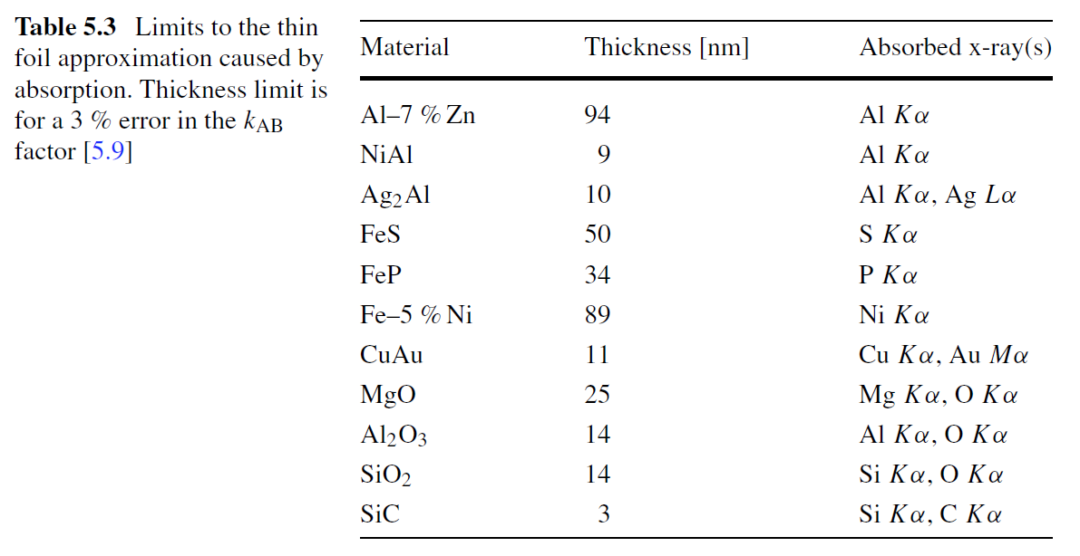
Limits to the thin film approximation
F&H

Slide 34
Single electron excitations
1: Incident electron transfers energy to a «core» electron of the atom, which exits the sample.
2: The atom is left in an excited state with a core hole.
3a: The atom can relax to the ground state either by emitting a photon (characteristic X-ray)…
3b:…or by emitting an Auger-electron

Slide 35
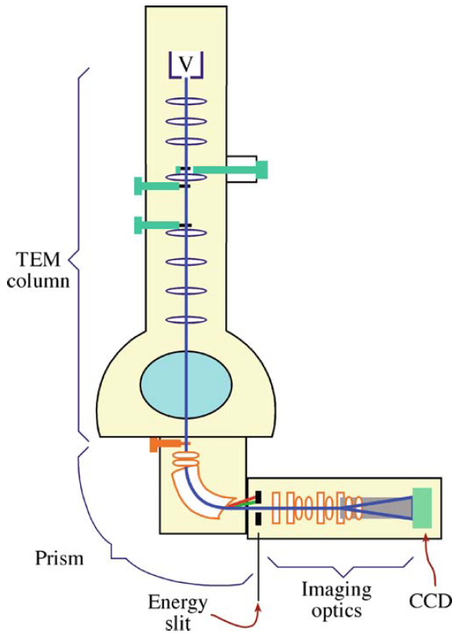
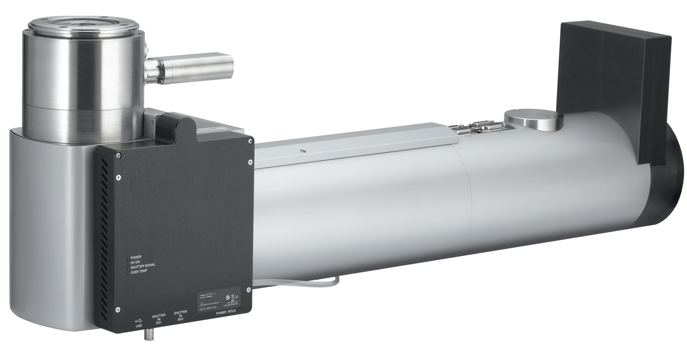
The post column Electron Energy Loss spectrometer/energy filter (EELS)
D. B. Williams and C. B. Carter (2009)

Slide 36
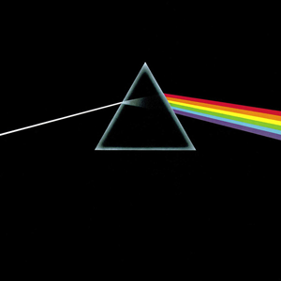

Slide 37
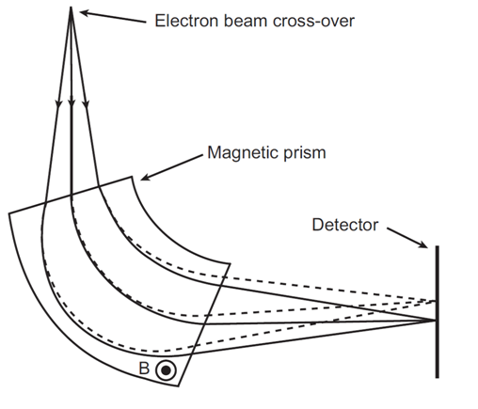
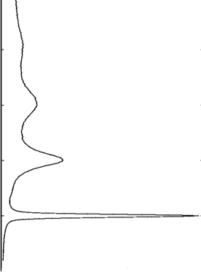


The magnetic prism
The force experienced by the electrons is a function of velocity (energy)
Different velocities give different curvature of the path
Non-relativistic case!
$$F=q v×B$$
$$r=\frac{mv}{qB}$$
Increasing energy loss

Slide 38
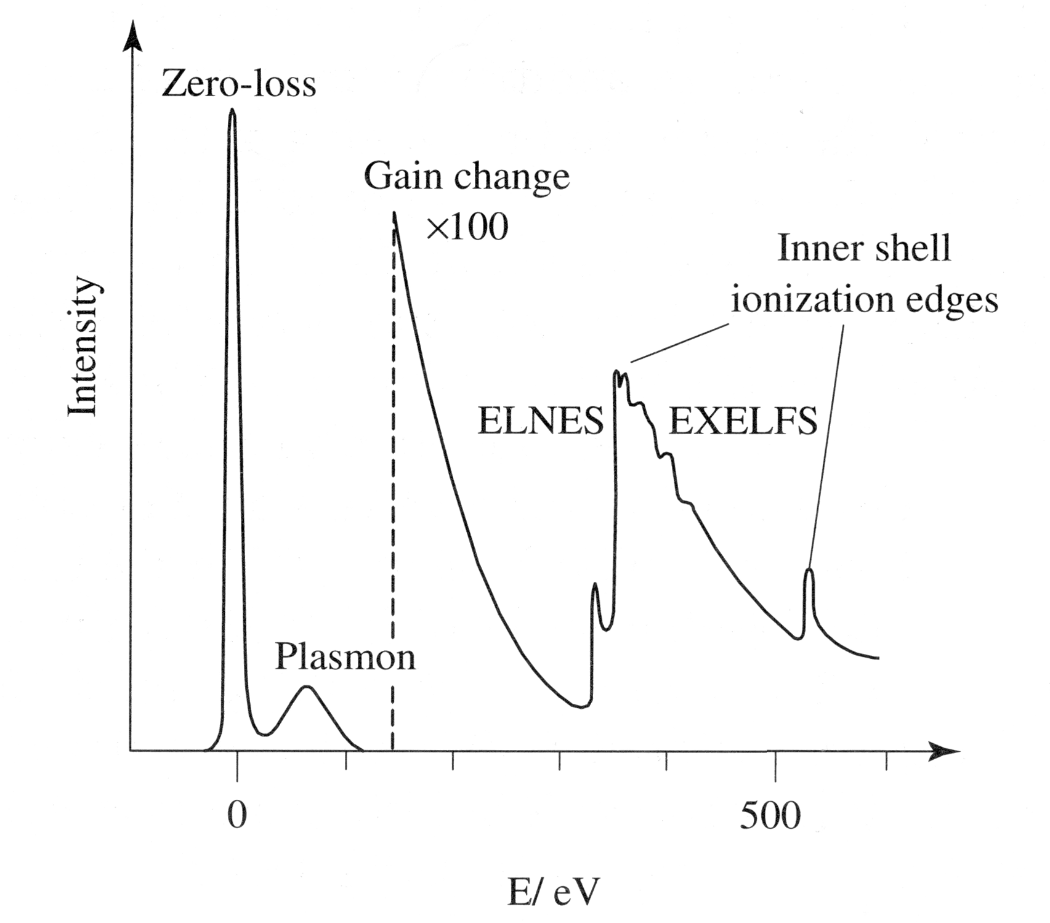
Sketch of an EELS spectrum
Zero energy loss peak (ZLP, ≈0 eV)
Low loss region. Valence band excitations, dominated by plasmons (collective excitations), dielectric properties (≈ 0-50 eV)
Core loss region, single electron transitions, bonding and density of states, progressively weaker signals (≈50 - 2000 eV)
R. Brydson (2001)

Slide 39
Inner shell edges (core loss edges)
Energy
unoccupied states
4s states
3d states
ε_{F}
3d states
Incident TEM electron
3p states
3s states
2p states
occupied states
Transmitted electron with energy loss

Slide 40
Energy
Conduction band
ε_{F}
Reminder:
1s: K shell
2s: L₁ shell
2p: L_{2,3} shell
3s: M₁ shell
3p: M_{2,3} shell
3d: M_{4,5} shell
…
Incident TEM electron
Valence band
«Core» electrons
«Core» electrons
«Core» electrons
«Core» electrons
Transmitted electron with energy loss

Slide 41
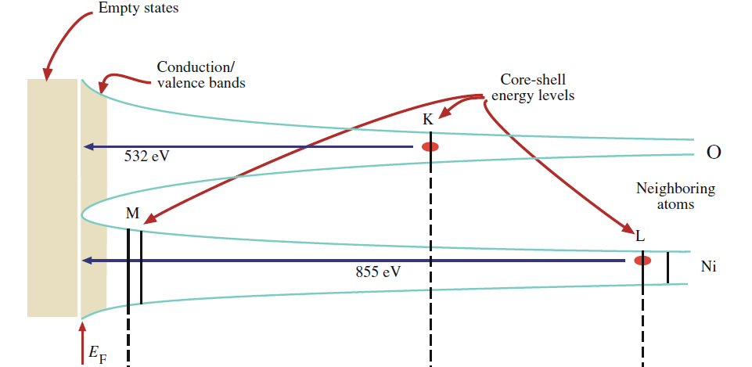
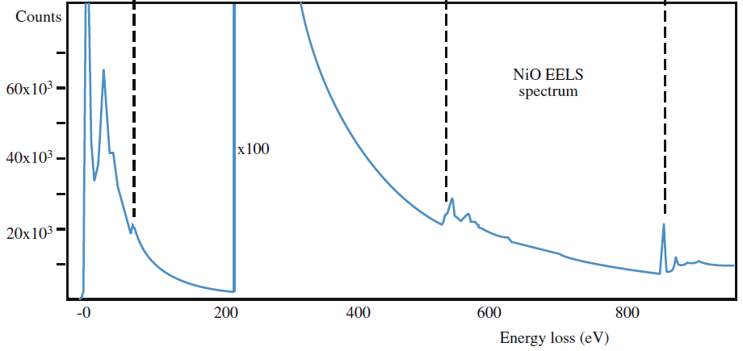

Slide 42
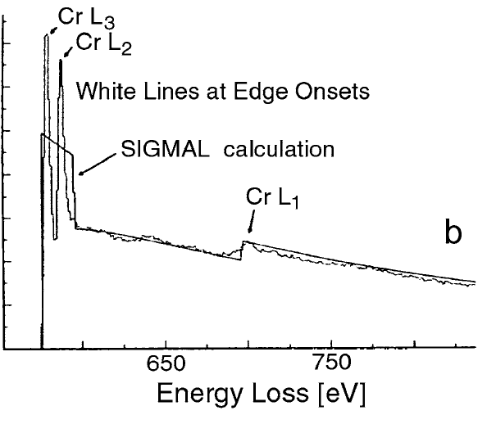
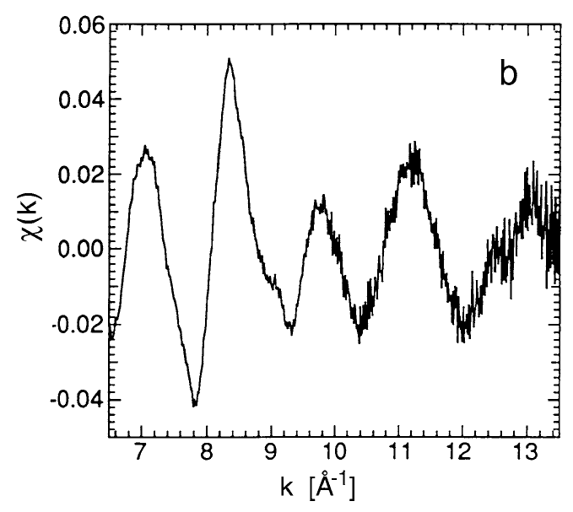
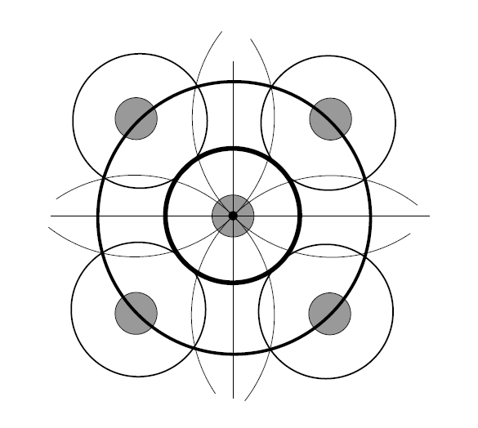
Uses of the core-loss features
Composition analysis and mapping (EFTEM)
Electronic structure and bonds (ELNES), comparison with DOS
Structure and atomic coordination (EXELFS)

Slide 43
Interband transitions, band gaps
Energy
The smallest possible energy loss corresponds to the band gap¹
Conduction band
ε_{F}
Valence band
¹Except phonons, Cerenkov etc
«Core» electrons
«Core» electrons
«Core» electrons
«Core» electrons

Slide 44
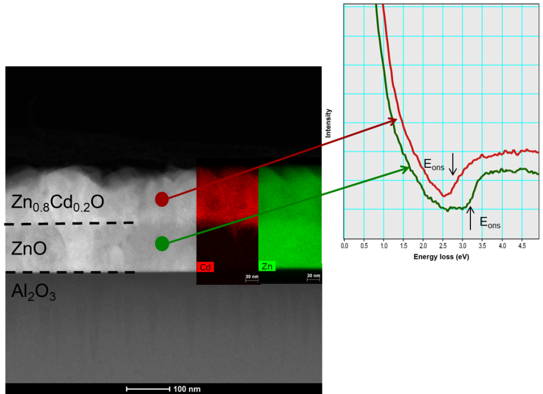
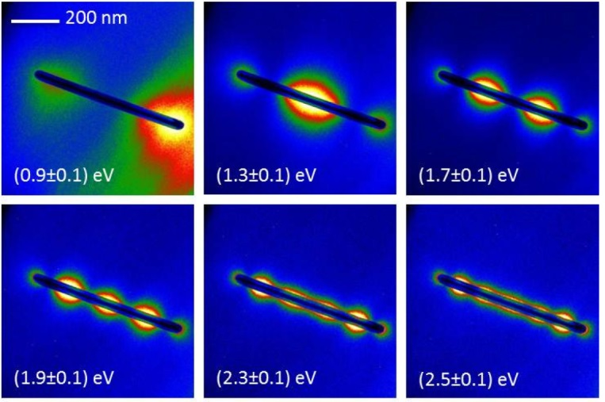
Uses of the low-loss features
Phase sensitive mapping
Thickness measurements and mapping
Investigations of valence electron density variations (change in plasmon energy)
Band gaps and interband transitions
Optical properties (dielectric function, surface plasmons)

Slide 45
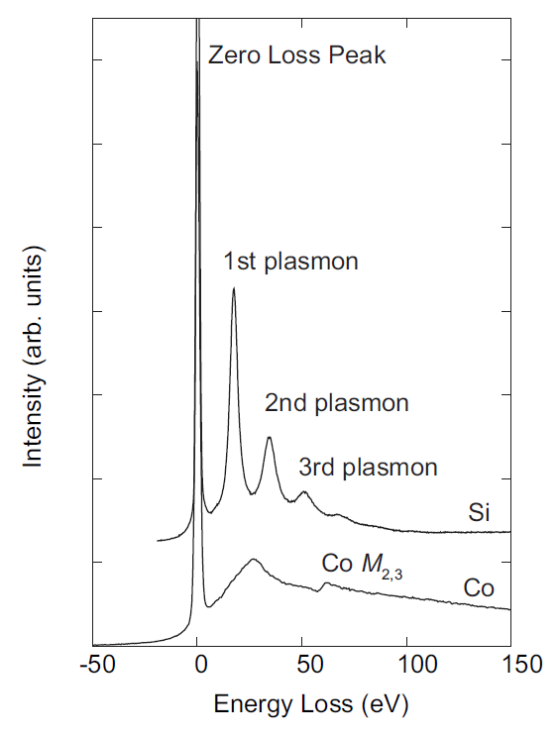
The low loss region
The low loss region contains both collective excitations and single electron events
Plasmons
Valence band/interband excitations (VEELS)
Also sometimes «core» loss events

Slide 46
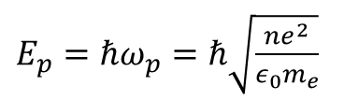
Collective oscillations of the valence electrons - plasmons
e⁻
+
+
+
+
+
+
+
+
+
+
+
+
+
+
+
+
+
+
+
+
+
+
+
+
+
+
+
Not atom characteristic, but phase characteristic
Characteristic frequency ω_{p} and energy E_{p}
$ω_{p}=\sqrt{\frac{ne^{2}}{ε_{0}m_{e}}}$
${E_{p}=ℏω}_{p}=ℏ\sqrt{\frac{ne^{2}}{ε_{0}m_{e}}}$

Slide 47
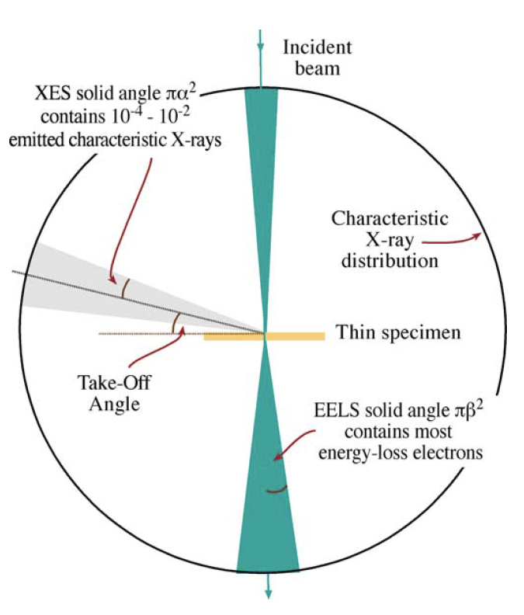
Comparison of geometry of EDS and EELS
The EDS detector has a fixed solid angle, and detect only a small fraction of the generated X-rays
The collection angle β of the EELS detector can be varied, and often captures the majority of electrons that have undergone energy loss

Slide 48
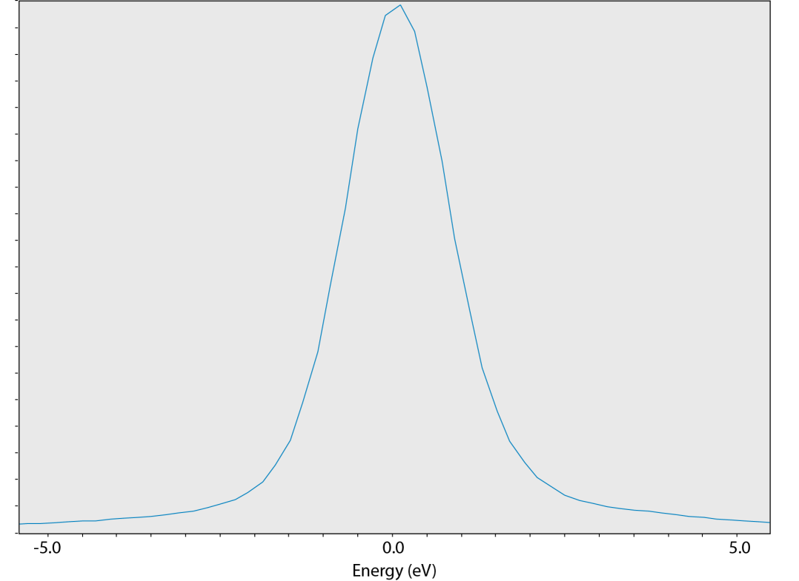
Energy resolution
The energy resolution is usually measured as the Full Width at Half Maximum (FWHM) of the Zero Loss Peak (ZLP)
The main determining factor is usually the energy spread of the electron source
However, other factors also have a strong influence
  Voltage stability
  Spectrometer stability
  Magnetic fields
Source | Minimum energy spread (eV FWHM)
W (thermionic) | ~3 eV
LaB₆ (thermionic) | ~1.5 eV
Thermally assisted field emission (Schottky FEG) | ~0.7 eV
«Cold» FEG | ~0.3 eV
Monochromated FEG* | 0.1-0.3 eV
* No fundamental limit ?
FWHM = 1.6 eV

Slide 49

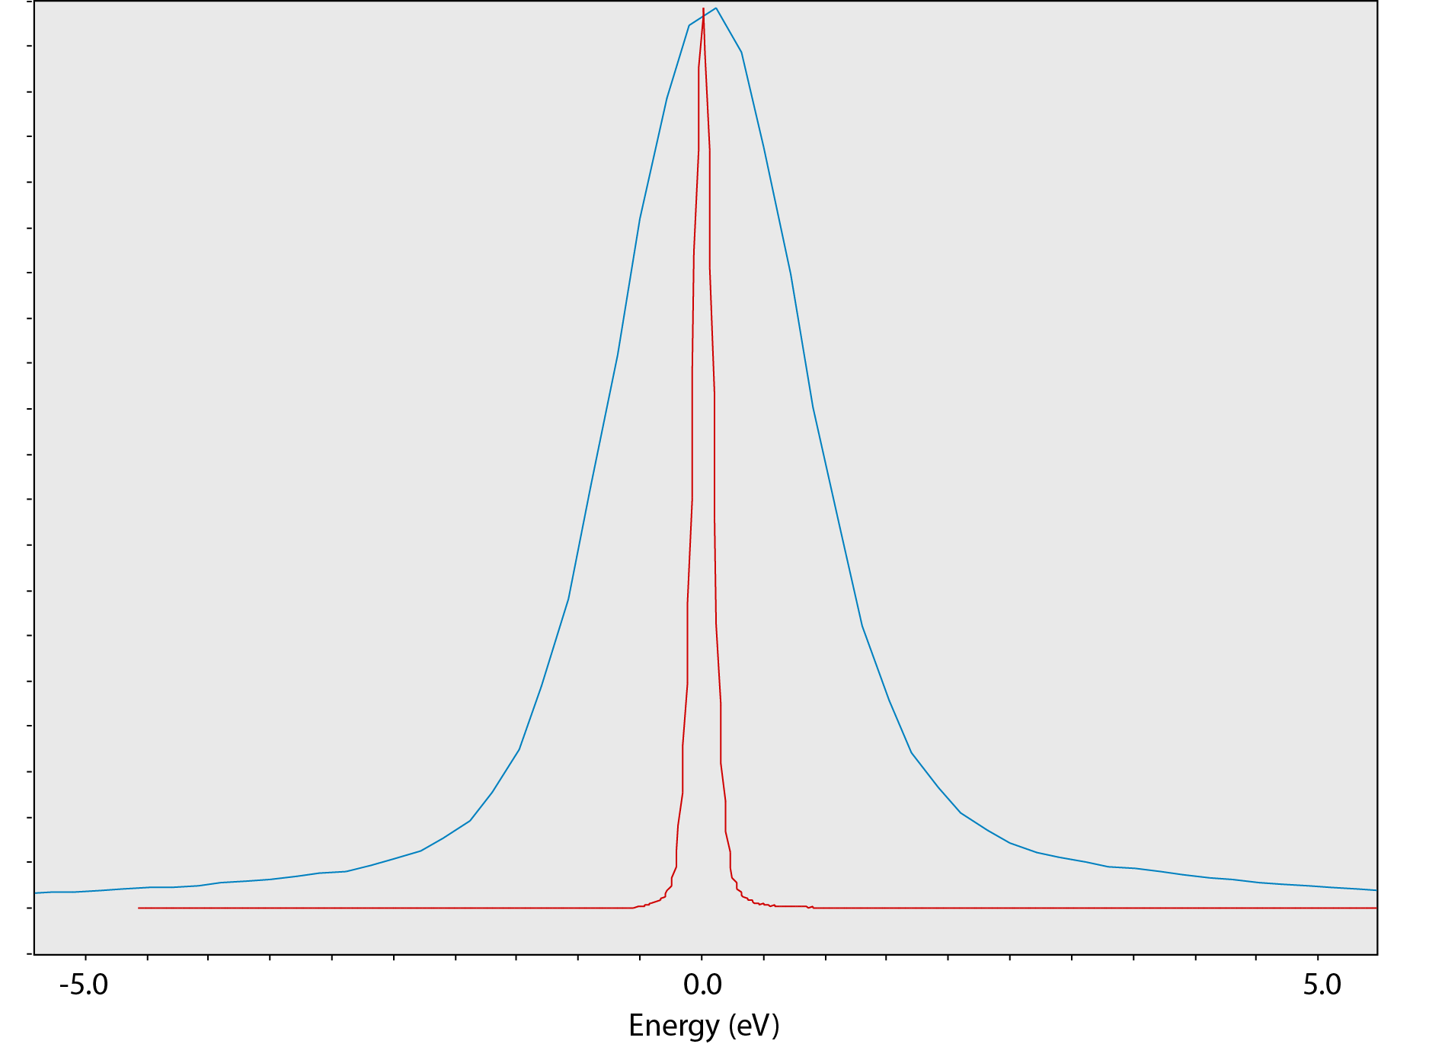
FWHM = 1.6 eV
FWHM = 0.15 eV

Slide 50
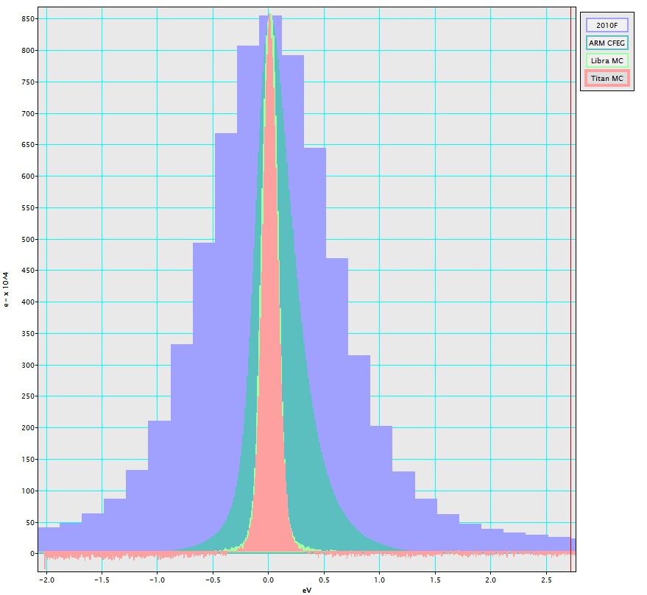

Slide 51
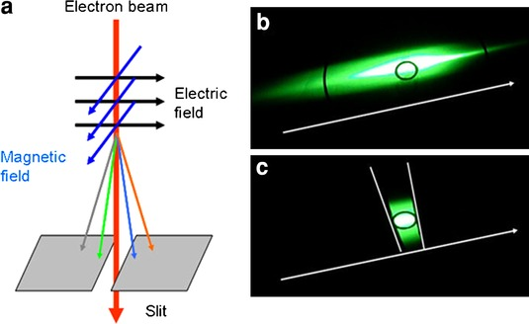


Wien filter monochromator (FEI)
$$F=q (E+v×B)$$
Electric and magnetic fields tuned so that the force on the electrons balance out for one specific velocity (energy) v₀.
$$q E={q v}_{0}×B$$
Electrons with this velocity continue straight ahead, other are spatially distributed
Electron beam after monochromator is spatially dispersed according to energy
W. Grogger et al. Top. Cat. (2008)

Slide 52
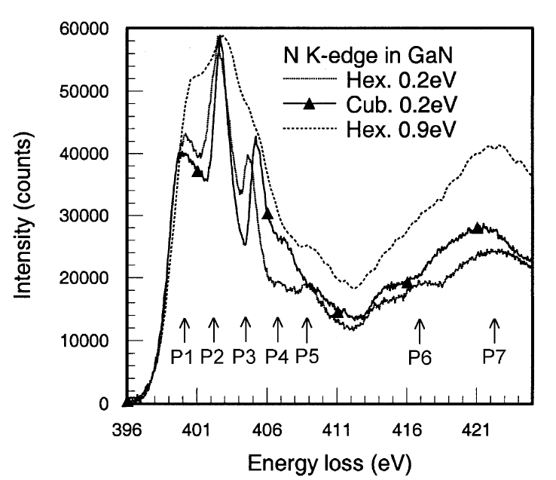
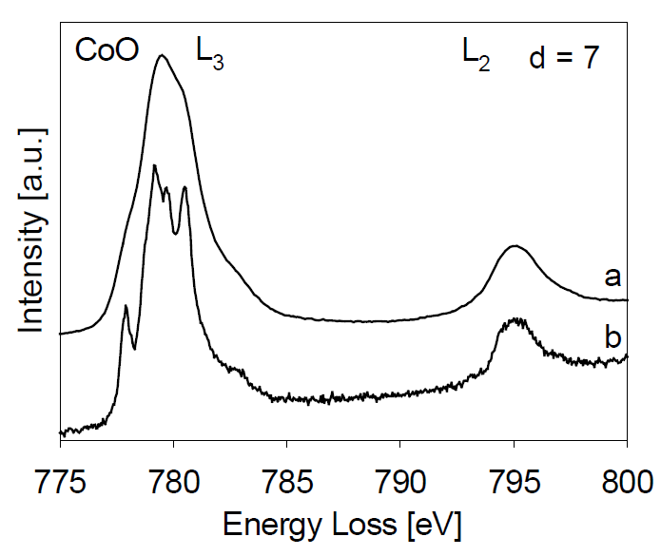
Effect of the improved energy resolution

Slide 53
Summary
The main energy transfer processes are:
  Single electron excitations
  Bremsstrahlung
  Collective excitations (plasmons)
Differentiate between primary and secondary processes
Nomenclature
What determines the characteristic X-ray energies
How can X-ray energies be measured?
  EDS vs WDS
The thin film approximation in TEM
  What approximationis made?
  What are the limits to this approximation and what happens when it breaks down?
  Difference between the Cliff-Lorimer method and the ZAF method
Electron Energy Loss Spectroscopy (EELS)
  The EELS spectrometer
  Typical features in the EELS spectrum and their uses
  Monochromation

