Slide 1
MENA 3200 Energy Materials
Materials for Electrochemical Energy Conversion
Fuel cells – Electrolysers - Batteries
Truls Norby

Slide 2
Overview of this part of the course
What is electrochemistry?
Types of electrochemical energy conversion devices
Fuel cells, electrolysers, batteries
General principles of materials properties and requirements
Electrolyte, electrodes, interconnects
Conductivity
Catalytic activity
Stability
Microstructure
Examples of materials and their properties
SOFC, PEMFC, Li-ion batteries

Slide 3
What is electrochemistry?
R
4e⁻
+
4H⁺
Redox chemistry – reduction and oxidation
Example: Homogeneous redox reaction
2H₂ + O₂ = 2H₂O
Electrochemistry is redox chemistry where reduction and oxidation take place at different locations:
Cathode: O₂ + 4H⁺ + 4e⁻ = 2H₂O | 1
Anode: 2H₂ = 4H⁺ + 4e⁻ | 1
Total: 2H₂ + O₂ = 2H₂O
The two locations must thus be connected with pathways for ions and electrons
O₂
2H₂O
2H₂
Proton conducting fuel cell
4e⁻
4H⁺
O₂
2H₂O
2H₂
Hydrogen membrane

Slide 4
Electrochemical energy conversion
R
4e⁻
4H⁺
+
O₂
2H₂O
Reaction:
Cathode: O₂ + 4H⁺ + 4e⁻ = 2H₂O | 1
Anode: 2H₂ = 4H⁺ + 4e⁻ | 1
Total: 2H₂ + O₂ = 2H₂O
If we have different pathways for ions and electrons,
electrolyte for ions,
electrodes + wire for electrons,
we can
extract electrical energy from a spontaneous reaction (e.g. fuel cell or discharging battery),
supply electrical energy to drive a non-spontaneous reaction (e.g. electrolyser cell or charging battery).
2H₂
Proton conducting fuel cell
+
U
4e⁻
4H⁺
O₂
2H₂O
2H₂
Proton conducting electrolyser

Slide 5
Electrochemical processes without electrodes
4e⁻
4H⁺
O₂
2H₂O
If the ions and electrons go in the same material – a mixed conductor – we cannot get or use electrical energy, but we can for instance get chemical processes, gas separation, or heat.
We may get or use work other than electrical – for instance pumping.
In this course we will however mostly disregard these processes, and concentrate on devices with electrolytes and electrodes.
2H₂
Hydrogen membrane
M
MO_{z/2}
ze⁻
M^{z+}
z/4 O₂
Oxidising (corroding) metal

Slide 6
Electrochemical cells
R
4e⁻
-
4H⁺
+
Reduction: A + xe⁻ = A^{x-} | y
Oxidation: B = B^{y+} + ye⁻ | x
Total: yA + xB = yA^{x-} + xB^{y+}
In text, we often represent cells by a diagram of the type
B | B^{y+} || A^{x+} | A
Multiple components in one phase are separated by comma
Phase borders: single lines
Half cell border (salt bridge): double line
Electrode where oxidation takes place is called anode.
Electrode where reduction takes place is called cathode.
Anode Oxidation (both start with vowels)
Cathode Reduction (both start with consonants)
Definition of anode and cathode thus not defined by sign of voltage, but on whether process consumes or releases electrons.
O₂
2H₂O
2H₂
Anode -
Cathode +
Proton conducting fuel cell
-
+
U
4e⁻
4H⁺
O₂
2H₂O
2H₂
Cathode -
Anode +
Proton conducting electrolyser

Slide 7
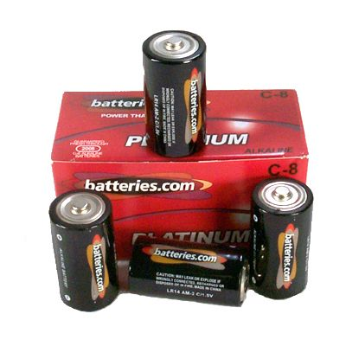
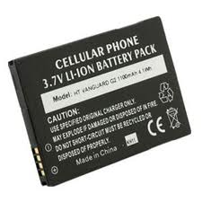
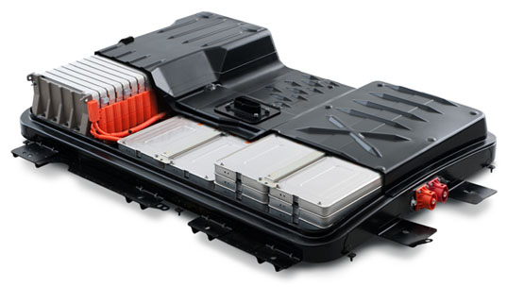
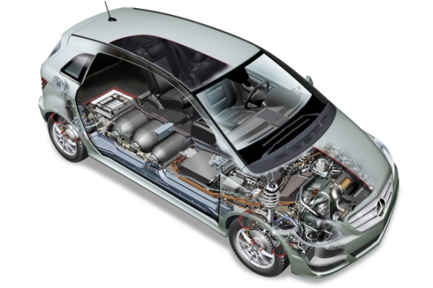
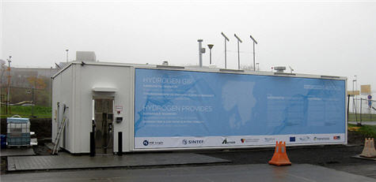
Batteries, fuel cells, and electrolysers
Primary batteries
Factory charged
Single discharge
Secondary batteries - accumulators
Rechargeable
Multiple discharges and recharges
All chemical energy stored
“Ternary batteries” – fuel cells
Fuel continuously supplied from external source
Electrolysers
Reversed fuel cells
Fuel generated continuously and stored externally

Slide 8
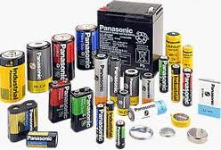
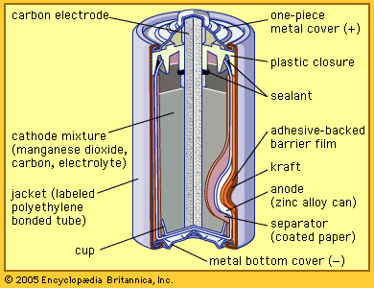
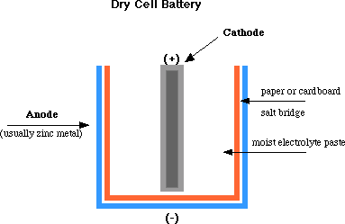
Primary battery
Example: “Dry cell”/Alkaline battery. Discharge:
Anode (-): Zn + 2OH⁻ = Zn(OH)₂ + 2e⁻
Cathode (+): MnO₂ + H₂O + e⁻ = MnOOH + OH⁻
Electrolyte: KOH

Slide 9
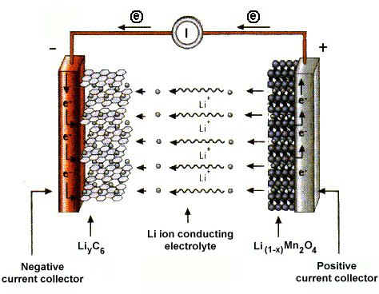
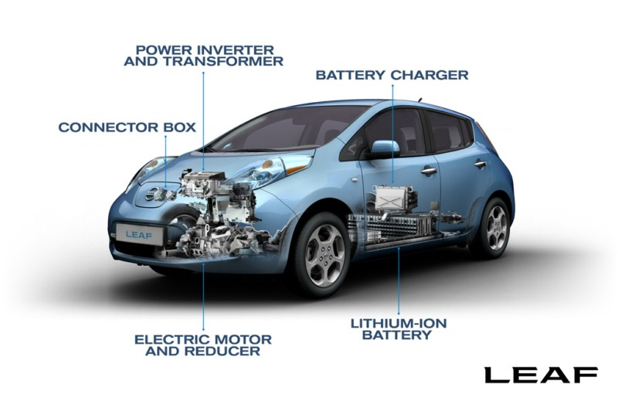
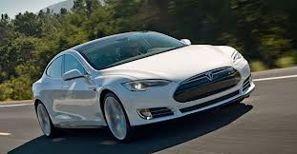
Secondary battery (rechargeable, accumulator)
Example: Li-ion battery. Discharge:
Anode(-): Li = Li⁺ + e⁻
Cathode(+): Li⁺ + 2MnO₂ + e⁻ = LiMn₂O₄
Electrolyte: Aqueous, polymer, or solid state Li⁺ ion conductor

Slide 10
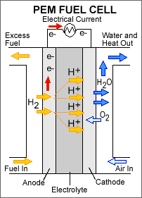
Fuel cell
Polymer Electrolyte Membrane Fuel Cell (PEMFC):
Anode(-): 2H₂ = 4H⁺ + 4e⁻
Cathode(+): O₂ + 4H⁺ + 4e⁻ = 2H₂O
Solid Oxide Fuel Cell (SOFC)
If necessary, first reforming of carbon-containing fuels:
CH₄ + H₂O = CO + 3H₂
Anode(-): 2H₂ + 2O²⁻ = 2H₂O + 4e⁻
Cathode(+): O₂ + 4e⁻ = 2O²⁻

Slide 11
Electrolysers
Supplied with low energy H₂O (or CO₂) and electrical energy
PEM: Produces H₂ from H₂O
Cathode(-): 4H⁺ + 4e⁻ = 2H₂
Anode(+): 2H₂O = O₂ + 4H⁺ + 4e⁻
SOEC: Produces H₂ from steam (or syngas CO+H₂, or a liquid fuel)
Cathode(-): 2H₂O + 4e⁻ = 2H₂ + 2O²⁻
Anode(+): 2O²⁻ = O₂ + 4e⁻
Materials otherwise as for fuel cells

