Slide 1
MENA 3200 Energy Materials
Materials for Electrochemical Energy Conversion
Part 3
Materials for SOFCs and PEMFCs
Truls Norby

Slide 2
Overview of this part of the course
What is electrochemistry?
Types of electrochemical energy conversion devices
Fuel cells, electrolysers, batteries
General principles of materials properties and requirements
Electrolyte, electrodes, interconnects
Conductivity
Catalytic activity
Stability
Microstructure
Examples of materials and their properties
SOFC, PEMFC, Li-ion batteries

Slide 3
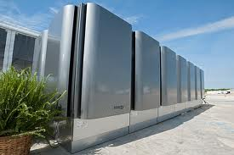
Solid Oxide Fuel Cells (SOFCs)

Slide 4
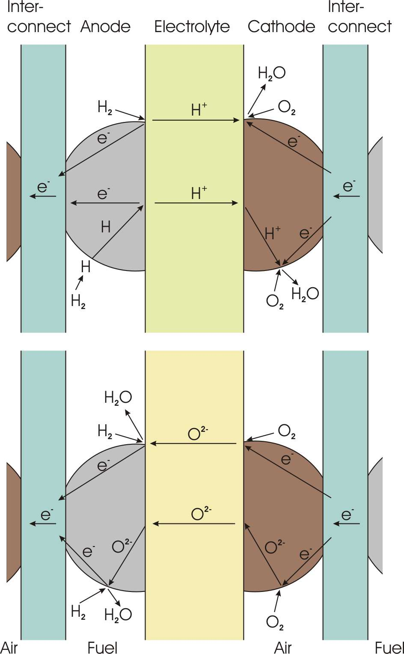
Solid Oxide Fuel Cell (SOFC)
R
4e⁻
+
2O²⁻
“oxide” reflects that the electrolyte is an oxide and that it conducts oxide ions
Electrode reactions
Anode(-): 2H₂ + 2O²⁻ = 2H₂O + 4e⁻
Cathode(+): O₂ + 4e⁻ = 2O²⁻
Operating temperature: 600-1000°C
Fuel: H₂ or reformed carbon-containing fuels
Potential advantages:
Fuel flexibility and tolerance
Good kinetics – no noble metals needed
High value heat
Current problems:
High cost
Lifetime issues
2H₂
2H₂O
O₂
Solid Oxide Fuel Cell (SOFC)

Slide 5
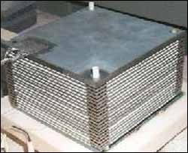
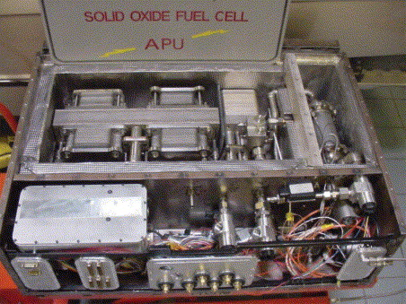
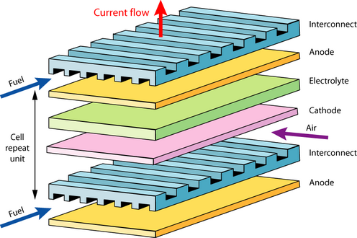
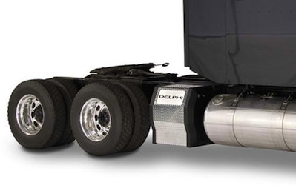
Typical SOFC designs
SOFCs for vehicle auxiliary power units

Slide 6
SOFC electrolyte material requirements
Oxide ion conductivity > 0.01 S/cm
Film of <10 μm gives <0.1 Ωcm² of resistance or <0.1 V loss at 1 A/cm²
Ionic transport number >0.99
Gastight
Tolerate both reducing (H₂) and oxidising (air/O₂) atmospheres
Be compatible with both electrodes (TEC and chemistry)

Slide 7
Oxide ion conductors
Oxygen vacancies
Obtained by acceptor dopants
Y-doped ZrO₂ (YSZ), Sc-doped ZrO₂
Gd-doped CeO₂ (GDC)
Sr+Mg-doped LaGaO₃ (LSGM)
Disordered inherent oxygen deficiency
Example: δ-Bi₂O₃
Oxygen interstitials
No clearcut examples…

Slide 8
Y-stabilised zirconia; YSZ
Doping ZrO₂ with Y₂O₃
Stabilises the tetragonal and cubic structures
Higher symmetry and oxygen vacancy mobilities
Provides oxygen vacancies as charge compensating defects
Oxygen vacancies trapped at Y dopants
8 mol% Y₂O₃ (8YSZ): highest initial conductivity
10 mol% Y (10YSZ): highest long term conductivity
Metastable tetragonal zirconia polycrystals (TZP) of 3-6 mol% Y₂O₃ (3YSZ, 6YSZ) gives transformation toughened zirconia – better mechanical properties but lower conductivity
Partially replacing Y with Sc and Yb gives less trapping and better strength

Slide 9
SOFC anode materials requirements
Electronic conductivity > 100 S/cm
Ionic transport as high as possible to spread the reaction from 3pb to the entire surface
Porous
Tolerate reducing (H₂) atmospheres
Be compatible with electrolyte and interconnect (TEC and chemistry)
Catalytic to electrochemical H₂ oxidation
For carbon-containing fuels:
Be moderately catalytic to reforming and catalytic to water shift
Not promote coking
Tolerant to typical impurities, especially S

Slide 10
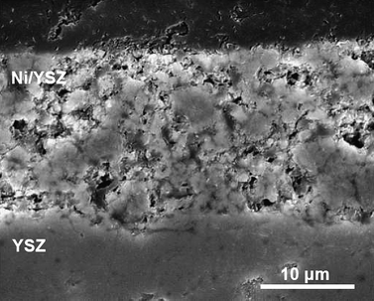
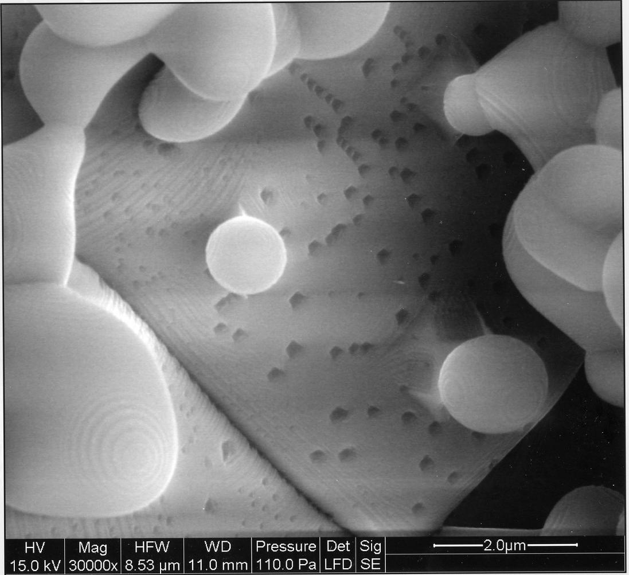
SOFC anodes: Ni-electrolyte cermet
Made from NiO and e.g. YSZ
NiO reduced in situ to Ni
Porous
All three phases (Ni, YSZ, gas) of approximately equal volume fractions and form three percolating networks.
Electrons
Ions
Gas
In addition, Ni is permeable to H, further enhancing the spreading of the reaction sites
Electrochemical oxidation of H₂ is very fast
Problems
Mechanical instability by redox and thermal cycles
Sulphur intolerance
Too high reforming activity. Tendency of coking
Remedies
Oxide anodes? (Donor doped n-type conductors)

Slide 11
SOFC cathode materials requirements
Electronic conductivity > 100 S/cm
Ionic transport as high as possible to spread the reaction from 3pb to the entire surface
Porous
Tolerate oxidising (air/O₂) atmospheres
Be compatible with electrolyte and interconnect (TEC and chemistry)
Catalytic to electrochemical O₂ reduction
Must tolerate the CO₂ and H₂O-levels in ambient air
Too basic materials (high Sr and Ba contents) may decompose under formation of carbonates or hydroxides

Slide 12
SOFC cathodes: Sr-doped LaMnO₃ (LSM)
For example La_{0.8}Sr_{0.2}MnO₃ (LSM)
p-type electronic conductor: [Sr_{La}/] = [h.]
Active layer is a “cercer” composite with electrolyte
Porous
All three phases (LSM, YSZ, gas) of approximately equal volume fractions and form three percolating networks.
Electrons
Ions
Gas
In addition, LSM is somewhat permeable to O (by mixed O²⁻ and e⁻ conduction), further enhancing the spreading of the reaction sites
Problems and remedies
Sensitive to Cr positioning from interconnect; coat interconnect and reduce operating temperature
Too little mixed conductivity; replace Mn with Co; LaCoO₃ has more oxygen vacancies than LaMnO₃.

Slide 13
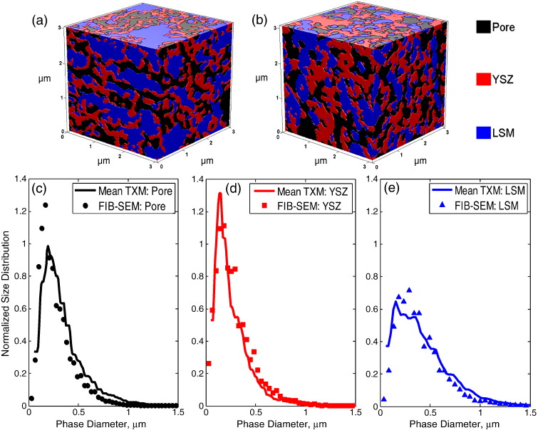
Tomography of the three percolating phases
G.C. Nelson et al., Electrochem. Comm., 13 (2011) 586–589.

Slide 14
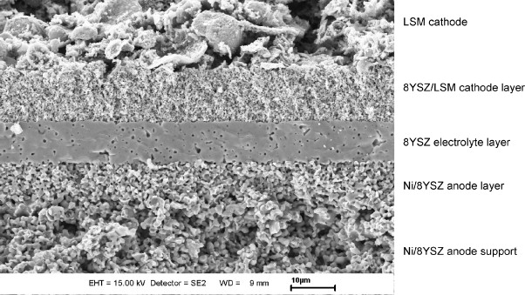
Anode-supported SOFC membrane electrode assembly (MEA)
T. Van Gestel, D. Sebold, H.P. Buchkremer, D. Stöver, J. European Ceramic Society, 32 [1] (2012) 9–26.

Slide 15
SOFC interconnect materials requirements
Electronic conductivity > 100 S/cm
Ionic transport number < 0.01 to avoid chemical shortcut permeation
Gas tight
Tolerate both reducing (H₂) and oxidising (air/O₂) atmospheres
Be compatible with anode and cathode electrode materials (TEC and chemistry)
Mechanical strength

Slide 16
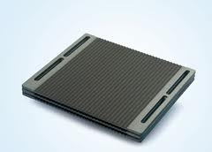
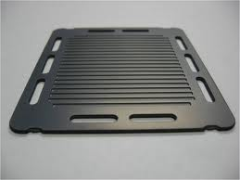
SOFC interconnects
Ceramic interconnects
Sr-doped LaCrO₃
p-type conductor: [Sr_{La}/] = [h.]
Problems:
Very hard to sinter and machine; expensive
Non-negligible O²⁻ and H⁺ conduction; H₂ and O₂ permeable
Metallic interconnects
Cr-Fe superalloys, stainless steels; Cr₂O₃-formers
Very good electrical and heat conduction
Mechanically strong
Problems:
Oxidation, Cr-evaporation
Remedies:
Reduce operation temperature

Slide 17
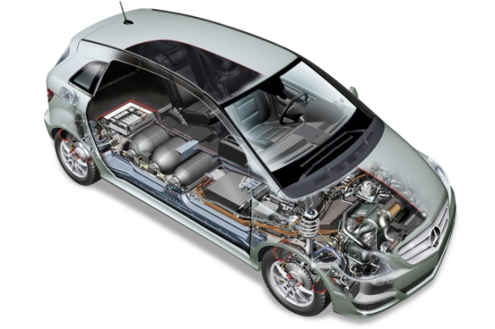
Polymer Electrolyte Membrane Fuel Cells (PEMFCs)

Slide 18
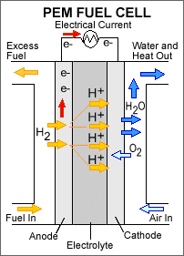
Polymer Electrolyte Membrane (PEM) Proton Exchange Membrane (PEM) PEM Fuel Cell (PEMFC)
Electrode reactions
Anode(-): 2H₂ = 4H⁺ + 4e⁻
Cathode(+): O₂ + 4H⁺ + 4e⁻ = 2H₂O
Operating temperature: 80°C
Fuel: Pure H₂
Advantages:
Robust materials
Challenges:
High cost of membrane and Pt catalyst
Carbon oxidation
Low value heat – heat exchange / cooling difficult
Water management

Slide 19
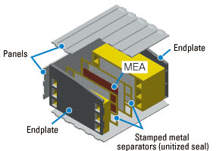
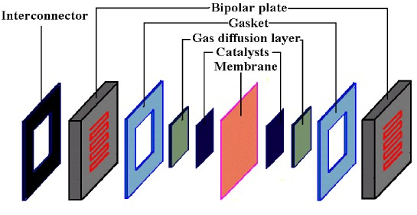
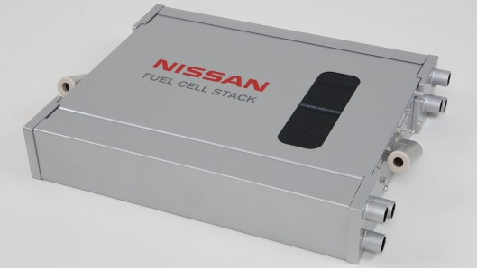
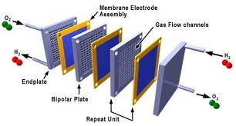
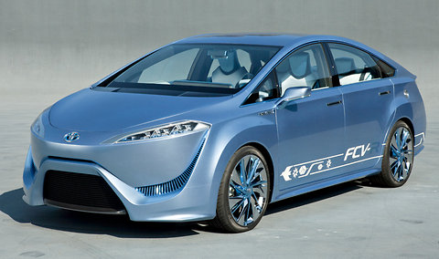
Typical PEMFC designs

Slide 20
PEMFC electrolyte material requirements
Proton conductivity > 0.1 S/cm
Ionic transport number >0.99
Gastight
Tolerate both reducing (H₂) and oxidising (air/O₂) atmospheres

Slide 21
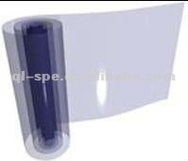
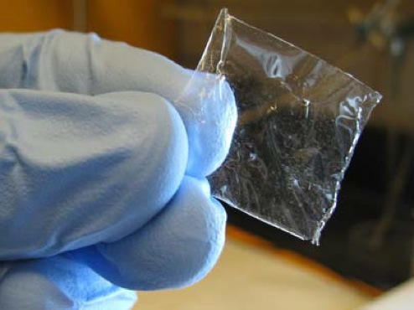
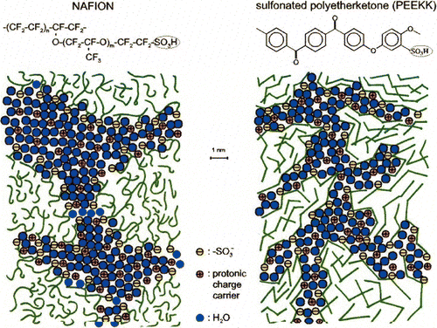
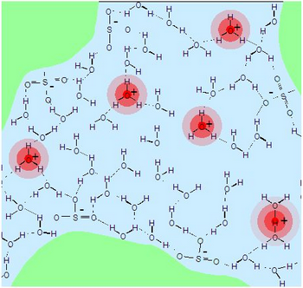
Polymer proton conductors
Nafion®
Perfluorinated backbone
Grafted
Sulfonated
Neutralised by NaOH; Na⁺
Proton exchanged; H⁺
Swelled with water
Hydrophobic framework
Channels with hydrophilic walls
Protolysis to form H₃O⁺ in the water phase
Transport of H⁺ drags ca. 6 H₂O molecules
Backdraft of water

Slide 22
PEMFC electrode materials requirements
Electronic conductivity
Catalytic activity at largest possible electrode-electrolyte interface
Porous to allow gas access
Tolerate reducing (H₂, anode) and oxidising (O₂, cathode) conditions

Slide 23
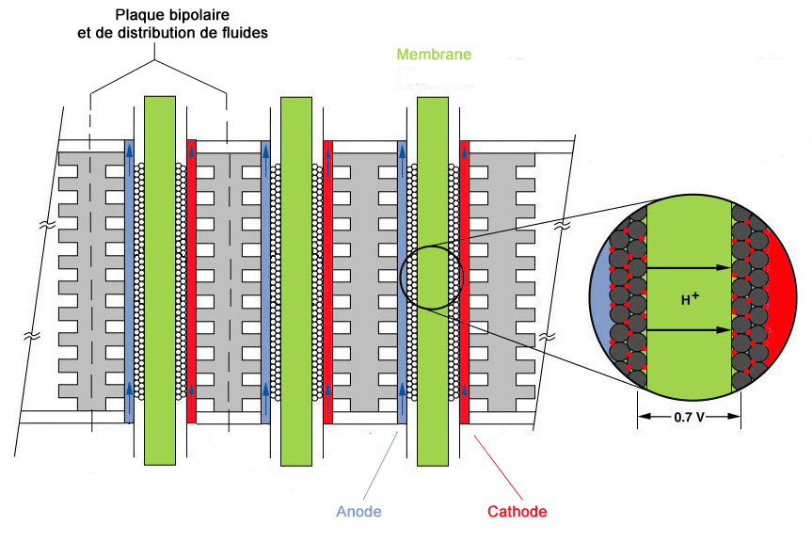
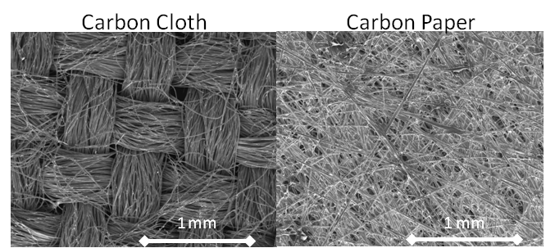
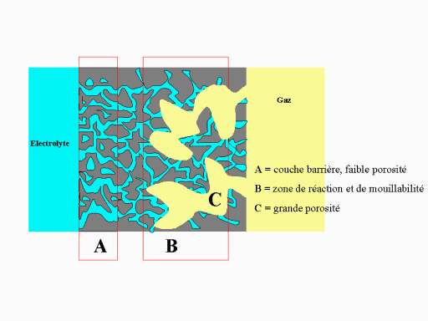
PEMFC electrode materials and structures
Carbon papers
Graphite
Carbon nanoparticles
Catalyst nanoparticles
Soaked with electrolyte
Porous gas diffusion layer

Slide 24
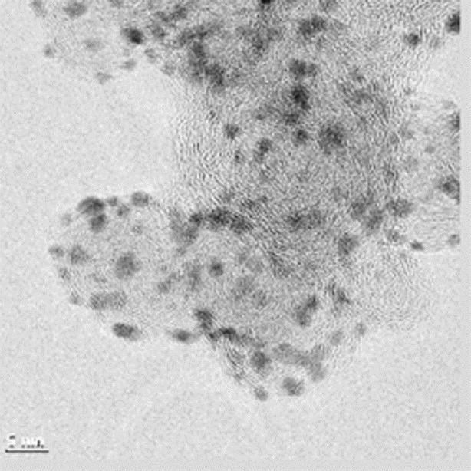
PEM electrode materials and structures
Noble metal nanoparticles dispersed on nanostructured carbon supports
Decreases noble metal loading
Challenge: Agglomeration of nanoparticles reduces activity
Challenge: Cathode carbon is oxidised by O₂ if no current is drawn.

Slide 25
PEMFC interconnect materials requirements
Electronic conductivity > 100 S/cm
Ionic transport number < 0.01 to avoid chemical shortcut permeation
Gas tight
Tolerate both reducing (H₂) and oxidising (air/O₂) atmospheres
Be compatible with electrode and electrolyte materials, notably acidity of electrolyte
Mechanical strength

Slide 26
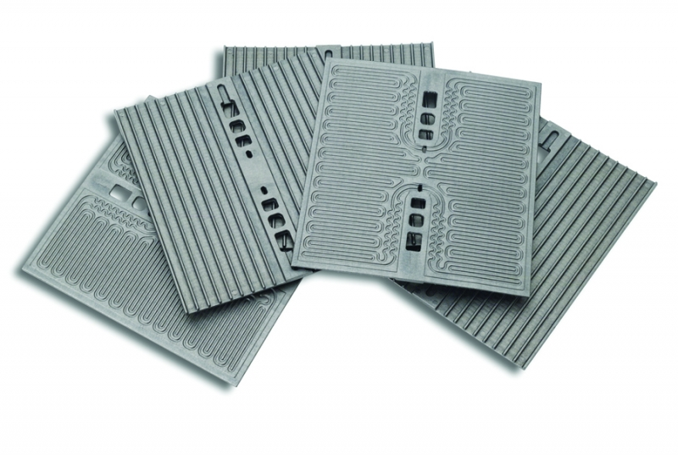
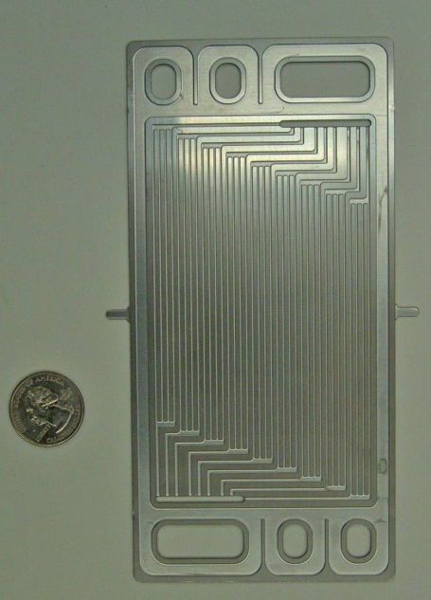
PEMFC interconnects
Graphite interconnects
Pure graphite
Composites
Light weight
Metallic interconnects
Commercial stainless steels
Very good electrical and heat conduction
Inexpensive
Mechanically strong
Problems:
Oxidation in contact with electrolyte

Slide 27
Electrolysers vs fuel cells
In an electrolyser, the product of a fuel cell (H₂O, possibly also CO₂) is fed…
…the process forced backwards to produce primarily H₂ and O₂
H₂ may in turn reduce CO₂ to form CO…
The same materials and structures may be used, but:
In a fuel cell, the chemical potential gradient is decreased due to losses – less severe materials requirements compared to equilibrium
In an electrolyser, the chemical potential gradient is increased to overcome the losses – more severe materials requirements compared to equilibrium; more reducing and oxidising conditions

