Slide 1
Magnetospheric dynamics

Slide 2
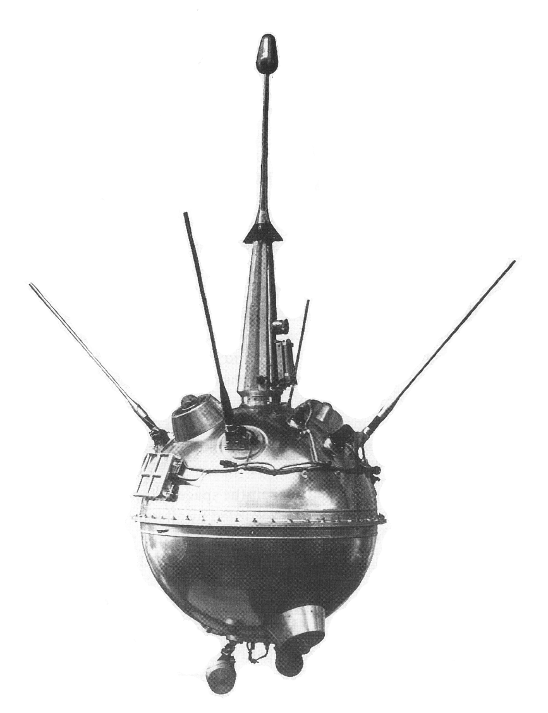
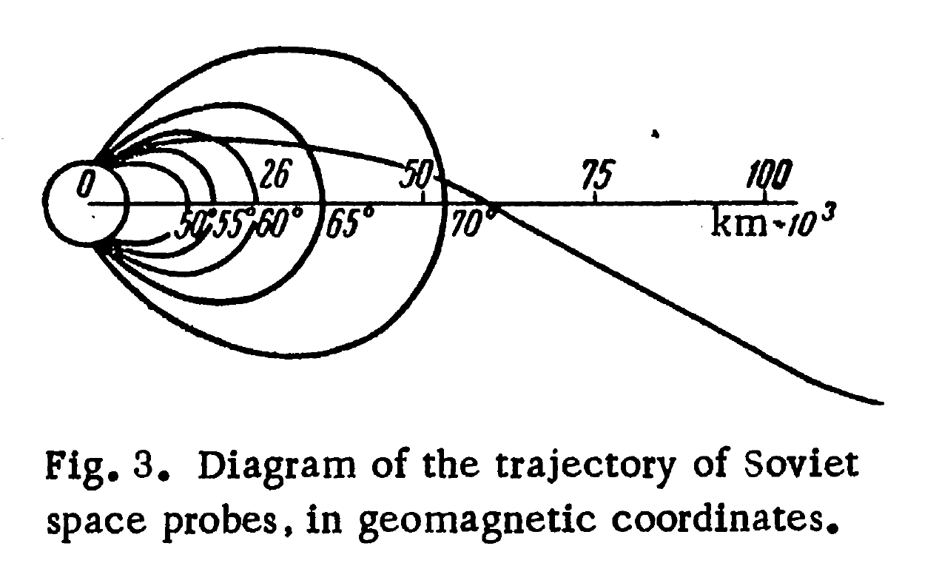
LUNIK 2, 12 September 1959

Slide 3
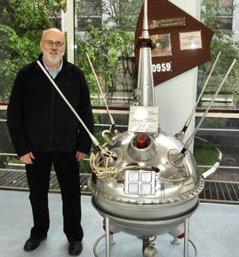
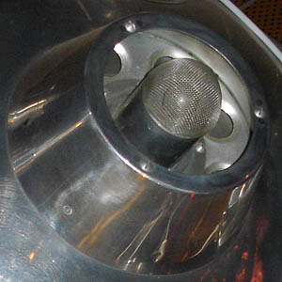
LUNIK 2, 12 September 1959

Slide 4
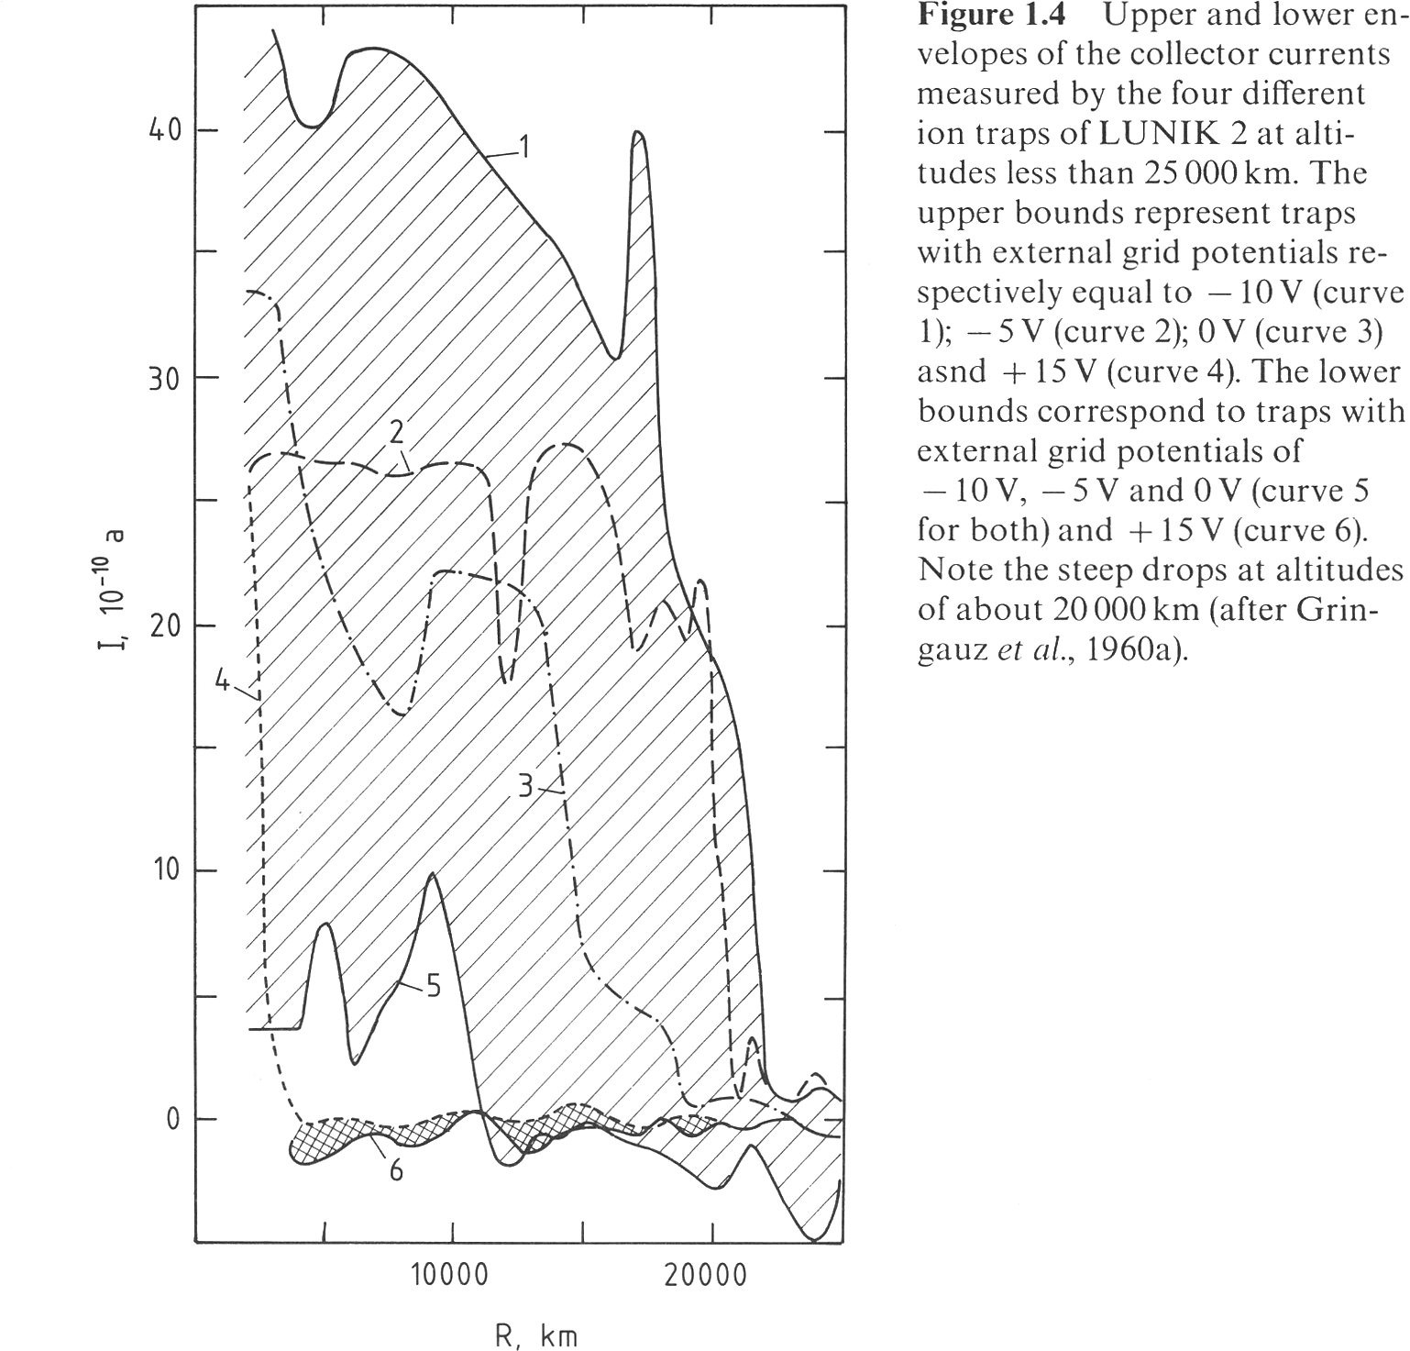
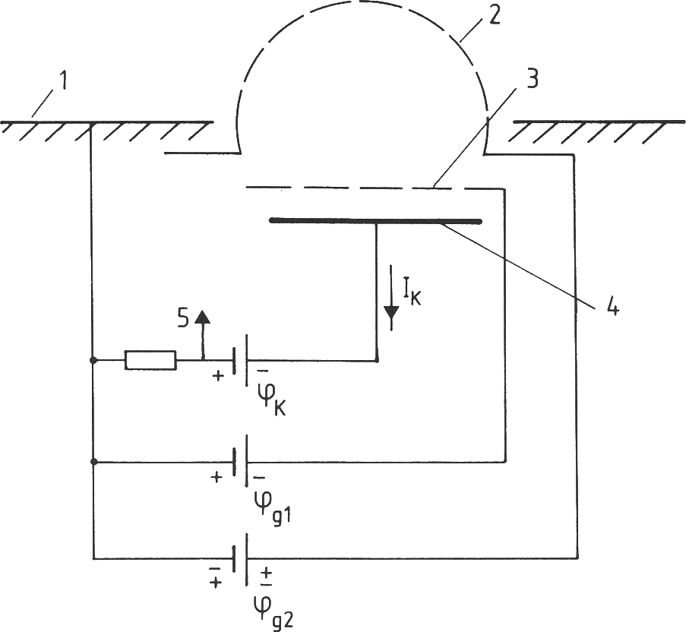
LUNIK 2, 12 September 1959

Slide 5
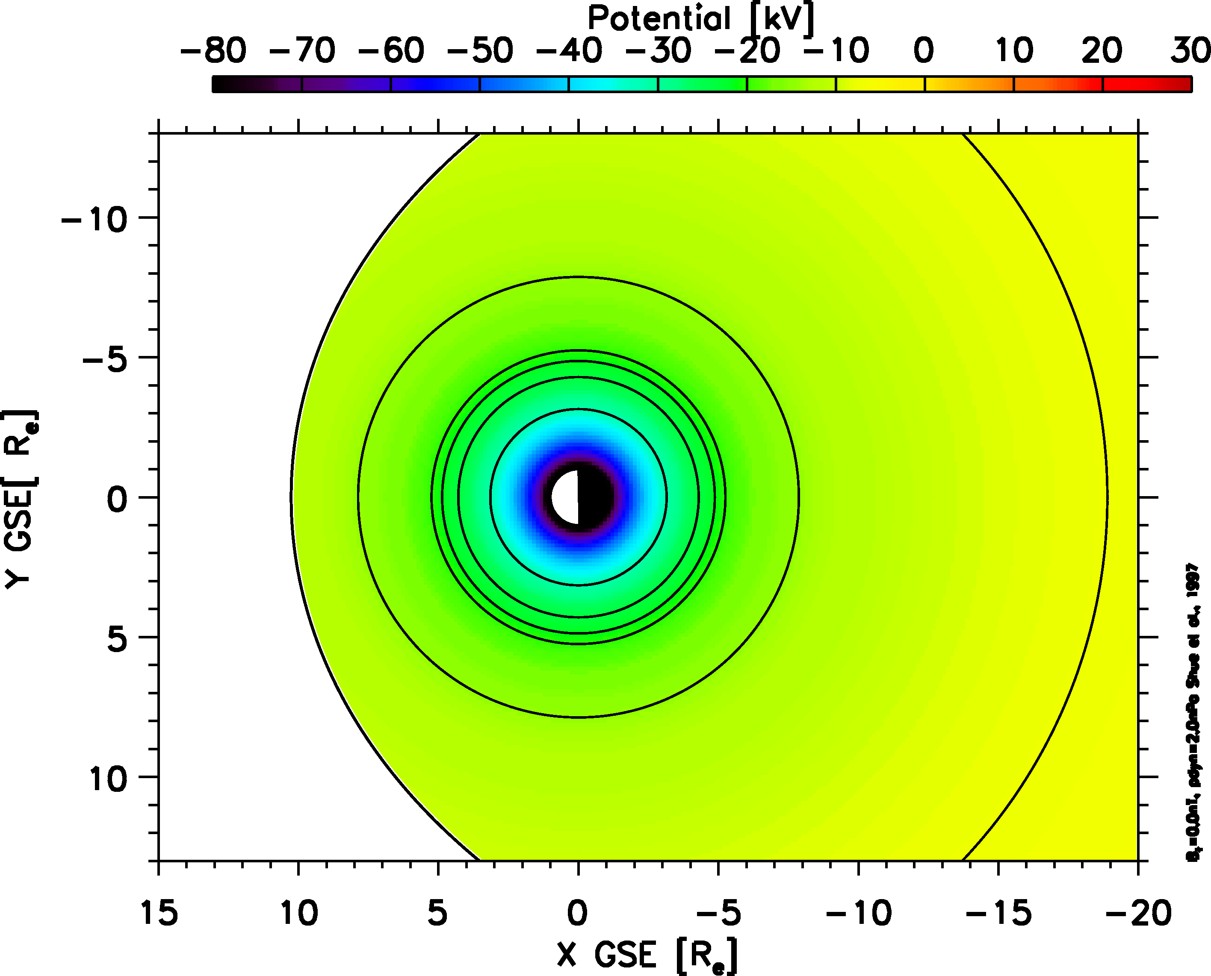
Corotation potential

Slide 6
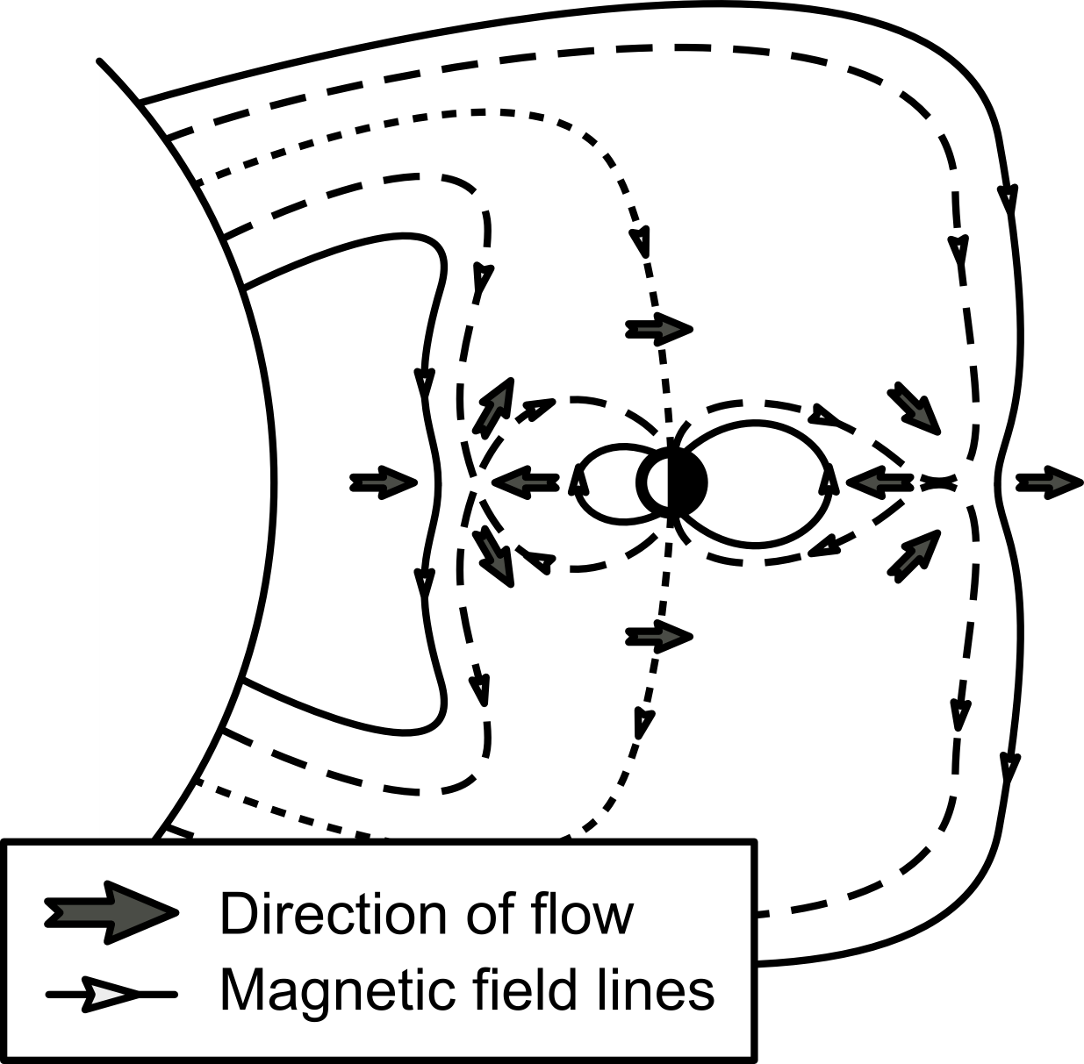
Dungey cycle

Slide 7
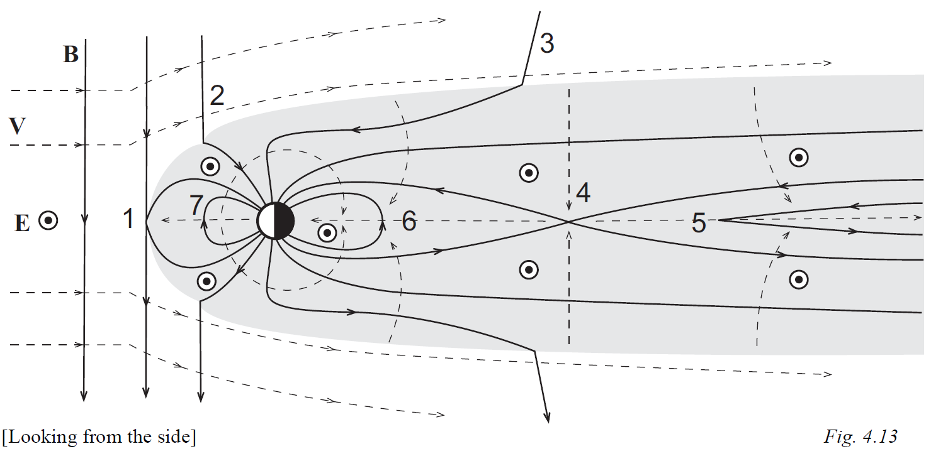
Dungey cycle

Slide 8
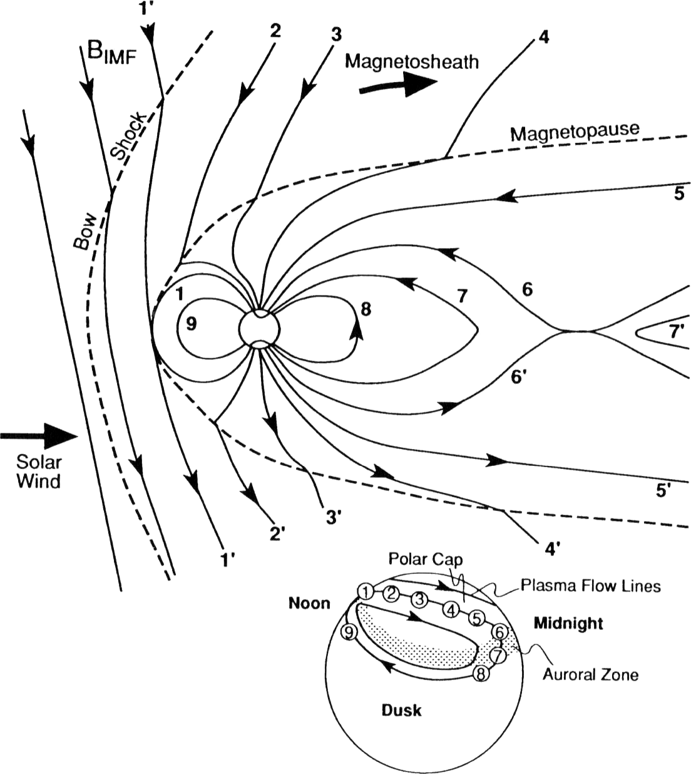
Dungey cycle
The plasma at the footpoint of the magnetic field lines undergoing the Dungey cycle is also moving
At the footpoint, i.e., inside the ionosphere, the plasma is moving in a twin-cell pattern
Image credit: Kivelson & Russell, 2001

Slide 9
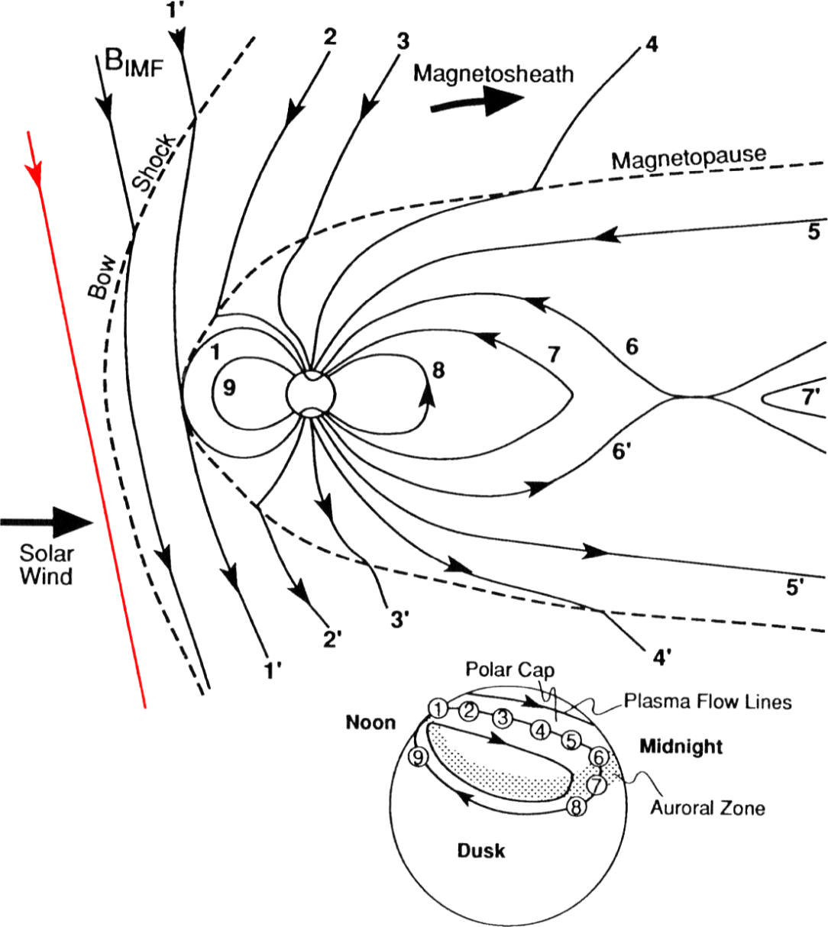
Dungey cycle
The plasma at the footpoint of the magnetic field lines undergoing the Dungey cycle is also moving
At the footpoint, i.e., inside the ionosphere, the plasma is moving in a twin-cell pattern
Image credit: Kivelson & Russell, 2001

Slide 10
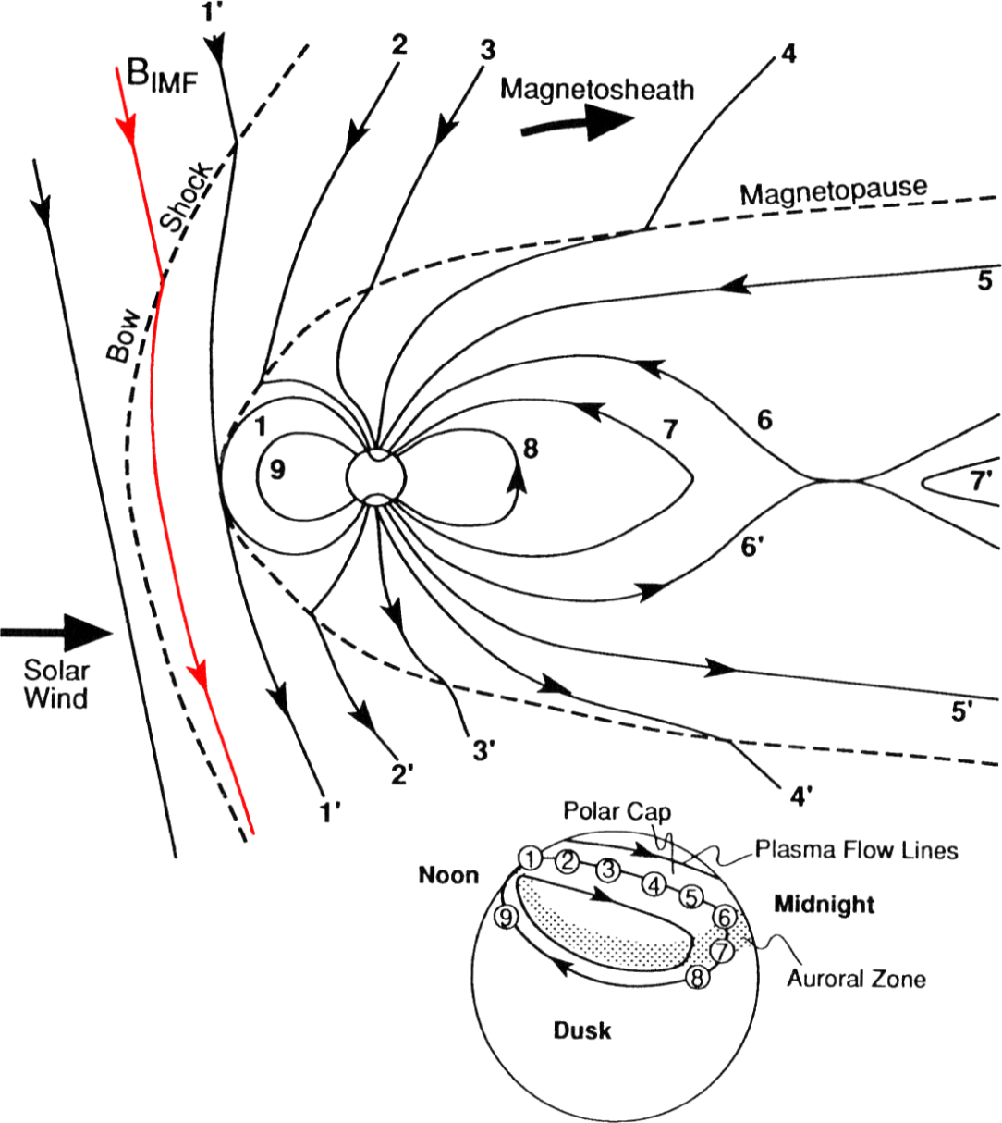
Dungey cycle
The plasma at the footpoint of the magnetic field lines undergoing the Dungey cycle is also moving
At the footpoint, i.e., inside the ionosphere, the plasma is moving in a twin-cell pattern
Image credit: Kivelson & Russell, 2001

Slide 11
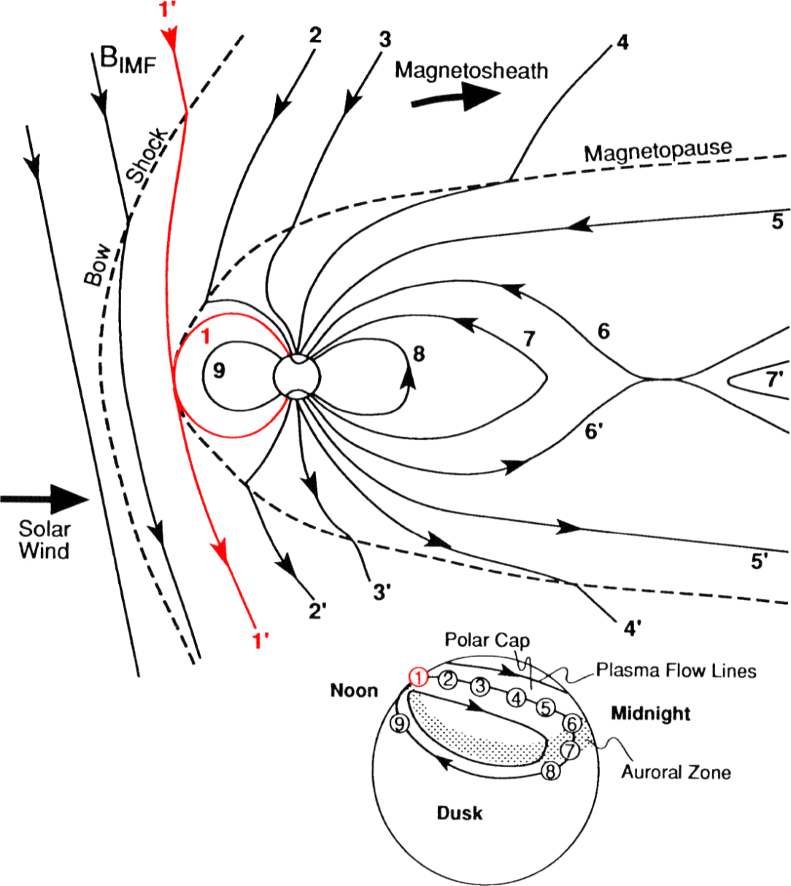
Dungey cycle
The plasma at the footpoint of the magnetic field lines undergoing the Dungey cycle is also moving
At the footpoint, i.e., inside the ionosphere, the plasma is moving in a twin-cell pattern
Image credit: Kivelson & Russell, 2001

Slide 12
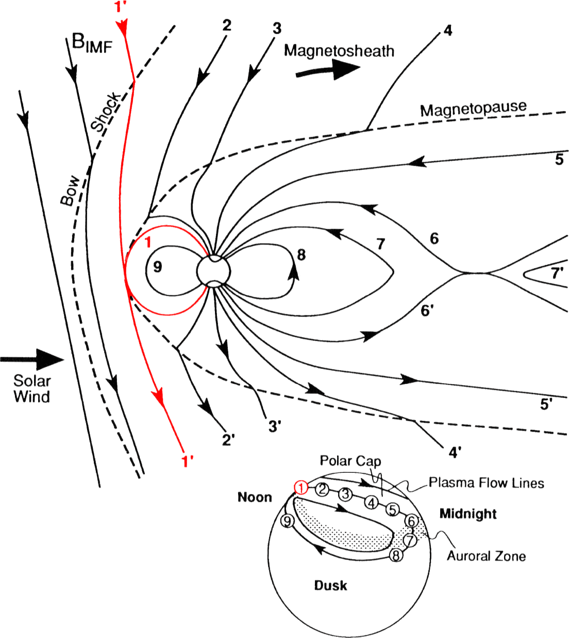
Dungey cycle
The plasma at the footpoint of the magnetic field lines undergoing the Dungey cycle is also moving
At the footpoint, i.e., inside the ionosphere, the plasma is moving in a twin-cell pattern
Image credit: Kivelson & Russell, 2001

Slide 13
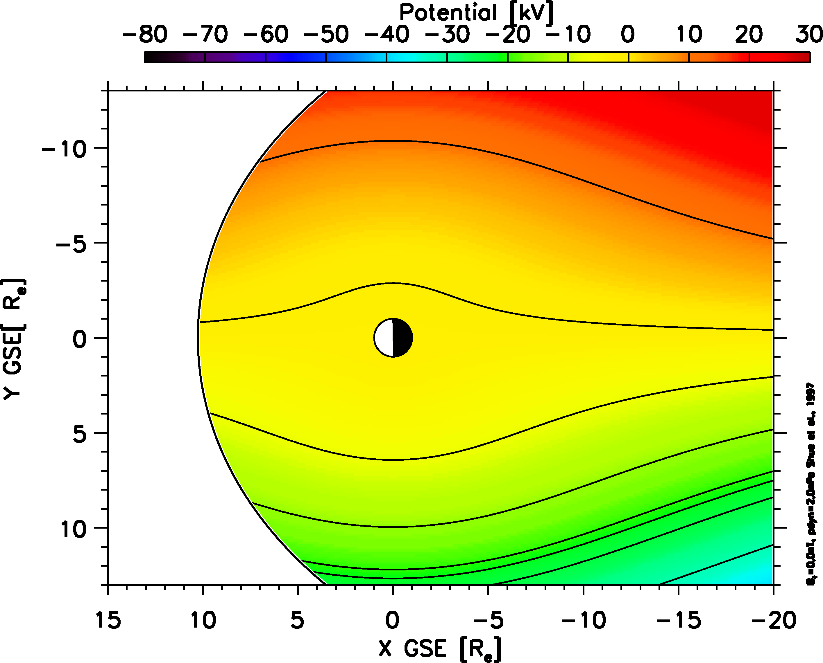
Convection potential

Slide 14
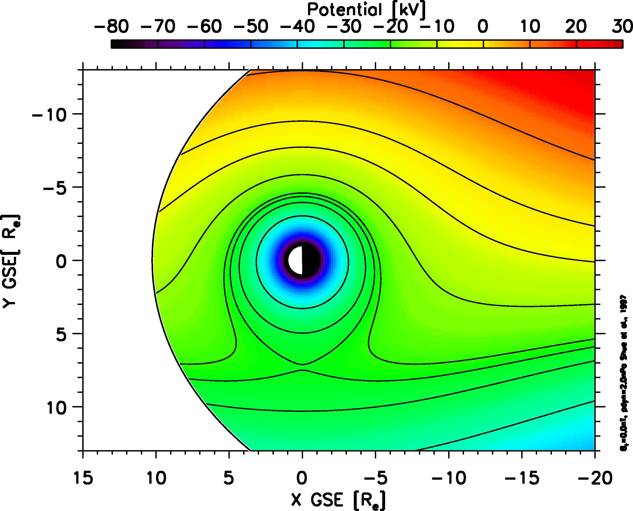
Convection + corotation

Slide 15
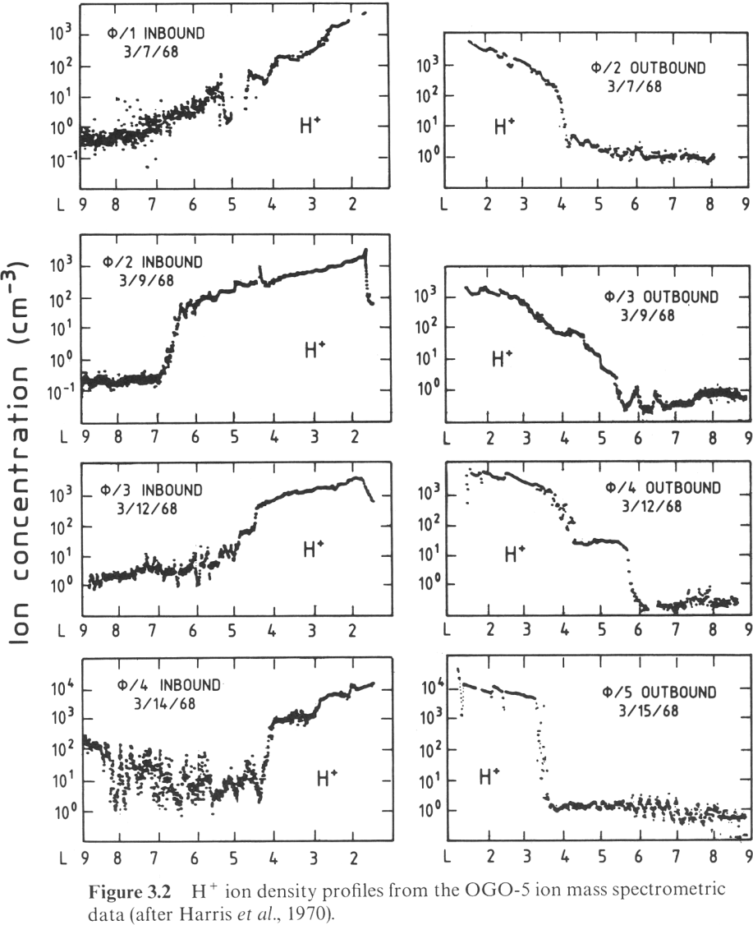
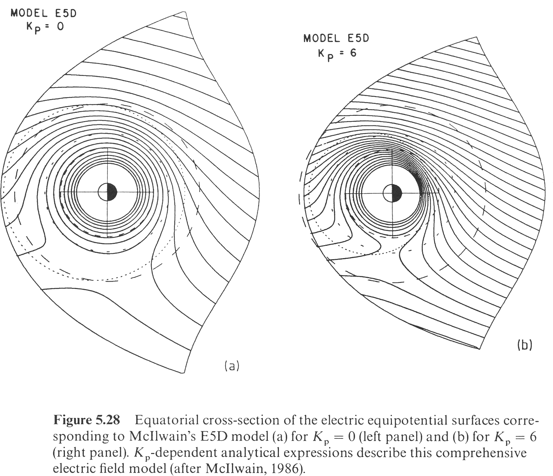
Dynamic plasmapause

Slide 16
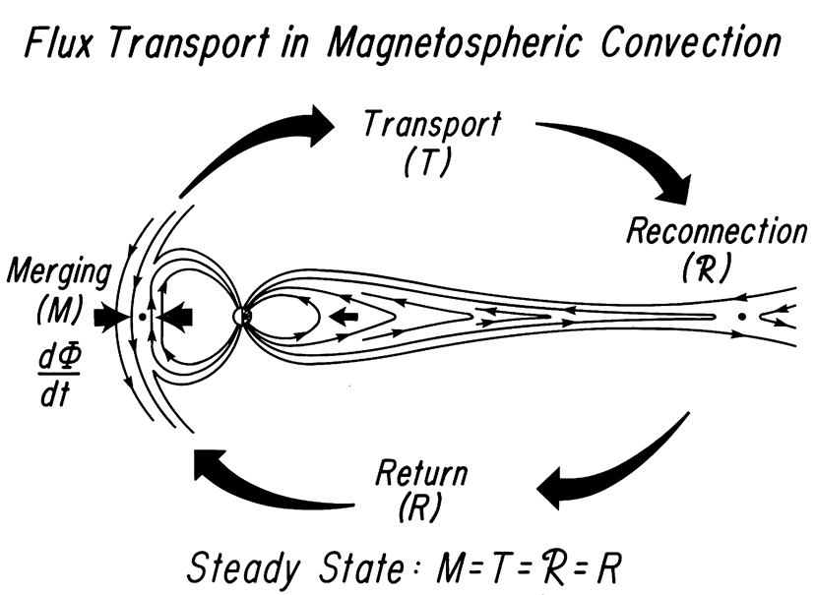
Steady state convection

Slide 17
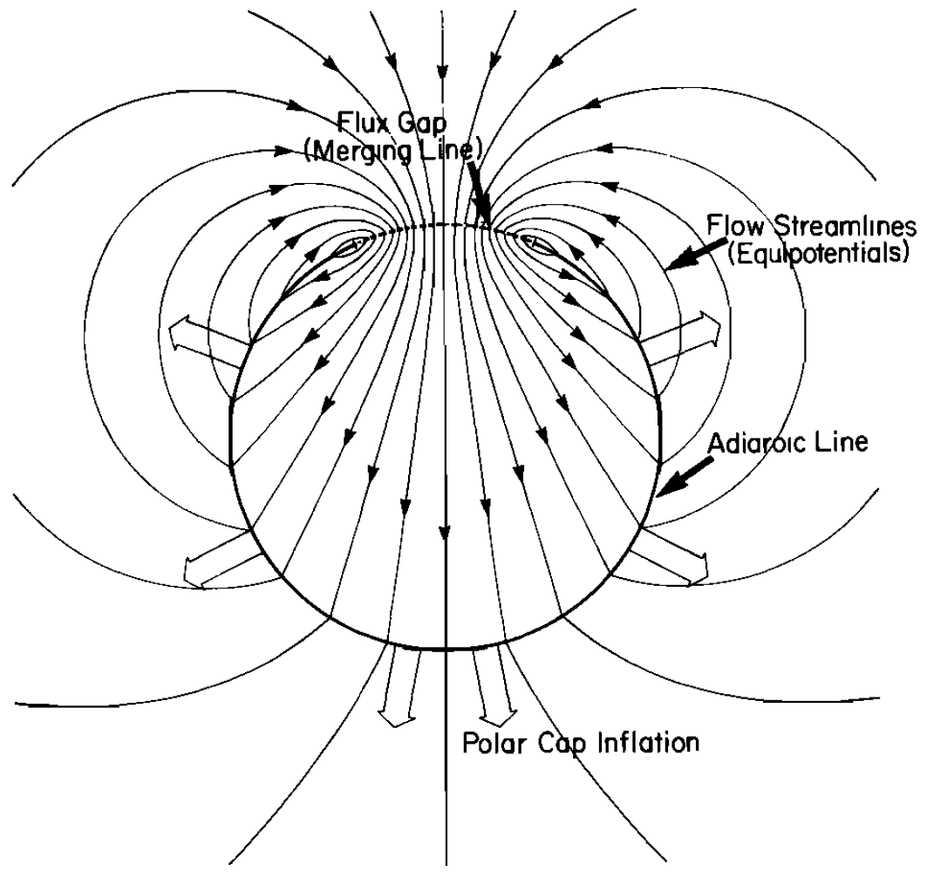
Dayside reconnection

Slide 18
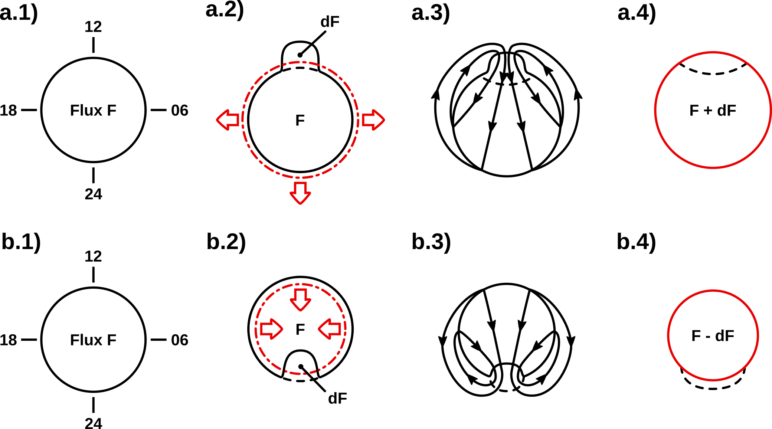
Ionospheric convection

Slide 19
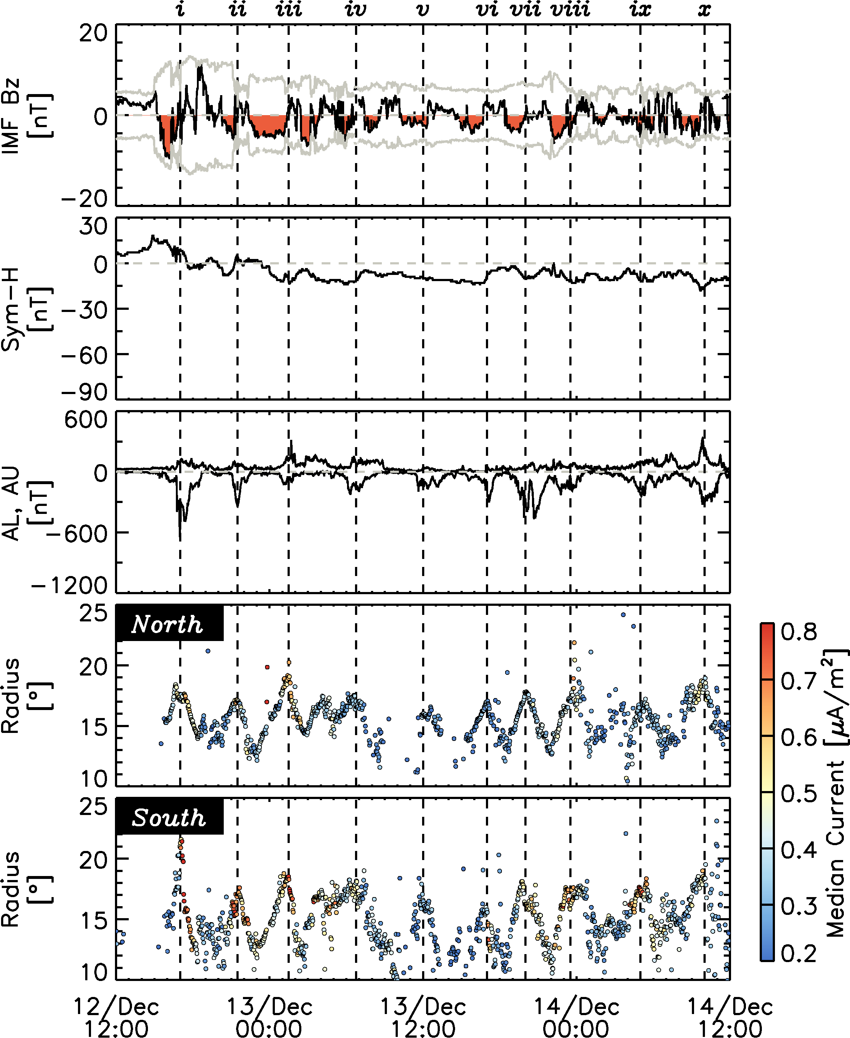
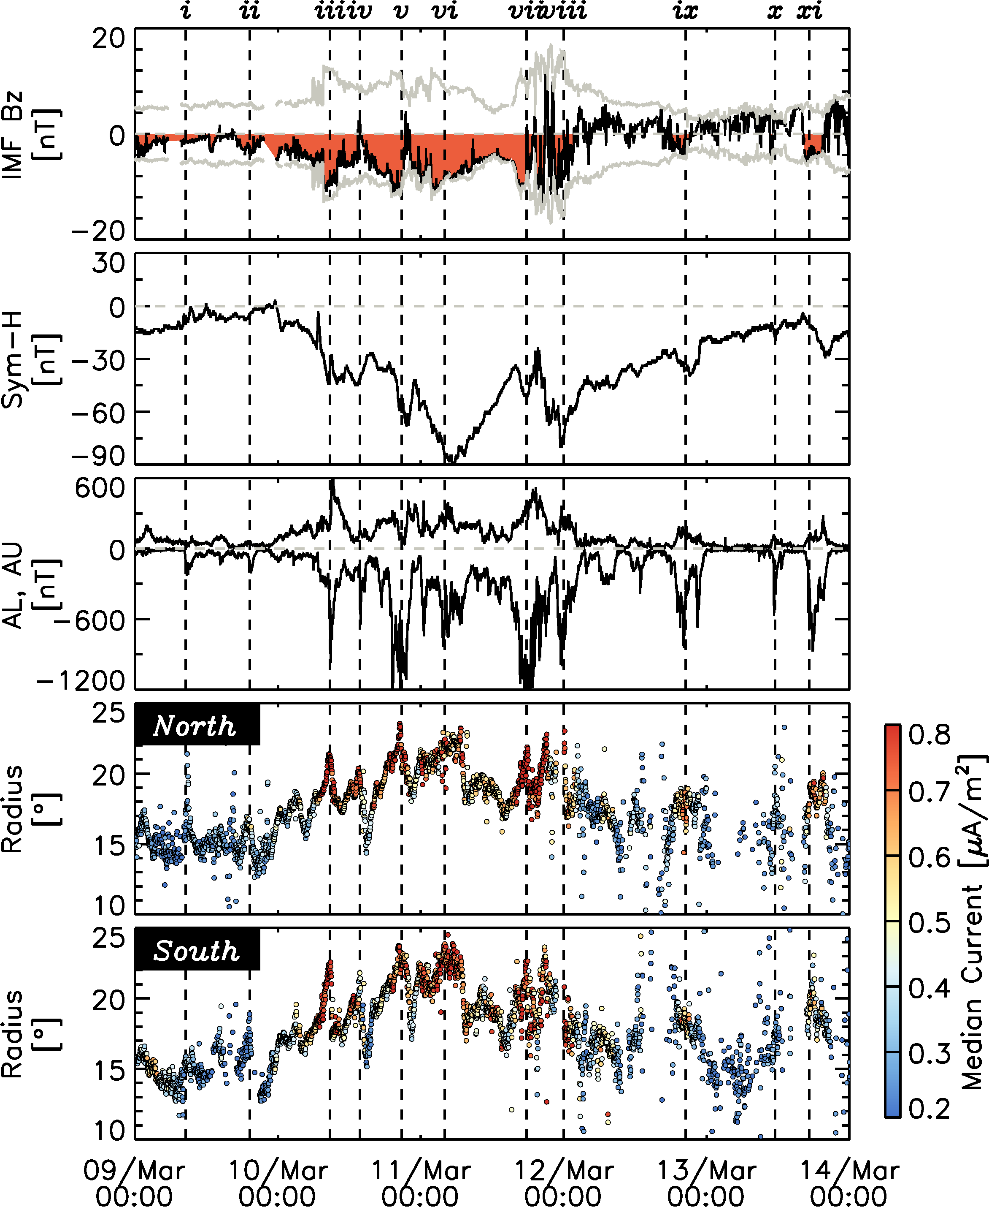
Measuring the OCB
Clausen et al., 2011

Slide 20
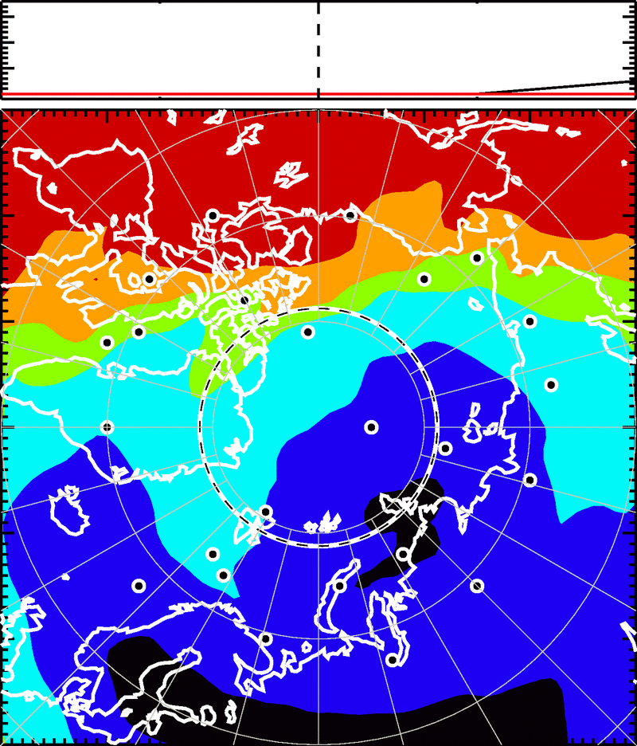
Polar plasma circulation
Dayside region is dominated by high plasma densities due to solar radiation

Slide 21
Polar plasma circulation
Dayside region is dominated by high plasma densities due to solar radiation
Convection transports parts of this high-density plasma toward the nightside

