Slide 1
Overview FYS 3610

Slide 2
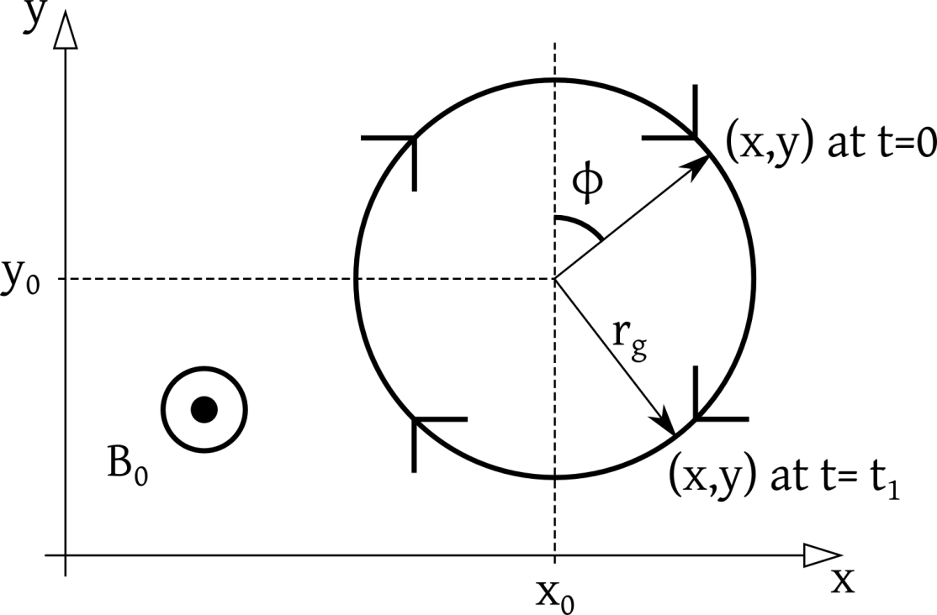
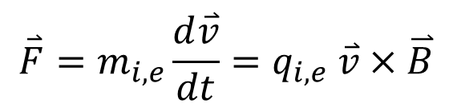
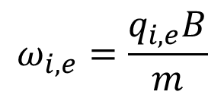
Single particle motion
$$\overset{⃑}{F}=m_{i,e}\frac{d\overset{⃑}{v}}{dt}=q_{i,e} \overset{⃑}{v}×\overset{⃑}{B}$$
$$ω_{i,e}=\frac{q_{i,e}B}{m}$$

Slide 3
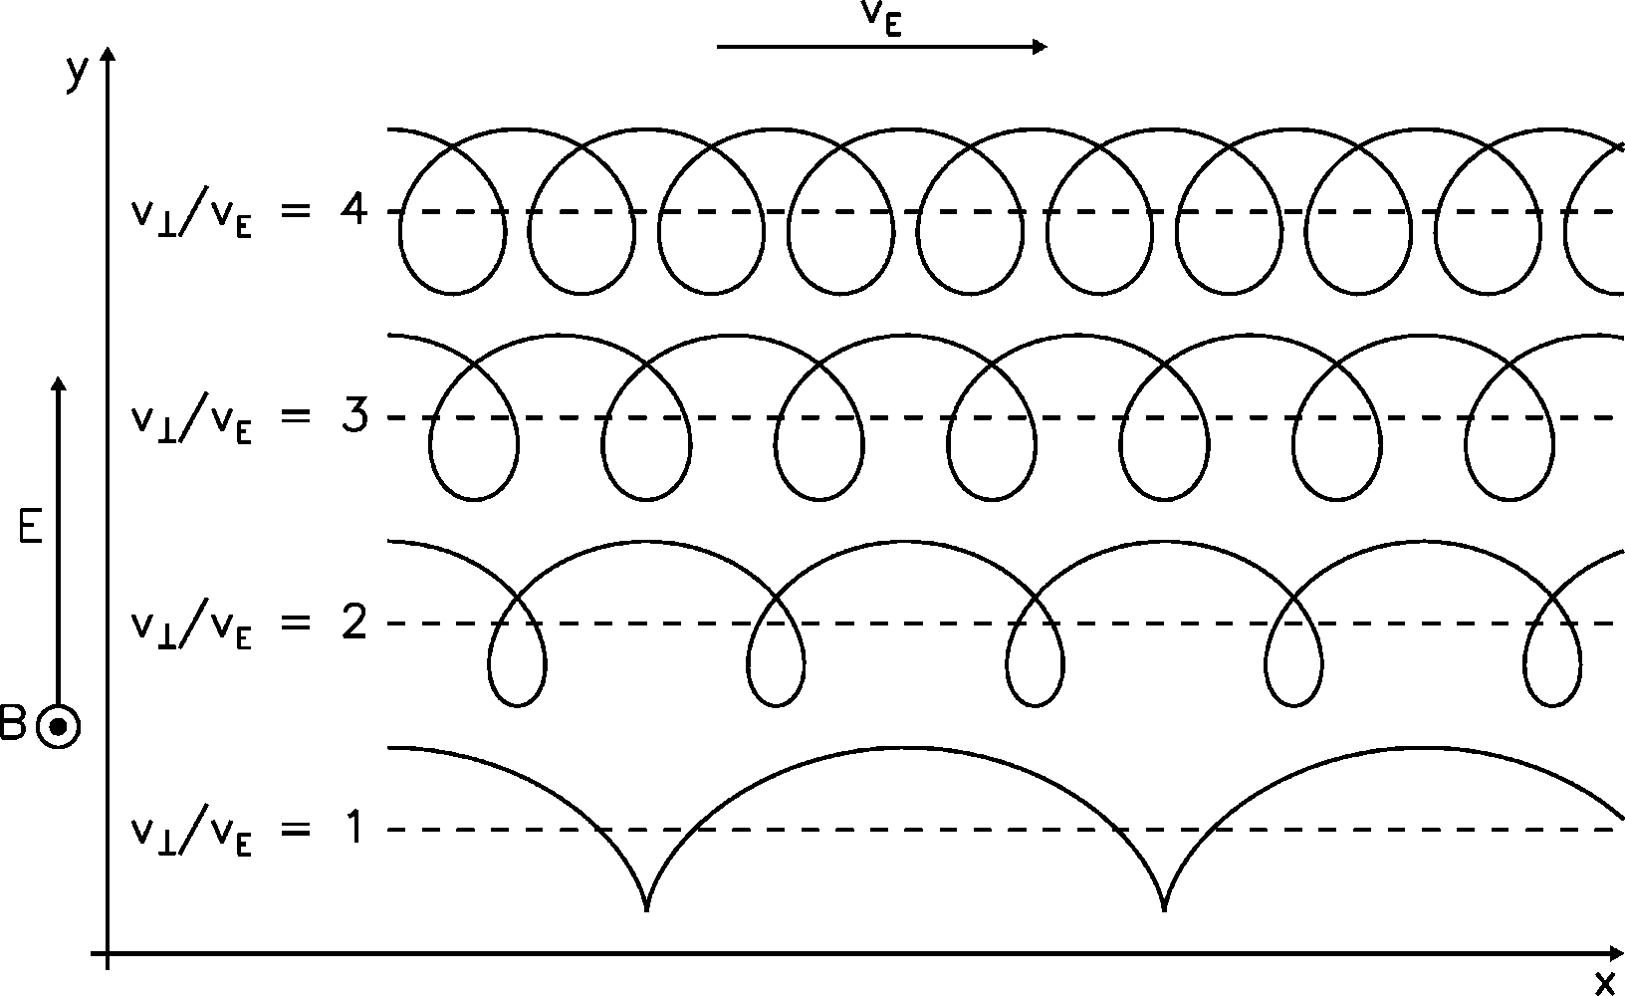
ExB drift

Slide 4
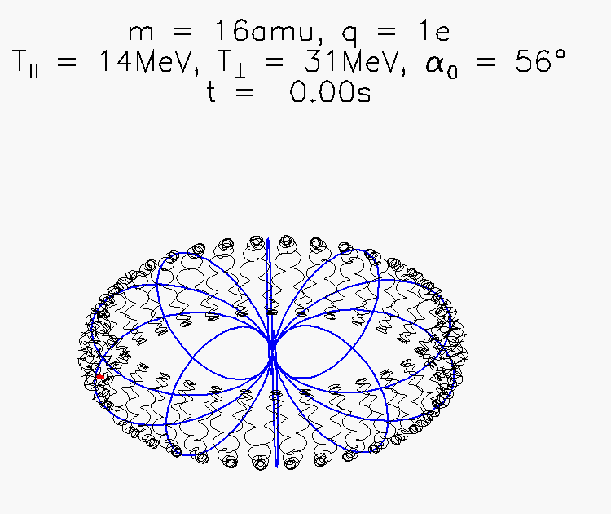
Single particle motion

Slide 5
Single particle motion

Slide 6
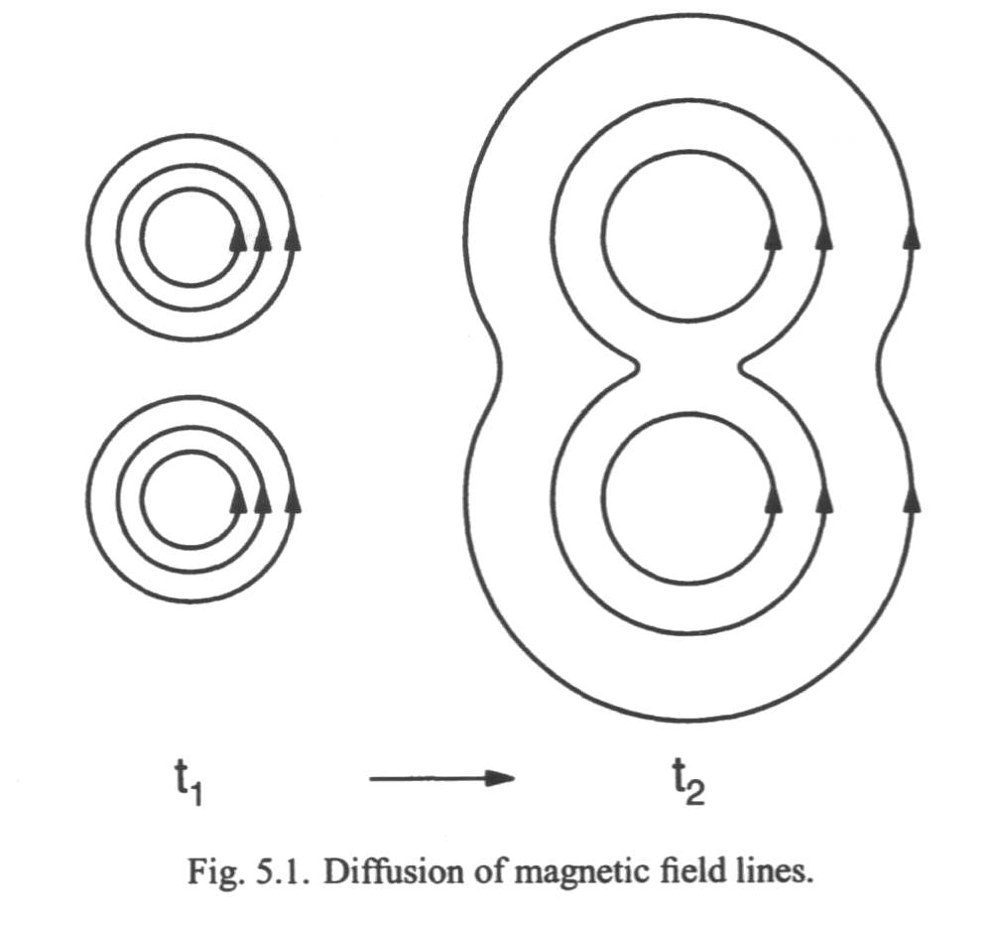
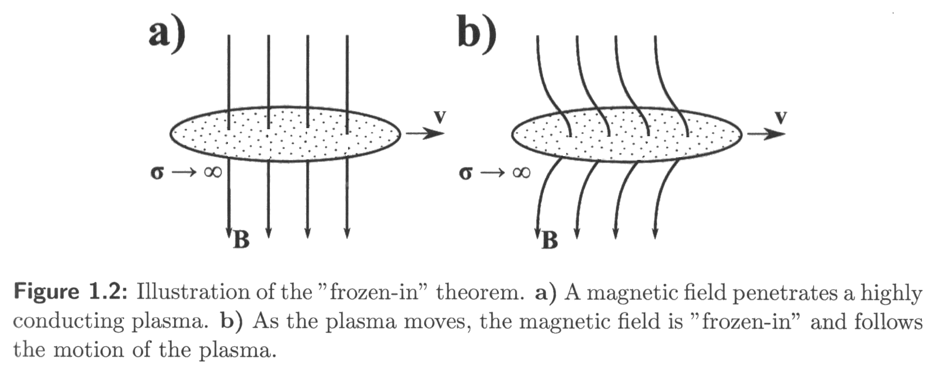
Diffusion vs. frozen-in

Slide 7
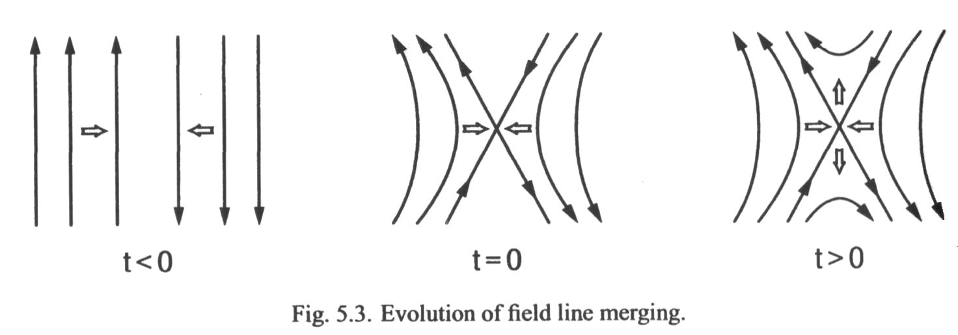
Magnetic reconnection

Slide 8
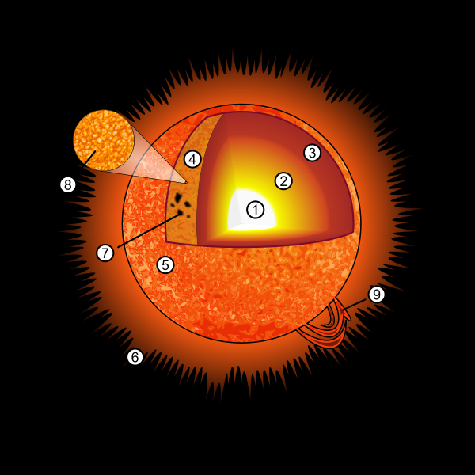
Some solar features

Slide 9
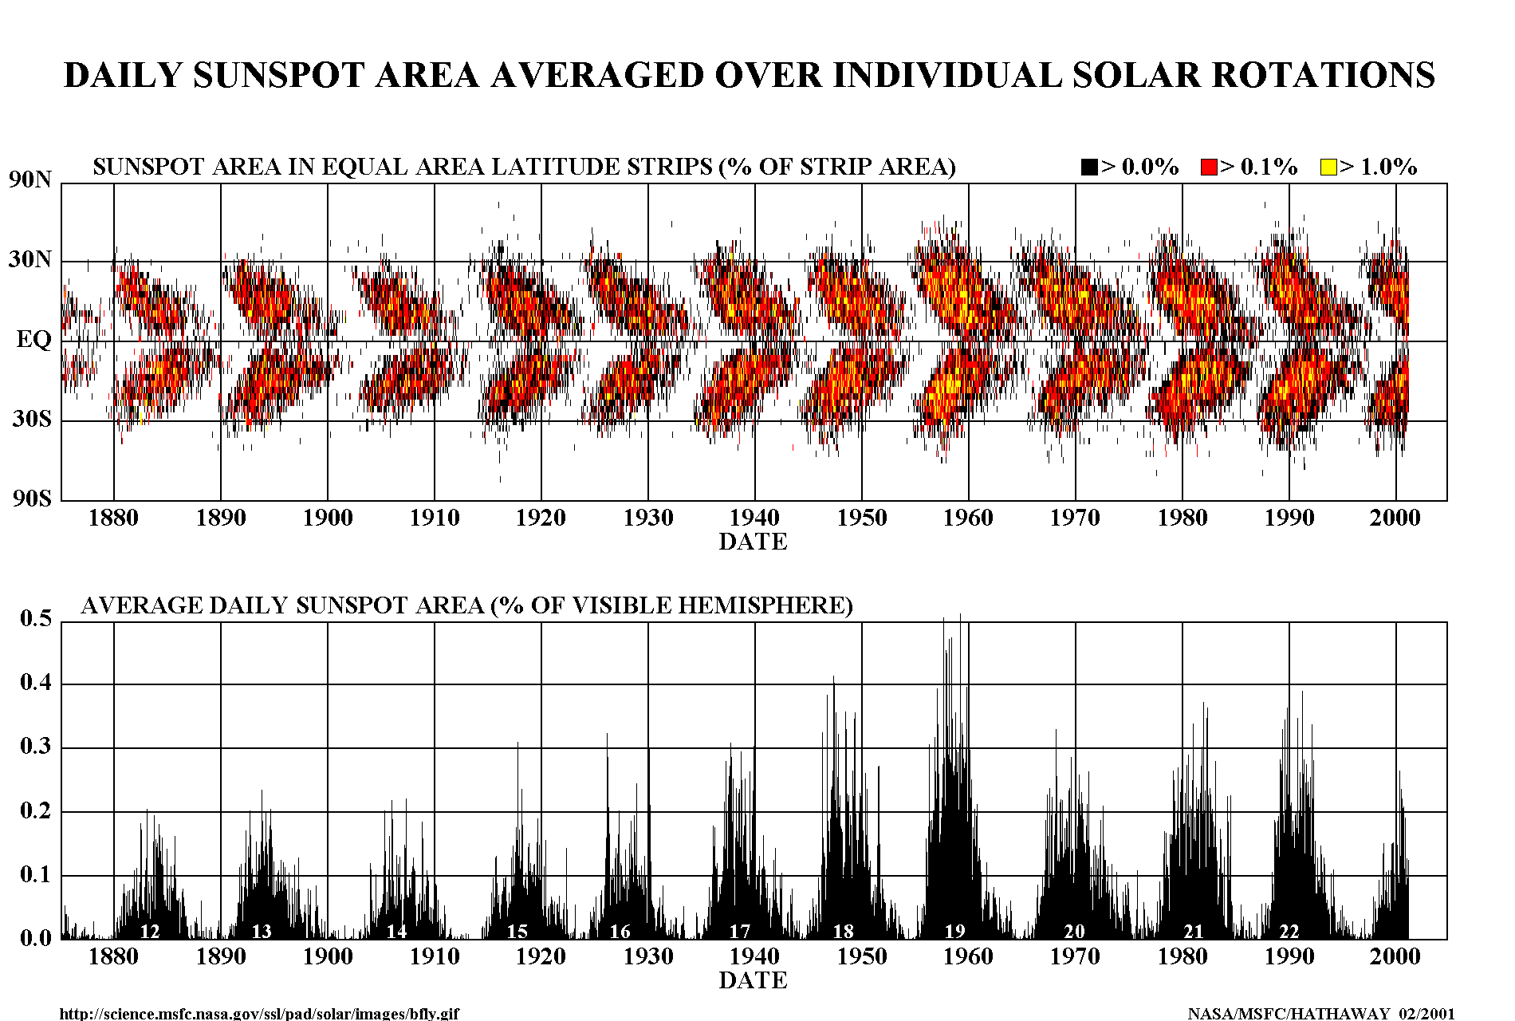
Butterfly diagram

Slide 10
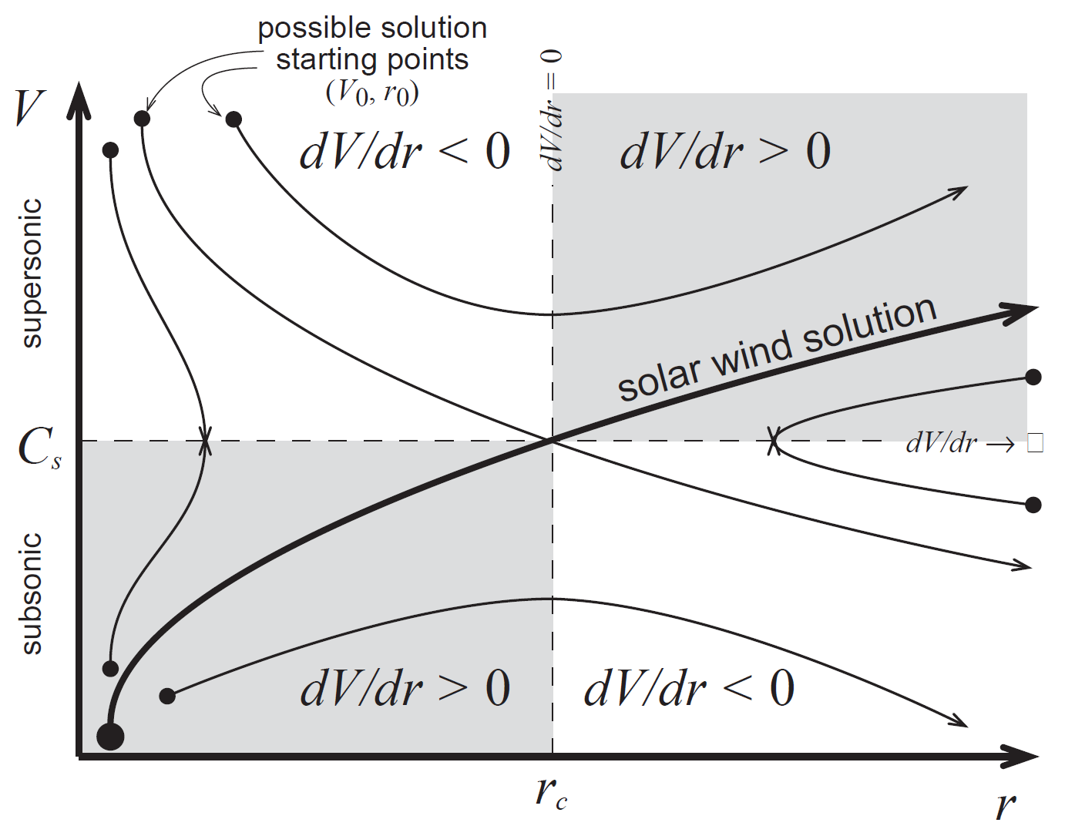
Gas dynamic model II

Slide 11
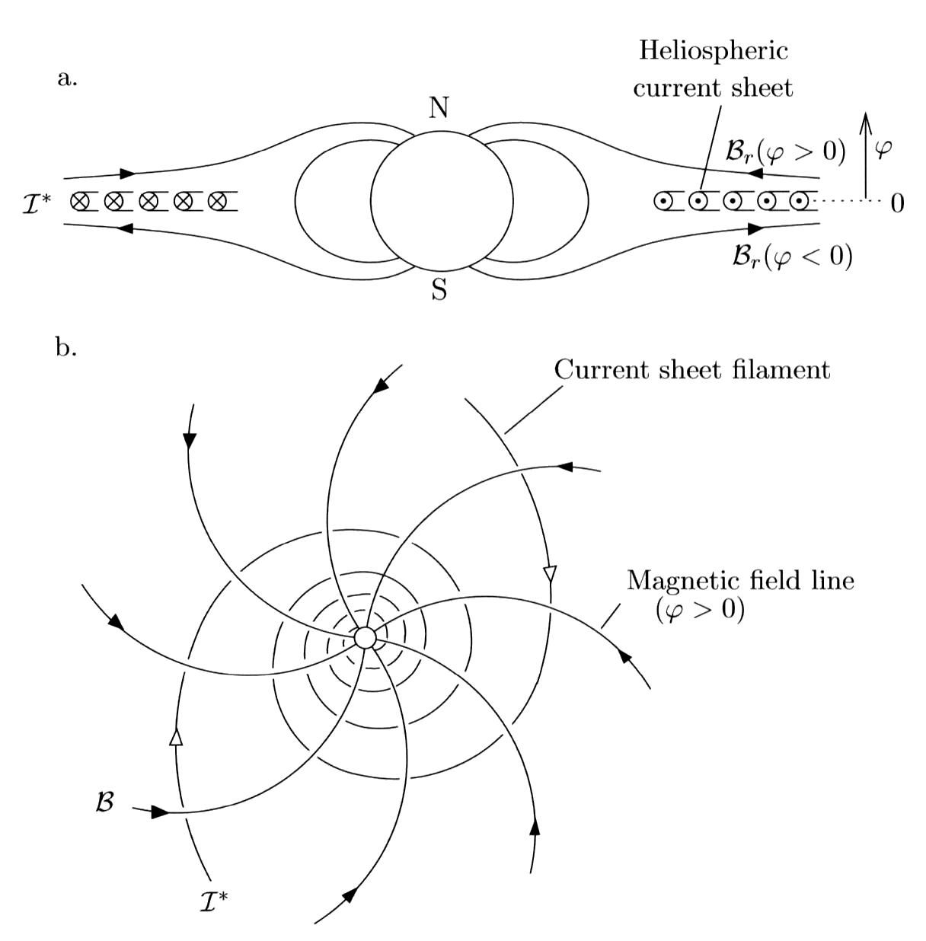
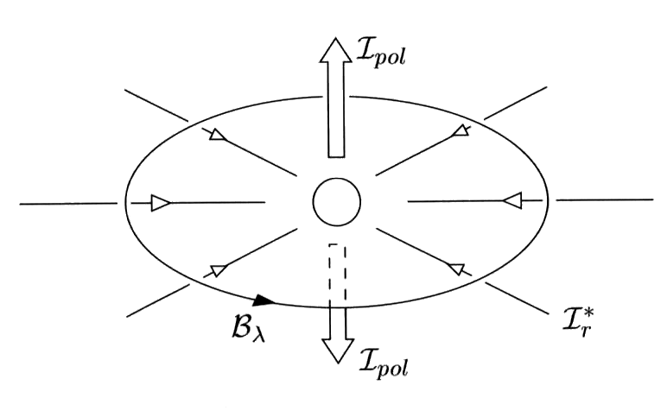
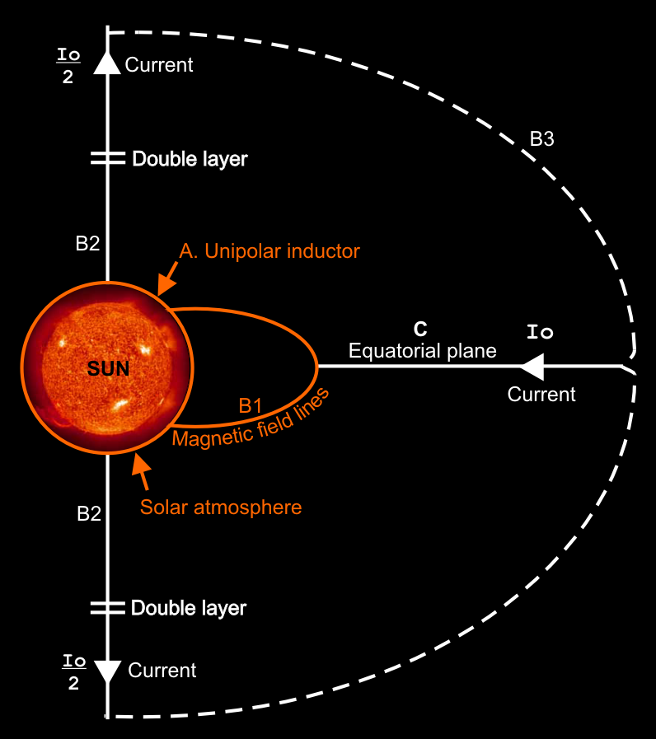
Heliospheric current circuit

Slide 12
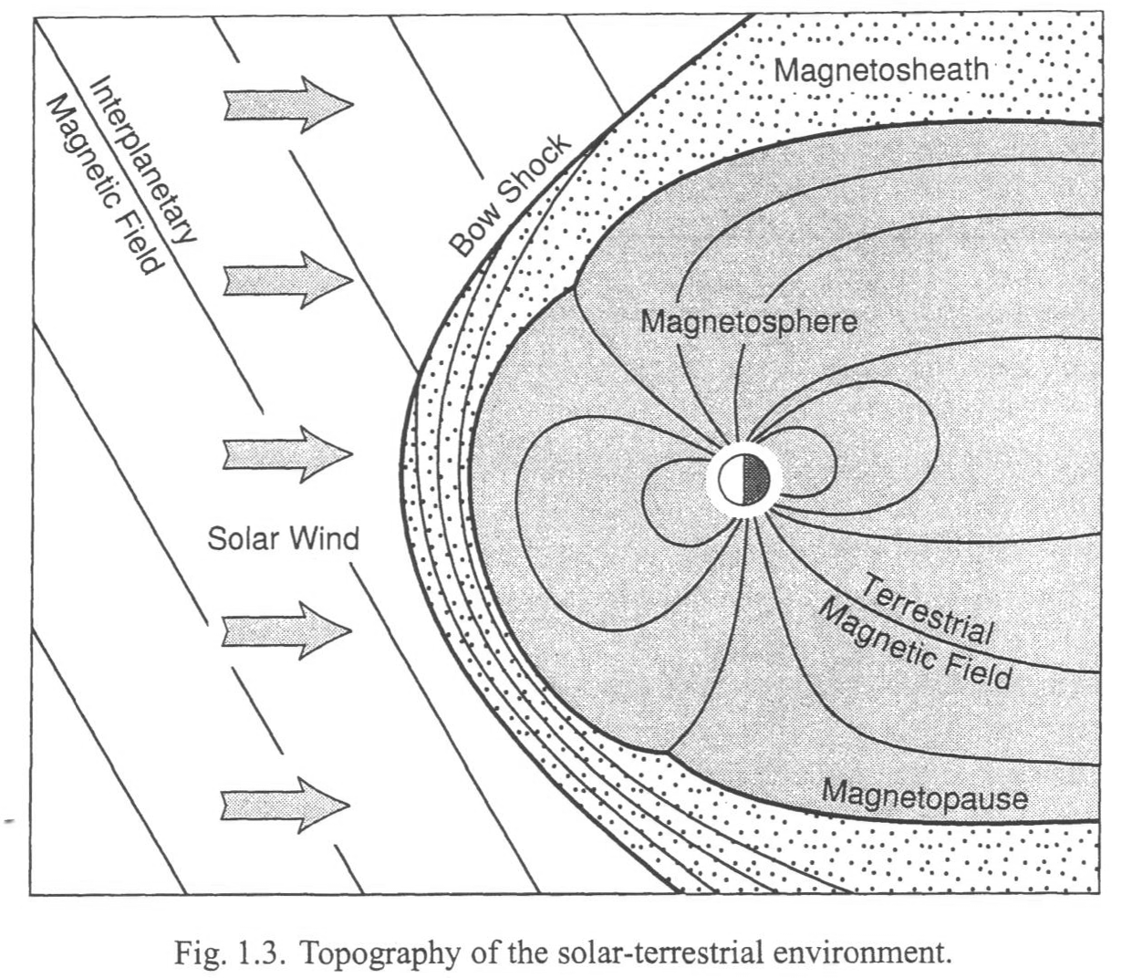
Dayside magnetosphere

Slide 13
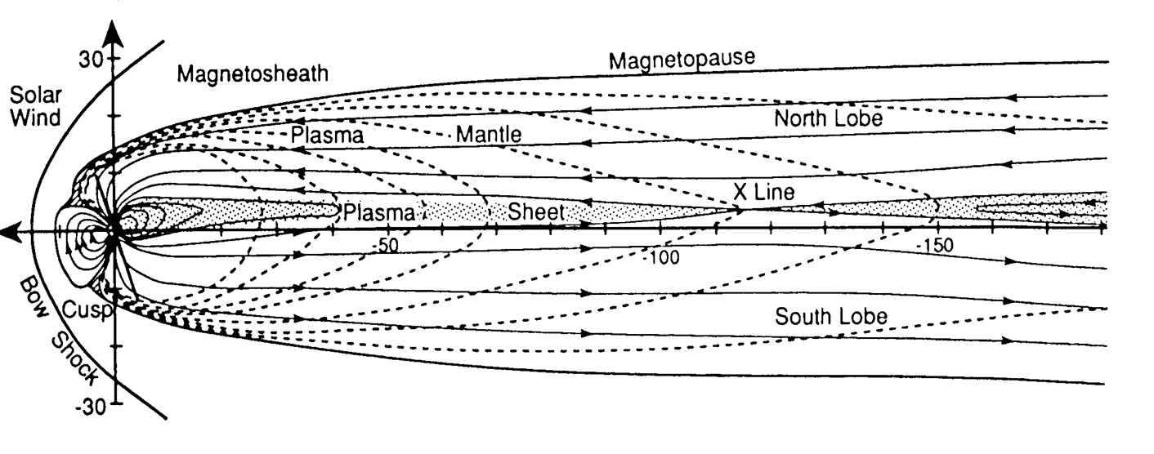
The magnetotail

Slide 14
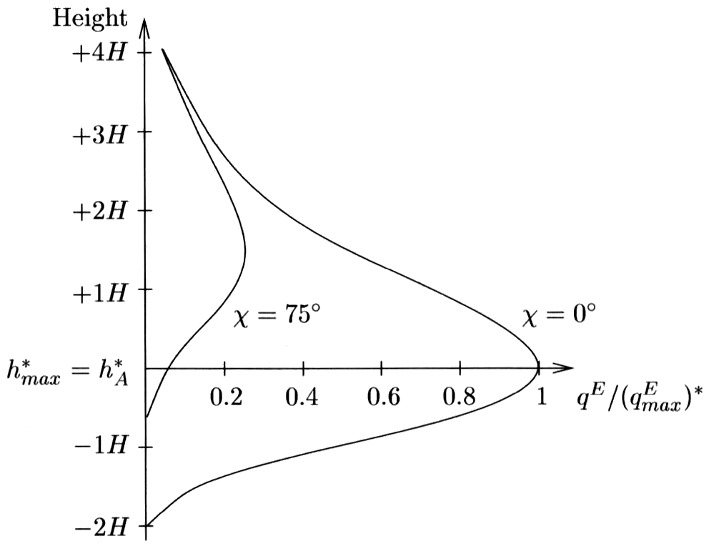
Chapman production function

Slide 15
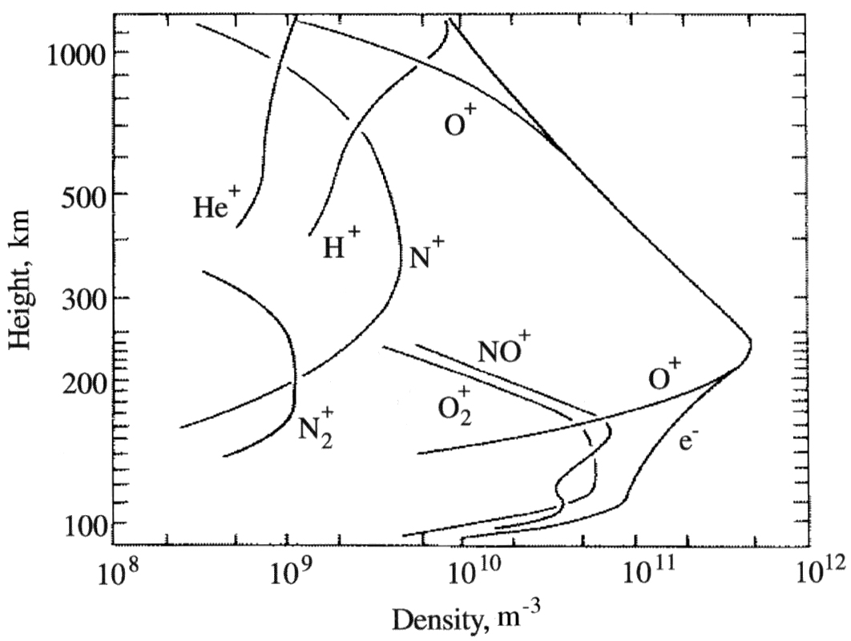
Ionospheric densities and composition

Slide 16
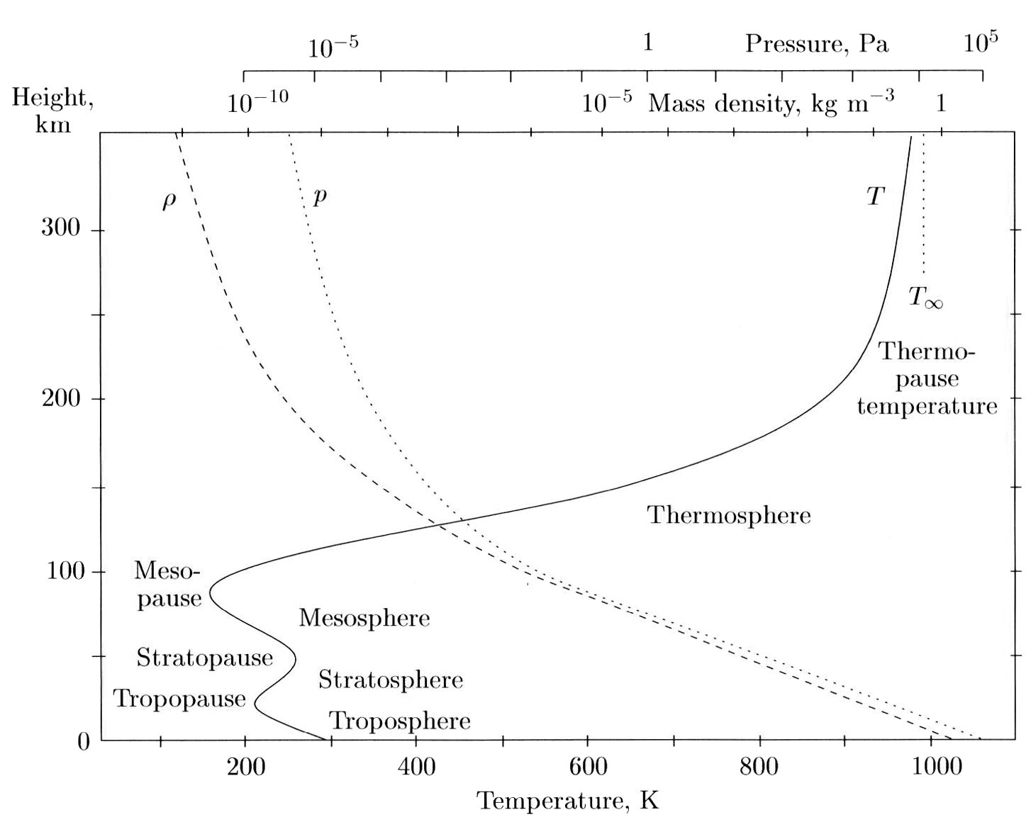
Atmospheric temperature profile

Slide 17
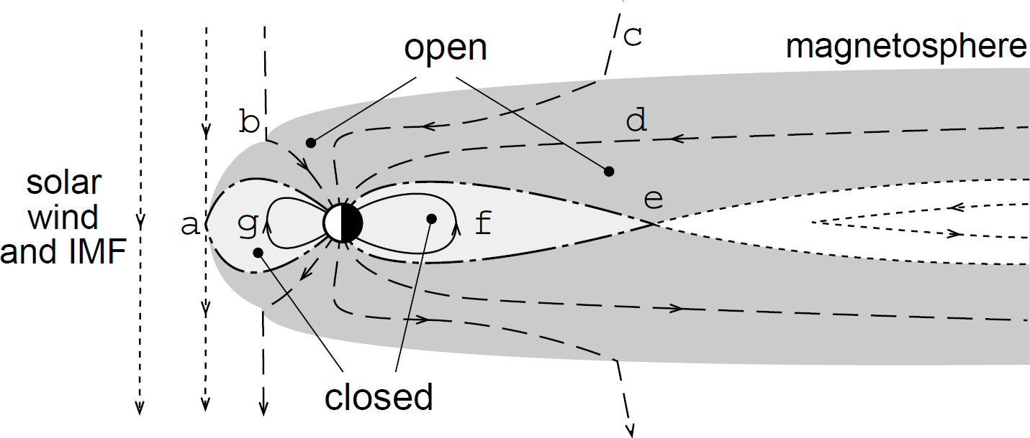
The magnetosphere

Slide 18
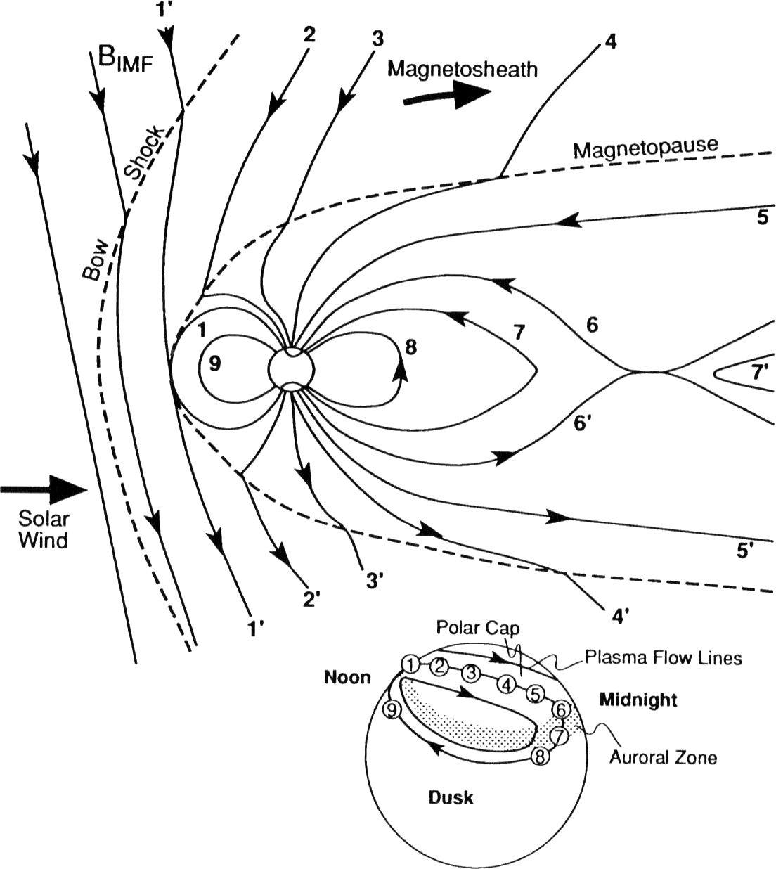
Dungey cycle

Slide 19
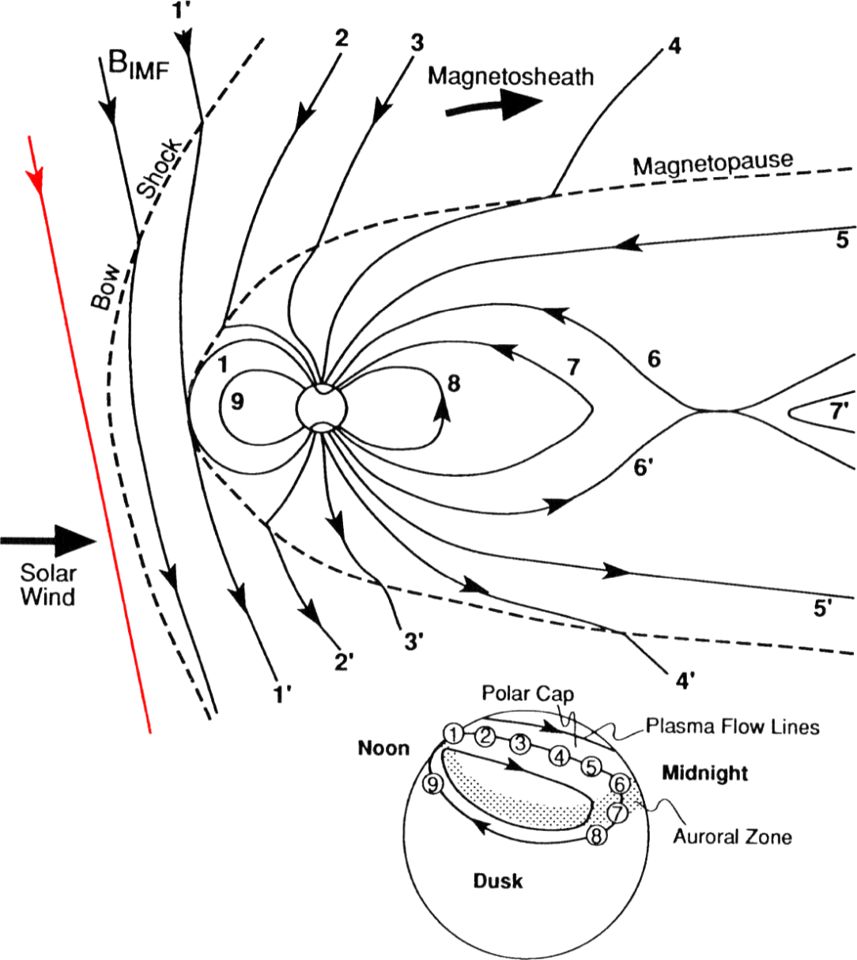
Dungey cycle

Slide 20
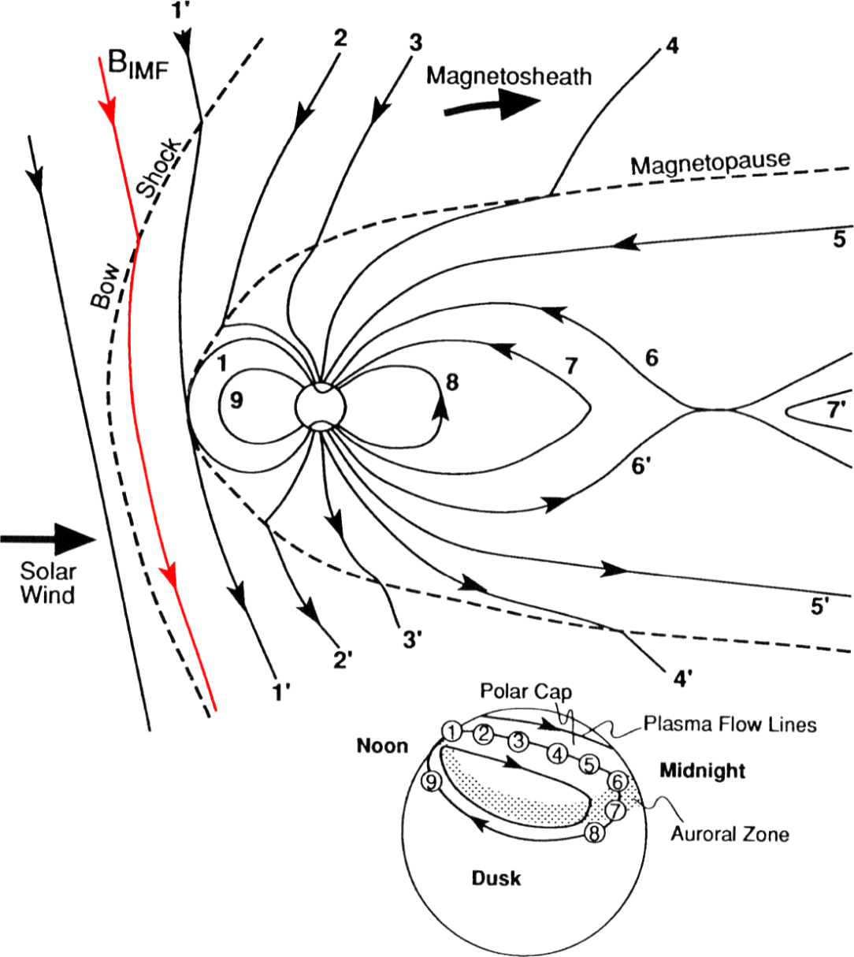
Dungey cycle

Slide 21
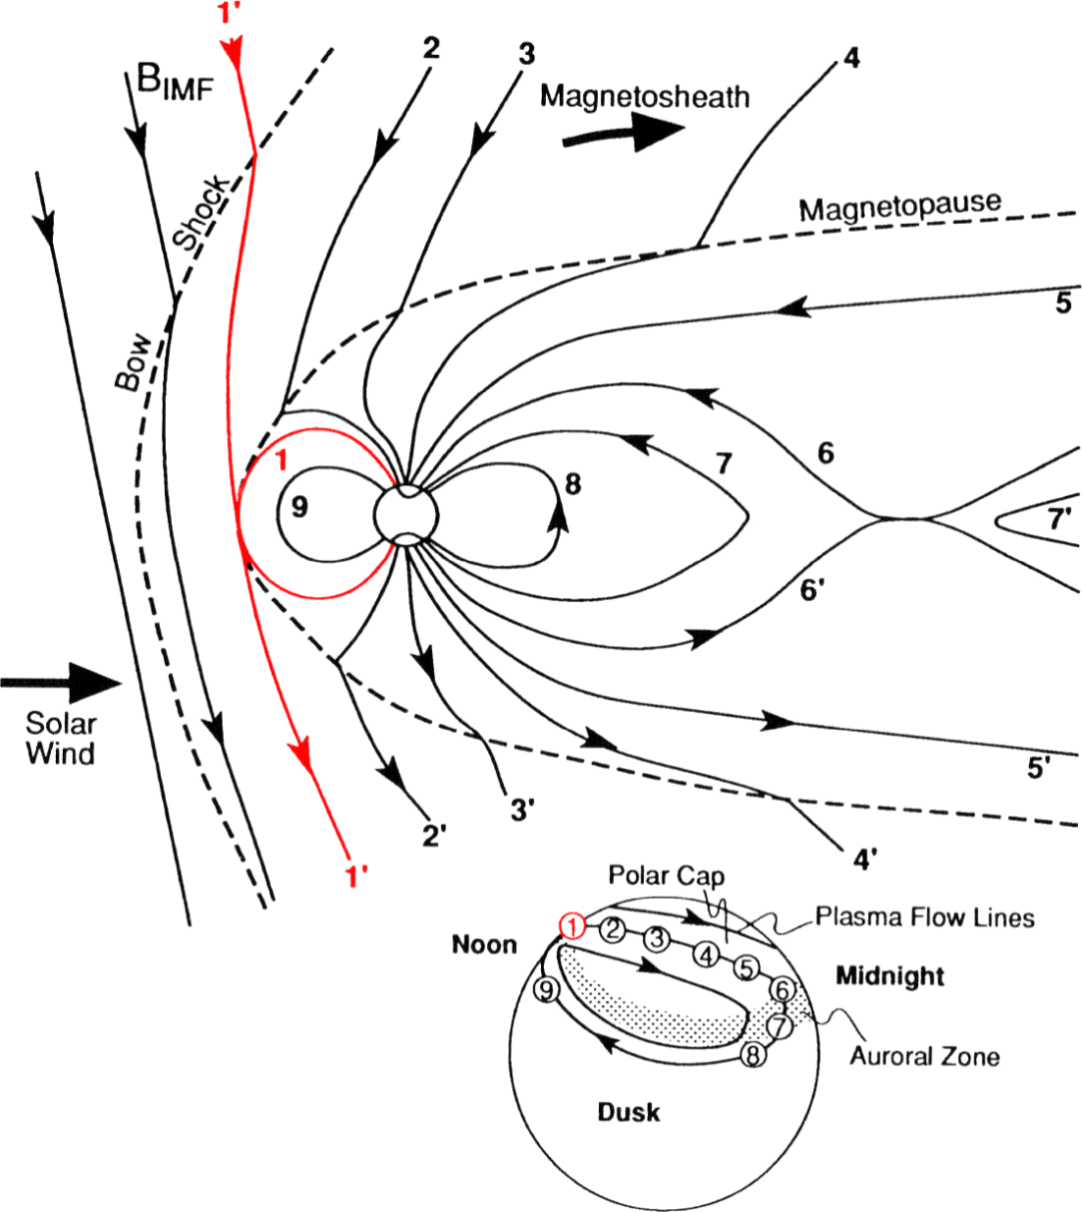
Dungey cycle

Slide 22
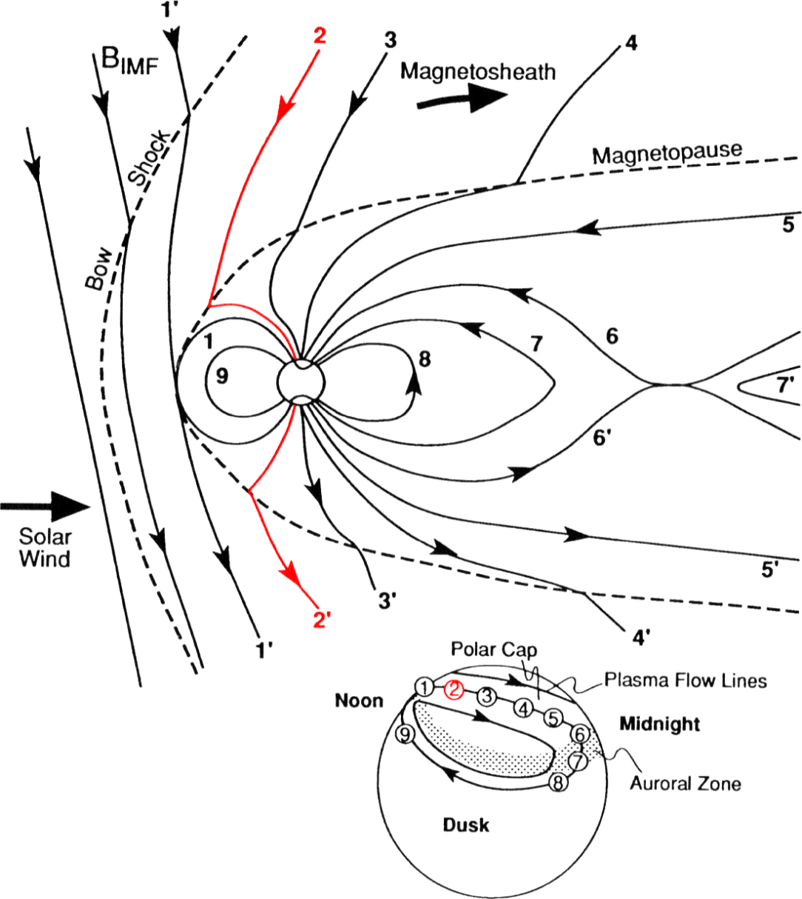
Dungey cycle

Slide 23
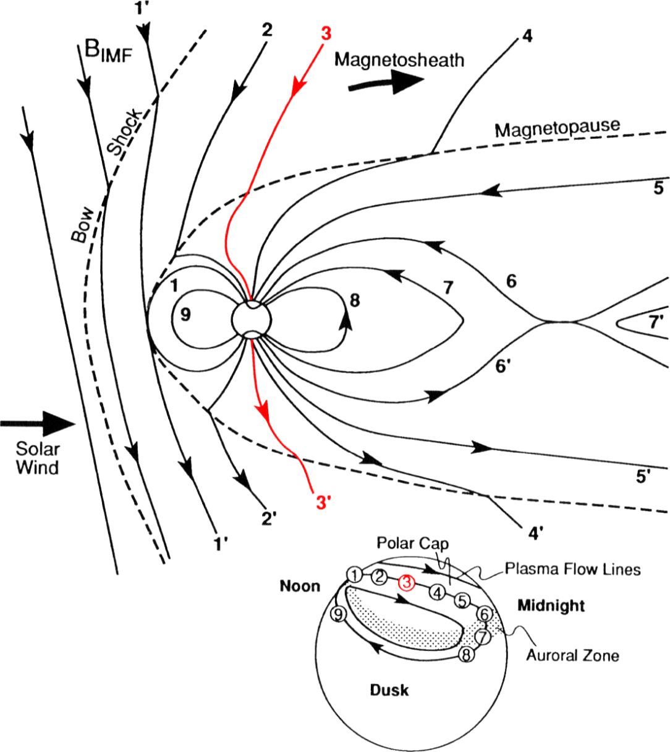
Dungey cycle

Slide 24
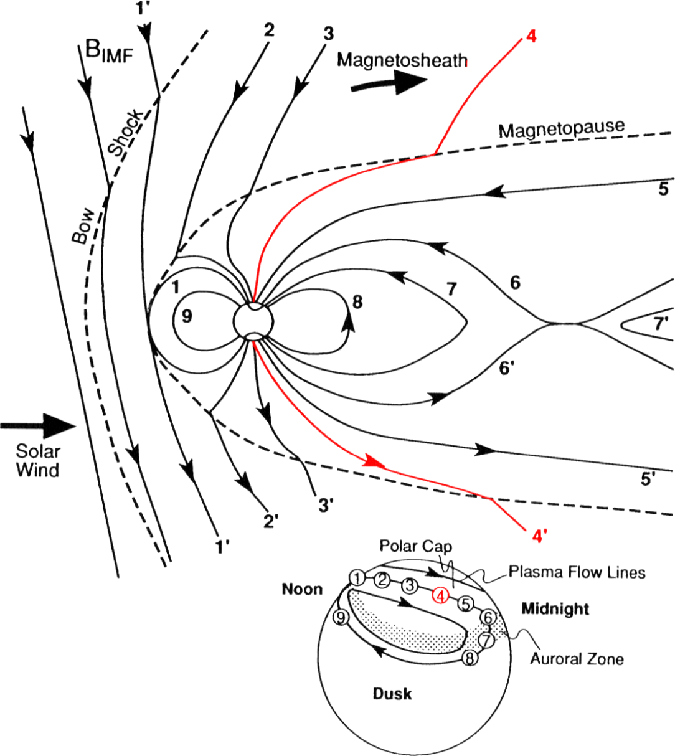
Dungey cycle

Slide 25
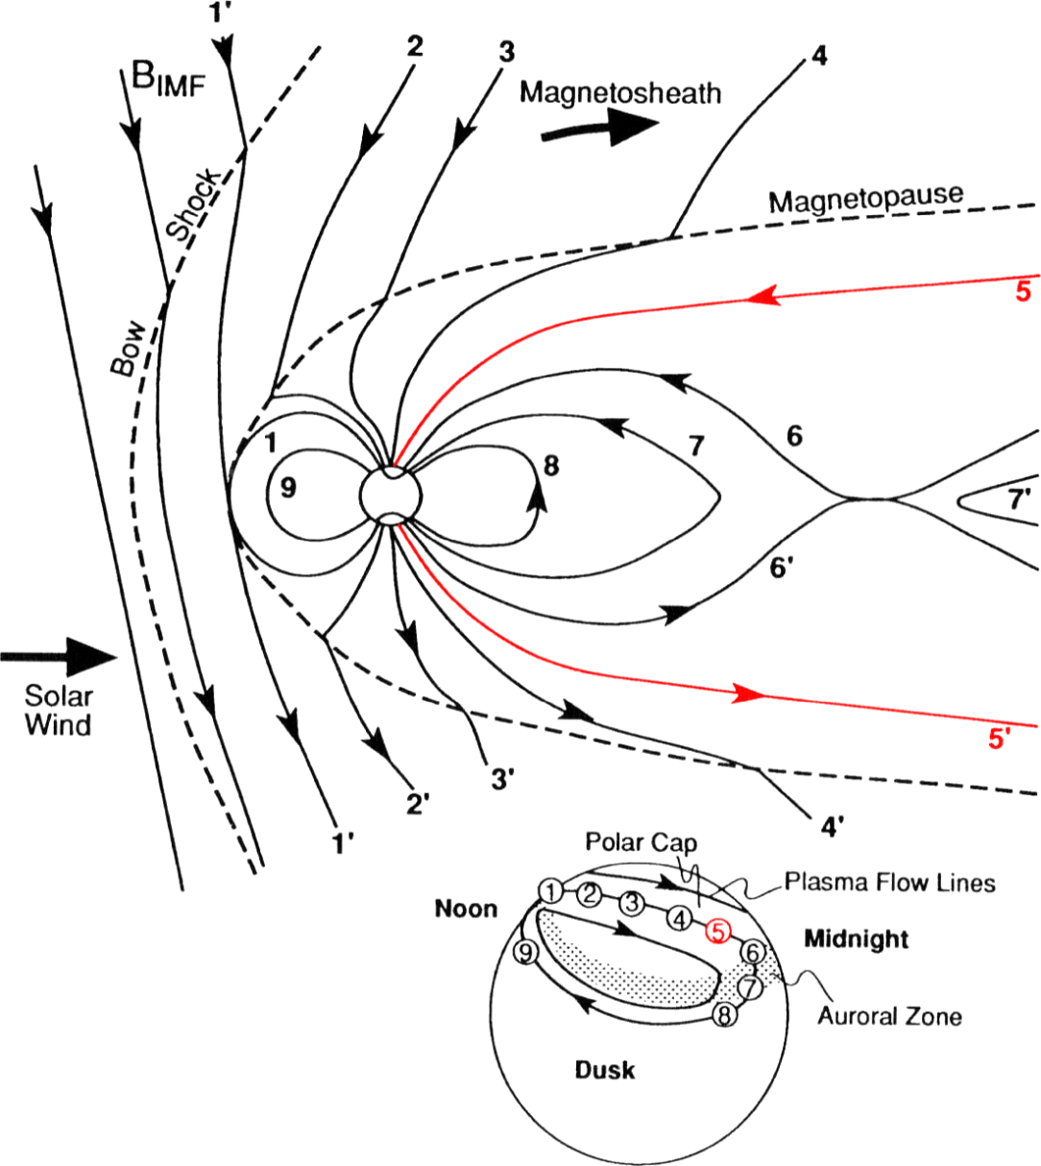
Dungey cycle

Slide 26
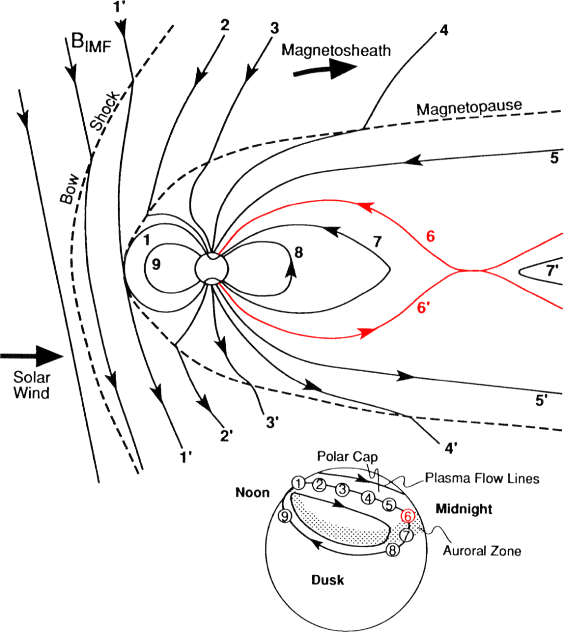
Dungey cycle

Slide 27
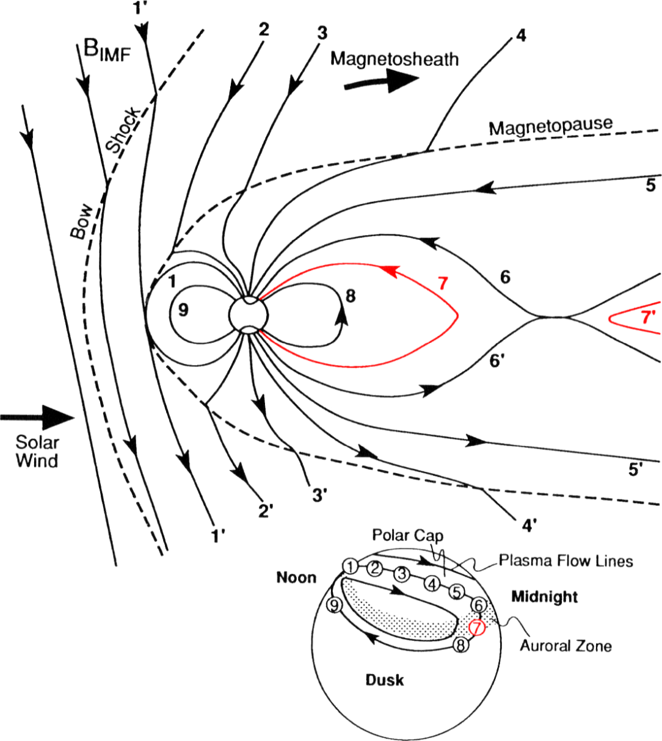
Dungey cycle

Slide 28
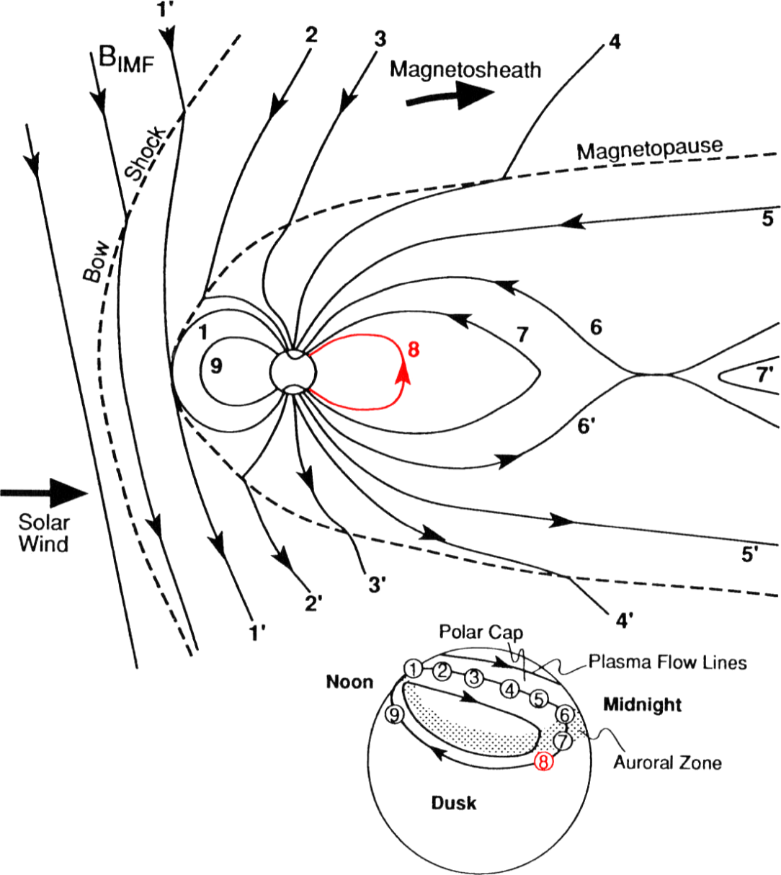
Dungey cycle

Slide 29
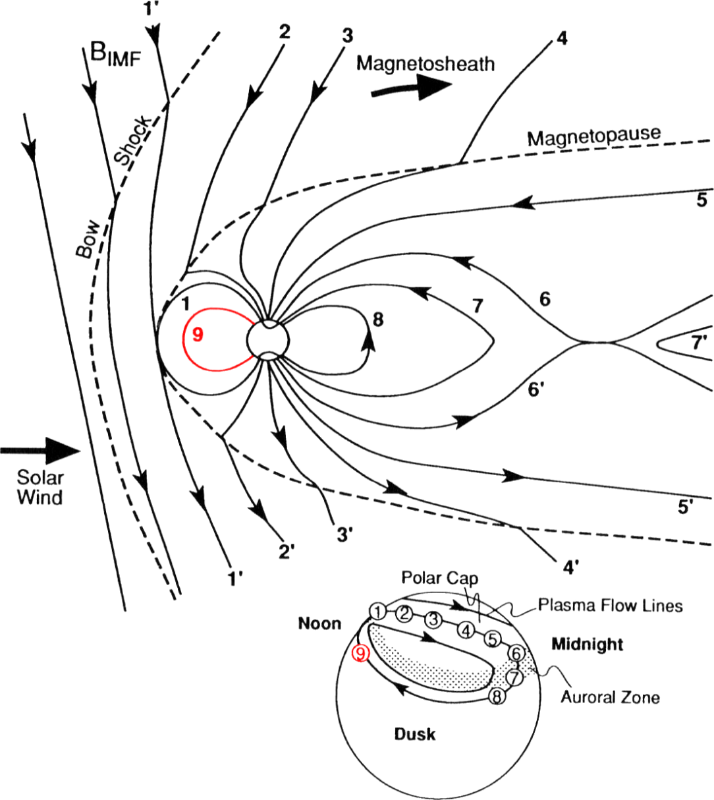
Dungey cycle

Slide 30
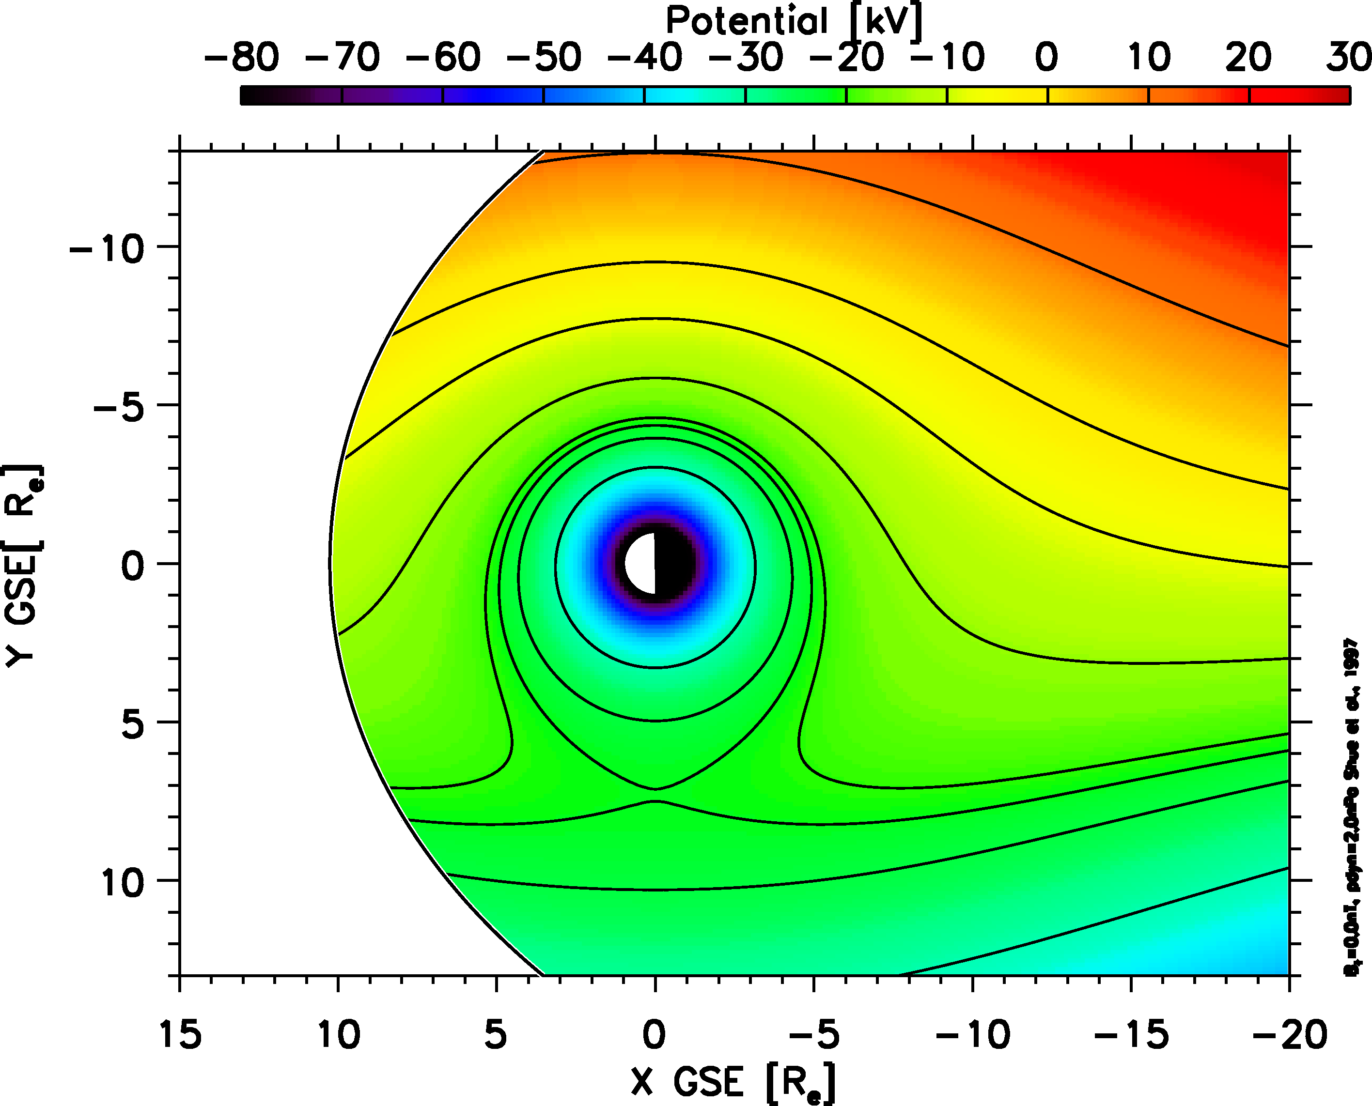
Convection + corotation

Slide 31
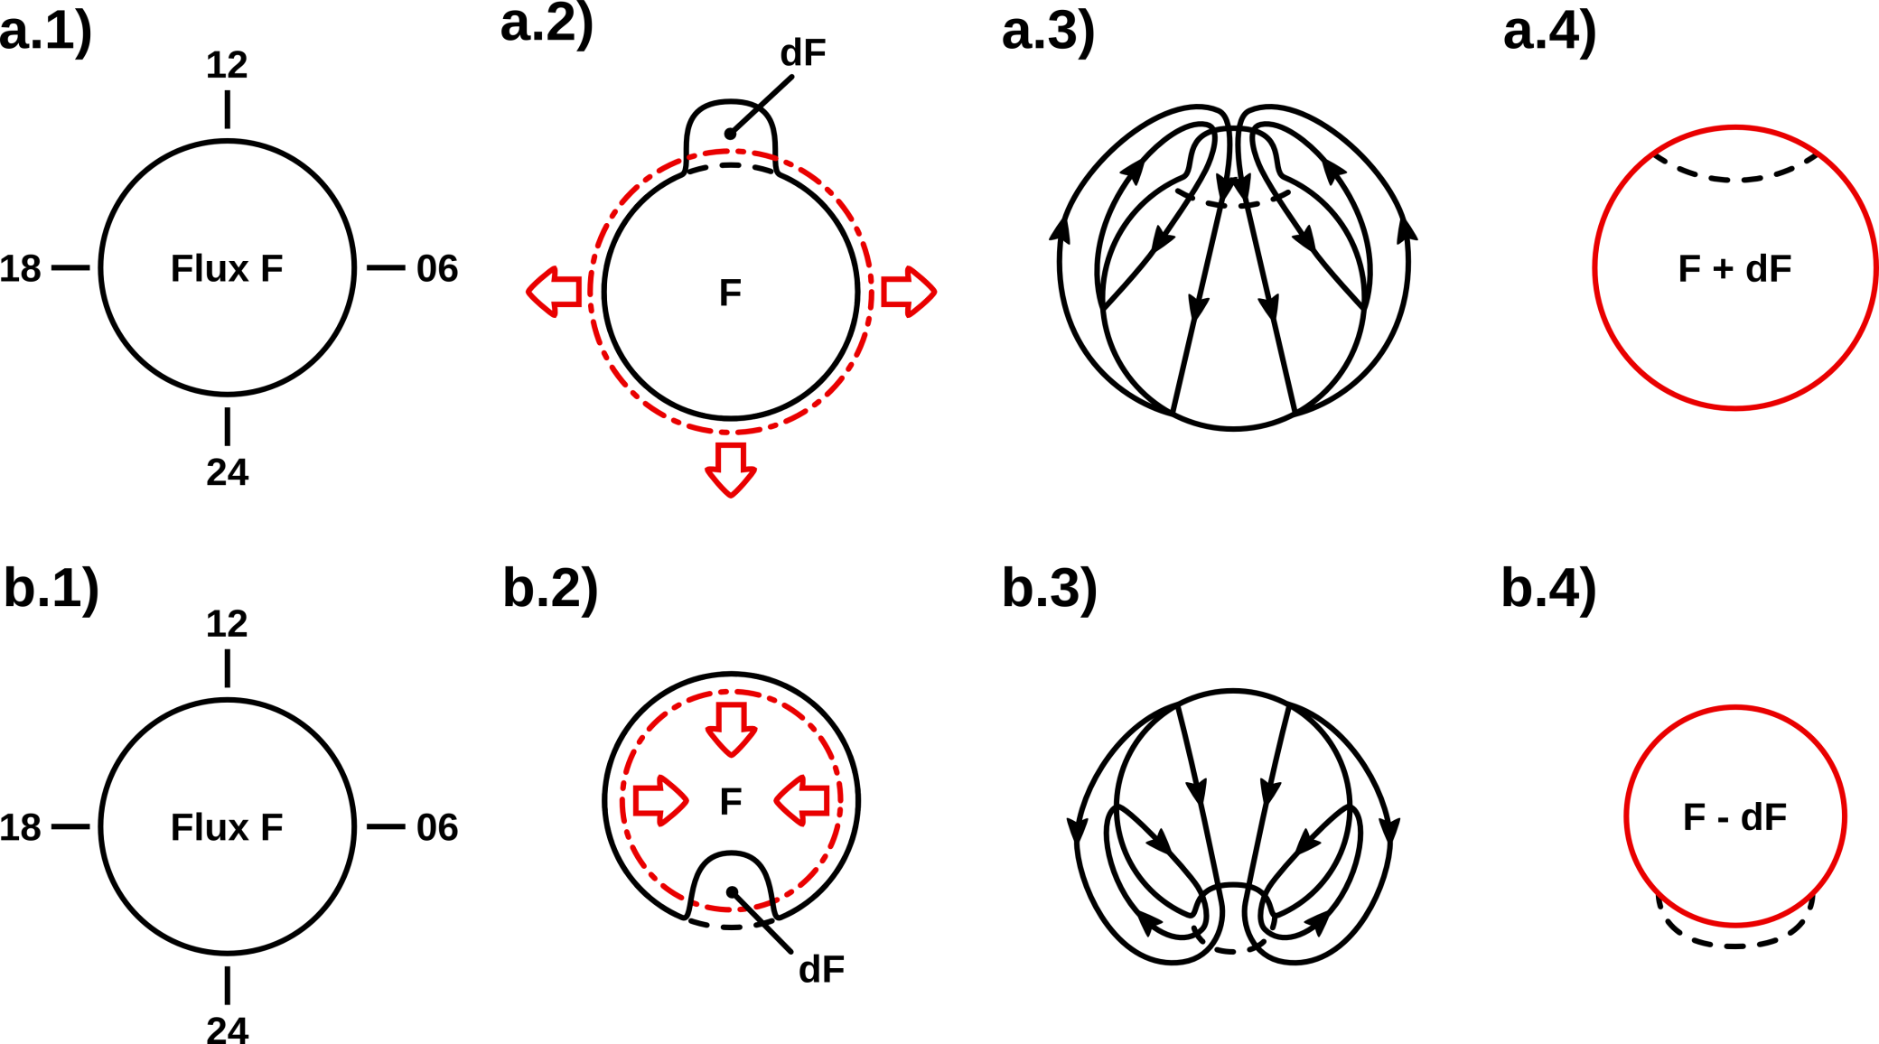
Ionospheric convection

Slide 32
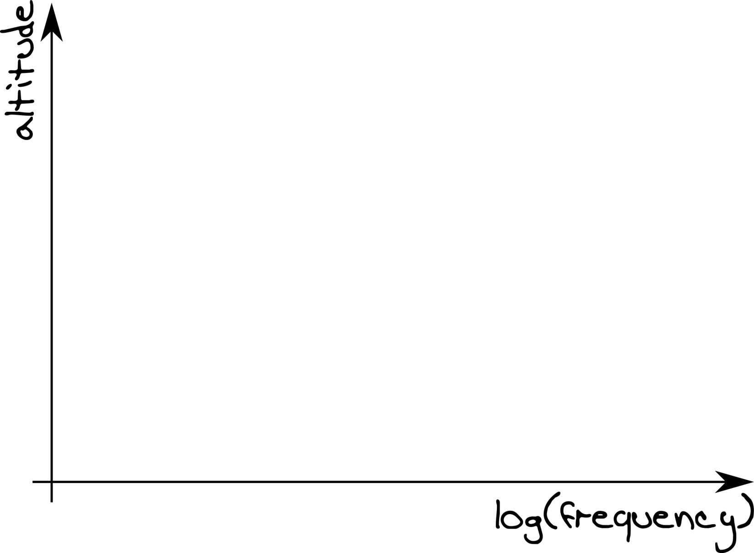
Dynamo layer

Slide 33
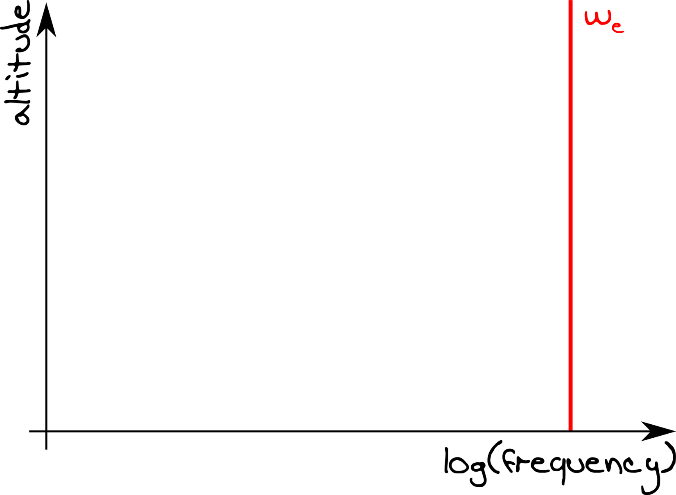
Dynamo layer

Slide 34
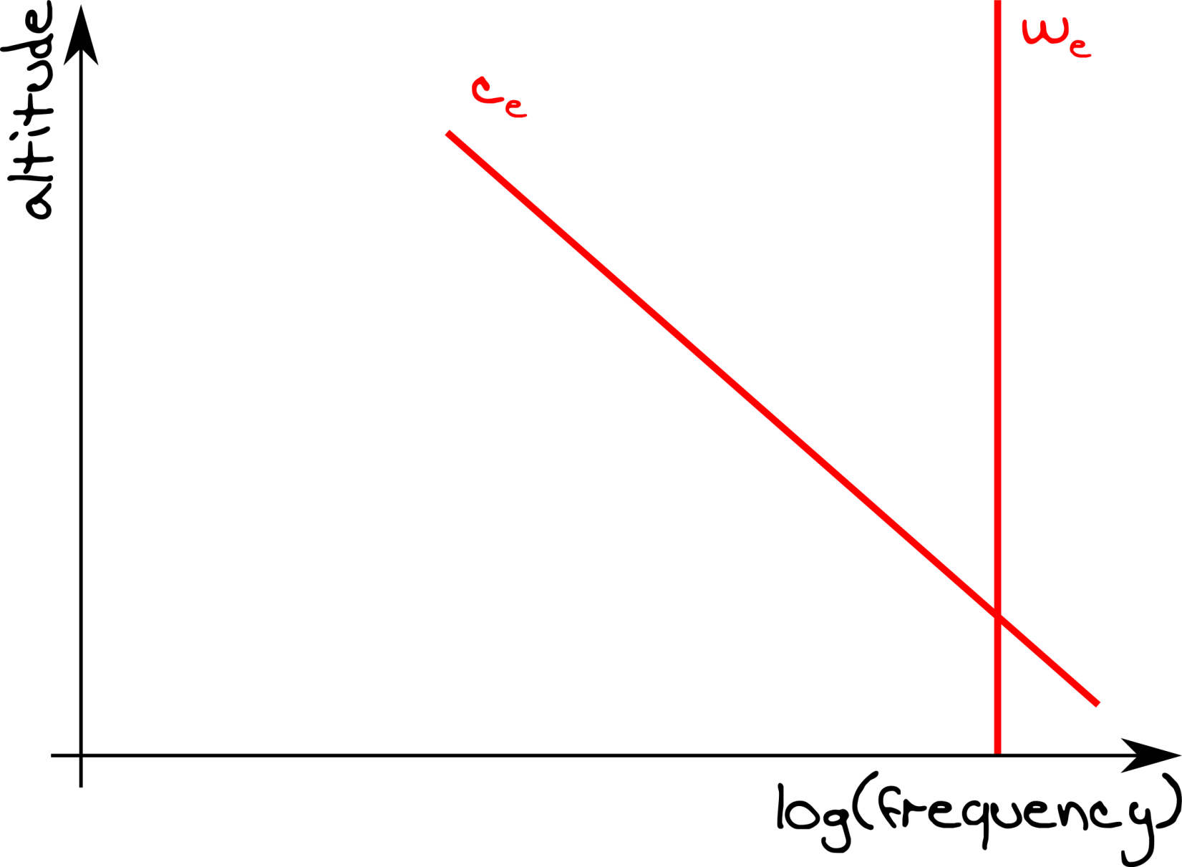
Dynamo layer

Slide 35
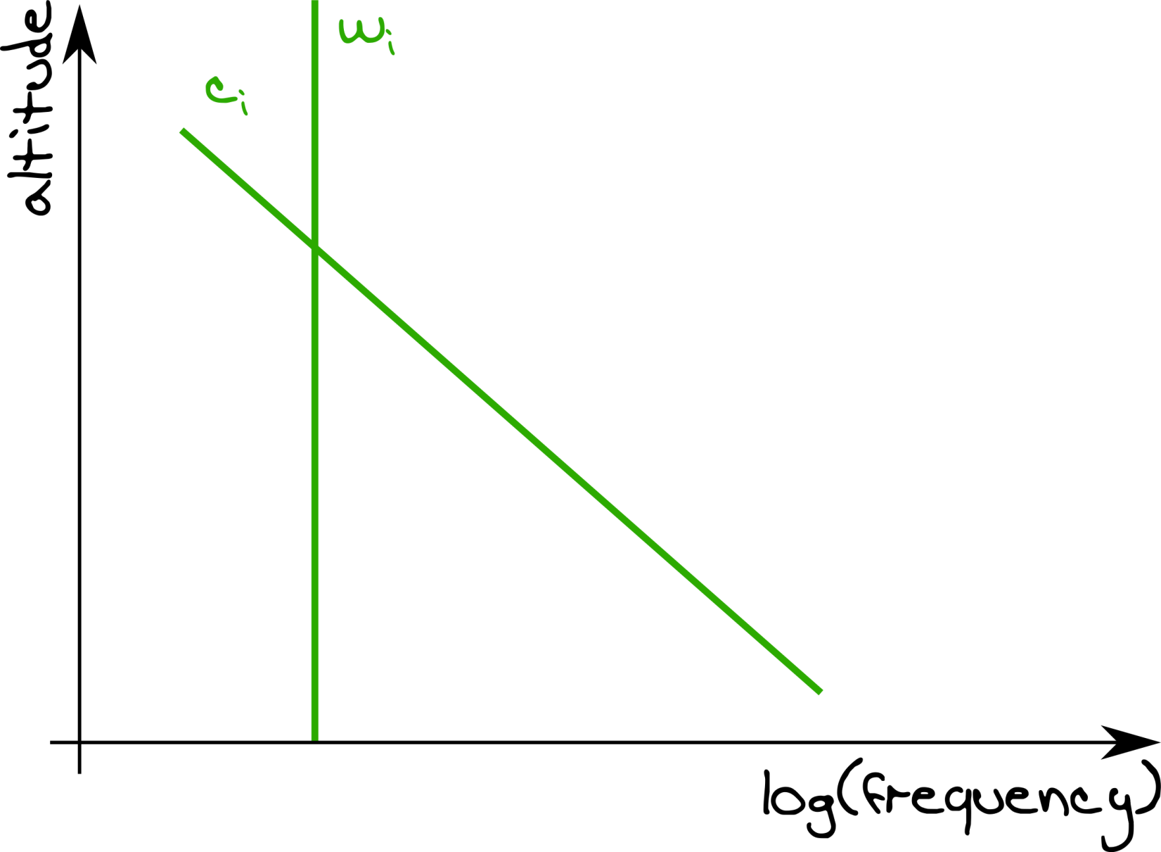
Dynamo layer

Slide 36
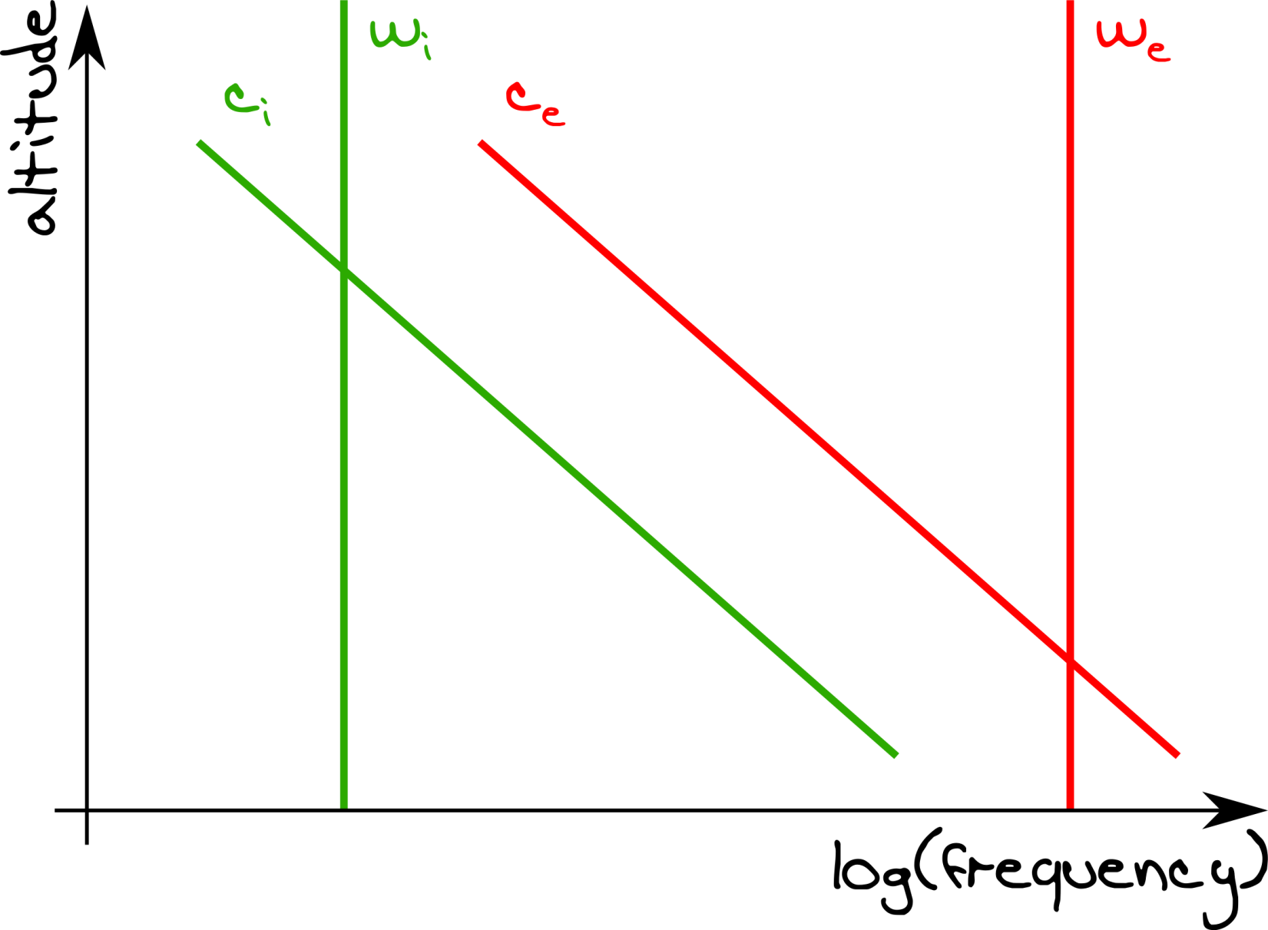
Dynamo layer

Slide 37
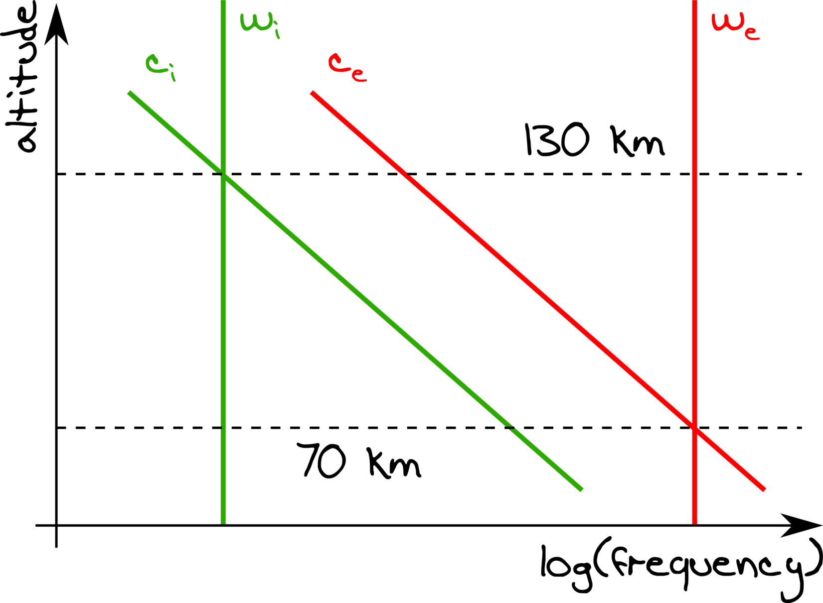
Dynamo layer

Slide 38
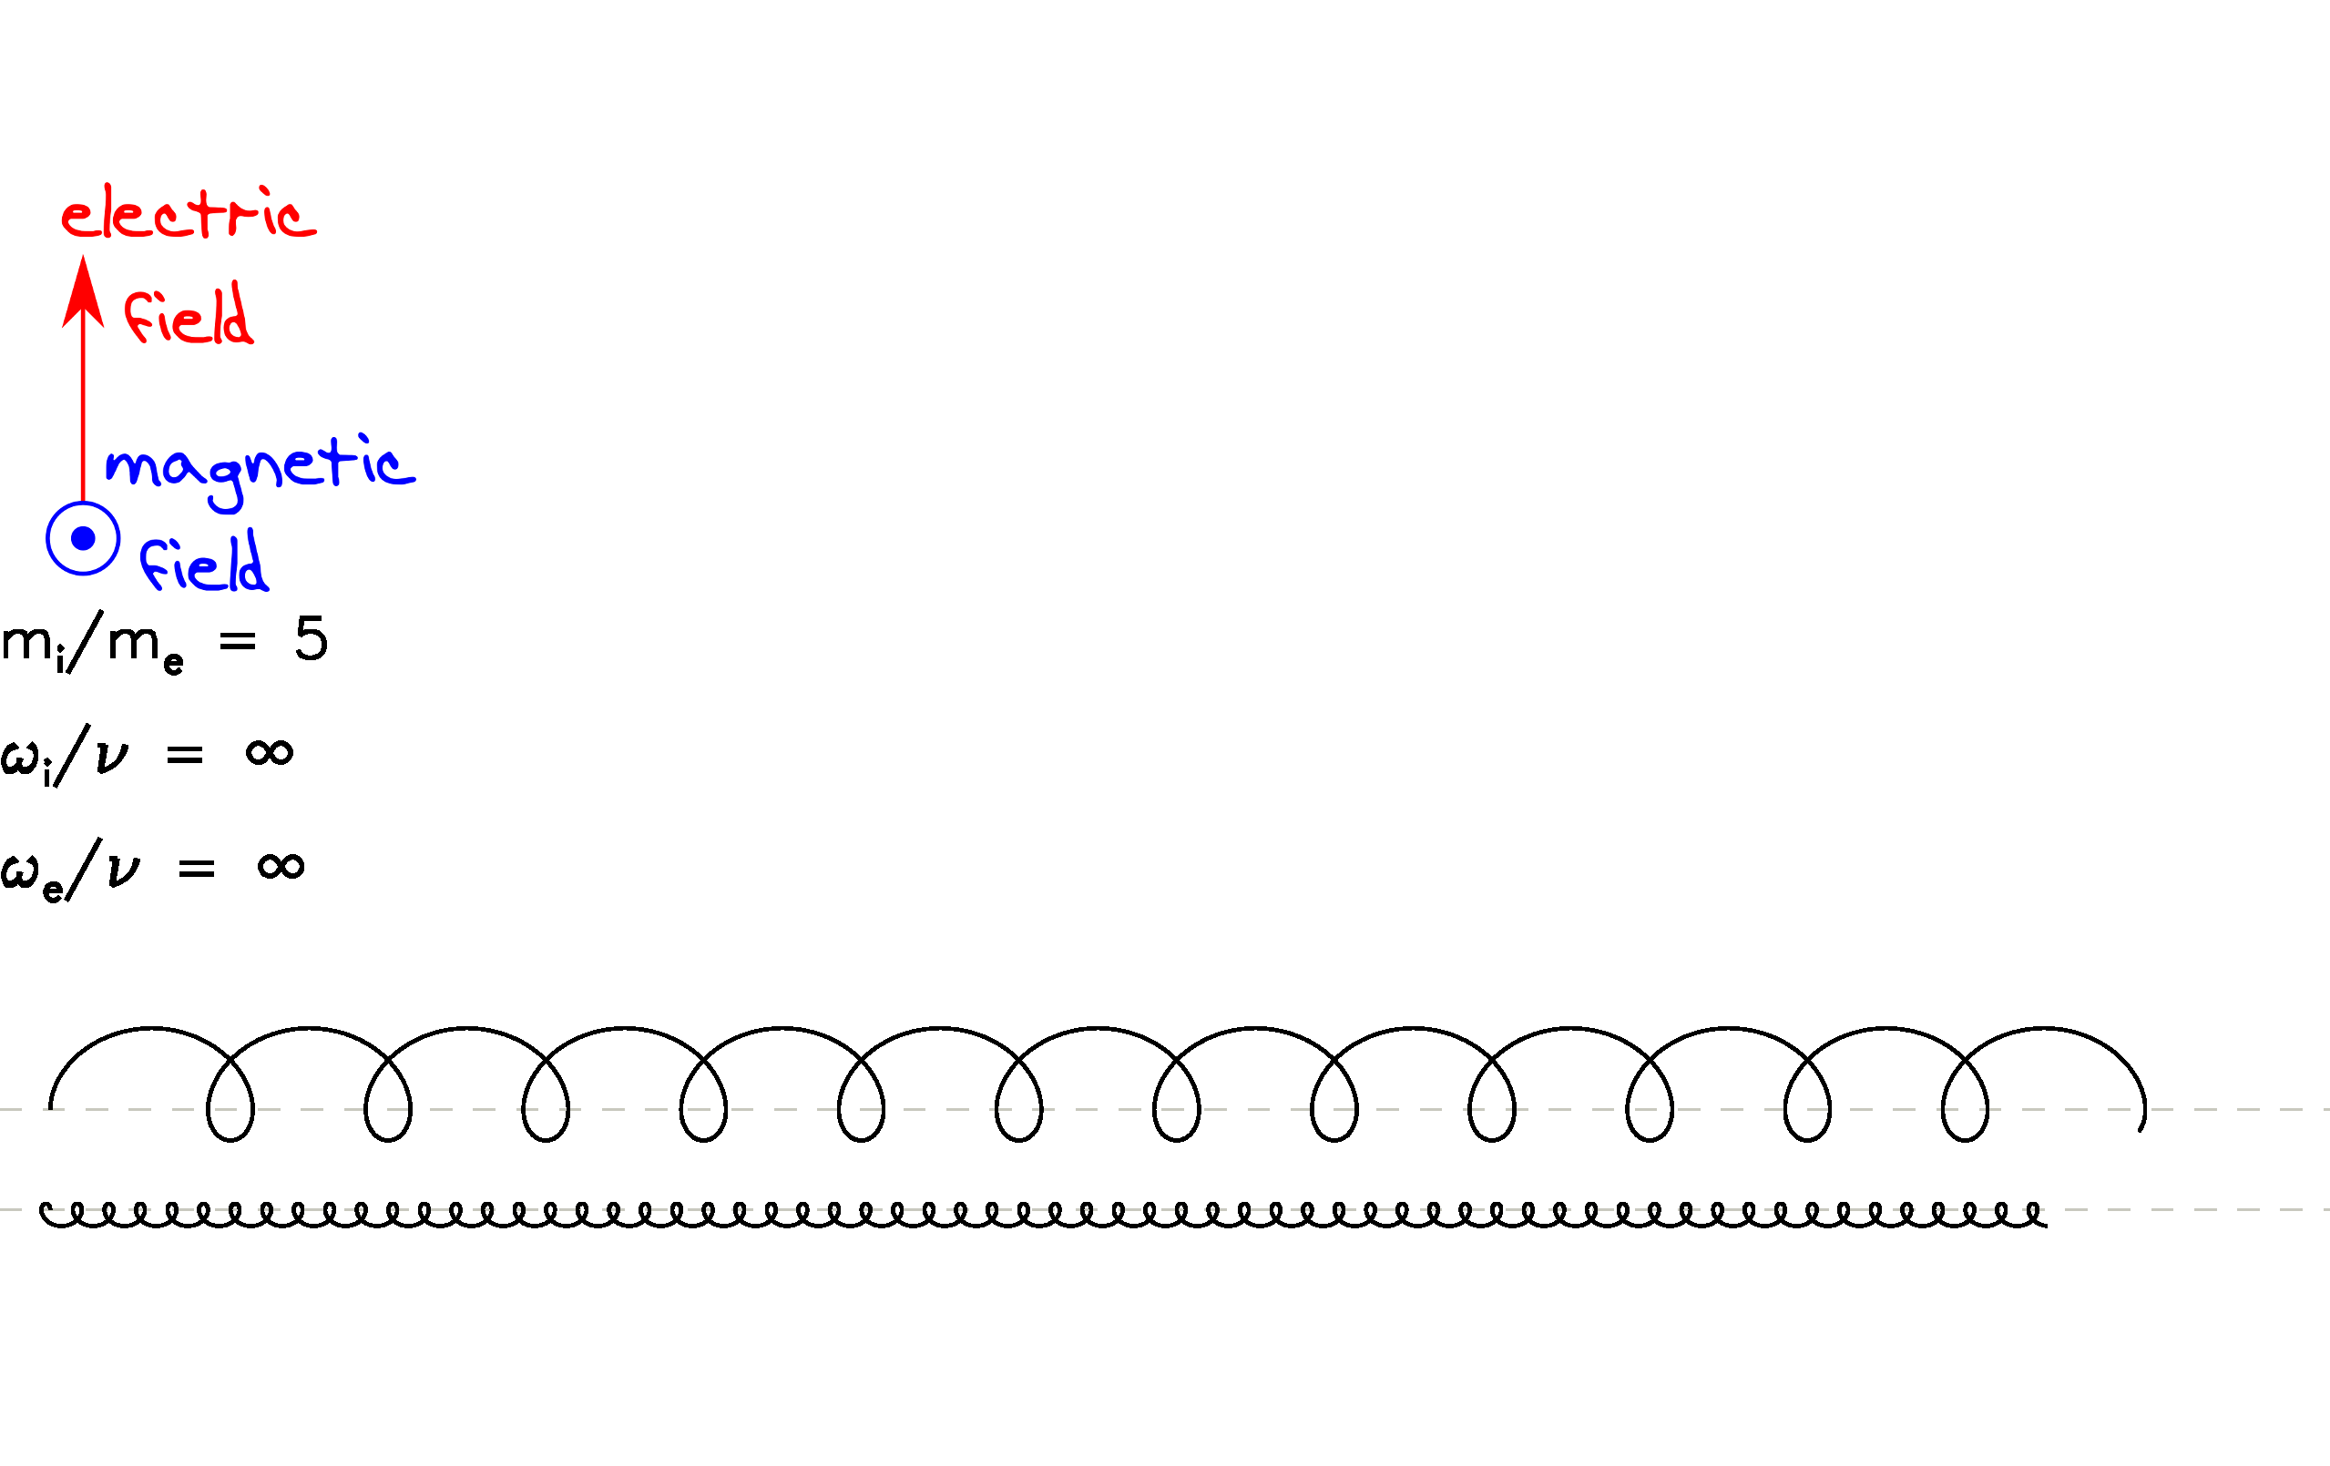
Collision vs gyro frequency

Slide 39
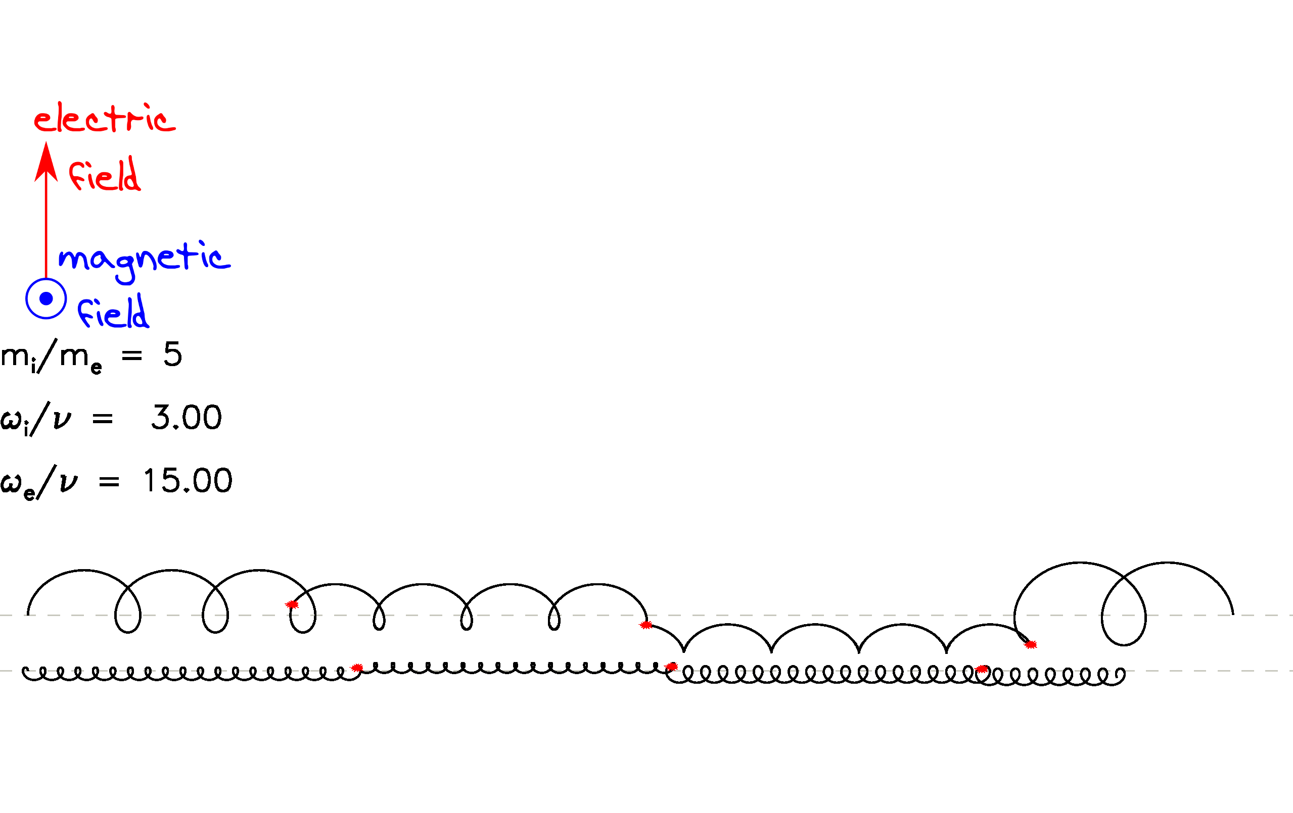
Collision vs gyro frequency

Slide 40
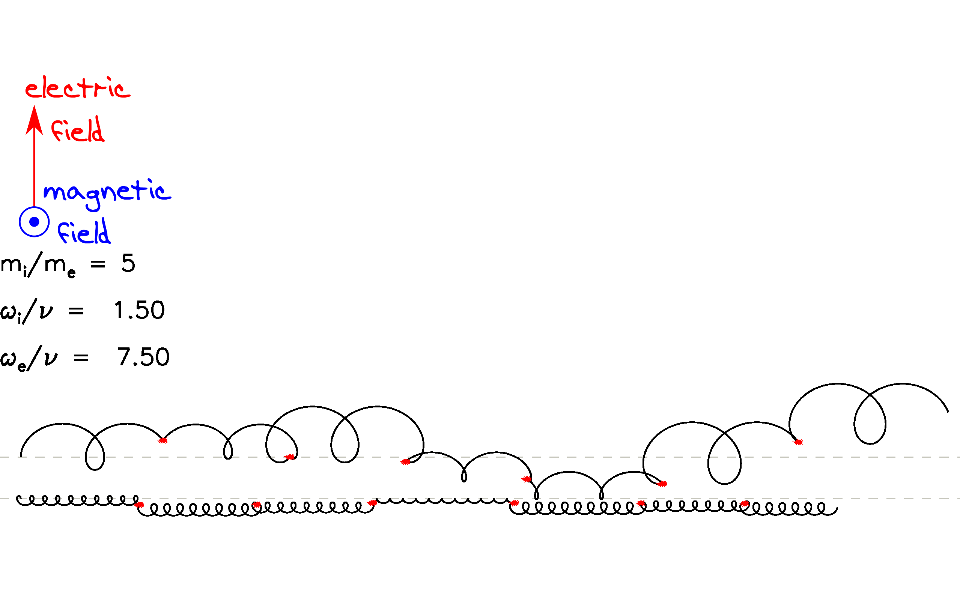
Collision vs gyro frequency

Slide 41
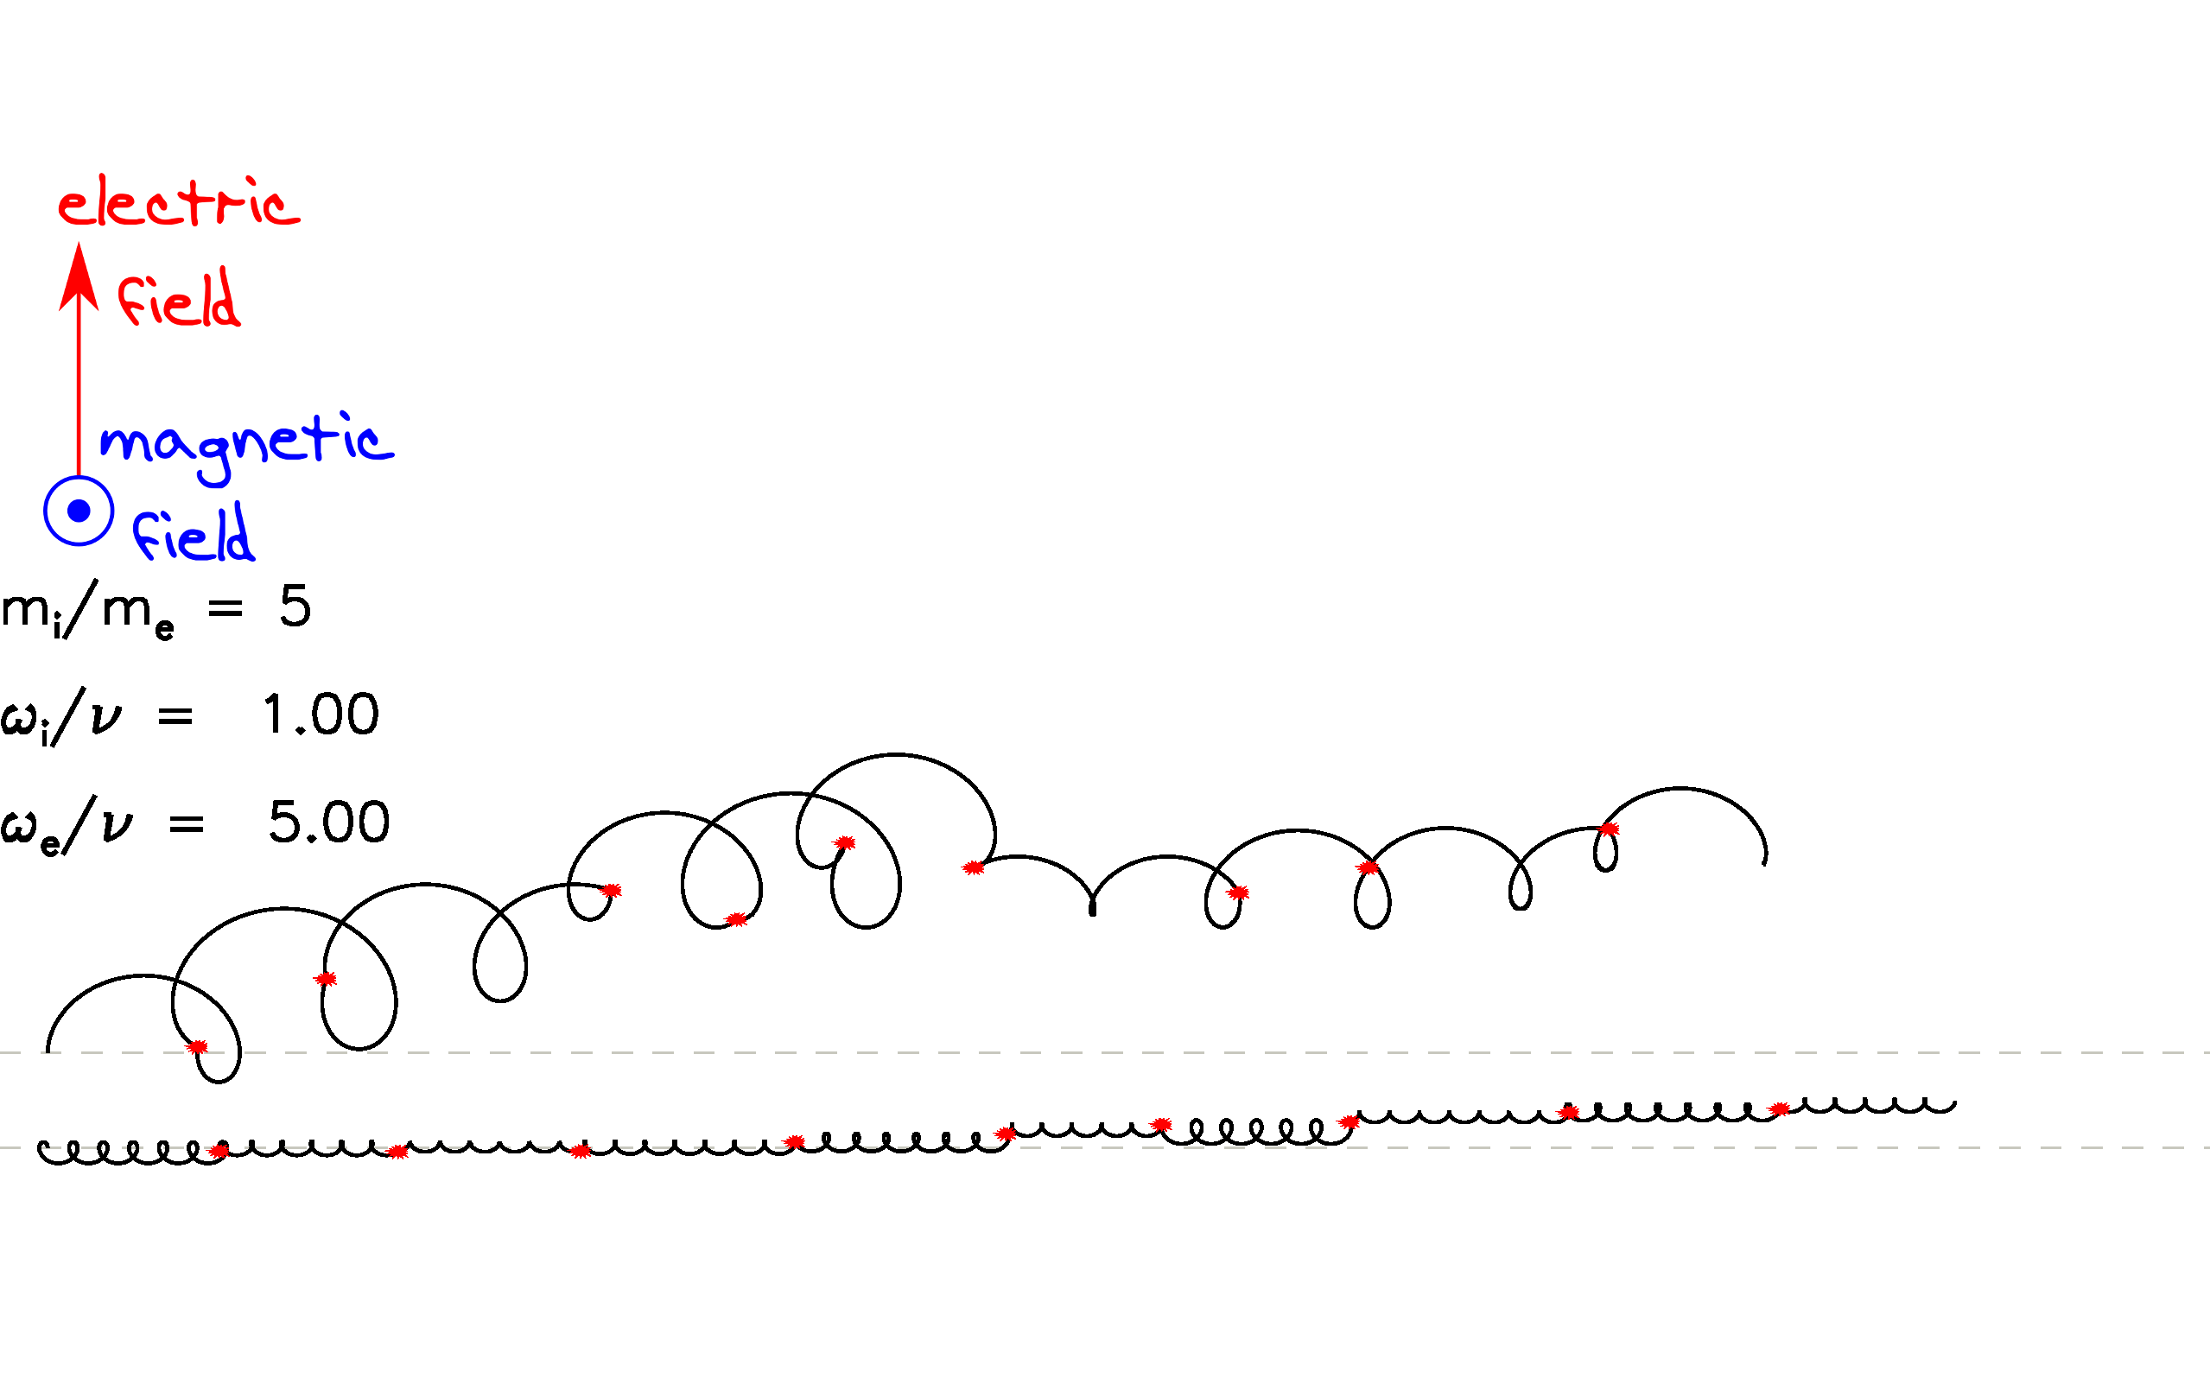
Collision vs gyro frequency

Slide 42
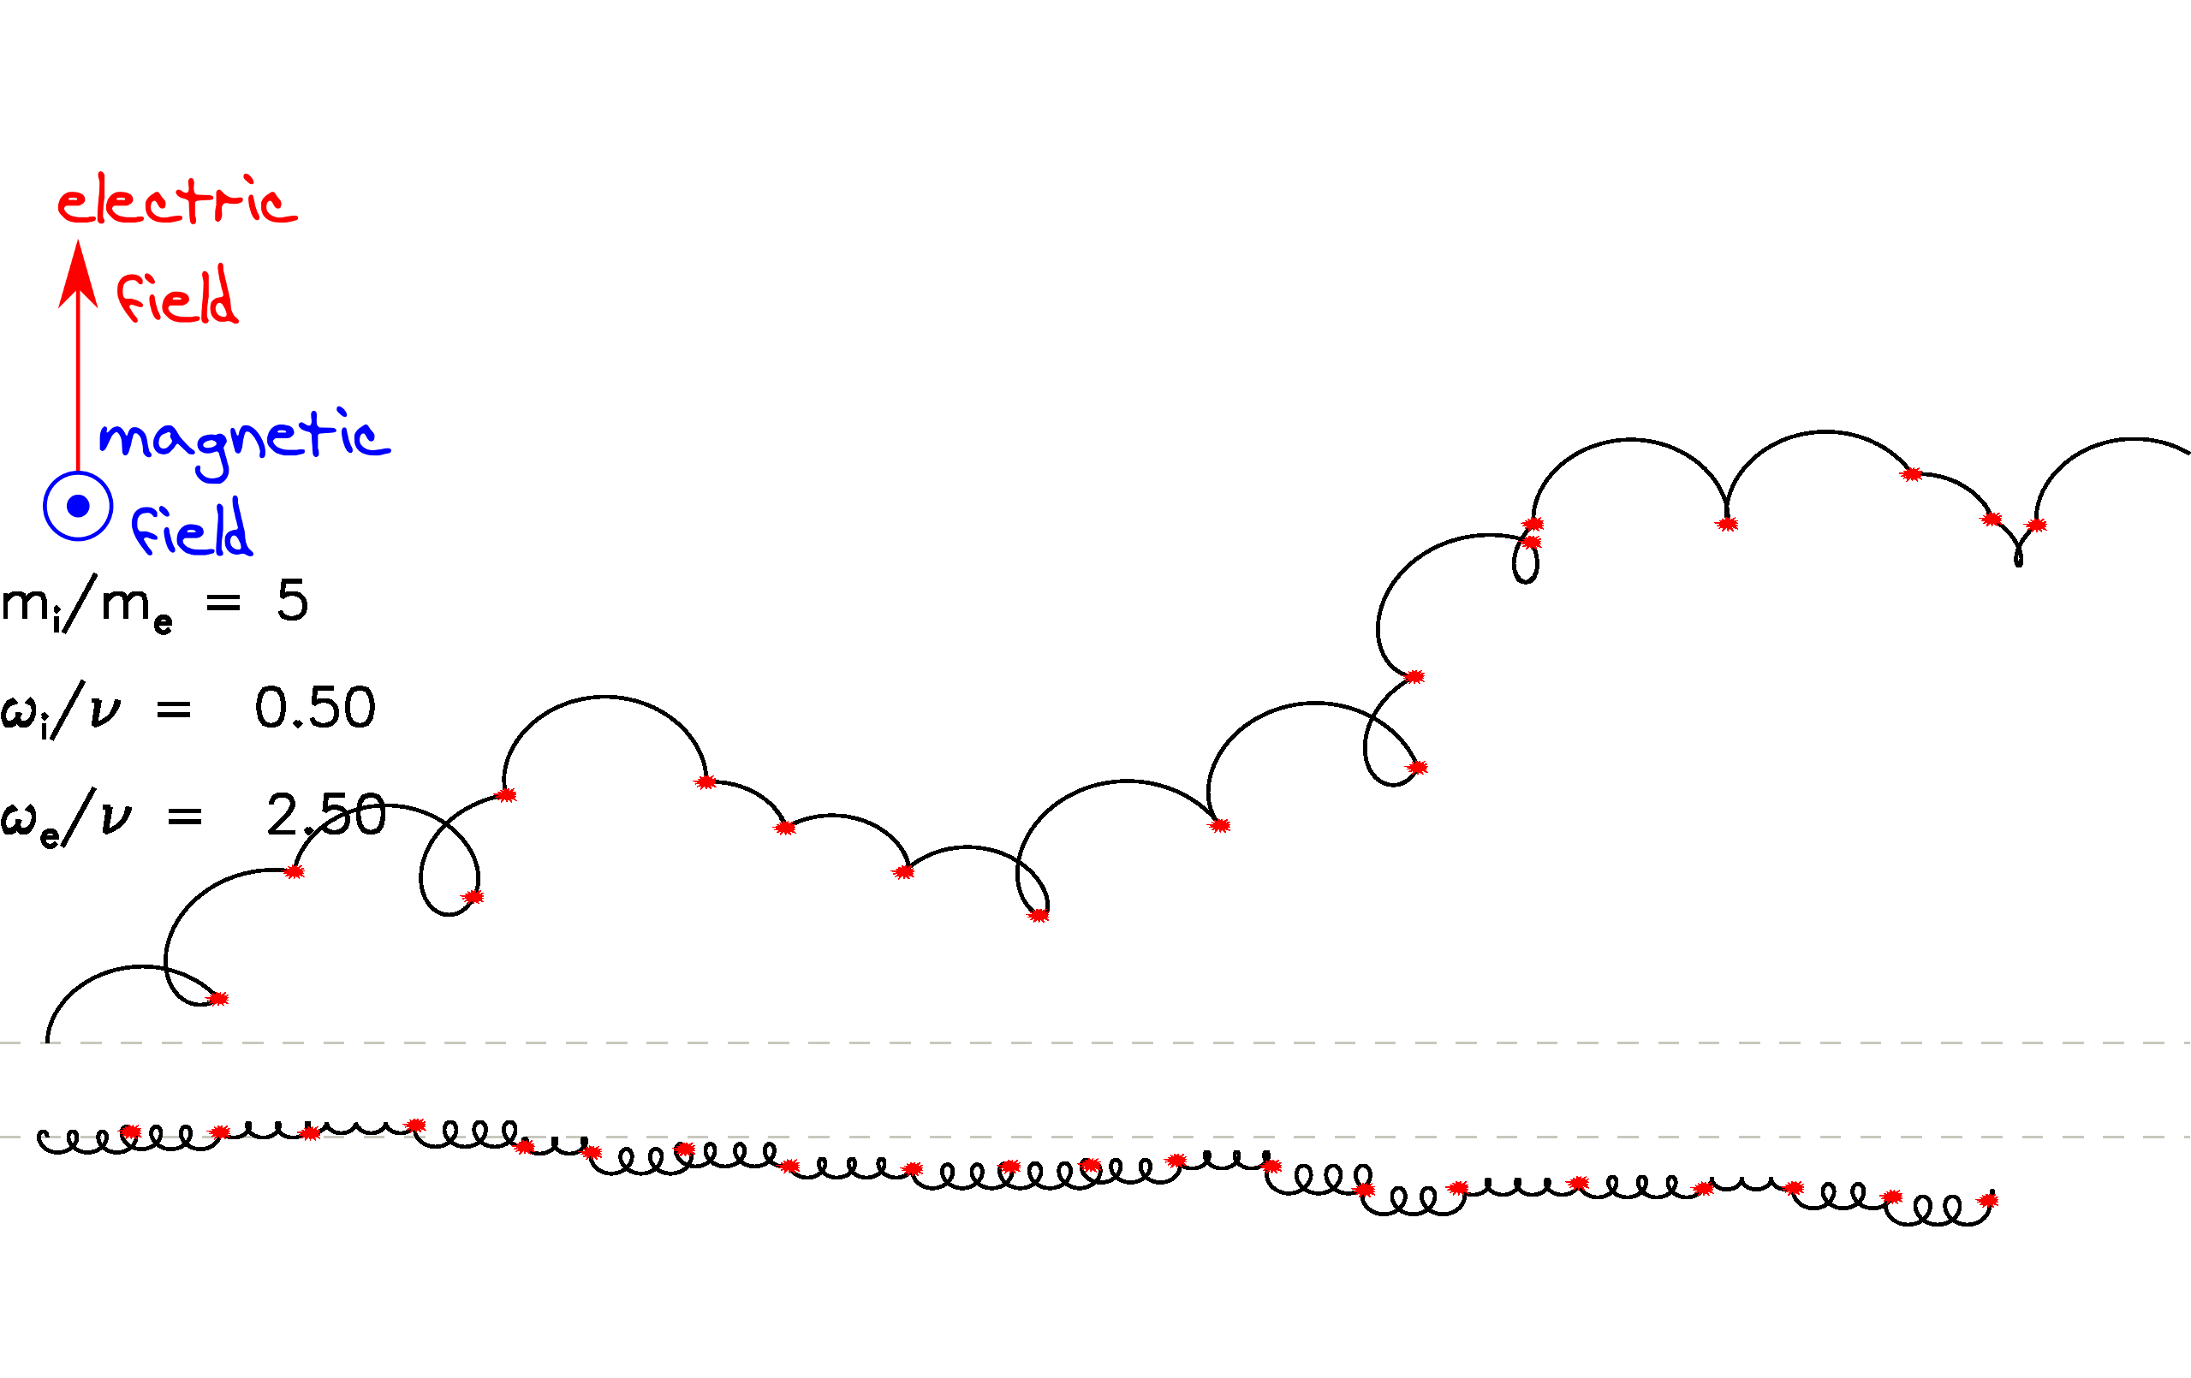
Collision vs gyro frequency

Slide 43
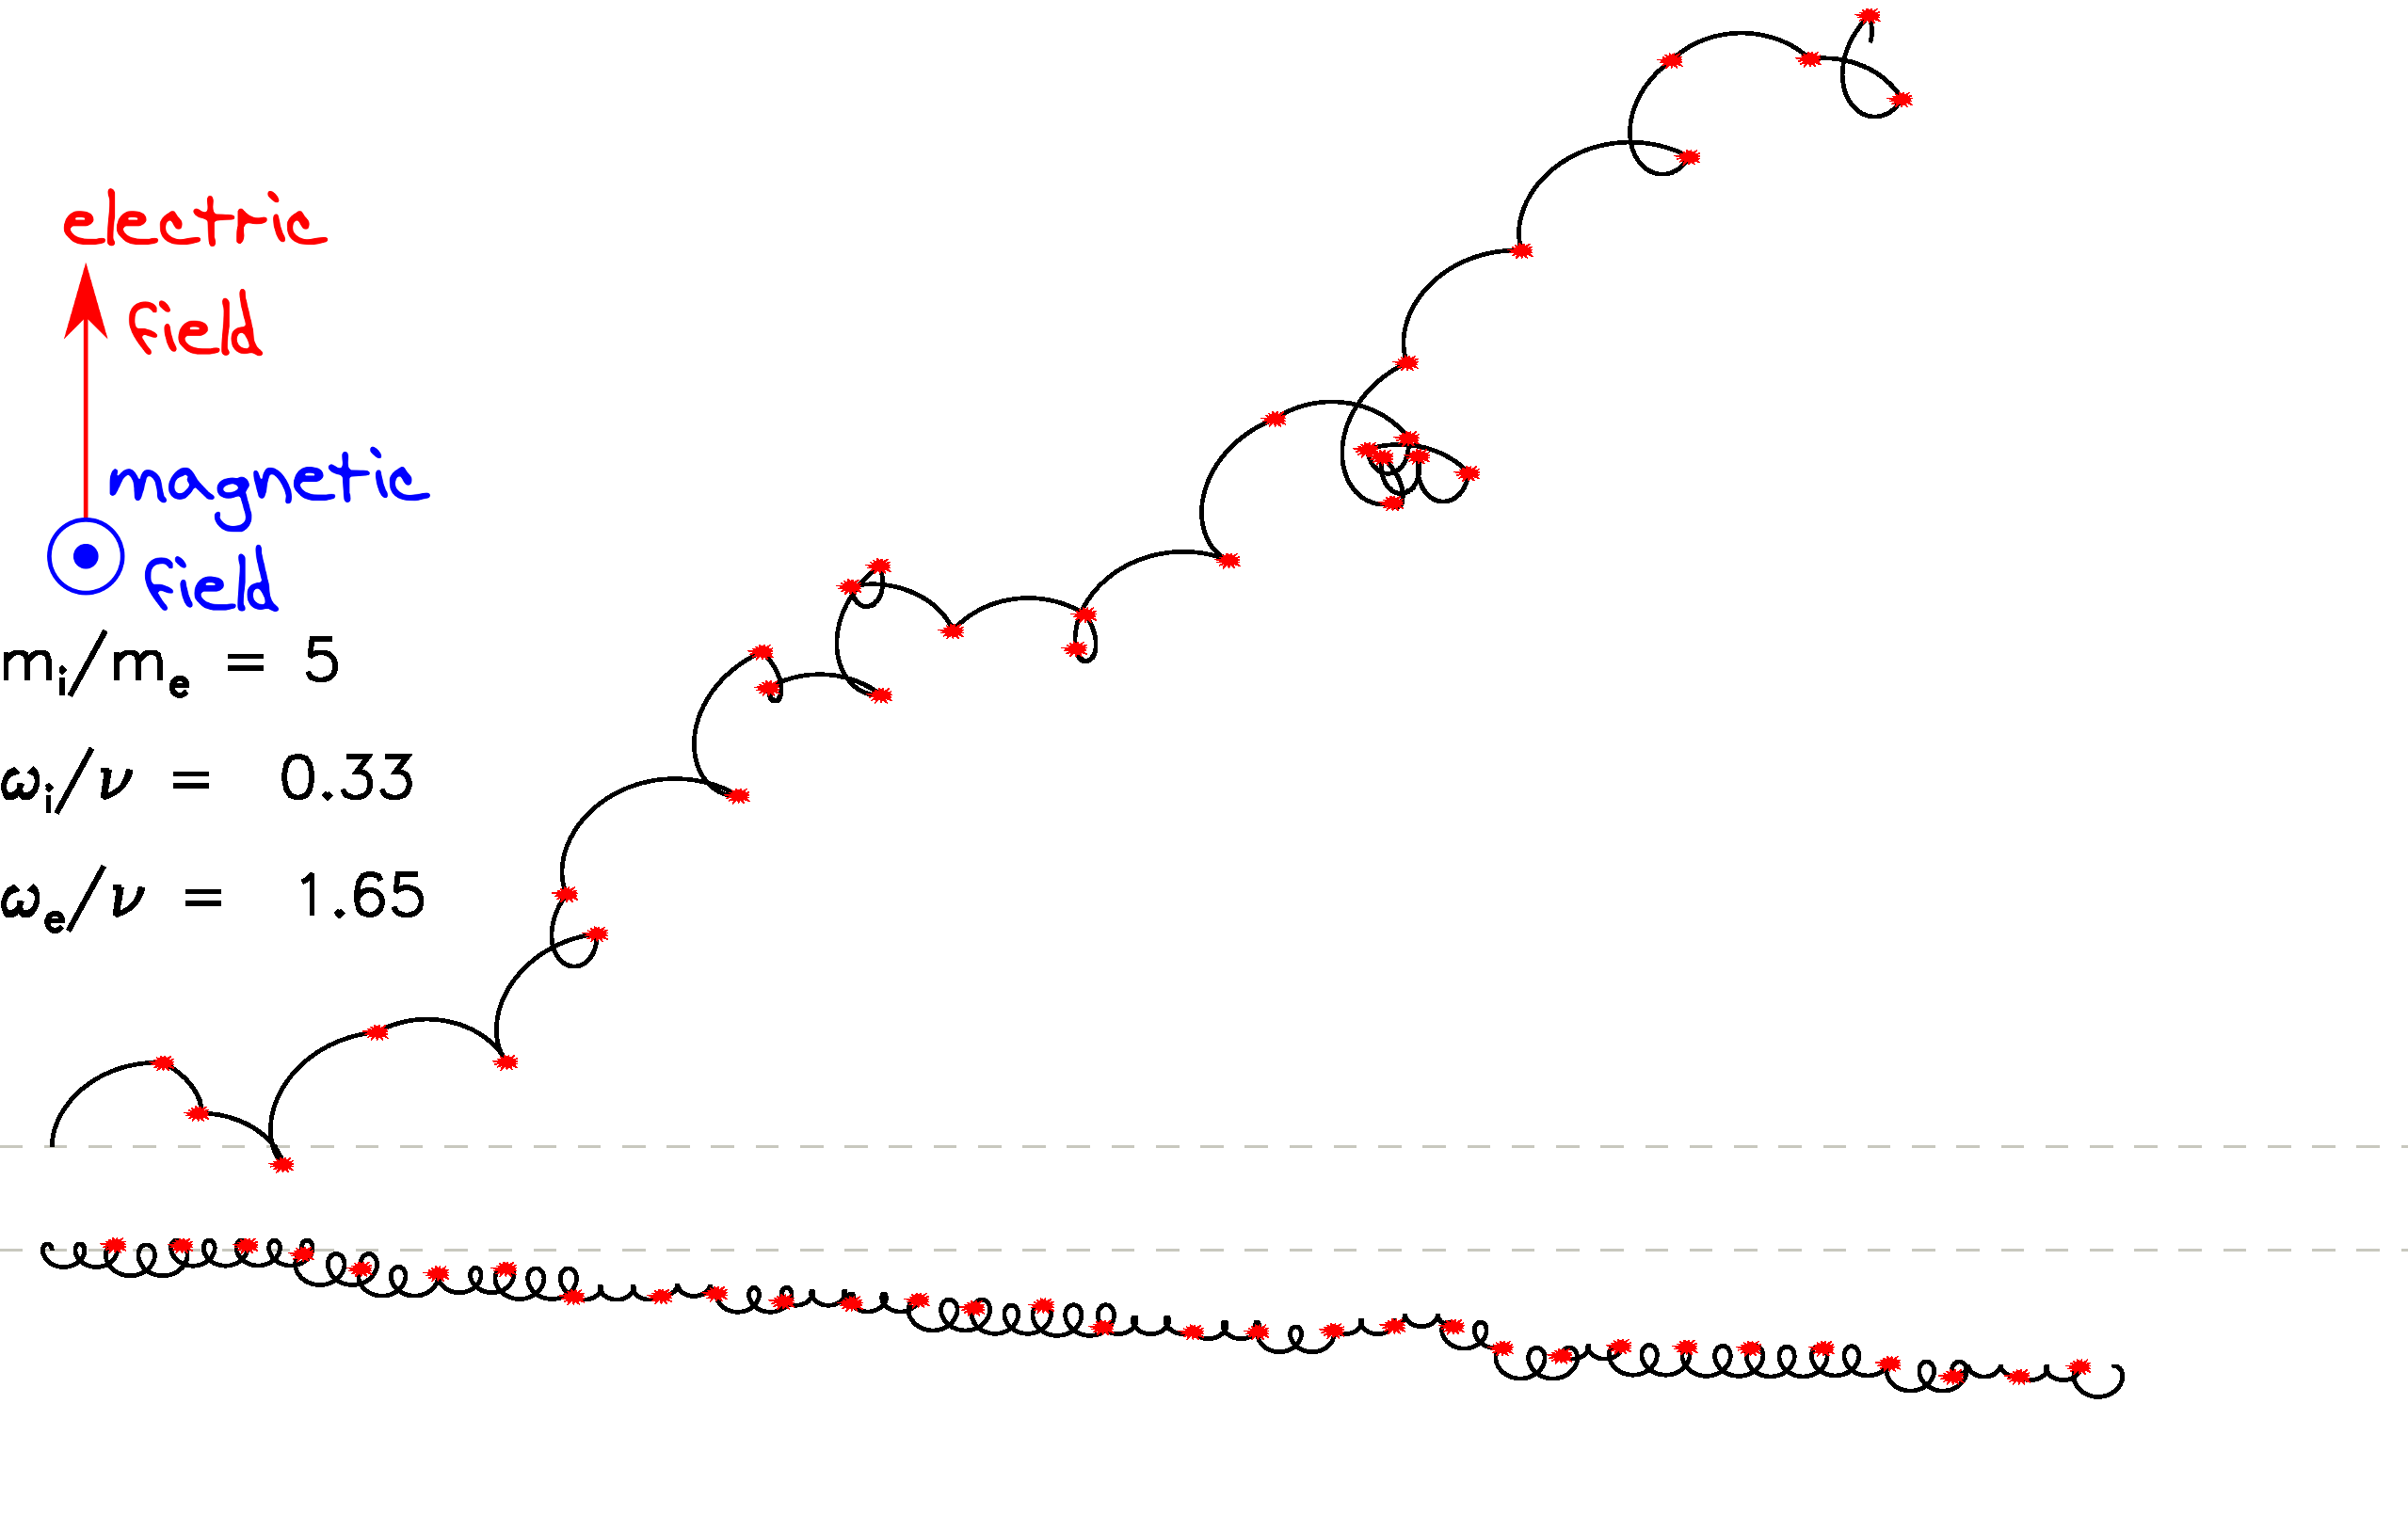
Collision vs gyro frequency

Slide 44
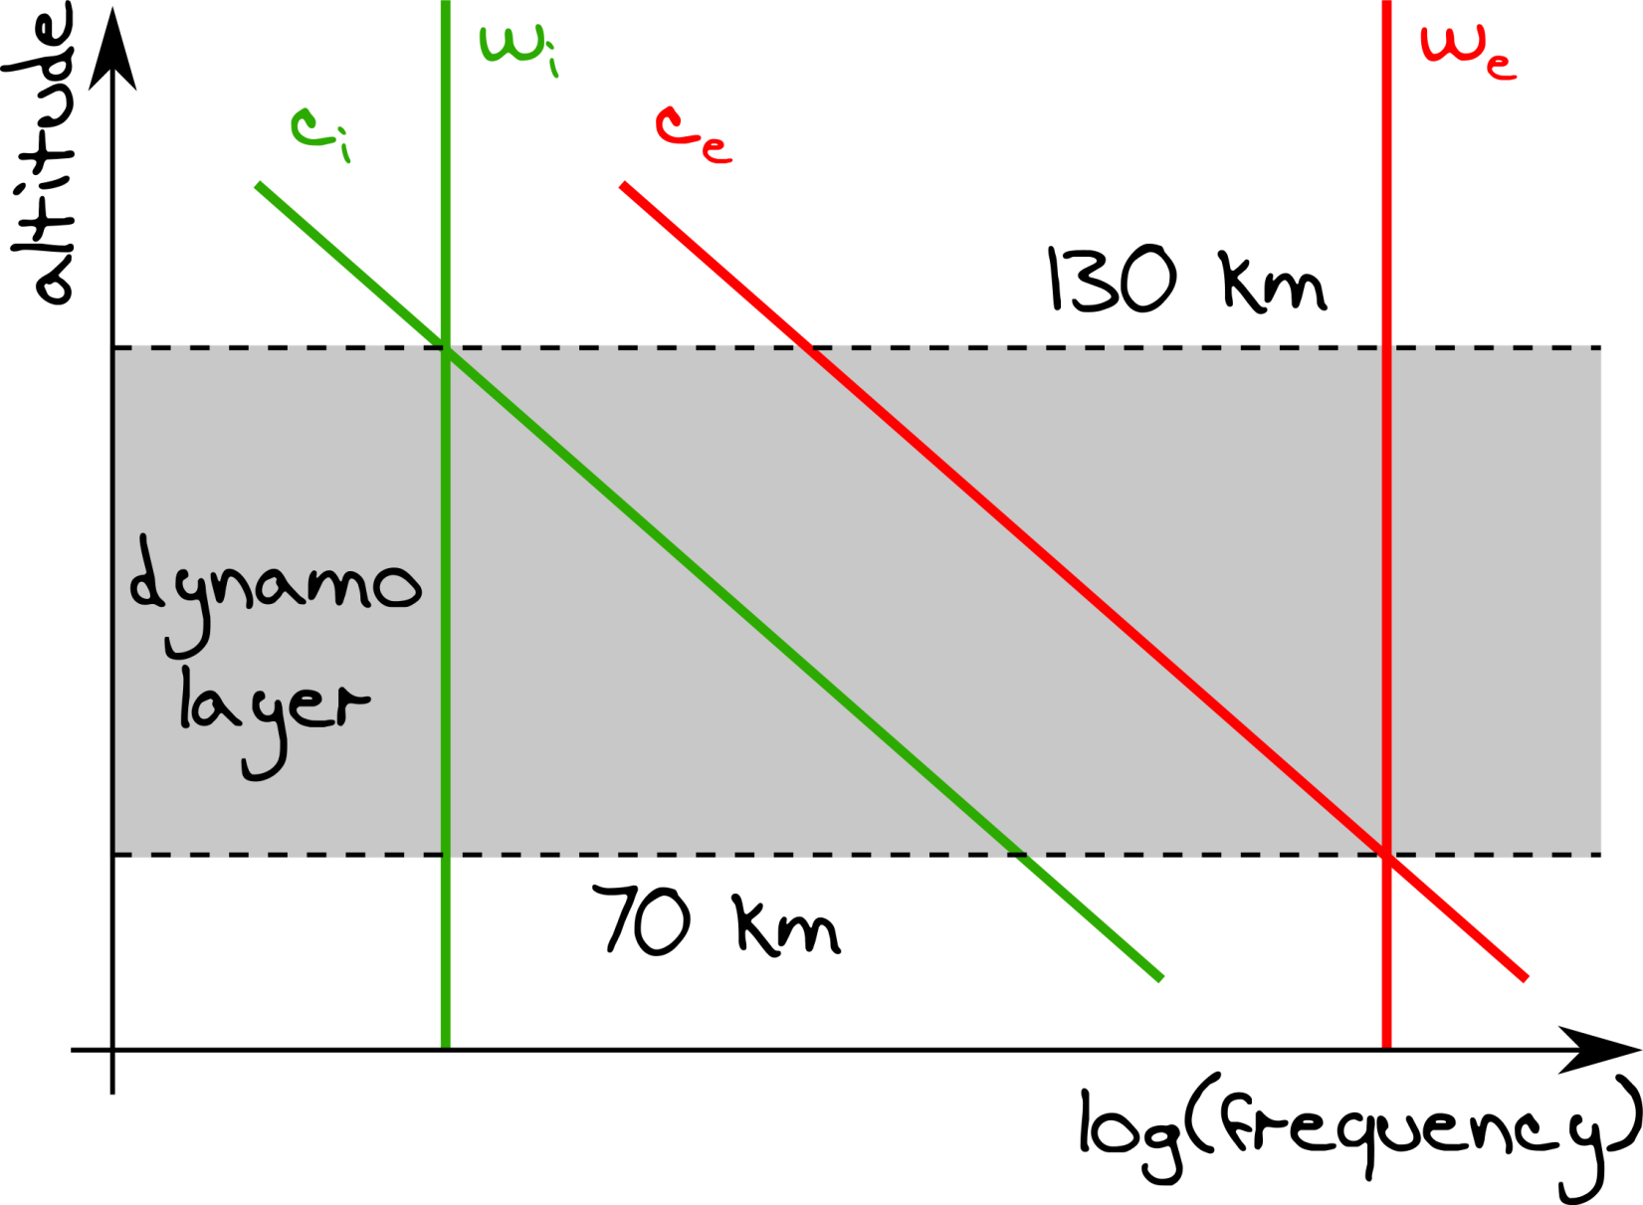
Dynamo layer

Slide 45
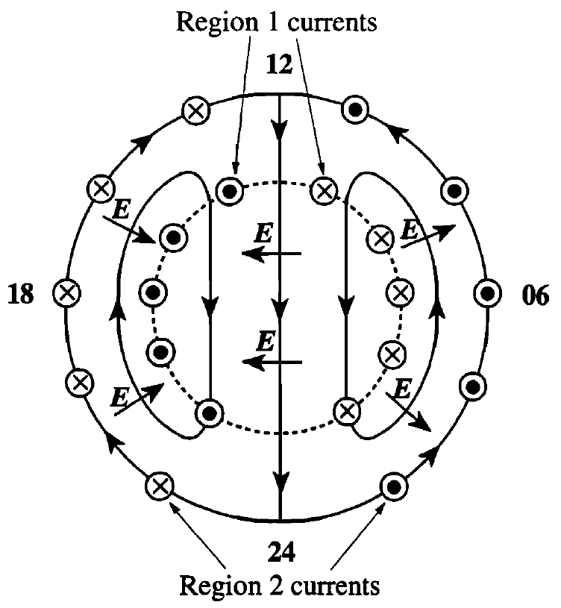
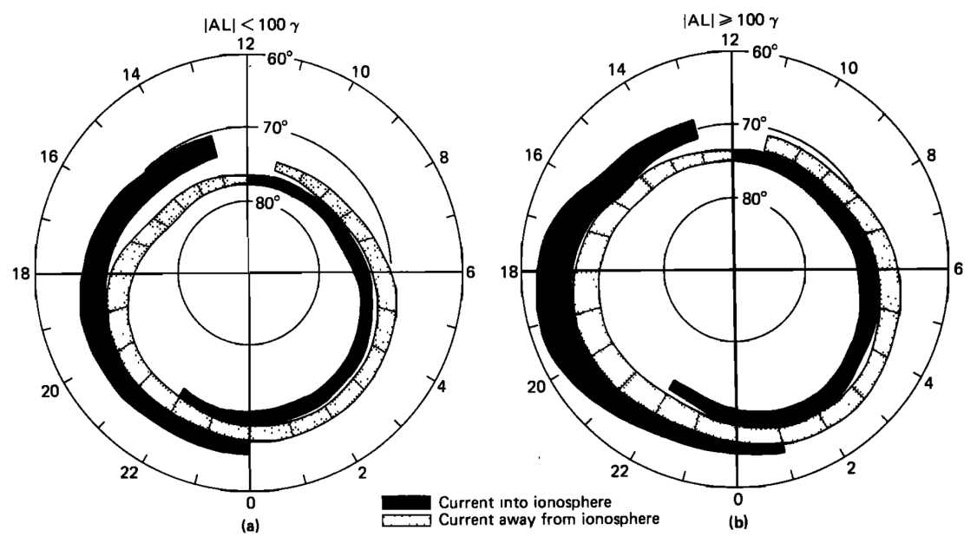
Polar convection & FACs

Slide 46
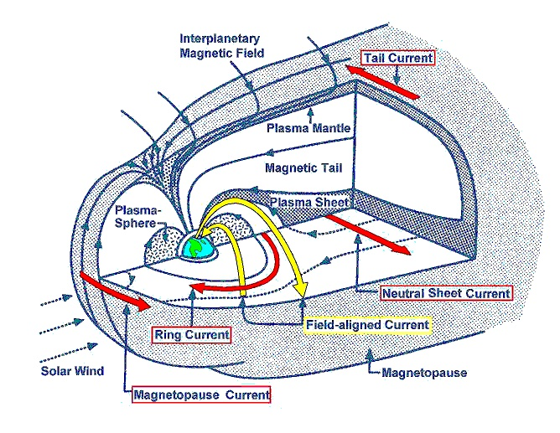
Current closure

Slide 47

Magnetospheric current loops

Slide 48

Substorm

Slide 49

Substorm

