Slide 1
Network layer
IN2140: Introduction to Operating Systems and Data Communication
Routing

Slide 2
Network layer
IN2140: Introduction to Operating Systems and Data Communication
Routing - repetition

Slide 3
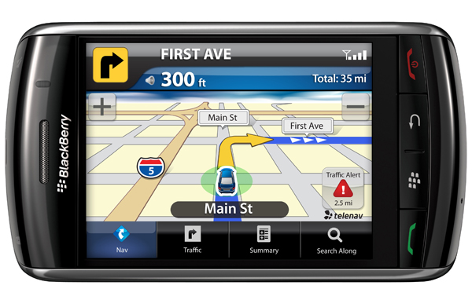
Network Layer
Primary task from a layer model perspective
To provide service to the transport layer
Connectionless or connection-oriented service
Uniform addressing
Internetworking: provide transitions between networks
Routing
Congestion control
Quality of Service (QoS)

Slide 4
Routing
The main L3 task is
enable data transfer from end system to end system
several hops, (heterogeneous) subnetworks
compensate for differences between end systems during transmission
The Intermediate Systems are often called Routers
routing depends on actual connections between intermediate systems (routers)
in many case, the organization into subnetworks coincides with routing borders and provides clues
but it is not essential for routing
network
is sub-network (subnet) of
network
end system
intermediate system
routing algorithms work on graphs

Slide 5
Inside the Network Layer
An L3 packet includes
for connection-oriented service:
route label
headers and trailer to specify service requirements
in particular:
information required by intermediate systems for forwarding
OR
for connectionless service:
end system address of the destination
IPv6 Header
virtual circuits require routing during connection setup
route label is used later
packet switching requires routing for every packet
destination address is used for every packet
Version
DSCP
ECN
Flow label
Payload length
Next header
Hop Limit
Source address
(128 bit)
Destination Address
(128 bit)
L4 Data

Slide 6
Network layer
IN2140: Introduction to Operating Systems and Data Communication
Routing - foundations

Slide 7
Routing: Foundations
Task
To define the route of packets through the network
From the source
To the destination system
Routing algorithm
Defines on which outgoing line an incoming packet will be transmitted
Route determination
Packet
Routing algorithm makes individual decision for each packet
Virtual circuit
Routing algorithm runs only during connect (session routing)

Slide 8
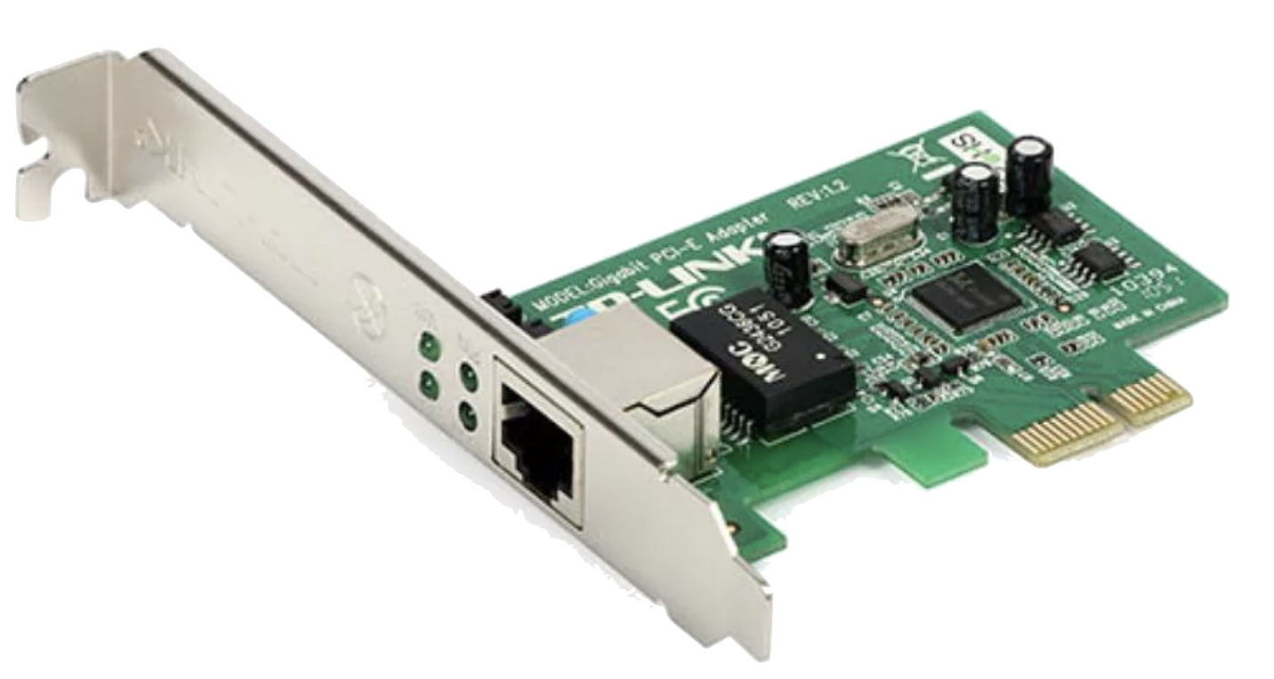
Routing: Routing and Forwarding
selecting an outgoing line
Router
Incoming
lines
Outgoing
lines
ES
IS
ES
ES
ES

Slide 9
Routing: Routing and Forwarding
Distinction can be made
Routing: makes decision which route to use
Forwarding: what happens when a packet arrives
Topology, link utilization, etc.
information
Router
Routing
Process
desti-
nation
link
A
0
Routing
table
Fills & Updates
B
2
C
1
Uses & Looks up
D
2
Data packets
Incoming
lines
Forwarding
Process
Outgoing
lines

Slide 10
Good Properties for Routing Algorithms
Correctness
Simplicity
Minimize load of ISes
Robustness
Compensation for IS and link failures
Handling of topology and traffic changes
Stability
Consistent results
No volatile adaptations to new conditions
Fairness
Among different sources compared to each other
Optimality

Slide 11
Routing Algorithms: Conflicting Properties
Often conflicting: fairness and optimization
Some different optimization criteria
average packet delay
total throughput
individual delay
conflict
a
b
c
x
IS
IS
IS
IS
IS
IS
X
Example:
communication among a → A, b → B, c → C uses full capacity of horizontal line
optimized throughput, but
no fairness for x → X – Tradeoff between fairness and optimization
A
B
C
Therefore often
hop minimization per packet
it tends to reduce delays and decreases required bandwidth
also tends to increase throughput

Slide 12
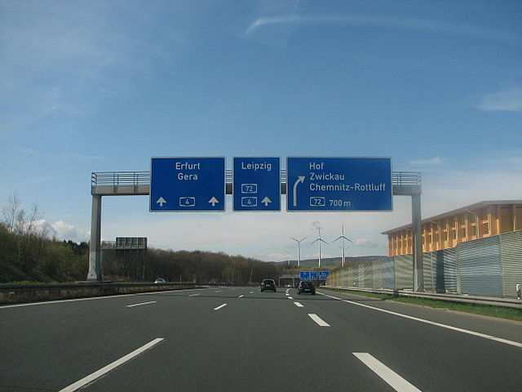
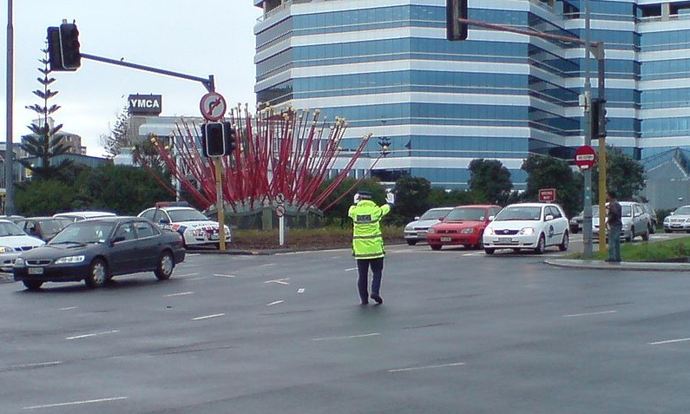
Classes of Routing Algorithms
Class: Non-adaptive Algorithms
Current network state not taken into consideration
Assume average values
All routes are defined off-line before the network is put into operation
No change during operation (static routing)
With knowledge of the overall topology
Spanning tree
Flow-based routing
Without knowledge of the overall topology
Flooding
Class: Adaptive Algorithms
Decisions are based on current network state
Measurements / estimates of the topology and the traffic volume
Further sub-classification into
Centralized algorithms
Isolated algorithms
Distributed algorithms
[Inkowik@wikipedia, CC BY SA 2.0]
[Ingolfsson@wikipedia]
Notes:
Inkowik@wikipedia -

Slide 13
Optimality Principle and Sink Tree
Starting idea: using a route has a cost
number of hops, delay, …
General statement about optimal routes
if router J is on the optimal path from router I to router K
then the optimal path from router J to router K uses the same route
Idea of the proof
best route from I to K is like this:
r1: from I to J, then
r2: from J to K
then r2 is also the best route from J to K
if better route r3 from J to K would exist
then concatenation of r1 and r3 would improve route from I to K
Set of optimal routes
from all sources
to a given destination
form a tree rooted at the destination: Sink Tree
r2
r1
I
J
K
r3

Slide 14
Sink Tree
Sink Tree for Destination B
B
0
A
1
B
C
1
B
A
C
F
2
C
D
2
D
E
D
E
I
2
J
G
J
J
2
F
F
I
N
3
I
H
N
E
3
L
H
N
L
H
3
K
K
G
3
K
3
M
O
M
O
L
4
O
4
M
4

Slide 15
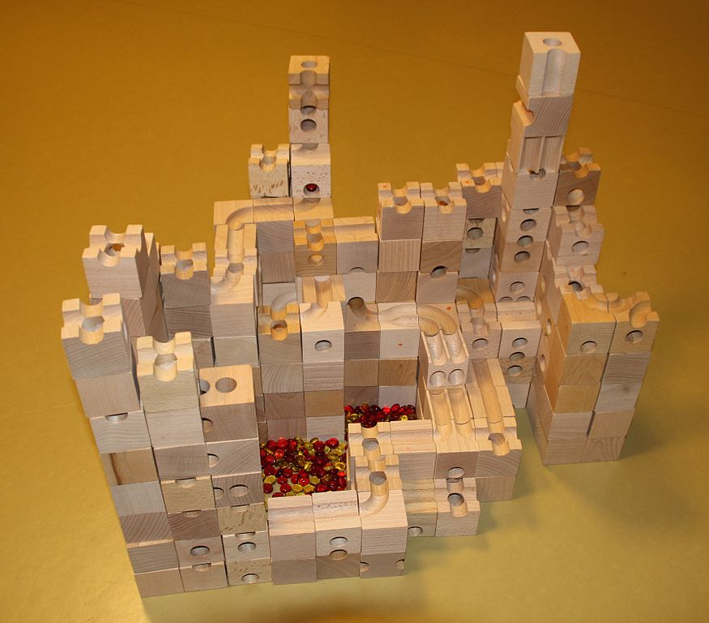
Sink Tree
Sink Tree for Destination B
B
[Adrian Michael@Wikipedia, CC BY 3.0]

Slide 16
Sink Tree
B
B
A
C
C
D
E
D
E
J
Sink Tree for
Destination B
F
G
J
F
I
I
H
N
L
H
N
L
K
K
M
O
M
O
Comments
tree: no loops
each optimal route is finite with bounded number of hops
not necessarily unique
other trees with same path lengths may exist
Goal of all routing algorithms
discover and use the Sink Trees for all routers
Not realistic to use Sink Trees as real-life routing algorithm
need complete information about topology
Sink Tree is only a benchmark for routing algorithms

Slide 17
Methodology & Metrics
Compute the shortest path between a given pair of routers
Different metrics for path lengths can be used
can lead to different results
sometime even combined
Metrics for the "ideal" route, e.g., a "short" route
number of hops
geographical distance
bandwidth
average data volume
cost of communication
delay in queues
...

Slide 18
Network layer
IN2140: Introduction to Operating Systems and Data Communication
Distributed Routing:
Link State Routing

Slide 19
Link State Routing
A very frequently use routing protocol
IS-IS (Intermediate System-Intermediate System)
OSPF (Open Shortest Path First)
Basic principle
IS measures the "distance" to the directly adjacent IS
Distributes information
Calculates the ideal route
Procedure
Determine the address of adjacent IS
Measure the "distance" (delay, ...) to neighbouring IS
Organize the local link state information in a packet
Distribute the information to all IS
Calculate the route based on the information of all IS

Slide 20
Link State Routing
1. Phase: gather information about the adjacent intermediate systems
H
H
D
E
G
D
E
G
B
I
B
I
A
C
F
A
C
F
LAN

Slide 21
Link State Routing
1. Phase: gather information about the adjacent intermediate systems
H
H
D
E
G
D
E
G
B
I
B
I
A
C
F
A
C
F
LAN
N
Initialization procedure
New IS
Sends a HELLO message over each L2 channel
Adjacent IS
Responds with its own address, unique within the network

Slide 22
Link State Routing
2. Phase: measure the "distance"
Definition of distance needed
Usually delay
Where to measure?
Topology, link utilization, etc.
information
Router
Routing
Process
desti-
nation
link
Routing
table
When to start timer?
A
0
Fills & Updates
B
3
C
1
Uses & Looks up
D
4
Data packets
Queues
ECHO
Forwarding
Process
HELLO
Incoming
lines
Outgoing
lines

Slide 23
Link State Routing
2. Phase: measure the "distance“
Queuing delay
Measuring without does not take load into account
Measuring with does ⇒ usually better
But
Possibility for oscillations (route flapping)
Once per routing table update

Slide 24
Link State Routing
3. Phase: organizing the information as link state packet
Including own address, sequence number, age, "distance"
Timing problems: validity and time of sending
Periodically
In case of major changes

Slide 25
Link State Routing
4. Distributing the local information to all IS
By applying the flooding procedure (very robust)
Therefore sequence number in packets
Problem: inconsistency
Varying states simultaneously available in the network
Indicate and limit the age of packet, i. e. IS removes packets that are too old
5. Computing new routes
Each IS for itself
Possibly larger amount of data available

Slide 26
Network layer
IN2140: Introduction to Operating Systems and Data Communication
Distributed Routing:
Distance Vector Routing

Slide 27
Distance Vector Routing
Principle
every IS maintains a table (i.e., vector) stating
best known distance to destinations
and line to be used
ISes update tables
by exchanging routing information with their neighbors

Slide 28
Distance Vector Routing
Each IS
maintains routing table with one entry per router in the subnet
is assumed to know the distances to each neighbor
sends list with estimated distances to each destination periodically to its neighbors
X receives list E(Z) from neighbor Y
Distance X to Y: e
Distance Y to Z: E(Z)
Distance X to Z via Y: E(Z)+e
IS computes new routing table from the received lists containing
Destination IS
Preferred outgoing path
Distance

Slide 29
Distance Vector Routing
A
B
C
D
A
I
H
K
line
A
0
24
20
21
8
A
B
12
36
31
28
20
A
G
C
25
18
19
36
28
I
E
H
F
D
40
27
8
24
20
H
E
14
7
30
22
17
I
F
23
20
19
40
30
I
I
J
K
L
G
18
31
6
31
18
H
H
17
20
0
19
12
H
I
21
0
14
22
10
I
J
9
11
7
10
0
-
K
24
22
22
0
6
K
L
29
33
9
9
15
K
delay
JA
8
JI
10
JH
12
JK
6
Previous routing table will not be taken into account
Reaction to deteriorations

Slide 30
Distance Vector Routing
Fast route improvement
Fast distribution of information about new short paths (with few hops)
Example
initially A unknown
later: A connected with distance 1 to B, this will be announced
Distribution proportional to topological spread
Synchronous (stepwise) update is a simplification
A
B
C
D
E
∞
∞
∞
∞
1
∞
∞
∞
1
2
∞
∞
1
2
3
∞
1
2
3
4

Slide 31
Distance Vector Routing
Slow distribution of information about new long paths (with many hops)
“Count to Infinity” problem of DVR
Example: deterioration
Here: connection destroyed
A was previously known, but is now detached
The values are derived from (incorrect) connections of distant IS
Comment
Limit "infinite" to a finite value, depending on the metrics, e.g.
‘infinite’ = maximum path length+1
A
B
C
D
E
1
2
3
4
3
2
3
4
3
4
3
4
5
4
5
6
5
6
5
6
7
6
7
6
7
8
7
8
∞
∞
∞
∞

Slide 32
Distance Vector Routing
Variant: ‘Split Horizon Algorithm’
Objective: improve the "count to infinity" problem
Principle
In general, to publicize the "distance" to each neighbour
If neighbor Y exists on the reported route, X reports the response "false" to Y
distance X (via Y) according to arbitrary i: ∞
A
B
C
D
E
1
2
3
4
Example: deterioration (connection destroyed)
B to C: A = ∞ (real), C to B: A = ∞ (because B is on path to A), ...
But: still poor, depending on topology, example
Connection CD is removed
A receives "false information" via B
B receives "false information" via A
Slow distribution (just as before)
∞
2
3
4
∞
∞
3
4
∞
∞
∞
4
∞
∞
∞
∞
A
C
D
B

