Slide 1
The Course
IN2140: Introduction to Operating Systems and Data Communication
A bunch of people …
Monday, January 23, 2023

Slide 2
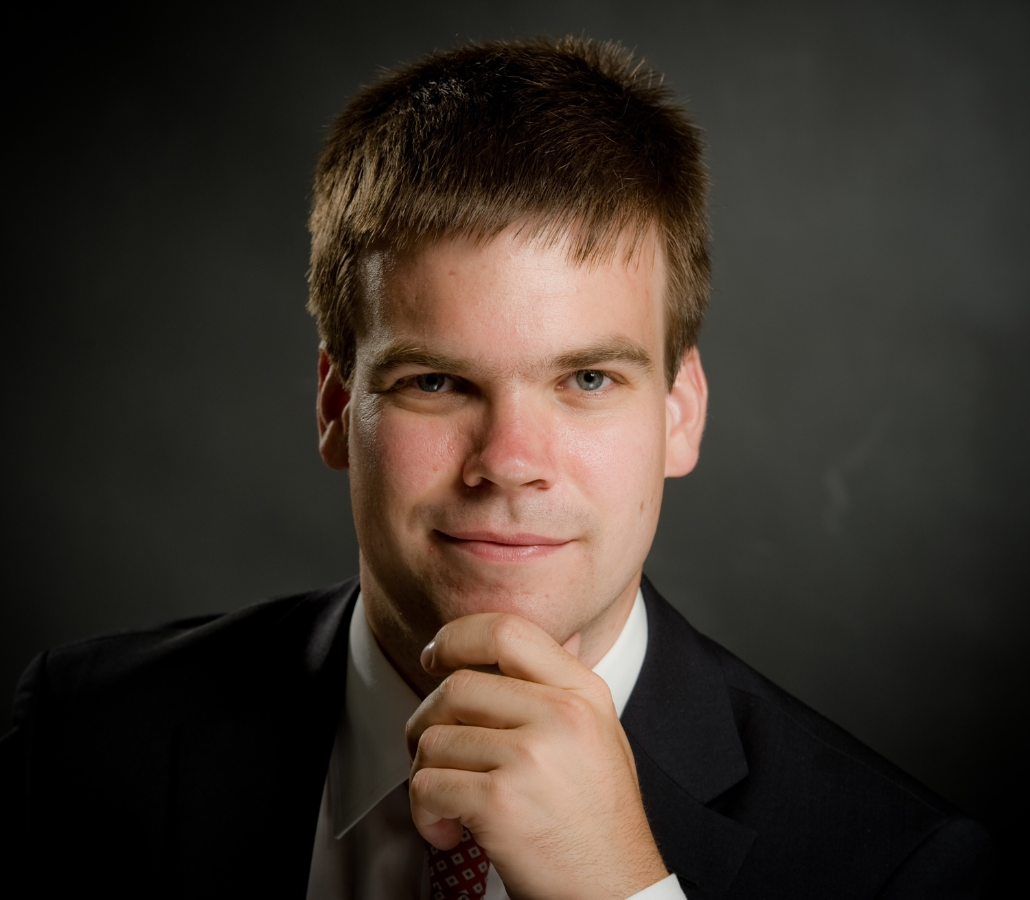
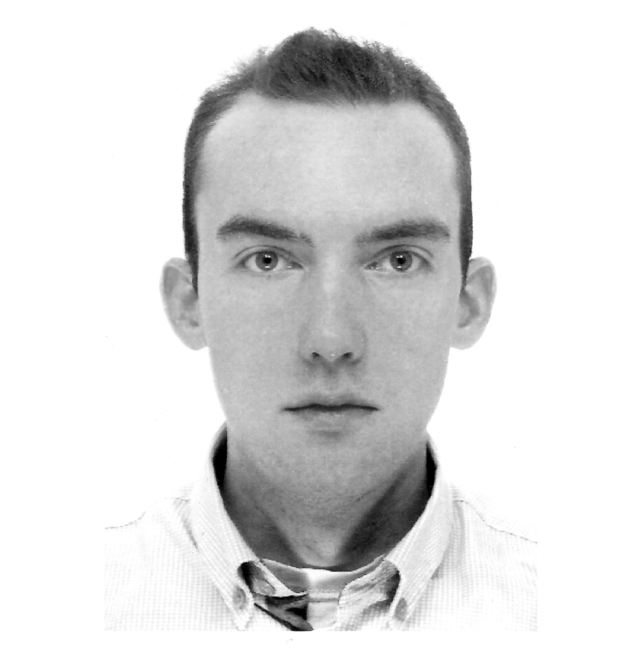
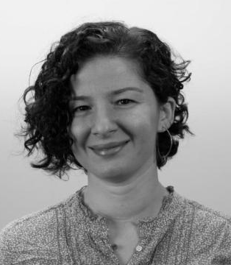
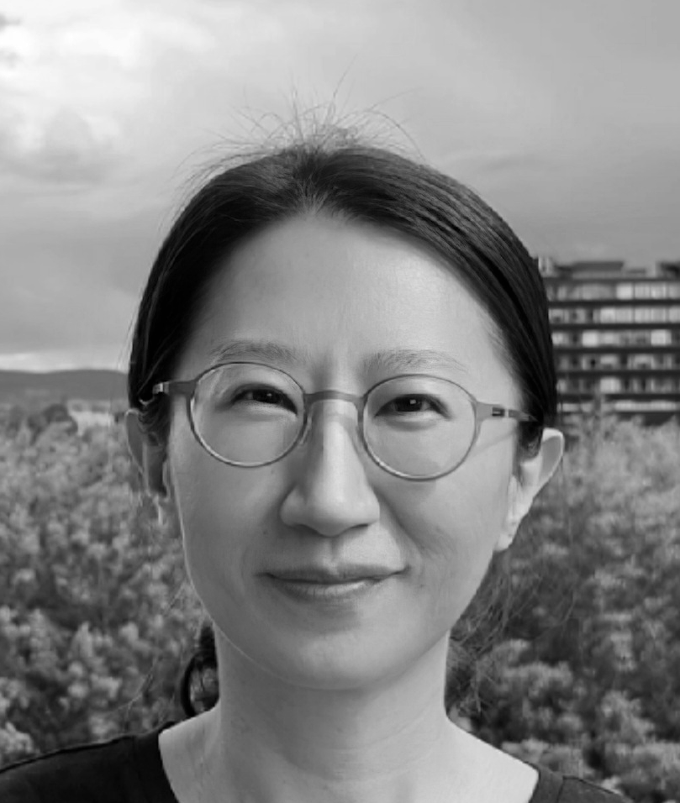
People
Lecturers
Magnus Klausen magnukla @ ifi
Carsten Griwodz griff @ ifi
Pål Halvorsen paalh @ ifi
Özgü Alay ozgua @ ifi
Jie Bian jiebi @ ifi
Group teachers
Mathias Enger Storvik, mathies
Ole Jørgen Norstrand, olejno
Lise Chen, liseche
Christopher Østensen Olberg, chrisool
Oskar Haukebøe, oskah
Philip Høeg Eriksen, philipe
Theo Halvorsen, theogh

Slide 3
Learning Outcome
Course content
an introduction to operating systems (OS), viewed from both the user’s and machine’s point of view
have basic knowledge of the most important components of an operating system
be able to develop small applications that call OS services
insight into how data communication is taking place
be able to choose between algorithms that enable today's data communication in the Internet
be able to develop programs with processes that communicate – within the computer and over a network
understanding theory through practice by programming
experience implementing algorithms for operating systems and data communication without the protective cover provided by runtimes and interpreters
learn to program in the C programming language

Slide 4
Learning Outcome: OS
have basic knowledge of the most important components of an operating system
be able to develop small applications that call OS services
Why?
Know that operating systems hide hardware complexity for you
Know about kernel space and user space, and how they interact
Learn typical algorithms for the most important operations performed by the operating system for you
Understand how algorithms perform
Understand that different algorithms are good for different workloads
Understand when software is wasting performance unnecessarily
Select the right hardware, services and algorithms when you build complex systems
Need-to-know for advanced courses in operating systems, compilers, distributed systems, parallel programming, HPC, ...

Slide 5
Learning Outcome: Datacom
be able to choose between algorithms that enable today's data communication in the Internet
be able to develop programs with processes that communicate – within the computer and over a network
Why?
Know how data and information are moved over a network
Understand how networks are structured
Know those parts of the network that you can change yourself
Write simple networked and distributed applications
Make the right choices when programming networked and distributed applications
Understand and change basic network configurations
Understand the cost of distributing applications
Understand the performance of complex distributed applications
Need-to-know for advanced courses in networks, distributed systems, parallel programming, HPC, security, ...
Notes:
"... can change yourself" - Jeg mener: ikke som nettverksadmin, du må ta flere kurs for dette. Men hvis du er admin av din egen maskin.

Slide 6
Learning Outcome: C
experience implementing algorithms for operating systems and data communication without the protective cover provided by runtimes and interpreters
learn to program in the C programming language
Why?
Understand memory and memory addresses in much more detail than from theory
Understand how operating systems are related to computer architecture
Understand that networks do not know about data structures and program structures
C brings you very close to the computer’s architecture and OS
Most importantly
C allows you to easily interpret every (readable) byte in the computer as you like
Re-interpretation is an absolute necessity for an operating system
Most programming languages make that very hard or impossible
You cannot write an OS without interpreting memory
C is the (grand-) parent of C++, Objective C, Java, C#, Scala, Python, PHP, Perl, Ruby, …
C is not the final word in OS writing, but so far, all others failed. Will Rust succeed?

Slide 7
Connecting the dots
OS: Introduksjon
OS: prosesser og CPU scheduling
Datakom: addresser på L2 og L3
Datakom: namer på L4 og DNS
Datakom: forbindelseso. & -løst
Datakom: metningskontroll
OS: minne
OS: lagring
OS: IPC
Datakom: introduksjon
Datakom: Flytkontroll
Datakom: ruting
Oblig 1: strings≈
Oblig 2: filer/ -system
HE: praksis
FE: teori
Basistypene, string, adresser, pekere
avanserte datatyper, aksess uten peker, dereferensering
grafer, serialisering, minnelayout
stack og heap, dynamic memory
håndtering av bits, boolske operatorer
Pipe, fork, relasjon til serialisering
sockets, getaddrinfo, klienter og servere
Filer, minnelayout
Forbindelsesløst & -orientert
avansert bruk av getaddrinfo, IPv6
hendelsesløkker

Slide 8
Teaching structure
theory
transfer
praxis
Compreh.
discussions
Comprehension tasks
Plenum
Group session
Understand theory
Operating systems
Programming tasks
Understand by programming
Networks
understanding
experience

Slide 9
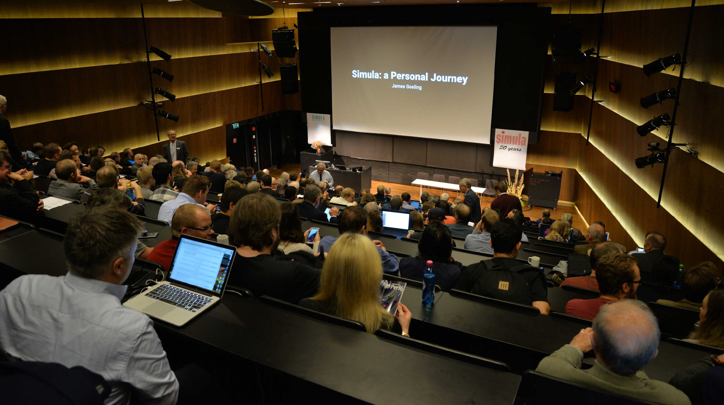
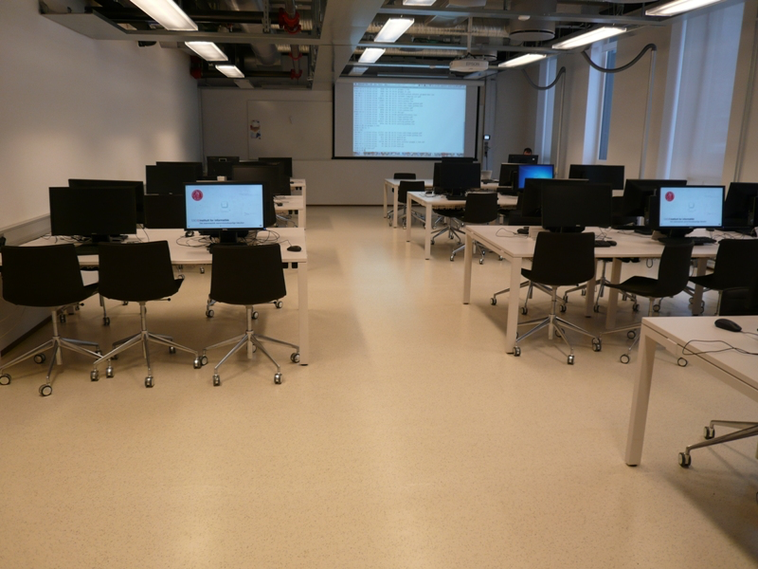
Teaching structure
Theory
Input
Tanenbaum’s books
Weekly videos
Weekly slides
Weekly comprehension questions
Live weekly discussion of answers to comprehension question
From theory to practice
Input
Live weekly, unrecorded sessions
From theory to code
Q&A
Practice
Input
Weekly “Cbra” videos
Live C concept presentation
Weekly exercises

Slide 10
Teaching structure
Theory
Practice
Attend «lecture» session
Answer comprehension questions
Ask theory questions
Reading groups
Voluntary
Attend «group» session
Solve programming tasks
Ask for help
Reading groups
Voluntary
2x/semester submit written answers to comprehension questions
Mandatory
2x/semester mandatory programming exercise
Mandatory
4-hour exam, mostly of comprehension question
Examination
3-week home exam, solving a programming task
Examination
From theory to practice
Attend «plenum» session
Get a practical look at theory
Ask questions
Voluntary

Slide 11
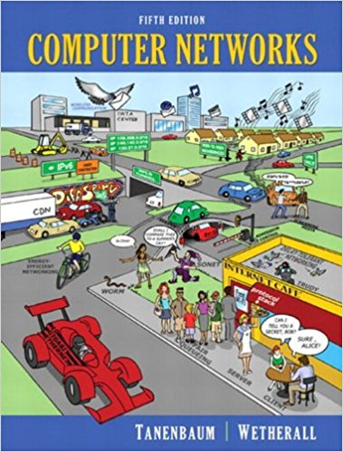
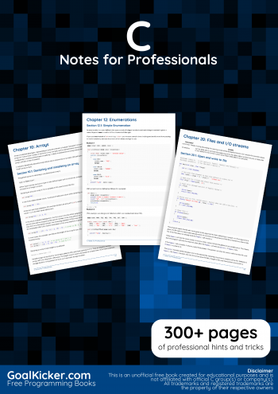
Pensum
Topics taught in the videos, slides and live sessions together with the given slides and exercises constitute the “pensum”
Supporting books
Modern Operating Systems: Andrew S. Tanenbaum
Computer Networks: Andrew S. Tanenbaum
C Notes for Professionals book: editor: web@petercv.com
Other useful C books:
The C programming Language: Brian Kernighan and Dennis Ritchie
C: A Reference Manual: Samuel P. Harbison and Guy L. Steele

Slide 12
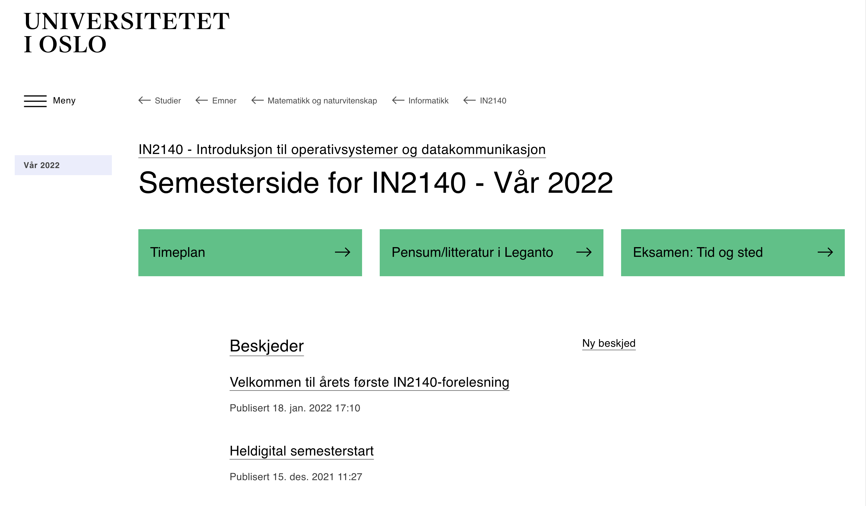
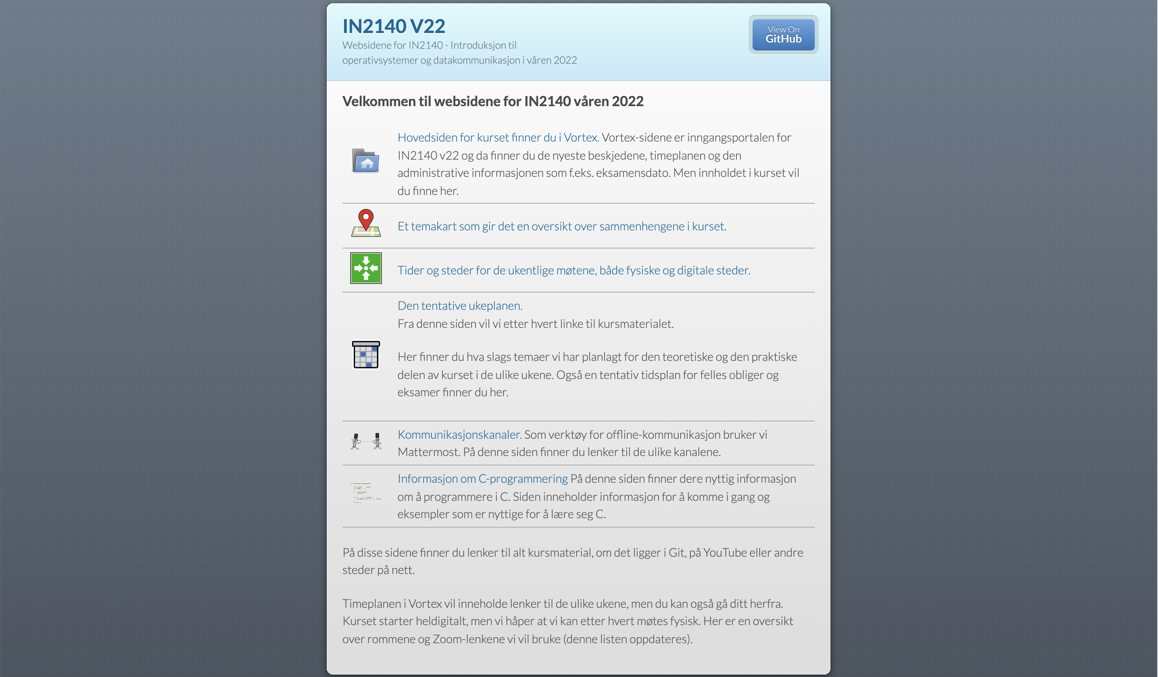
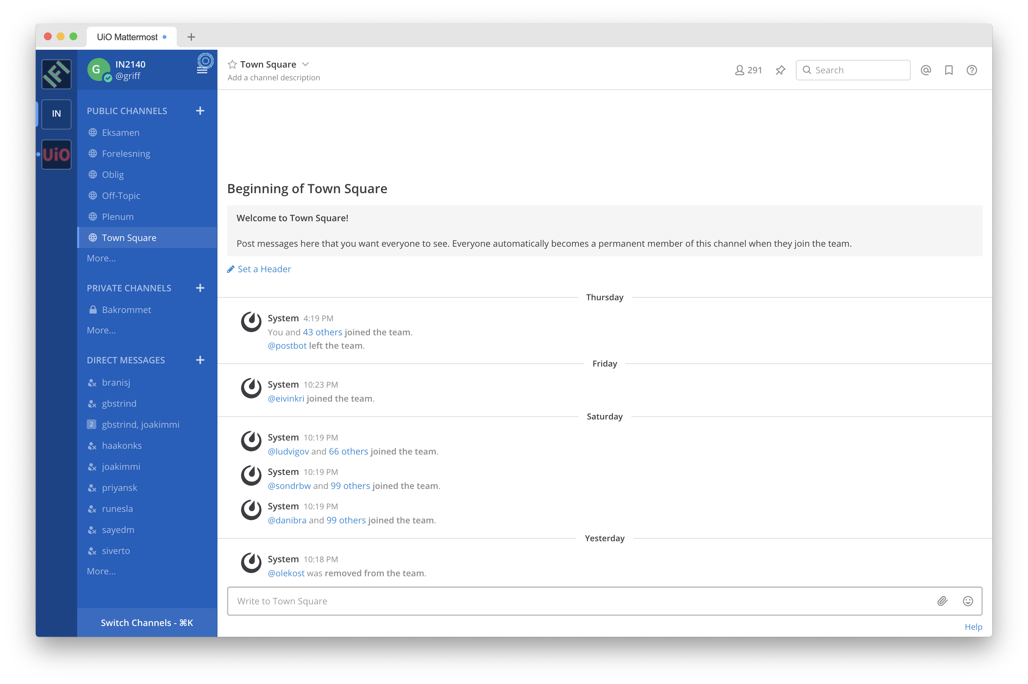
Information
Course homepage in Vortex
your starting point
messages & news
schedule (timeplan) – not actively used
weekly schedule (ukeplan) with links
Github
collection of all teaching material: slides, code etc.
Mattermost
official channels for your discussions
we monitor for FAQs – hot or important topics are picked up in the Plenum session
Devilry
for submitting your responses to mandatory tasks
Inspera
for both exams

Slide 13
Exams and Mandatory Exercises
Mandatory exercises: groups of 5 or 6 students
answer comprehension questions on two occasions
one C programming exercise
preparation for home exam
few multiple choice questions about theory
preparation for final exam
tentative dates in Vortex (Ukeplan)
Programming exam
focus on programming and documenting one concept related to OS and DataCom
tentative date: 28.4 – 16.5
Theory exam
focus on the concepts, not programming
date 7.6.
4 hours
Note:
spring 2023 exams are similar to 2021+2022 exams but very different from earlier ones
Notes:
GROUPS !!!

Slide 14
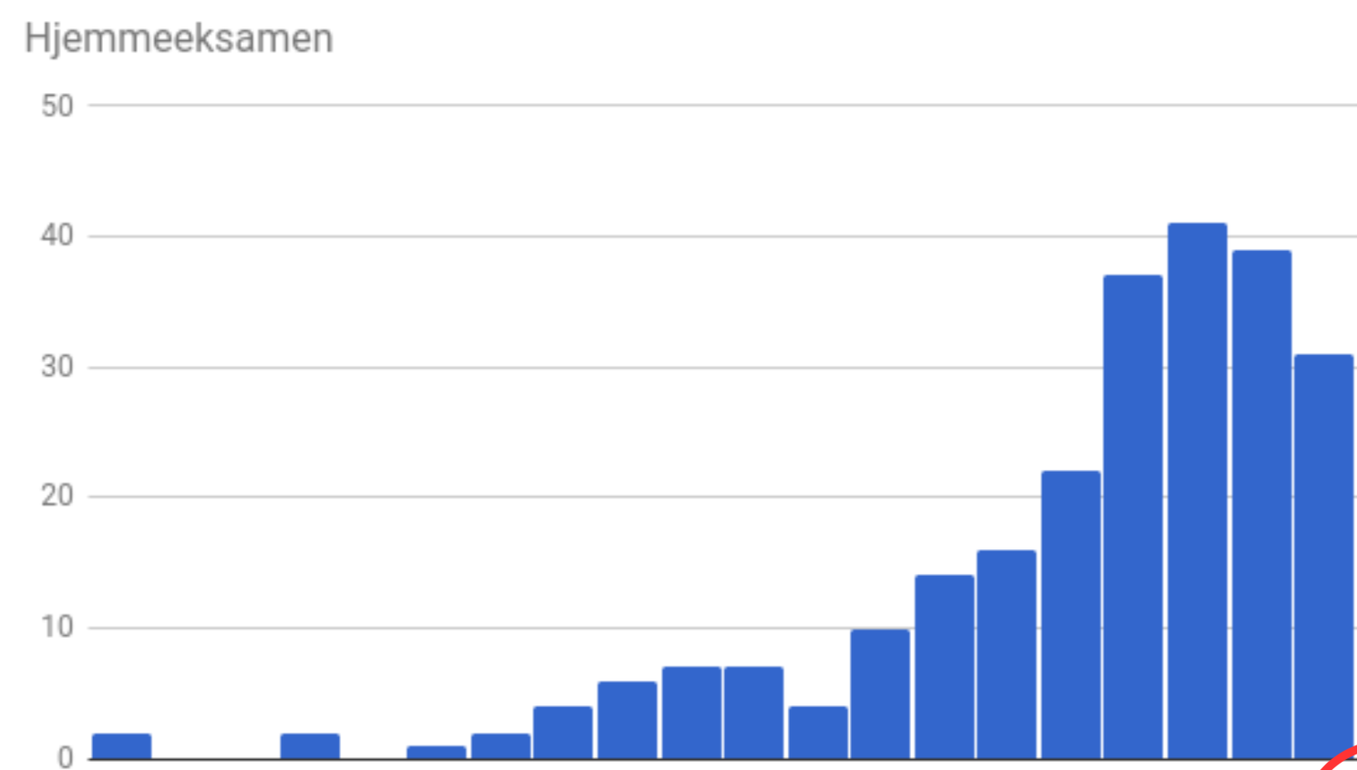
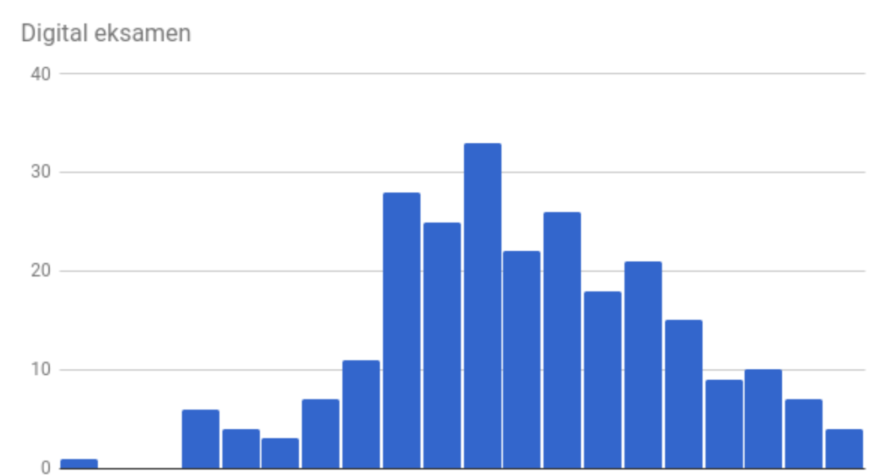
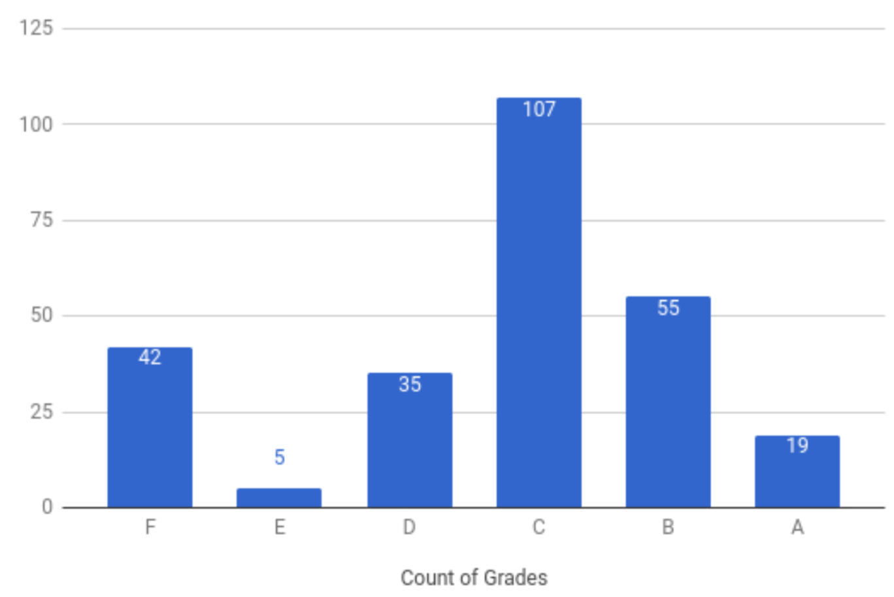
Evaluation and grading
Passing oblig 1 is required to submit the programming exam
Passing obligs 1+2 and comprehension questions is required for admission to the theory exam
Passing programming exam and theory exam is required to pass the course
admission to the theory exam
Grading:
40% homeexam
60% final exam
Both exams count
+
=
programming is fun, but counts only for 40% of the final grade

Slide 15
Questions?

