Slide 1
Group Session 05.05.2021
Email: hpnguyen@ifi.uio.no

Slide 2
Mandatory assignment 4 – Deadline
Remember the deadline for Mandatory assignment 4
Monday, 10. May, 2021, 11:59 PM

Slide 3
Todays plan
Mandatory Assignment 3 – Solution
(I will remove the solution from this powerpoint after some time)
Control Theory – Exam problems
The plan for future group sessions

Slide 4
Mandatory Solution - Start

Slide 5
!REMOVED!

Slide 6
Mandatory Solution - Finish

Slide 7
Control Theory – Exercise 1

Slide 8
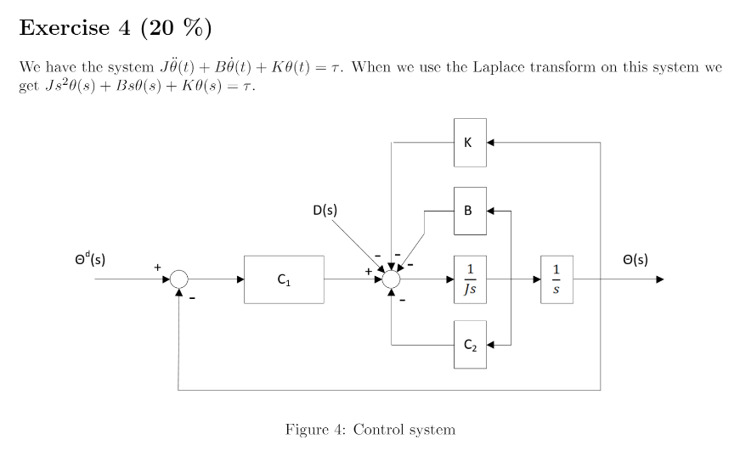
Control Theory – Exercise 4, 2017

Slide 9
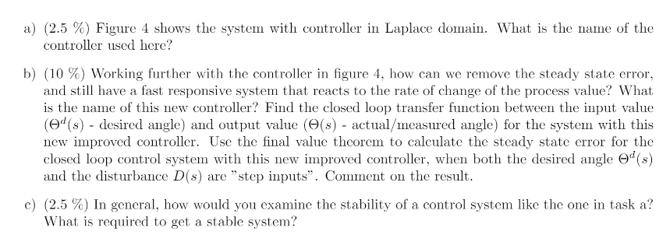
Control Theory – Exercise 4, 2017

Slide 11
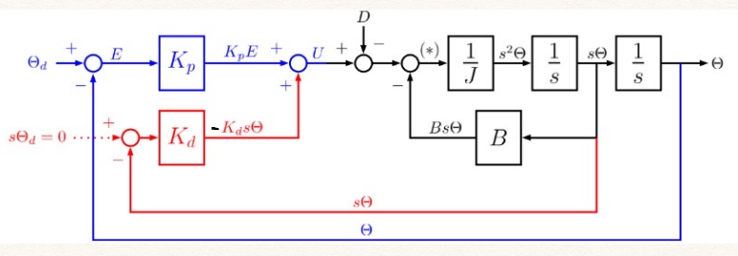
$$sθ(s)$$

Slide 12
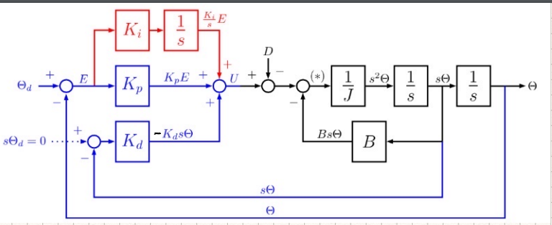
Control Theory – Exercise 4, 2017

Slide 13
$$e\left(s\right)=θ^{d}(s)−θ(s)$$
$$\dot{e}\left(s\right)=sθ^{d}(s)−sθ(s)$$
$$u_{controller}=K_{p}e\left(s\right)+\frac{K_{i}}{s}e\left(s\right)+K_{d}\dot{e}(s)$$
$$u_{controller}=K_{p}\left(θ^{d}\left(s\right)−θ\left(s\right)\right)+\frac{K_{i}}{s}\left(θ^{d}\left(s\right)−θ\left(s\right)\right)+K_{d}\left(sθ^{d}\left(s\right)−sθ\left(s\right)\right)$$
$$u_{controller}=K_{p}θ^{d}\left(s\right)−K_{p}θ\left(s\right)+\frac{K_{i}}{s}θ^{d}\left(s\right)−\frac{K_{i}}{s}θ\left(s\right)+K_{d}sθ^{d}\left(s\right)−K_{d}sθ\left(s\right)$$
0
$$u_{controller}=K_{p}θ^{d}\left(s\right)−K_{p}θ\left(s\right)+\frac{K_{i}}{s}θ^{d}\left(s\right)−\frac{K_{i}}{s}θ\left(s\right)−K_{d}sθ\left(s\right)$$
$$u_{actuator}=Js^{2}θ\left(s\right)+Bsθ\left(s\right)+Kθ\left(s\right)−D(s)$$
Set $u_{controller}$ = $u_{actuator}$ and solve for $θ\left(s\right)$
Transfer function = $H\left(s\right)=\frac{Y(s)}{X(s)}=\frac{θ(s)}{θ^{d}(s)}$
$$K_{p}θ^{d}\left(s\right)−K_{p}θ\left(s\right)+\frac{K_{i}}{s}θ^{d}\left(s\right)−\frac{K_{i}}{s}θ\left(s\right)−K_{d}sθ\left(s\right)=Js^{2}θ\left(s\right)+Bsθ\left(s\right)+Kθ\left(s\right)$$

Slide 14
$$K_{p}θ^{d}\left(s\right)+\frac{K_{i}}{s}θ^{d}\left(s\right)=Js^{2}θ\left(s\right)+Bsθ\left(s\right)+Kθ\left(s\right)+K_{p}θ\left(s\right)+\frac{K_{i}}{s}θ\left(s\right)+K_{d}sθ\left(s\right)$$
$$θ^{d}\left(s\right)(K_{p}+\frac{K_{i}}{s})=θ\left(s\right)(Js^{2}+Bs+K+K_{p}+\frac{K_{i}}{s}+K_{d}s)$$
$$\frac{θ^{d}\left(s\right)\left(K_{p}+\frac{K_{i}}{s}\right)+D(s)}{(Js^{2}+Bs+K+K_{p}+\frac{K_{i}}{s}+K_{d}s)}=θ\left(s\right)$$
$$θ\left(s\right)=\frac{θ^{d}\left(s\right)\left(K_{p}+\frac{K_{i}}{s}\right)+D(s)}{(Js^{2}+Bs+K+K_{p}+\frac{K_{i}}{s}+K_{d}s)}$$
Transfer function
$$ɸ=(Js^{2}+Bs+K+K_{p}+\frac{K_{i}}{s}+K_{d}s)$$
$$\frac{θ\left(s\right)}{θ^{d}\left(s\right)}=\frac{ \left(K_{p}+\frac{K_{i}}{s}\right)+D(s)}{(Js^{2}+Bs+K+K_{p}+\frac{K_{i}}{s}+K_{d}s)}$$

Slide 15
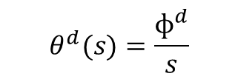
Step input reference
Constant disturbance
$$θ^{d}(s)=\frac{ɸ^{d}}{s}$$
$$D(s)=\frac{D}{s}$$
Set transfer function in this theorem
Final state-theorem
$$θ\left(s\right)=\frac{θ^{d}\left(s\right)\left(K_{p}+\frac{K_{i}}{s}\right)−D(s)}{ɸ}$$
$$\lim_{s→0}{sθ(s)}$$
$$\lim_{s→0}{s\frac{θ^{d}\left(s\right)\left(K_{p}+\frac{K_{i}}{s}\right)−D(s)}{ɸ}}$$
Replace $θ^{d}$ with step input reference and D(s) with constant disturbance
$$\lim_{s→0}{s\frac{\frac{ɸ^{d}}{s}\left(K_{p}+\frac{K_{i}}{s}\right)−\frac{D}{s}}{ɸ}}$$
$$\lim_{s→0}{\frac{ɸ^{d}\left(K_{p}+\frac{K_{i}}{s}\right)−D}{ɸ}}$$

Slide 16
$$\lim_{s→0}{\frac{ɸ^{d}\left(K_{p}+\frac{K_{i}}{s}\right)−D}{(Js^{2}+Bs+K+K_{p}+\frac{K_{i}}{s}+K_{d}s)}}$$
| $∗s$
Prevent dividing by zero
| $∗s$
$$\lim_{s→0}{\frac{ɸ^{d}\left(K_{p}+\frac{K_{i}}{s}\right)s−Ds}{(Js^{3}+Bs^{2}+Ks+K_{p}s+K_{i}+K_{d}s^{2})}}$$
Use limit and observe when, s, approaches 0, i.e, s = 0
0
0
$$\lim_{s→0}{\frac{ɸ^{d}\left(K_{p}+\frac{K_{i}}{s}\right)s−Ds}{(Js^{3}+Bs^{2}+Ks+K_{p}s+K_{i}+K_{d}s^{2})}}$$
0
0
0
0
0
$$=\frac{ɸ^{d}(K_{i})}{K_{i}}=ɸ^{d}$$
We reach our targeted value

Slide 17
Control Theory – Exercise 4, 2017
$$θ\left(s\right)=\frac{θ^{d}\left(s\right)(K_{p}+\frac{K_{i}}{s})−D(s)}{(Js^{2}+Bs+K+K_{p}+\frac{K_{i}}{s}+K_{d}s)}$$
Zeros
Poles
Poles and zero solutions should be negative and within the red circle
Solve the denominator by itself by setting s=0
Solve the nominator by itself by setting s=0

Slide 18
Control Theory – Exercise 2

Slide 19
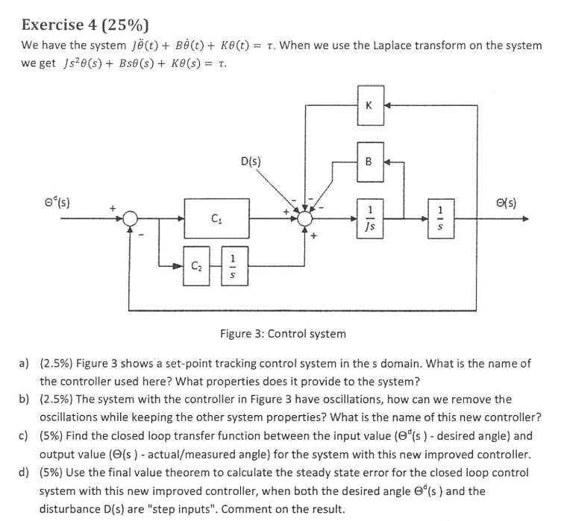
Control Theory – Exercise 4, 2018

Slide 20
Control Theory – Exercise 4, 2018
This is a PI-controller

Slide 21
Control Theory – Exercise 4, 2018
- Add damping to reduce the oscillations with a derivative term known as $K_{d}$

Slide 22
Control Theory – Exercise 4, 2018
See ‘previous exercise’ and follow the same steps and approach

Slide 23
Control Theory – Exercise 4, 2018
See ‘previous exercise’ and follow the same steps and approach

Slide 24
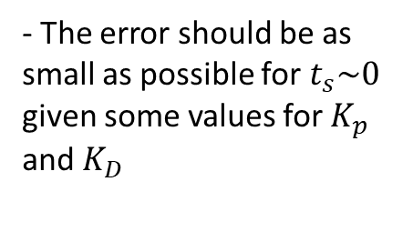
Hint and tips for assignment 4
$$K_{p}=3K_{d}$$
Usually good
$$K_{D}=\frac{K_{p}}{3}$$
- Find the fastest response for settling or convergence, i.e $t_{s}\sim 0$
- The error should be as small as possible for $t_{s}\sim 0$ given some values for $K_{p}$ and $K_{D}$

Slide 25
Group sessions from now on
Week 18, 5. May and 7. May
- Mandatory assignment 4 - Walkthrough solution
Control Theory - Exam problems
Week 19, 12. May and 14. May
- Homogeneous Transform - Summary and Exam problems
- Forward-Kinematics - Summary and Exam problems
*(Inverse-kinematics)* - Included if time
Week 20, 19. May and 21. May
- Inverse-Kinematics - Summary and Exam problems
- Dynamics - Summary and Exam problems
*(Control Theory)* - Included if time
*(ROS)* - Included if time
Week 21, 26.May or 28.May
- Last official group session - Feel free to request any topics you want further explanation
- Additional information or questions about the exam might be explained further here
Week 23, 11. June
- Examination in IN3140

