Slide 1
Group Session 07.05.2021
Email: hpnguyen@ifi.uio.no

Slide 2
Mandatory assignment 4 – Deadline
Remember the deadline for Mandatory assignment 4
Monday, 10. May, 2021, 11:59 PM

Slide 3
Todays plan
Mandatory Assignment 3 – Solution
(I will remove the solution from this powerpoint after some time)
Control Theory – Exam problems
The plan for future group sessions

Slide 4
Mandatory Solution - Start

Slide 5
!REMOVED!

Slide 6
Mandatory Solution - Finish

Slide 7
Control Theory – Exercise 1

Slide 8
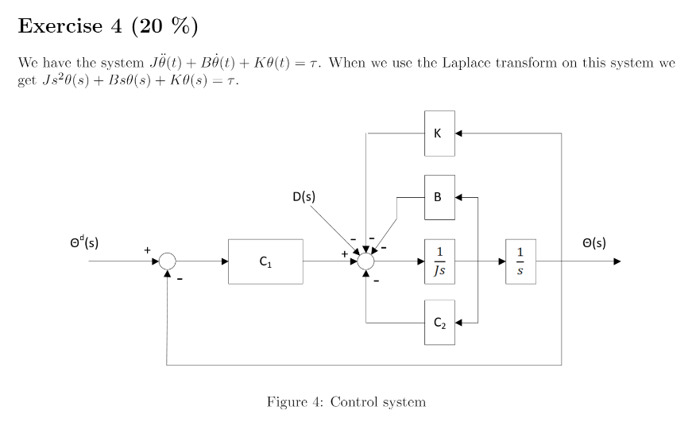
Control Theory – Exercise 4, 2017

Slide 9
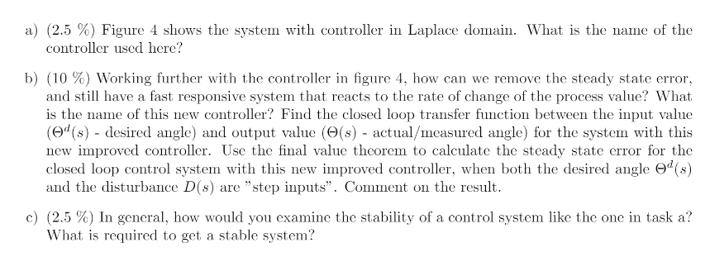
Control Theory – Exercise 4, 2017

Slide 10
$$θ(s)$$
$$sθ(s)$$

Slide 11
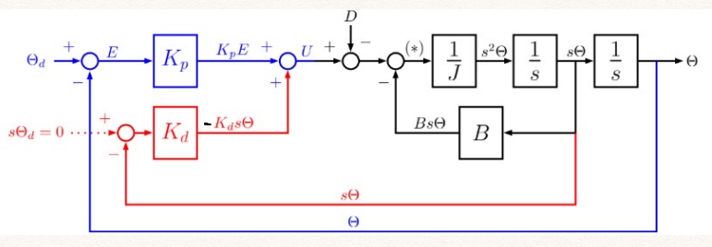
$$sθ(s)$$

Slide 12
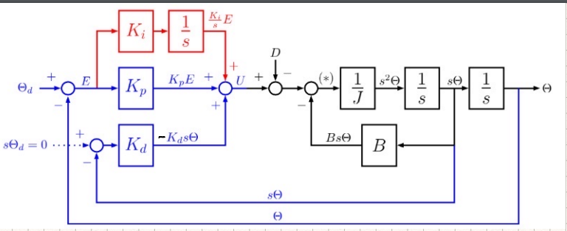
Control Theory – Exercise 4, 2017

Slide 13
$$u_{actuator}={Js}^{2}θ\left(s\right)+Bsθ\left(s\right)+Kθ\left(s\right)−D(s)$$
$e\left(s\right)=θ^{d}(s)−θ$(s)
$$u_{controller}=K_{p}e\left(s\right)+K_{D}\dot{e}\left(s\right)+\frac{K_{i}}{s}e(s)$$
$$\dot{e(s)}=sθ^{d} (s)−sθ(s)$$
$$u_{controller}=K_{p}(θ^{d}−θ)+K_{D}({\dot{θ}}^{d}−\dot{θ})+\frac{K_{i}}{s}(θ^{d}−θ)$$
$$u_{controller}=K_{p}θ^{d}(s)−K_{p}θ(s)+K_{D}sθ^{d} (s)−K_{D}sθ(s)+\frac{K_{i}}{s}θ^{d}(s)−\frac{K_{i}}{s}θ(s)$$
We want the velocity to reach zero as it reaches its targeted value, hence this term becomes 0
0
$$u_{controller}=K_{p}θ^{d}(s)−K_{p}θ(s)−K_{D}sθ(s)+\frac{K_{i}}{s}θ^{d}(s)−\frac{K_{i}}{s}θ(s)$$
Find the transferfunction setting $u_{actuator}$ = $u_{controller}$ and by solving for $θ$
$$K_{p}θ^{d}(s)−K_{p}θ(s)−K_{D}sθ(s)+\frac{K_{i}}{s}θ^{d}(s)−\frac{K_{i}}{s}θ(s)={Js}^{2}θ\left(s\right)+Bsθ\left(s\right)+Kθ\left(s\right)−D(s)$$

Slide 14
$$K_{p}θ^{d}(s)−K_{p}θ(s)−K_{D}sθ(s)+\frac{K_{i}}{s}θ^{d}(s)−\frac{K_{i}}{s}θ(s)={Js}^{2}θ\left(s\right)+Bsθ\left(s\right)+Kθ\left(s\right)−D(s)$$
$K_{p}θ^{d}\left(s\right)+\frac{K_{i}}{s}θ^{d}\left(s\right)+D\left(s\right)={Js}^{2}θ\left(s\right)+Bsθ\left(s\right)+Kθ\left(s\right)+\frac{K_{i}}{s}θ\left(s\right)+K_{D}sθ\left(s\right)$+ $K_{p}θ\left(s\right)$
$θ^{d}\left(s\right)(K_{p}+\frac{K_{i}}{s})+D\left(s\right)=θ\left(s\right)({Js}^{2}+Bs+K+\frac{K_{i}}{s}+K_{D}s$+ $K_{p})$
$$\frac{θ^{d}\left(s\right)(K_{p}+\frac{K_{i}}{s})+D\left(s\right)}{({Js}^{2}+Bs+K+\frac{K_{i}}{s}+K_{D}s\text{+ }K_{p})}=θ\left(s\right)$$

Slide 15
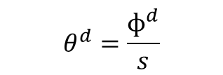
Step input reference
Constant disturbance
$$θ^{d}=\frac{ɸ^{d}}{s}$$
$$D\left(s\right)=\frac{D}{s}$$
Using Final Falue theorem
Set your transferfunction in here
$$\lim_{s→0}{sθ(s)}$$
$$\frac{θ^{d}\left(s\right)(K_{p}+\frac{K_{i}}{s})+D\left(s\right)}{({Js}^{2}+Bs+K+\frac{K_{i}}{s}+K_{D}s\text{+ }K_{p})}=θ\left(s\right)$$
$$\lim_{s→0}{s}\frac{θ^{d}\left(s\right)(K_{p}+\frac{K_{i}}{s})+D\left(s\right)}{({Js}^{2}+Bs+K+\frac{K_{i}}{s}+K_{D}s\text{+ }K_{p})}$$
Replace $θ^{d}(s)$ with step input reference and the disturbance
$$\lim_{s→0}{s}\frac{\frac{ɸ^{d}}{s}(K_{p}+\frac{K_{i}}{s})+\frac{D}{s}}{({Js}^{2}+Bs+K+\frac{K_{i}}{s}+K_{D}s\text{+ }K_{p})}$$

Slide 16
$$\lim_{s→0}{s}\frac{\frac{ɸ^{d}}{s}(K_{p}+\frac{K_{i}}{s})+\frac{D}{s}}{({Js}^{2}+Bs+K+\frac{K_{i}}{s}+K_{D}s\text{+ }K_{p})}$$
$$\lim_{s→0}{\frac{ɸ^{d}(K_{p}+\frac{K_{i}}{s})+D}{({Js}^{2}+Bs+K+\frac{K_{i}}{s}+K_{D}s\text{+ }K_{p})}}$$
| * s
Prevent dividing by zero
| * s
$$\lim_{s→0}{\frac{sɸ^{d}(K_{p}+\frac{K_{i}}{s})+Ds}{({Js}^{3}+Bs^{2}+Ks+K_{i}+K_{D}s^{2}\text{+ }K_{p}s)}}$$
Now we can use the lim
0
0
$$\lim_{s→0}{\frac{sɸ^{d}(K_{p}+\frac{K_{i}}{s})+Ds}{({Js}^{3}+Bs^{2}+Ks+K_{i}+K_{D}s^{2}\text{+ }K_{p}s)}}$$
0
0
0
0
0

Slide 17

$$=\frac{ɸ^{d}(K_{i})}{(K_{i})}$$
$$=ɸ^{d}$$
The result will be the targeted$θ^{d}$

Slide 18
Control Theory – Exercise 4, 2017
$$θ\left(s\right)=\frac{θ^{d}\left(s\right)(K_{p}+\frac{K_{i}}{s})−D(s)}{(Js^{2}+Bs+K+K_{p}+\frac{K_{i}}{s}+K_{d}s)}$$
Zeros
Poles
Solve the denominator by solving for s
Poles and zero solutions should be negative and within the red circle
Solve the nominator by solving for s

Slide 19
Control Theory – Exercise 2

Slide 20
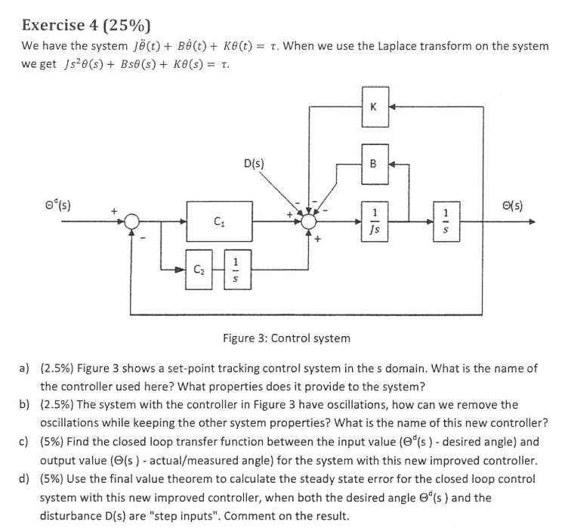
Control Theory – Exercise 4, 2018

Slide 21
Control Theory – Exercise 4, 2018
This is a PI-controller

Slide 22
Control Theory – Exercise 4, 2018
- Add damping to reduce the oscillations with a derivative term known as $K_{d}$

Slide 23
Control Theory – Exercise 4, 2018
See ‘previous exercise’ and follow the same steps and approach

Slide 24
Control Theory – Exercise 4, 2018
See ‘previous exercise’ and follow the same steps and approach

Slide 25
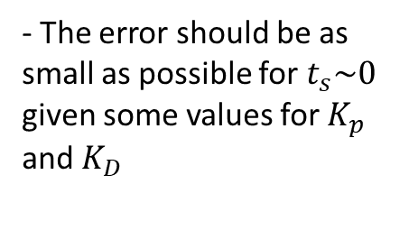
Hint and tips for assignment 4
$$K_{p}=3K_{d}$$
Usually good
$$K_{D}=\frac{K_{p}}{3}$$
- Find the fastest response for settling or convergence, i.e $t_{s}\sim 0$
- The error should be as small as possible for $t_{s}\sim 0$ given some values for $K_{p}$ and $K_{D}$

Slide 26
Adjust set_point Adjust Kp Adjust Kd
- Observe the time-response, time_settling
- Observe the error and explain

Slide 27
Final value theorem
Kapittel 6.3 formel (6.21 og 6.22)

Slide 28
Group sessions from now on
Week 18, 5. May and 7. May
- Mandatory assignment 4 - Walkthrough solution
Control Theory - Exam problems
Week 19, 12. May and 14. May
- Homogeneous Transform - Summary and Exam problems
- Forward-Kinematics - Summary and Exam problems
*(Inverse-kinematics)* - Included if time
Week 20, 19. May and 21. May
- Inverse-Kinematics - Summary and Exam problems
- Dynamics - Summary and Exam problems
*(Control Theory)* - Included if time
*(ROS)* - Included if time
Week 21, 26.May or 28.May
- Last official group session - Feel free to request any topics you want further explanation
- Additional information or questions about the exam might be explained further here
Week 23, 11. June
- Examination in IN3140

