Slide 1
Ethics in Natural Language Processing
Pierre Lison
IN4080: Natural Language Processing (Fall 2022)
03.11.2022

Slide 2
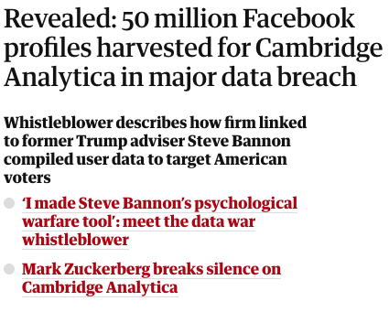
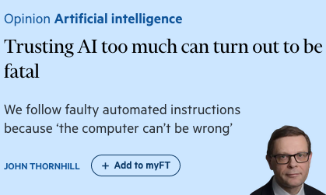
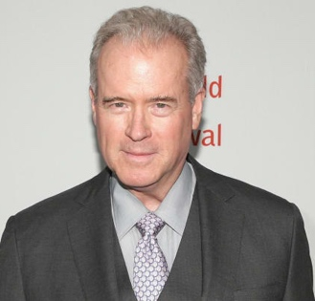
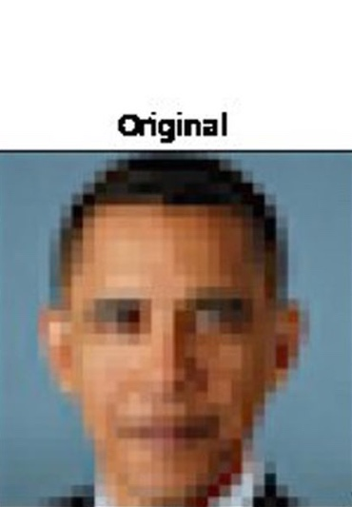
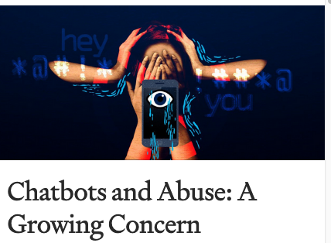
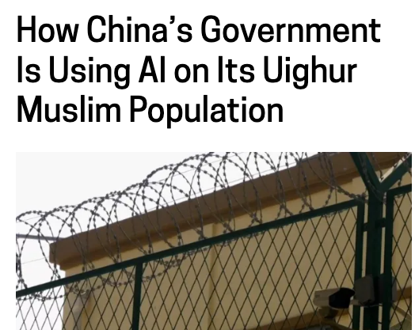
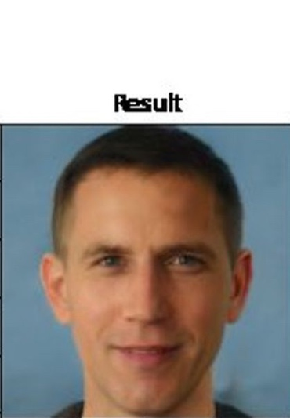
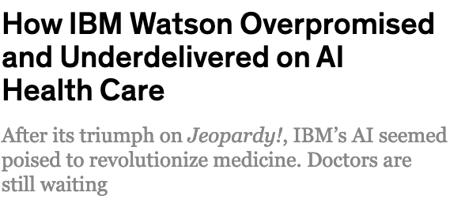

Slide 3
Plan for today
What is ethics?
Misrepresentation & bias
Unintended consequences
Misuses of technology
Privacy & trust

Slide 4
Plan for today
What is ethics?
Misrepresentation & bias
Unintended consequences
Misuses of technology
Privacy & trust

Slide 5
Ethics
= the systematic study of conduct based on moral principles, reflective choices, and standards of right and wrong conduct
[P. Wheelwright (1959), A Critical Introduction to Ethics]
A practical discipline – how to act?
Depends on our values, norms and beliefs
No unique, objective answers!
But more than just "opinions" – need to justify our choices in a rational manner

Slide 6
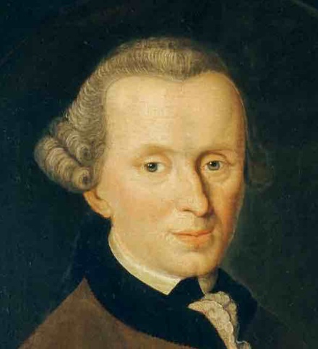
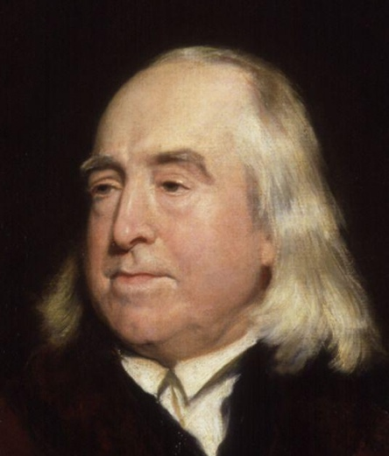
Ethics
Various philosophical traditions to define what is good/bad:
Deontological: respect of moral principles and rules
Consequentialist: focus on the outcomes of our actions
(and more)
Imannuel Kant (1724-1804)
Jeremy Bentham (1748-1832)
No particular "side" in this lecture
Inspiration from multiple ethical perspectives

Slide 7
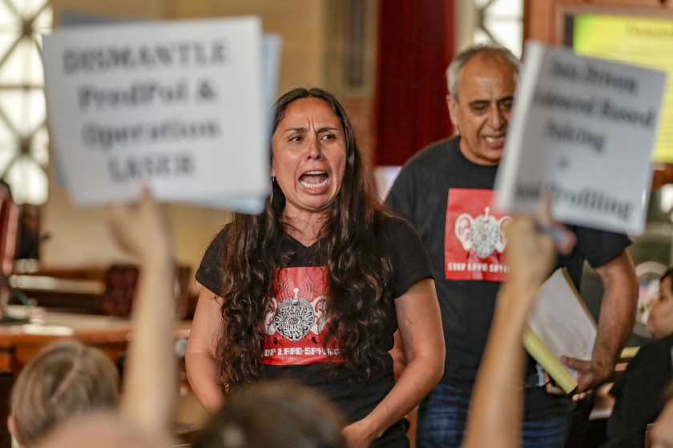
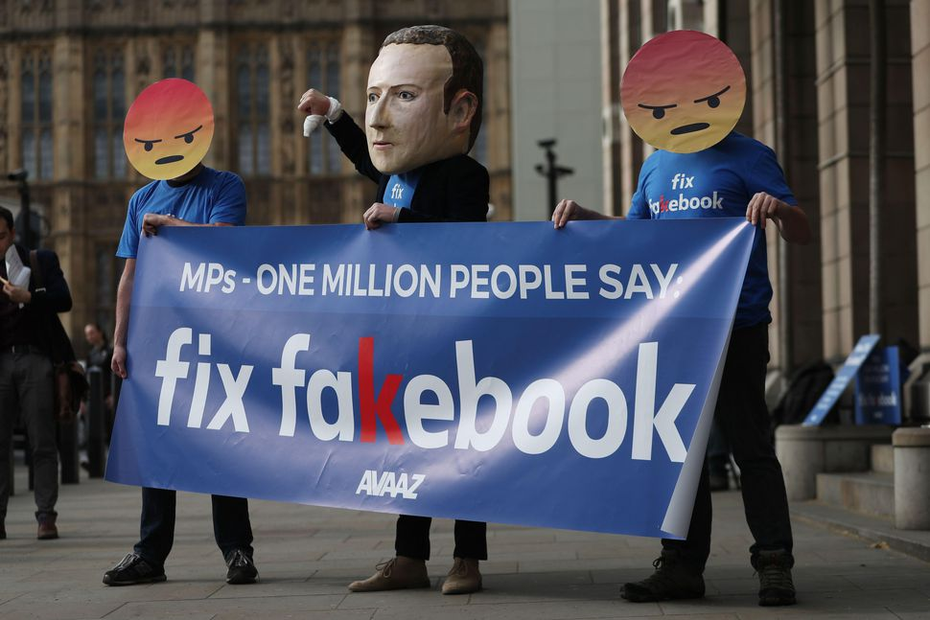
Ethics
Protests against LAPD's system for "data-driven predictive policing"
Protests against Facebook's perceived passivity against disinformation campaigns (fake news etc.)
The NLP tools we build, deploy or maintain have real impacts on real people
Who might benefit/be harmed?
Can our work be misused?
Which objective do we optimise?

Slide 8
Ethics
Ethical behaviour is a basis for trust
We have a professional duty to consider the ethical consequences of our work
Ethical ≠ Legal!
Plenty of actions are not illegal but will be seen by most as unethical
Laws should embody moral principles - but don't always do
www.acm.org/code-of-ethics

Slide 9
Plan for today
What is ethics?
Misrepresentation & bias
Unintended consequences
Misuses of technology
Privacy & trust

Slide 10
Language and people
"The common misconception is that language has to do with words and what they mean.
It doesn't.
It has to do with people and what they mean."
[H. Clark & M. Schober (1992), "Asking questions and influencing answers", Questions about questions.]
Language data does not exist in a vacuum – it comes from people and is used to communicate with other people!
These people may have various stereotypes & biases
& their relative position of power and privilege affects the status of their language productions

Slide 11
Demographic biases
Certain demographic groups are largely over-represented in NLP datasets
That is, the proportion of content from these groups is >> their demographic weight
Ex: young, educated white males from US
Under-representation of linguistic & ethnic minorities, low-educated adults, etc.
& gender: 16% of female editors in Wikipedia (and 17% of biographies are about women)
https://www.theguardian.com/technology/2018/jul/29/the-five-wikipedia-biases-pro-western-male-dominated

Slide 12
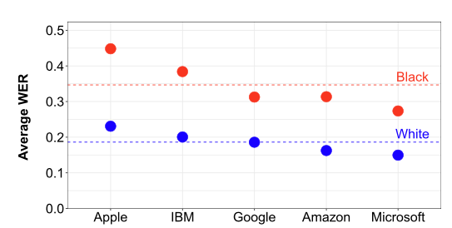
Demographic biases
Under-represented groups in the training set of an NLP model will often experience lower accuracies at prediction time
[A. Koenecke et al (2020). Racial disparities in automated speech recognition. Proceedings of the National Academy of Sciences]
Can lead to the technological exclusion of already disadvantaged groups

Slide 13
Elderly users
Sketch from Saturday Night Live, 2017

Slide 14
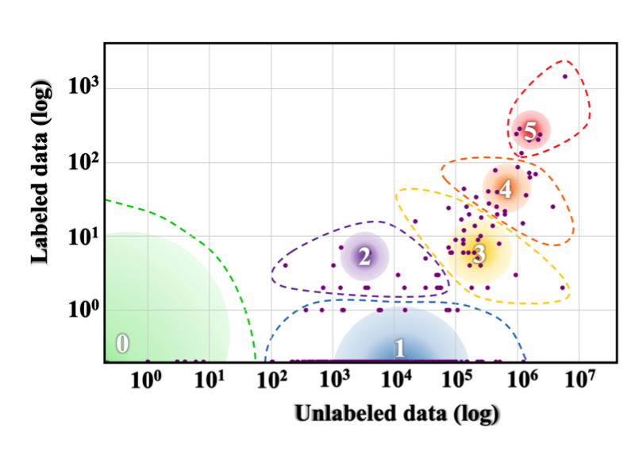
Linguistic (in)justice
Only a small fraction of the world's 7000 languages covered in NLP datasets & tools
"The Winners"
English
"The Underdogs"
Note the logarithmic scale!
"The Rising Stars"
"The Hopefuls"
"The Scraping-By"
"The Left-Behind"
[Joshi et al (2020), The State and Fate of Linguistic Diversity and Inclusion in the NLP World, ACL]

Slide 15
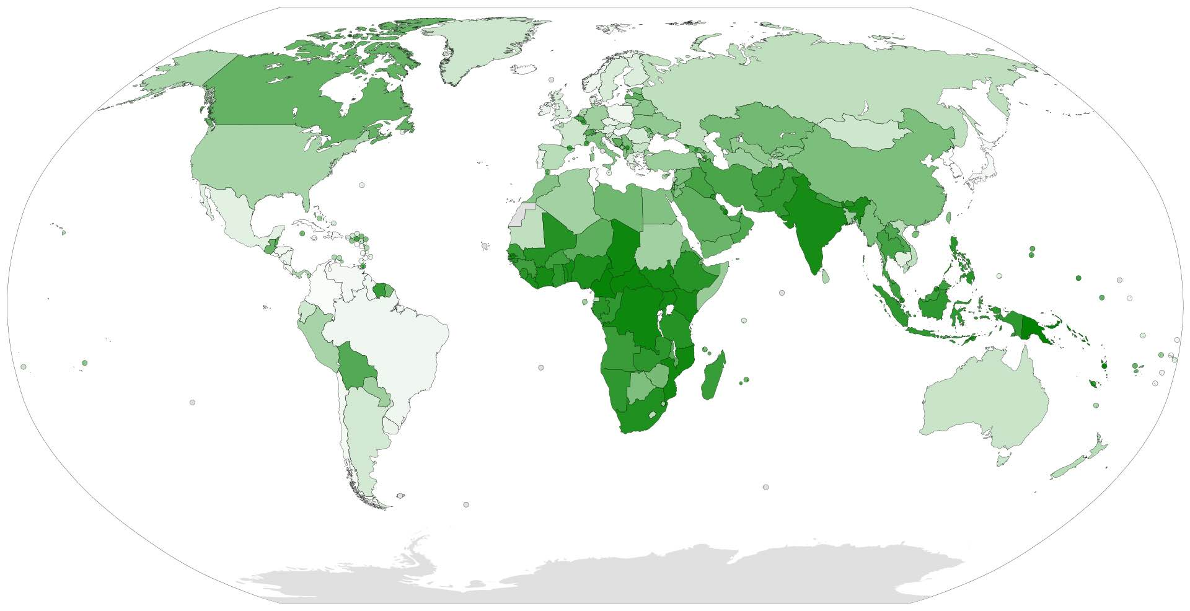
Linguistic (in)justice
The lack of linguistic resources & tools for most languages is a huge ethical issue
We exclude from our technology the part of the world's population that is already most vulnerable, both culturally and socio- economically!
Linguistic diversity index

Slide 16
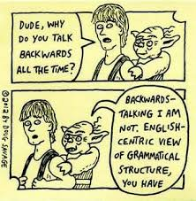
Linguistic (in)justice
The dominance of US & British English in NLP is also a scientific problem
NLP research not sufficiently exposed to typological variety
Focus on linguistic traits that are important in English (such as word order)
Neglect of traits that are absent or minimal in English (such as morphology)

Slide 17
Social biases
Stereotypes, prejudices, sexism & other types of social biases expressed in the training data will also creep into our NLP models
Masculine form
Feminine form

Slide 18
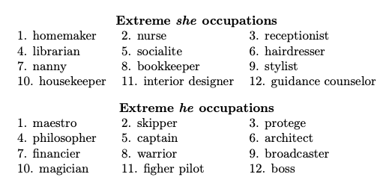
Social biases
Also observed in language modelling:
And even in word embeddings:
[Bolukbasi, T. et al (2016). Man is to computer programmer
as woman is to homemaker? Debiasing word embeddings. In NIPS.]

Slide 19
Social biases
NLP models may not only reflect but also amplify biases in training data
& make biases appear more "objective"
Harms caused by social biases are often diffuse, unconscious & non-intentional
More pernicious & difficult to address!
Relatively small levels of harm ("microagressions"), but experienced repeatedly by whole social groups
[Hovy, D., & Spruit, S. L. (2016).
The social impact of natural language processing. In ACL]

Slide 20
Debiasing
pretty
brave
Identify bias direction (more generally: subspace)
"Neutralise" words that are not definitional
(=set to zero in bias direction)
Equalise pairs (such as "boy" – "girl")
scientist
childcare
$$\vec{boy} −\vec{girl}$$
}
take average
$$\vec{he} −\vec{she}$$
boy
...
girl
he
she
Bias
(1 dim.)
Non-bias (299 dim.)
[Bolukbasi, T. et al (2016). Man is to computer programmer
as woman is to homemaker? Debiasing word embeddings. In NIPS.]

Slide 21
Gender in MT
In languages with grammatical gender, the speaker gender may affect translation:
English: I'm happy
French: Je suis heureux (if speaker is male)
Je suis heureuse (if speaker is female)
Male-produced texts are dominant in translated data → male bias in MT
Solution: tag the speaker gender
[M/F]
[Vanmassenhove, E., et al (2018). Getting Gender Right in Neural Machine Translation. In EMNLP]

Slide 22
Debiasing
she
One easy debiasing method is through data augmentation, i.e. by adding gender-swapped examples to the training set
she
he
[Zhao, J. et al (2018). Gender Bias in Coreference Resolution: Evaluation and Debiasing Methods. In NAACL-HLT]

Slide 23
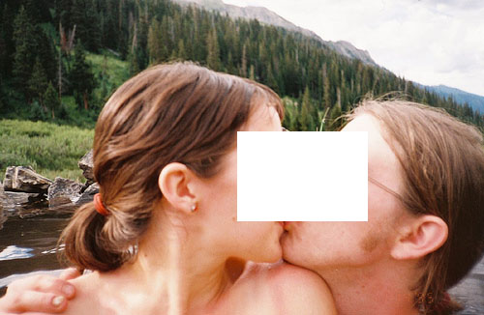
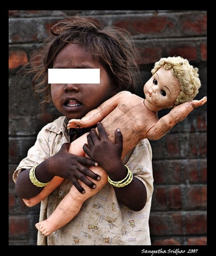
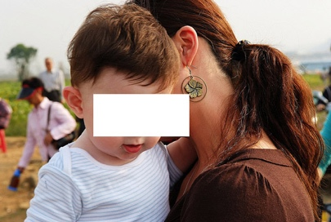
Social biases
Biases can also creep in data annotations (categories, output strings etc.)
Annotations are never neutral, they are a prism through which we see the world
Those are real labels in ImageNet, the most widely used dataset in computer vision !
"swinger"
"toy"
"loser"
[K. Crawford & T. Paglen (2019) "Excavating AI: The politics of images in machine learning training sets"]
"hermaphrodyte"
"mixed-blood"

Slide 24
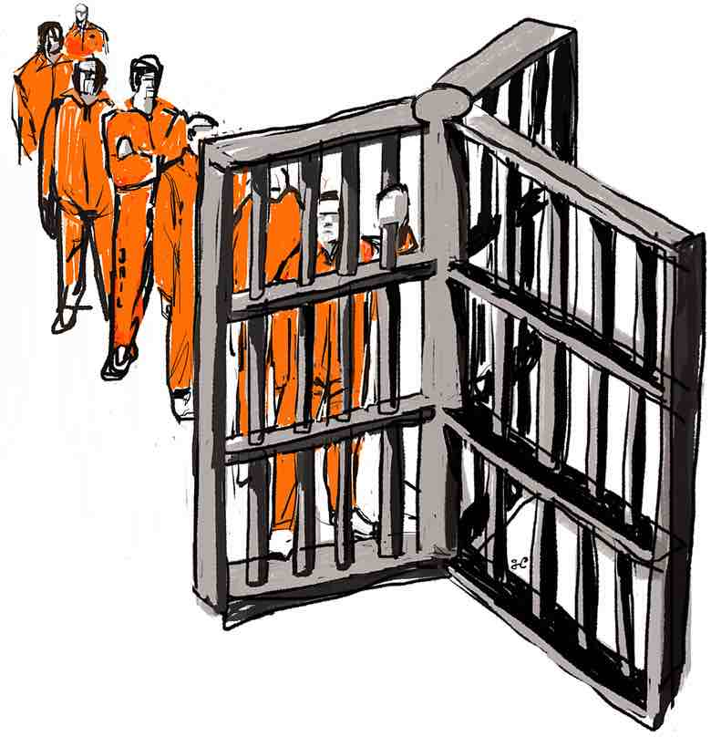
Fairness
We want our systems to be fair. What does that mean?
Imagine a group of individuals distinguished by a sensitive attribute A, like race or gender
Each individual has a feature vector X, and we wish to make a prediction $\hat{Y}$ based on X
Example: predict the likelihood of recidivism among released prisoners, while ensuring our predictions are not racially biased

Slide 25
Definitions of fairness
Unawareness: require that the features X leave out the sensitive attribute A
Problem: ignores correlations between features (such as the person's neighbourhood)
Demographic parity:
$$P_{A=1}\left(\hat{Y}=1\right)≈P_{A=0}\left(\hat{Y}=1\right)$$
In our example, this would mean that the proportion of prisoners predicted to become redicivists should be (approx.) the same for whites and non-whites

Slide 26
Definitions of fairness
Predictive parity: (with y = 0 and 1)
${ P}_{A=1}\left(Y=y| \hat{Y}=y\right)≈P_{A=0}\left(Y=y | \hat{Y}=y\right)$
Equality of odds
$$P_{A=1}\left(\hat{Y}=y| Y=y\right)≈P_{A=0}\left(\hat{Y}=y | Y=y\right)$$
→ The precision of our predictions (recidivism or not) should be the same across the two groups
→ The recall of our predictions should be the same. In particular, if I am not going to relapse to crime, my odds of being marked as recidivist should be similar

Slide 27
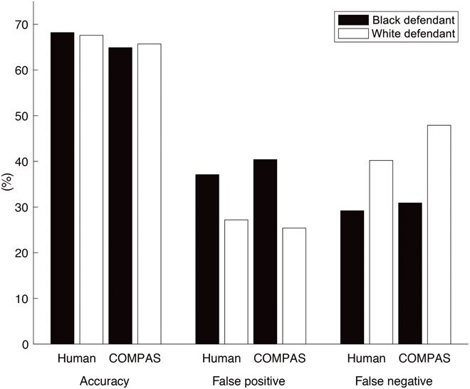
Fairness
[Friedler, S. A. et al (2016).
On the (im)possibility of fairness]
Those fairness criteria are incompatible - cannot satisfy them simultaneously!
COMPAS software:
Optimised for predictive parity
Led to biased odds (black defendants much more likely to be false positives)

Slide 28
What is ethics?
Misrepresentation & bias
Unintended consequences
Misuses of technology
Privacy & trust

Slide 29
Unintended consequences
As computing professionals, we have a duty to consider how the software we develop may be used in practice.
What may be the (intended or unintended) impacts of this software on individuals, social groups, or society at large?

Slide 30
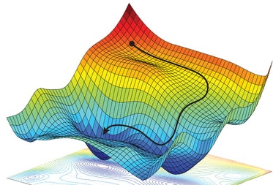
Training objectives
ML models are built to optimise a given objective function
Or, equivalently, minimise a loss function
In classification, we often seek to minimise the cross-entropy loss between the model predictions and the actual labels
In reinforcement learning, we maximise the expected cumulative reward
The objective function defines what we perceive as good solutions for a task

Slide 31
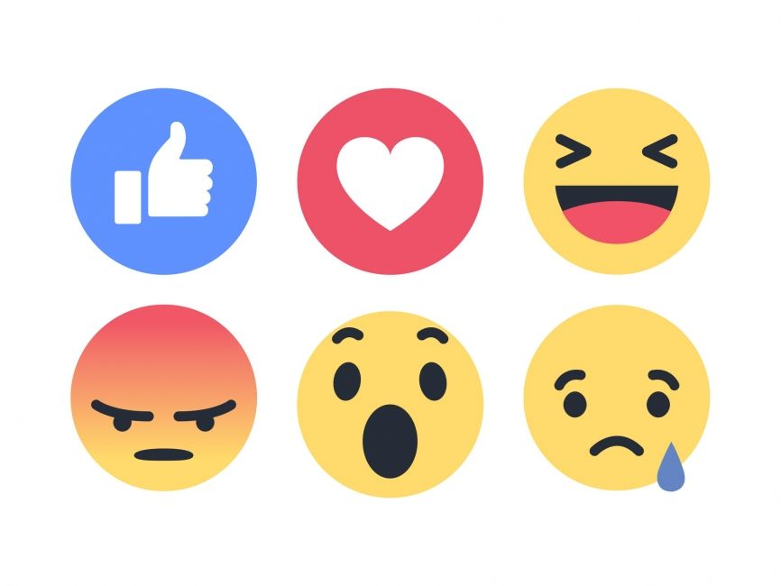
Training objectives
"Externalities" that are not part of the objective function are thus ignored
Example: ML models used in social media are often optimized towards maximising user engagement
As it turns out, controversial & divise content yields more user engagement on social media
Which leads to wide-ranging consequences, such as heightened political polarisation

Slide 32
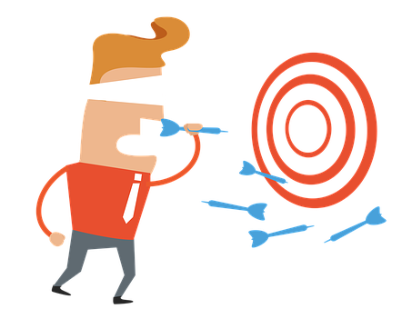
Training objectives
Ideally, we wish our objective function to include all factors that we consider part of a "good solution"
Such as not increasing political polarisation
Not always possible in practice, specially for factors that cannot be easily measured
But we must be aware of the discrepancy between what we would consider as "good solutions" and what we actually optimise

Slide 33
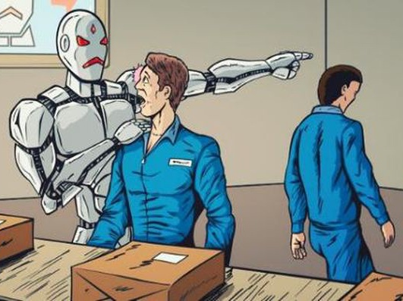
Automation
The deployment of AI systems to automate tasks currently performed by humans raises many ethical issues
Such as its influence on the job market (and thus on social inequalities)
But the social impact of automation cannot be discussed without looking into matters of socio-economic policy & welfare → we leave out this question for today

Slide 34
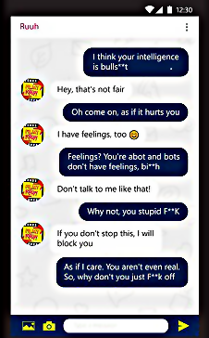
Abusive language
High proportion (> 10%) of user utterances in chatbots exhibit abusive language
Sexual harassment, insults, hate speech, toxic language
Influence on human-human conversations?
How should the chatbot respond?
[De Angeli, A., & Brahnam, S. (2008). I hate you!
Disinhibition with virtual partners. Interacting with computers.]
[P. Harish, "Chatbots and abuse: A growing concern. Medium]

Slide 35
Sexist language

Slide 36
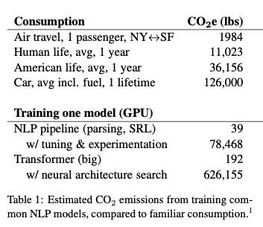
Other ethical questions
Reliance on crowdsourcing for annotations, characteristed by extremely low wages, no social protection and no taxation
Climate impact of of deep learning:
[Fort, K., Adda, G., & Cohen, K. B. (2011). Amazon mechanical turk: Gold mine or coal mine? Computational Linguistics]
[Strubell, E., Ganesh, A., & McCallum, A. (2019). Energy and policy considerations for deep learning in NLP. ACL]

Slide 37
Plan for today
What is ethics?
Misrepresentation & bias
Unintended consequences
Misuses of technology
Privacy & trust

Slide 38
Deception
NLP can be used to deceive people:
Impersonate the voice of existing individuals
Generate fake news using neural LMs
Or simply trick people into believing they talk with a real person and not a chatbot
→ When you use NLP to create synthetic content, always inform your audience about it
(for chatbots: are the replies from a human or a bot?)

Slide 39
Manipulation
AI tools can even employed for manipulation purposes:
Disinformation campaigns, trolling
Fishing attempts in cyber-security
Interestingly, NLP can also be used to counter these malicious activities:
Automated detection of fake news & trolls
[Zhou, X., & Zafarani, R. (2020). A survey of fake news: Fundamental theories, detection methods, and opportunities. ACM Computing Surveys]

Slide 40
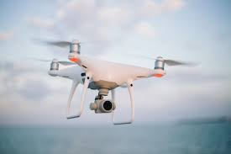
Dual use
= technology that can be used for both peaceful & military aims
Nuclear power being a prominent example (civilian nuclear ↔︎ nuclear missiles)
AI systems are also dual use
Autonomous weapon systems, surveillance, reconnaissance, etc.
We need to be aware of those uses!
https://www.forbes.com/sites/cognitiveworld/2019/01/07/the-dual-use-dilemma-of-artificial-intelligence/

Slide 41
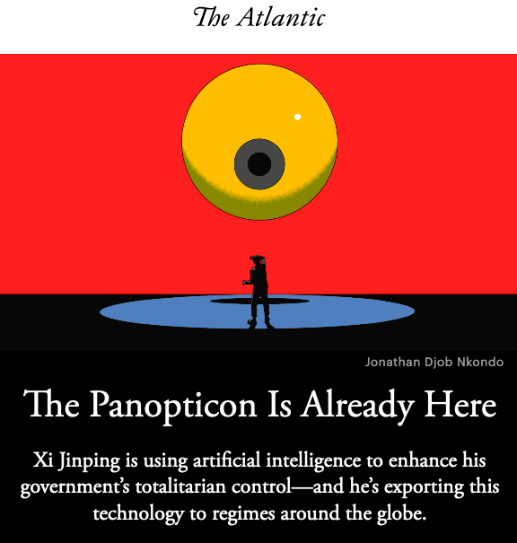
Surveillance
The data trails we leave behind us online are constantly growing
Making it possible to build up detailed profiles of everyone
AI/NLP have become an important tool for web-scale online surveillance

Slide 42
Plan for today
What is ethics?
Misrepresentation & bias
Unintended consequences
Misuses of technology
Privacy & trust

Slide 43
Privacy
= a fundamental human right:
Protected through various national and international legal frameworks (in Norway and other EEA countries: GDPR)
No one shall be subjected to arbitrary interference with his privacy, family, home or correspondence, nor to attacks upon his honour and reputation.
Everyone has the right to the protection of the law against such interference or attacks.
United Nations Declaration of Human Rights, 1948, Article 12

Slide 44
Privacy
= any data related to an identifiable individual
GDPR regulates the storage, processing and sharing of personal data
Personal data cannot be processed without proper legal ground
Most important ground is the consent of the individual to whom the data refers
Consent must be freely given, explicit & informed
If you develop software storing text content that may include personal information, you must collect the consent of the individual(s) in question (or anonymise, cf. next slide)

Slide 45
Privacy
Alternatively, you may anonymise the data
anonymisation = complete and irreversible removal of any information which, directly or indirectly, may lead to the individual being re-identified
ID number | Date of birth | Postal code | Gender | AIDS?
30088231948 | 30/08/82 | 0950 | M | No
24039115691 | 24/03/91 | 7666 | F | No
10096519769 | 10/09/65 | 3895 | M | No
27107546609 | 27/10/75 | 9151 | F | Yes
Direct identifier (must be removed)
Sensitive attribute
Quasi identifiers (can re-identify when combined with background knowledge)

Slide 46
Privacy
Editing/masking
NLP can also be employed to detect and edit out personal identifiers in text
Using e.g. sequence labelling, like in NER
But can we truly anonymize text in a GDPR-compliant manner?
Short answer: no.
[Lison, P, Pilán, I., Sánchez, D., Batet, M. and Øvrelid, L. (2021) Anonymisation Models for Text Data: State of the art, Challenges and Future Directions. ACL 2021.]
[Weitzenboeck, E., Lison, P., Cyndecka, M. & Langford, M. (2022) GDPR and unstructured data: is anonymization possible? International Data Privacy Law, 12(3).]

Slide 47
Privacy
User expectations can be quite far removed from our research practices in NLP:
Expect to be asked for content | Disagree | 7.2
 | Tend to disagree | 13.1
 | Tend to agree | 24.7
 | Agree | 55.0
Expect to be anonymised | Disagree | 4.1
 | Tend to disagree | 4.8
 | Tend to agree | 13.7
 | Tend to agree | 76.4
Opinion of Twitter users about the use of their tweets for research purposes
[Williams, M. L., Burnap, P., & Sloan, L. (2017). Towards an Ethical Framework for Publishing Twitter Data in Social Research. Sociology]

Slide 48
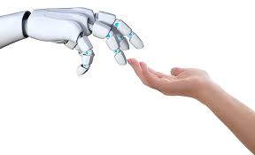
Trust
How much trust should humans place in the output of an AI system?
Need to a find a balance between mistrust (which makes the system useless) and overtrust (which creates excessive risks)
Need to provide explanations for the system predictions and communicate uncertainties associated with them
[Wagner, A. R., Borenstein, J., & Howard, A. (2018). Overtrust in the robotic age. CACM]

Slide 49
Explainability
Deep learning models are "black boxes" whose outputs are difficult to explain
This opacity is problematic, especially for models used for decisions affecting people
Why is the model predicting that a given individual should be refused a loan?
Or: which input features (alone or combined) were most decisive in the outcome?
GDPR mandates a "right to explanation"

Slide 50
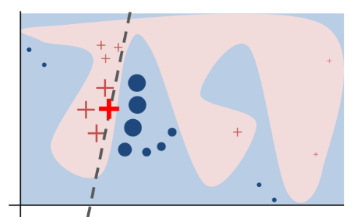
Explainability
Very active research topic in ML/NLP!
Current methods work by converting a learned neural net to a simpler model
One easy method: LIME
Local approximation with a linear model
Gives us the "weight" of each feature in the decision
[Ribeiro, M. T., Singh, S., & Guestrin, C. (2016). " Why should I trust you?" Explaining the predictions of any classifier. ACM SIGKDD]

Slide 51
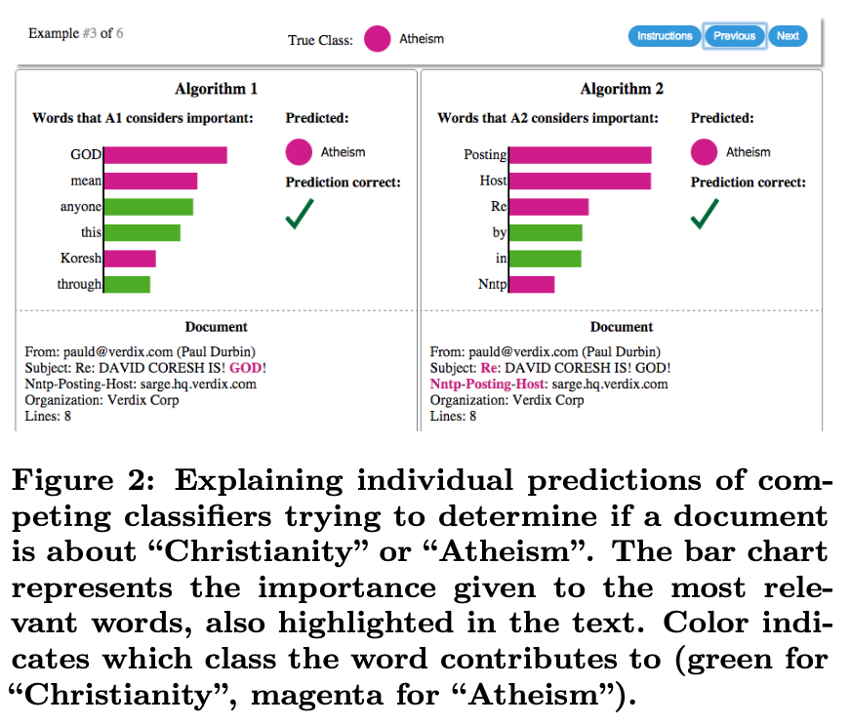
Example from LIME paper
Binary text classifier using a neural network
... Approximated locally (for a given text) as a logistic regression model based on word occurrences.
Using the logistic regression, we can then inspect the weights attached to each word.

Slide 52
Plan for today
What is ethics?
Misrepresentation & bias
Unintended consequences
Misuses of technology
Privacy & trust
Wrap up

Slide 53
Take-home messages
As computing professionals, you must be aware of the ethical consequences of your work!
Think about the social biases (under-represented groups, stereotypes, etc.) in your training data
Reflect over how your IT systems will be deployed, and what unintended impacts they may have
Make sure your software respects user privacy and does not erode user trust

