Slide 1
Dialogue systems & chatbots
Pierre Lison
IN4080: Natural Language Processing (Fall 2023)
17.10.2023

Slide 2
The next 3 weeks
What are they?
What applications?
How does (human-human) dialogue actually work?
Dialogue systems
What are the core components of dialogue systems?
Can they be learned from data?
How are dialogue systems designed, built and evaluated?
2

Slide 3
Plan
Lab sessions:
October 20:
  Linguistic analysis
  Basics of Numpy
October 27:
  Exercises on NLU & ASR
November 3:
  Exercises on dialogue management & RL
  Help with assignment
Lectures:
October 17:
  What is dialogue?
  Basic chatbot models
October 24:
  Chatbots (cont') & NLU
  Short intro to ASR
October 31:
  Dialogue management
  System design & evaluation
3

Slide 4
Assignment
Oblig 3 released this week
  Deadline: november 6
Three parts:
  Chatbots: data-driven chatbot trained on movie and TV subtitles
  Speech processing: implement a simple voice activity detector
  Dialogue management: build a (simulated) talking elevator
4

Slide 5
Material
The slides from the 3 lectures
Chapter 24 of the upcoming version (v3) of Jurafsky & Martin’s SLP book
  & part of chapter 25 on phonetics
  & dialog chapter from previous J&M edition
+ a few additional references listed in the weekly syllabus for the course
5

Slide 6
Plan for today
A short intro to dialogue systems
What is human dialogue?
Basic chatbot models
6

Slide 7
Plan for today
A short intro to dialogue systems
What is human dialogue?
Basic chatbot models
7

Slide 8

Dialogue systems?
A dialogue system is an artificial agent designed to interact with humans using (spoken or text-based) natural language
Dialogue system
output signal
(machine utterance)
input signal
(user utterance)
User
8

Slide 9

What for?
Highly intuitive: no need for training or expertise: all you need is to talk/write!
Touch-based interfaces may be inadequate, cumbersome or dangerous (car driving)
Language is the ideal medium to express complex ideas in a flexible and efficient way
9

Slide 10
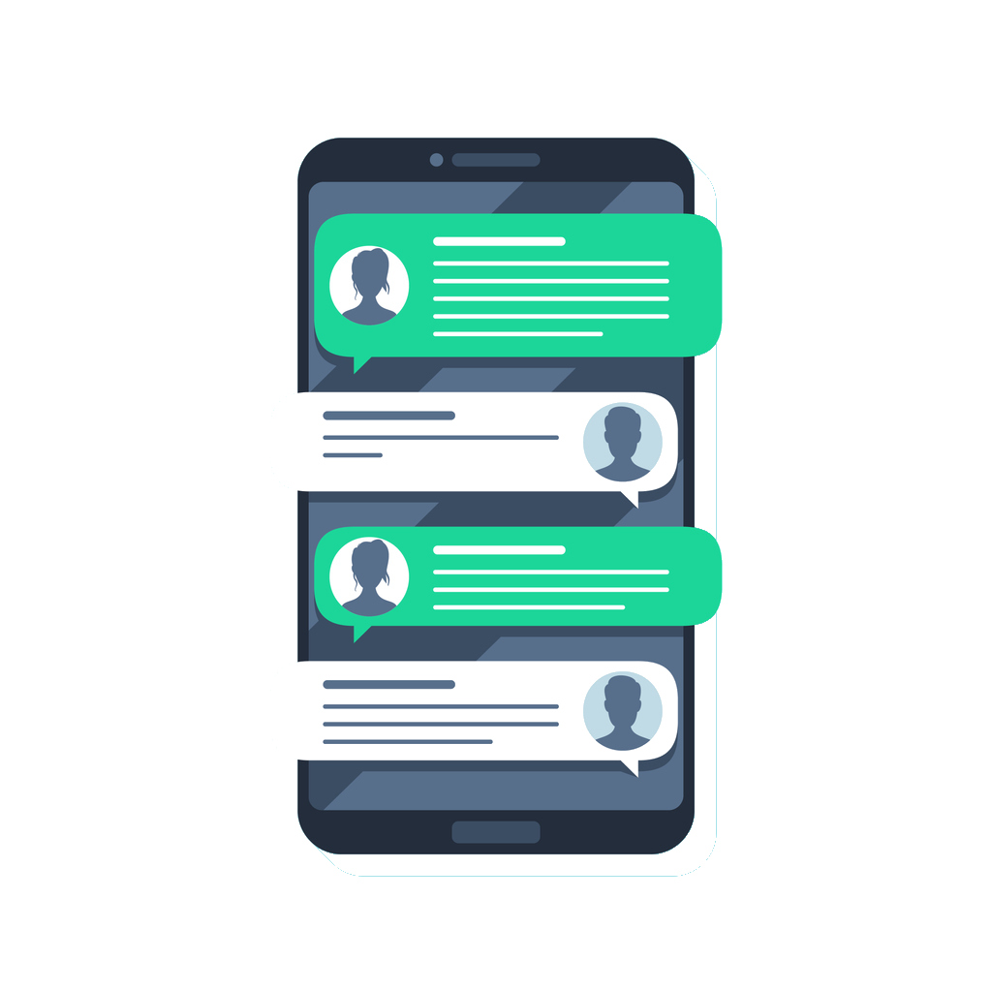
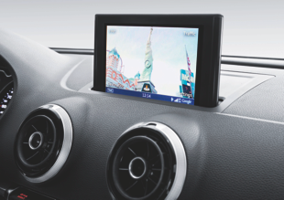
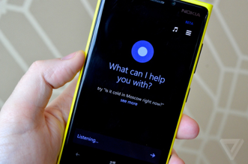
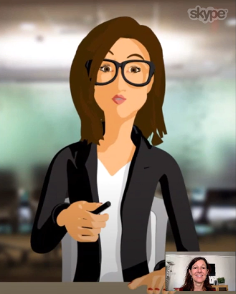
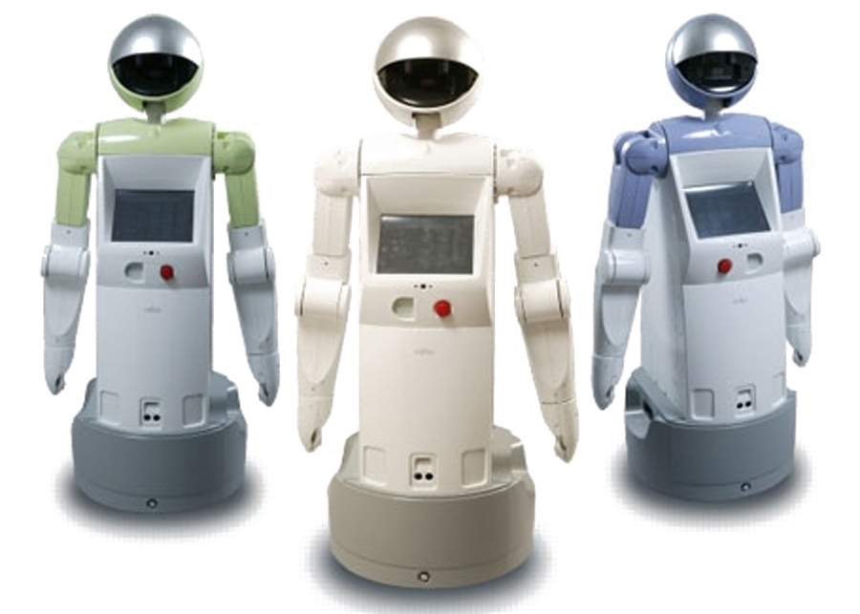

Applications
In-car navigation & control
Chatbots
Mobile virtual assistants (Siri, Cortana, etc.)
Service robots
Smart home environments
Tutoring systems
10

Slide 11

Why is it interesting?
Major application area for NLP (with large R&D investments)
Study language «as a whole», as it is used in real interactions
Playground for key AI problems:
  Sense, reason and act under uncertainty
  Capture the context & other agents
11

Slide 12
Basic architecture
Representation of user intent (category, embeddings from LLM, etc.)
Language
Understanding
Generation / response selection
User
input signal
(user utterance)
output signal
(machine utterance)
12

Slide 13
Basic architecture
Language
Understanding
Generation / response selection
This pipeline is often used for chatbots
Main limitation: no management of the dialogue itself (beyond local context)
Most appropriate for short interactions
13

Slide 14
Architecture with DM
Other Context
State tracking
Dialogue state
Selection of response / prompt
User intent
Dialogue management
High-level response / prompt
Language
Understanding
User
Generation
input signal
(user utterance)
output signal
(machine utterance)

Slide 15

Outline
In two weeks, we’ll look at dialogue management in more details
  How to integrate the external context?
  How to handle multiple (i.e. non-verbal) modalities?
  How to design, build and evaluate dialogue systems?
But let’s first have a look at how human conversation actually works
15

Slide 16
Plan for today
A short intro to dialogue systems
What is human dialogue?
16

Slide 17
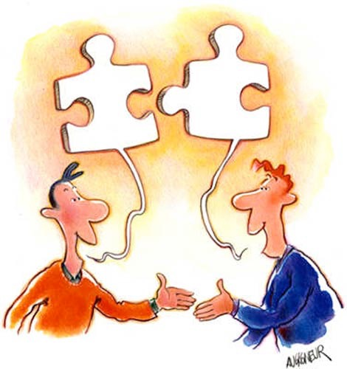
What is dialogue?
  Spoken (“verbal”) + possibly non-verbal interaction between two or more participants
  Dialogue is a joint, social activity, serving one or several purposes for the participants
  What does it mean to view dialogue as a joint activity?
17

Slide 18
Turn-taking
Dialogue participants take turns
  Turn = continuous contribution from one speaker
  Turn-taking is a resource allocation problem
Surprisingly fluid in normal conversations:
  Minimise both gaps (no speaker) and overlaps (more than one speaker)
  Interval between speakers is around 250 ms
[Duncan (1972): «Some Signals and Rules for Taking Speaking Turns in Conversations», in Journal of Personality and Social Psychology]
18

Slide 19
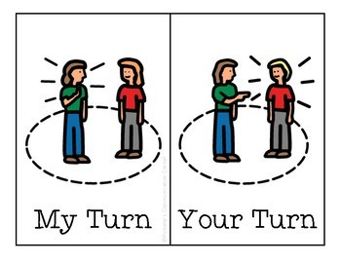
Turn-taking
How are turns taken or released?
Markers for turn boundaries:
  Complete syntactic/semantic unit?
  Dialogue structure (greetings → greetings, question → answer)
  Intonation (falling intonation signals that speaker if finished)
  Non-verbal cues (eye gaze, gestures)
  Silence & hesitation markers (unfilled pauses ≠ filled pauses)
  Social conventions
19

Slide 20
Example of turn-taking
Speaker 1: | han vil bo i skogen ?
Speaker 2: | # altså hvis jeg hadde kommet og sagt " skal vi flytte i skogen ? " så hadde han sagt ja
Speaker 1: | mm
Speaker 2: | men jeg vil ikke bo i skogen
Speaker 1: | nei det skjønner jeg
Speaker 2: | så vi må jo finne et sted som er mellomting og det jeg vil ikke bo utpå landet # i hvilken som helst (uforståelig) ...
Speaker 1: | * men det kommer jo an på hvor i skogen da
[«Norske talespråkskorpus - Oslo delen» (NoTa), collected and annotated by the Tekstlaboratoriet]
20

Slide 21
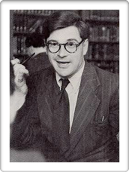
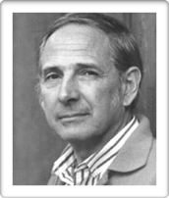
Dialogue acts
Each utterance is an action performed by the speaker
  The speaker has a specific goal (which might be only to establish or maintain rapport with the listeners)
  The utterance produces specific effects upon the listeners, or the world at large
  «Language as action» perspective
J.L. Austin (1911-1960)
philosopher of language
J. Searle (1932, - )
philosopher of language
[J. L. Austin (1955), How to do things with words.]
21

Slide 22
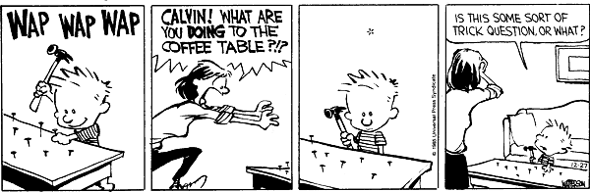
Dialogue acts
The mother reaction has a specific purpose
  Communicating her suprise/anger, and stop Calvin
Her question will trigger some effects:
  A psychological reaction from Calvin (e.g. surprise)
  Possibly a real-world effect as well (Calvin stopping his action)
22

Slide 23
Searle’s taxonomy
Assertives: committing the speaker to the truth of a proposition. E.g.: «The exam will take place on November 25»
Directives: attempts by the speaker to get the addressee to do something. E.g. : «could you please clean up your room?»
Commissives: committing the speaker to some future course of action. E.g.: «I promise I’ll clean up my room».
Expressives: expressing the psychological state of the speaker. E.g.: «thanks for cleaning up your room».
Declaratives: bringing about a different state of the world by the utterance. E.g.: «You’re fired».
23

Slide 24
Deixis
Dialogue often referential to a spatio-temporal context
Such references are called deictics
  Related concepts: indexicals, anaphora
The meaning of a deictic depends on the context in which it is uttered (including the speaker perspective)
« I am lecturing in this room right now »:
depends on who says it
depends on where it is said
depends on when it is said
24

Slide 25

Deictic markers
  Pronouns: «I», «you», «my», «yours»
  Adverbs of time and place: «now», «yesterday», «here», «there»
  Demonstratives: «this», «that»
  Tense markers: «he just left»
  Others: «the mug to your right», «go away!», «the other one»
  Non-verbal signs, based on gestures, gaze, etc.
25

Slide 26
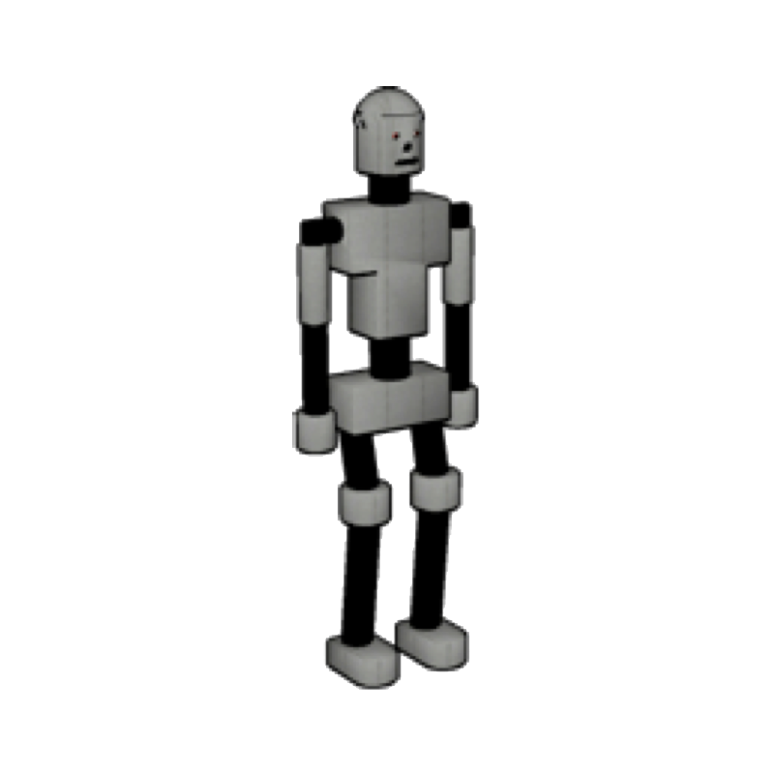

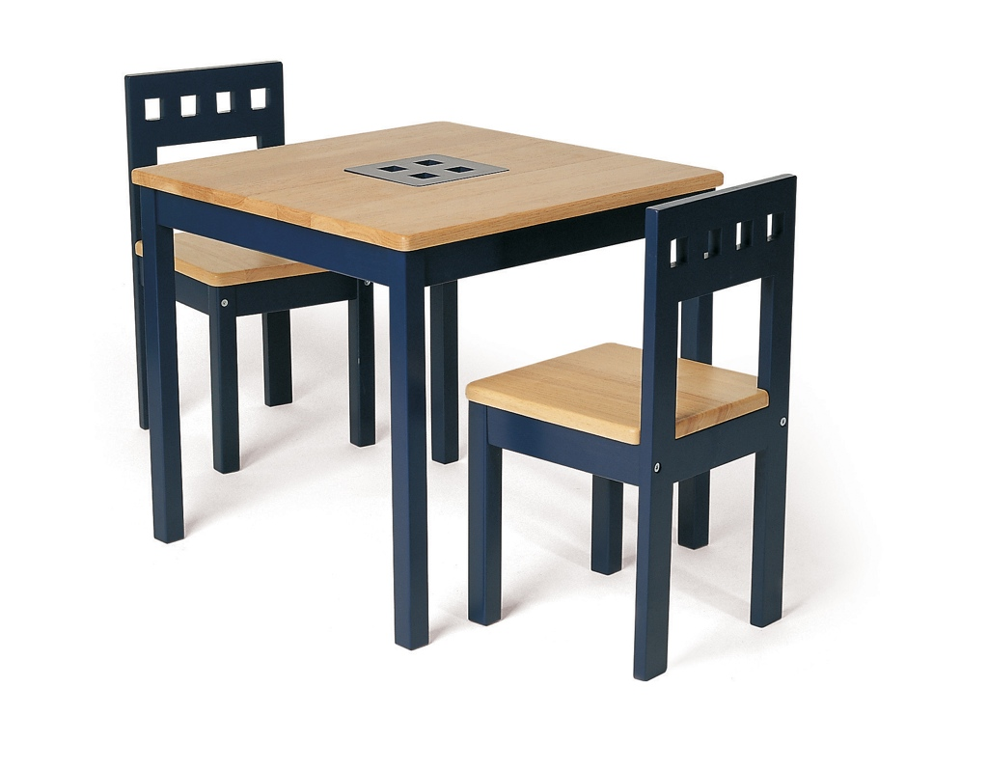

Deixis
Deictics can refer to virtually anything:
  Objects: «take that mug»
  Events: «don’t do that», «this car accident was awful»
  Persons: «You’re being an idiot»
  Abstract entities: «This methodology is flawed»
Perspective is important:
The table is behind me!
behind the guy = in front of me!
26

Slide 27
Grounding
Speaker A’s knowledge
Dialogue is a joint, collaborative process between the participants
  Need to ensure mutual understanding
Gradual expansion and refinement of common ground
  Common ground = shared knowledge
Speaker B’s knowledge
Common
ground
[H. H. Clark and E. F. Schaefer (1989), «Contributing to discourse», in Cognitive Science]
27

Slide 28

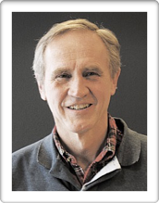
Grounding
Grounding is the process of gradually augmenting the common ground during the interaction
  Variety of signals and strategies
Multiple levels:
  Contact (attention to interlocutor)
  Perception (detection of utterance)
  Understanding (comprehension of utterance)
  Attitudinal reactions
Herbert H. Clark
psycholinguist
[Jens Allwood (1992), «On discourse cohesion», in Gothenburg papers in Theoretical Linguistics.]
Jens Allwood linguist
28

Slide 29
Grounding acts
Backchannels: «uh-uh», «mm», «yeah»
Explicit feedback: «ja det skjønner jeg»
Implicit feedback: A: «I want to fly to Rome» → B: «there are two flights to Rome on Wednesday: ... »
Clarification strategies: «Did you mean to Rome or to Goa?», «could you confirm that ...»
Repair strategies: «OK, you’re not going to Goa. Where do you want to go then?»
29

Slide 30
Examples of grounding
Speaker 1: | vi vasker den hver dag vi # vi har mopp
Speaker 2: | mm ## ja det er fort og faren til M27 legger nytt teppe han # det er gjort på to timer ## så det er fort gjort
Speaker 1: | ja ## da er ikke noe sak
Speaker 2: | vi har skifta teppe tre ganger allerede han gjør det gratis
Speaker 1: | hæ ?
Speaker 2: | vi har skifta teppe tre ganger og # han han ...
Speaker 1: | * jeg skjønner ikke hvorfor dere har teppe
Speaker 2: | jeg syns det var rart jeg òg # men e # (sibilant)
[«Norske talespråkskorpus - Oslo delen» (NoTa), collected and annotated by the Tekstlaboratoriet]
30

Slide 31
Examples of grounding
Speaker 1: | e # nei det er ikke mange
Speaker 2: | ja * nei
Speaker 1: | men heldigvis så var ikke Petter Rudi tatt ut denne gangen da
Speaker 2: | ja # jeg skjønner ikke hva han skal på landslaget å gjøre
Speaker 1: | * nei han har ingen ting på landslaget
Speaker 2: | nei # definitivt
Speaker 1: | å gjøre # han er ubrukelig
Speaker 2: | * moldensere
Speaker 1: | hm?
Speaker 2: | ja disse moldenserne
Speaker 1: | en gang til?
Speaker 2: | disse moldenserne
Speaker 1: | * å ja (fremre klikkelyd) # unnskyld # jeg hørte ikke hva du sa
implicit feedback (repetition of landslaget)
clarification requests
[«Norske talespråkskorpus - Oslo delen» (NoTa), collected and annotated by the Tekstlaboratoriet]
31

Slide 32
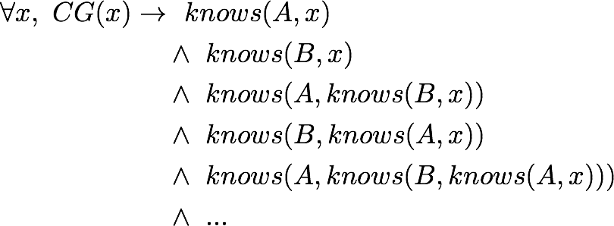
Grounding
Common ground is more than «knowledge that happens to be shared by all participants»
  The participants must also know that it is shared (i.e. know that the others know it as well)
Given two speakers A and B, the common ground CG can be defined as :
32

Slide 33
Conversational implicatures
Very often, part of the meaning of utterance is not explicitly stated, but only implied
How can we retrieve this «suggested» meaning, and go beyond literal interpretations?
  Need to make some assumptions about the speaker to help us infer the hidden part
A: «Is William working today?»
B: «He has a cold»
33

Slide 34
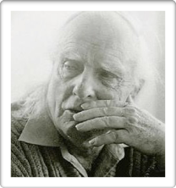
Conversational implicatures
Same idea again: dialogue as a collaborative process
Grice’s Cooperative Principle:
  Maxim of Quality: «be truthful»
  Maxim of Quantity: «be exactly as informative as required»
  Maxim of Relation: «be relevant»
  Maxim of Manner: «be clear»
Paul Grice (1913-1988)
philosopher of language
[Paul Grice (1975), Logic and Conversation.]
34

Slide 35

Conversational implicatures
Based on the cooperative principle, one can draw conversational implicatures
  All participants are assumed to adhere to the maxims
  If an utterance initially seems to deliberately violate a maxim, the listener will then infer additional hypotheses required to make sense of the utterance
35

Slide 36
Conversational implicatures
A: «Is William working today?»
B: «He has a cold»
At first glance, B seems to violate the maxim of relevance - he does not directly answer A’s question
But looking at the utterance more closely, we can read it as implying that (due to his cold) he is probably at home, and thus not working today
This is because we assume that B is cooperative and wouldn’t have uttered «he has a cold» if it didn’t help answering A’s question
36

Slide 37
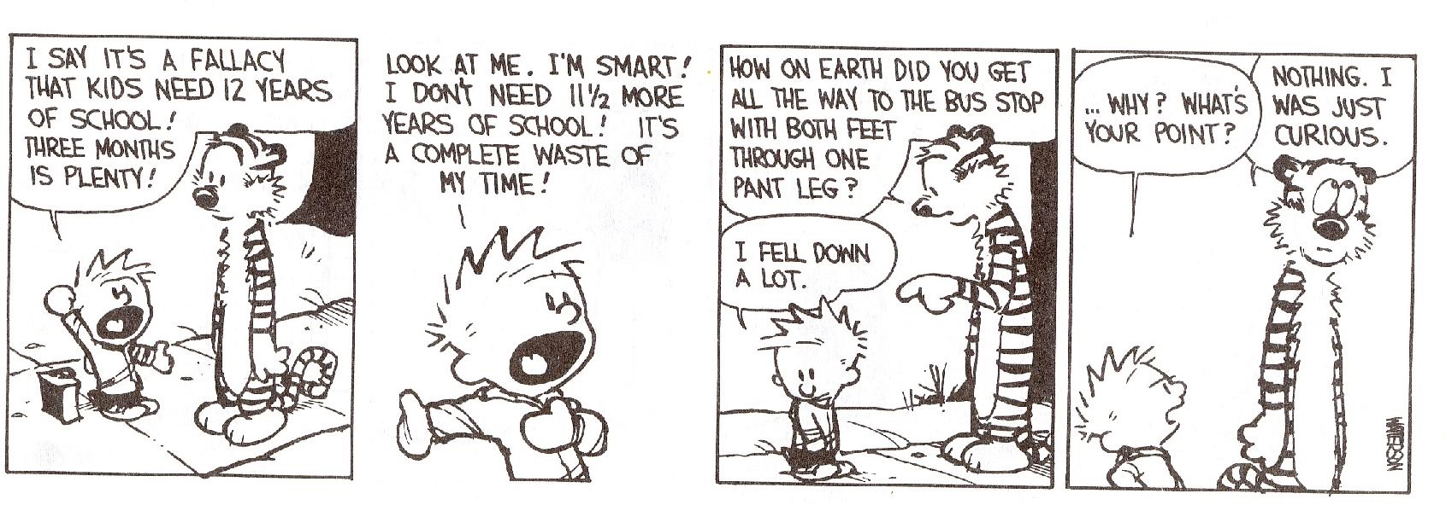
Conversational implicatures
Hobbes’ question is suggesting something about Calvin’s need for schooling, without stating it explicitly
We can understand it because we assume that Hobbes’ contribution is cooperative and thus relevant to the discussion
37

Slide 38
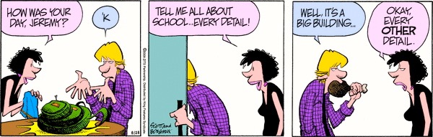
Conversational implicatures
When the cooperative maxims are violated, we can quickly notice it:
Which maxim is violated here?
38

Slide 39
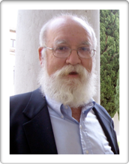
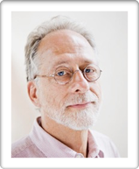
(shared) intentionality
Humans naturally view each other as goal-directed, intentional agents
  Understand other agents in terms of belief, desires and intentions (theory of mind)
But there’s more: humans can jointly attend to external entities and establish shared intentions
Daniel Benett (1942, -)
philosopher of mind
[Dennett, D (1996), The intentional stance.]
Michael Tomasello (1950, -)
developmental psychologist
[Tomasello, M (2018), Becoming Human: A Theory of Ontogeny]
39

Slide 40
Alignment
Participants in a dialogue continuously align their mental representations
  Notion of common ground discussed earlier
But dialogue participants also align at a deeper level, by unconsciously imitating each other
As the interaction unfolds, the participants automatically align their wording, pronunciation, speech rate, and gestures
[Garrod, S., & Pickering, M. J. (2009). Joint action, interactive alignment, and dialog. Topics in Cognitive Science]
40

Slide 41
Plan for today
A short intro to dialogue systems
What is human dialogue?
Basic chatbot models
41

Slide 42
Chatbots
High-level representation of user intent (category, embedding, etc.)
Language
Understanding
Generation / response selection
input signal
(user utterance)
output signal
(machine utterance)
User

Slide 43
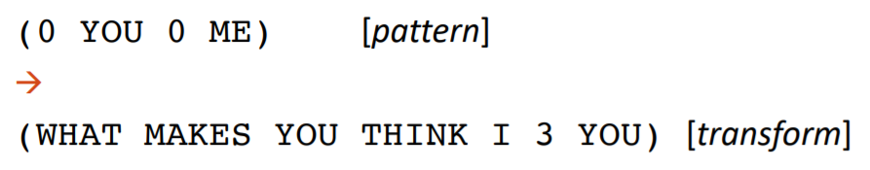
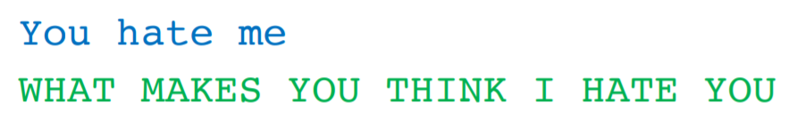
Rule-based models
Pattern-action rules
For instance:
[example from D. Jurafsky]
43

Slide 44
IR models
Alternatively, one can adopt a data-driven approach and learn how to respond to the user based on a dialogue corpus
Key idea:
  Given a user input q, find the utterance t in the dialogue corpus that is most similar to q
  Then return as response the utterance r following t in the corpus
44

Slide 45
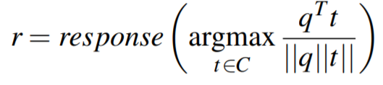
IR models
How to determine which utterance is «most similar» to the actual user utterance?
  Cosine similarity over some vectors
  The vectors can be TF-IDF weighted words
  Or utterance-level embeddings
45

Slide 46
Example
TF vectors:
Corpus:
hei !
hei ! har du det bra ?
ja , hva med deg ?
bare bra
har du spist ?
ja
bare | bra | deg | det | du | ja | har | hei | hva | med | spist | , | ! | ?
 |  |  |  |  |  |  | 1 |  |  |  |  | 1
 | 1 |  | 1 | 1 |  | 1 | 1 |  |  |  |  | 1 | 1
 |  | 1 |  |  | 1 |  |  | 1 | 1 |  | 1 |  | 1
1 | 1
 |  |  |  | 1 |  | 1 |  |  |  | 1
 |  |  |  |  | 1
46

Slide 47
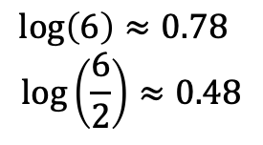
Example
TF-IDF vectors:
Corpus:
hei !
hei ! har du det bra ?
ja , hva med deg ?
bare bra
har du spist ?
ja
bare | bra | deg | det | du | ja | har | hei | hva | med | spist | , | ! | ?
 |  |  |  |  |  |  | .48 |  |  |  |  | .48
 | .48 |  | .78 | .48 |  | .48 | .48 |  |  |  |  | .48 | .48
 |  | .78 |  |  | .48 |  |  | .78 | .78 |  | .78 |  | .48
.78 | .48
 |  |  |  | .48 |  | .48 |  |  |  | .78
 |  |  |  |  | .48
New user utterance q: "går det bra med deg?"
TF-IDF vector:
 | .48 | .78 | .78 |  |  |  |  |  | .78 |  |  |  | .48
47

Slide 48
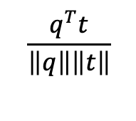

Example
bare | bra | deg | det | du | ja | har | hei | hva | med | spist | , | ! | ?
 |  |  |  |  |  |  | .48 |  |  |  |  | .48
 | .48 |  | .78 | .48 |  | .48 | .48 |  |  |  |  | .48 | .48
 |  | .78 |  |  | .48 |  |  | .78 | .78 |  | .78 |  | .48
.78 | .48
 |  |  |  | .48 |  | .48 |  |  |  | .78
 |  |  |  |  | .48
0
1.07
1.45
0.23
0
0
0
0.50
0.56
0.17
0
0
 | .48 | .78 | .78 |  |  |  |  |  | .78 |  |  |  | .48
48

Slide 49
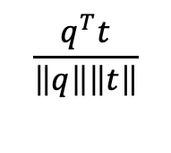
Example
Corpus:
hei !
hei ! har du det bra ?
ja , hva med deg ?
bare bra
har du spist ?
ja
0
0.50
0.56
0.17
0
0
→ The utterance closest to q in our corpus is utterance 3: "ja, hva med deg?"
→ the system should choose as response utterance 4
New user utterance q: "går det bra med deg?"
System response: "bare bra"
49

Slide 50
Dual encoders
Another type of IR-based chatbots
We compute here the dot product between the user input (called "context") and a possible response
u_{c}
Utterance encoder (context)
Where are you ?
Dot product u_{c} ∙ u_{r}
u_{r}
Utterance encoder (response)
(= score expressing how good/appropriate the response is for the given context)
Over there !

Slide 51
Dual encoders
The encoders are typically deep neural networks based on e.g. transformers
Utterance encoder (context)
u_{c}
Where are you ?
u_{c} ∙ u_{r}
u_{r}
Utterance encoder (response)
Over there !
The two encoders often rely on a shared neural network, apart from a last transformation step that is specific for the context or response

Slide 52
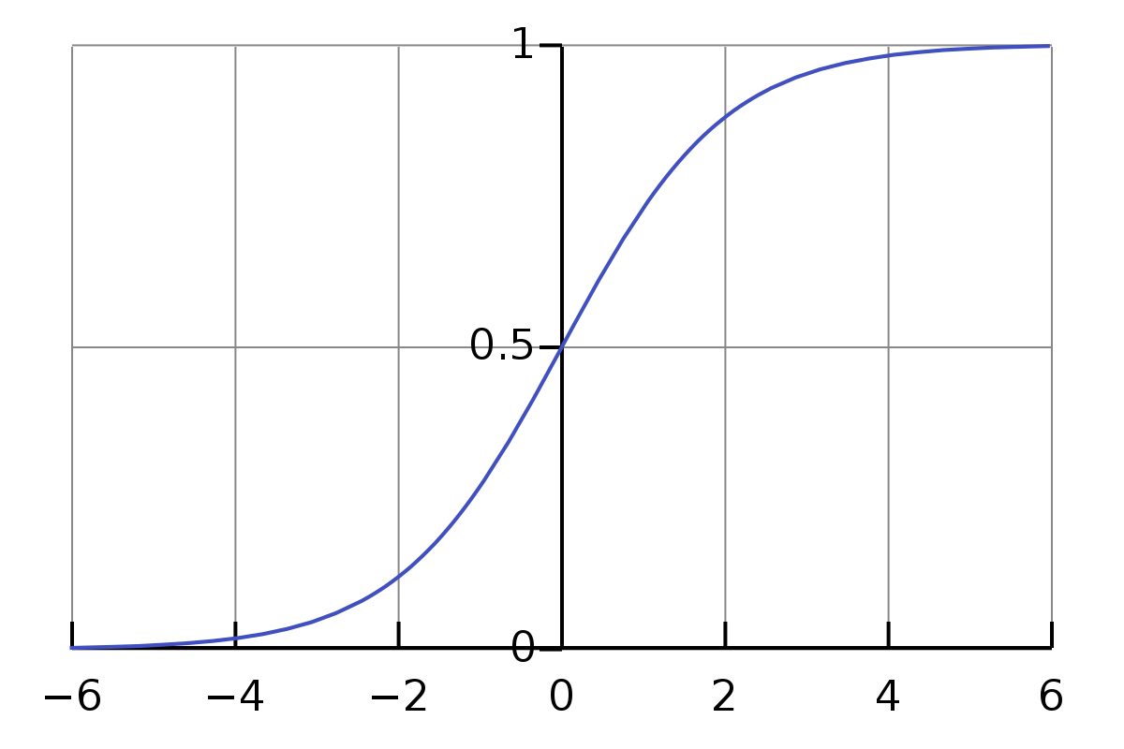
Dual encoders
σ(x) = $\frac{1}{1+e^{−x}}$
u_{c}
Utterance encoder (context)
Where are you ?
σ(u_{c} ∙ u_{r})
u_{r}
Utterance encoder (response)
We can add a sigmoid function to compress the score into the [0,1] range
Over there !
Dual encoders are trained with both positive and negative examples:
Positive : actual consecutive pairs of utterances observed in the corpus → output=1
Negative: random pairs of utterances → output=0

Slide 53
Plan for today
A short intro to dialogue systems
What is human dialogue?
Basic chatbot models
Wrap up
53

Slide 54
Summary (1)
Dialogue = joint social activity
  Dialogue participants take turns
  Each turn is composed of one or several dialogue acts
  Cooperation to ensure mutual understanding (gradual expansion of common ground)
  Cooperative interpretation of each other’s utterances (conversational implicatures)
  Takes place in a context which is crucial for making sense of the interaction (cf. deictics)

Slide 55
Summary (2)
Language Understanding
Response selection
We also looked at basic models for chatbots:
  Rule-based systems, which map conditions (e.g. surface patterns on the user utterance) to responses
  IR-based systems searching for the most similar utterance in a dialogue corpus, and then selecting the utterance after it

Slide 56
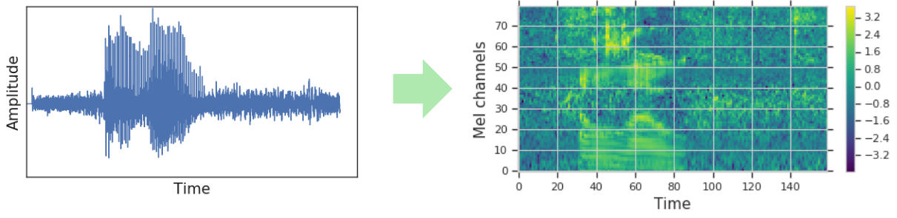
Next week
In the next lecture, we'll look at more advanced chatbot models
  NLU-based approaches (intent & slot recognition)
  Generative models
+ short intro to phonetics & speech recognition!

