Slide 1
Codec 63
Load YUV
F_{n}
(current)
DCT
Quant
Entropy coding
Motion estimation
F_{n-1}
(reference)
Motion compen-sation
recon-struction
iDCT
iQuant

Slide 2
Not in Codec 63
Prepare
(RGB2YUV)
F_{n}
(current)
DCT
Quant
Reorder
Entropy coding
Motion estimation
ok
F_{n-1}
(reference)
F_{n-1}
(reference)
F_{n-1}
(reference)
Motion compen-sation
Intra prediction
fail
recon-struction
iDCT
iQuant

Slide 3
main
c63enc.c:193 main
Load YUV
F_{n}
(current)
DCT
Quant
Entropy coding
Motion estimation
F_{n-1}
(reference)
Motion compen-sation
recon-struction
iDCT
iQuant

Slide 4
read_yuv
Load YUV
c63enc.c:30 read_yuv
F_{n}
(current)
DCT
Quant
Entropy coding
Motion estimation
F_{n-1}
(reference)
Motion compen-sation
recon-struction
iDCT
iQuant

Slide 5
c63_encode_image
Load YUV
c63enc.c:80 c63_encode_image
F_{n}
(current)
DCT
Quant
Entropy coding
Motion estimation
F_{n-1}
(reference)
Motion compen-sation
recon-struction
iDCT
iQuant

Slide 6
c63_encode_image
common.c:83 dct_quantize
common.c:56 dct_quantize_row
Load YUV
F_{n}
(current)
DCT
Quant
Entropy coding
Motion estimation
F_{n-1}
(reference)
Motion compen-sation
recon-struction
iDCT
iQuant

Slide 7
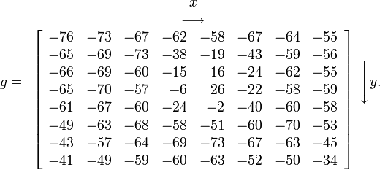
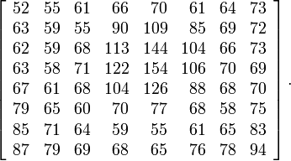
DCT
- 128 =
Each 8×8 block (Y, Cb, Cr) is converted to a frequency-domain representation, using a normalized, two-dimensional DCT
two-dimensional DCT:
G_{u,v} is the DCT at output coordinates (u,v)
u and v are from {0, ..., 7}
g_{x,y} is the pixel value at input coordinates (x,y)
α is a normalizing function:
Notes:
Note: if u and v are 0, cos(0)=1 has a lot of weight. So, we normalize “harder” by multiplying with 1/8. On the left and upper edge, one of the cos values is 1, so we multiply with sqrt(1/8)*sqrt(2/8)=1/4*sqrt(1/2)=1/5.66. Inside, no cos values are 1, so we multiply with sqrt(2/8)^2=1/4

Slide 8
DCT
- 128 =
A 2D DCT can be replaced by applying a 1D DCT twice
two-dimensional DCT:
can be replaced by
$I_{u,y}=α(u)\sum_{x=0}^{7}{g_{x,y}cos\left[\frac{π}{8}\left(x+\frac{1}{2}\right)u\right]}$, $G_{u,v}=α(v)\sum_{y=0}^{7}{I_{u,y}cos\left[\frac{π}{8}\left(y+\frac{1}{2}\right)v\right]}$
Notes:
Note: if u and v are 0, cos(0)=1 has a lot of weight. So, we normalize “harder” by multiplying with 1/8. On the left and upper edge, one of the cos values is 1, so we multiply with sqrt(1/8)*sqrt(2/8)=1/4*sqrt(1/2)=1/5.66. Inside, no cos values are 1, so we multiply with sqrt(2/8)^2=1/4

Slide 9
c63_encode_image
common.c:83 dct_quantize
common.c:56 dct_quantize_row
dsp.c:105 dct_quant_block_8x8
dsp.c:72 quantize_block
dsp.c:21 dct_1d
dsp.c:7 transpose_block
dsp.c:19 scale_block
Load YUV
F_{n}
(current)
DCT
Quant
Entropy coding
Motion estimation
F_{n-1}
(reference)
Motion compen-sation
recon-struction
iDCT
iQuant

Slide 10
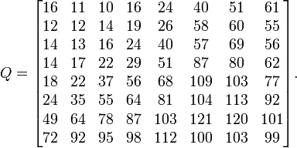
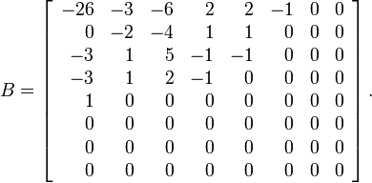
Quantization Example

Slide 11
c63_encode_image
common.c:83 dct_quantize
common.c:56 dct_quantize_row
dsp.c:105 dct_quant_block_8x8
dsp.c:72 quantize_block
dsp.c:21 dct_1d
dsp.c:7 transpose_block
dsp.c:19 scale_block
Load YUV
F_{n}
(current)
DCT
Quant
Entropy coding
Motion estimation
F_{n-1}
(reference)
Motion compen-sation
recon-struction
iDCT
iQuant
tables.c:7 yquanttbl_def
tables.c:19 uvquanttbl_def

Slide 12
c63_encode_image
common.c:83 dct_quantize
common.c:56 dct_quantize_row
dsp.c:105 dct_quant_block_8x8
dsp.c:72 quantize_block
dsp.c:21 dct_1d
dsp.c:7 transpose_block
dsp.c:19 scale_block
Load YUV
F_{n}
(current)
DCT
Quant
Entropy coding
Motion estimation
F_{n-1}
(reference)
Motion compen-sation
recon-struction
iDCT
iQuant
common.c:44 dequantize_idct
common.c:13 dequantize_idct_row
dsp.c:127 dequant_idct_block_8x8
dsp.c:88 dequantize_block
dsp.c:38 idct_1d
tables.c:7 yquanttbl_def
tables.c:19 uvquanttbl_def

Slide 13
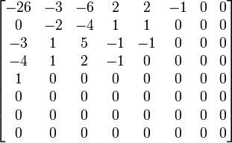
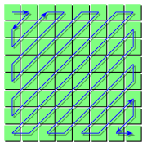
Lossless compression
The resulting data for all 8×8 blocks is further compressed with a loss-less algorithm
1. organize numbers in zigzag pattern
-26, -3, 0, -3, -2, -6, 2, -4, 1, -4, 1, 1, 5, 1, 2, -1, 1, -1, 2, 0, 0, 0, 0, 0, -1, -1, 0 , 0, 0, 0, 0, 0, 0, 0, 0, …., 0, 0
2. run-length coding

Slide 14
c63_encode_image
Load YUV
F_{n}
(current)
DCT
Quant
Entropy coding
Motion estimation
c63write.c:345 write_frame
F_{n-1}
(reference)
Motion compen-sation
recon-struction
iDCT
iQuant

Slide 15
Full Search Motion Estimation
F_{n-1}
(reference)
F_{n}
(current)
Find best match
and so on ...
For comparing blocks:
SAD - Sum of Absolute Differences
W: fixed set, but not only integers !

Slide 16
c63_encode_image
Load YUV
F_{n}
(current)
DCT
Quant
Entropy coding
Motion estimation
c63write.c:345 write_frame
F_{n-1}
(reference)
Motion compen-sation
recon-struction
iDCT
iQuant

Slide 17
Motion Estimation
The estimators often use a two-step process, with initial coarse evaluation and refinements
Don’t do this for every frame, you must sometimes encode macroblocks in a “safe” mode that doesn’t rely on others
This is called “Intra”-mode
When a complete frame is encoded in I-mode (always in MPEG-1 and MPEG-2), this is called an I-frame
x264 calls I-frames "keyframes". But the word keyframe has many, many other meanings as well. Avoid misunderstandings by writing I-frame.
Refinements include trying every block in the area, and also using sub-pixel precision (interpolation)
quarter pixel in H.264

Slide 18
Motion Compensation
When the best motion vector has been found and refined, a predicted image is generated using the motion vectors
The reference frame can not be used directly as input to the motion compensator
The decoder never sees the original image. Instead, it sees a reconstructed image, i.e. an image that has been quantized (with loss)
A reconstructed reference image must be used as input to motion compensation

Slide 19
Frame Reconstruction
The motion compensator requires as input the same reference frame as the decoder will see
De-quantize and inverse-transform the residuals and add them to our predicted frame
The result is (roughly) the same reconstructed frame as the decoder will receive

Slide 20
Residual Transformation
The pixel difference between the original frame and the reconstructed frame is called residuals
Since the residuals only express the difference from the prediction, they are much more compact than full pixel values such as in JPEG
Residuals are transformed using DCT and Quantization
MPEG uses special Quantization tables for residuals
in INF5063, we don’t (so far)

