Slide 1
Memory Hierarchies
IN5050: Programming heterogeneous multi-core processors
Carsten Griwodz
February 18, 2020

Slide 2
Hierarchies at scale
Distributed storage
CPU registers
L1 cache
NAS and SAN
L2 cache
Disks arrays
On-chip
memory
Hard (spinning)
disks
L3 cache
Solid state
disks
Locally attached
main memory
Bus attached
main memory
Battery-backed
RAM

Slide 3
Registers
Classical registers
6502: 4 (AX, DX, DY, stack pointer (SP))
8080: 7x 8-bit + SP OR 1x 8-bit and 3x 16-bit + SP
8086: 8x 16-bit incl SP OR 8x 8-bit, 4x 16-bit incl SP
68000: 8x 32-bit data, 8x 32-bit address, 8x 32-bit float
Cell PPE core: 32x 64bit, 32x 64-bit float, 32x 128-bit SIMD
Cell SPE core: 128x 128-bit SIMD
Core i7: 16x (64-/32-/16-/8-bit) + 32x (512-/256-/128-bit SIMD)
ARM A64: 31x 64-bit + 32x 64-bit float
CUDA CC 5.x: 1x (64-/32-bit) + 128x 512-bit SIMD

Slide 4
Registers
Register sets in typical processors
processor | Generic | Special | Float | SIMD
MOS 6502 | 2 | 1xAccu 1x16 SP
Intel 8080 | 7x8 or 1x8 + 3x16 | 1x16 SP
Intel 8086 | 8x16 or 8x8 + 4x16
Motorola 68000 | 8x32 | 8x32 address | 8x32
ARM A64 | 31x64 |  | 32x64
Intel Core i7 | 16x (64|32|16|8) |  |  | 32x (512|256|128)
Cell PPE core | 32x64 |  | 32x64 | 32x128
Cell SPE core |  |  |  | 128x128
CUDA CC 5.x | 1x (64|32) |  |  | 128x512
Notes:
does the i7 use general or SIMD registers for float ops?

Slide 5
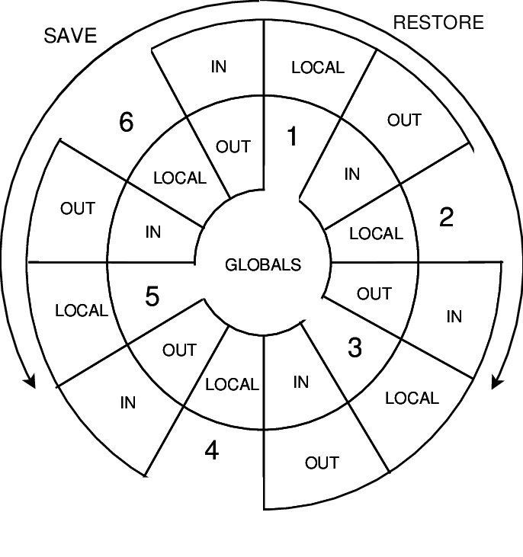
Registers
Register windows
Idea: compiler must optimize for a subset of actually existing registers
Function calls and context changes do not require register spilling to RAM
Berkeley RISC: 64 register, but only 8 visible per context
Sun Sparc: 3x8 in a shifting register book, 8 always valid
very useful if OS should not yield on kernel calls
nice with upcall concept

Slide 6
CPU caches
Effects of caches
 |  | Latency
 |  | Intel Broadwell Xeon E5-2699v4 | Intel Broadwell Xeon E5-2640v4 | IBM POWER8
Cache level | L1 | 4 cyc | 4 cyc | 3 cyc
 | L2 | 12-15 cyc | 12-15 cyc | 13 cyc
 | L3 | 4MB: 50 cyc | 4 MB: 49-50 cyc | 8MB: 27-28 cyc
Random load from RAM regions of size ... | 16 MB | 21 ns | 26 ns | 55 ns
 | 32-64 MB | 80-96 ns | 75-92 ns | 55-57 ns
 | 96-128 MB | 96 ns | 90-91 ns | 67-74 ns
 | 384-512 MB | 95 ns | 91-93 ns | 89-91 ns
Notes:
POWER8: low-level NUMA design (bought Sequent?) brings RAM assignment logic
Intel: QPI crossbar switch, but no RAM reassignment logic

Slide 7
Cache coherence
Problems
User of one cache writes a cacheline, users of other caches read the same cacheline
Needs write propagation from dirty cache to other cache
Users of two caches write to the same cacheline
Needs write serialization among caches
Cacheline implies that sharing be true or false
Cache coherence algorithms
Snooping
Based on broadcast
Write-invalidate or Write-update
Directory-based
Bit vector, tree structure, pointer chain
Intel Knights Mill: cache coherent interconnect with MESIF protocol
Notes:
MESIF – modified exclusive shared invalid forward – only S and F are unsafe, at most one cache can be in F state for a cacheline, it is then the designated responder for incoming S requests

Slide 8
GPU caches
CUDA and OpenCL – the SIMT method
Relevance of alignment between threads
Cache coherence

Slide 9
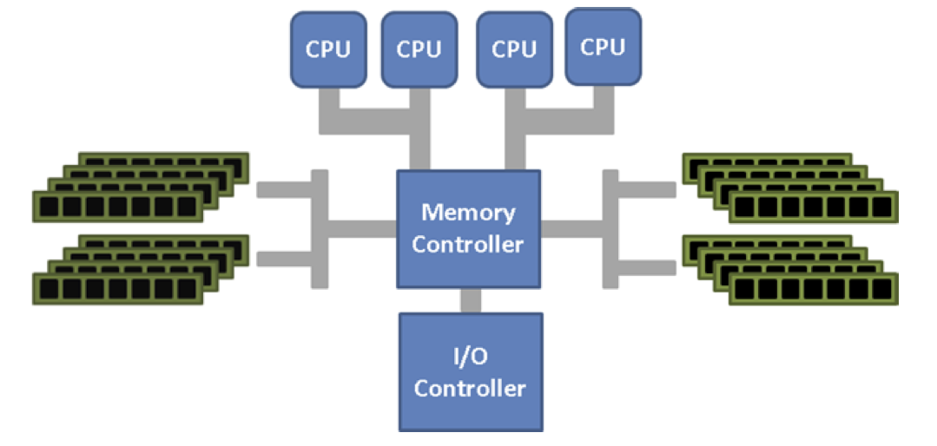
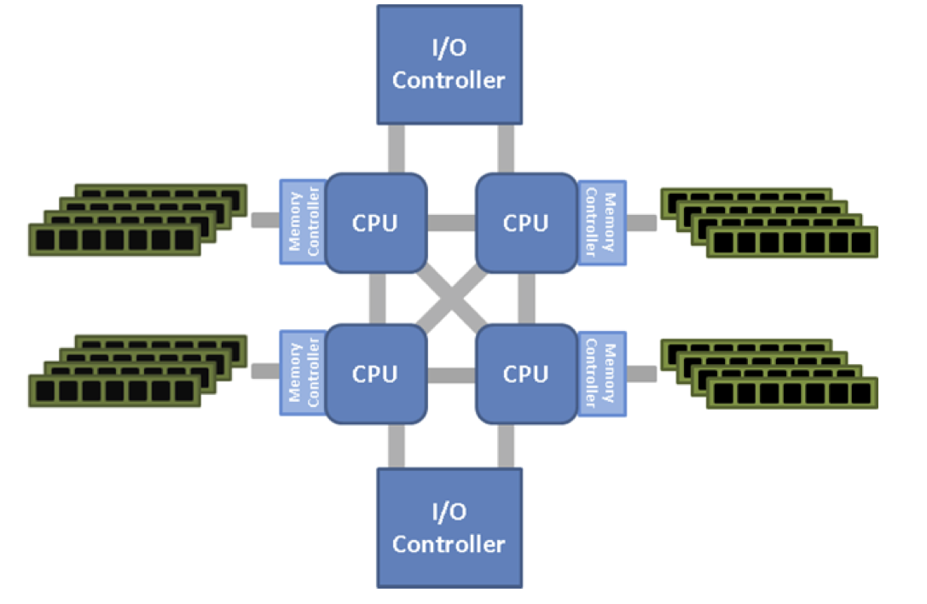
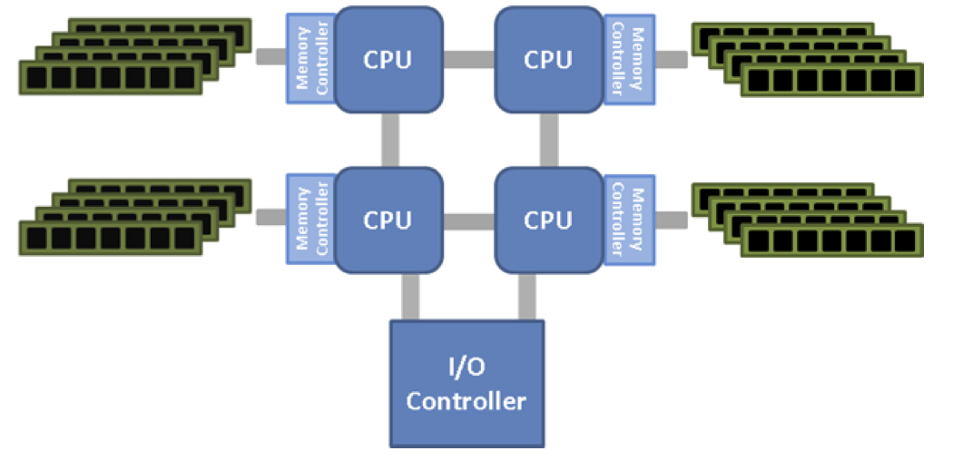
Main memory
Classical memory
attachment,
e.g. Front-side bus
-
uniform addressing
but bottlenecked
AMD HyperTransport
memory attachment
Intel QuickPathInterconnect
memory attachment

Slide 10
Types of memory: NUMA
Same memory hierarchy level - different access latency
AMD Hypertransport hypercube interconnect example
Memory banks attached to different CPUs
Streaming between CPUs in hypercube topology (Fully mesh in QPI helps)
Living with it
Pthread NUMA extensions to select core attachment
Problem with thread migration
Problem with some «nice» programming paradigms such as actor systems

Slide 11
Types of memory: non-hierarchical
Historical Amiga
Chip memory
shared with graphics chips
accessible for Blitter
Local memory
onboard memory
Fast memory
not DMA-capable, only CPU-accessible
DMA memory
accessible for Blitter
Any memory
on riser cards over Zorro bus, very slow
like a DMA engine only for memory, but also boolean operations on blocks of memory

Slide 12
Types of memory: throughput vs latency
IXP 1200
Explicit address spaces
latency, throughput, plus price
Scratchpad – 32bit alignment, to CPU only, very low latency
SRAM – 32bit alignment, 3.7Gbps throughput read, 3.7 Gbps write, to CPU only, low latency
SDRAM – 64bit alignment, 7.4Gps throughput, to all units, higher latency
Features
SRAM/SDRAM operations are non-blocking hardware context switching hides access latency (the same happens in CUDA)
«Byte aligner» unit from SDRAM
not unified at all:
different assembler instructions for Scratchpad, SRAM and SDRAM
Intel sold the IXP family to Netronome
renamed to NFP-xxxx chips, 100 Gbps speeds
C compiler is still broken in 2020

Slide 13
Hardware-supported atomicity
Ensure atomicity of memory across cores
Transactional memory
e.g. Intel TSX (Transactional Synchronization Extensions)
Supposedly operational in some Skylake processors
Hardware lock elision: prefix for regular instruction to make them atomic
Restricted transactional memory: extends to an instruction group including up to 8 write operations
e.g. Power 8
To be used conjunction with the compiler
Transaction BEGIN, END, ABORT, INQUIRY
Transaction fails in case of access collision within a transaction, exceeding a nesting limit, or exceeding a writeback buffer size
Allow speculative execution with memory writes
Conduct memory state rewind and instruction replay of transaction whenever serializability is violated

Slide 14
Hardware-supported atomicity
Ensure atomicity of memory across cores
IXP hardware queues
push/pop operations on 8 queues in SRAM
8 hardware mutexes
atomic bit operations
write transfer registers, read transfer registers for direct communication between microengines (cores)
Cell hardware queues
Mailbox to send queued 4-byte messages from PPE to SPE and reverse
Signals to post unqueued 4-byte messages from one SPE to another
CUDA
Atomic in device memory
Atomic in shared memory
shuffle and ballot
“push/pop” is badly named: they are queues, not stacks
really slow
rather fast

Slide 15
Content-addressable memory
Content addressable memory (CAM)
solid state memory
data accessed by content instead of address
Design
simple storage cells
each bit has a comparison circuit
Inputs to compare: argument register, key register (mask)
Output: match register (1 bit for each CAM entry)
READ, WRITE, COMPARE operations
COMPARE: set bit in match register for all entries where Hamming distance between entry and argument is 0 at key register positions
Applications
Typical in routing tables
Write a destination IP address into a memory location
Read a forwarding port from the associated memory location
TCAM (ternary CAM) merges argument and key into a query register of 3-state symbols

Slide 16
Swapping and paging
Memory overlays
explicit choice of moving pages into a physical address space
works without MMU, for embedded systems
Swapping
virtualized addresses
preload required pages, LRU later
Demand paging
like swapping, but lazy loading
Zilog memory style – non-numeric entities
no pointers → no pointer arithmetic possible
More physical memory than CPU address range
very rare, e.g. Commodore C128, register for page mapping
set page choice globally
x86 “Real Mode” works around the same problem at “instruction group level”

Slide 17
DMA – direct memory access
DMA controller
Initialized by a compute unit
Transferring memory without occupying compute cycles
Usually commands can be queued
Can often perform scatter-gather transfer, mapping to and from physically contiguous memory
Modes
Burst mode: use the bus fully
Cycle stealing mode: share bus cycles between devices
Background mode: use only cycles unused by the CPU
Challenges
Cache invalidation
Bus occupation
No understanding of virtual memory
SCSI DMA, CUDA cards, Intel E10G Ethernet cards: own DMA controller, priorities implementation-defined
Amiga Blitter (bus cycles = 2x CPU cycles)
ARM11 – background move between main memory and on-chip high-speed TCM (tightly coupled memory)

Slide 18
Automatic CPU-GPU memory transfer
CUDA Unified Memory
Allocates a memory block like malloc
Can be accessed from CPU and from GPU
Easy on shared-memory designs (laptops, special HPC designs)
Hard on computers where CPU and GPU have different memories
DMA-capable
Compiler and runtime decide when to move data
Rodinia benchmark,
Normalized to hand-coded speed
DOI 10.1109/HPEC.2014.7040988

Slide 19
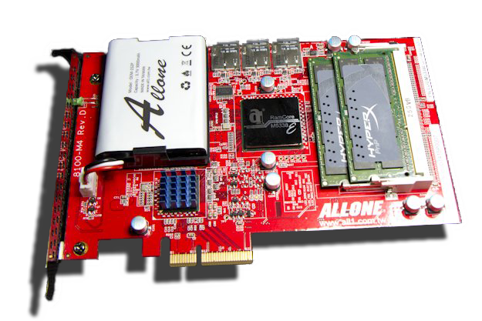
Battery-backed RAM
Battery-backed RAM is a form of disk
Faster than SSD, limited by bus speed
Requires power for memory refresh
Not truly persistent
Hybrid BBRAM/Flash
Speed of BBRAM
Battery for short-term persistence
SD card for long-term persistence
ALLONE Cloud Disk Drive 101 RAMDisk – 32GB capacity

Slide 20
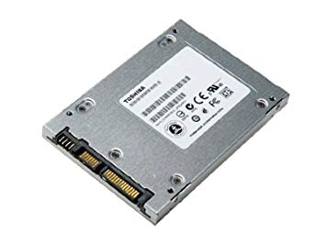
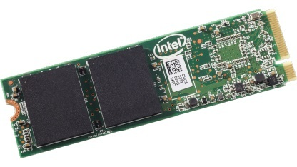
SSD - Solid Stage Disks storage
Emulation of «older» spinning disks
in terms of latency between RAM and spinning disks
limited lifetime is a major challenge
With NVMe
e.g. M.2 SSDs
Memory mapping
DMA
could make serial device driver model obsolete
Notes:
NVMe: non-volatile memory express

Slide 21
Hard disks
Baseline for persistent storage
Persistent
Re-writable
Moderate throughput
Decent lifetime
head here
Average delay is 1/2 revolution “Typical” average: 8.33 ms (3.600 RPM) 5.56 ms (5.400 RPM) 4.17 ms (7.200 RPM) 3.00 ms (10.000 RPM) 2.00 ms (15.000 RPM)
block I want

Slide 22
Disk storage
Partitions
Location matters on spinning disks
High sector density on outside of disk gives more throughput per rotation
Priorities between disks
SCSI / SAS / FibreChannel disks
Prioritized Ids – gives DMA priority
PCIe-attached storage blades
Non-standardized priority
Typical disk today
Zoned Constant-Area Velocity Disk
Spare sectors at the edge of each zone
note that some zCAV disks are slowing down a bit on outer cylinders:
reduces transfer errors

Slide 23
Disk storage
Filesystem considering location
JFS
PV - physical volume
a disk or RAID system
VG - volume group
physical volumes with softraid policy
enables physical move of disks
LV - logical volume
partition-like hot-movable entity on a VG
can prefer specific disk regions, also non-contiguous
another softraid layer
FS – file system
can grow and shrink
like Linux UUID for disks

Slide 24
HSM - Hierarchical storage management
See here: https://en.wikipedia.org/wiki/Hierarchical_storage_management
Disk and tape
Old and new disks
Fast and slow disks
Older ideas:
Mixing low and high throughout sectors

Slide 25
Tape drives
Features
High capacity (>200 TB/tape)
Excellent price/GB (0,10 NOK)
Very long lifetime (1970s tapes still working)
Decent throughput due to high density (1 TB/hr)
Immense latency
Robotic tape loading
Spooling
Famous example
StorageTek Powderhorn
Google uses Tape for backup

Slide 26
Remote memory
Distributed operating systems
Remote memory access is deeply hardcoded into the OS
Treat like NUMA systems with extreme speed differences

Slide 27
Network attached storage and storage area networks

Slide 28
Networked file systems
Remote file system
e.g. NFS - Network file system, CIFS – Common Internet file system
Limited caching, file locking, explicit mount like a separate file system
Distributed file system
e.g AFS – Andrews file system, DFS – DCE file system
Aggressive caching, unique global directory structure
Cluster file systems
e.g. HadoopFS, GPFS – General parallel file systems, Lustre
Sacrifice ease of use for bandwidth
P2P file systems
e.g. OceanStore – files striped across peer nodes, location unknown
Sacrifice speed (latency and bandwidth) for resilience and anonymity

Slide 29
Network cards
Interrupt reduction
Collating receives, DMA on receive
No sending DMA; but both Nagle and Pacing increase latency

Slide 30
Links
IXP memory http://www.ecs.umass.edu/ece/wolf/courses/ECE697J/docs/IXP1200%20HW%20Ref%20Manual.pdf

