Slide 1
Experimental Design and Analysis
IN5060: Performance in distributed systems
Özgü Alay

Slide 2
How to
Design a proper set of experiments for measurement.
Estimate the contribution of each alternative to the performance.
Check if the alternatives are significantly different.
Isolate the measurement errors.
Develop a model that best describes the data obtained.
Check if the model is adequate.

Slide 3
Example
Personal workstation design
Processor: AMD Ryzen 3,5,9 or Intel Core i5, i7, i9.
RAM size: 8G, 16GB, or 32GB bytes
Storage: 512GB, 1TB, 2TB
Workload: Gaming, managerial, or scientific.

Slide 4
Terminology
Response Variable: Outcome. E.g., throughput, response time
Factors (predictors): Variables that affect the response variable. E.g., CPU type, RAM size, etc...
Levels (treatment): The values that a factor can assume, E.g., RAM size has three levels: 8G, 16GB, or 32GB bytes
Primary Factors: The factors whose effects need to be quantified. E.g., CPU type, RAM size only, etc…
Secondary Factors: Factors whose impact need not be quantified. E.g., the workloads.
Replication: Repetition of all or some experiments.

Slide 5
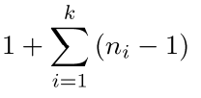
Experimental Design
The number of experiments, the factor level and number of replications for each experiment.
Simple Designs: Vary one factor at a time
Not statistically efficient.
Wrong conclusions if the factors have interaction.
Full Factorial Design: All combinations
Can find the effect of all factors.
Too much time and money.

Slide 6
How to choose the factors?
Domain knowledge is needed to define the primary/secondary factors
System limitations: controllable parameters, number of repetitions, etc…
Assume you want to measure the performance of a oprational 4G network, what factors can you control?

Slide 7
Statistical Significance
Dunn’s test is used to identify significant difference between the means of two or more distributions for a given confidence interval
Null Hypothesis: There is no significant difference between the two distributions
Alternative Hypothesis: There is significant difference between the two distributions.
If the p-value is less than a specified significance level (α) (usually 0.05, 0.01 or 0.001), you can declare the difference to be statistically significant and reject the test's null hypothesis.
The lower the p-value, the more significant the difference is!

Slide 8
Modelling: Simple Linear Regression
Regression Model: Predict a response for a given set of predictor variables.
Response Variable: Estimated variable
Predictor Variables: Variables used to predict the response. predictors or factors
Linear Regression Models: Response is a linear function of predictors.
Simple Linear Regression Models: Only one predictor

Slide 9
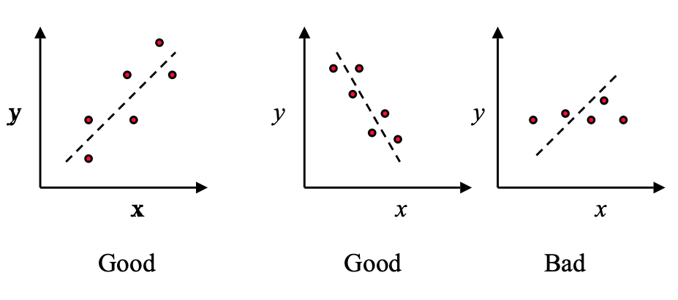
What is a good model?
Check visiually first how your data looks

Slide 10
A simple good model
Choose the line that minimizes the sum of squares of the errors
where, is the predicted response when the predictor variable is x.
The parameter b₀ and b₁ are fixed regression parameters to be determined from the data.
Given n observation pairs {(x₁, y₁), …, (x_{n}, y_{n})}, the estimated response for the i^{th} observation is:

Slide 11
Minimizing the error
The error is:
The best linear model minimizes the sum of squared errors (SSE):

Slide 12
Common Mistakes in Experimentation
The variation due to experimental error is ignored.
Important parameters are not controlled.
Effects of different factors are not isolated
Simple one-factor-at-a-time designs are used
Interactions are ignored
Too many experiments are conducted
Remember the noise in real world measurements! We need STATISTICS ☺

