Slide 1
5G Coverage and Performance

Slide 2
From 4G to 5G Transition
From 4G to 5G Transition
Today – 4G Access
Device attaches to LTE/4G radio and Evolved Packet Core (EPC)
Early 5G – Non-Standalone
Device attaches to 5G-NR, which routes either via 4G Base Station to EPC, or direct to EPC
4G acts as control plane
5G Standalone
Device attaches to 5G-NR and 5G Core Network.
EPC
4G
5G-CN
5G

Slide 3
5G NSA field trials and testing
5G Non-Standalone (NSA) is being largely adopted for the rollout of 5G networks
It is key to investigate how 5G NSA performs in the wild
Large-scale measurement campaign on 5G NSA deployments for four Mobile Network Operators (MNOs) in Rome, Italy
Empirical analysis of the 5G coverage, deployment, and application performance

Slide 4
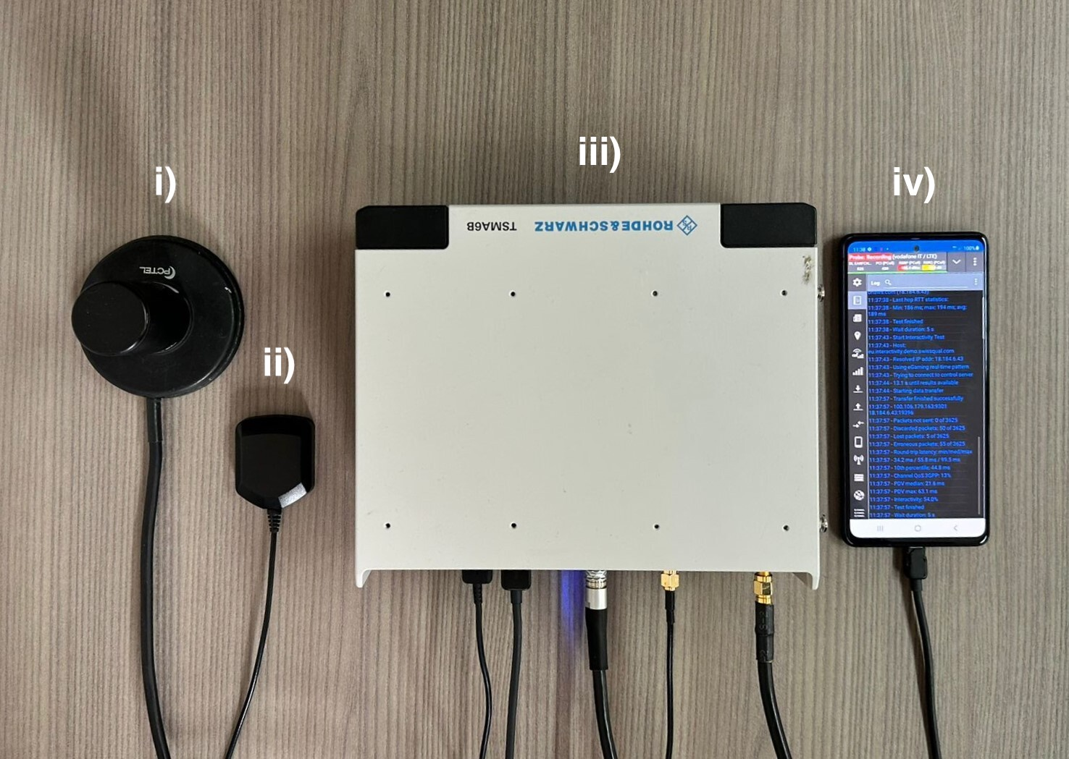
Measurement Setup and Campaign
Four MNOs (Op1-Op4) offering 4G and 5G NSA connectivity in Rome, Italy
Measurements period: 2 months (early April 2023 - late May 2023)
Campaign organized in “sub-campaigns”: different days, different times of the day and different locations
Four mobility scenarios:
Indoor Static (IS): measurements indoor
Indoor Walking (IW) measurements while walking indoor
Outdoor Walking (OW): measurements while walking outdoor
Outdoor Driving (OD): measurements while driving a car
RF antenna
GPS antenna
R&S TSMA6 scanner
5G capable UE
For network analysis, troubleshooting, visualization, and data exporting, we used the R&S ROMES software
Notes:
Outdoor Walking (OW): measurements while walking (average speed of 3.53 km/h, with stops due to traffic lights)
Outdoor Driving (OD): measurements performed while driving a car (average speed of 19.4 km/h, with stops due to traffic lights)

Slide 5
Passive Measurements
TSMA6 detects and decodes downlink control information
Measurements 4G and 5G at each location
Dataset features:
Spatial (Latitude and Longitude) and temporal (Time) information
Carrier frequency identifiers
Signal strength/quality indicators
Notes:
4G: measurements on the Reference Signal (RS) sent by 4G PCIs
5G: measurements on the SSS, sent by 5G PCIs in the SSBs:
SS Reference Signal Received Power (SS-RSRP)
SS Reference Signal Received Quality (SS-RSRQ)
SS Signal to Interference and Noise Ratio (SS-SINR)

Slide 6
Carrier frequency identifiers
https://www.spectrummonitoring.com/frequencies.php?market=I
Notes:
4G: measurements on the Reference Signal (RS) sent by 4G PCIs
5G: measurements on the SSS, sent by 5G PCIs in the SSBs:
SS Reference Signal Received Power (SS-RSRP)
SS Reference Signal Received Quality (SS-RSRQ)
SS Signal to Interference and Noise Ratio (SS-SINR)

Slide 7
Signal Indicators
RSRP: Indicates the average power of the received reference signal spread over the full bandwidth. It is affected by distance, nearby buildings, walls, weather conditions, etc.
Range: -144dBm (bad) to -44dBm (good)
RSRQ: Indicates the quality of the received reference signal. It is defined as RSRQ = N x RSRP / RSSI, where N is the number of Physical Resource Blocks.
Range: -19.5dB (bad) to -3dB (good)
SINR: Indicates the signal-to-noise ratio of the received signal. In other words, it measures the ratio of the desired signal power to the sum of the power of the interfering signals and can be used to measure the quality of the connection
Range: -20dB (bad) to 20dB (good)
Respective signal indicator ranges for 5G slightly differ.

Slide 8
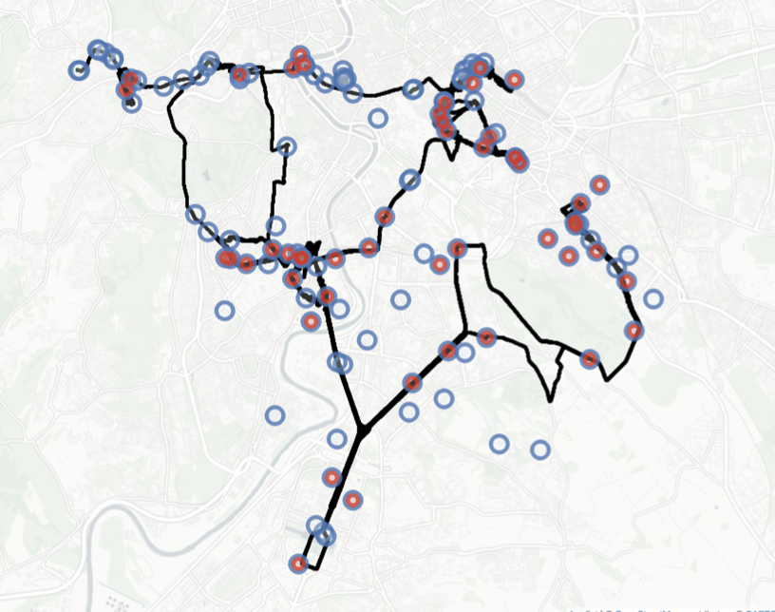
5G Deployment
Spatial representation of the radio network deployment for 𝑂𝑝1. The blue and red markers indicate the estimated positions of 4G and 5G base stations, respectively. The black line in the background indicates the routes during the entire measurement campaign.

Slide 9
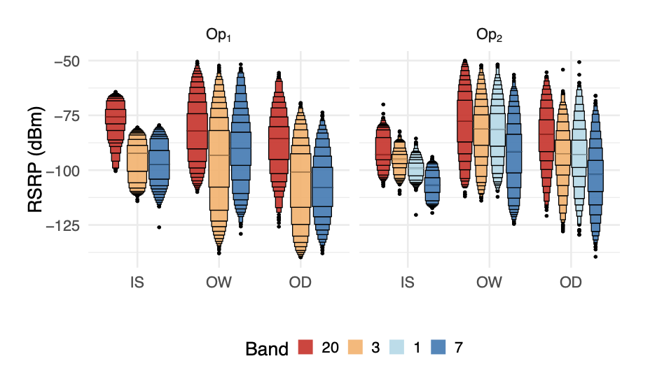
4G Coverage
Distribution of 4G RSRP [dBm] across carrier frequencies (in a letter-value plot format and order by highest to lowest frequency)

Slide 10
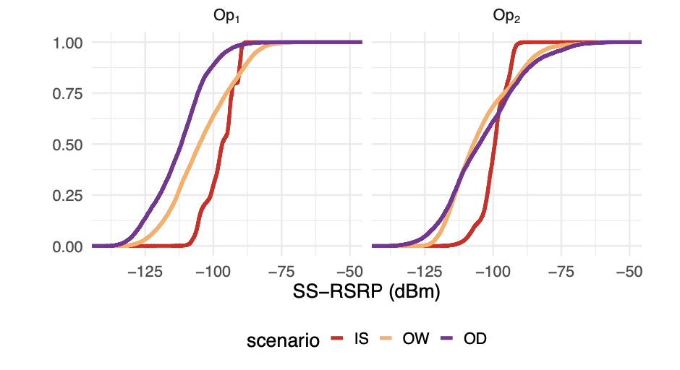
5G Coverage
Distribution of 5G SS-RSRP [dBm] (in an ecdf format), for 𝑂𝑝1 and 𝑂𝑝2 and grouped by scenario.

Slide 11
Significance Tests
Kruskal-Wallis (non-parametric): Determine statistical significance between the means of more than two independent groups Assumptions:
No assumptions
Null Hypothesis: The means across all groups are equal
Alternative Hypothesis: At least one group mean is different from the rest
if p-value is less than a significance level (e.g., 0.05), we can reject the null hypothesis
Dunn’s Test (non-parametric): If Kruskal-Wallis shows statistical significance, conduct Dunn’s test to determine which groups are different (test each combination of groups)

Slide 12
Operator and Technology comparison
Technology | IS | IW | OW | OD
LTE | 0.2906 | 0.0274 * | 0.2480 | 0.3581
5G | 0.1594 | 0.00033 *** | 0.1152 | 0.1439
Operators have significant differences especially for Indoor scenarios.
Operator comparison
Operator | IS | IW | OW | OD
1 | 0.0021 ** | 2.3e-09 *** | 0.0117 * | 1e-05 ***
2 | 0.0133 * | 1e-06 *** | 0.00078 *** | 1e-05 ***
Different technologies have significant differences for both operators.
Technology comparison

Slide 13
Behind the Doors: 4G and 5G Datasets

Slide 14
Data Sources
Coverage data:
GEach batch of samples sharing the same timestamp/gps coordinates represent a single measurement point (in space).
Each sample holds information for the UE - cell connection (e.g., GPS UE location, RSRP, RSRQ, SINR, cell identifiers, etc.)
Cell data: (will not be provided for this module)
A separate set of data with additional information for each cell (e.g., GPS cell location, power, cell identifiers, etc.)

Slide 15
Data Structure
13 different locations in Rome, Italy
Several iterations for each location (each iteration uses a different active measurements setup – not relevant for this module)
2 .csv files (coverage + cell) under each sub-folder + additional files exported by ROMES

Slide 16
Post-Processing challenges
Cleaning: Remove metadata and measurement configuration details
Missing Data: How to handle?
e.g., MCN missing - Action: insert it by using other features (such as Frequency)
e.g., GPS missing - Action: if indoor campaign, insert it manually
Mutate Data: Add features useful for the analysis
e.g., location, mobility scenario, folder structure (for future segmentation), etc.
Invalid Data: Requires domain knowledge
Look for outliers and extreme values
Determine either extreme (of interest) behavior or measurement error (next page)

Slide 17
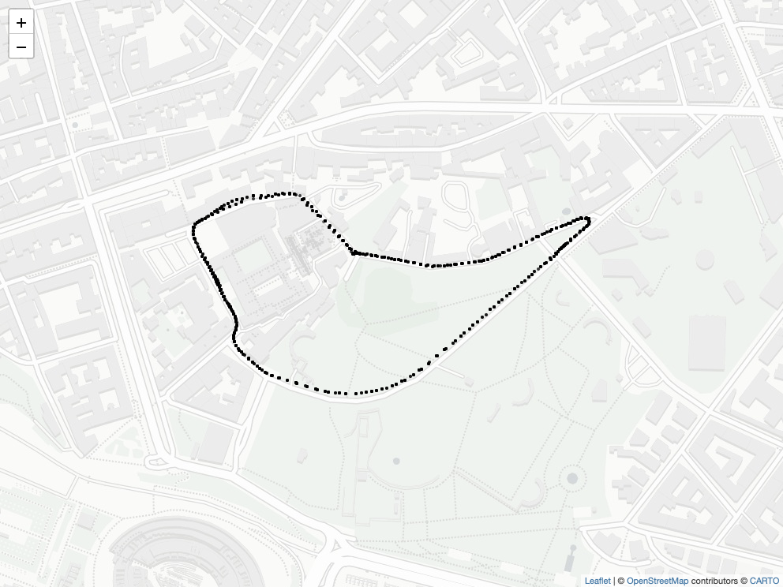
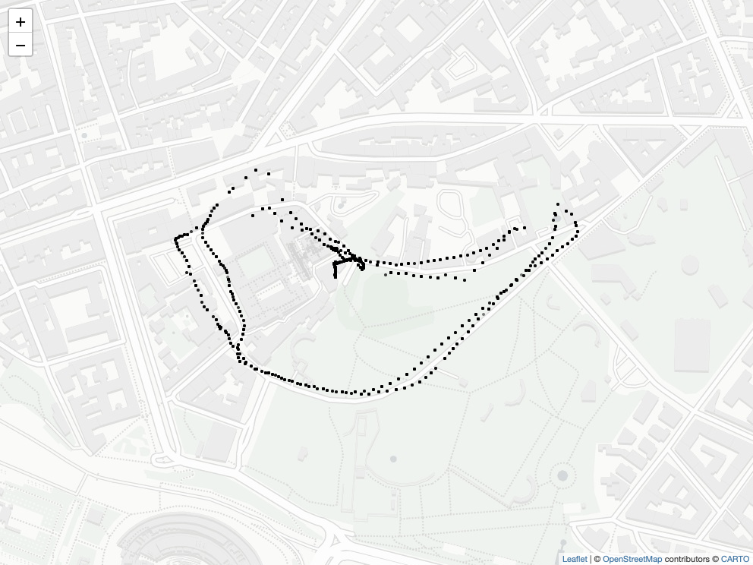
Visualization
Data illustration with map visualization tools
Identify the walking/driving traces
check for faulty GPS
Pinpoint areas with low coverage at glance
Visualize the cell spatial distribution
Can be generalized or expanded with new data

Slide 18
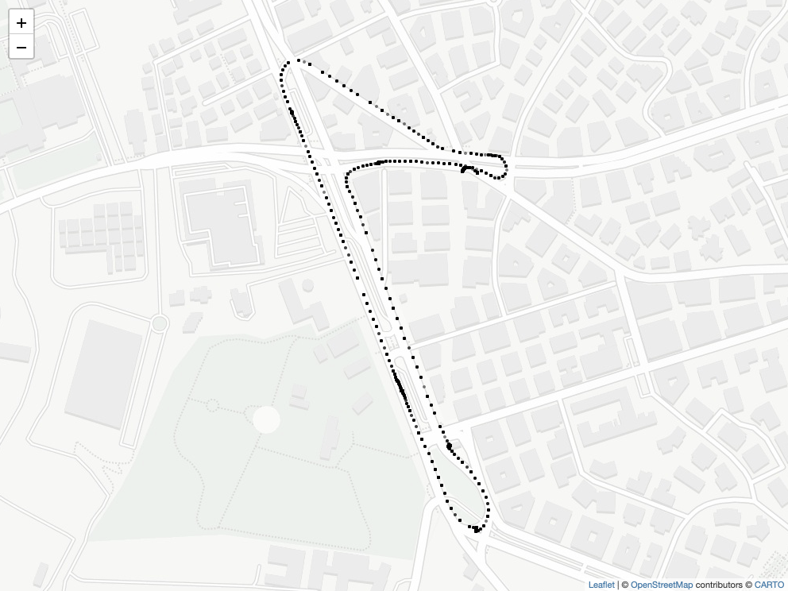
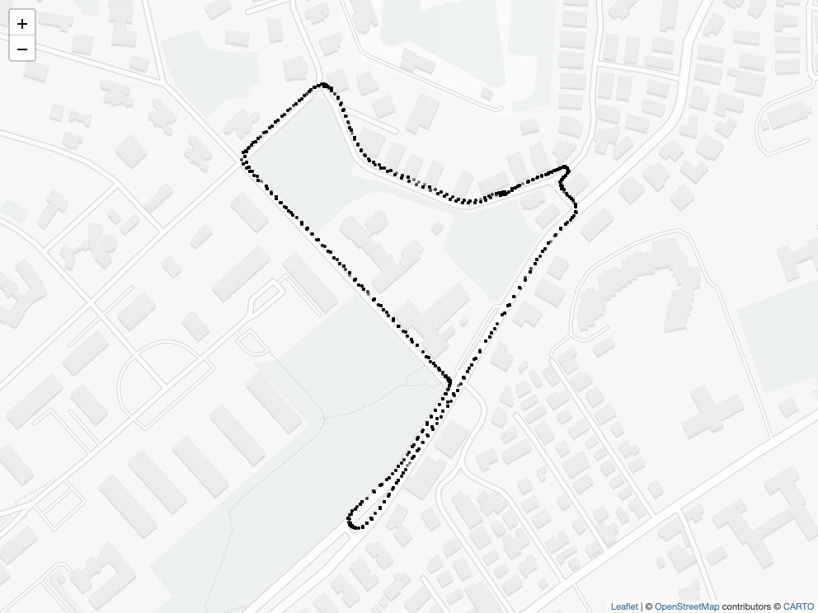
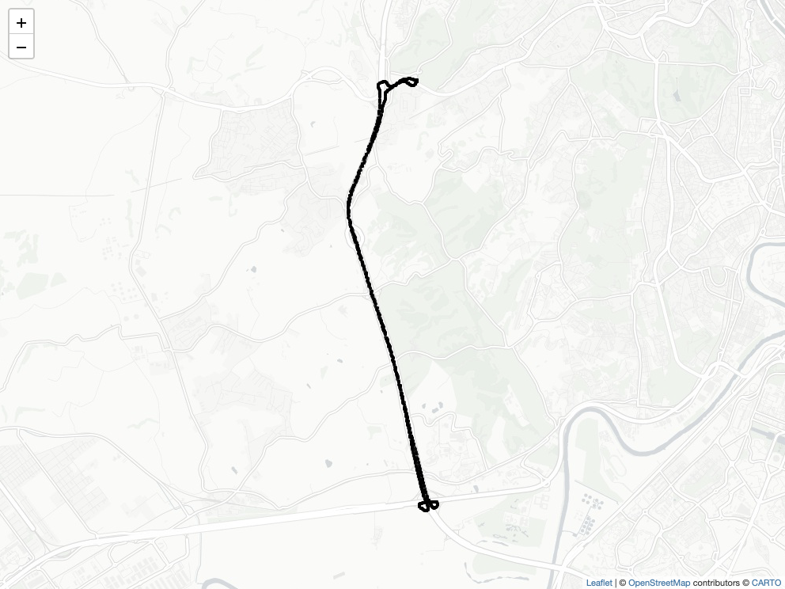
Visualization of GPS location

Slide 19
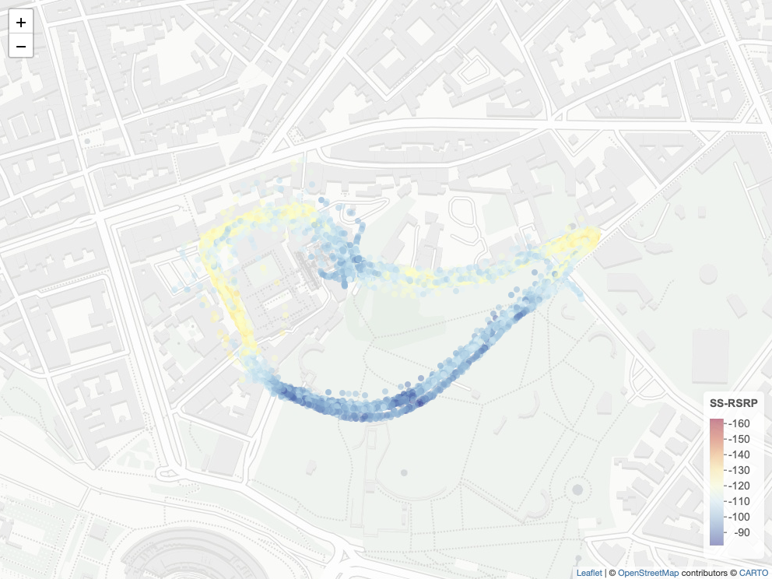
Visualization of Coverage (SS-RSRP) Op1

Slide 20
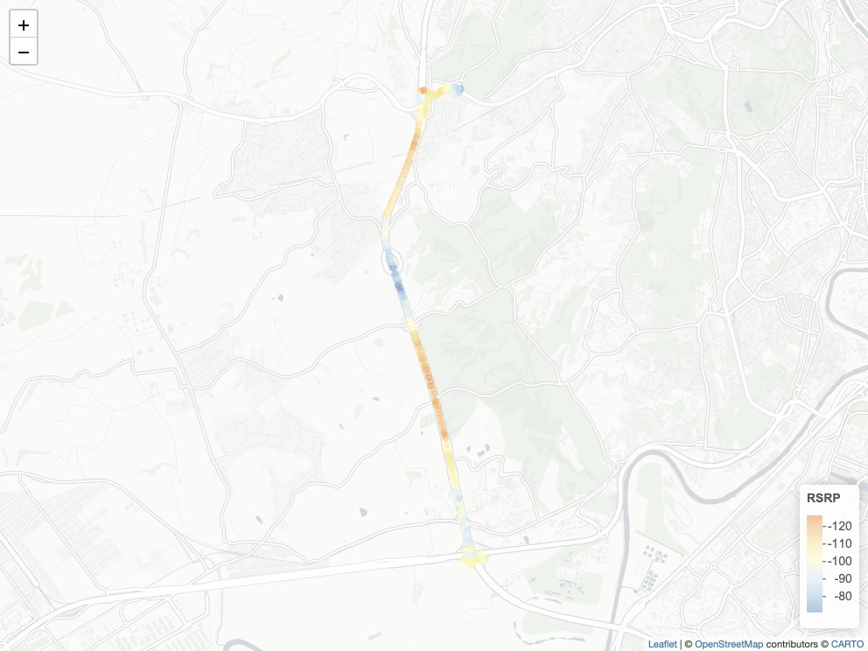
Visualization of Coverage (RSRP) - Band 20

Slide 21
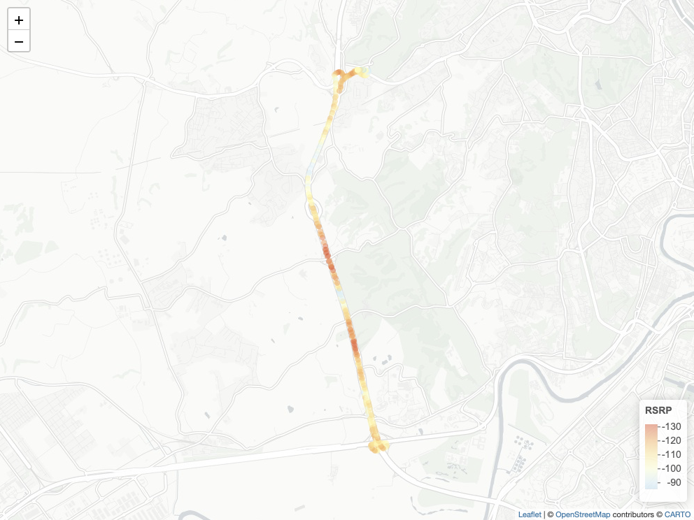
Visualization of Coverage (RSRP) - Band 7

Slide 22
Assignment

Slide 23
Dataset Statistics
Data will be provided in an R file format (.RDS)
2 files (4G/5G data)
185MB (4G), 315MB (5G)
You have to read both files in R (or python using the pyreadr wrapper)
You can later export to .csv (if desired)
Each sample represents a passive scan
i.e., given a location, a unique cell Identity and a non-unique PCI are reported alongside signal related information (next slide for a complete set of features):
cell Identity indicators are not always present in 5G (approx ⅔ of the times missing) - due to on-going deployment of NSA

Slide 24
Dataset Statistics
4G: 13.665.682 samples
5G: 27.213.859 samples
Locations
Scenarios
 | 1 | 2 | 3 | 4 | 6 | 7 | 8 | 9 | 10 | 11 | 12 | 13 | 15
 | IS | IS | IS | OW/OD | IS/IW | OD | IS | OD | OD | IS | IS | IS | IS
4G | 30.66% | 16.13% | 1.55% | 7.94% | 3.26% | 7.56% | 18.34% | 10.71% | 0.99% | 0.80% | 0.46% | 0.78% | 0.77%
5G | 31.30% | 15.68% | 0.62% | 6.17% | 4.30% | 12.04% | 16.00% | 10.90% | 0.74% | 0.81% | 0.53% | 0.69% | 0.16%
 | IS | IW | OW | OD
4G | 71.83% | 0.94% | 0.49% | 26.73%
5G | 68.94% | 1.18% | 0.41% | 29.44%

Slide 25
Dataset Statistics
Operators
 | Tim | Vodafone | Iliad | Wind
4G | 33.66% | 33.39% | 14.01% | 18.92%
5G | 5.82% | 44.24% | 18.29% | 31.63%

Slide 26
Features (4G)
Feature | Brief Description | Feature | Brief Description
Date | Measurement Date | eNodeB.ID (4G-only) | Unique eNodeB Identifier
Time | Measurement Time | Power/SS-Power | Power Received on the Entire Bandwidth [dBm]
Latitude | UE Latitude | SINR/SS-SINR | Signal-to-Interference-plus-Noise Ratio [dB]
Longitude | UE Longitude | RSRP/SS-RSRP | Reference Signal Receive Power [dBm]
Speed | Moving Speed [Km/h] | RSRQ/SS-RSRQ | Reference Signal Received Quality [dB]
EARFCN | Band-Carrier Frequency | location | Location name
Frequency | Carrier Frequency [MHz] | workspace | Workspace name (iteration)
PCI | Physical Cell Identifier | scenario | Scenario (IS/IW/OW/OD)
MCC | Mobile Country Code | SSB-Idx (5G-only) | Beam Indicator
MNC | Mobile Network Code | RNC-CellID(H) (5G-only) | Cell indicator
CI (4G-only) | Unique CellID Identifier | RNC-CellID(D) (5G-only) | Cell indicator

Slide 27
Example
4G
5G

Slide 28
What to evaluate
Coverage performance
Given a selected number of different (sub-)campaigns, compare the coverage performance of different operators (further dissect per frequency band) and different technologies (4G, 5G).
Given two or more sub-campaigns at the same location (e.g., repetitions of indoor/outdoor campaigns), show how the coverage changes over time.
Given a single operator, compare the coverage performance across different locations or scenarios. HINT: Particularly interesting for OD campaigns
Other aspects to evaluate:
Does speed affect coverage performance
What beamforming strategies are followed by each operator
Feel free to evaluate other aspects of the data
Analysis of variance. How significantly different are the different data groups?

Slide 29
Contact Points
ozgua@ifi.uio.no
konstako@ifi.uio.no

