Slide 1

IN5060
Quantitative
Performance Analysis
autumn course

Slide 2

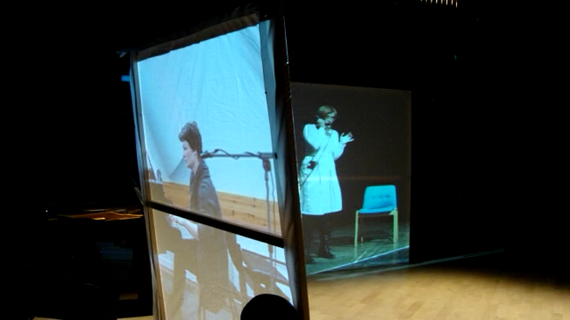
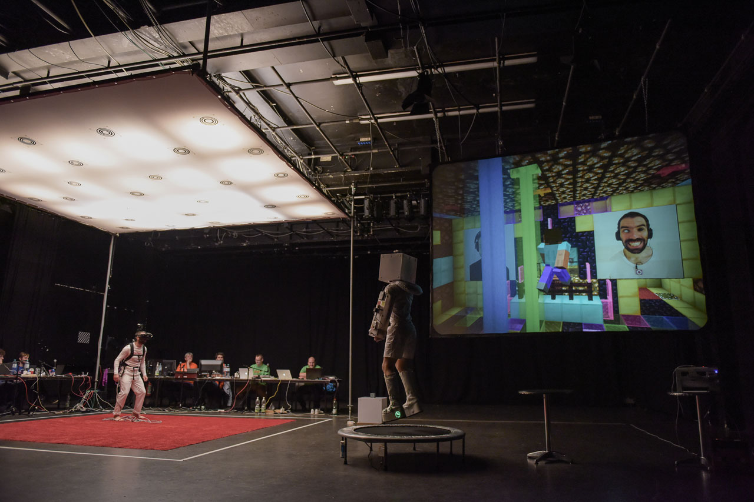
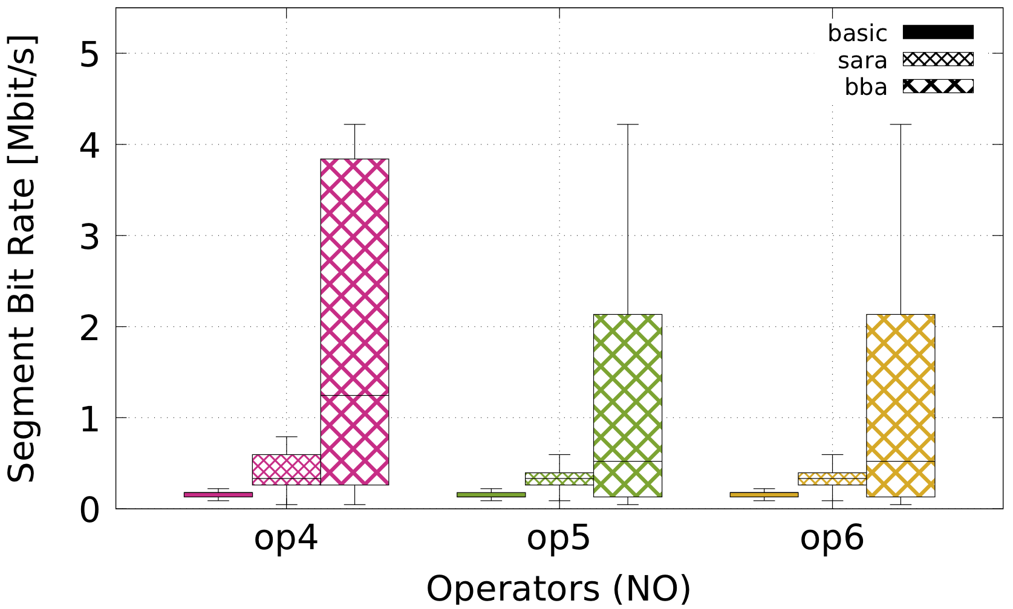
What is performance?
Stage performance
World Opera Production – Dec 2011 @ Tromsø
Download performance by position
HTTP Adaptive Streaming measured on Bygdøy Ferry, 2011
Download performance by operator & algorithm
HTTP Adaptive Streaming, MONROE nodes, 2018
Stage performance
Third Life Project@WUK – Oct 2015 @ Vienna

Slide 3
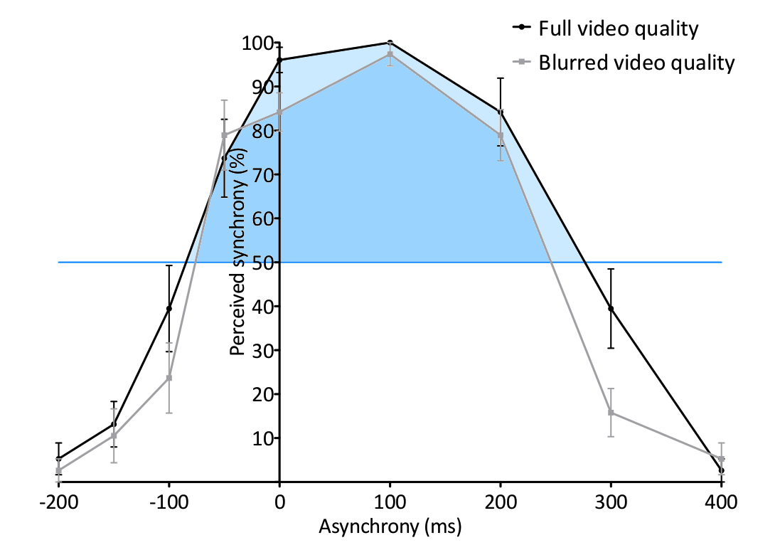
What is performance?
Stage performance
World Opera Production – Dec 2011 @ Tromsø
Download performance by position
HTTP Adaptive Streaming measured on Bygdøy Ferry, 2011
Users’ perception (Quality of Experience)
Asynchrony between audio and video, 2015
Download performance by operator & algorithm
HTTP Adaptive Streaming, MONROE nodes, 2018
Stage performance
Third Life Project@WUK – Oct 2015 @ Vienna

Slide 4
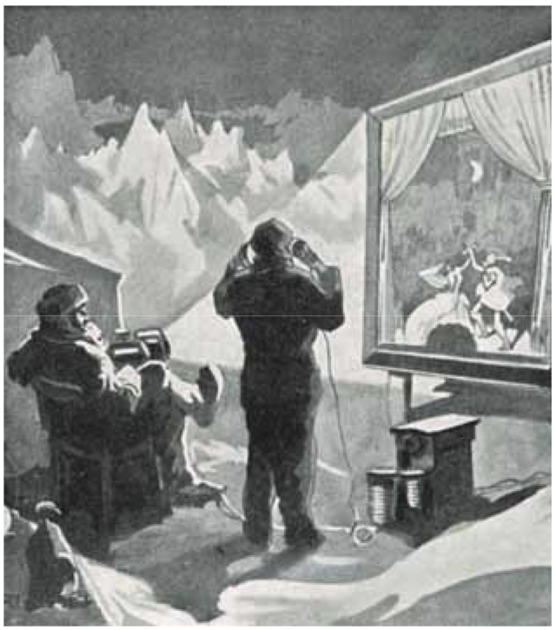


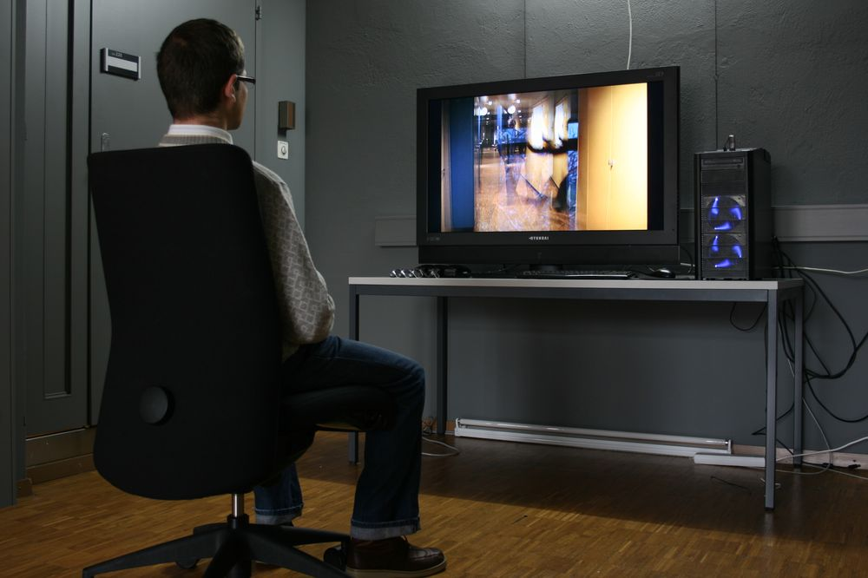
Quantitative Performance Analysis
Engineers and researchers solve quantifiable challenges
Idea
Simulation Study
Prototype
Product
Deployment
Feedback

Slide 5
Quantitative Performance Analysis
Engineers and researchers solve quantifiable challenges
Idea
Each step requires a
performance assessment
argue for feasibility
demonstrate practicality
study in a context
measure in the real world
assess value / success
Simulation Study
Prototype
Product
Deployment
Feedback
Performance Evaluation

Slide 6
Quantitative Performance Analysis
Engineers and researchers solve quantifiable challenges
Idea
Simulation Study
Prototype
Simulation
Emulation
Analysis
Monitoring and measurement
User studies
Product
Deployment
Feedback
Performance Evaluation

Slide 7
Quantitative Performance Analysis
Engineers and researchers solve quantifiable challenges
Idea
IN5060: experience 3 examples
Simulation Study
Prototype
Simulation
Monitoring and measurement
User studies
Product
Deployment
Feedback
Performance Evaluation

Slide 8
Quantitative Performance Analysis
Designing and conducting studies
pre-considerations
avoiding bias
measurement points and methods
data reduction
drawing conclusions
Presentation and reporting
formulating a message
selecting relevant factors
extracting and interpreting statistics
dimension reduction
selecting presentation modes
Specific considerations
simulation
monitoring and measurement
user studies

Slide 9
Quantitative Performance Analysis
This course is meant to provide you with a taste of the skills needed to become a good system analyst.
It will provide you with hands-on experience in system evaluation
It will (to some extent)
  confront you with the tradeoffs encountered when analysing real systems
  confront you with the error sources and red herrings encountered when analysing real systems

Slide 10
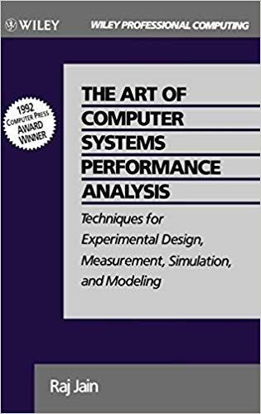
Quantitative Performance Analysis
The course is based on the book “The Art of Computer Systems Performance Analysis: Techniques for Experimental Design, Measurement, Simulation, and Modeling” by Raj Jain
Reading the book is not mandatory
for the course or even necessary
to complete, but if you have a chance
to read it in full, do so!

Slide 11
System performance analysis
Who is interested in system performance analysis?
The HW designer (company) wants to show that their system is The Best and Greatest system of All Time
A software provider wants to show that their application is superior to the competition
The researcher wants to publish her papers, and needs to convince the reviewers that their research improves on the state- of-the-art
The system administrator or capacity planner needs to choose the system that is best suited for their purpose
The enthusiast who wants to see if the newest rage from <insert favourite multinational corporation> is real, or fake news
Notes:
Which of these is BIASed ?

Slide 12
System performance analysis
How do they achieve this?
  By providing a comparison between their own system and “the competition”
  The results need to be (or appear) convincing to the target audience
  This comparison is made through proper system performance analysis
The techniques of models, simulations and measurement are all useful for solving performance problems
  IN5060 will focus on experimental design, simulation, measurement and analysis
  For modelling try for instance: MAT-INF3100 - Linear Optimisation

Slide 13
Theory and practice
Theory / models will provide us with candidates for system optimisations
Deploying them in reality may in many cases lead to unforeseen results
  Hardware differences
  Non-deterministic systems
  Unexpected workloads
Key techniques needed
  Mathematical analysis
  Simulation
  Emulation
  Measurement
  User studies
  Measurement techniques (monitors)
  Data analysis (statistics and presentation)
  Experiment design

Slide 14
Quantitative Performance Analysis
Key skills of performance analysts

Slide 15
Key skills needed – evaluation techniques
To select appropriate evaluation techniques, performance metrics and workloads for a system
You must choose which metrics to use for the evaluation
You must choose which workloads would be representative
What metrics would you choose to compare:
Two solid state disk (SSD) drives?
Two adaptive video streaming algorithms?
Two IaaS Clouds?

Slide 16
Key skills needed – measurements
Conduct performance measurements correctly
You must choose how to apply workloads to the system
You must choose how to measure (monitor) the system
Which type of monitor (or “probe”, hardware or software) would be suitable for measuring each of the following:
Number of instructions executed by a processor?
Context switch overhead on a multi-user system?
Response time of packets on a network?

Slide 17
Key skills needed – proper statistical techniques
Use proper statistical techniques to compare several alternatives
Whenever there are non-deterministic elements in a system, there will be variations in the observed results
You need to choose from the plethora of available statistical methods in order to correctly filter and interpret the results
Which link is better?

Slide 18
Key skills needed – do not measure forever
Design measurement and simulation experiments to provide the most information with the least effort
You must choose the number of parameters to investigate
You must make sure you can draw statistically viable conclusions
The performance of a system depends on the following factors:
Garbage Collection Technique used: G1, G2, or none
Type of workload: editing, computing, or machine learning
Type of CPU: C1, C2, or C3
How many experiments are needed?
How do you estimate the performance impact of each factor?

