Slide 1
Bounded Model Checking

Slide 2
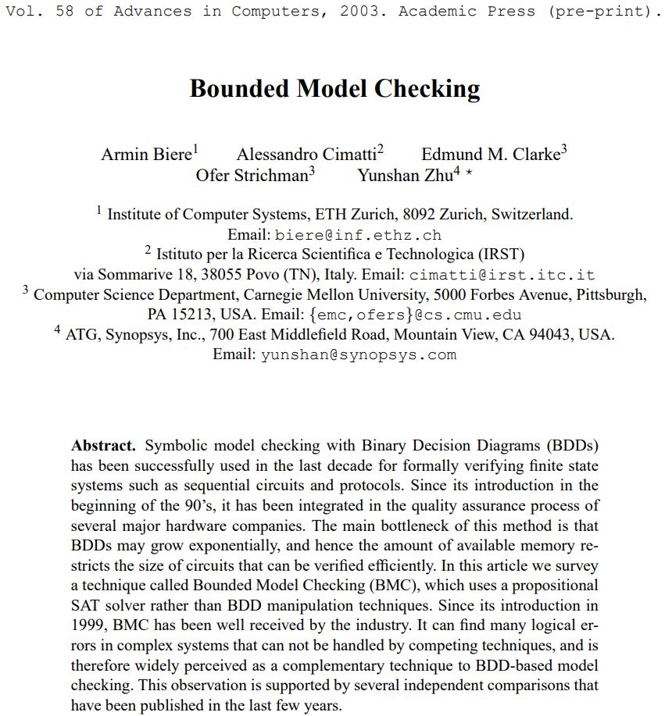

Slide 3
Contents
Motivation
What is Bounded Model Checking?
Translation from Bounded MC to SAT
Completeness

Slide 4
Prerequisites
General Model Checking
Temporal Logic
Omitted Content
SAT
Practical Examples

Slide 6
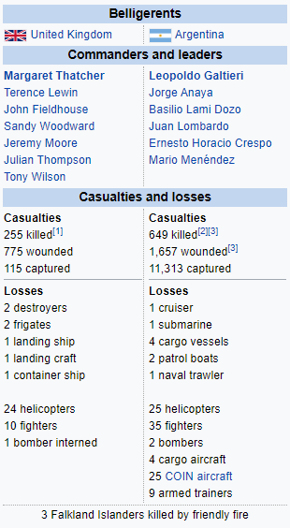
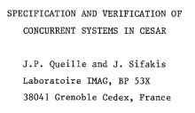
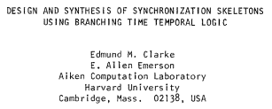
Notes:
Michael Jackson Thriller
The break-up of the AT&T monopoly
Falklands War
Model Checking invented twice

Slide 7
Exhaustively examines the reachable states of a program
Guaranteed to terminate if finite state space
Produces counterexamples

Slide 8
Model checking algorithms use instructions in the program to generate sets of states to be analyzed.
These states must be stored to ensure that they are visited at most once.

Slide 9
STATE-SPACE EXPLOSION
Model checking algorithms use instructions in the program to generate sets of states to be analyzed.
These states must be stored to ensure that they are visited at most once.
Notes:
The exponential growth in the number of states poses the main challenge to model checking

Slide 10
Explicit-state model checking
Few thousand states
1996: Partial order reduction
Symbolic model checking
1986: Binary Decision Diagrams
1993: Counter-Example Abstraction Refinement
1999: Bounded Model Checking
20
10 states
Abstract State Analysis
1977: Abstract Interpretation

Slide 11
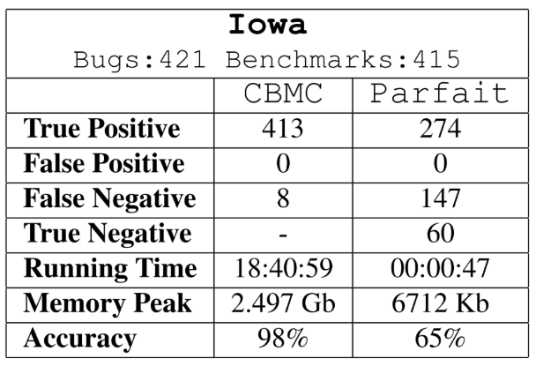
Notes:
BegBunch – benchmarking framework developed by Sun Labs at Oracle.
Parfait: Abstract State Analysis, CBMC: BMC

Slide 12
Why do we do what we do
To provide a rigorous guarantee of quality
in a highly automated and scalable way
to cope with the enormous complexity of software systems

Slide 13
Why BMC instead of BDD?
Wrong question
BMC sacrifices verification on behalf of finding (minimal) counterexamples
For verification, use BDD
When to use BMC instead of BDD?
Sometimes the state-space is infinite
Sometimes you have little faith in the system
BDD needs more manual guidance in order to optimize
Notes:
Minimal counterexamples are good because they are easier to understand and fix
BDD on infinite state space won’t terminate, often you run BDD until you run out of time or space and call it verified
BMC finds counter examples faster than BDD, less time waiting to fix the errors

Slide 14
Idea
Search for counterexamples in executions whose length is bounded by some integer k
If counterexample found, return it.
If not, increase k until problem becomes intractable
or you have reached the Completeness Threshold
The BMC problem can be reduced to SAT
(which have become really efficient)
k between 60 and 80 outperformed BDD-based techniques in 2003
Notes:
BDD need more manual guidance in order to optimize

Slide 15
Safety:
What should not happen
Liveness:
What should eventually happen

Slide 16
Kripke Structure M
M=(S,I,T,L)
S: set of states
I$⊂$S: set of initial states
T$⊂$SxS: transition relation
$L:S→P\left(A\right)$: the labeling function
Notes:
FL(s) is made of the atomic propositions that hold in s

Slide 17
Definition 1 (Paths)
Each path $π$ in M is a sequence of states, given in an order that respect the transition relation in M.
If $s_{0}$ is an initial state, the path is initialized.
The length of $π$ can be finite or infinite.
We assume the set of initial states is non-empty, and that the transition relation is total.

Slide 18
Definition 2 (Witness)
LTL formulas are defined over all paths
Finding counterexamples corresponds to finding a contradicting trace
If we find such a trace, we call it a witness for the property
Gp corresponds to the question whether there exists a witness to F$¬p$

Slide 20
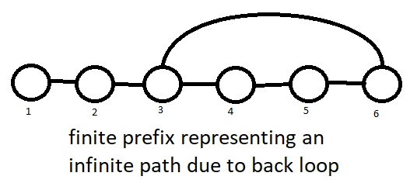

Slide 21
Definition 3 (k-loop)
For $l≤k we call a path π a \left(k,l\right)$-loop if
there is a transition from state k to state $l$
and $π$ is composed of the states 0 to $l−1$
followed by an infinite repetition of the states $l$ to k
We call $π$ a k-loop if there exists a $k≥l≥0$
for which $π$ is a $\left(k,l\right)$-loop.

Slide 22
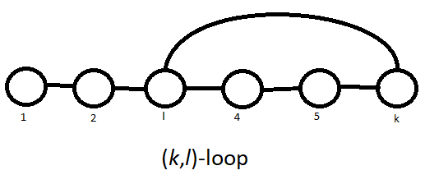

Slide 23
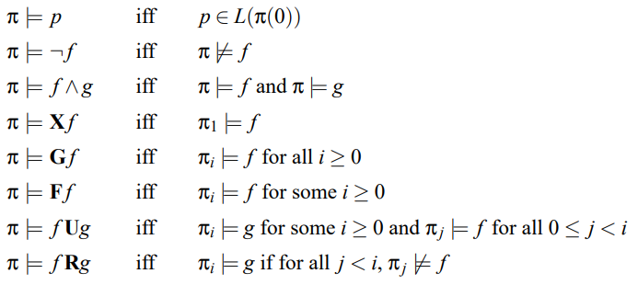
G: Global (always)
F: Finally (eventually)
X: neXt
Semantics for a path with a loop

Slide 24
What if the path is not a k-loop
Valid along $π$ if we can find an index $i≥0$ such that p is valid along the suffix $π_{i}$ of $π$.
(k+1)-th state $π$(k) does not have a successor.
Cannot define the bounded semantics recursively over suffixes of $π$.

Slide 25
What if the path is not a k-loop
Introduce the notation

Slide 26
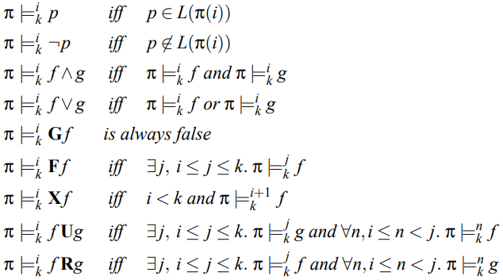
Semantics for a path without a loop
Notes:
Always false as f might not hold for k+1

Slide 27
Semantics for a path without a loop
Notes:
Always false as f might not hold for k+1

Slide 28
If a LTL formula is valid along a path with a bound, it is valid along a path without a bound.
Lemma 2. If a Kripke structure validates an unbounded existential LTL formula, then there exist a $k≥0$ such that the Kripke structure validates the bounded existential LTL formula.
Theorem 1. A Kripke structure validates an unbound existential LTL formula iff there exist a $k≥0$ such that the Kripke structure validates the bounded existential LTL formula.
Lemma 1.

Slide 29
We have now defined the semantics for bounded model checking.
We still have to reduce bounded model checking to propositional satisfiability.

Slide 30
Goal
Given a Kripke structure M,
an LTL formula f
and a bound k
construct a propositional formula ${\left[M,f\right]}_{k}$
that is satisfiable iff $π is a witness for$ f

Slide 31
Constraints the path to be valid
(with regards to the transition relation in M) starting from an initial state
Translation without a loop
Translation with a loop

Slide 32
Definition 4 (Unfolding of the Transition Relation)
For a Kripke structure $M, k≥0$

Slide 33
${[M]}_{6}=I\left(1\right) \& T\left(1,2\right)\&T\left(2,3\right)\&T\left(3,4\right)\&T\left(4,5\right)\&T(5,6)$=1

Slide 34
Definition 5 (Loop Condition)
The loop condition $L_{k} is true iff there exist a back loop from$ state $s_{k}$ to a previous state or to itself:

Slide 35
Definition 6 (Successor in a Loop)
Let $k,l,i$ be non-negative integers such that $l,i≤k$.
The successor succ$(i)$ of $i$ in a $\left(k,l\right)$-loop is defined as
$$succ\left(i\right)≔i+1 | i<k$$
$$succ\left(i\right)≔l | i=k$$

Slide 36
Definition 7 (Translation of an LTL Formula for a Loop)
Let f be an LTL formula, $k,l,i≥0, with$ $l,i≤k$.
Notes:
Left propositional, right temporal. Loop -> no cutoff -> standard semantics. Unrolling fix points.

Slide 37
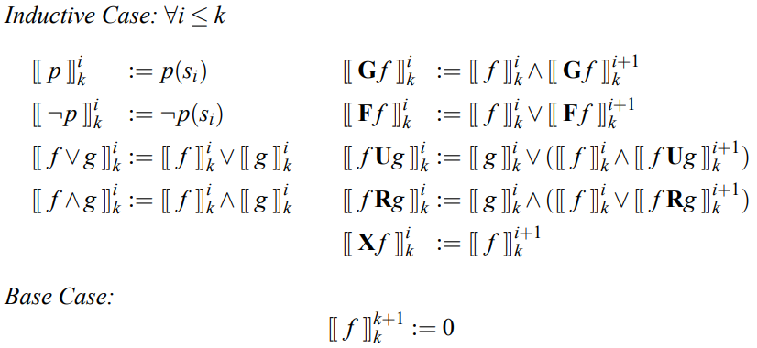
Definition 8 (Translation of an LTL Formula without a Loop)
Same principles, succ(i) simplified to i+1, and index $l$ not needed.

Slide 38
“But none of this matters unless I can verify that the system is correct!”

Slide 39
Good news!
BMC can achieve completeness.
Which I’ll show it time allows.

Slide 40
The Completeness Threshold
For every finite state system M, a property p, and a given translation scheme,
there exist a number CT,
such that the absence of errors up to cycle CT
proves that

Slide 41
The Completeness Threshold
For formulas of the form Gp, this is simply the minimal number of steps requires to reach all states.
This is called the reachability diameter:
Which is a really just a formal way of stating that $rd(M)$ is the longest, ‘shortest path’ from an initial state to any reachable state.

Slide 42
The Completeness Threshold
This equation is hard to solve for realistic models
However, it is possible to compute an over-approximation with a SAT instance
which calculates the longest loop-free path in M starting from an initial state.

Slide 43
So far we have focused on existentially quantified temporal logic formulas:
To verify an existential LTL formula against a Kripke structure, one need to find a witness.

Slide 44
In the case of Liveness, the dual is also true:
If a proof of liveness exist, it can be established by examining all finite sequences of length k starting from initial states

Slide 45
Definition 9 (Translation for Liveness Properties)

Slide 46
Induction
Prove safety properties by finding (manually) a strengthening inductive invariant;
an invariant that is inductive,
and implies the questioned safety property.

Slide 47
Induction
This is done over three steps:
1. Check base case is unsatisfiable

Slide 48
Induction
This is done over three steps:
2. Check induction step is unsatisfiable

Slide 49
Induction
This is done over three steps:
3. Establish that the strengthening inductive invariant implies the property for an arbitrary i:

Slide 50
Summary
Stated the need for symbolic model checking
Defined the semantics for Bounded Model Checking
Translated the BMC-problem to a SAT-problem
Discussed how to regain completeness

Slide 51
Questions? Comments?

Slide 52
Thank you for your attention!

