Slide 1
IN5350/IN9350 – Fall 2019
CMOS Image Sensor Design
Dr. Johannes Sølhusvik
Associate Adjunct Professor (Førsteamanuensis II)
johasol@ifi.uio.no, Mob: 92412647

Slide 2
Teaching Assistant
Name: Tohid Moradi Khanshan
Email: tohidm@ifi.uio.no
Assistance with exercises, spice simulations, exam prep, etc.

Slide 3
Course goal
Learn how CMOS image sensors measure light and colour and output digital pixel values
Understand the basics of the entire camera signal chain from light in to JPEG compressed images out
Focus on pixels and readout circuits, signal/noise ratio and dynamic range
…and to spur your interest in designing your own image sensor chip, for instance in an MSc or PhD project.

Slide 4
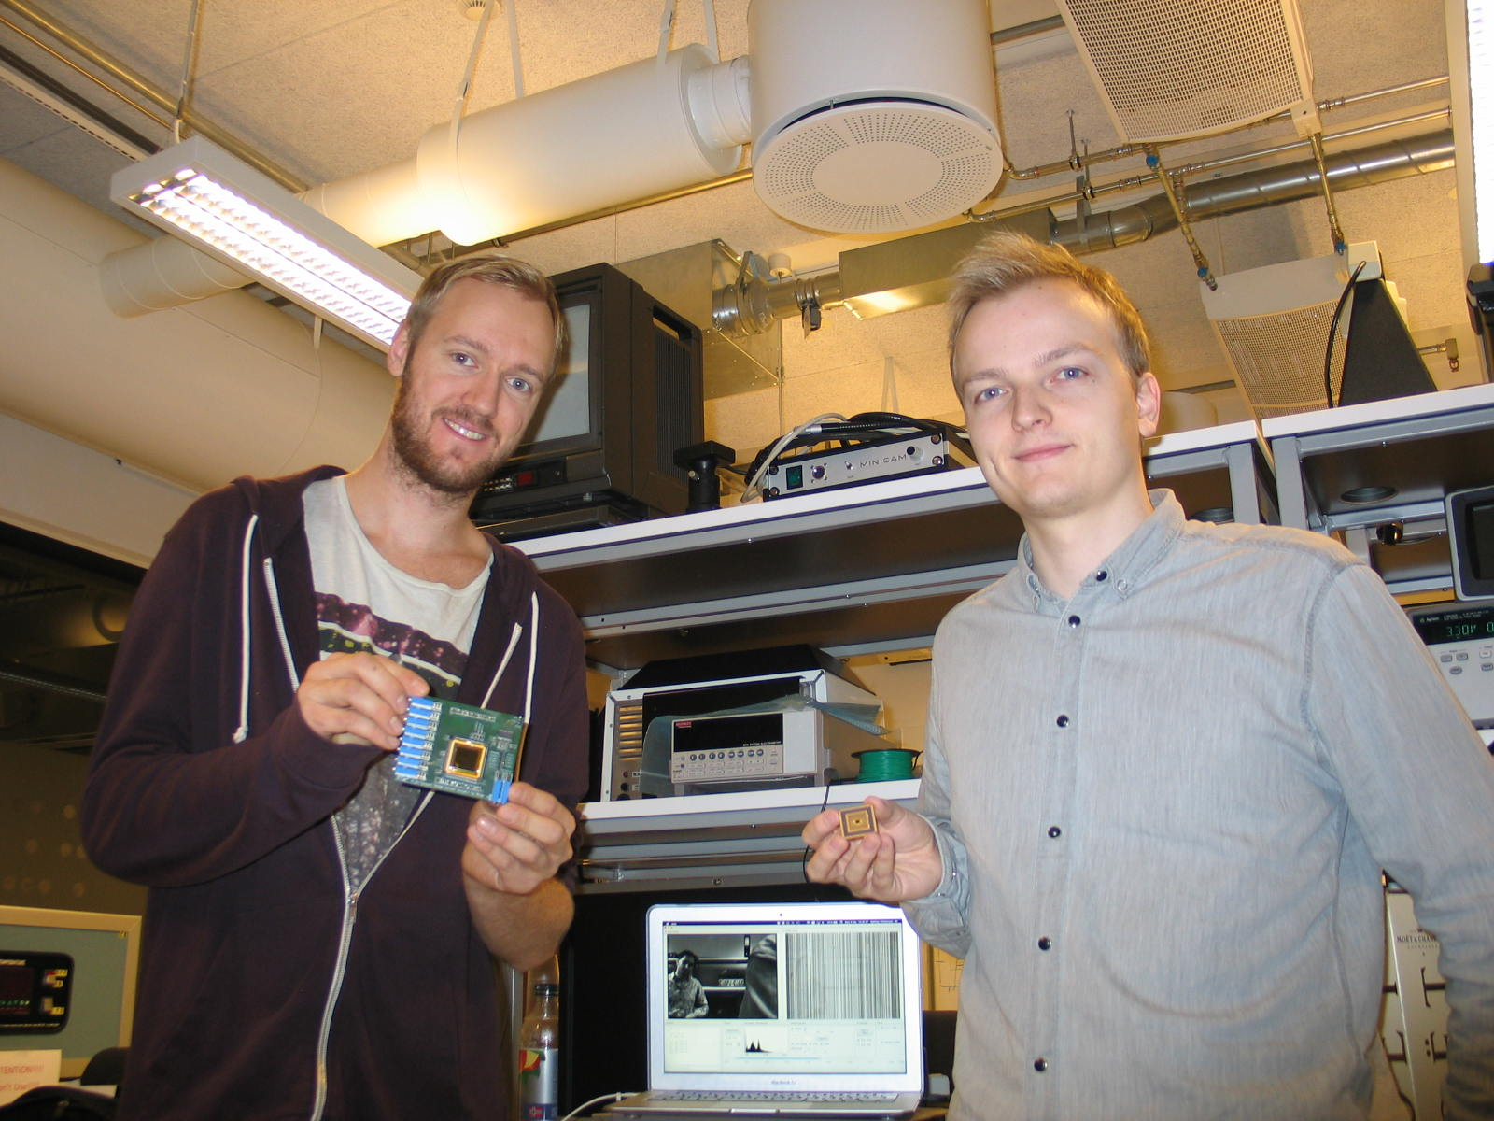
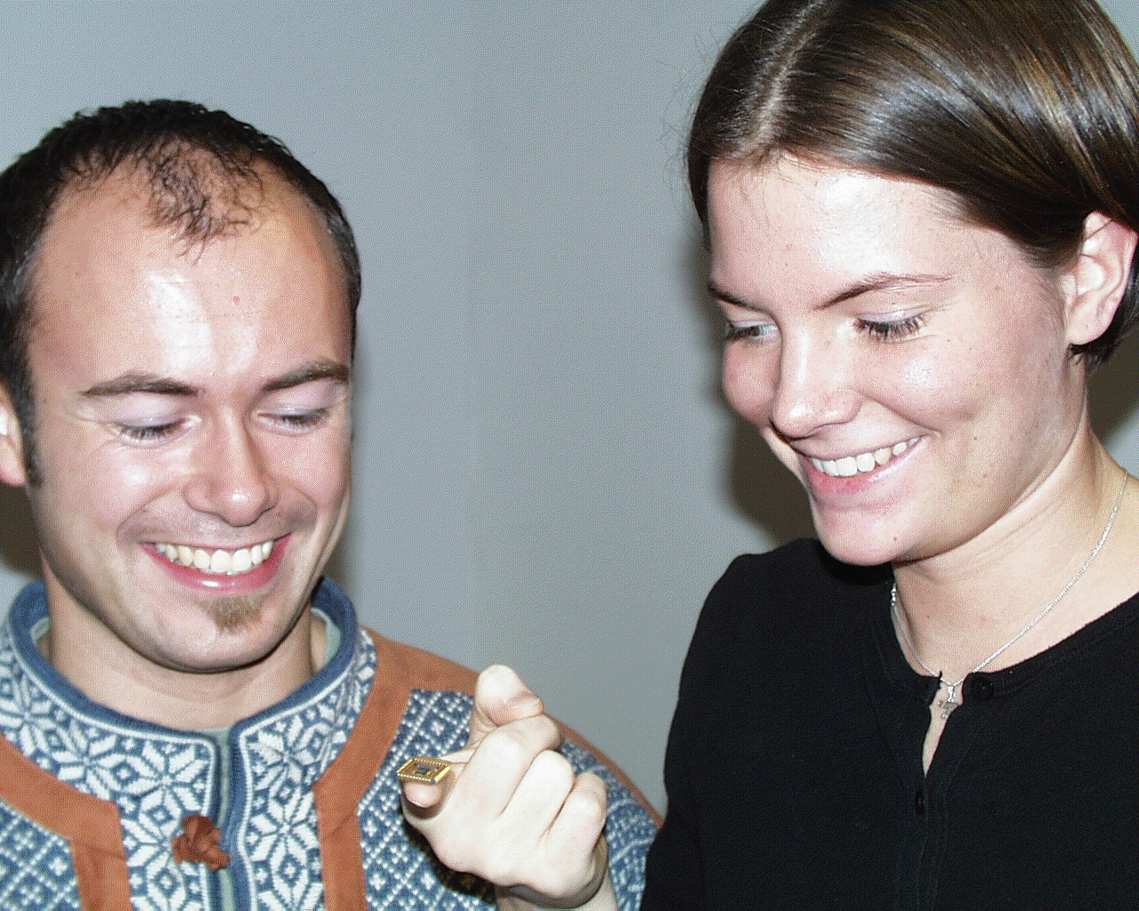
MSc projects: Design of CMOS image sensor chips in 0.35um process
Johnny and Siri
Stian and Mathias

Slide 5
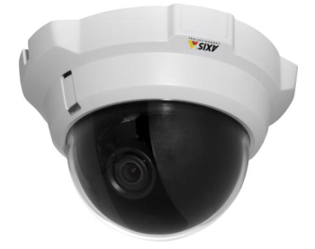
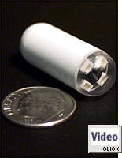
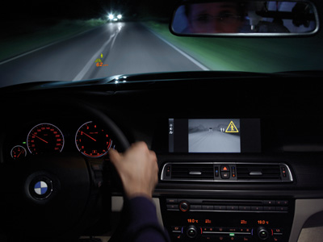
Application examples
Security camera
(low light, <0.1lux)
SLR camera
(>30Mpixels)
Machine vision
(high-speed, >500Hz)
Phone camera
(small size, <5mm)
Automotive camera
(20bits/pixel)
Pill camera
(low power, <10mW)

Slide 6
Teaching
Lectures on Fridays 0915-1200 in lecture room Perl
Exceptions announced on IN5350 home page
Mandatory exercises (hand-outs after lecture)
Document published on the IN5350 home page after lecture
Grade: pass/fail (must pass all to take exam)
1 hour group/lab work after each lecture
Tohid and/or Johannes will be present to help
Mandatory project
Grade: pass/fail (must pass to take exam)
Topic&field is optional:
Analog design (e.g. pixel array and readout circuits)
Digital design (e.g. readout sequencer, signal processing)
Algorithm design (image processing in Matlab/Python/etc)
Test and measurements using existing camera

Slide 7
Course literature
All mandatory course material covered in slides and exercises
Additional information (book): Image Sensors and Signal Processing for Digital Still Cameras, by Junichi Nakamura
Other good imaging books: http://cmos-image-sensor.blogspot.no/2010/06/list-of-image-sensor-books.html
Free download of state-of-the-art conference papers: www.imagesensors.org

Slide 8
Examination
Written examination (4 hours)
All mandatory assignments have to be accepted in order to take the exam
Exam date: Thursday 28 November at 09:00
Place: Silurveien 2
Examination system: Inspera

Slide 9
How to prepare for exam?
Study all lecture slides
Review obligatory exercises
Practice with previous exams
Will be distributed later

