Slide 1
INF5350 – CMOS Image Sensor Design
Lecture 1 – CMOS camera systems overview

Slide 2
Lecture 1 objectives
Overview how cameras work from light in to digital images out
Introduce topics to be covered in more detail later in the course

Slide 3
Literature
Only lecture notes are obligatory
Reference:
Nakamura et al:
Ch. 1 (background material)
Ch. 2 (until 2.1.2)

Slide 4
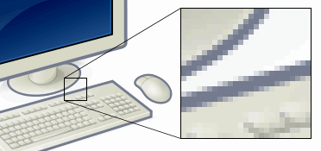
Picture definition
Defn: 2D array of pixels (picture elements) each containing numbers (R+G+B or Y+U+V) to describe the pixel color and its brightness (intensity)
Zoom-in on LCD screen w/RGB pixels
Zoom-in to see individual pixel elements
Every pixel outputs Red+Green+Blue light

Slide 5
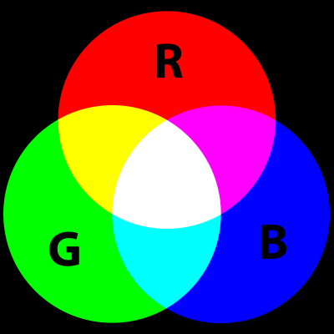
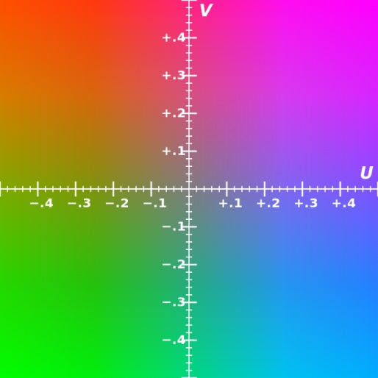
RGB vs YUV color representation
RGB
YUV
YUV image
along with its
Y,
U,
V components.
U-V color plane
(Y=0.5)
Mixing primary colors (RGB)

Slide 6
RGB to YUV, and vice-versa
$$Y^{′}=0.299R+0.587G+0.114B$$
$$U=0.492(B−Y^{′})$$
$$V=0.877(R−Y^{′})$$
$$\left[\begin{matrix}Y \\ U \\ V\end{matrix}\right]=\left[\begin{matrix}0.2988 & 0.5869 & 0.1143 \\ −0.1689 & −0.3311 & 0.5000 \\ 0.5000 & −0.4189 & −0.0811\end{matrix}\right]\left[\begin{matrix}R \\ G \\ B\end{matrix}\right]$$
$$\left[\begin{matrix}R \\ G \\ B\end{matrix}\right]=\left[\begin{matrix}1 & 0 & 1.402 \\ 1 & −0.3441 & −0.7141 \\ 1 & 1.772 & 0.00015\end{matrix}\right]\left[\begin{matrix}Y \\ U \\ V\end{matrix}\right]$$

Slide 7
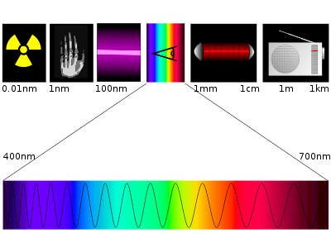
The electromagnetic spectrum
Gamma
X-ray
UV
Visible
Infrared
Radio waves
λ=
Wavelength
λ=400nm
λ=700nm

Slide 8
Camera system
Shutter
CIS
Digital Image Processing (ISP)
Memory card
Lens
Data bus
USB
System Controller
LCD monitor
CIS = CMOS image sensor

Slide 9
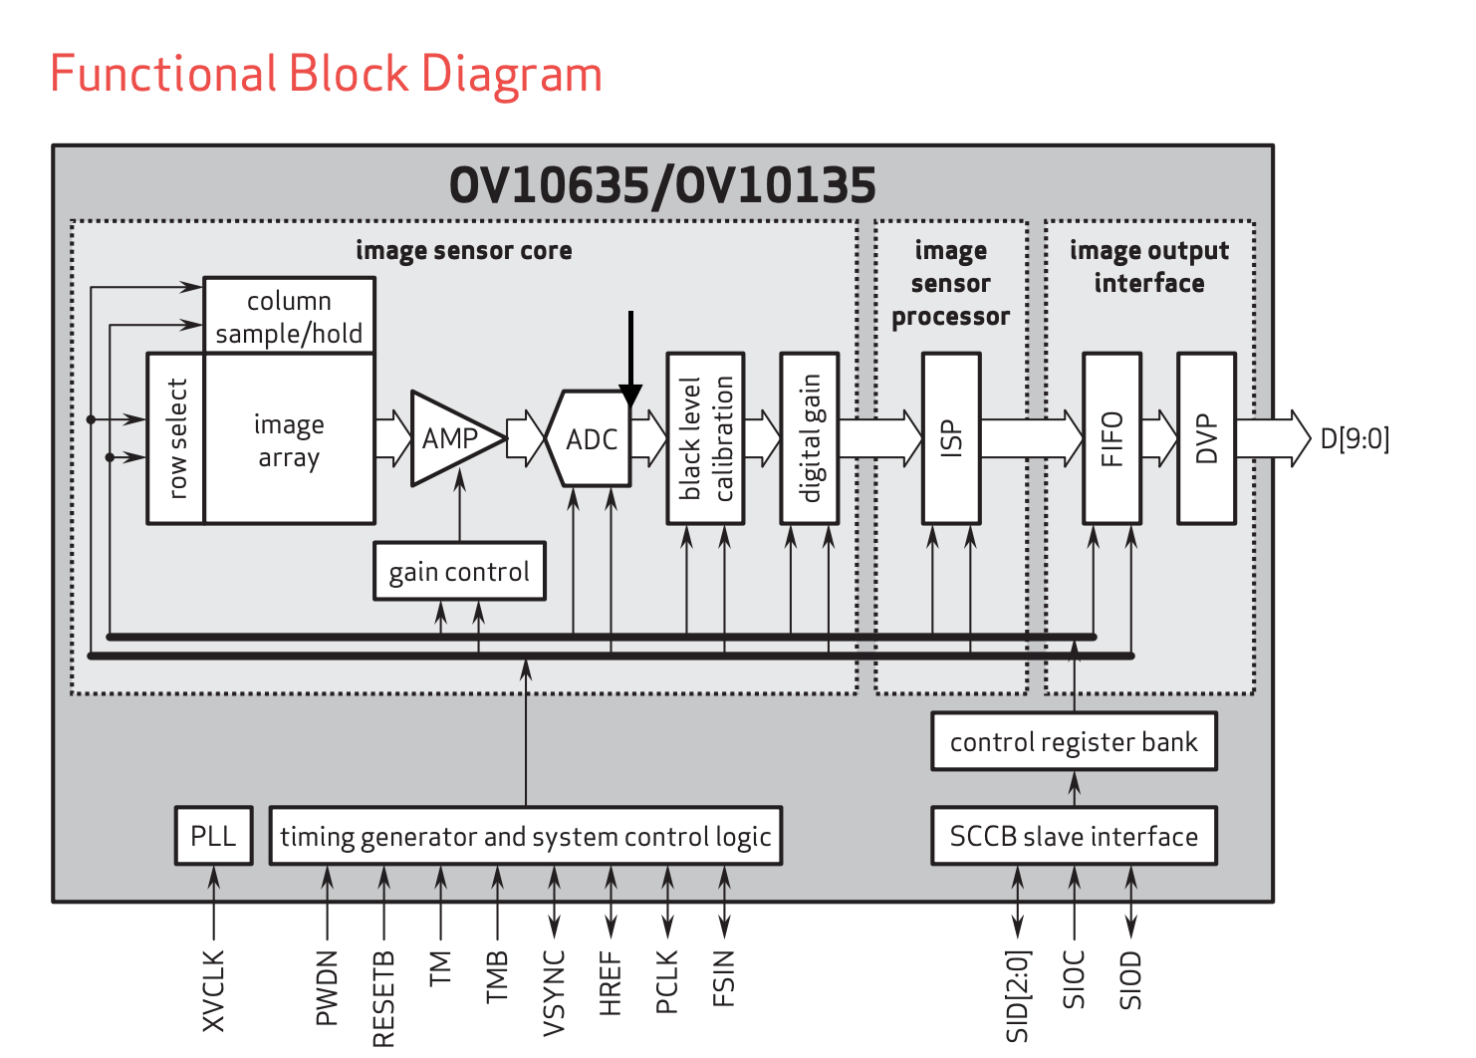
CIS chip architecture example

Slide 10
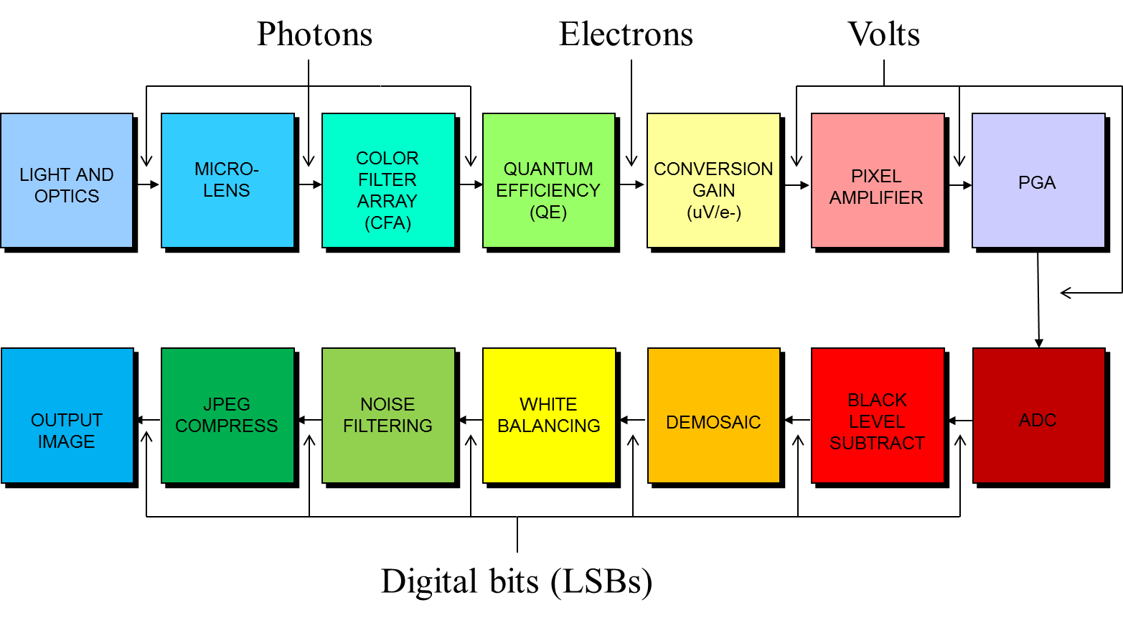
Camera signal chain
COLOUR PROCESSING
LENS CORRECTION
DEFECT PIXEL CORRECTION
BLACK LEVEL COMPEN-SATION

Slide 11
Illustration of micro-lens array
0.8-5um diameter
(=pixel size)
Micro-lenses improve light sensitivity and sharpness
Purpose is to focus incoming light to the middle of the pixel to avoid light leakage (losses) to neighbouring pixels and/or light loss due to reflections off transistors, metal routing, etc

Slide 12
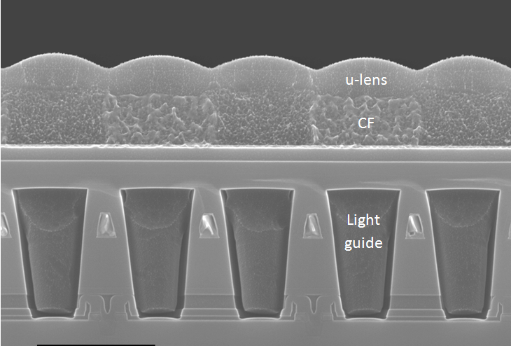
Frontside illuminated (FSI) CMOS sensor
Micro lense
3-6um
Color filter
Passivering
1-3um
Metal routing
Photon detection
P-doped silicon
12

Slide 13
Backside illuminated (BSI) CMOS sensor
Incoming light
1-2um
’Backside’
BSI avoids the need for the light to go through these routing layers
’Frontside’
After CMOS process, wafer is thinned to ca 5um and placed on a carrier wafer. Then CFA and ulenses are deposited.
Better light sensitivity than FSI (Frontside illuminated) sensor
BSI technology important for small pixel sizes <6um

Slide 14
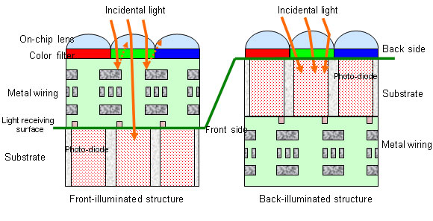
FSI vs BSI

Slide 15
CMOS-sensor with ’Bayer’ color filter array
Photo
diode
Repetitive 2x2 pattern (RGBG)
CFA = color filter array

Slide 16
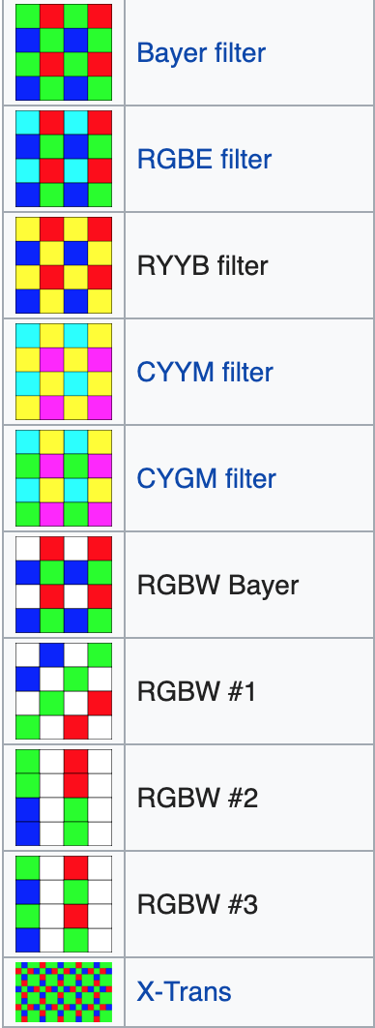
CFAs used in CMOS image sensors
The choice of CFA depends on application requirements, i.e. light sensitivity vs colour accuracy vs spatial resolution

Slide 17
CMOS pixel array (4T pixels)
C_{fd} node converts photon charges (e-) into voltage (ΔV)
SF
SF
PD
C_{fd}
PD
C_{fd}
SF drives voltage on output column bus.
SF current source is outside array (one per column)
SF
SF
PD
C_{fd}
PD
C_{fd}
V_{col0}
V_{col1}
I_{bias}
I_{bias}

Slide 18
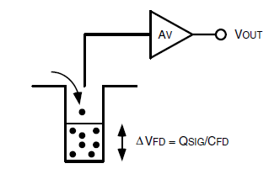
Conversion gain
FD
Charge detection scheme:
Conversion gain:
q = 1.6 x 10⁻¹⁹ C
C_{FD} = floating diffusion capacitance
Assuming number of electrons capture = S_{electrons}
Voltage swing at FD node: ΔV_{FD} = CG S_{electrons}

Slide 19
Sequential row readout
0V
Step-1: enable selected row
Step-2: sample each column value (Vcoln)
Step-3: disable row
Step-4: increment row address, repeat above steps
3V
0V
0V
V_{col1}
V_{col2}
V_{col3}
V_{col4}

Slide 20
Sequential row readout
0V
0V
3V
0V
V_{col1}
V_{col2}
V_{col3}
V_{col4}

Slide 21
Sampling and digitizing output from pixel array
SHR
G x ΔV
C1
V_{rst}
+
V_{col<n>}
G
A/D
ΔV
D_{out}
SHS
-
V_{sig}
OpAmp
C2
SHR
V_{rst}
ΔV proportional to number of photons in the pixel
V_{col<n>}
ΔV
SHS
V_{sig}

Slide 22
Black level compensation (BLC)
ADC output values non-zero even if pixel output signal is zero
Any clipping at 0DN in ADC leads to non-linear sensor data (asymmetric histogram curve)
Offset voltage (Voffset) added to pixel signal before A/D converter
Additional offset comes from dark current generation when operating at elevated temperatures and/or long integration times
Image processing functions (e.g. defect pixel correction, lens correction, HDR, and color processing) rely on ‘linear’ pixel values, i.e. proportional to incoming light level (without offsets). Hence, BLC is needed.
BLC uses optical black pixels (shielded with opaque material) to estimate average black level value
Average across many pixels to remove noise
NB. Important black level is same across the array (no shading)

Slide 23
Black level compensation (BLC)
Before BLC
After BLC
2^{Nbits}
2^{Nbits}
Pix. value (a.u.)
Pix. value (a.u.)
Offset pedestal
0
0
0
0
Light level (a.u.)
Light level (a.u.)
Offset due to dark current and/or analogue offset
Offset removed. Pixel values are now ‘linear’, ie proportional to light level

Slide 24
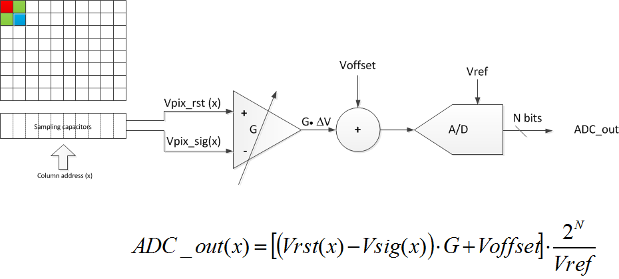
CIS readout chain
Dark current BLC component proportional to exposure time and gain, and doubles every ~7degC.
Fixed black level independent of Tint, Temp, and Gain
Typical values:
Vpix_rst=2V, Vpix_sig=1-2V, G=1x-16x, Voffset=50mV, Vref=1V, N=10

Slide 25
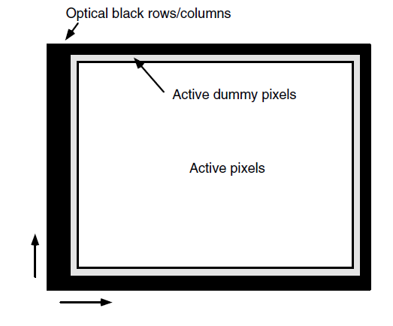
Example of optical black rows/columns

Slide 26
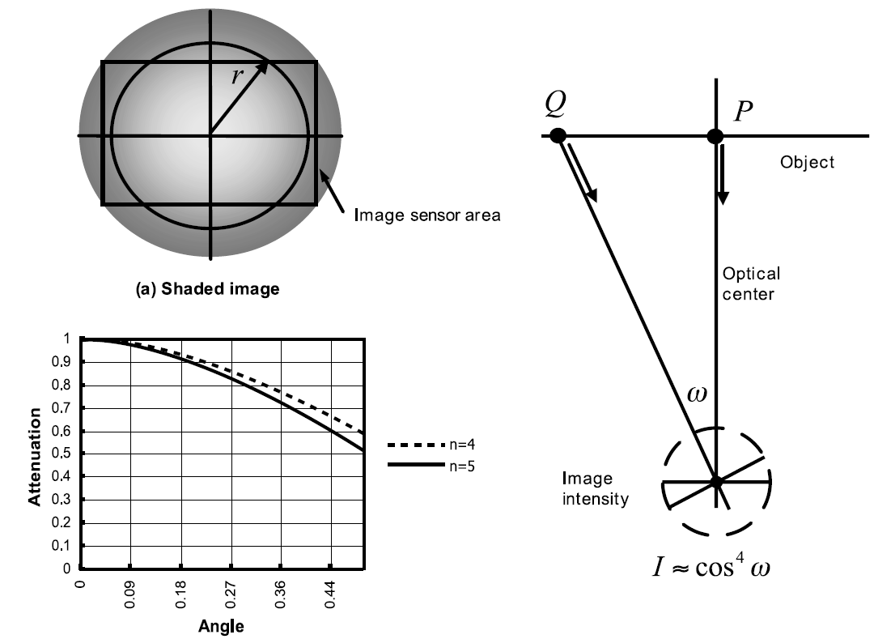
Lens shading correction

Slide 27
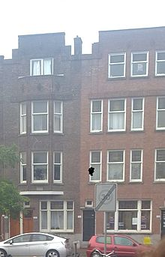
Defect pixel correction
Objective: Detect and correct abnormal (damaged) pixels
Can be done automatically on-the-fly and/or in mass production by writing (x,y) positions into non-volatile memory
Correct by interpolation from neighboring pixels
DPC complexity and quality depends on power and chip size budget
Example image from Wikipedia

Slide 28
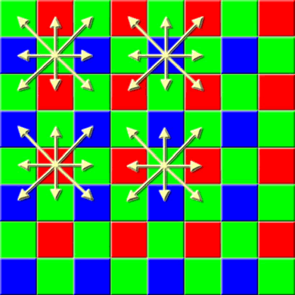
Color interpolation
Purpose: to generate R+G+B for each pixel position
Three common methods:
Nearest neighbor interpolation
(Bi)Linear interpolation
Bi-Cubic spline interpolation

Slide 29
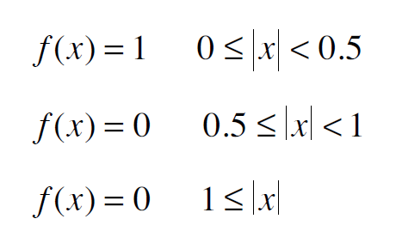
Nearest neighbor interpolation
x: distance to pixel i
f(x): weighting factor

Slide 30
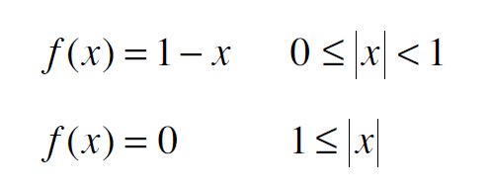
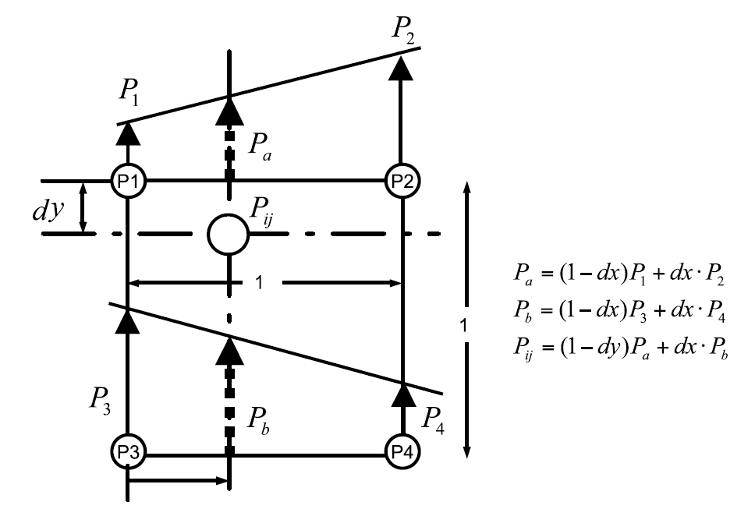
Linear and Bi-Linear interpolation
x: distance to pixel i
f(x): weighting factor
Linear:
Bi-Linear (x and y direction):

Slide 31
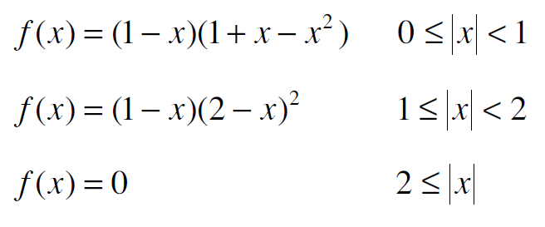
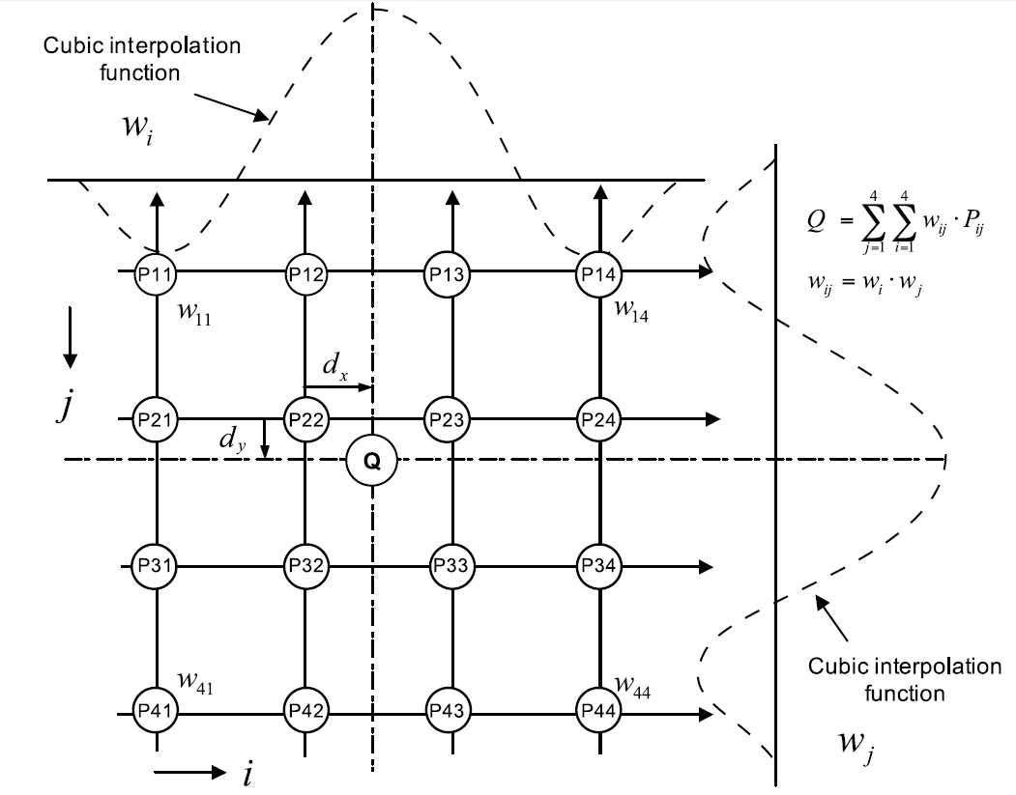
Bi-Cubic spline interpolation
Cubic
spline:
Bi-cubic spline:

Slide 32
HW implementation cost

Slide 33
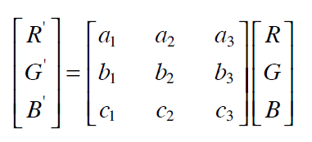
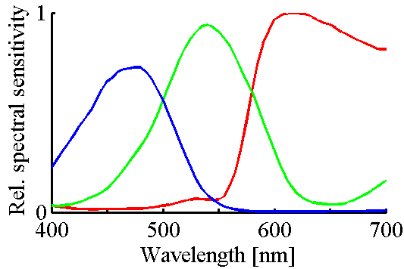
Color correction
Purpose: Improve color accuracy by compensating for crosstalk between R-G-B pixels
Crosstalk due to imperfect colour filters, reflections, charge leakage, etc.
Matrix ‘A’ = Color correction matrix (CCM)
3x3 matrix with fixed values typically stored in non-volatile memory
Blue to green crosstalk, a₃
Red to green crosstalk, a₁
This condition ensures average brightness remains unchanged

Slide 34
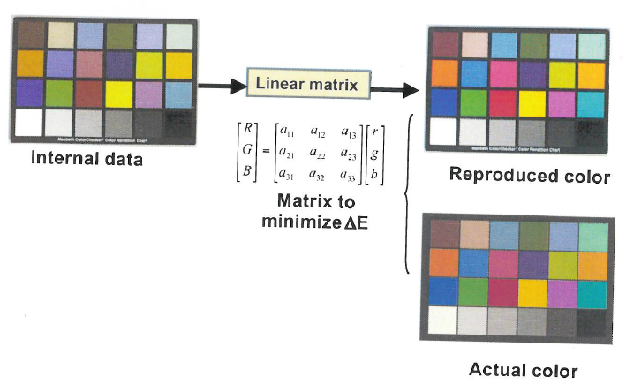
Camera colour characterization
[r, g, b]
[R, G, B]
Captured raw image (after CIP)
After color correction (CCM)
Target results

Slide 35
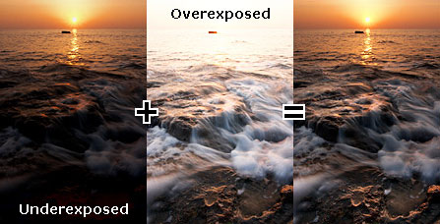
HDR combines multiple pictures
Two captures combined into one picture with correct exposure everywhere!

Slide 36
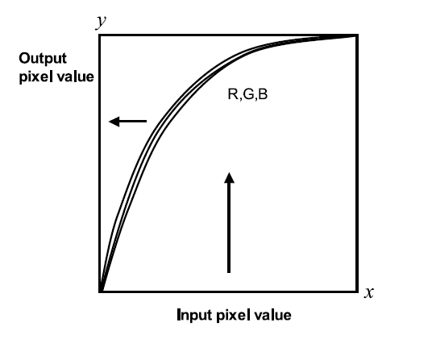
Tone mapping / gamma curve
Purpose: (i) Map output image to 8b RGB display, (ii) Data compression
Popular mapping scheme: y(x) = x^{γ}
γ ~0.45 typical value
Global TM
Same function on entire image
Reversable
Local TM
Function changes accross image
Better image quality
Non-reversable

Slide 37
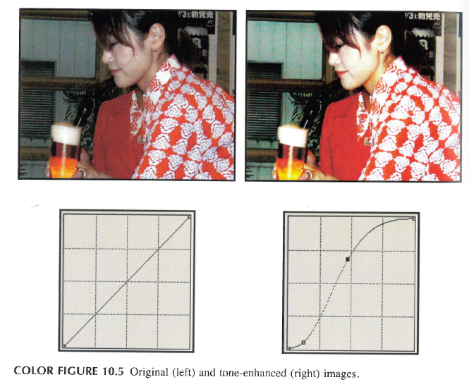
Tone mapping example

Slide 38
Thanks!

Slide 39
ADDITIONAL SLIDES FOR INFORMATION

Slide 40
CIS signal chain (single A/D architecture)

Slide 41
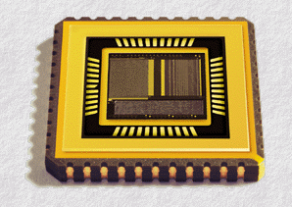
Digital Camera-on-a-chip in CMOS
A/D converters
Timing and control
Pixel array
ISP, PLLs, Vrefs, TempSensor, I/O, etc

Slide 42
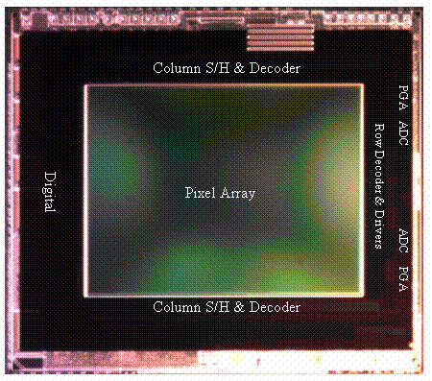
Block diagram of CMOS image sensor
2MP, ¼”, 15fps
Source: ISSCC ’09

Slide 43
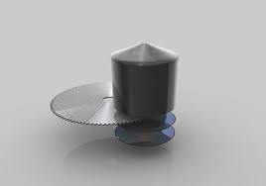
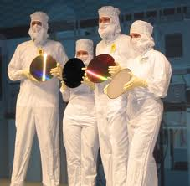
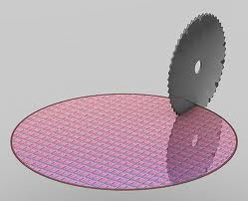
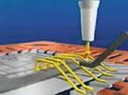
Fabrication of integrated circuits in CMOS
ii) 300mm wafers
with CMOS die
i) From Si-ingot to Si-substrate (300mm)
iii) Dicing wafers into die
iv) From die to chips in package

Slide 44
Active research topics in the field of CIS design (selected examples)
Multi-layer stacked chip camera modules
Pixel, ADCs, ISP, memory, I/O in separate layers
More parallelism, similar to human visual system
High dynamic range (HDR) capture
HDR involves combining high/low sensitivity captures
How to avoid LED flicker issues
How to avoid motion artefacts
Reducing power consumption
Typical CIS power consumption is 100-500mW
Difficult to maintain as array size (resolution) keeps increasing
Need <10mW to enable battery driven IoT cameras, pill cameras, door bells, etc.
Stacking paradigm shift to enable lower power
Improved infrared response for LL imaging, etc

Slide 45
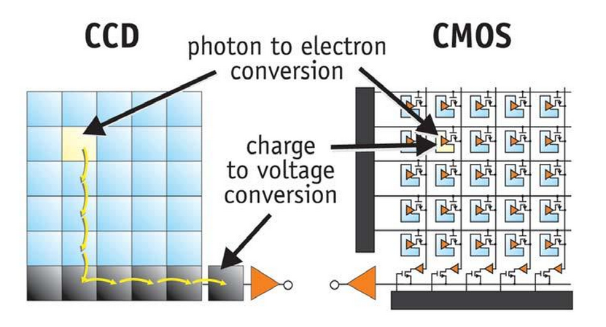
CCD vs CMOS
Foton til elektron
konvertering
Ladning til
spenning konvertering

Slide 46
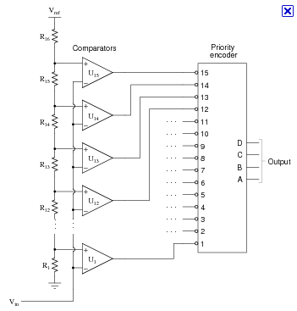
Analog/Digital conversion (Volts to bits)
1111=15d
1110
1101
1100
1011
1010
1001
1000
0111
0110
0101
0100
0011
0010
0001
0000
Input voltage

