Slide 1
IN5350 – CMOS Image Sensor Design
Lecture 2 – 3T and 4T pixels

Slide 2
Contents
Introduction
3T pixel
Circuit
Timing diagram (capture and readout)
Hard vs soft reset
4T pixel circuit and timing diagram

Slide 3
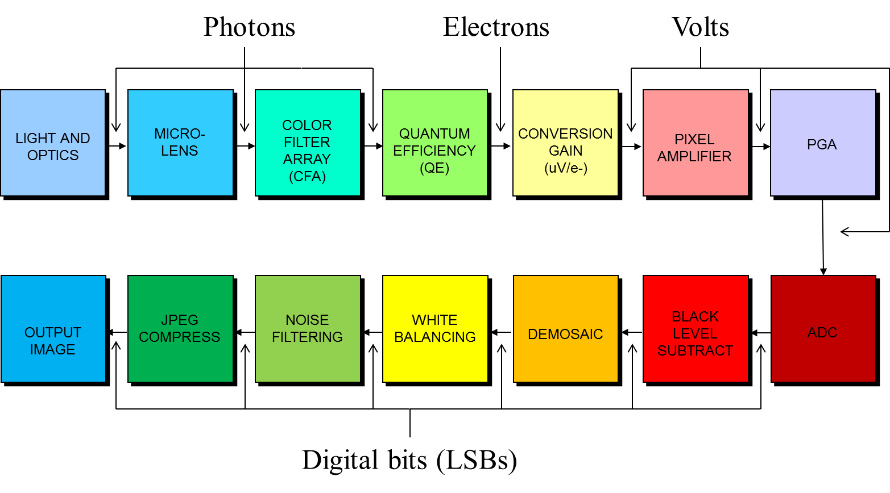
Camera signal chain
This lecture
Photodiode

Slide 4
3x3 pixel array with address decoders
Row 0
Diode
Diode
Diode
Row (y) decoder
Row 1
Diode
Diode
Diode
Row 2
Diode
Diode
Diode
Output
Column (x) decoder

Slide 5
3T pixel
V_{RST}
T_{int}
V_{DD}
ROW
RST
M_{rst}
RST
M_{sf}
I_{pd}
V_{PD}
PD
M_{sel}
V₂
V₁
V_{COL}
N.A.
ROW
V_{COL}

Slide 6
3T pixel
Photodiode (PD) is reverse bias and the n-side is ‘floating’ during image capture. PD acts as a capacitor. Its voltage drops proportionally to the photocurrent.
M_{rst} is a reset switch. Its purpose is to pre-charge the photodiode to a starting voltage V_{RST} before image capture starts.
M_{sf} serves as a common drain amplifier (aka source follower). Note its current source is placed outside the pixel array and shared by all pixels on that column.
M_{sel} is a row select switch. When enabled the source follower of that pixel will drive the column line (aka bit line from RAM terminology).

Slide 7
3T pixel image capture process
Step-1: Pulse RST (pre-charge PD to V_{RST})
Removes any photon-charge from previous capture
Step-2: Wait for exposure time to elapse
Step-3: Turn ON M_{sel}
To enable pixel SF to drive column bus
Step-4: Sample column voltage (V₁=V_{out})
This voltage is called the ‘signal level'
Step-5: Pulse the RST switch
Forces PD back to its original pre-charge level (V_{RST})
Step-6: Sample column voltage (V₂=V_{out})
Final result: ΔV = V₂ – V₁

Slide 8
3T pixel remarks
Compatible with off-the-shelf CMOS devices
CFA and ulens deposition available from other vendors
PD composed of NW/P-sub
Use thick oxide NFETs to withstand 3V operation

Slide 9
Hard reset vs soft reset
Vth in NFETs typically 0.5-0.8V
M_{rst} turns off gradually as V_{PD} increases which leads to too low V_{GS}
This means V_{PD} will never reach V_{RST} during pre-charge but instead asymptotically move towards RST-Vth (aka ‘soft reset’)
Soft vs Hard reset of PD
Pros: sqrt(2) lower kTC-noise; simplest implementation
Cons: incomplete reset causes charge lag (traces of charge from previous frame occurs in current frame)
Hard reset obtained by boosting RST voltage to V_{RST}+V_{th} or by setting V_{RST} < V_{DD}-V_{th}

Slide 10
Motivation for delta-sampling (V1-V2)
Question
Ref above timing diagram, if PD is always pre-charged to the same voltage (ie VRST with hard reset or VRST-Vth with soft reset) then why waste time sampling this pre-charge level (V2) when reading the pixel?
Answer
SF output dc level depends on Vth which can vary significantly (+/- tens of mV) from pixel to pixel and cause Fixed Pattern Noise (FPN) artefacts. Delta sampling mitigates this issue.

Slide 11
Fixed pattern noise (FPN) examples
Pixel FPN from SF Vth variation
Mitigated by delta-sampling
Vertical FPN from Vth variation in current source
Mitigated by delta-sampling

Slide 12
4T pixel circuit and timing
T_{int}
V_{RST}
ROW
RST
M_{rst}
COL
V_{DD}
TX
RST
FD
PD
M_{tx}
M_{sf}
TX
M_{sel}
V_{FD}
ROW
V₁
V₂
V_{COL}
N.A.

Slide 13
4T pixel remarks
PD behaves similarly to 3T pixel, ie always reverse biased and generates charge proportional to the light level.
M_{tx} is called a transfer gate. Its purpose is to enable/disable charge flow between PD and FD.
M_{rst} reset switch controls (i) pre-charge of PD and (ii) pre-charge of FD node during CDS readout.
M_{sf} serves as a source follower as in 3T pixel.
M_{sel} is a row select switch. Same as in 3T pixel.

Slide 14
4T pixel image capture process
Step-1: Pulse RST and TX simultaneously
Resets PD. Removes any photon-charge from previous capture
N part of diode is 100% depleted. Hence, V_{PD} after pre-charge is fixed at Vpin (defined by N_{D} implants) with zero kTC-noise.
Step-2: Wait for exposure time to elapse
Step-3: Assert ROW
To enable pixel voltage on column bus
Step-4: Pulse RST (keeping TX off)
Step-5: Sample column output voltage (V₁=V_{out})
This corresponds to the FD reset level
Step-6: Pulse the TX switch (0.5-1us pulse width, typical value)
PD photo-electrons move to FD which has a higher potential
Once charge transfer is complete V_{PD} returns to Vpin
Step-7: Sample column voltage (V₂=V_{out})

Slide 15
4T pixel remarks
N region in the PD is 100% depleted after pre-charge => no kTC-noise
Shallow P+ layer (connected to ground) on top of N region to absorb any dark current generated at the Si/SiO₂ interface => MUCH lower dark current (10x-1000x).
P+ pinning layer requires extra process steps compared to off-the-shelf CMOS
In addition, special engineering of the transfer gate (TX) implants is needed to ensure low DC and that all PD electrons move across to FD without lagging behind causing image artefacts in the subsequent frame
Often, special engineering is also done with the SF device (typically buried channel device) to obtain best possible noise performance
Anti-blooming path via TX and RST, ie these devices must pass through electrons when PD is saturated

Slide 16
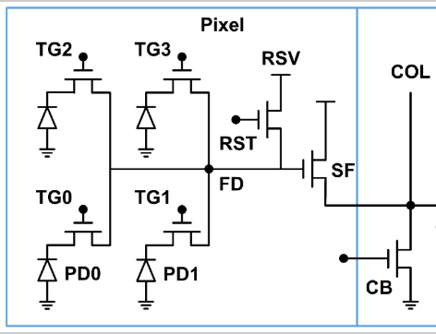
Pixel sharing enables higher fill factor
2x2 sharing => From 4 to 7/4 devices/pixel
VRST
SF
SEL

Slide 17
3T vs 4T pixels
3T
4T
Fully CMOS compatible
High noise (kTC, DC, ..)
Used in applications where S/N ratio is not important
2x1, 2x2, 2x3 sharing enables fewer devices per pixel
Pixel implants different from the CMOS devices
Extremely low noise (no KTC, low DC, ..)
Used in nearly all of today’s digital cameras
2x1, 2x2, 2x3 sharing enables fewer devices per pixel

