Slide 1
Project schedule
Task/milestone | Start | Finish
Chose topic/scope | 16-Sep | 20-Sep
Create project plan (tasks, milestones, schedule) | 20-Sep | 27-Sep
MS1 – project plan approved by Johannes | 30-Sep | 30-Sep
Study literature on the topic | 27-Sep | 4-Oct
Design/simulation | 4-Oct | 25-Oct
Write up prelim report (inc references, design, results) | 25-Oct | 29-Oct
MS2 – submit preliminary report to Johannes | 29-Oct | 29-Oct
Design/simulation | 29-Oct | 15-Nov
Write up final report (incl references, design, results) | 15-Nov | 22-Nov
MS3 – submit final report to Johannes & presentation | 22-Nov | 22-Nov
MS4 – grading (pass/fail) by Johannes & Tohid | 22-Nov | 22-Nov
Exam | 28-Nov 2019

Slide 2
Course project
Project size: 40-60hrs total
Schedule: see next slide
Grade: pass/fail (must pass to take exam).
Topic&field is optional:
  Analog design (e.g. SPICE: pixel array and readout circuits)
  Digital design (e.g. RTL: readout timing, image signal processing)
  Algorithm design (Matlab/Python: BLC, DPC, AEC, AWB)
Deliverables: (i) Project plan, (ii) Project report, (iii) Presentation
Groups of max 2 persons is allowed, but clearly differentiate who did what in the project.
For access to nanolab in 5th floor email your name, username, and card number to Olav Stanly Kyrvestad <olavky@ifi.uio.no>
All SW (Cadence, Matlab, etc) available on all machines at IFI, as well as via remote login from external computer

Slide 3
IN5350 – CMOS Image Sensor Design
Lecture 4
Section I – Readout timing
Section II – Readout circuits

Slide 4
IN5350 – CMOS Image Sensor Design
Lecture 4
Section I – Readout timing
Section II – Readout circuits

Slide 5
Contents
Introduction
Section I
  Electronic rolling shutter
  Blanking time (HB and VB)
Section II
  Row decoder/driver
  Voltage boosting and driving
  Analog CDS
  Digital CDS

Slide 6
CIS block diagram
Pixel array
Timing and control logic
Row decoder
Column ADCs
ISP
Output FIFO
Line memory

Slide 7
Analog vs Digital CDS
Analog CDS
  Sample&Hold(Vrst & Vsig) => OpAmp => deltaV => ADC
  Pros: faster (less ADC activity), lower readnoise floor
  Cons: vertical FPN due to column offset variations (parasitics)
Digital CDS
  Vrst => ADC, Vsig => ADC, digital calculation of ‘deltaV’ (ie number of photons captured)
  Pros: less analogue circuit complexity, best VFPN performance (analog offsets subtracted off)
  Cons: need 2x faster ADC, root(2) higher noise when subtracting the two samples to get ‘deltaV’
Commercially imagers use predominantly digital CDS

Slide 8
4T pixel readout
Trow<i>
Trow<i+1>
RS
RST
SHR
TG
SHS
ADC_busy
DCDS
ACDS

Slide 9
Electronic rolling shutter
Readout
Row<j>
T_{exp}
(T_{exp}/T_{row} rows)
Reset
Row<j+Texp/Trow>
‘Readout’ and ‘Reset’ pointers move in parallel from row to row
‘Readout’ points at output row to be sampled, digitized and sent to the output FIFO
‘Reset’ points at row to be reset (pre-charged), thus starting a new capture
Readout and reset pointers increment after completion. Total rowtime is ‘Trow’.
Exposure time (Texp) = Nrows x Trow, where Nrows=number of rows between Reset pointer and Readout pointer

Slide 10

Frame timing
time
T_{int}
T_{row}
Pixel row0
Pixel row1
Pixel row2
Pixel row3
Pixel row4
T_{frame}
Exposure time
Let N_{rows}=total number of pixel rows
Time to readout all rows (aka frame time)
  T_{frame} = N_{rows} x T_{row}
  Frame rate = 1/T_{frame}
  E.g. 50Hz video => T_{frame} = 20ms
Row readout time
Not to scale
T_{frame} usually msec
T_{row} usually usec

Slide 11
Frame timing (short exposure time)
time
T_{int}
T_{row}
Pixel row0
idle
Pixel row1
Pixel row2
Pixel row3
Pixel row4
idle
T_{frame}
T_{int} : exposure time adjustable between one row and 1/f_{video}
Pixel should be in reset mode during idle time in order to prevent PD saturation and blooming of charge into neighbouring pixels

Slide 12
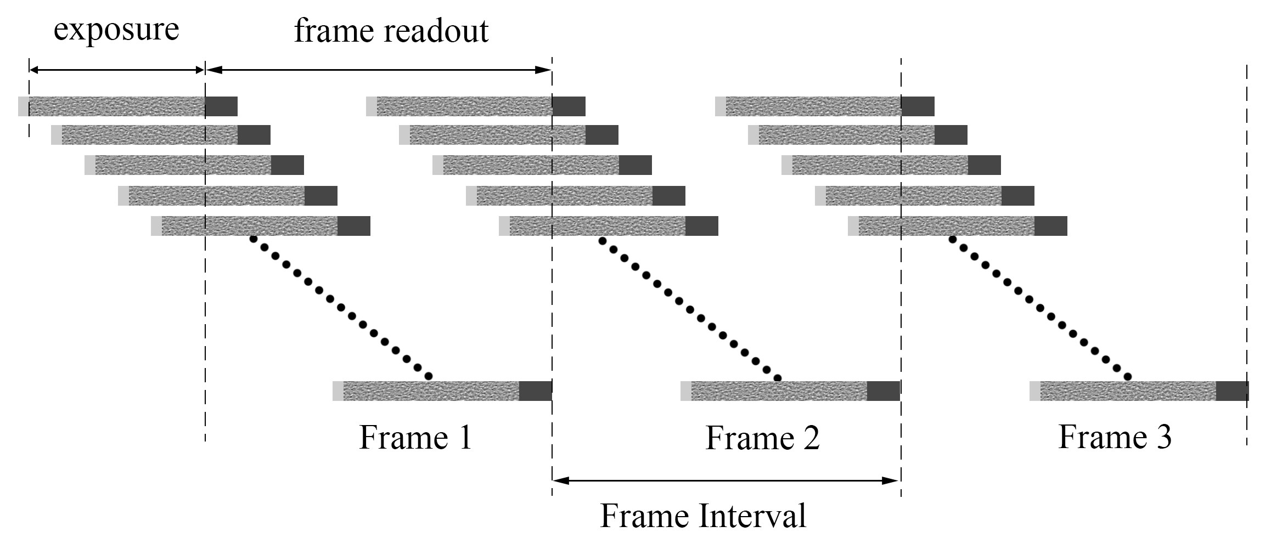
Frame timing
pixels ‘idling’
pixels ‘idling’

Slide 13
Contents
Introduction
Section I
  Electronic rolling shutter
  Blanking time (HB and VB)
Section II
  Row decoder/driver
  Voltage boosting and driving
  Analog CDS
  Digital CDS

Slide 14
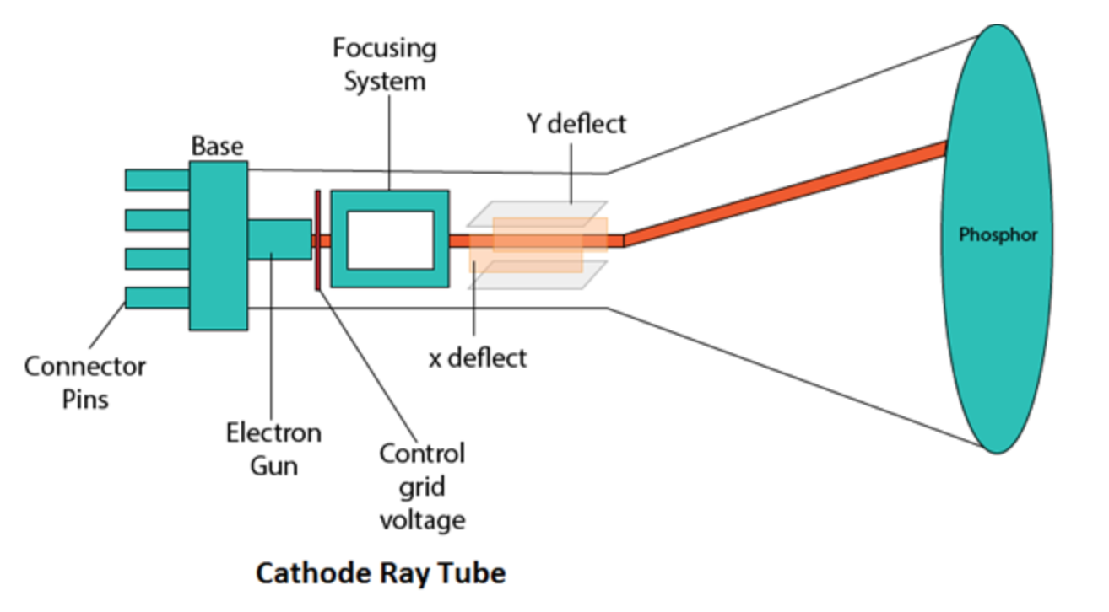
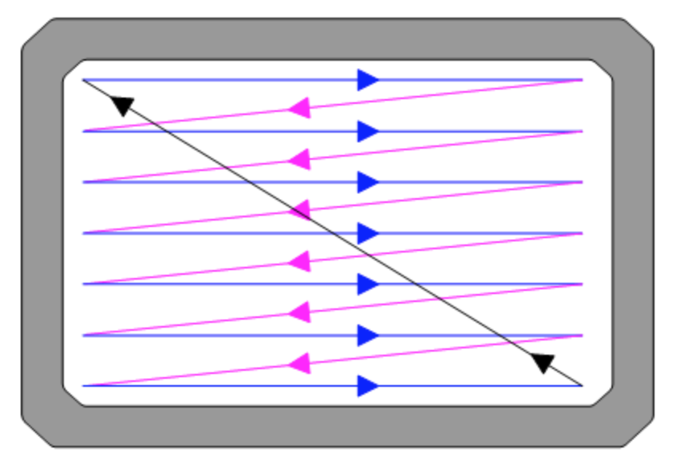
Electron beam scanning principle in old analogue TVs (cathode ray tubes)
Cathode Ray Tube
Raster scanning principle
Horizontal blanking time
i.e. electron beam OFF
Vertical blanking time, i.e. electron beam OFF

Slide 15
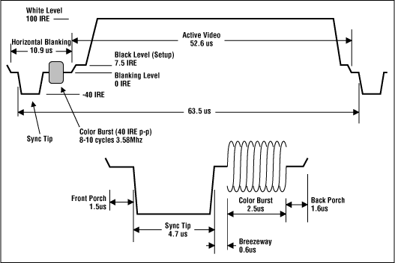
Analogue NTSC video format

Slide 16
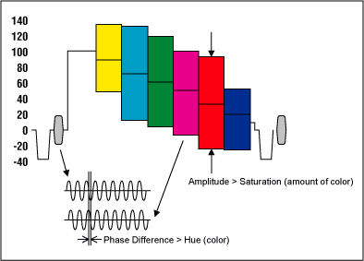
Analogue NTSC video format

Slide 17
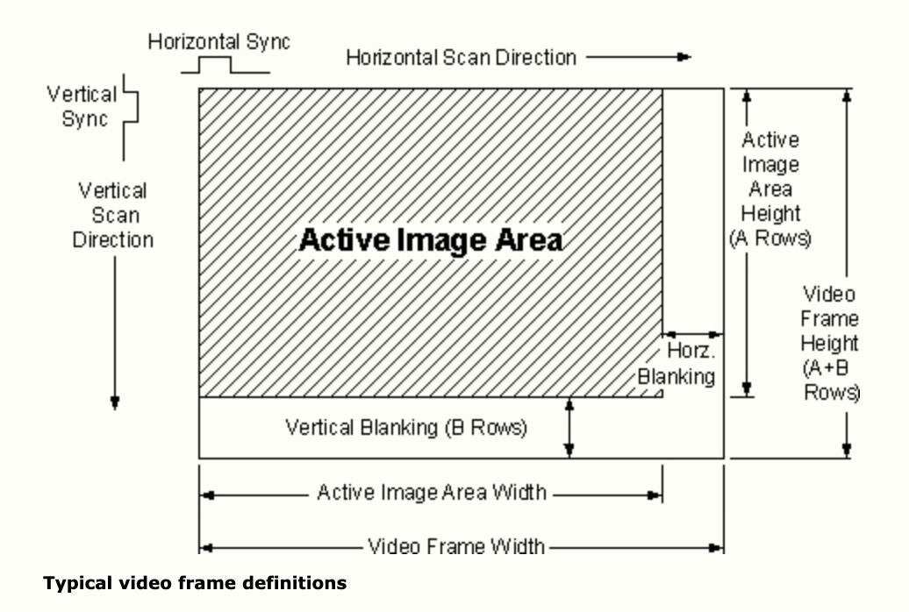
Typical video frame definitions

Slide 18
Contents
Introduction
Section I
  Electronic rolling shutter
  Blanking time (HB and VB)
Section II
  Row decoder/driver
  Voltage boosting and driving
  Analog CDS
  Digital CDS
  A/D converters

Slide 19
Row decoder circuit example
VTX
VRST
VTX 0
VRST 0
VROWSELECT 0
VTX 1
VRST 1
VROWSELECT 1
VTX 2
VRST 2
VROWSELECT 2

Slide 20

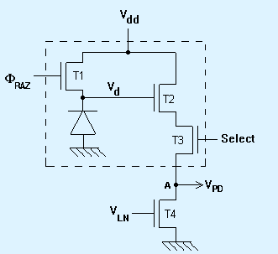
3T CMOS Active Pixel Structure
Schematics
Layout
RST
Detector
surface
Select
RST
V_{DD}
V_{out}

Slide 21
Boosting
To keep ON resistance low in pixel switches (RST, RS, and TX) when/if their source/drain potentials get large, it is possible to ‘boost’ the gate voltage above VDD.
Voltage across C_{L}:
1: V_{L}(1)=V_{DD}
2. V_{L}(2)=V_{L}(1)+I dT/C_{L}
=V_{DD}(1+C_{B}/(C_{B}+C_{L}))
RST
1
2
1
2
C_{B}
VDD
V_{boost} = VDD(1+C_{B}/(C_{B}+C_{L}))
1
1
C_{L}
VDD

Slide 22
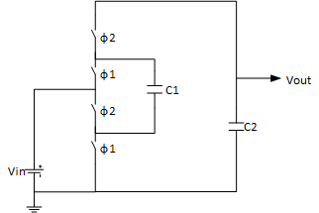
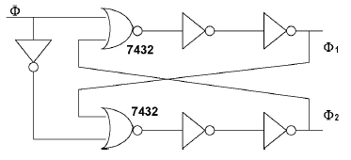
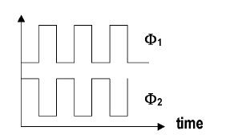
Boost circuit with non overlapping clock generator

Slide 23
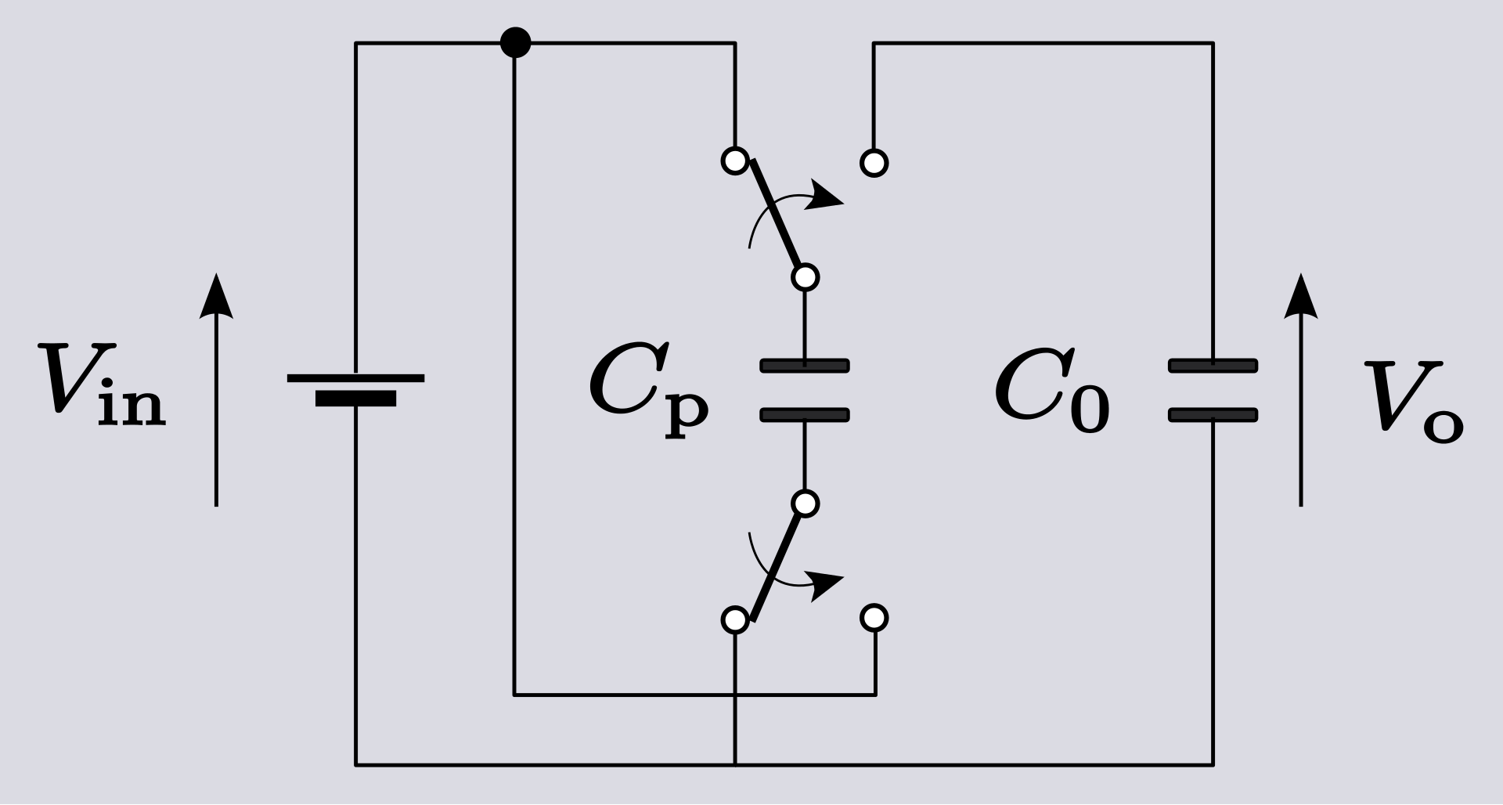
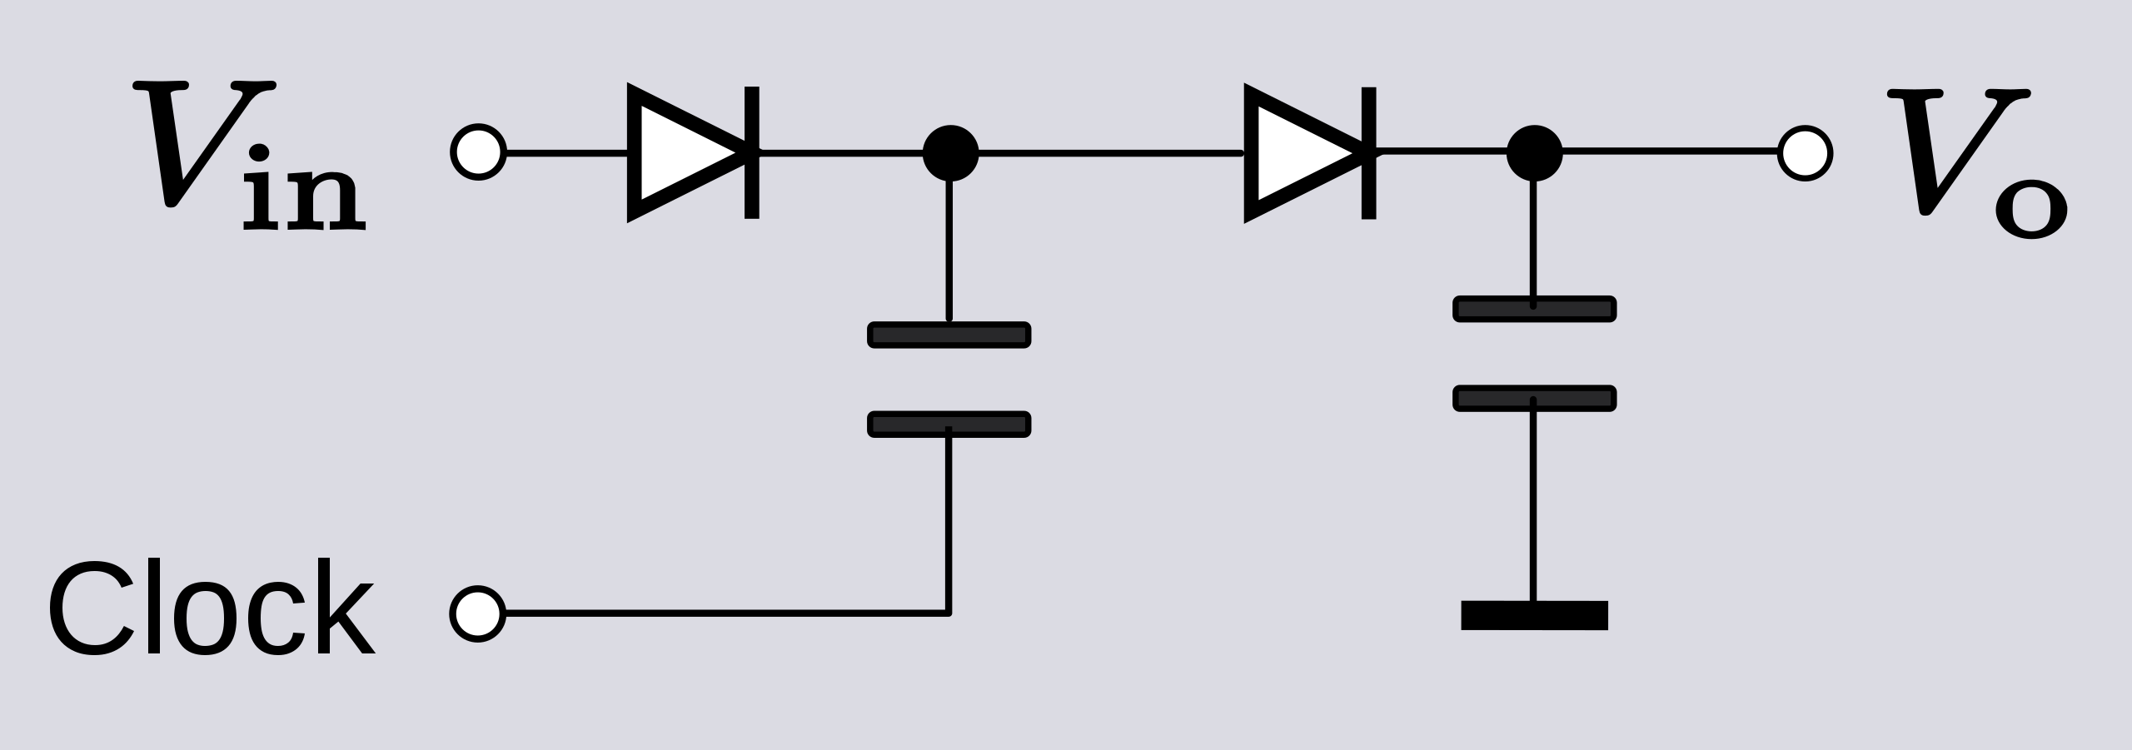
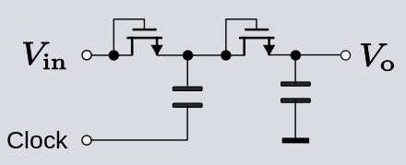
Alternative boosting circuits (charge pumps)
Charge pump doubler. C_{p} delivers charge to C_{o} to compensate for current load on the output
Dickson doublers

Slide 24
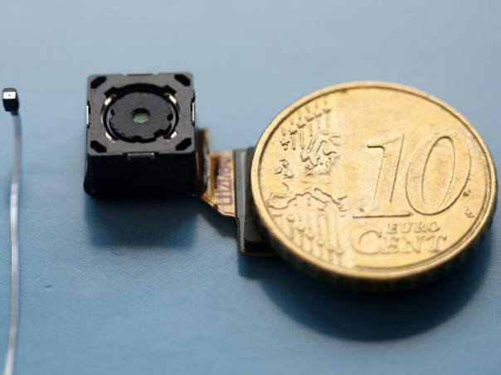
ADCs for CMOS image sensors
Serial readout
  w/Pipeline ADC
Column-parallel readout
  w/Ramp ADC
  w/SAR-ADC

Slide 25
Correlated Double Sampling
VDD
RowSel
RST
TG
V_{FD}
or Vout
SHR
SHS
RST
TG
FD
Source follower
RowSel
ΔV
Vout
Vbias

Slide 26
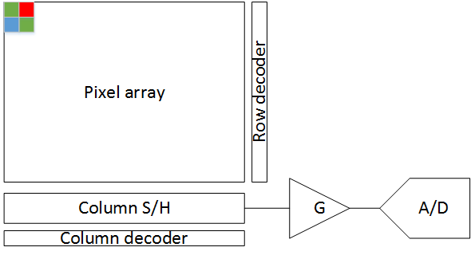
Serial readout architecture
Serial readout suitable for small arrays and moderate framerates
Typically pipeline ADC
Advantages:
Small die size
Uniform response
Disadvantages:
Low framerate
Column bus limits noise and power performance

Slide 27
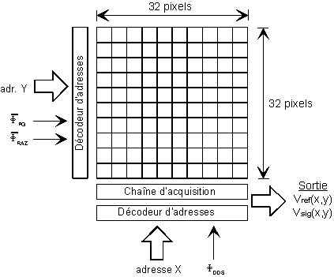
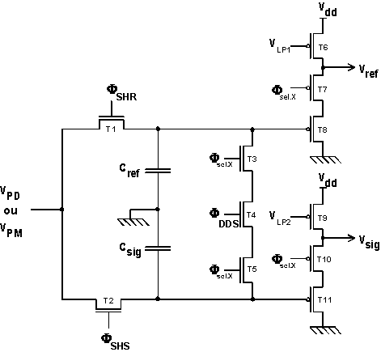
Serial readout architecture (example)
Image sensor
ASP+Address decoder
ASP
Address decoder
27

Slide 28
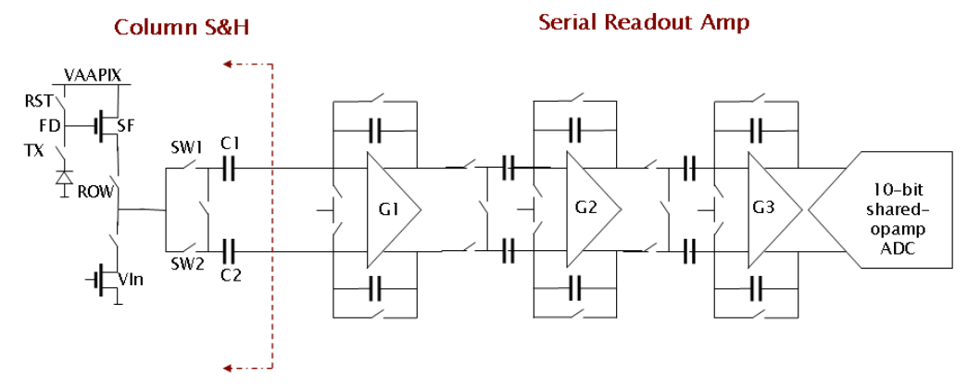
Serial readout architecture
Large capacitance output bus not good for noise and power (speed)
Source: Cho et al, IISW’07

Slide 29
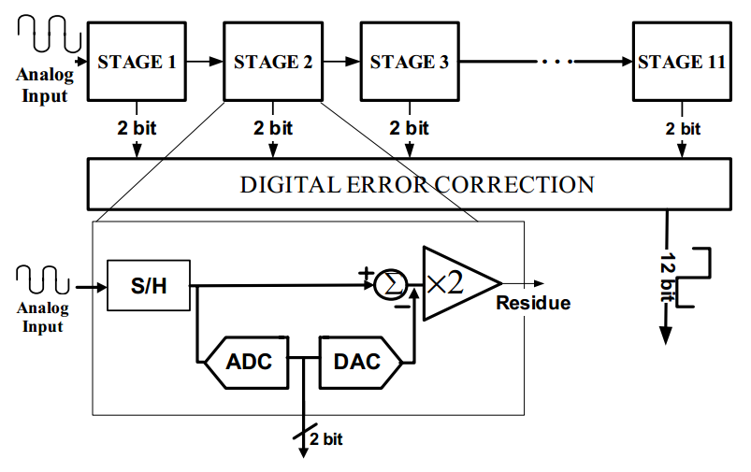
3.3V 12 BIT 6.3 MS/S PIPELINED ADC
Source: Hamami et al, ISCAS04

Slide 30
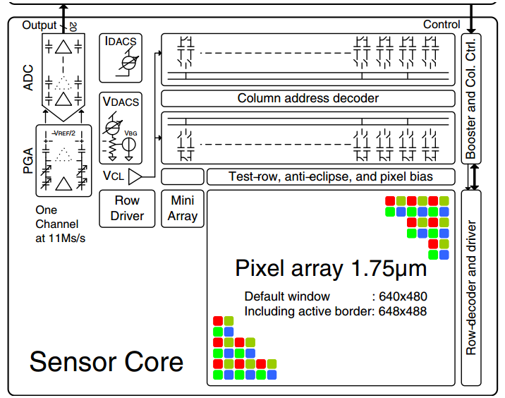
Source: Johansson et.al, ISSCC 2011

Slide 31
Agenda
Pixels and readout circuits
Serial readout
  w/Pipeline ADC
Column-parallel readout
  w/Ramp ADC
  w/SAR-ADC

Slide 32
Column Parallel Readout
Advantages:
Fast readout
Low noise
Low power
Disadvantages:
Large chip size
Difficult to implement at small pixel pitch
Column non-uniformity

Slide 33
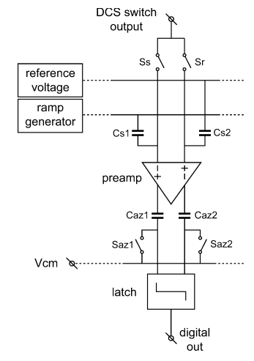
Ramp ADC column circuit
Pixel output
SHR
SHS
Reference: Snoeij et al, IEEE J. of SSC, 2006

Slide 34
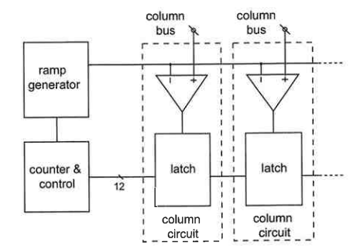
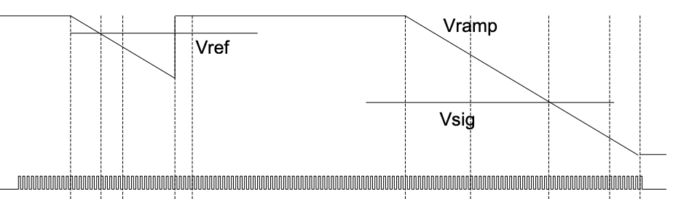
Slope ADC
Vramp
Clk

Slide 35
Ramp ADC remarks
Most widely used in commercial CMOS imagers
Relatively low circuit complexity
Low noise bandwidth
Small area (ramp generator shared)
One ADC per column with shared input ramp
Requires a lot of clocks (2^{Nbits}) per conversion
  Used by counter
  Typically accompanied by on-chip PLL (100-1000MHz)

Slide 36
Successive Approximation ADC
(aka SAR ADC)
Successive Approximation Register
Vin
S/H
+
-
Control logic
SAR
Comparator
Binary output
Vref(b0/16+b1/8+b2/4+b3/2)
b3
b2
b1
b0
DAC
Vref
Ex: Vin=0.7V, Vref=1V
=> Output=1011
Vref = max input voltage (all 1s)

Slide 37
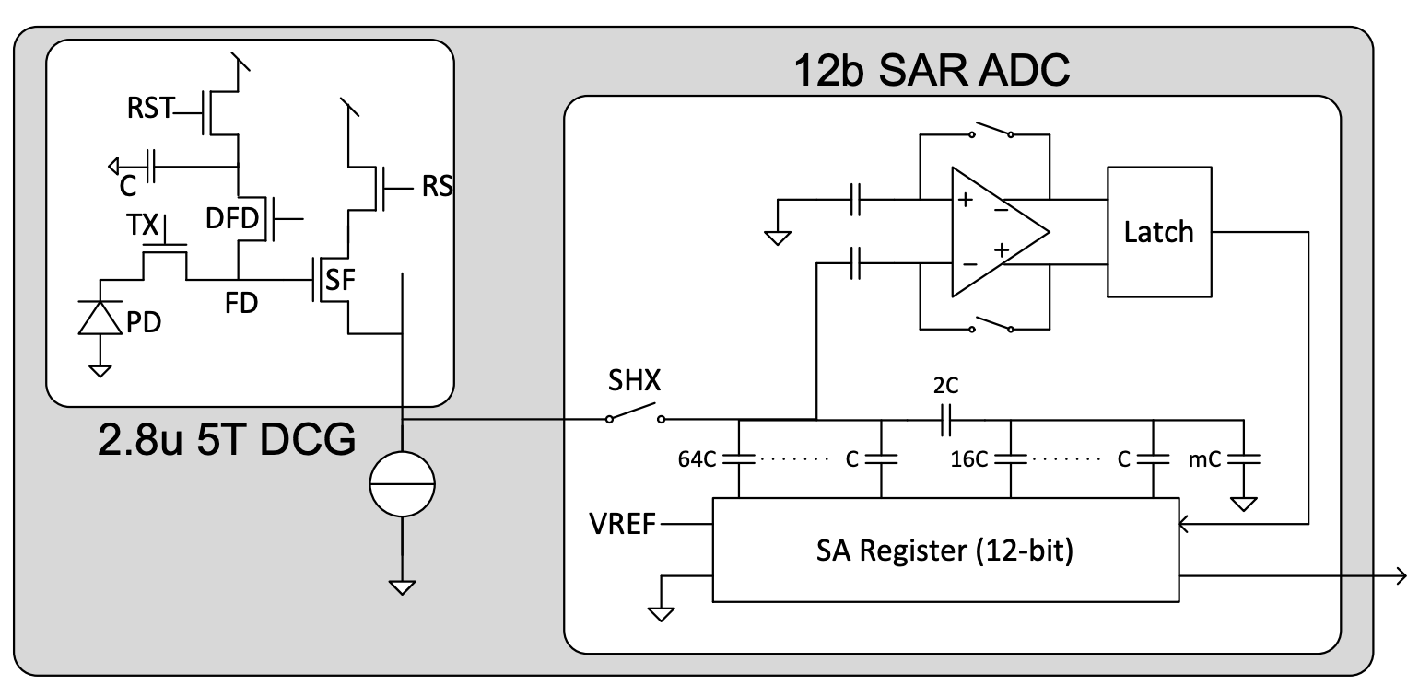
12b SAR ADC with split capacitor DAC
Source: Solhusvik et al, IISW’17, Japan

Slide 38
SAR ADC remarks
Most widely used ADC in the general industry (but ramp ADC dominates in imagers)
Faster than ramp ADC because it requires only N_{bits} clocks per conversion (vs 2^{Nbits})
  12b@1us typical performance in commercial sensors
Besides the comparator and output latch, an N-bit capacitor DAC is needed in every column
  Challenging column layout
Typically limited to 12-14bits, but higher resolution versions do exist (not in imagers)

